Slide 1
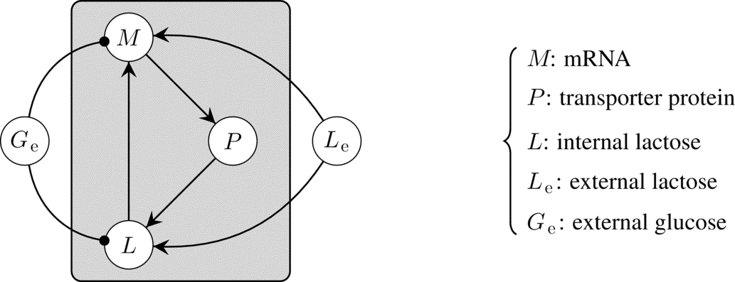
Notes:
FIGURE 5.1 A simplified gene regulatory network of the lac operon, from a model proposed in Chapter 1 of Ref. [20].

Slide 2
Notes:
FIGURE 5.2 Two undirected graphs on six nodes and their degree distributions.

Slide 3
Notes:
FIGURE 5.3 A graph with has four “types” of vertices that can be described by their degree. The clustering coefficient of each is shown
at right. Note that in general, two vertices could have the same degree but different clustering coefficients.

Slide 4
Notes:
FIGURE 5.4 In the hexagon graph, there are (5/2) = 10 pairs of distinct vertices {s, t} different from vertex 0. Eight of these pairs have a
unique shortest path (SP) between them; the others have two shortest paths. Some examples are shown in the table on the right. Exactly
3 of these 12 shortest paths pass through 0, so the betweenness of vertex 0 (and by symmetry, any other vertex) is 1/4.

Slide 5
Notes:
FIGURE 5.5 From left to right: A small-world, scale-free, and random network on 18 nodes and 36 edges. The small-world network
has mostly “local” edges but also a few long-range connections. The scale-free network is characterized by a few “hubs.” The random
network has no clear distinguishing feature like the other two.

Slide 6
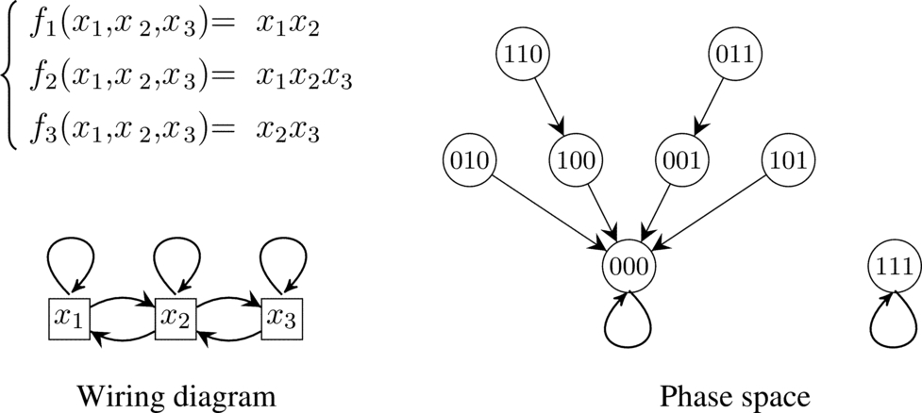
Notes:
FIGURE 5.6 A simple Boolean network (X,F) on three nodes.

Slide 7
Notes:
FIGURE 5.7 Two binary decision trees of f = x₁x₂x₃ + x₁x₂ + x₁x3, with respect to variable orders x₁ < x₂ < x3 (left) and x3 < x₂ < x₁
(right). A dashed edge out of node xi means that xi = 0, and a solid edge out of xi means xi = 1. Each evaluation of x₁ = a₁, x₂ = a₂,
and x₃ = a₃ corresponds to a unique leaf which is labeled by f (a₁, a₂, a₃).

Slide 8
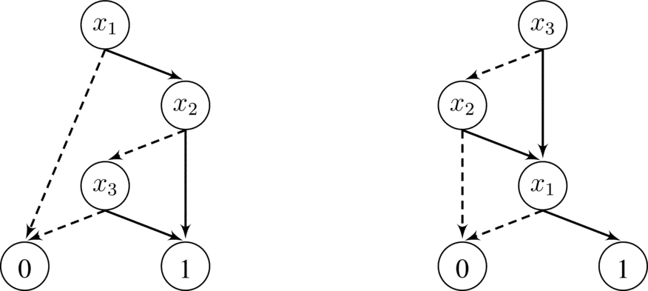
Notes:
FIGURE 5.8 Two BDDs of f = x₁x₂x₃ + x₁x₂ + x₁x₃. The one on the left arises from the variable order x₁ < x₂ < x₃, and the one on
the right arises from x₃ < x₂ < x₁.

Slide 9
Notes:
FIGURE 5.9 The merging process applied to the binary decision tree of f = x₁x₂x₃ + x₁x₂ + x₁x₃, with order x₃ < x₂ < x₁. The tree
on the left is obtained by merging the two circled subtrees in Figure 5.7 and removing the parent vertex. The middle tree is formed by
merging the two circled subtrees on the leftmost tree, and the tree on the right is formed by eliminating the x₁-labeled vertex.

Slide 10
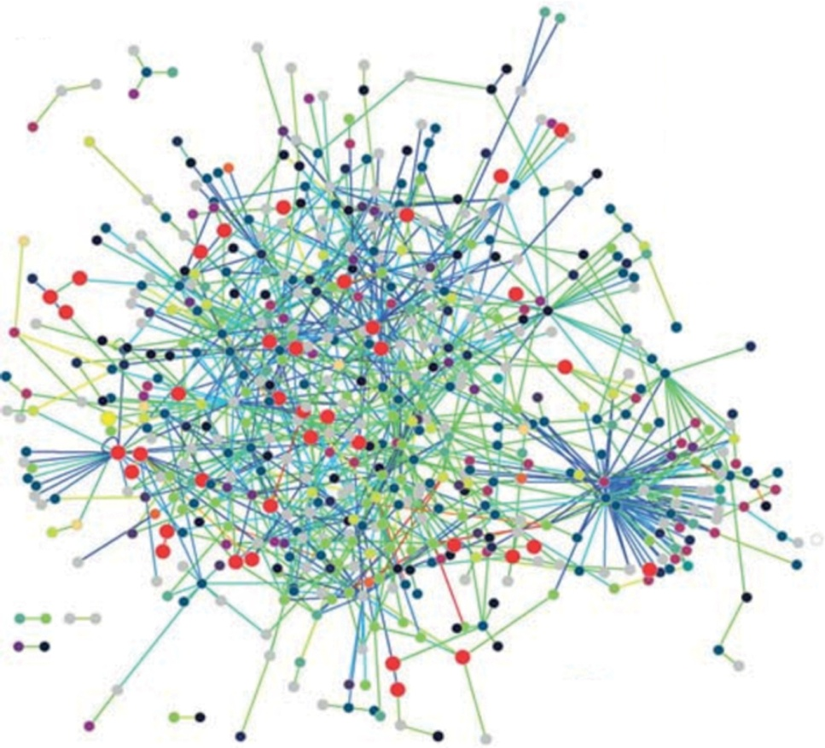
Notes:
FIGURE 5.10 The protein interaction network of Treponema pallidum, from Ref. [46].

Slide 11
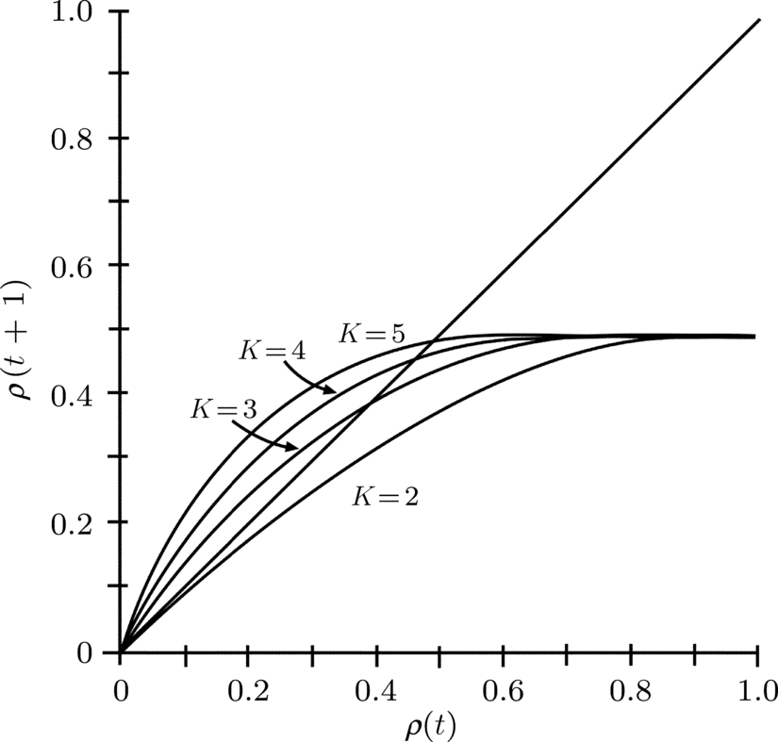
Notes:
FIGURE 5.11 Derrida plots for random NK-networks for various values of K, where the Boolean functions are sampled uniformly, as
derived in Ref. [31].

Slide 12
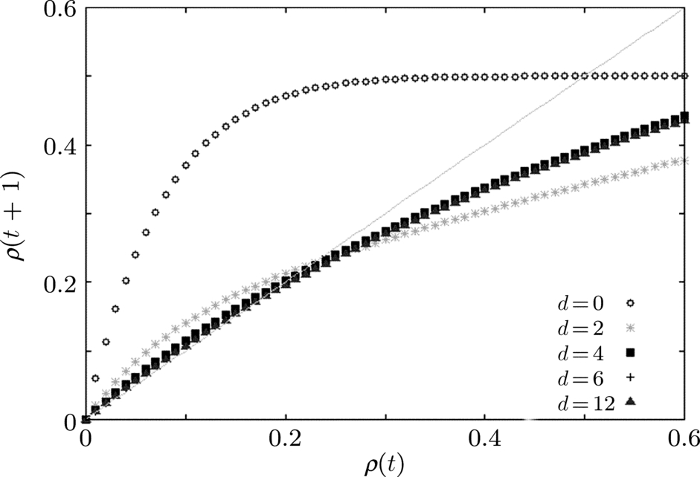
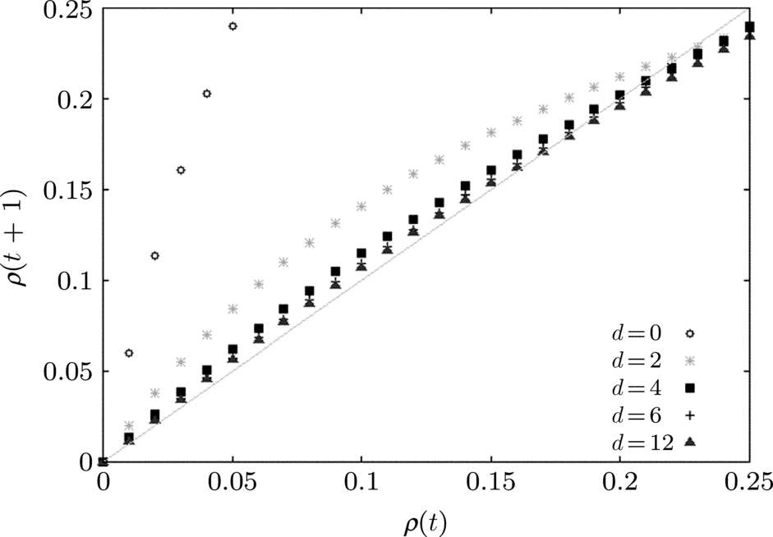
Notes:
FIGURE 5.12 An example Derrida plot measuring the stability of functions based on their canalizing depth. On the x-axis is the
(normalized) size of a perturbation, and on the y-axis is the size of that perturbation in the next time step. The plot on the right is a
zoomed in version of the one on the left.

Slide 13
Exercise 5.7
Notes:
Exercise 5.7. There are 11 distinct graphs on 4 vertices, which are shown below:

Slide 14
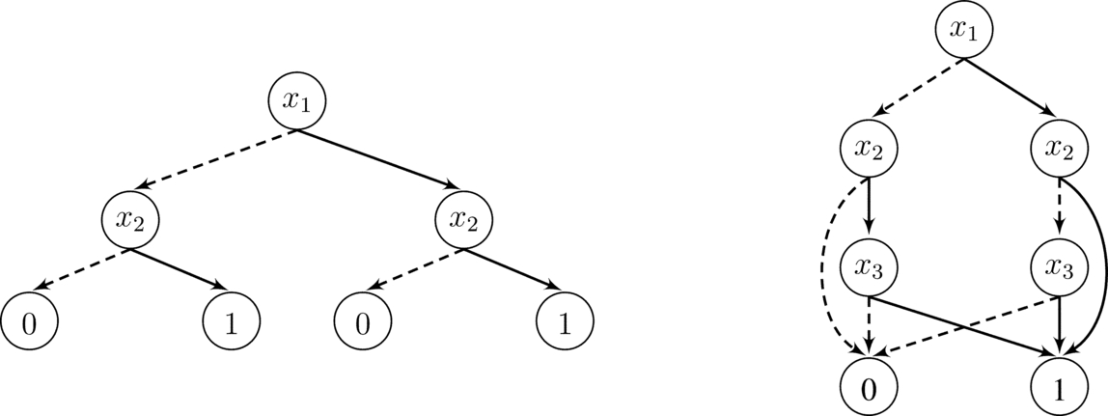
Exercise 5.16
Notes:
Exercise 5.16. Determine the Boolean functions described by the following diagrams by writing out the truth
table. Are these functions nested canalizing? Simplify the diagrams by merging identical substructures until you
wind up with a BDD.

