Slide 1
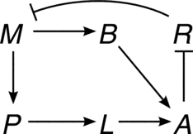
Notes:
FIGURE 6.1 Wiring diagram of toy model of the lac operon. Blunt arrows denote negative edges.

Slide 2
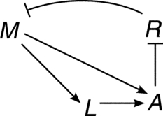
Notes:
FIGURE 6.2 Wiring diagram of the reduced network of the toy model of the lac operon.

Slide 3
Notes:
FIGURE 6.3 Wiring diagram for the last reduced network of the toy model of the lac operon.

Slide 4
Notes:
FIGURE 6.4 Wiring diagram of the Boolean network from Example 6.1. Left: original network; right: reduced network after removing
x₃. Circles denote negative edges.

Slide 5
Notes:
FIGURE 6.5 Wiring diagram of the Boolean network from Example 6.2. Left: original network; right: reduced network after removing
x₅, x₄, x₃ (in that order).

Slide 6
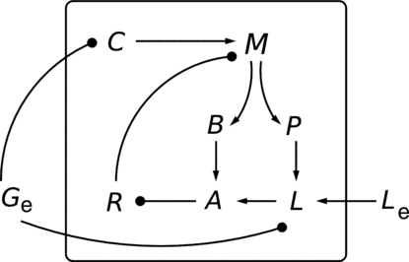
Notes:
FIGURE 6.6 Wiring diagram of the Boolean model of the lac operon. Molecular components that are represented by more than a single
variable have been collapsed into a single node (e.g., Le represents x₁₁ and x₁₂).

Slide 7
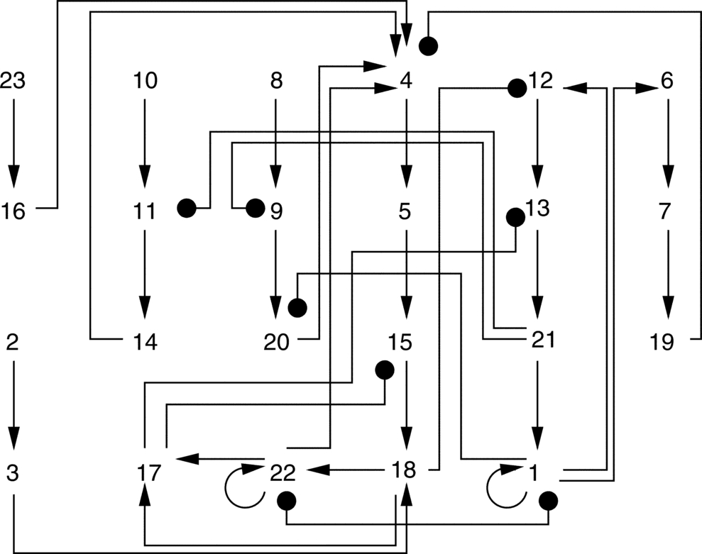
Notes:
FIGURE 6.7 Wiring diagram of the Boolean model of Th-cell differentiation.

Slide 8
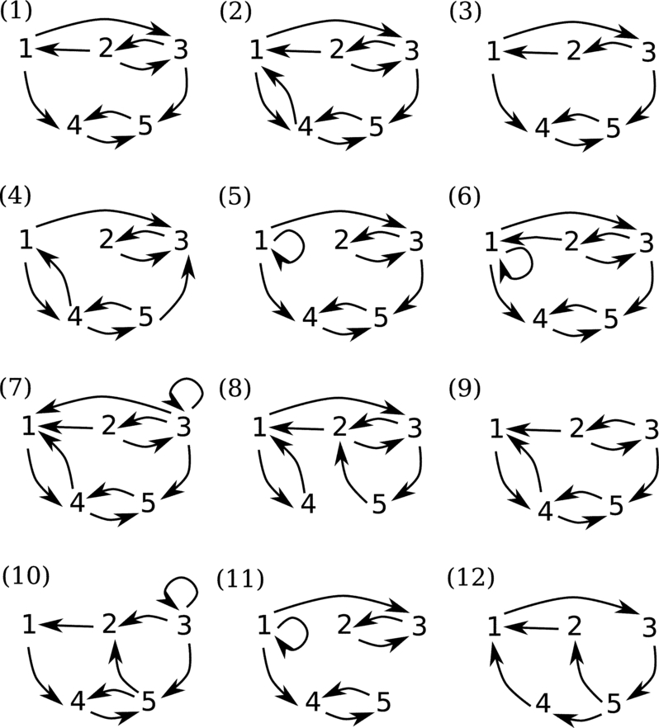
Notes:
FIGURE 6.8 Wiring diagrams for Exercises 6.35, 6.36 and 6.38.

Slide 9
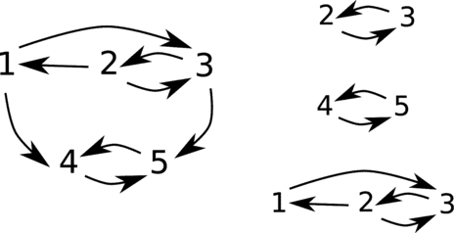
Notes:
FIGURE 6.9 Wiring diagram (left) and some strongly connected subgraphs (right).

Slide 10
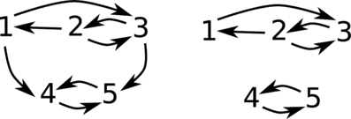
Notes:
FIGURE 6.10 Wiring diagram (left) and strongly connected components (right).

Slide 11
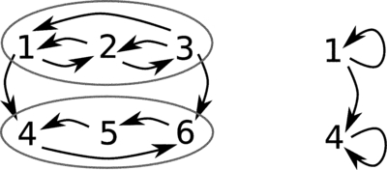
Notes:
FIGURE 6.11 Wiring diagram of AND network from Example 6.7 (left) with its strongly connected components highlighted in circles
and the reduced wiring diagram (right).

Slide 12
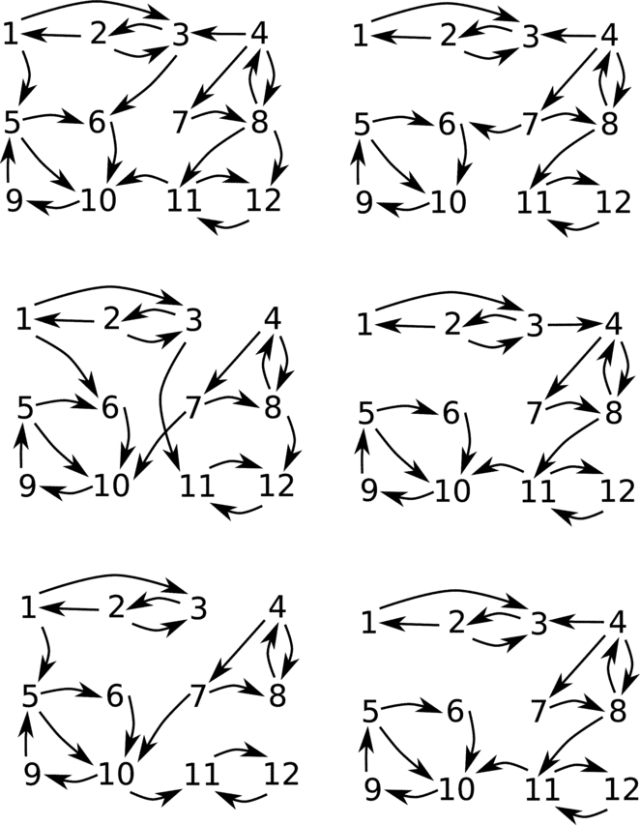
Notes:
FIGURE 6.12 Wiring diagrams for Exercise 6.40.

