Slide 1
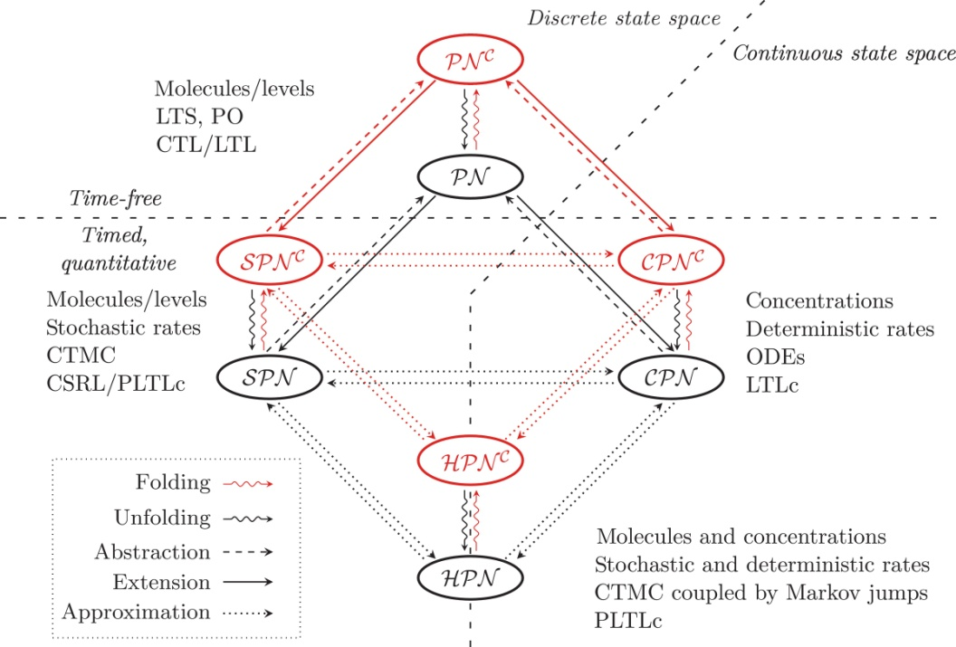
Notes:
FIGURE 7.1 The unifying Petri net framework, adapted from [5], with kind permission from Springer Science +Business Media B.V.,
Figure 1, p. 399. See Table 7.1 for abbreviations.

Slide 2
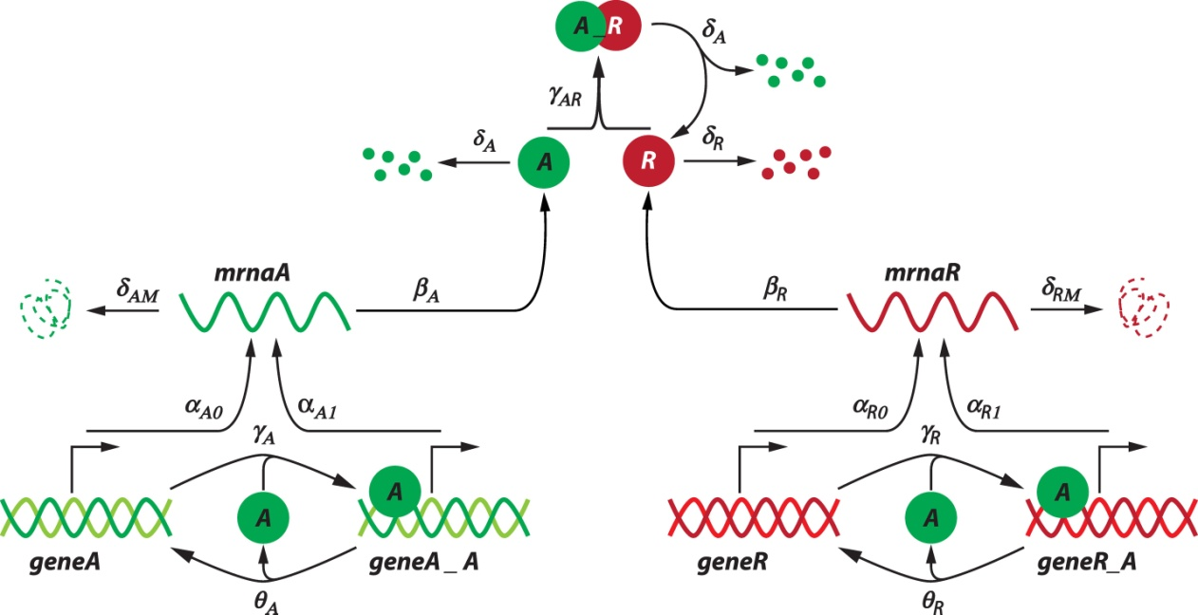
Notes:
FIGURE 7.2 General scheme of a gene regulatory network of circadian oscillation (inspired by and redrawn after [14]), comprising four
levels: (1) gene regulation, (2) mRNA synthesis by transcription of the DNA, (3) protein synthesis by translation of the RNA, and (4)
protein-protein interaction. (1) The activator protein A binds to the promoter of its encoding gene as well as to the promoter of the gene
encoding the repressor protein R. (2) According to the model, there is a basal as well as an increased transcription of the activator mRNA
and the repressor mRNA due to binding of the activator to the corresponding promoters. (3) The mRNAs are translated into the respective
proteins. (4) The activator protein and repressor protein form a complex with each other. Degradation of the activator protein occurs upon
dissociation of the complex. The mRNAs and the unbound proteins are degraded as well.

Slide 3
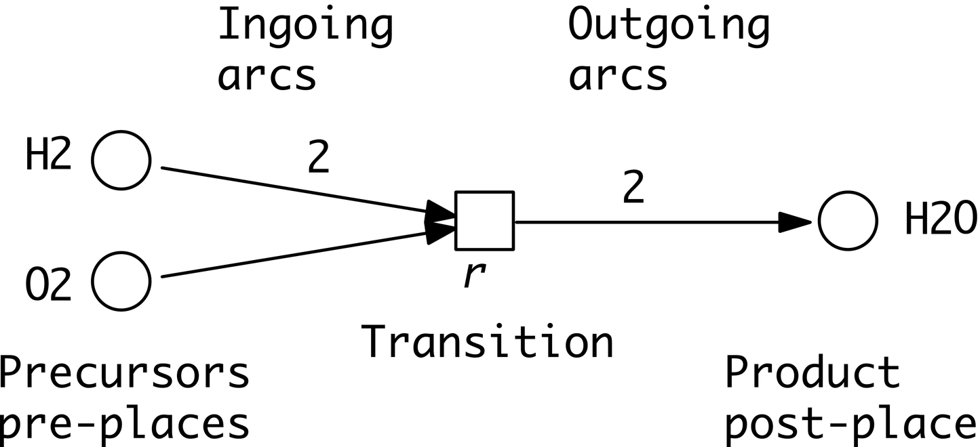
Notes:
FIGURE 7.3 Petri net for the well-known chemical reaction r : 2H₂ + O₂ →2H₂O. Hint: Node names have to obey the same constraints
as known from most programming languages for identifiers. The first character has to be a letter or underscore, followed by any
combination of letters, numbers, and underscores; no other special characters are allowed, neither subscripts nor superscripts.

Slide 4
Notes:
FIGURE 7.4 Petri net for r : 2H₂ + O₂ →2H₂O and three possible states, each connected by a firing of the transition r. Initially, there
are four tokens on place H₂ and three tokens on place O₂, while place H₂O is clean (zero tokens). The transition r is not enabled anymore
in the marking reached after these two single firing steps.

Slide 5
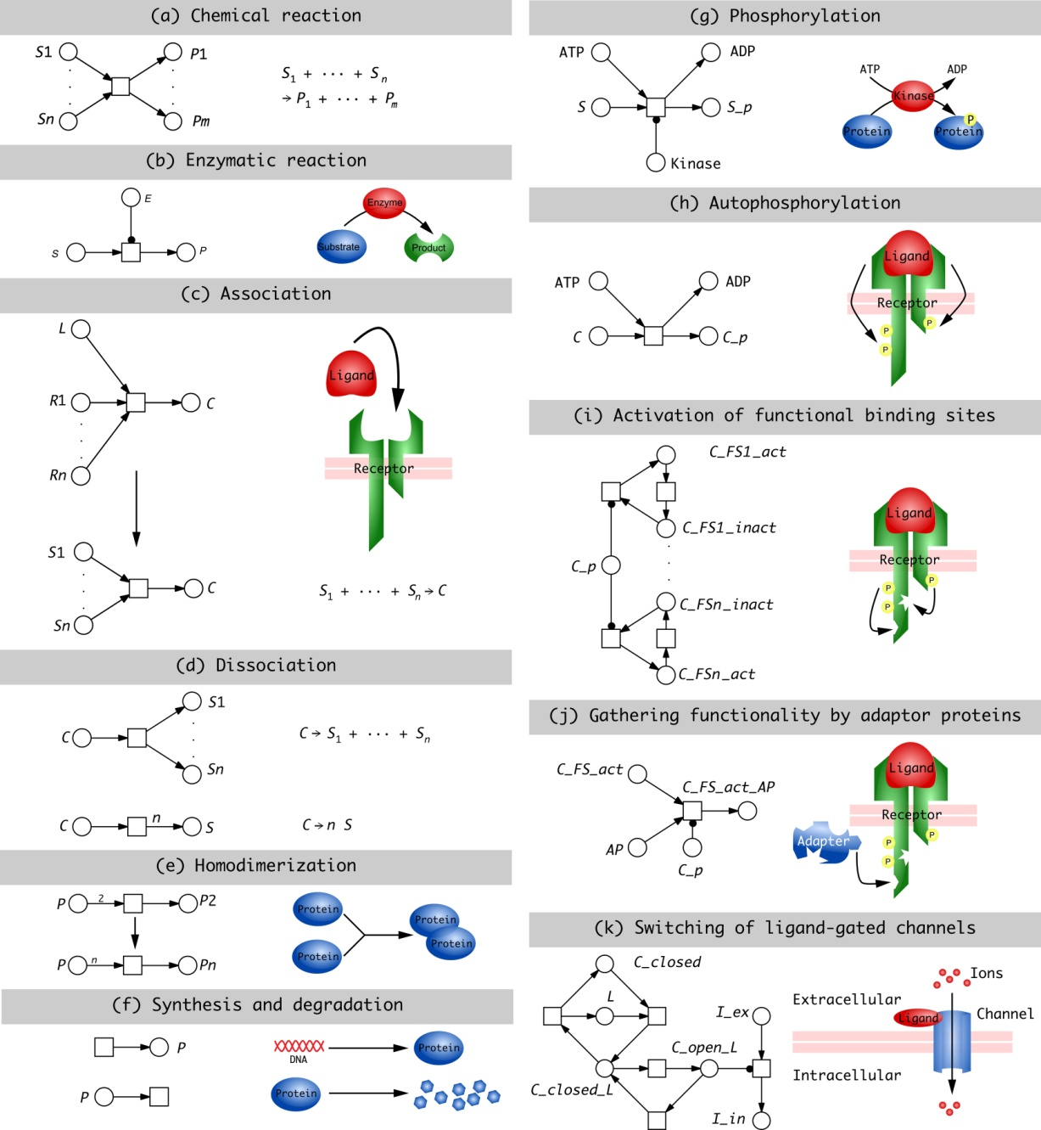
Notes:
FIGURE 7.5 Petri net components of typical biochemical mechanisms; for abbreviations see Table 7.6. Please note the abstraction by
the use of side conditions.

Slide 6
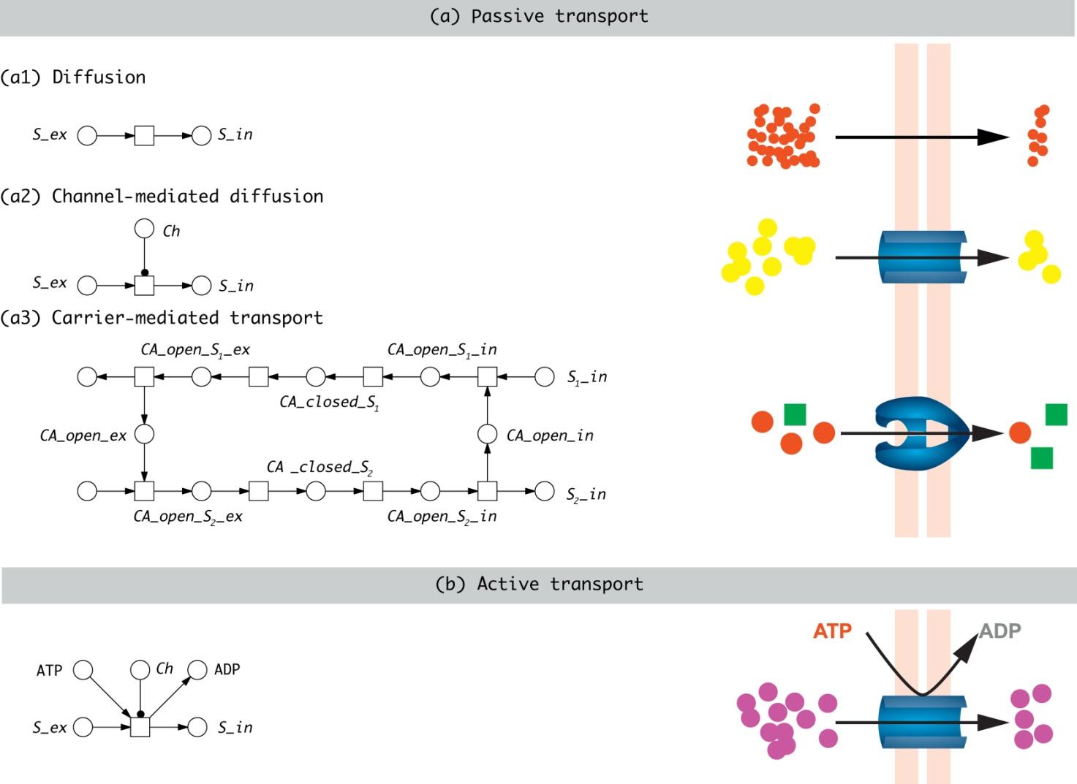
Notes:
FIGURE 7.6 Petri net components of typical examples of transport mechanisms over biological membranes; for abbreviations see
Table 7.6.

Slide 7
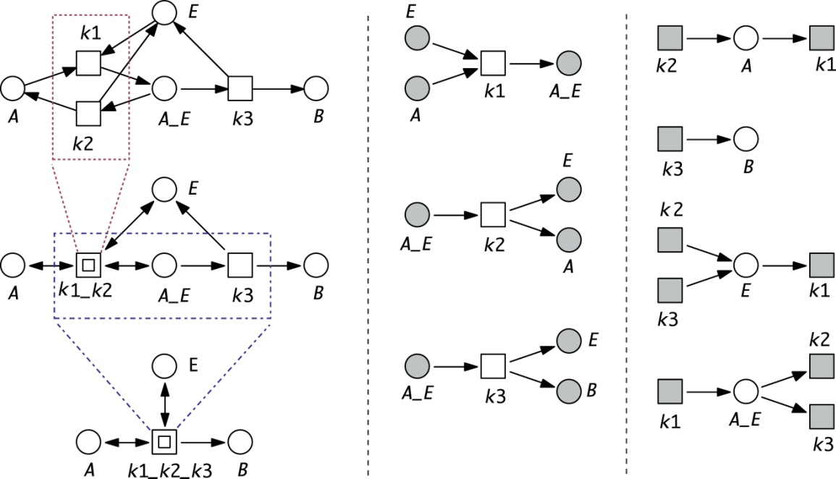
Notes:
FIGURE 7.7 Different, but equivalent graphical representations of one and the same PN modeling the enzymatic reaction A + E ↔
A_E →B + E, with A_E being the enzyme-substrate complex. (Left) Macro transitions yield hierarchically structured models; (middle)
reaction-centric representation by the use of logical places; (right) species-centric representation by the use of logical transitions.

Slide 8
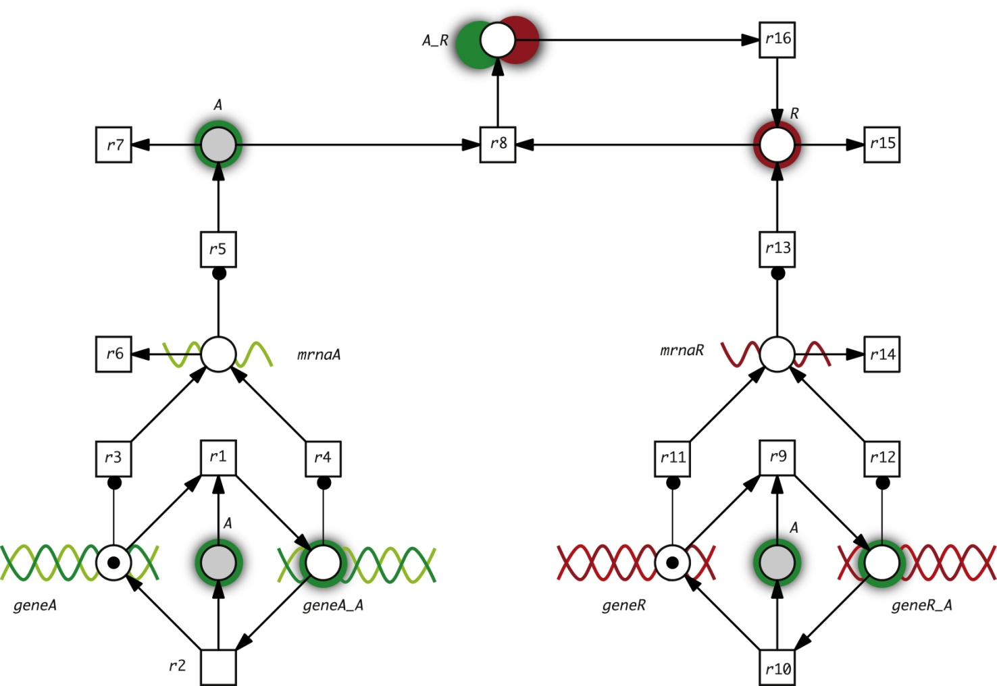
Notes:
FIGURE 7.8 Petri net for the circadian clock model, according to [14], enhanced by some illustrative icons; compare general scheme in
Figure 7.2. See Table 7.2 for a description of the places (variables), and Table 7.3 for a list of the transitions (reactions).

Slide 9
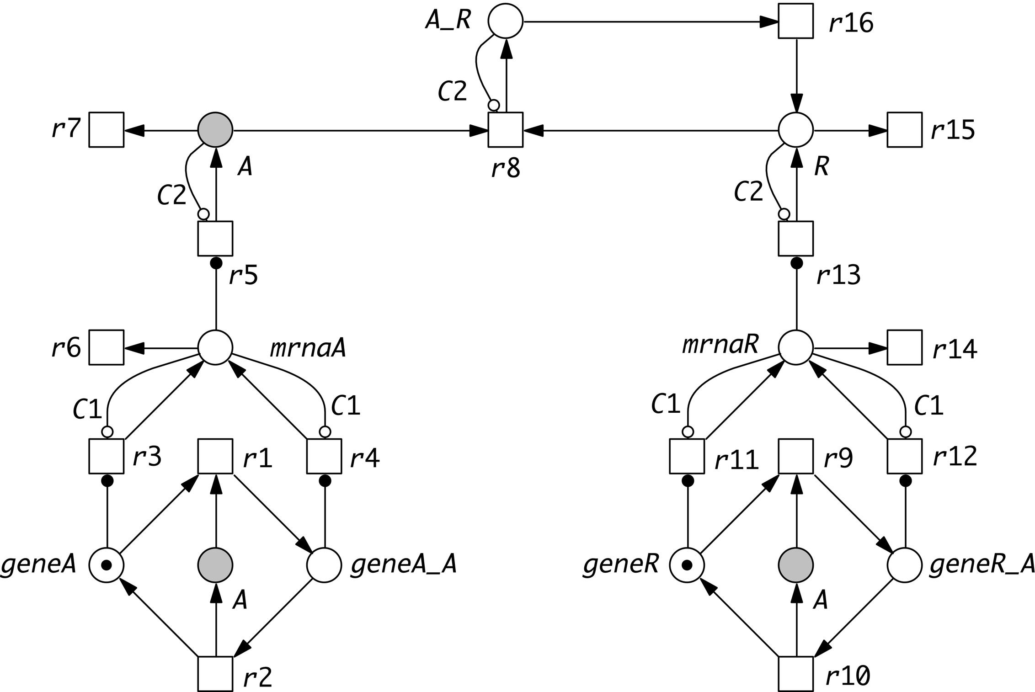
Notes:
FIGURE 7.9 The running example in a bounded version—maximal C1 tokens can be accumulated on the mRNA places, and maximal
C2 tokens by mRNA translation on the protein places. Inhibitory arcs (hollow circle as arc head) with arc weight C1 (C2) limit the
generation of mRNA (proteins). C1 and C2 are constants to conveniently parameterize the model; compare Table 7.7. These inhibitory
arcs do not reflect biomolecular mechanisms.

Slide 10
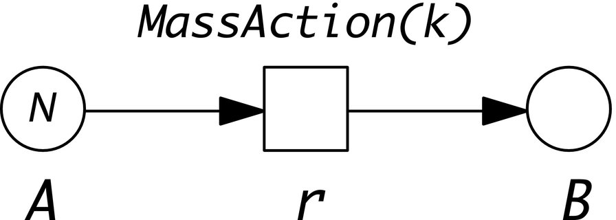
Notes:
FIGURE 7.10 SPN1 for the irreversible reaction A k−
→B, with initially N tokens on A; see Figure 7.11 for some simulation results with
k = 1 and N = 10, 1000.

Slide 11
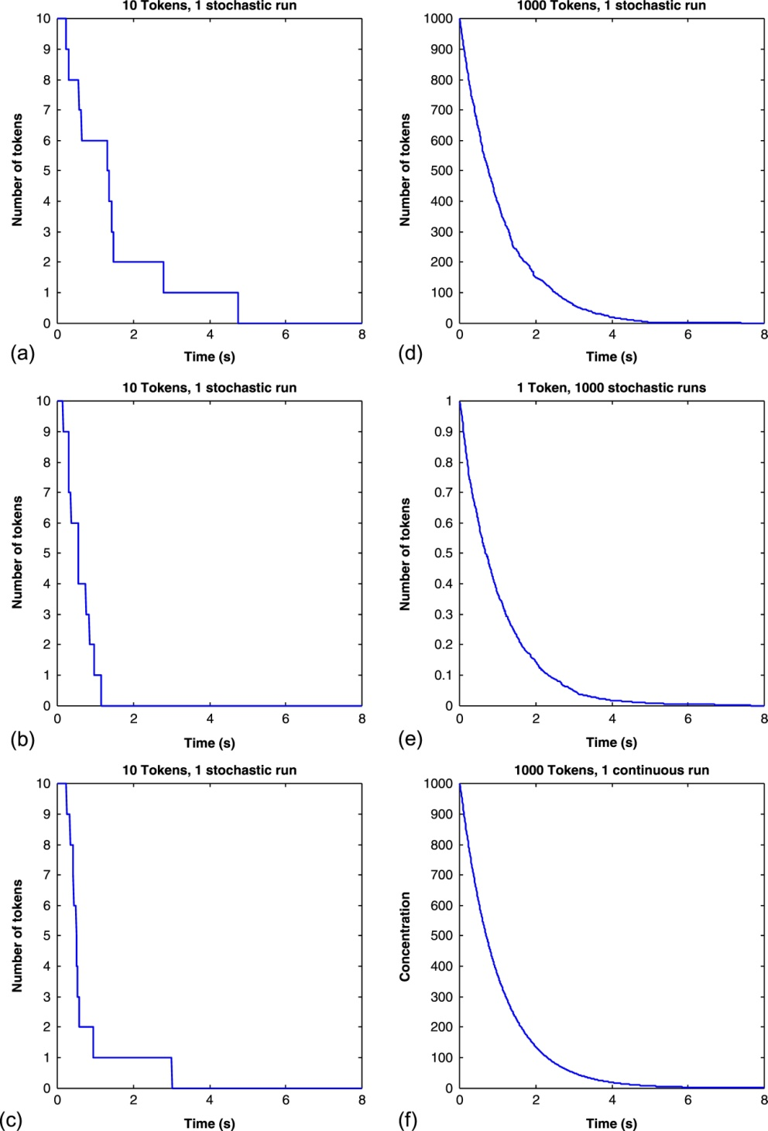
Notes:
FIGURE 7.11 Stochastic simulations of SPN1 in Figure 7.10 in different settings. (a)-(c) Three single runs for N = 10; each run is
different due to stochasticity. Stochasticity is leveled out by increasing N, or averaging over an increasing number of runs: (d) N = 1000,
single run; (e) N = 1 and 1000 runs; (f) continuous run. This discussion is adapted from [41].

Slide 12
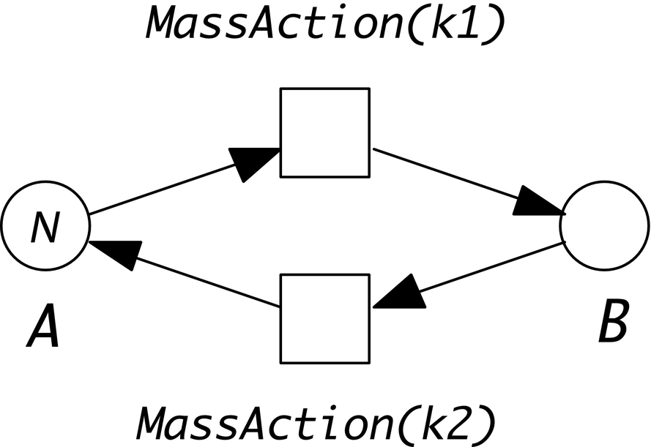
Notes:
FIGURE 7.12 SPN2 for the reversible reaction A k1 − −k2 B, with initially N tokens on A; see Figure 7.13 for some simulation results with
k1 = 1, k2 = 1, and N = 10, 100, 500.

Slide 13
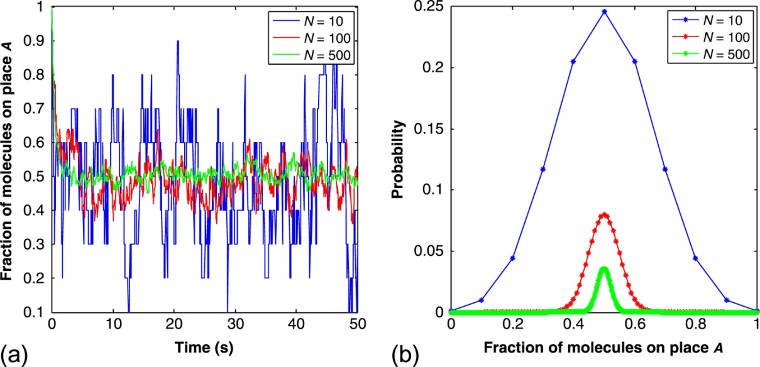
Notes:
FIGURE 7.13 Exploring SPN₂ in Figure 7.12 with N = 10, N = 100, and N = 500 tokens (molecules). (a) Single stochastic simulation
runs; fluctuations decrease with increasing numbers of tokens. (b) Probability distribution of the fractions of tokens on A in the steady
state. Please note that this is actually a discrete function. This discussion is adapted from [42].

Slide 14
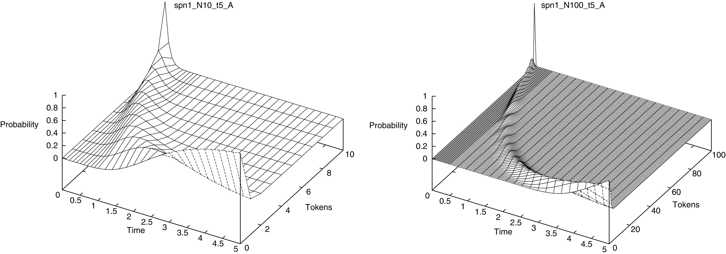
Notes:
FIGURE 7.14 Transient analysis for SPN₁ in Figure 7.10 for N = 10 (left) and N = 100 (right). The 3D plots show the evolution of
the probability distribution of the token number on A up to time point 5.

Slide 15
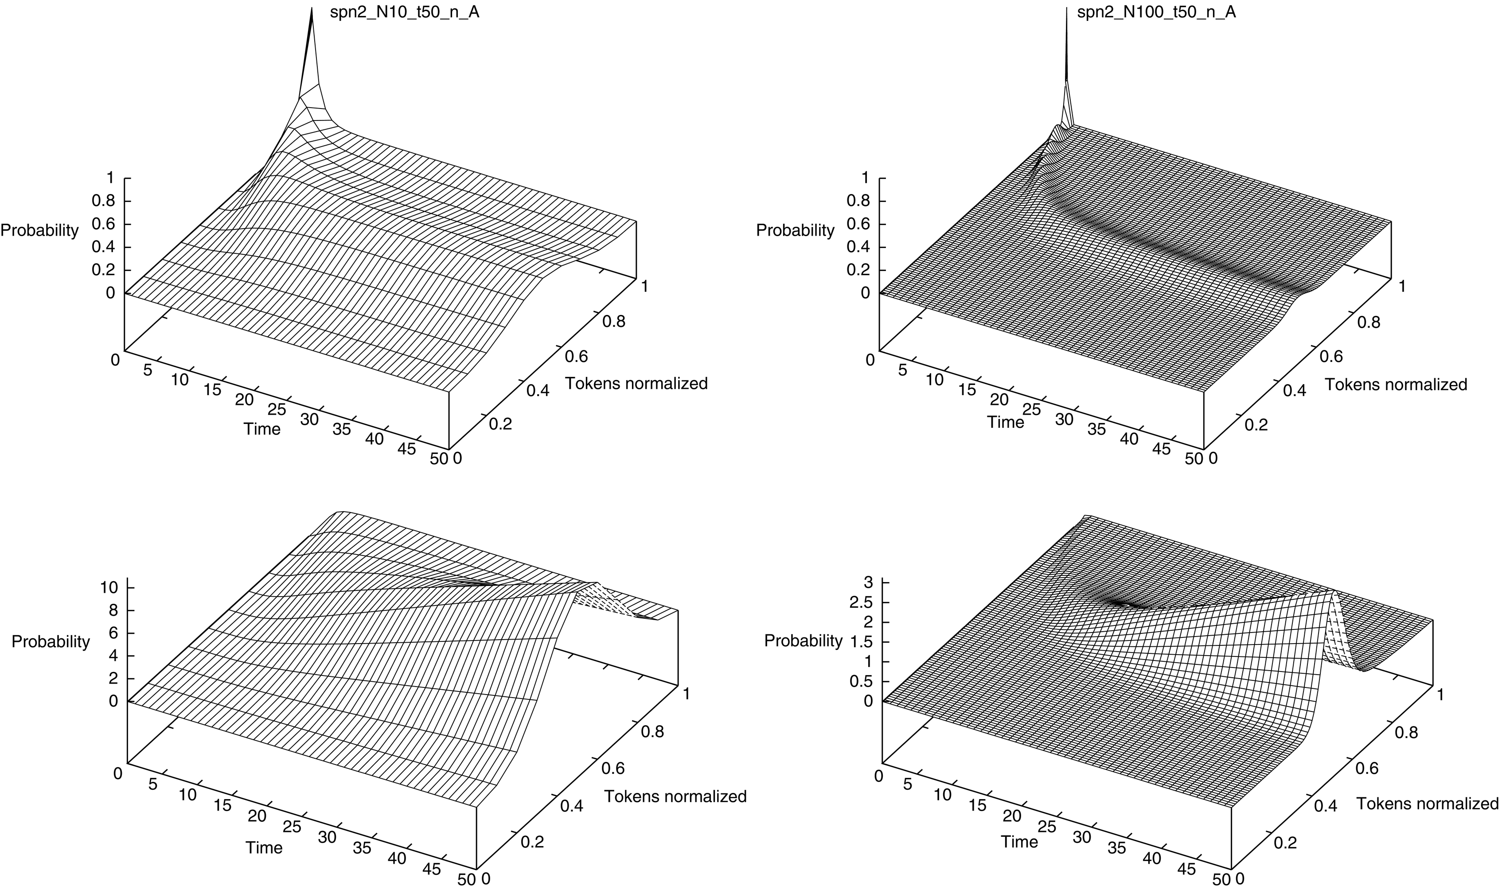
Notes:
FIGURE 7.15 Transient analysis for SPN2 in Figure 7.12 for N = 10 (left) and N = 100 (right). The 3D plots in the first row show
the evolution of the probability distribution of the fraction of tokens on A up to time point 50. The second row gives the cumulative
probability distributions, sharpening the effect; compare the closed-form solution in Figure 7.13b.

Slide 16
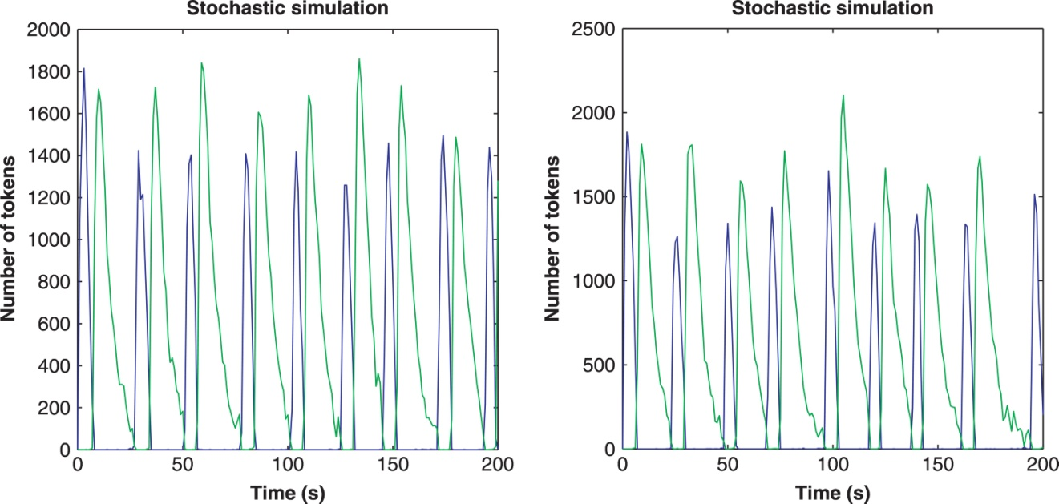
Notes:
FIGURE 7.16 Two plots of single stochastic simulation runs (showing A and R) when reading the running example as SPN. Each single
run looks different in terms of oscillation.

Slide 17
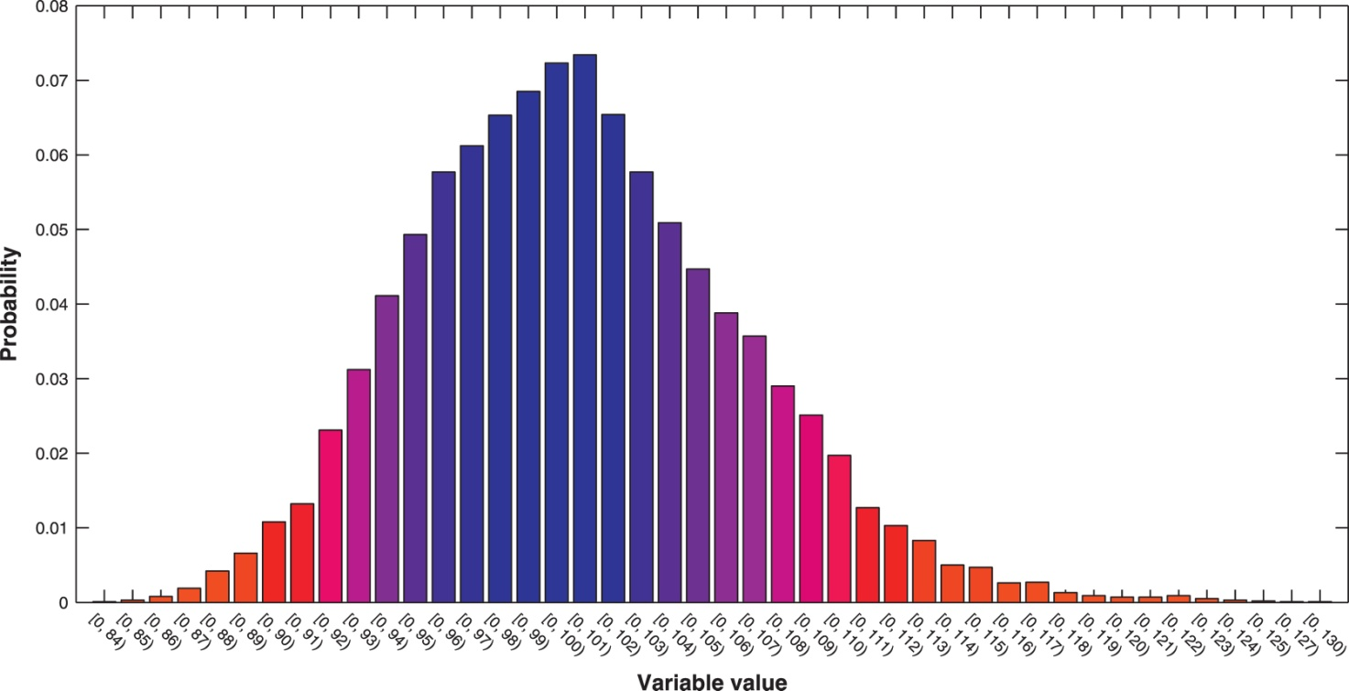
Notes:
FIGURE 7.17 Probability distribution of the value range for the two mRNA places, determined for the SPN model by 10,000 stochastic
simulation runs with τ = 100. Increasing the number of runs smooths the bell shape, but does not shift the value range. Values beyond
120 are most unlikely.

Slide 18
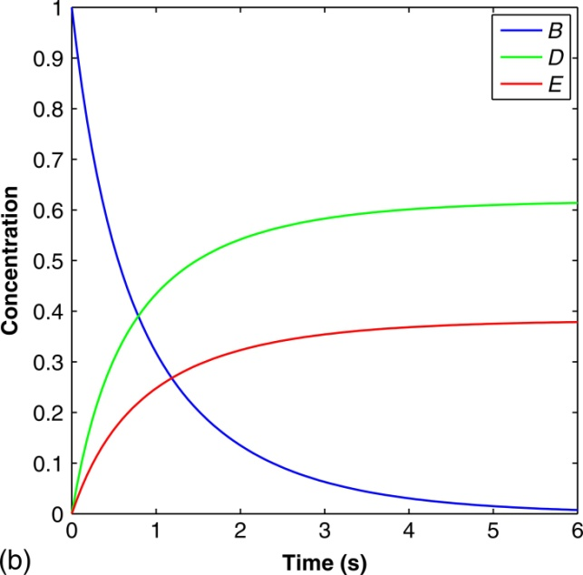
Notes:
FIGURE 7.18 CPN do not know conflicts. (a) CPN₃—the two transitions r1 and r2 share the token value of B. It depends on the
parameters k1, k2, and the stoichiometric factors x, y how much each transition gets. (b) Deterministic simulation of CPN₃ with k1 = 1,
k2 = 0.5, and all other constants set to 1.

Slide 19
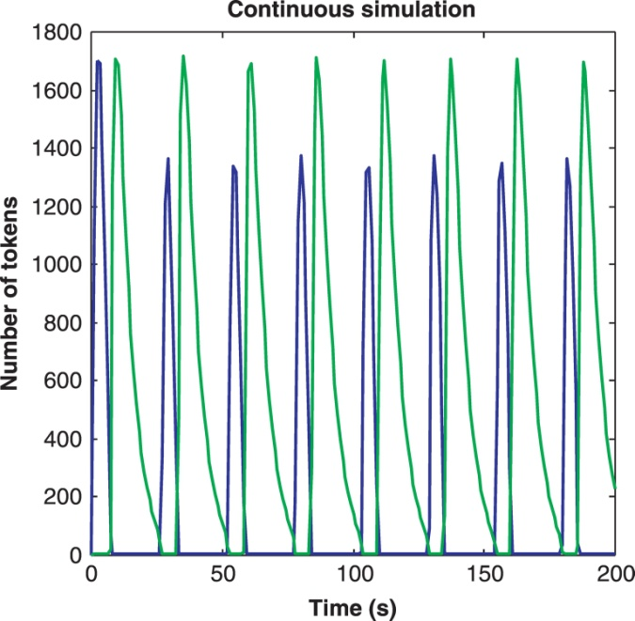
Notes:
FIGURE 7.19 Plot of a deterministic simulation run (showing A and R) when reading the running example as CPN.

Slide 20
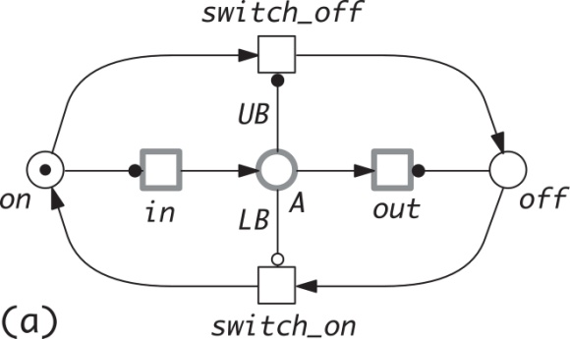
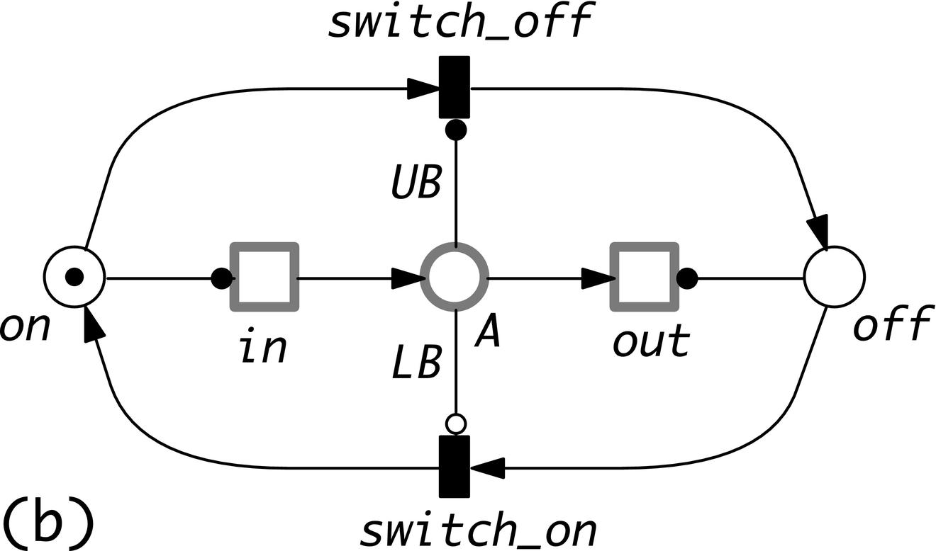
Notes:
FIGURE 7.20 Two hybrid Petri nets regulating the continuous place A to keep its token value in the interval [LB,UB]. We apply the
drawing convention to show continuous nodes in thicker lines to visually distinguish them from the discrete nodes. The continuous
in/outflows are alternately switched on/off by discrete transitions, (a)HPN₁: stochastic transitions and (b)HPN₂: immediate transitions.
All (stochastic/continuous) rates apply mass-action kinetics. See Figure 7.21 for hybrid simulation runs.

Slide 21
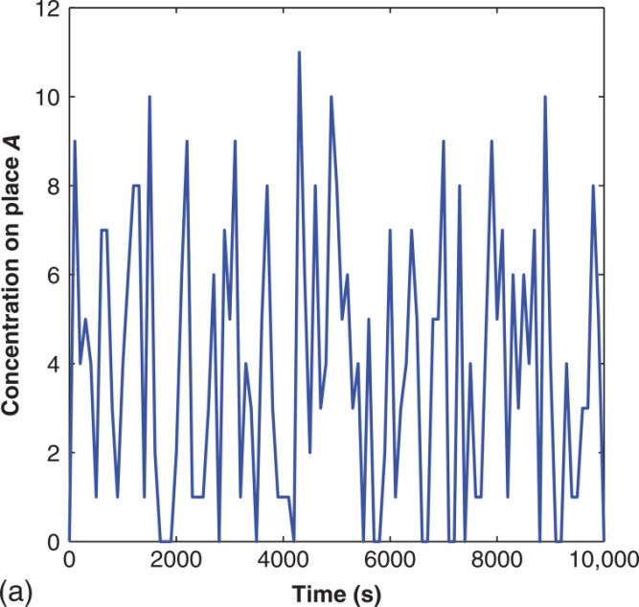
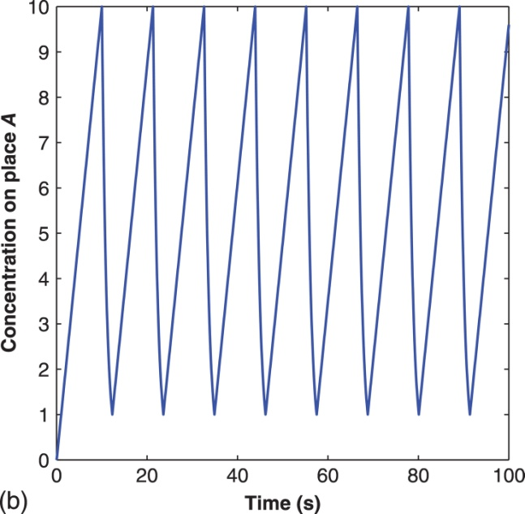
Notes:
FIGURE 7.21 Hybrid simulation runs for HPN₁ and HPN₂ in Figure 7.20; all kinetic parameters are set to 1, and LB = 1,UB = 10.

Slide 22
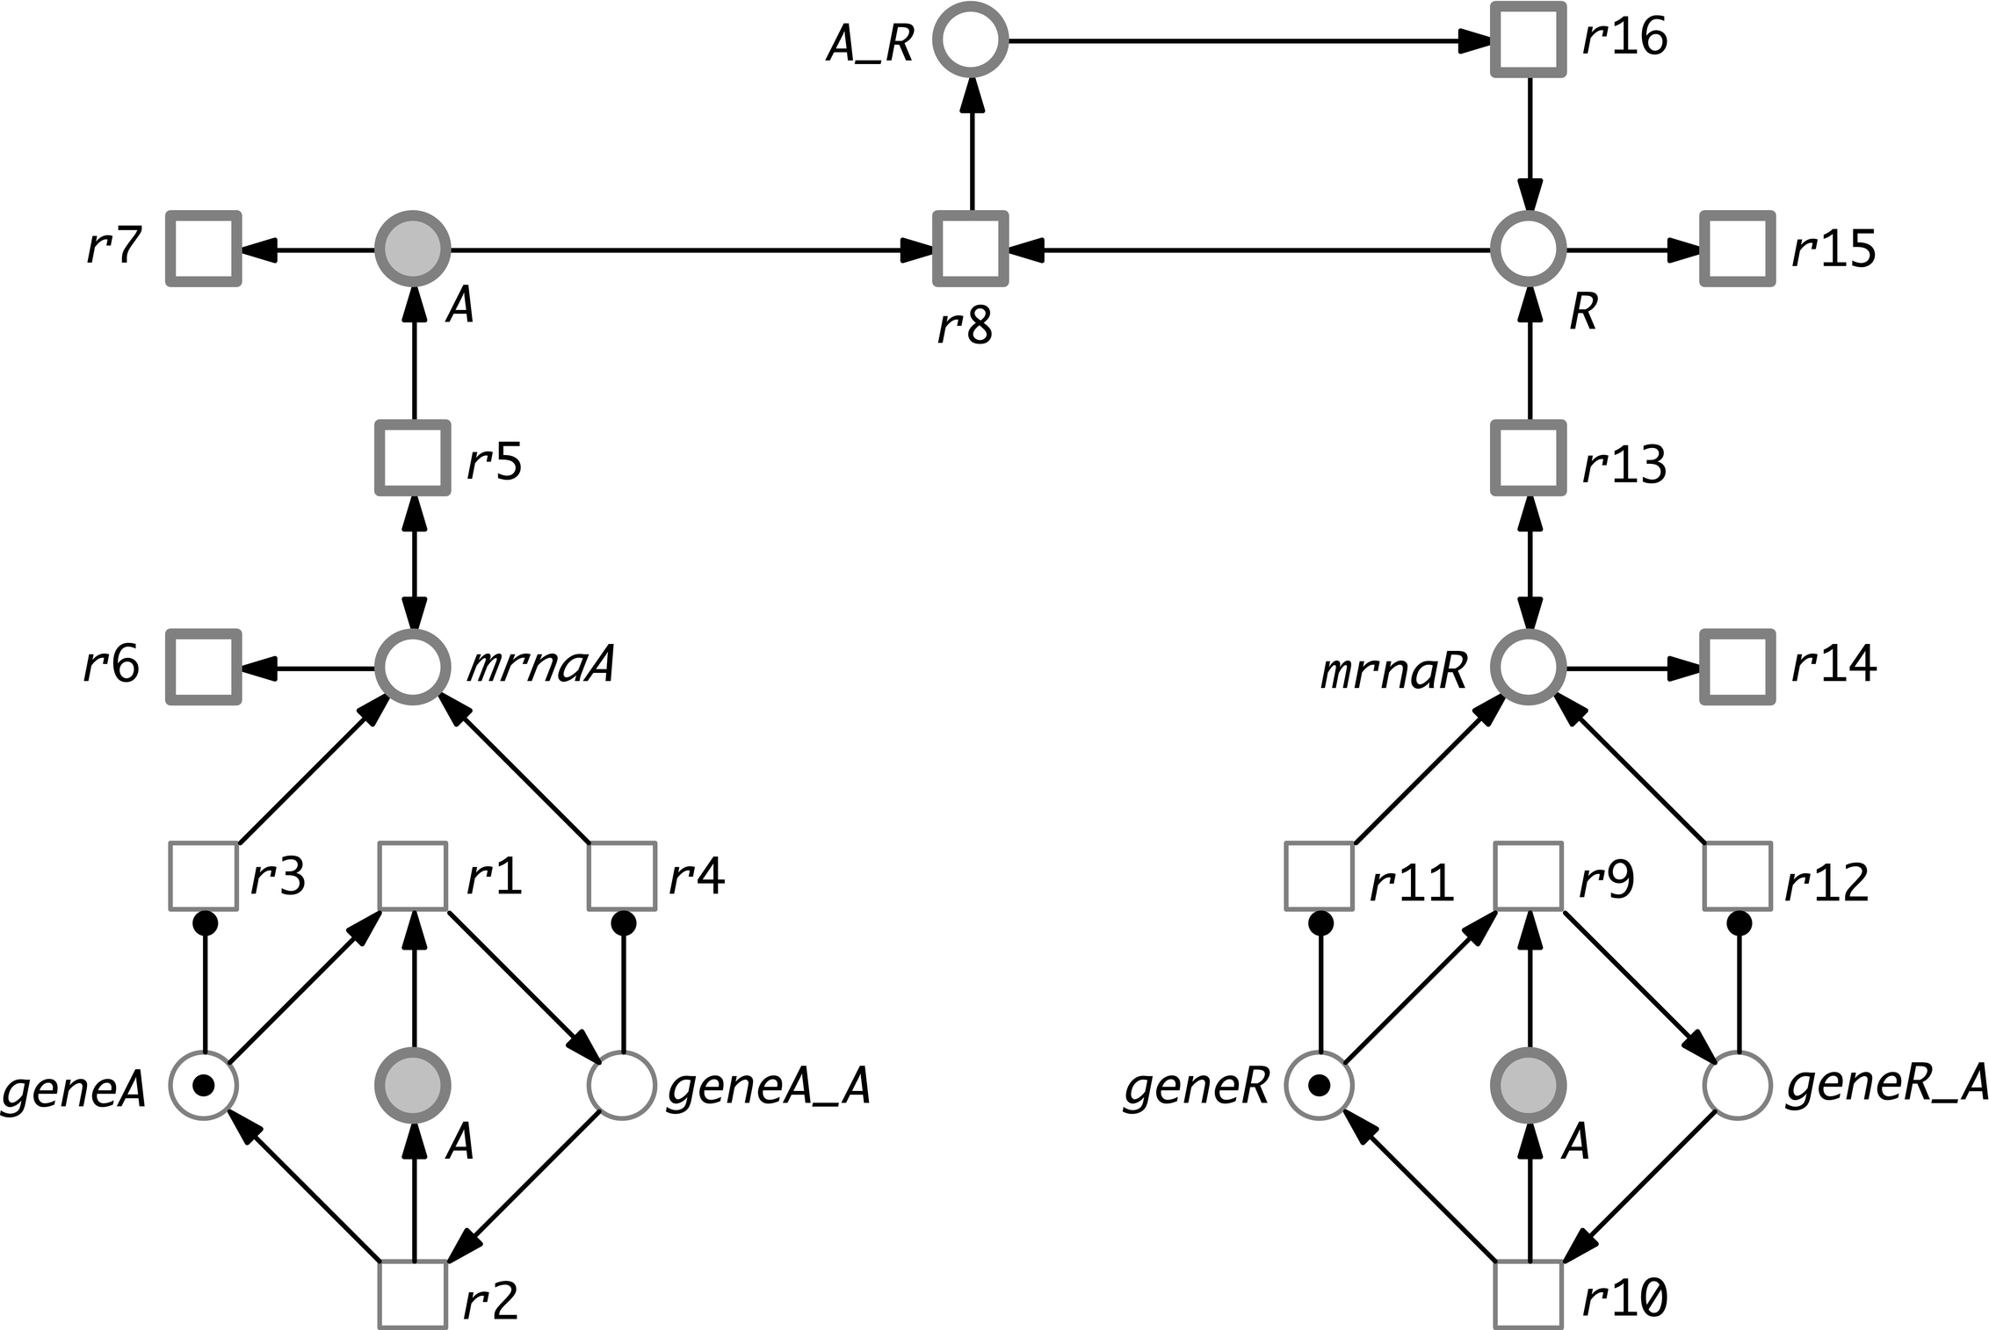
Notes:
FIGURE 7.22 Reading the running example as HPN. All gene-related places and their pre- and post-transitions are treated as discrete
nodes. Please note that read arcs connecting continuous nodes have been replaced by two opposite arcs.

Slide 23
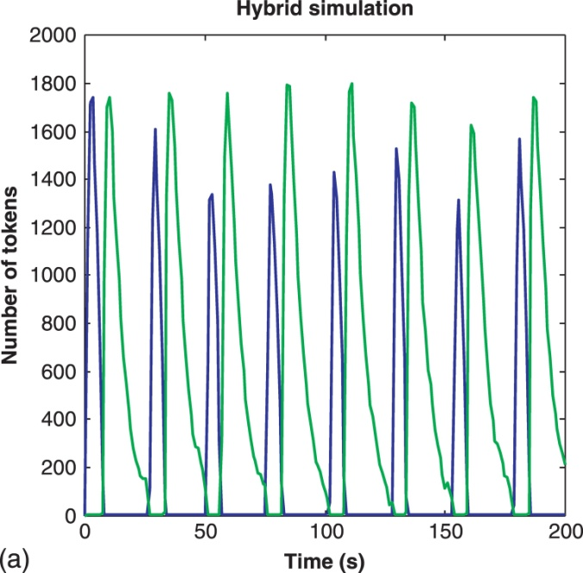
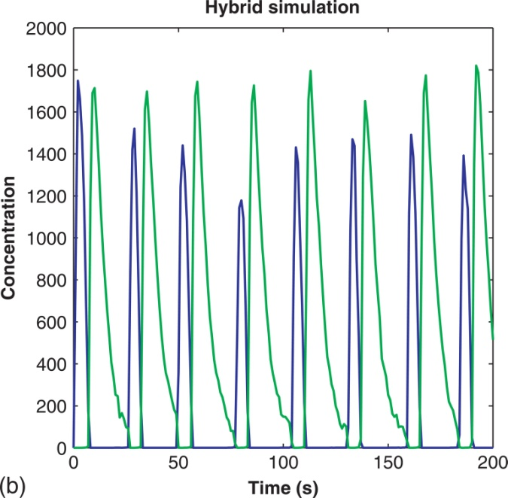
Notes:
FIGURE 7.23 Two plots of hybrid simulation runs (showing A and R) when reading the running example as HPN.

Slide 24
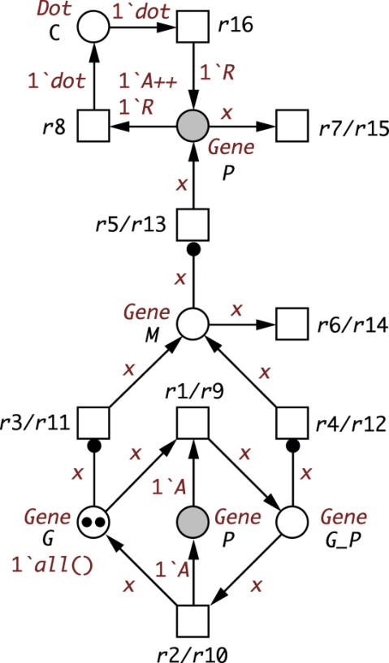
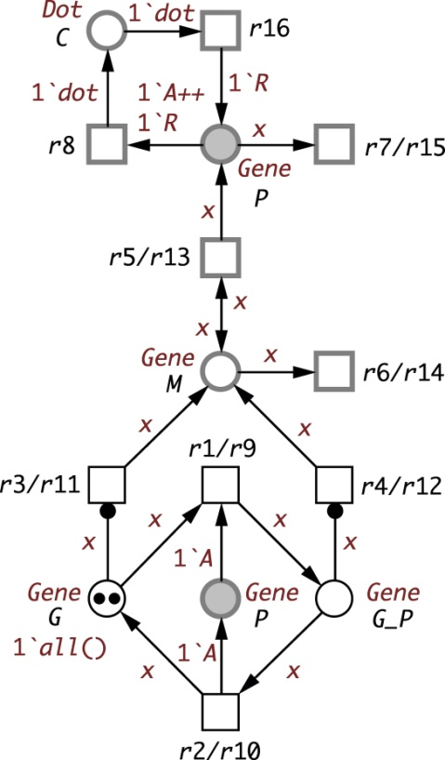
Notes:
FIGURE 7.24 Colored Petri net models for the running example—SPN^{C} (left), HPN^{C} (right). These models correspond exactly to
the Petri nets in Figures 7.8 and 7.22, respectively. The tokens shown give the total number of tokens of any color. This is replaced by
the corresponding multiset upon animation.

Slide 25
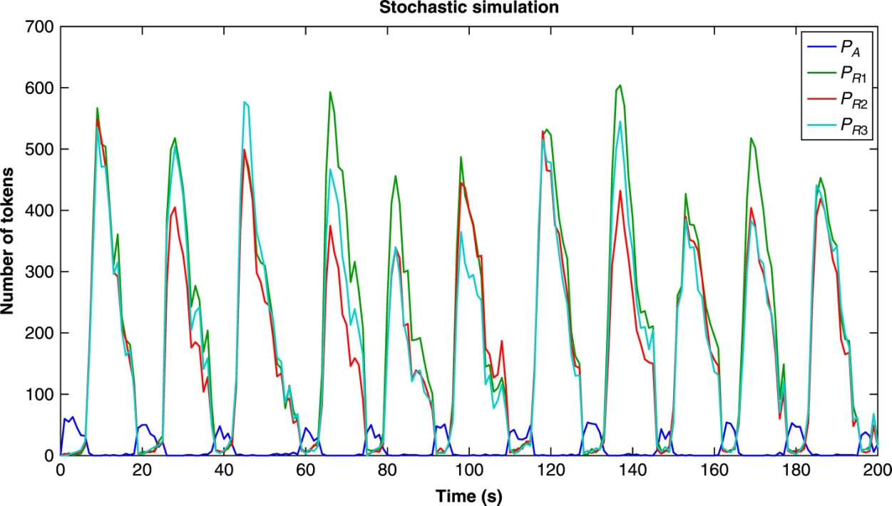
Notes:
FIGURE 7.25 Plot of a stochastic simulation run for the running example with one activator and three repressors; compare Exercise 7.28.

