Slide 1
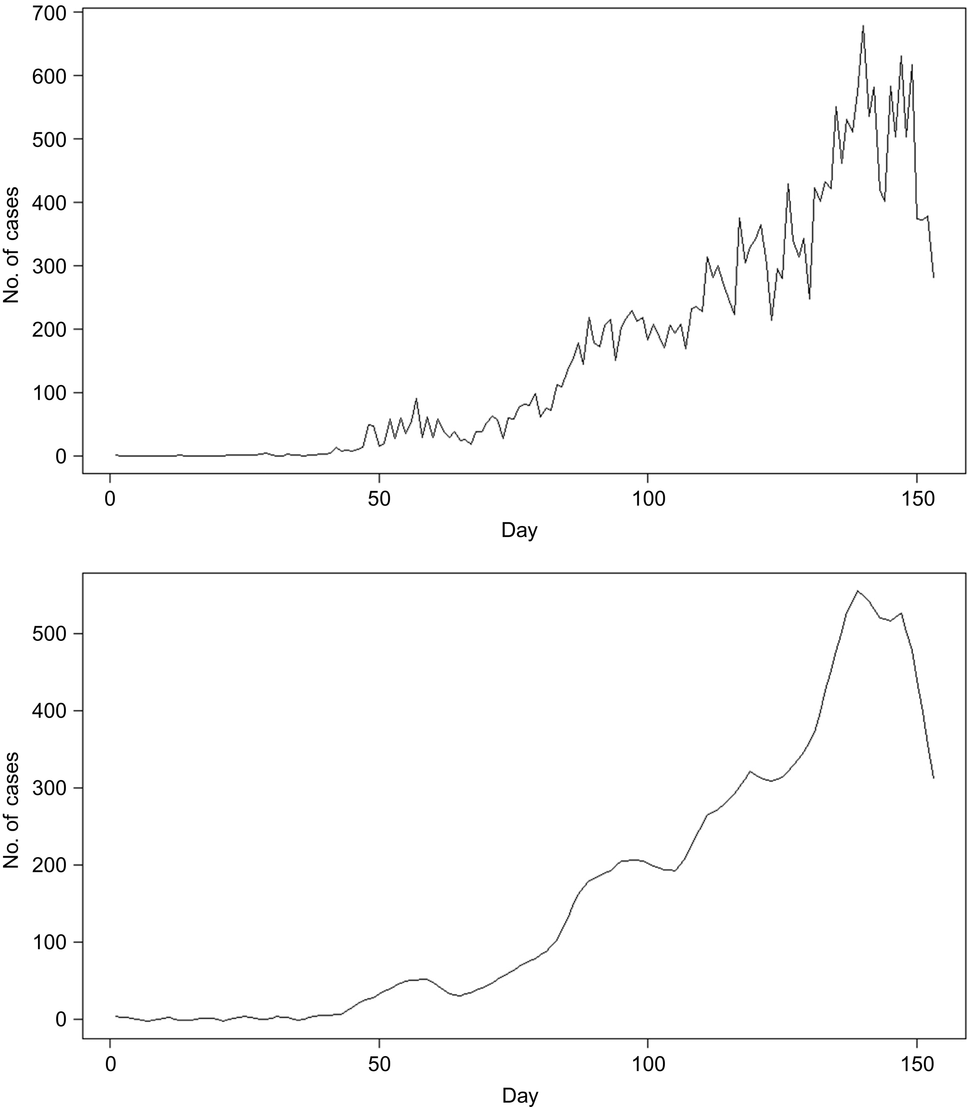
Notes:
FIGURE 8.1 Top panel: Number of confirmed new cases of H1N1 infections during the 2009 outbreak in Hong Kong. Bottom panel:
Epidemic curve for this outbreak deduced from the data shown in the top panel. Reproduced from [13].

Slide 2
Notes:
FIGURE 8.2 New infections per day in three simulated outbreaks. Panel a: No control measures in place. Panel b: Control measure
B implemented. Panel c: Control measure C implemented.

Slide 3
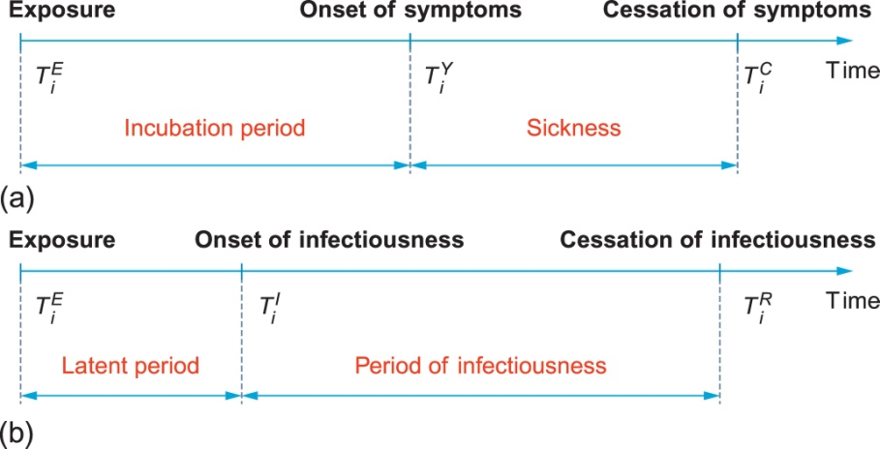
Notes:
FIGURE 8.3 Schematic representation of transition times.

Slide 4
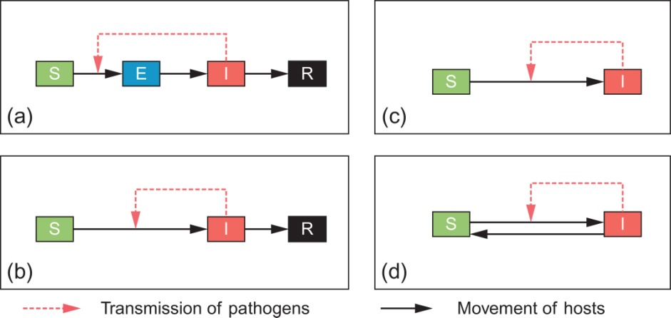
Notes:
FIGURE 8.4 Schematic representation of model types. Panel a: SEIR-models. Panel b: SIR-models. Panel c: SI-models. Panel d:
SIS-models.

