Slide 1
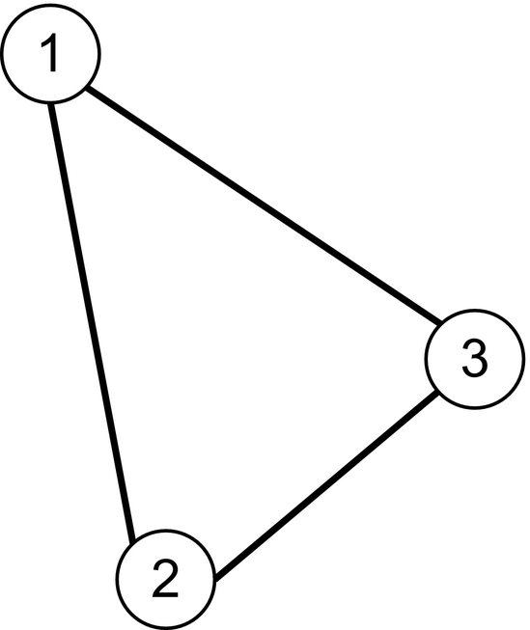
Notes:
FIGURE 9.1 The triangle is a graph K3 with three vertices.

Slide 2
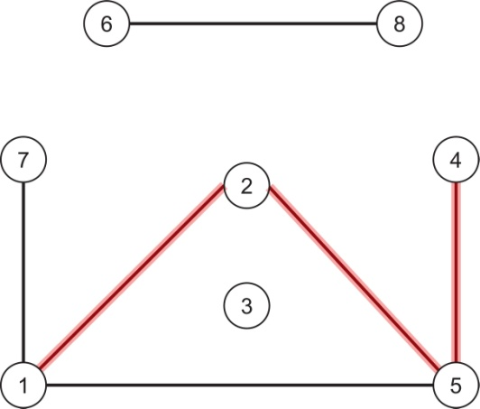
Notes:
FIGURE 9.2 The graph G₁. The edges traversed by the path P = (1, 2, 5, 4) are highlighted.

Slide 3
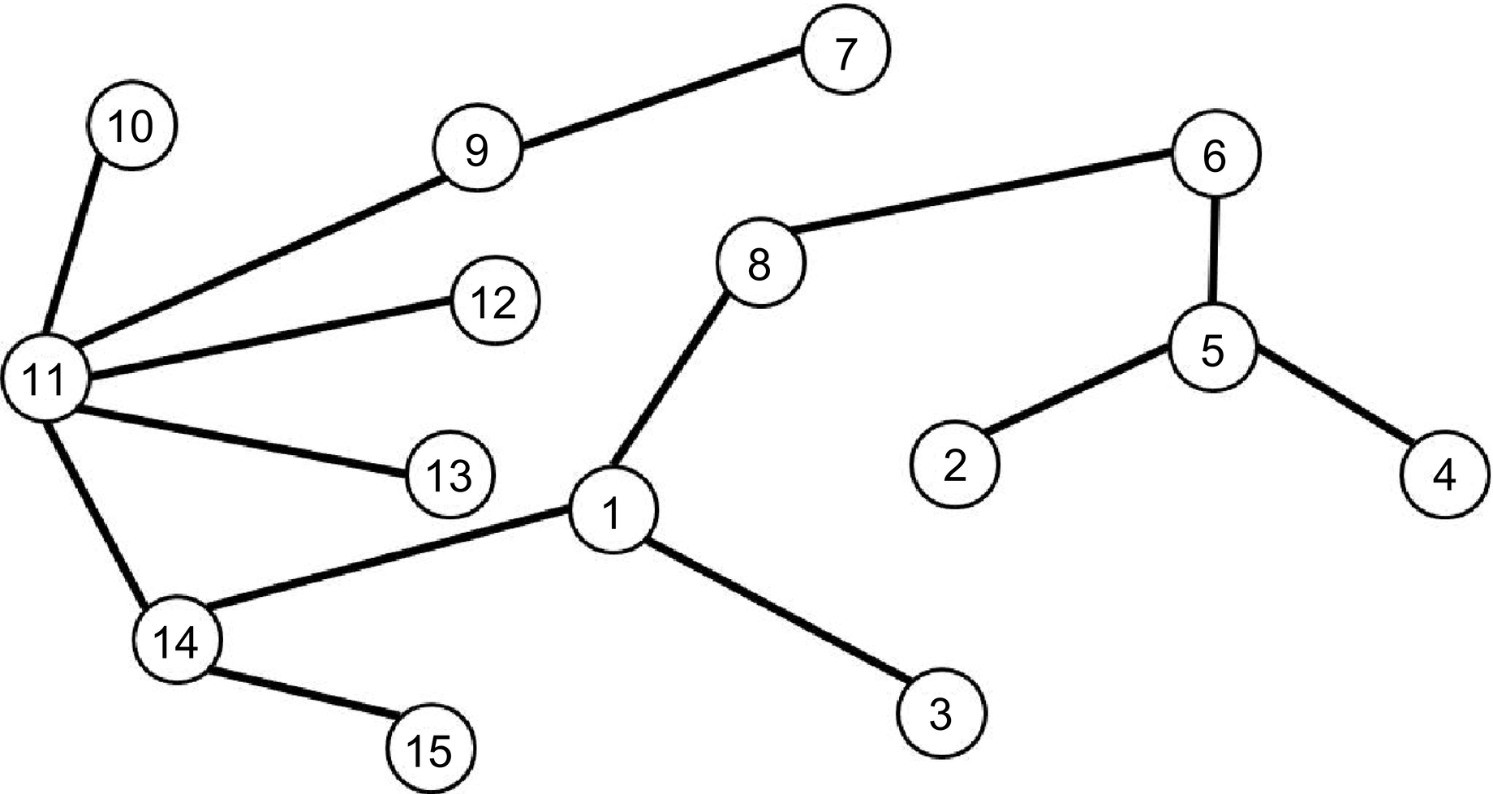
Notes:
FIGURE 9.3 The graph G_{T} . It is a tree with set of leaves {2, 3, 4, 7, 10, 12, 13, 15}.

