Slide 1
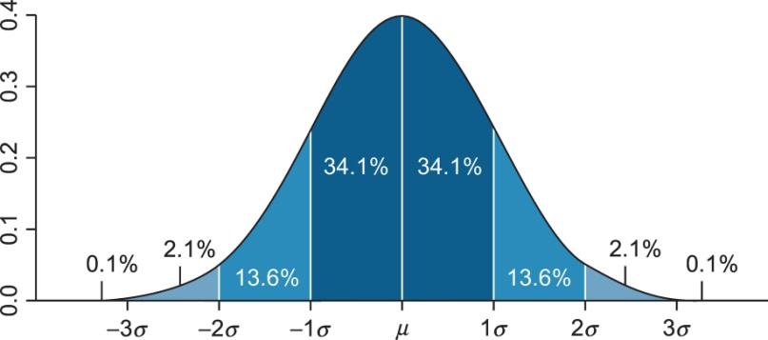
Notes:
FIGURE 10.1 The normal distribution. By Mwtoews [CC-BY-2.5 (http://creativecommons.org/licenses/by/2.5)], via Wikimedia
Commons.

Slide 2
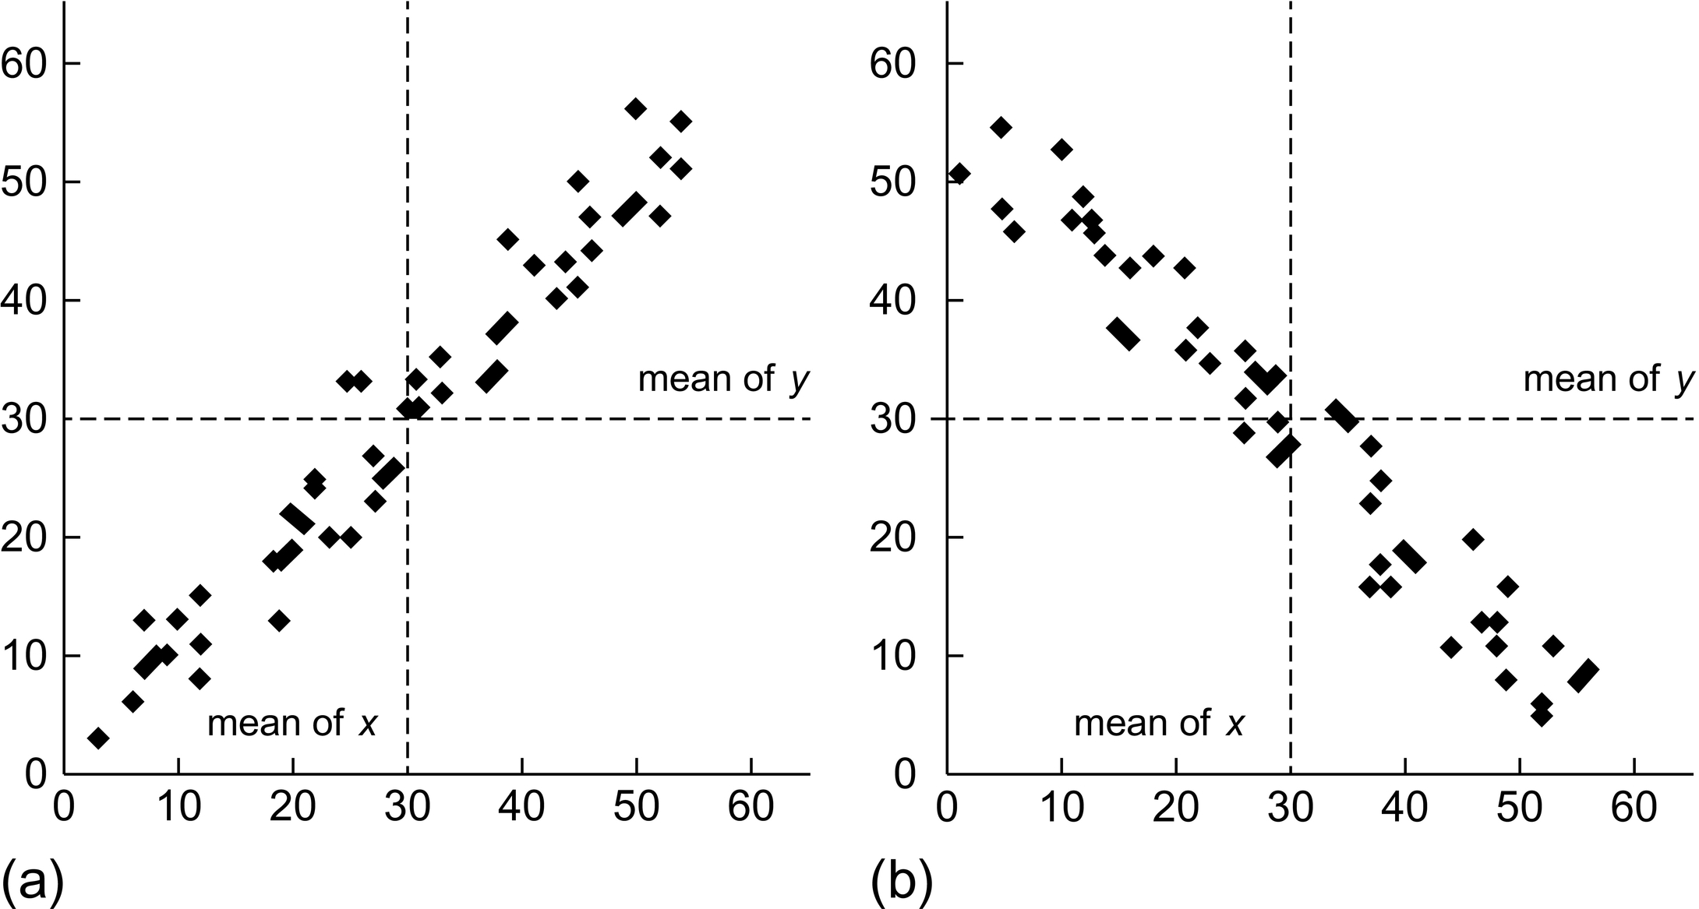
Notes:
FIGURE 10.2 Scatterplots illustrating a positive (a) and negative (b) covariance. The vertical line x = μx and the horizontal line
y = μy divide the plane into four quadrants. When Cov(X,Y) is positive, most of the data points fall into the quadrants where (xi − μx)
and (yi − μy) are both positive or where they are both negative, so that the products (xi − μx) (yi − μy) are more often positive. When
Cov(X,Y) is negative, most of the points fall into the quadrants where one of (xi − μx) and (yi − μy) is positive and the other negative,
so that the products (xi − μx) (yi − μy) are more often negative.

Slide 3
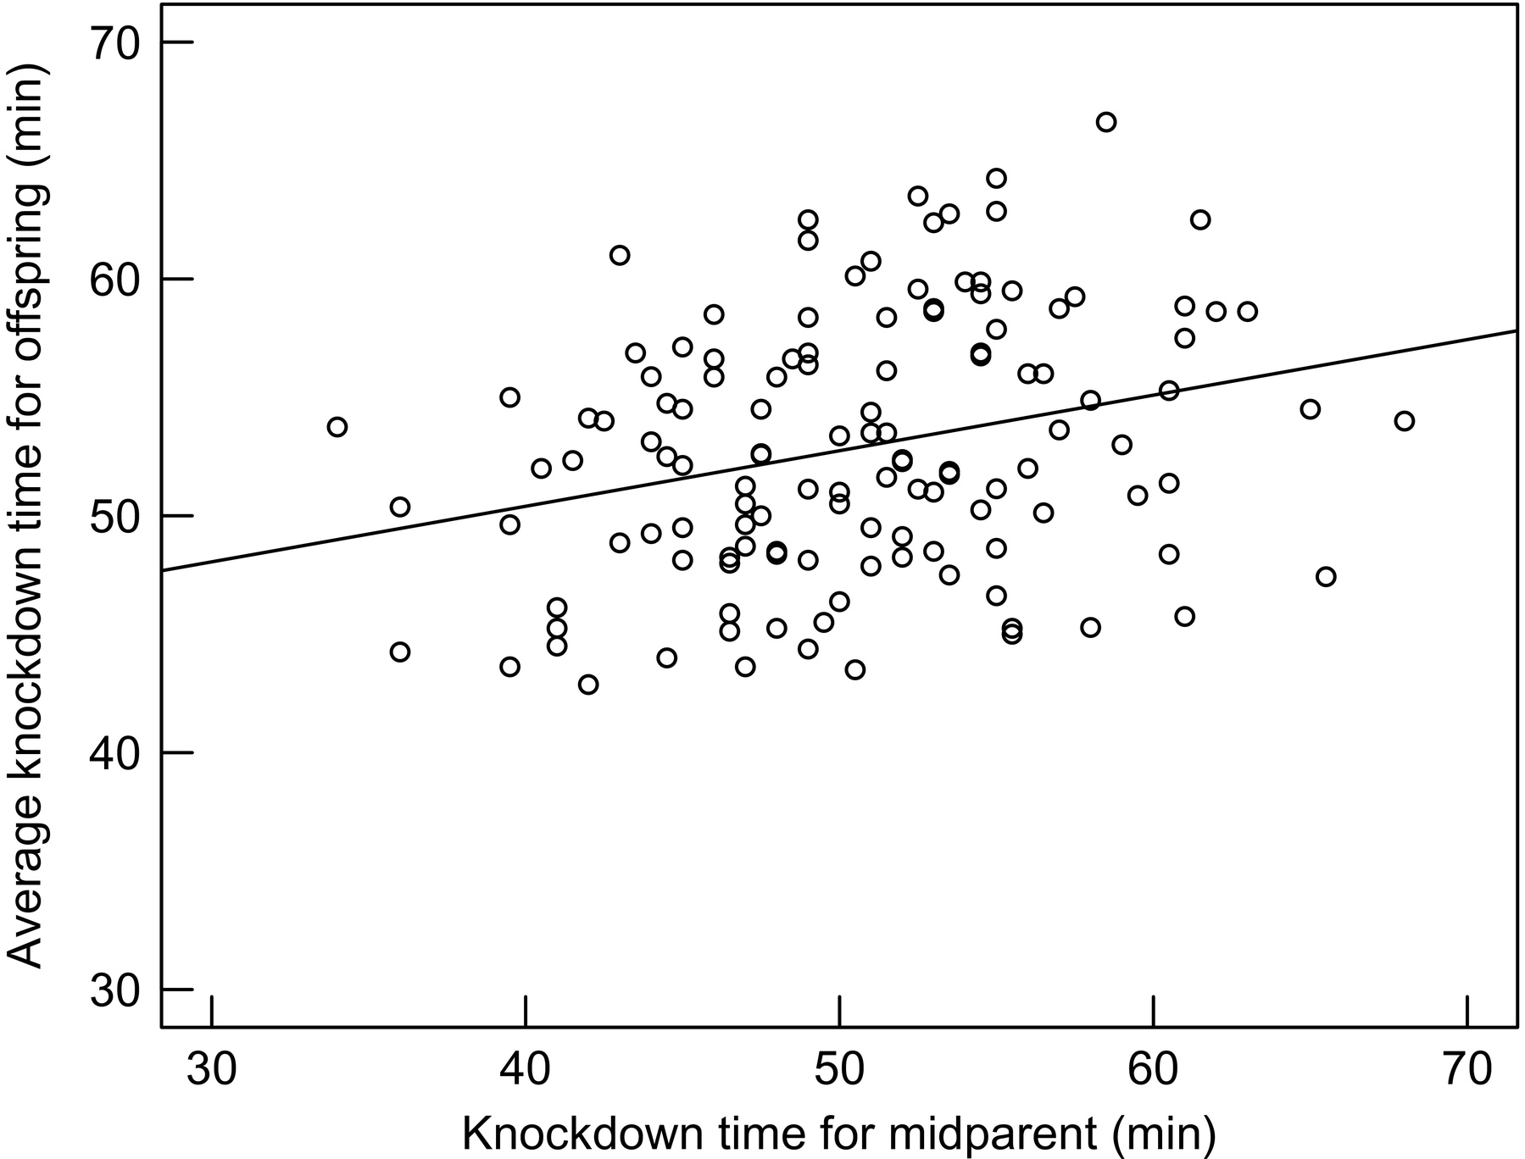
Notes:
FIGURE 10.3 Heritability of knockdown time at 37 ◦C and less than 10% humidity in Drosophila melanogaster. Knockdown time for
offspring was averaged across eight individuals per family. The midparent value is the average knockdown time of the mother and father.
Data from Bubliy et al. [15].

