Slide 1
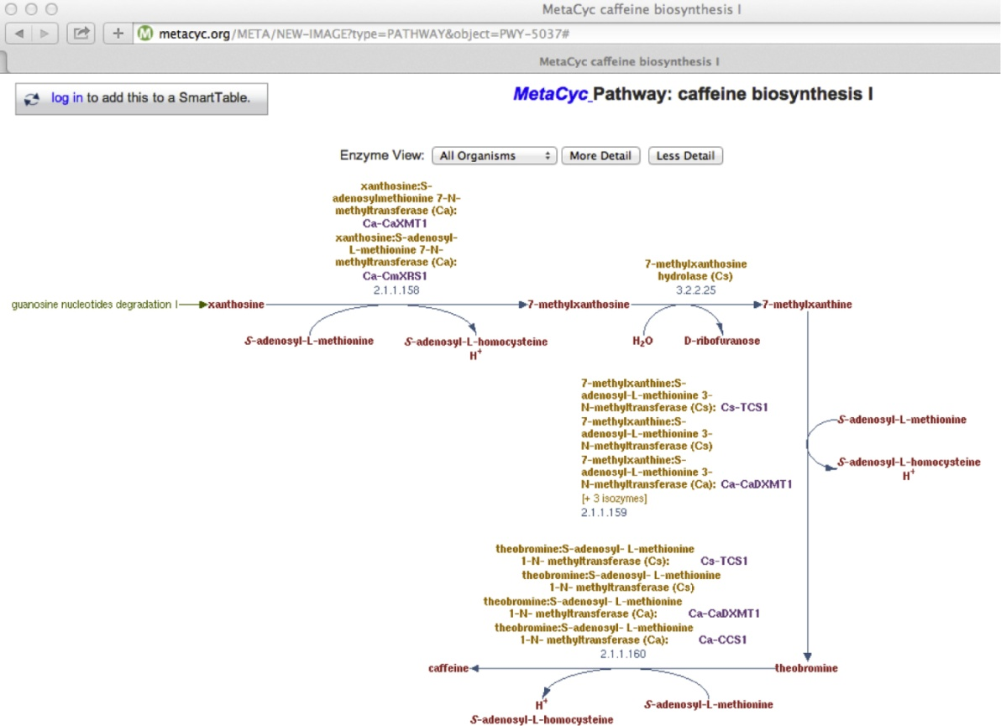
Notes:
FIGURE 11.1 A graphical representation of a putative major pathway for caffeine biosyntheses as per MetaCyc [6].

Slide 2
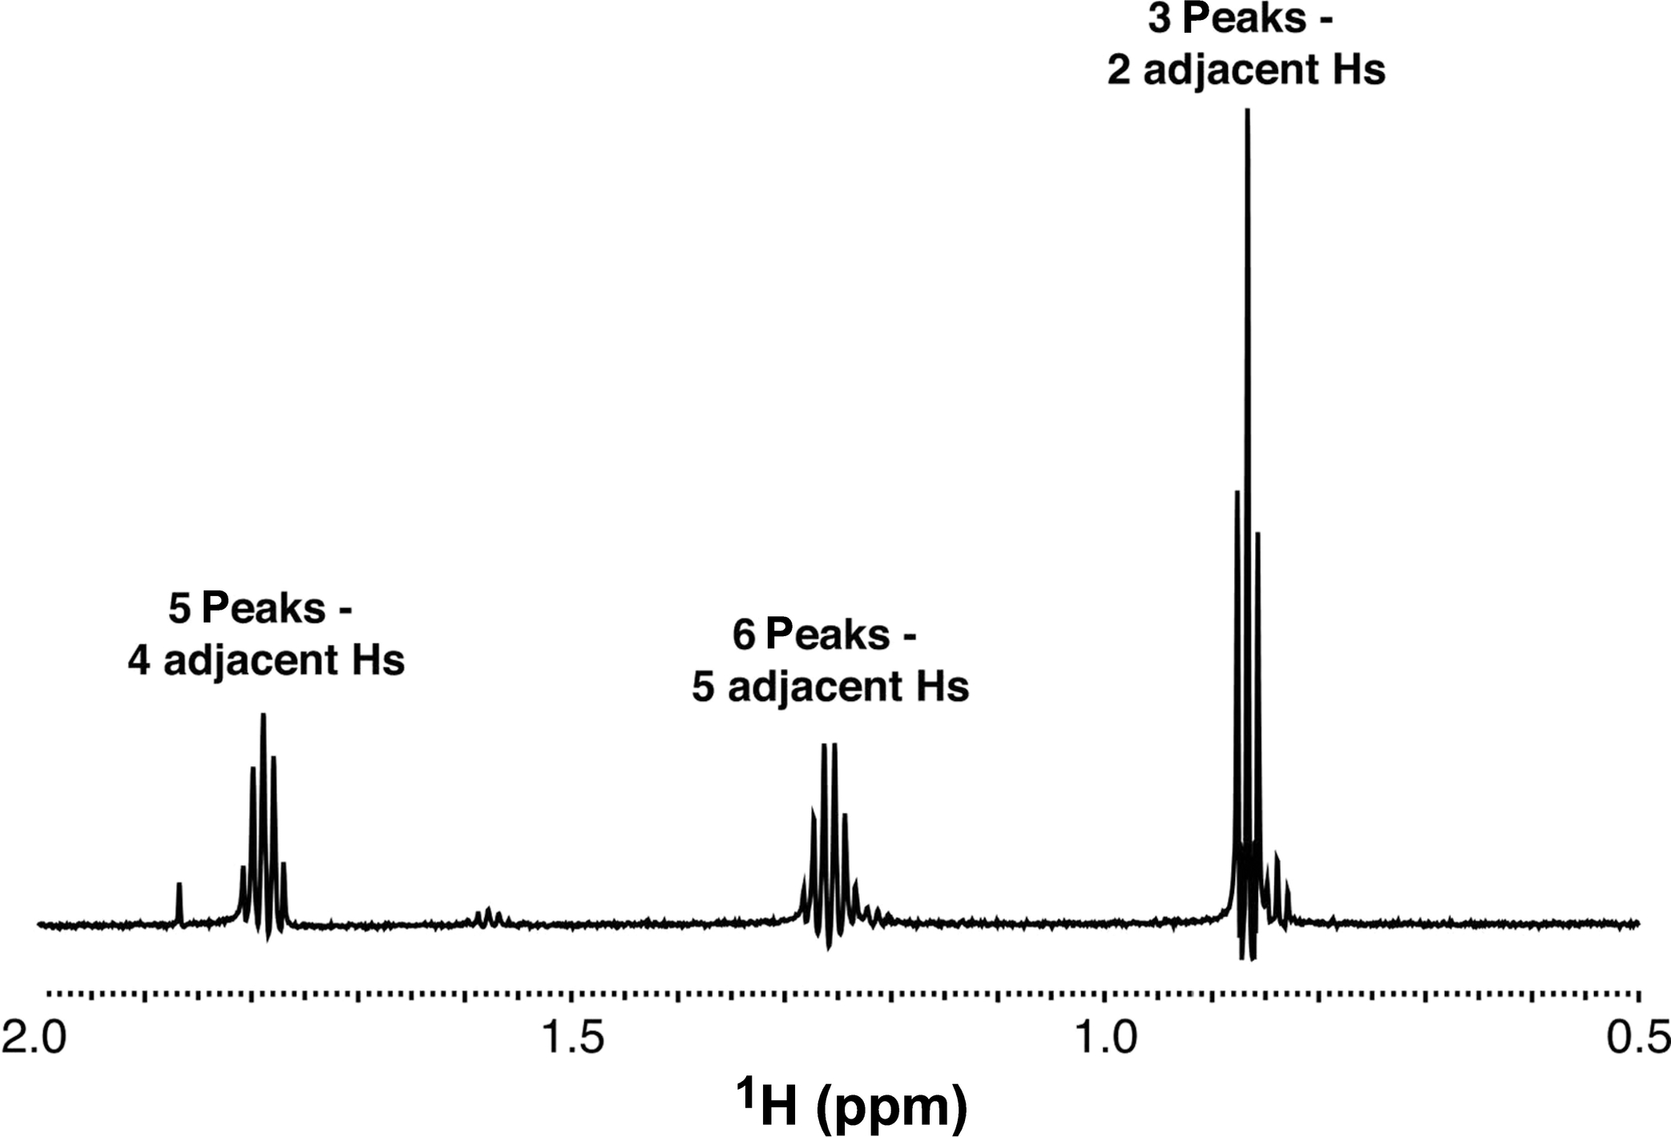
Notes:
FIGURE 11.2 A typical ¹H NMR spectrum. Coupling between hydrogen nuclei that are close together in a molecule leads to peak
multiplicity. The number of coupled hydrogen atoms is one less than the number of assocated peaks.

Slide 3
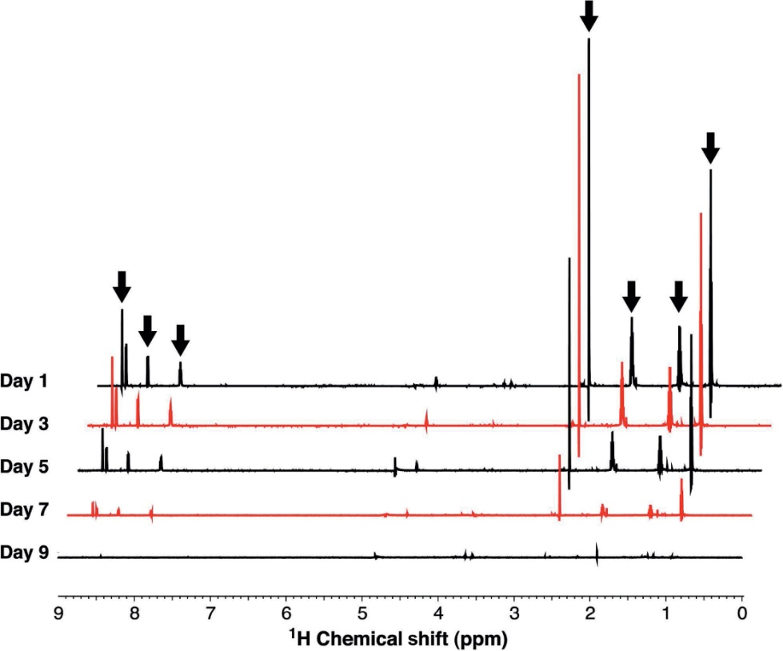
Notes:
FIGURE 11.3 ¹H NMR spectra of an IL being degraded by a bacterial culture. The original compound (black arrows) becomes
completely degraded since the corresponding signals disappear by Day 9. No appearance of new signals suggests that the bacteria do not
excrete any metabolites of the compound.

Slide 4
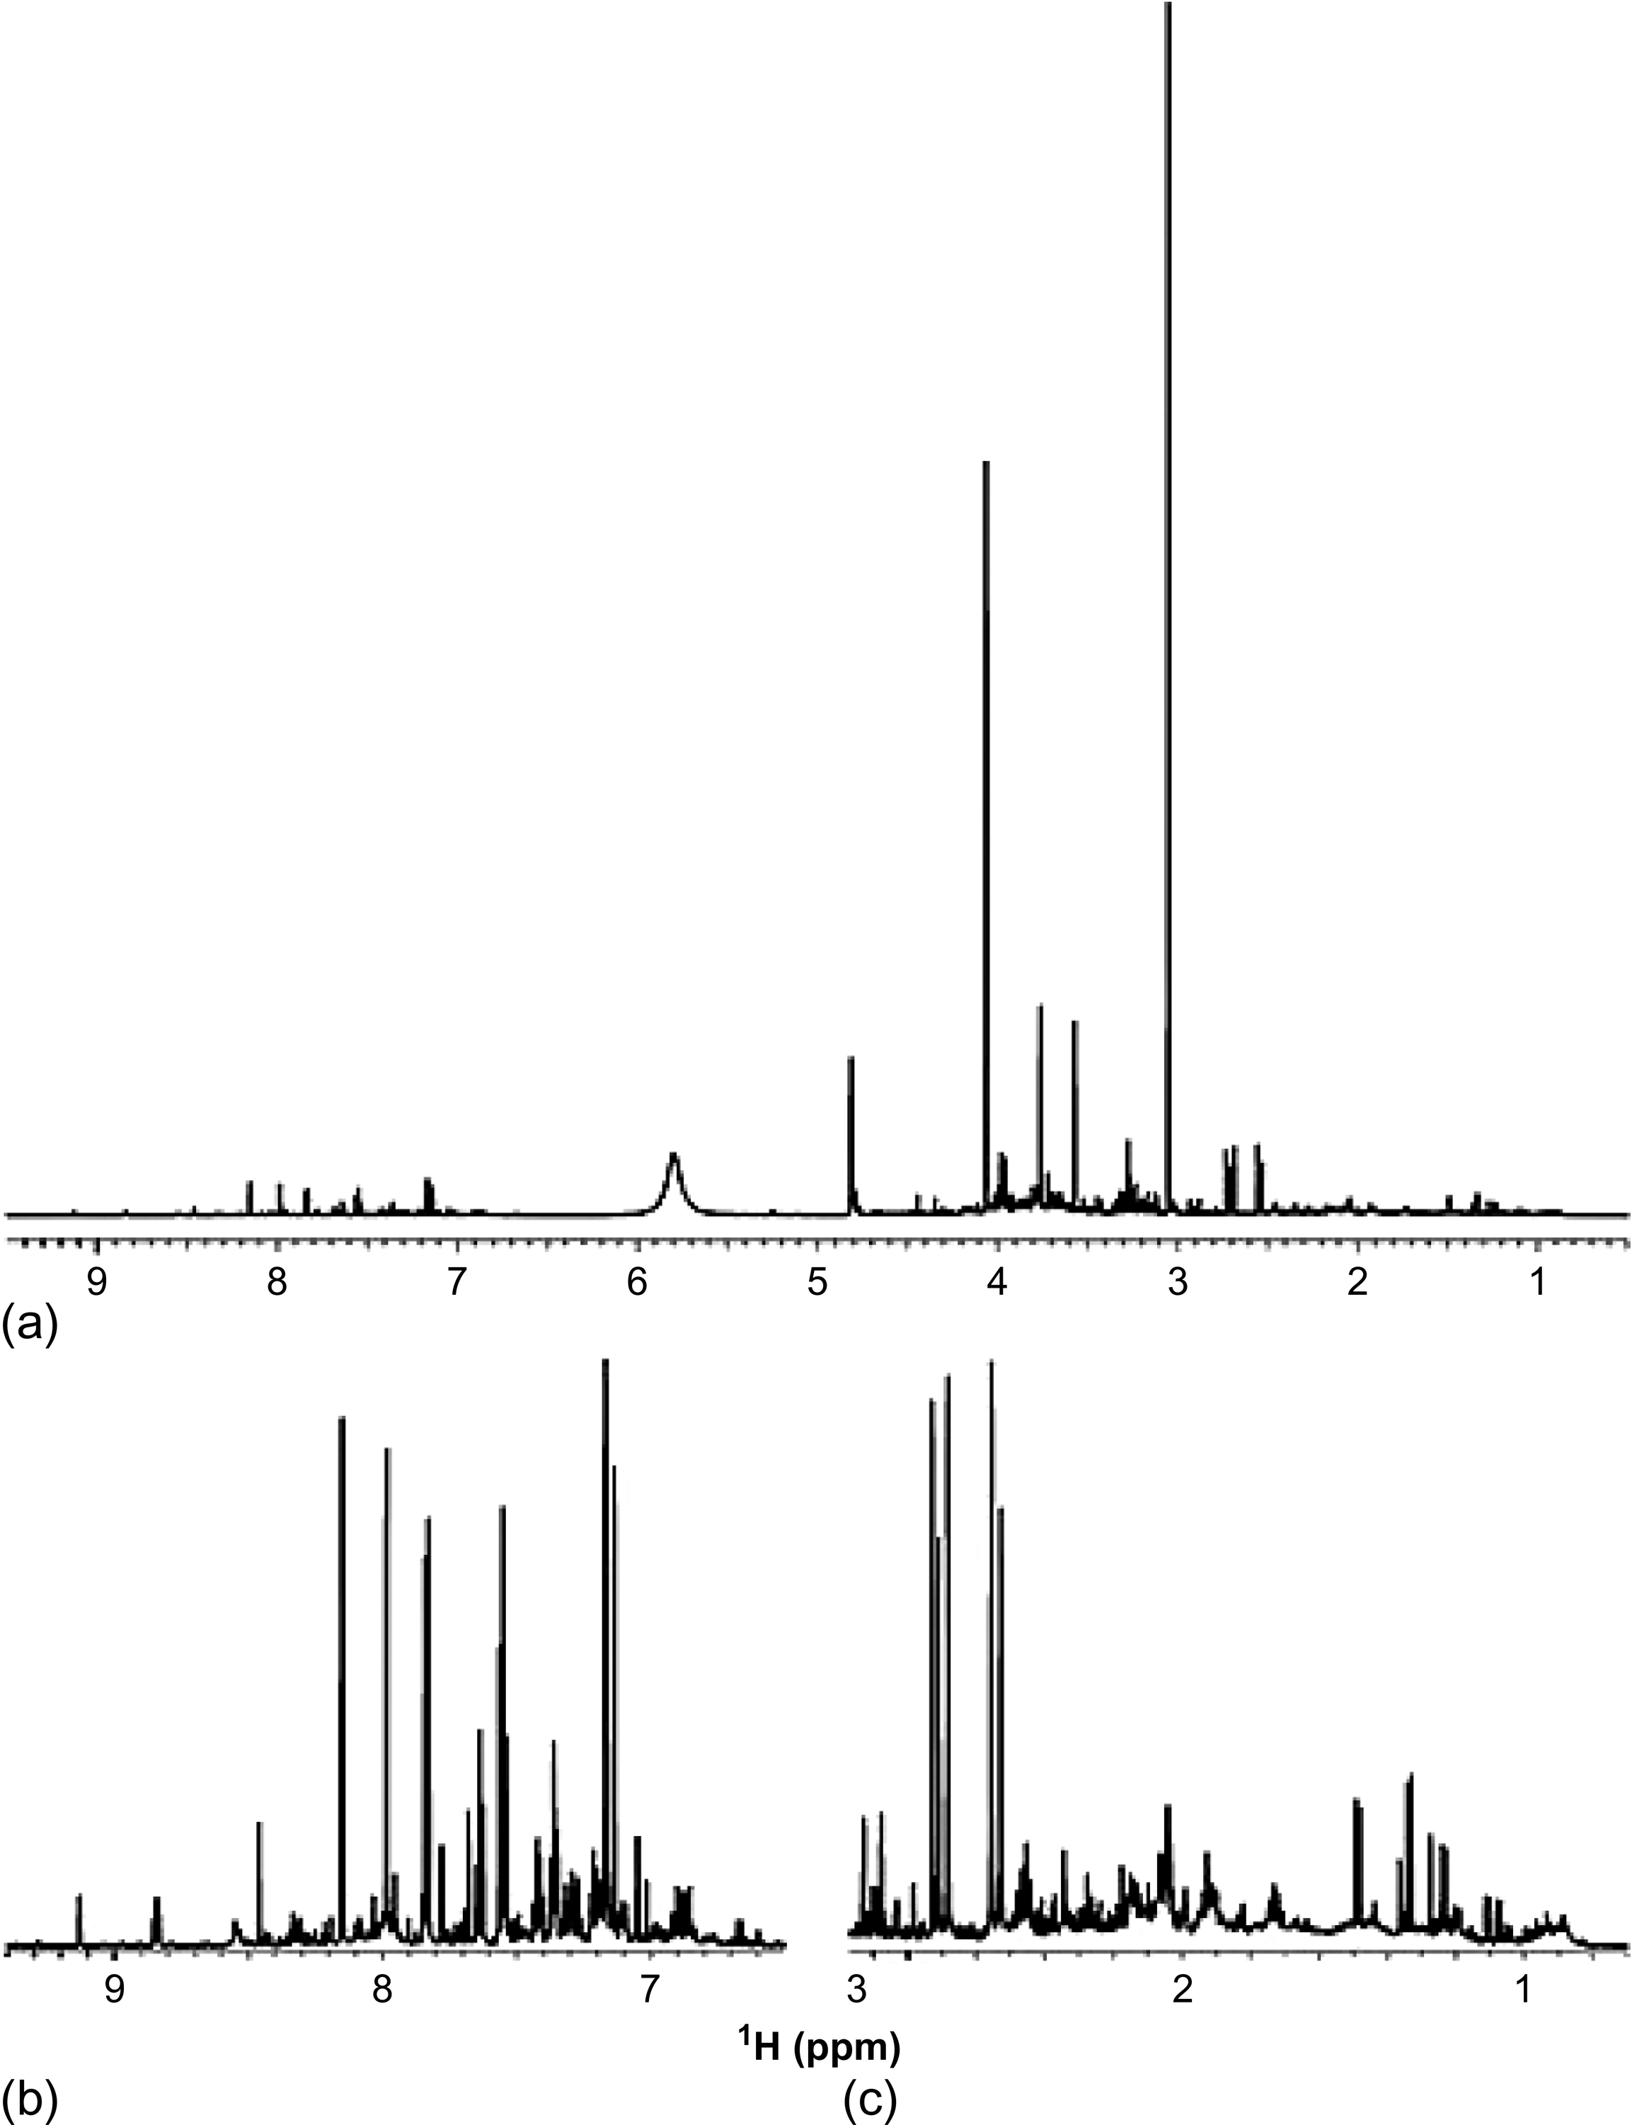
Notes:
FIGURE 11.4 ¹H NMR spectrum of urine. (a) The full spectrum of urine reveals that some components have higher concentrations than
others. The intense resonances at 3 and 4.1 ppm are likely associated with creatinine, the most concentrated chemical in urine. (b, c)
Exclusion of spectral regions that contain intense resonances reveals the complex chemical makeup of urine. We thank Claudio Luchinat
and Leonardo Tenori at CERM in Florence, Italy for providing this urine NMR spectrum.

