Slide 1
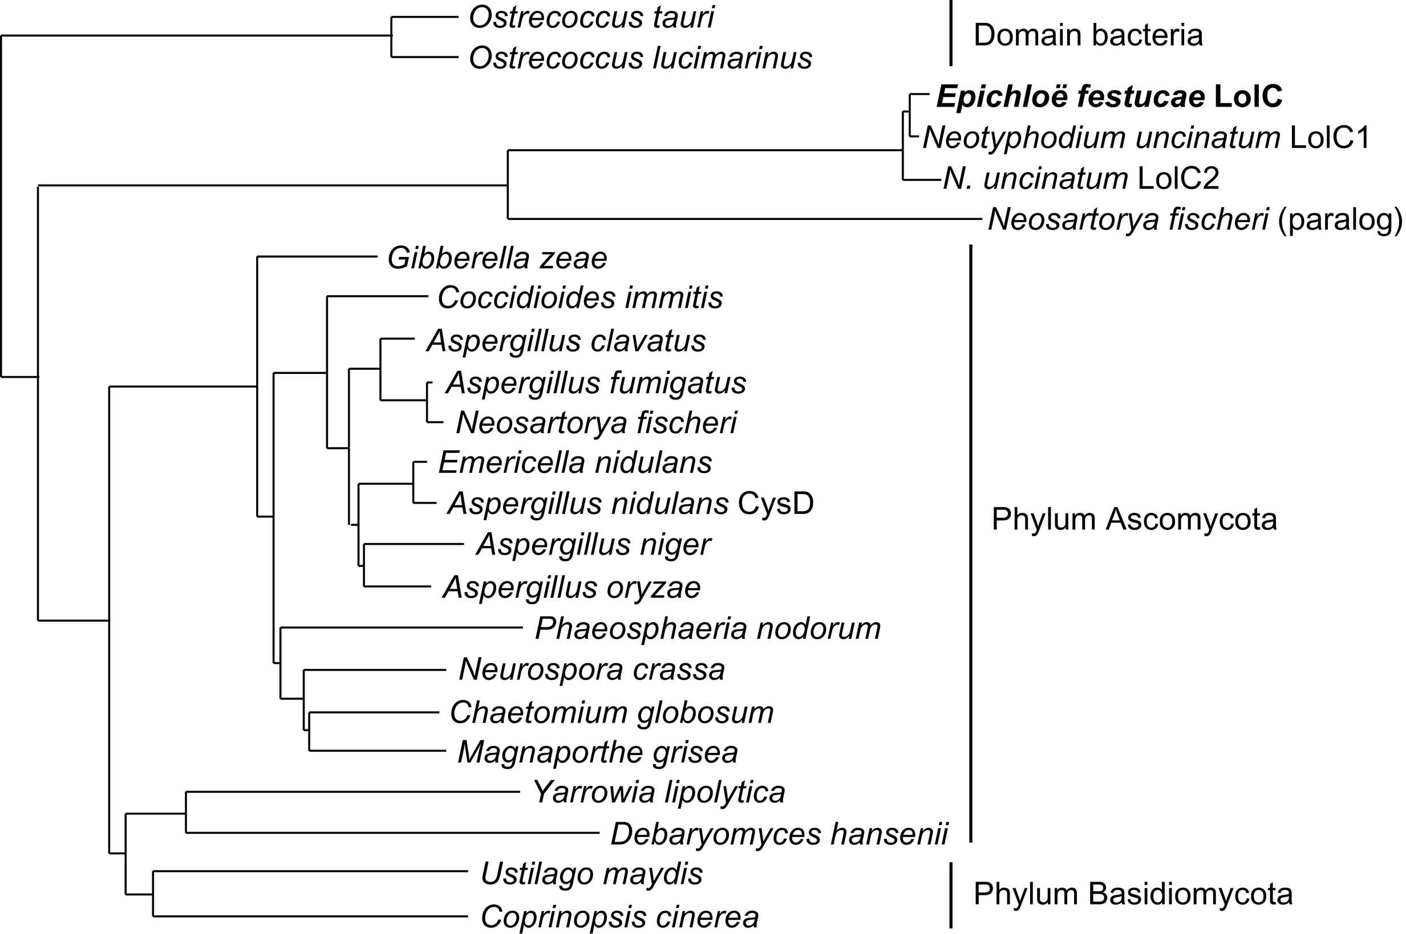
Notes:
FIGURE 12.1 Example of a phylogenetic tree. This tree is reconstructed by NJ using the data relating LolC from Epichloë and
Neotyphodium spp. to the most closely related sequences identified by blastp of the GenBank database. Taxonomic relationships are
indicated for the CysD orthologs.

Slide 2
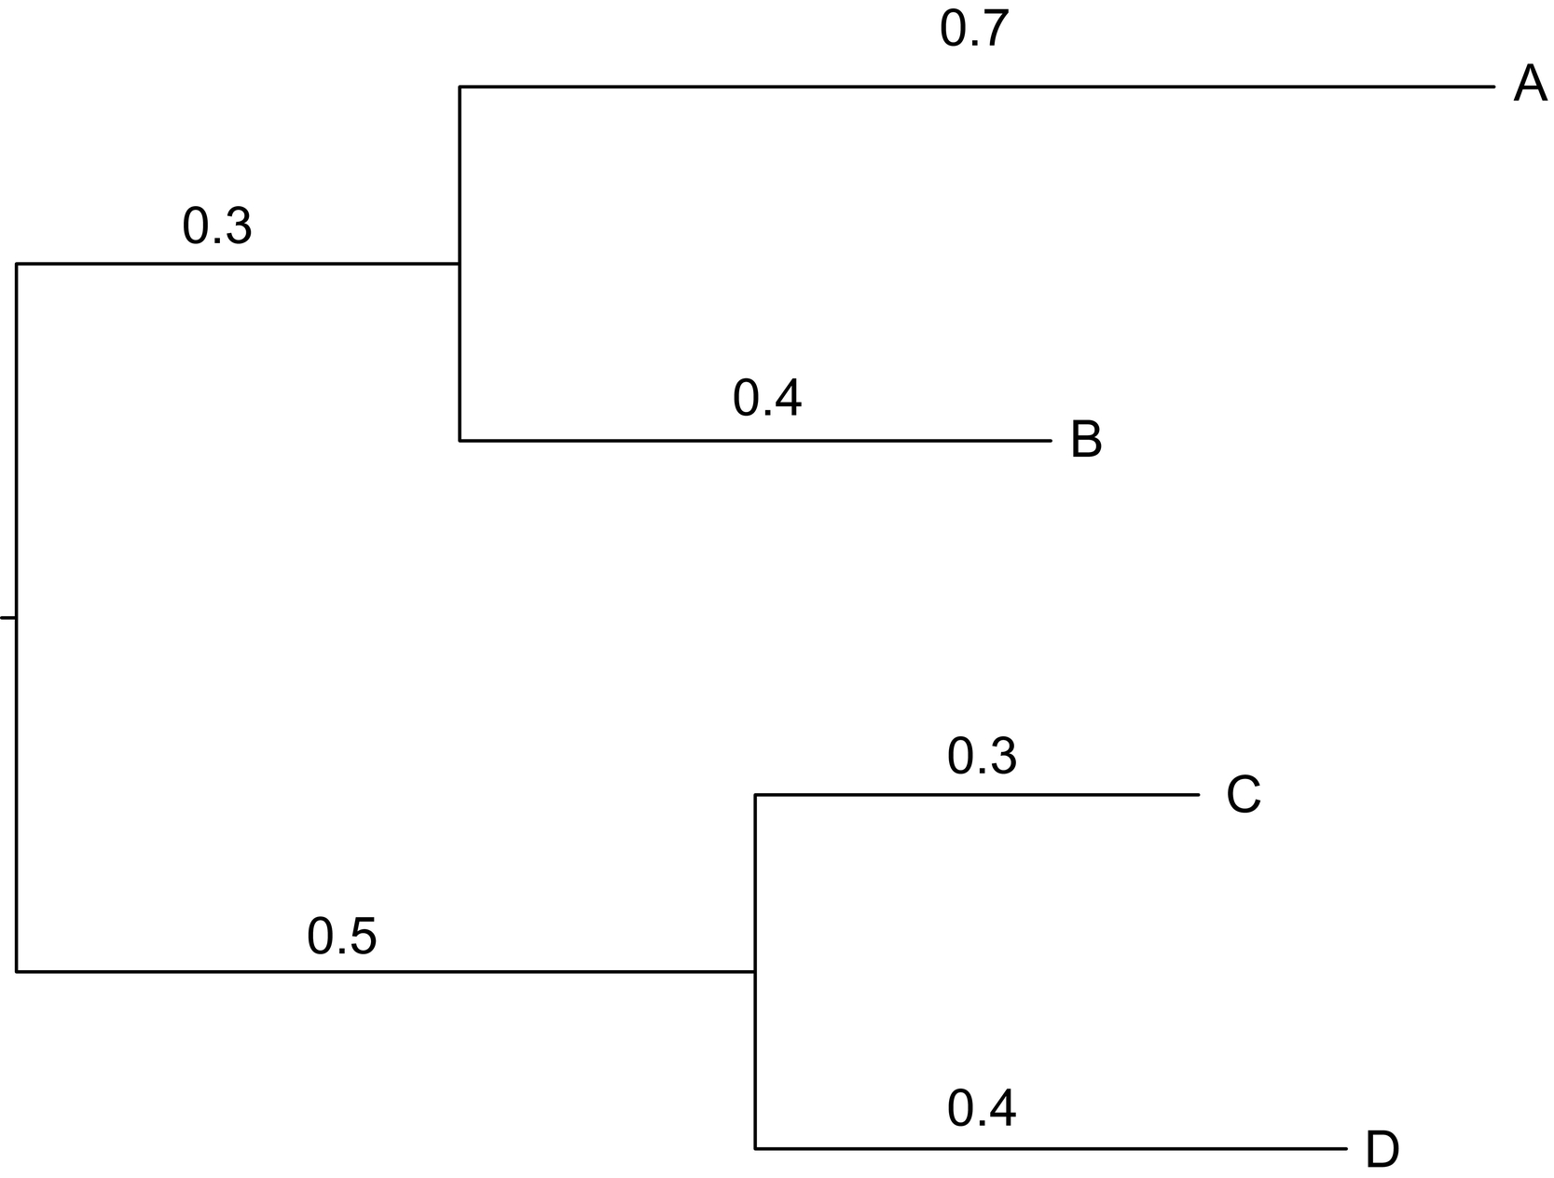
Notes:
FIGURE 12.2 Tree for the Newick format in the example in Exercise 12.3.

Slide 3
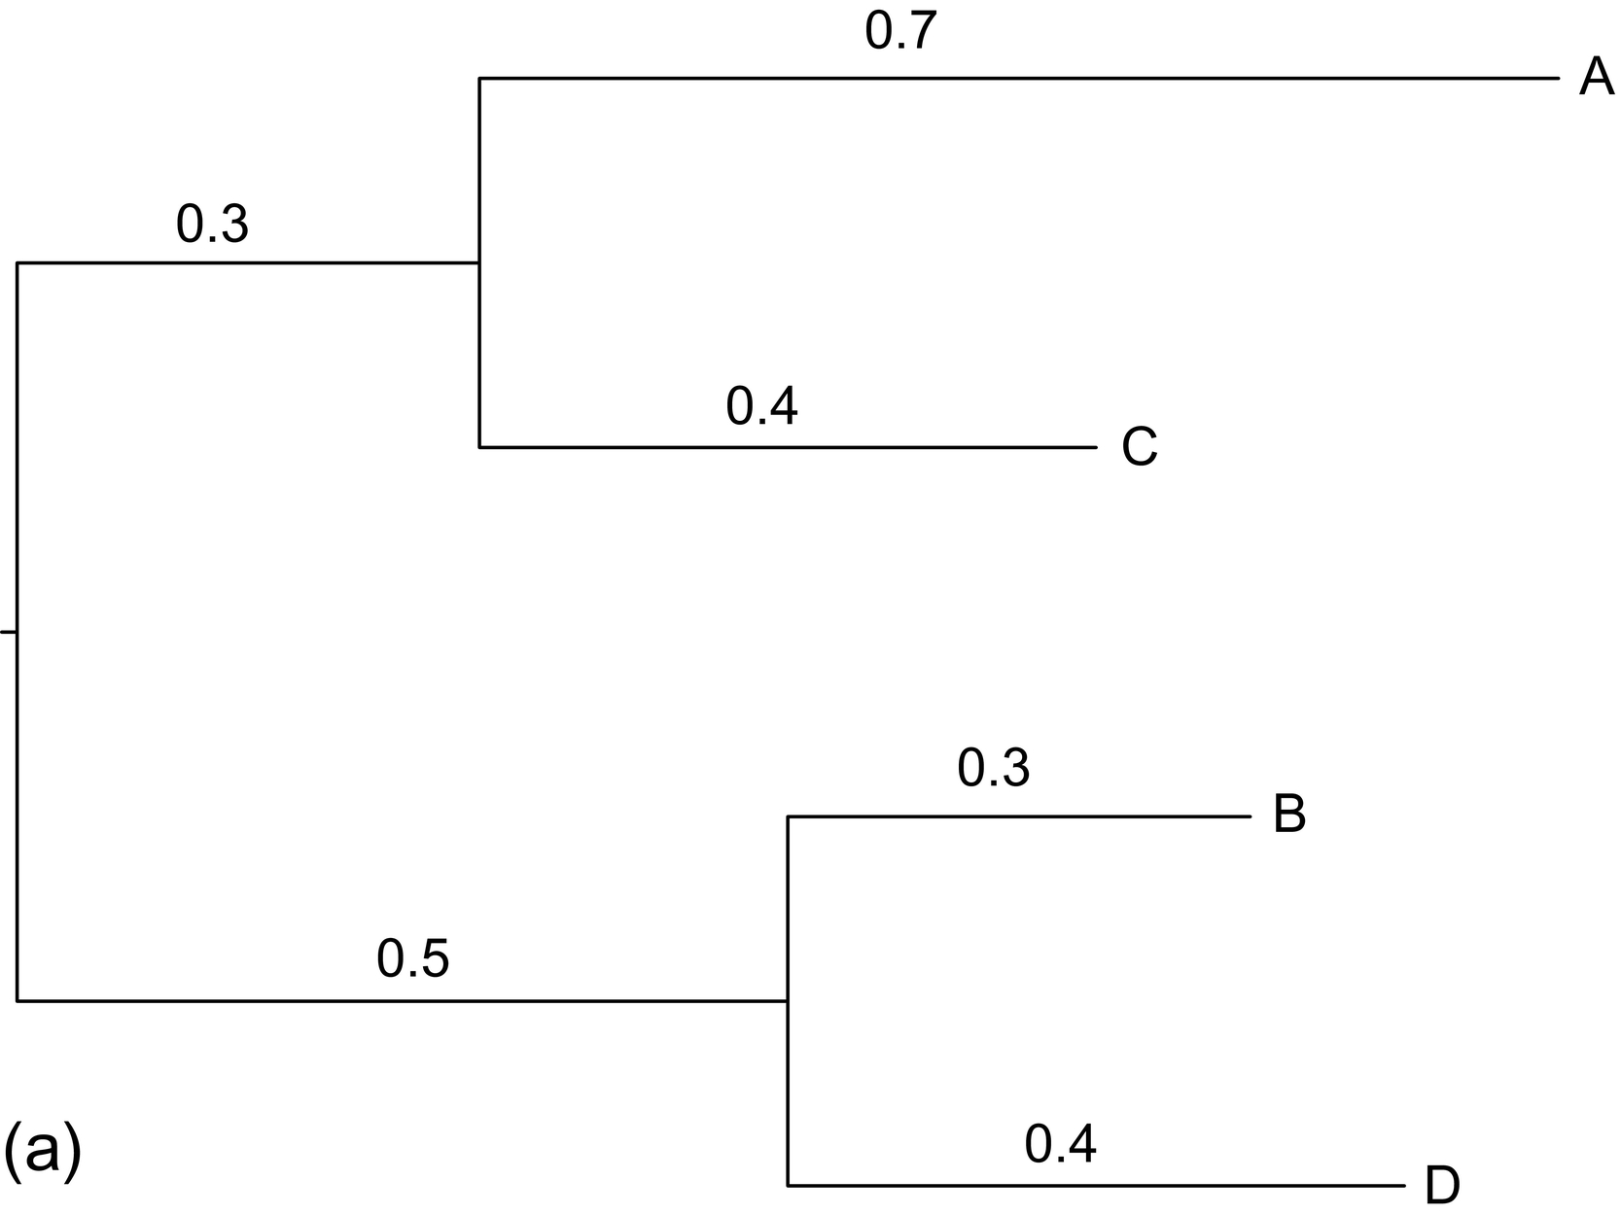
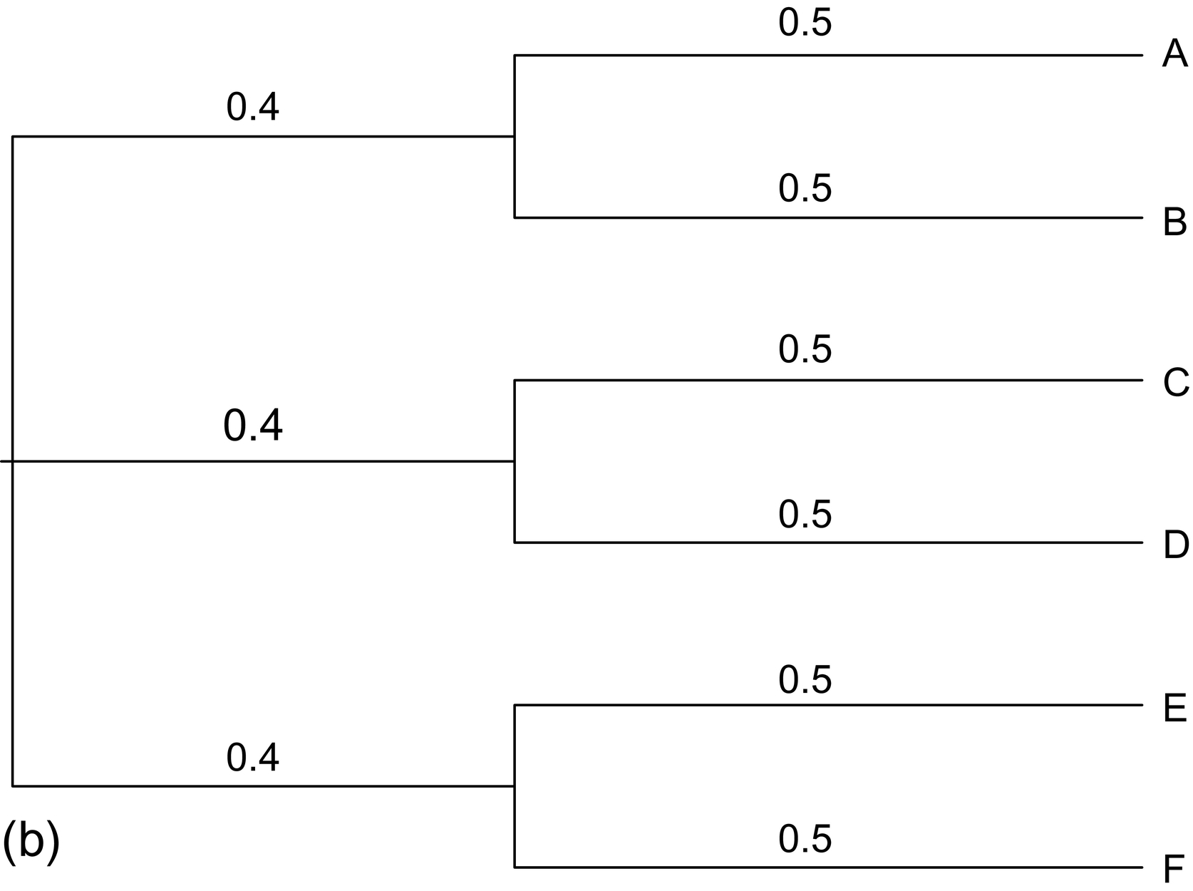
Notes:
FIGURE 12.3 Trees for Exercise 12.3.

Slide 4
Notes:
FIGURE 12.4 A portion of the hemoglobin multiple sequence alignment, with numbers at left indicating the starting position in each
sequence. Periods indicate that characters are identical to the character shown in the top sequence. Lowercase characters indicate
characters are different than those found in the HBA1 sequence, while the dashes represent gaps in the sequence alignment.

Slide 5
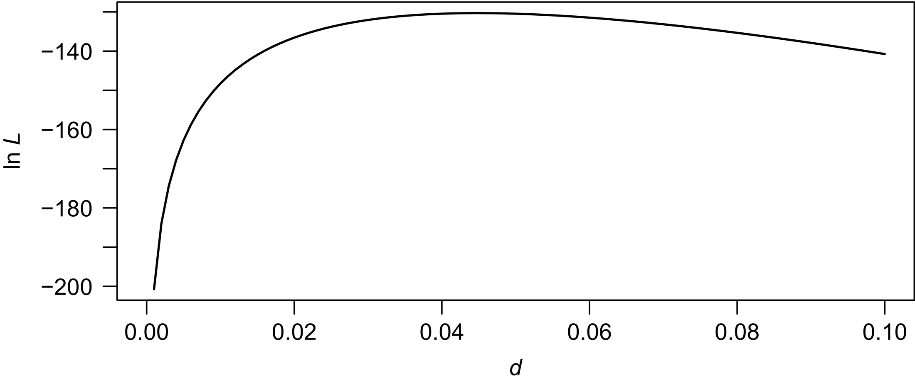
Notes:
FIGURE 12.5 Log-likelihood function for the JC model and the sequences HBA1 and HBA2.

Slide 6
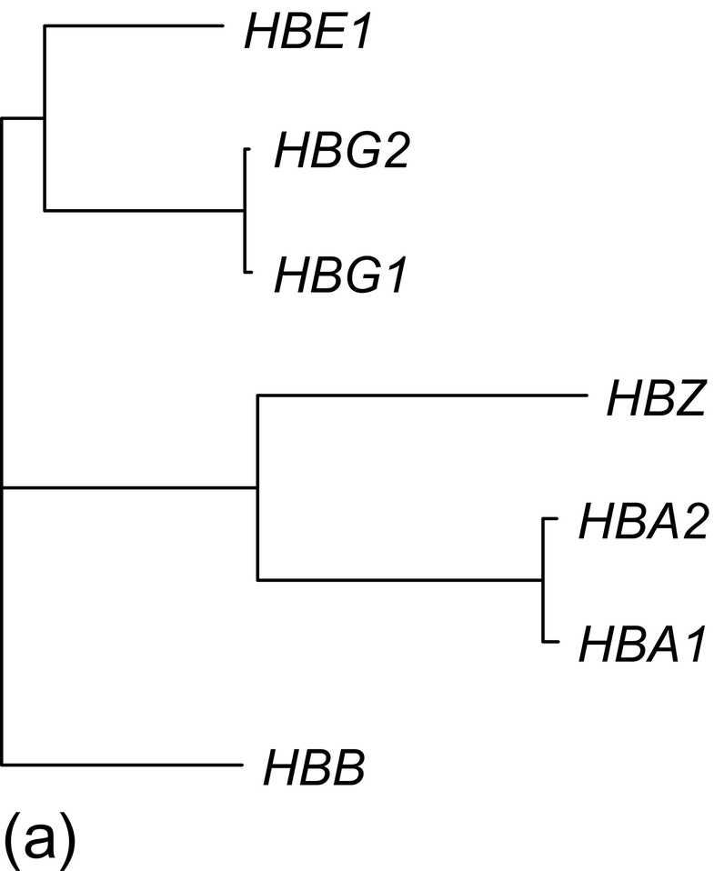
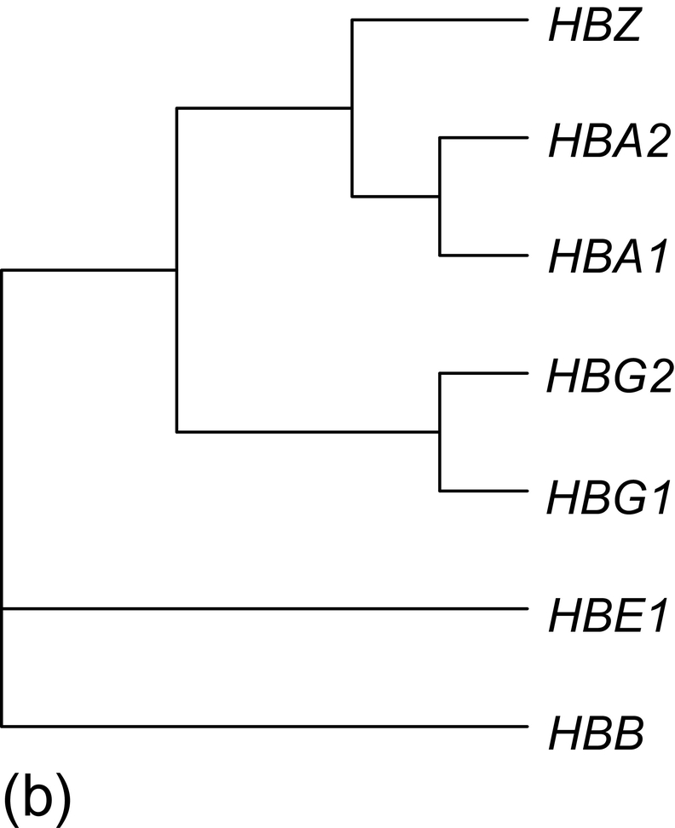
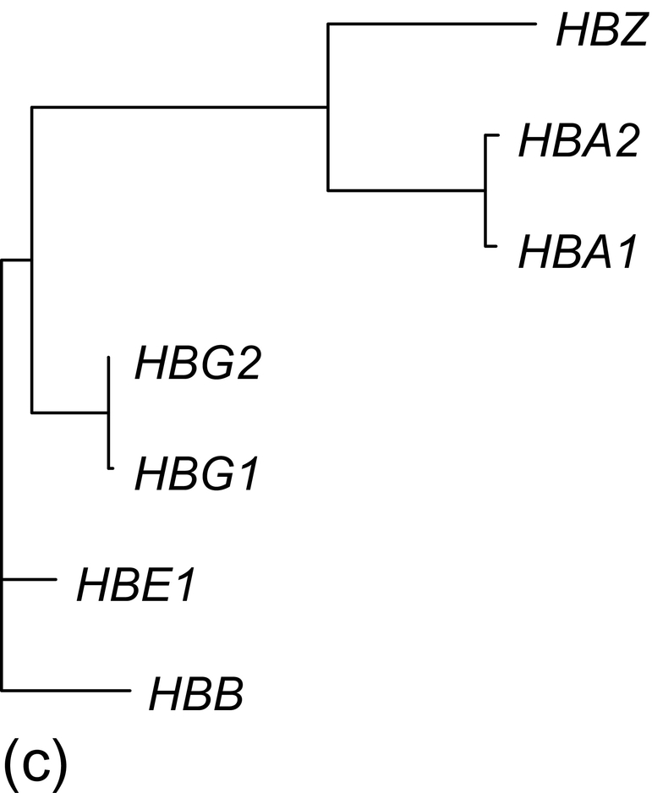
Notes:
FIGURE 12.6 Trees reconstructed from the hemoglobin gene data using three different methods.

Slide 7
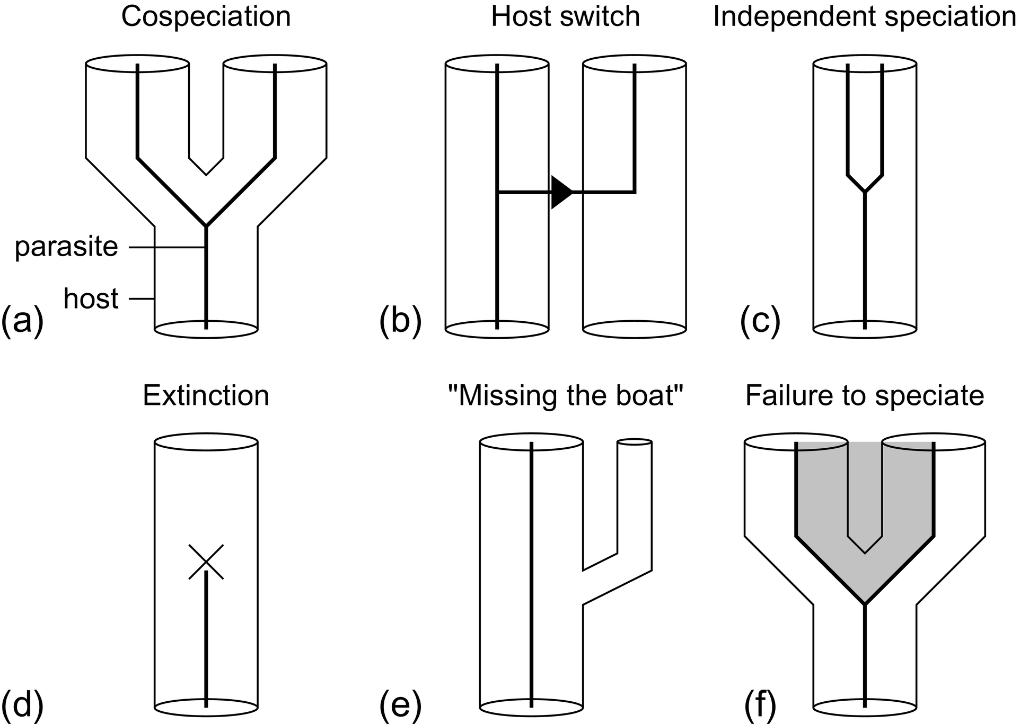
Notes:
FIGURE 12.7 Evolutionary events that can occur during gene-genome (host-parasite) coevolution [62]. These are equivalent to the
following processes associated with gene-genome coevolution: (a) “Tracking”: Gene trees track species trees, or gene trees track each
other. (b) Lateral gene transfer (LGT). (c) Duplication. (d) Extinction of a gene lineage or a gene lineage is unsampled. (e) Missing
the boat: a gene lineage is unrepresented in a new species. (f) Trans-species polymorphism. Multiple gene lineages are carried through
multiple speciation events, either because of selection or because of insufficient time (depending on N_{e}, the effective population size) for
fixation.

