Slide 1
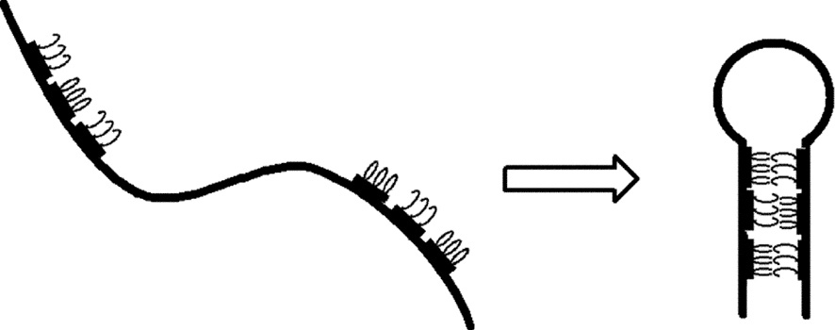
Notes:
FIGURE 13.1 A cartoon of the ribbon and Velcro analogy

Slide 2
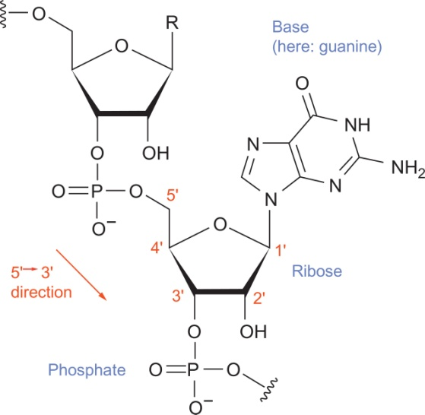
Notes:
FIGURE 13.2 Two nucleotides attached together via a phosphodiester bond, forming the sugar-phosphate backbone. Figure created by
Narayanese at the English language Wikipedia and provided under the Creative Commons Attribution-Share Alike 3.0 Unported license
(http://creativecommons.org/licenses/by-sa/3.0/legalcode).

Slide 3
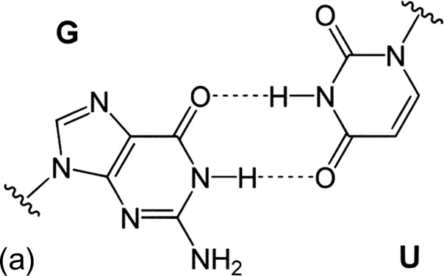
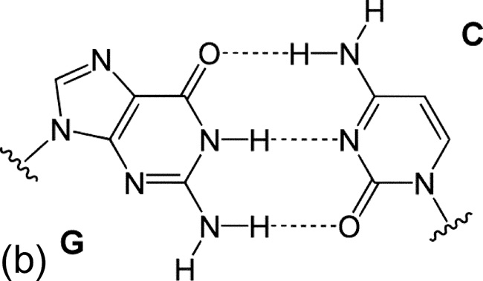
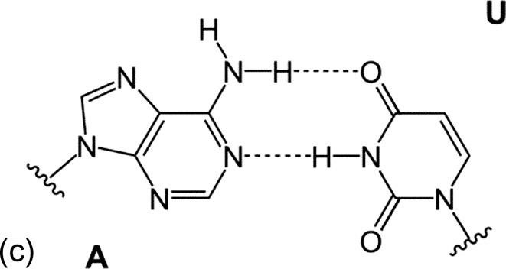
Notes:
FIGURE 13.3 The three base pairs found in RNA molecules.

Slide 4
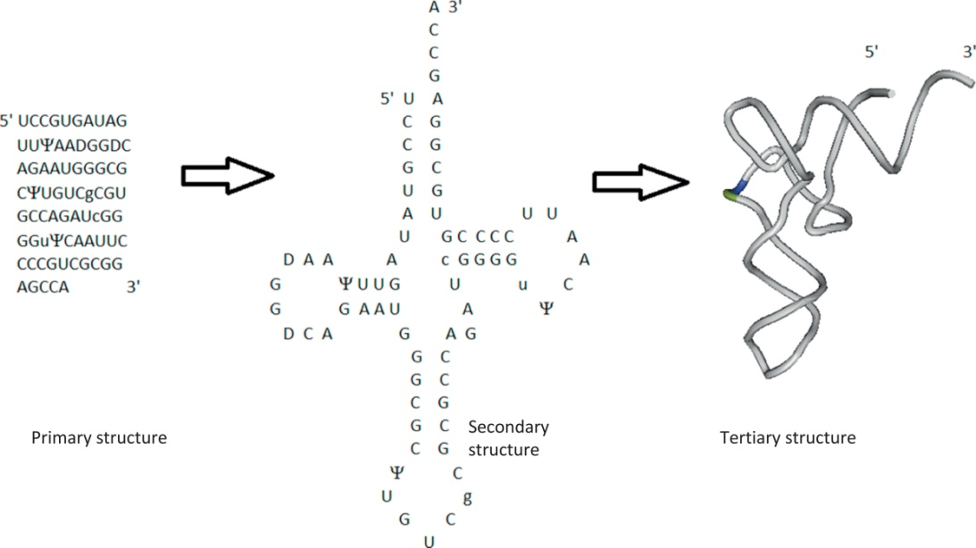
Notes:
FIGURE 13.4 Primary, secondary, and tertiary structures of the yeast aspartic acid transfer RNA. Nonstandard symbols are as follows:
is pseudouracil, D is dihydrouracil, c is 5-methyl cytosine, g is 1-methyl guanine, and u is 5-methyl uridine. Primary sequence data
obtained from the Nucleotide Data Base ndbserver.rutgers.edu [2, 3]. Tertiary structure was prepared using Cn3D (www.ncbi.nlm.nih.
gov) with data from [4].

Slide 5
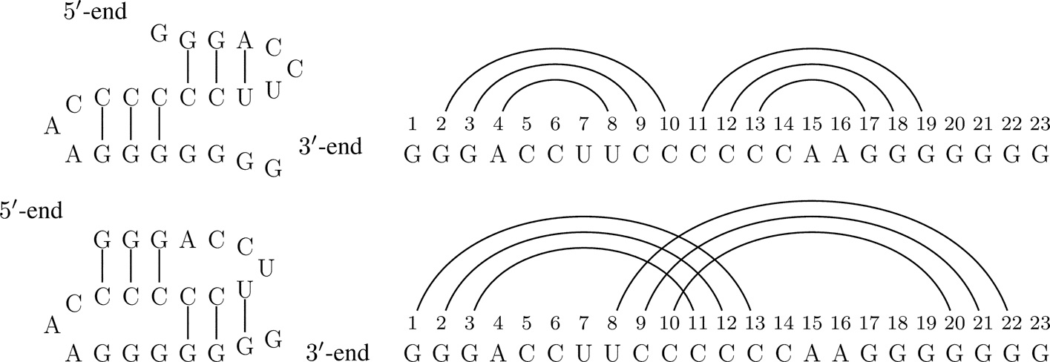
Notes:
FIGURE 13.5 Two different folds of an RNA strand, and the corresponding arc diagrams. The first structure has a noncrossing arc
diagram. The second structure is a pseudoknot because its arc diagram has crossings—it is a 3-noncrossing structure.

Slide 6
Notes:
FIGURE 13.6 The Motzkin path and point-bracket representation of the noncrossing arc diagram from Figure 13.5.

Slide 7
Notes:
FIGURE 13.7 A picture illustrating the recursion in Eq. (13.1).

Slide 8
Notes:
FIGURE 13.8 Two 2-loops: a bulge loop (left) and an interior loop (right). Each secondary structure also contains two 2-loops that are
stacked pairs.

Slide 9
Notes:
FIGURE 13.9 The four cases that need to be considered when the bases bi and bj can bond with each other.

Slide 10
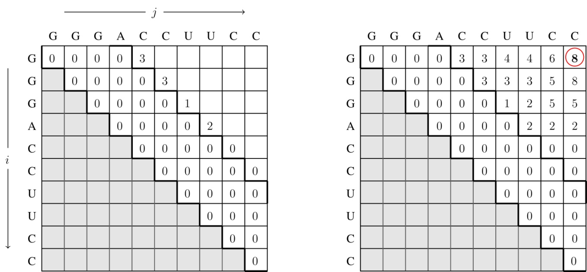
Notes:
FIGURE 13.10 Recording the optimal scores in a table during a dynamic programming routine.

Slide 11
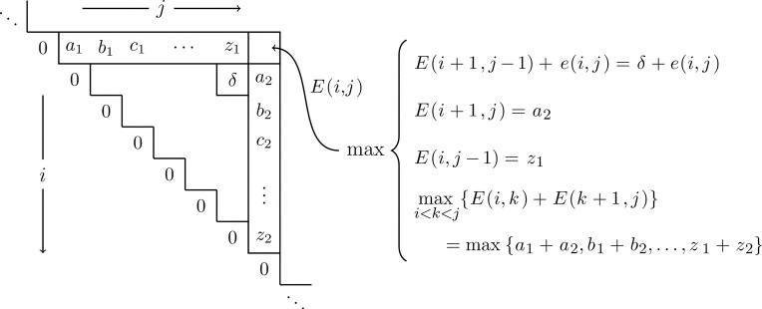
Notes:
FIGURE 13.11 A visual of how the energy score E(i, j) is calculated.

Slide 12
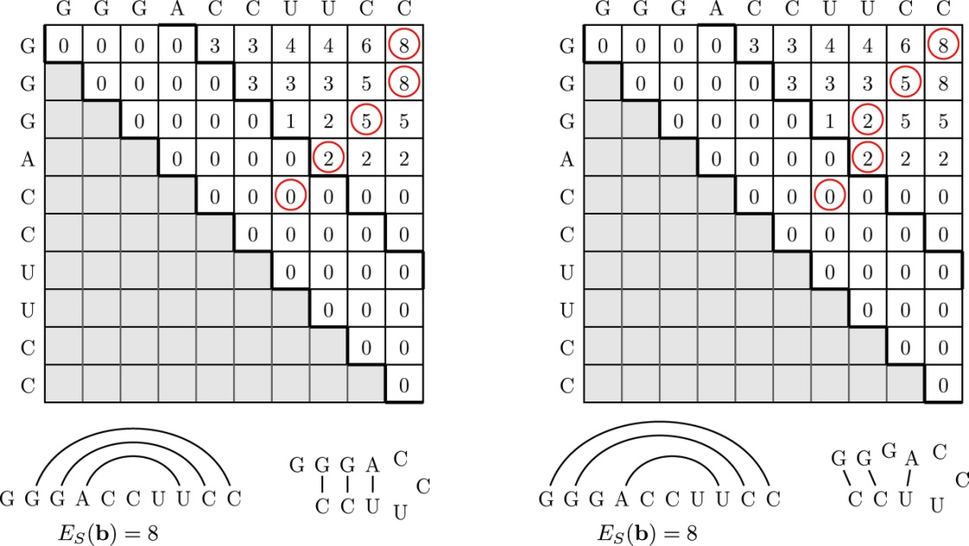
Notes:
FIGURE 13.12 Two different tracebacks from the same sequence and the associated arc diagrams and secondary structures.

Slide 13
Notes:
FIGURE 13.13 Two more foldings of the same RNA sequence of length 10. The sum ES(b) of the bond strengths as defined in Eq. (13.2),
is given.

Slide 14
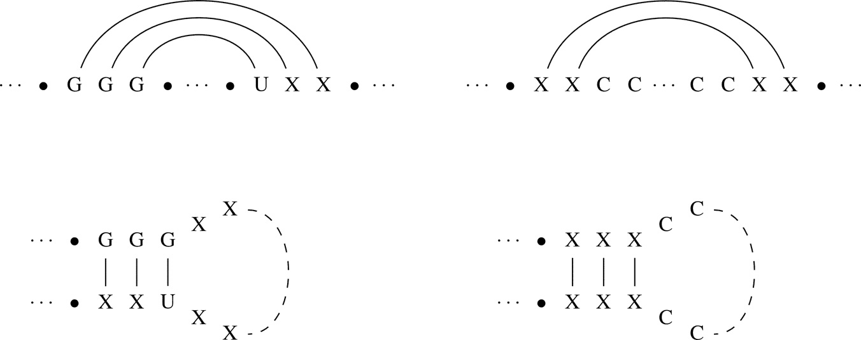
Notes:
FIGURE 13.14 A GGG-loop (left) and a poly-C hairpin loop (right). The arc diagrams are shown at top and the secondary structure
shown below.

Slide 15
Notes:
FIGURE 13.15 The base pair (bi+1, bj−1) = (X, Y) is a stacked base pair because (i, j) is also paired. UNAFold stores the energy of
(X, Y) in a table in a text file. The value not only depends on what bond (X, Y) is, but also on the fact that it is stacked beneath a CG-bond.

Slide 16
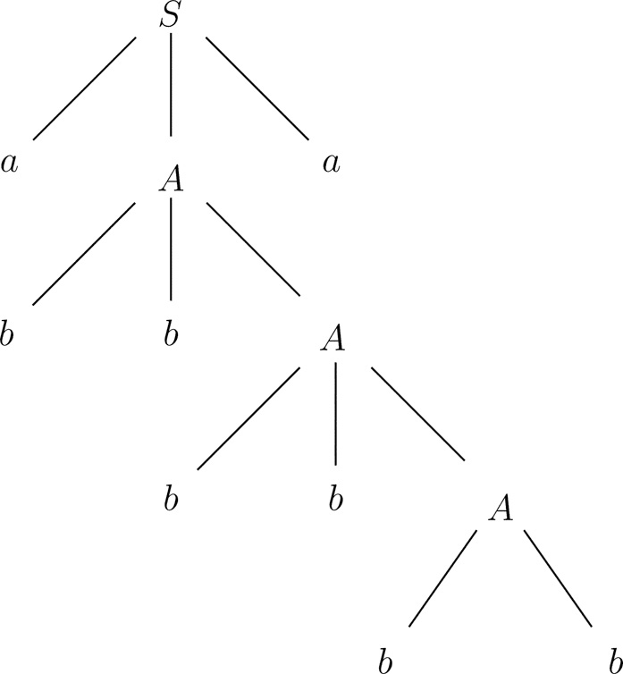
Notes:
FIGURE 13.16 Parse tree for the derivation of the string α = abbbbbba from the context-free grammar S →aAa, A→ bbA|bb. Notice
that α can be read off from the tree by starting at S and “walking around” the tree in a counterclockwise order.

Slide 17
Notes:
FIGURE 13.17 The six legal folds of the sequence b = GGACUGC that have at least one base pair and the corresponding probability
of being generated by the Knudsen-Hein grammar. The “unfolded” secondary structure has probability P(S0) = p61
q1q72
.

Slide 18
Notes:
FIGURE 13.18 Example derivation using the Knudsen-Hein grammar.

Slide 19
Notes:
FIGURE 13.19 Two left derivations, and the corresponding parse trees, for the string α = aaa derived from the ambiguous grammar
S →SS | a.

Slide 20
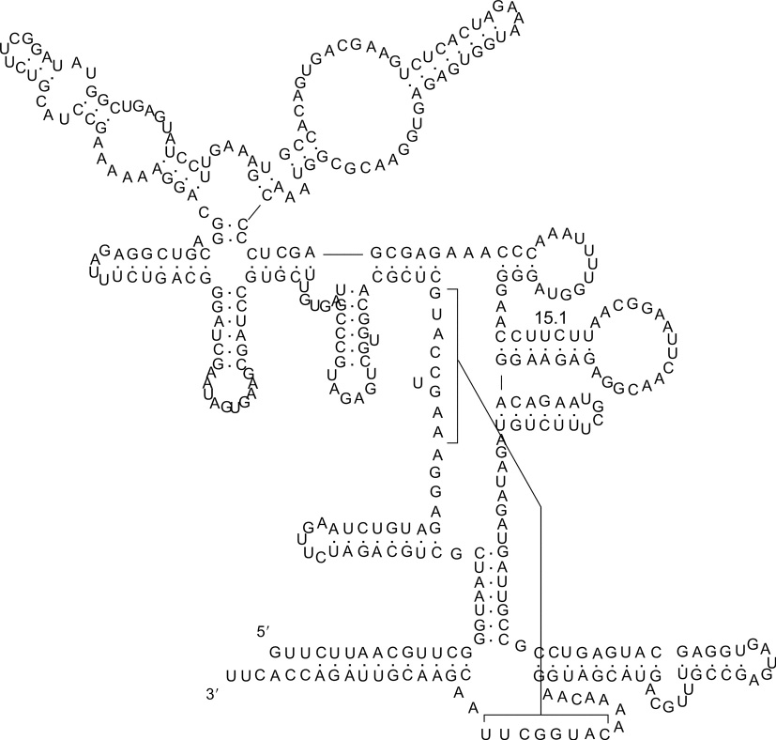
Notes:
FIGURE 13.20 An RNA pseudoknot structure from RNase P class B found in Bacillus subtilis. The secondary structure is drawn in
the plane without crossings, and the pseudoknotting is shown by the brackets: the subsequence CAUGGCUU on the multiloop at the
bottom (this appears “reversed” because it is read from the 5-to-3 direction) bonds with the subsequence AAG[U]CCAUG on another
multiloop. The [U] denotes an unpaired base in a size-1 bulge loop. Image from http://en.wikipedia.org/wiki/RNase_P.

Slide 21
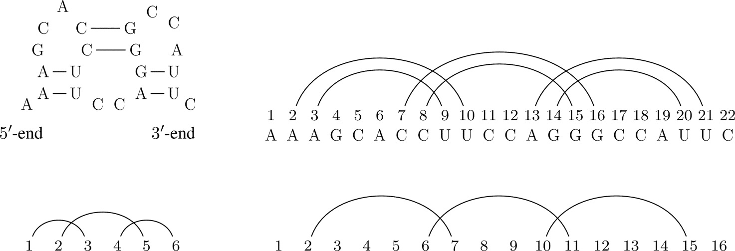
Notes:
FIGURE 13.21 A pseudoknot arises from two “kissing hairpins.” Its arc diagram is shown to the right. Directly below it is its core, which
is formed by collapsing every stack to a single arc. To the left of the core is its shape, which is formed by removing isolated vertices, and
then repeating the collapsing process if necessary.

Slide 22
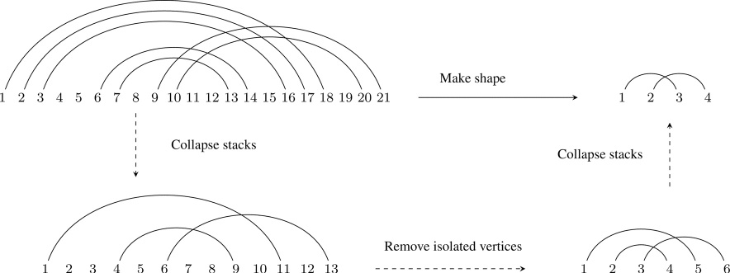
Notes:
FIGURE 13.22 Given the arc diagram in the upper left, its core is formed by collapsing all stacks into single arcs. To find its shape, all
isolated vertices are removed. However, this introduces new stacks of size greater than 1, so this process must be repeated. The shape is
the diagram in the upper right.

Slide 23
Exercise 13.1
Notes:
Exercise 13.1. Consider the RNA structures shown below.

Slide 24
Notes:
This is illustrated by the following example of the generation of the structure S2 from Figure 13.17.

