Slide 1
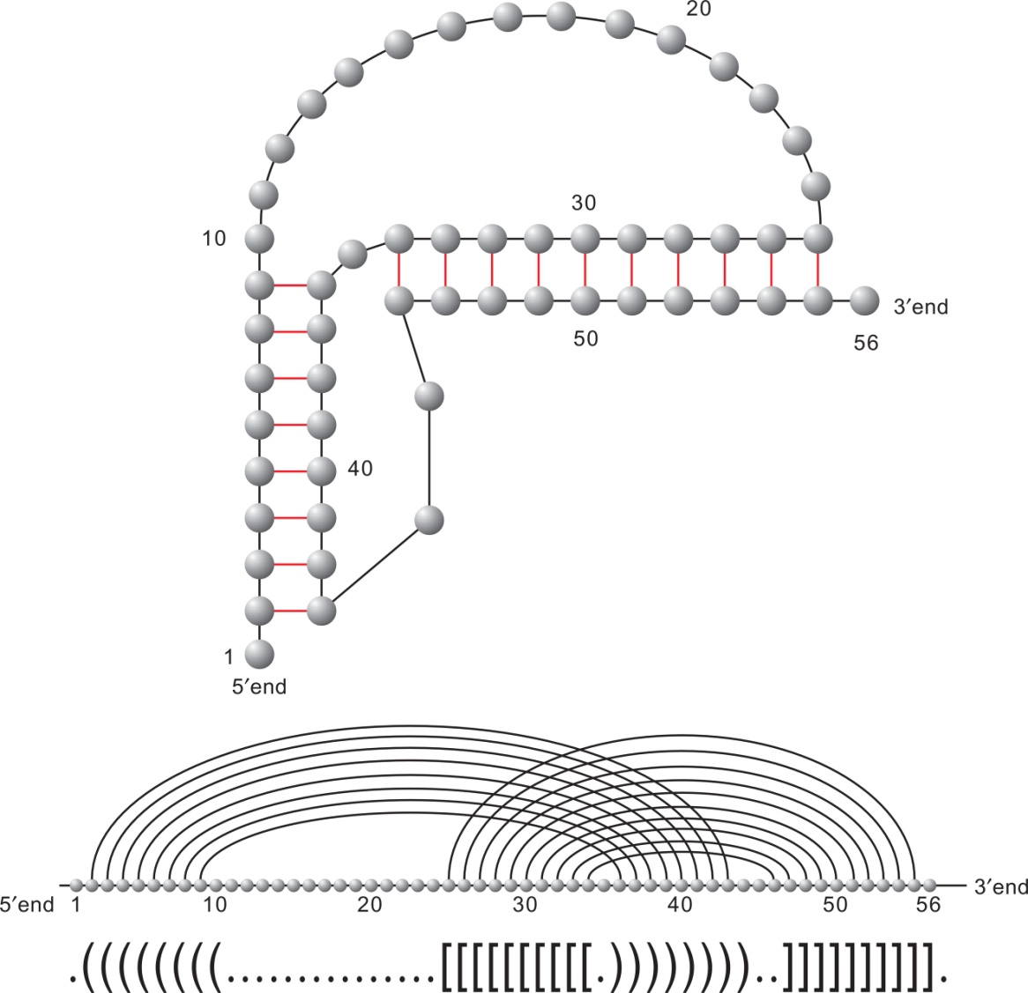
Notes:
FIGURE 14.1 RNA structure as planar graph (hydrogen bonds (resp. backbone) represented by dark gray (resp. black) edges) and
diagram.

Slide 2
Notes:
FIGURE 14.2 From a diagram (a) to its shape (b).

Slide 3
Notes:
FIGURE 14.3 The four shapes employed in the topological folding algorithm gfold.

Slide 4
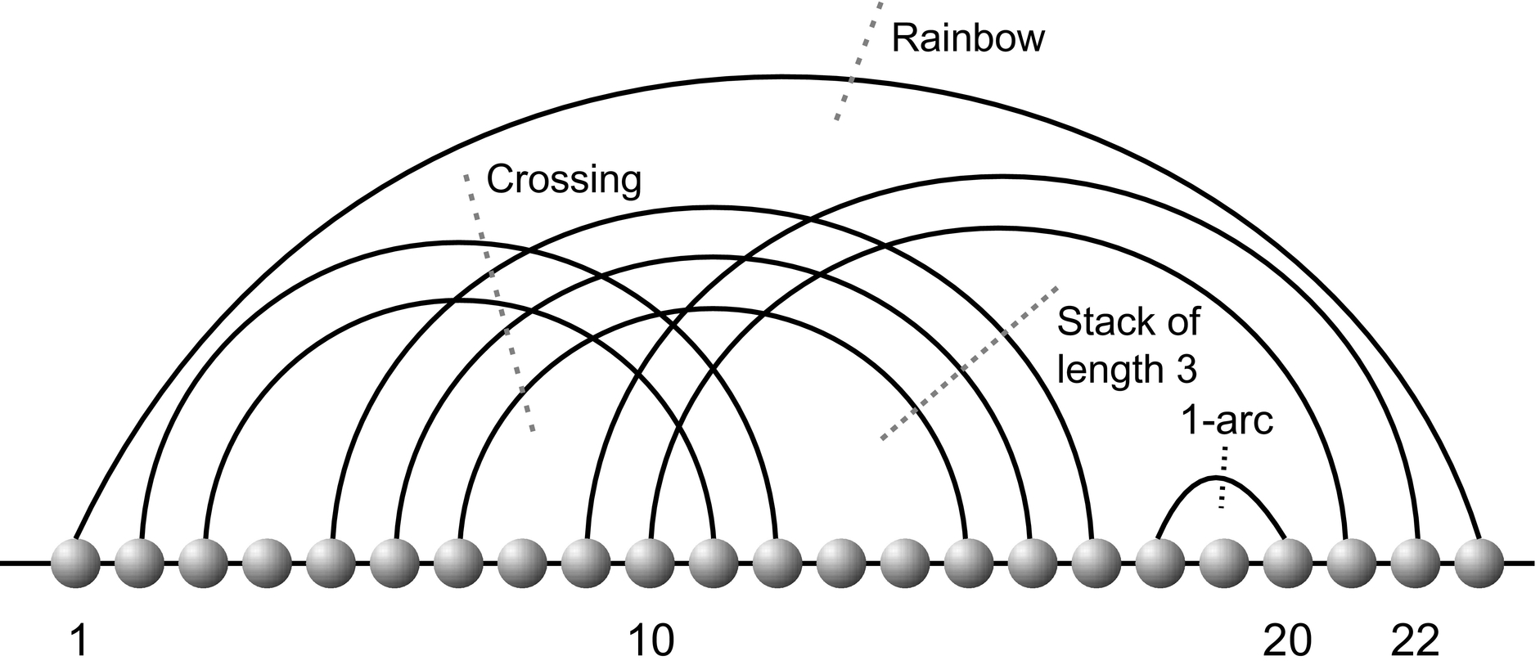
Notes:
FIGURE 14.4 A diagram with rainbow, 1-arc, and crossing stacks marked.

Slide 5
Notes:
FIGURE 14.5 Inflation of edges and vertices to ribbons and disks. Here, we have four vertices, five edges, and one boundary component
(a,b, c,d, e,f , g,h,i,j). The corresponding surface has Euler characteristic χ = v − e + r = 0 and genus g = 1; see Equations (14.1)
and (14.2).

Slide 6
Notes:
FIGURE 14.6 Computing the number of boundary components. The diagram contains 5 + 9 edges and 10 vertices. We follow the
alternating paths described in the text and observe that there are exactly two boundary components gray and dark gray. According to
Equation (14.1), the genus of the diagram is given by 1 − 12
(10 − 14 + 2) = 2.

Slide 7
Notes:
FIGURE 14.7 Reduction to fatgraphs with a single vertex. Contracting the backbone of a diagram into a single vertex decreases the length
of the boundary components and preserves the genus. The contracted fatgraph is equivalent to the labeled directed cycle. The backbone of
the polymer can be recovered by reinflating the disk into the backbone. The polygon (right-hand side) represents the standard 2D-model
of a surface as discussed in [21].

Slide 8
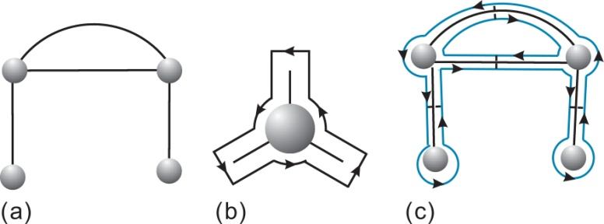
Notes:
FIGURE 14.8 From graphs to fatgraphs: (a) A graph with four vertices and four edges. (b) Inflation of a vertex. (c) A fatgraph derived
from (a) induces a topological surface.

Slide 9
Notes:
FIGURE 14.9 Exercise 14.1.

Slide 10
Notes:
FIGURE 14.10 The Poincaré dual: we map a fatgraph with one vertex and three boundary components into a fatgraph with three vertices
and one boundary component.

Slide 11
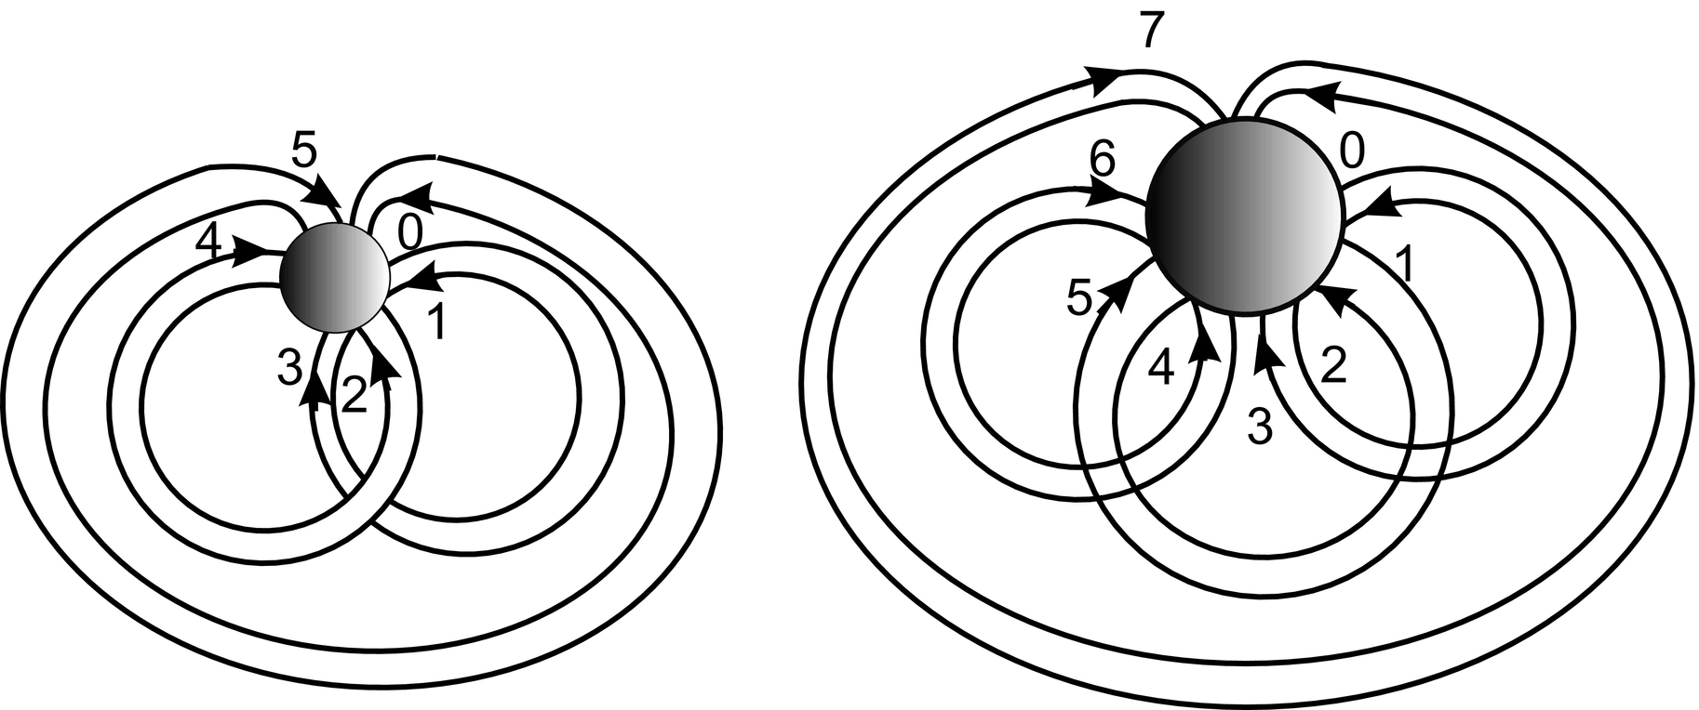
Notes:
FIGURE 14.11 Exercise 14.2.

Slide 12
Notes:
FIGURE 14.12 σ and γ order.

Slide 13
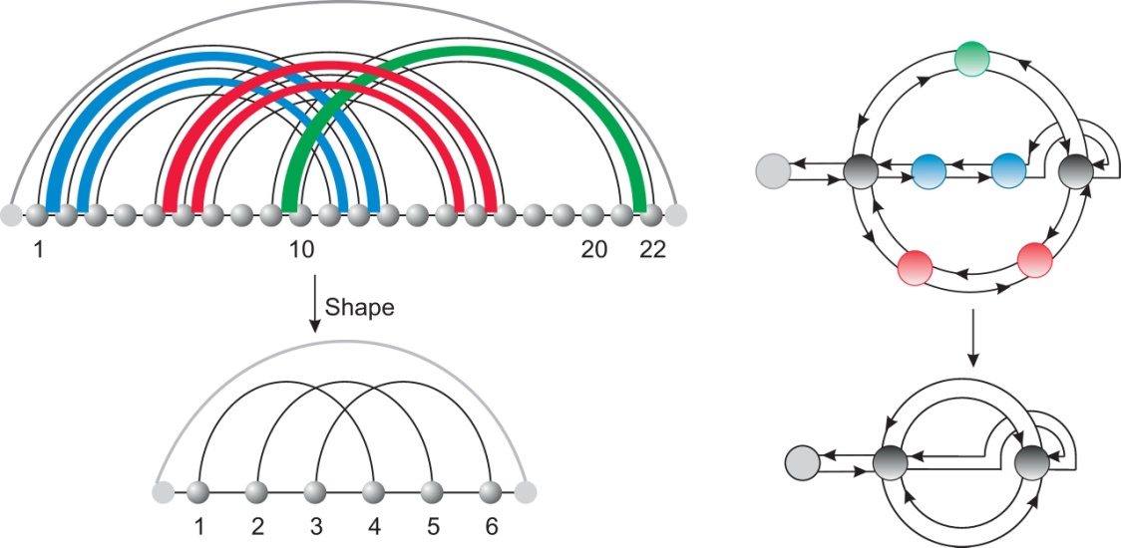
Notes:
FIGURE 14.13 From a diagram to a shape by removing all 1-arc and parallel arcs. The dash arc is a rainbow arc, where a preshape is
nested inside.

Slide 14
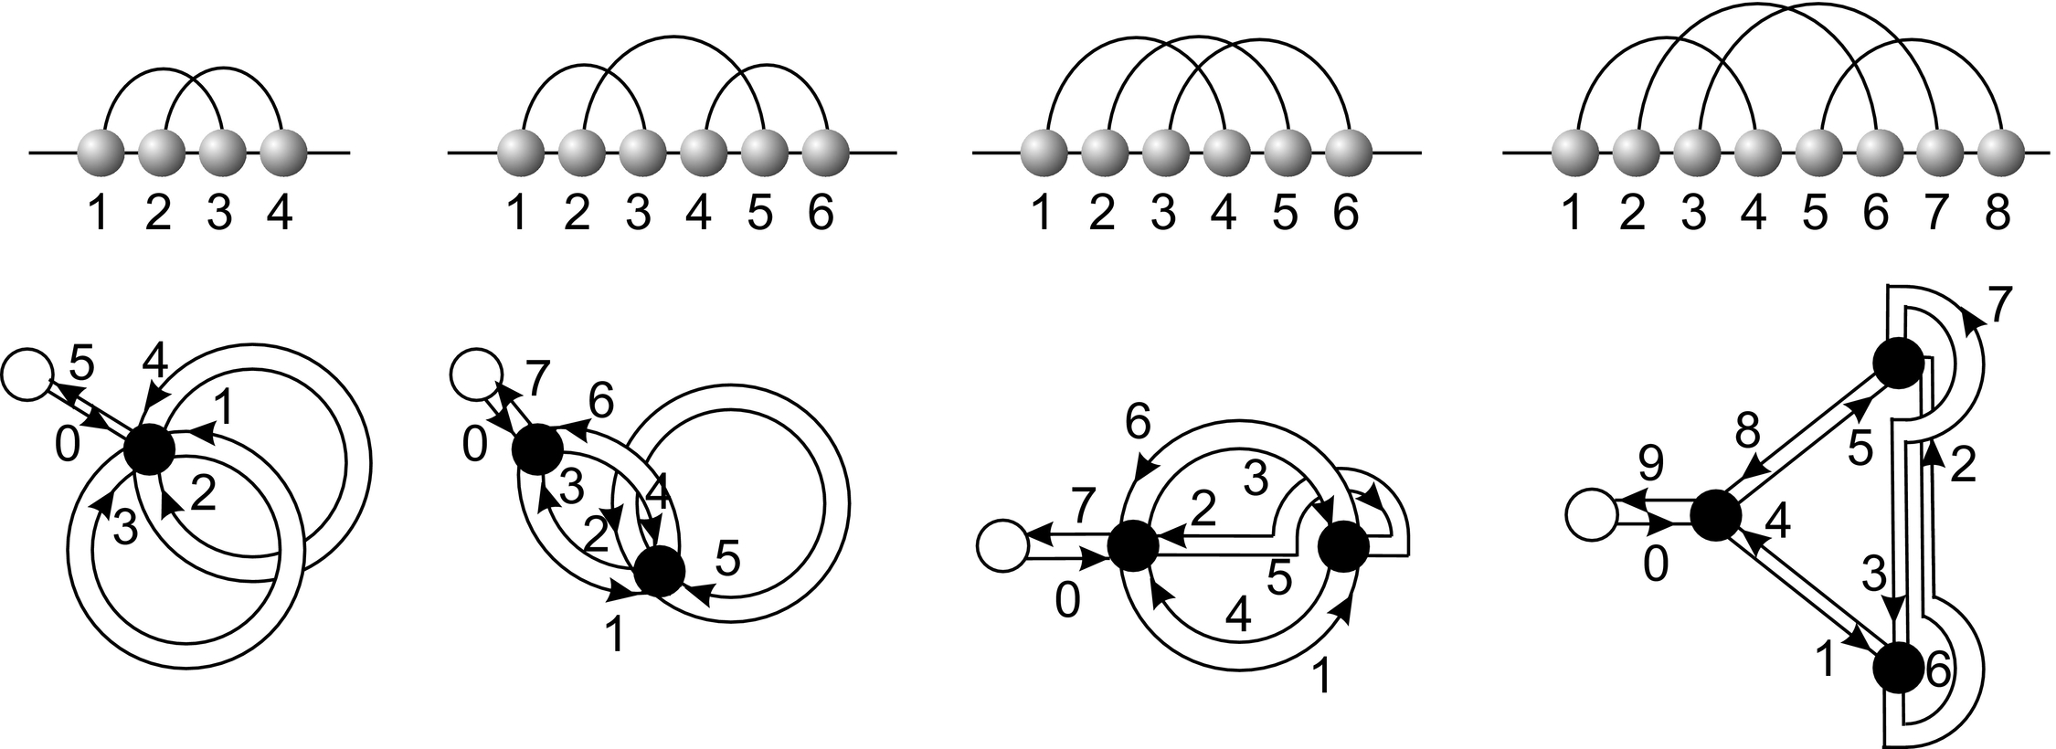
Notes:
FIGURE 14.14 The four shapes of genus 1.

Slide 15
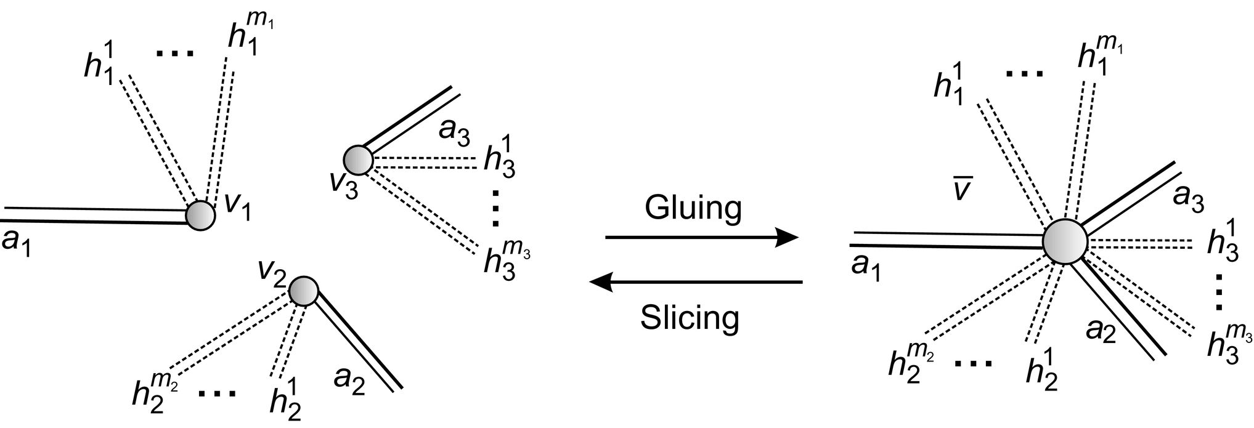
Notes:
FIGURE 14.15 Gluing and slicing in unicellular maps.

Slide 16
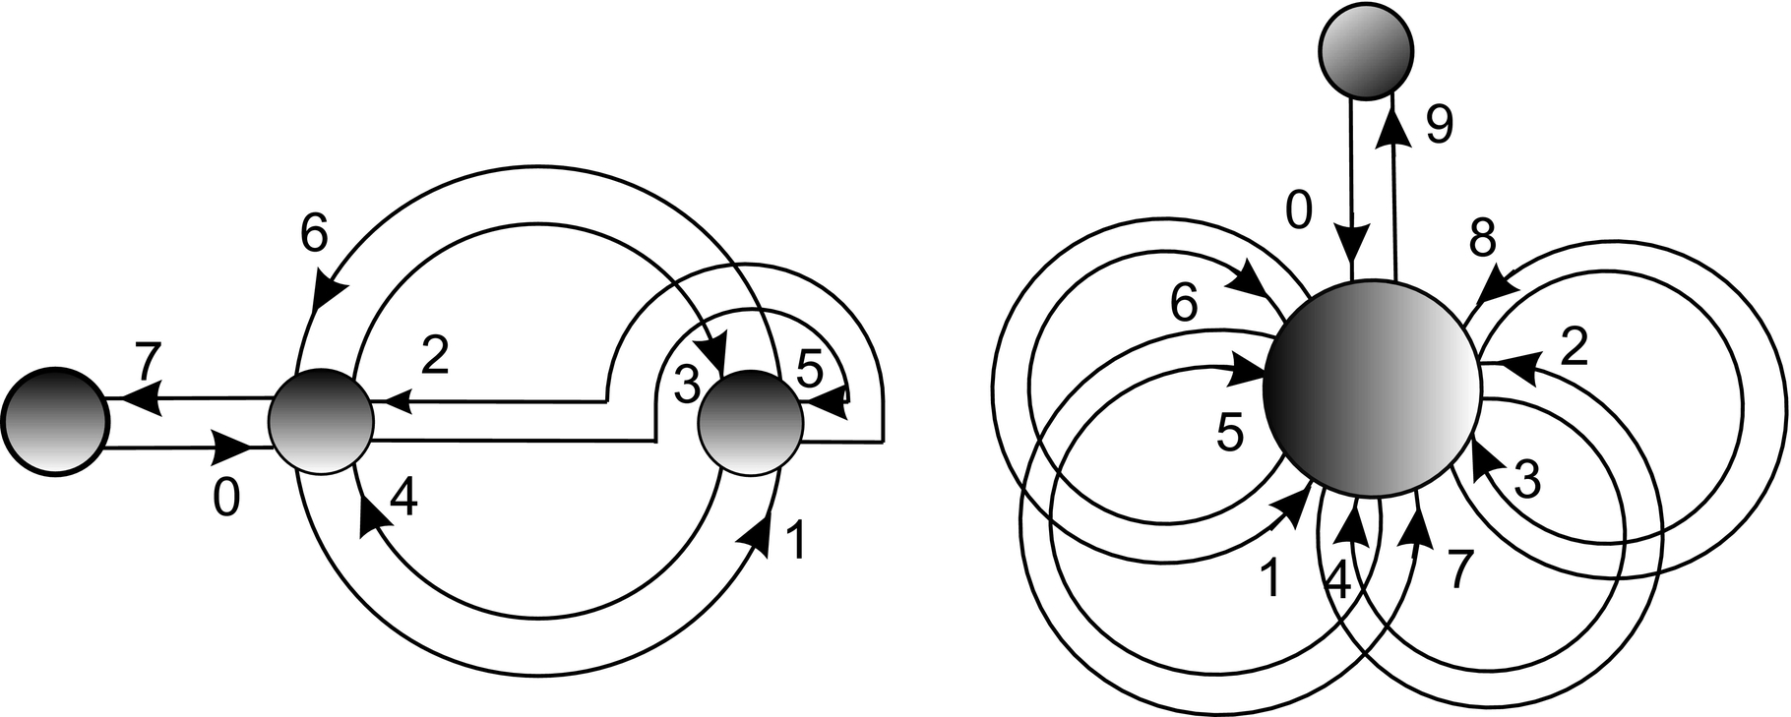
Notes:
FIGURE 14.16 Exercise 14.3.

Slide 17
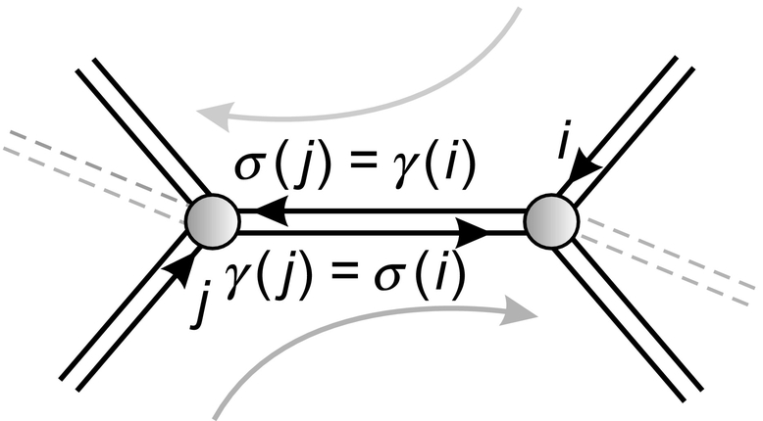
Notes:
FIGURE 14.17 Pairing of up- and down-steps.

Slide 18
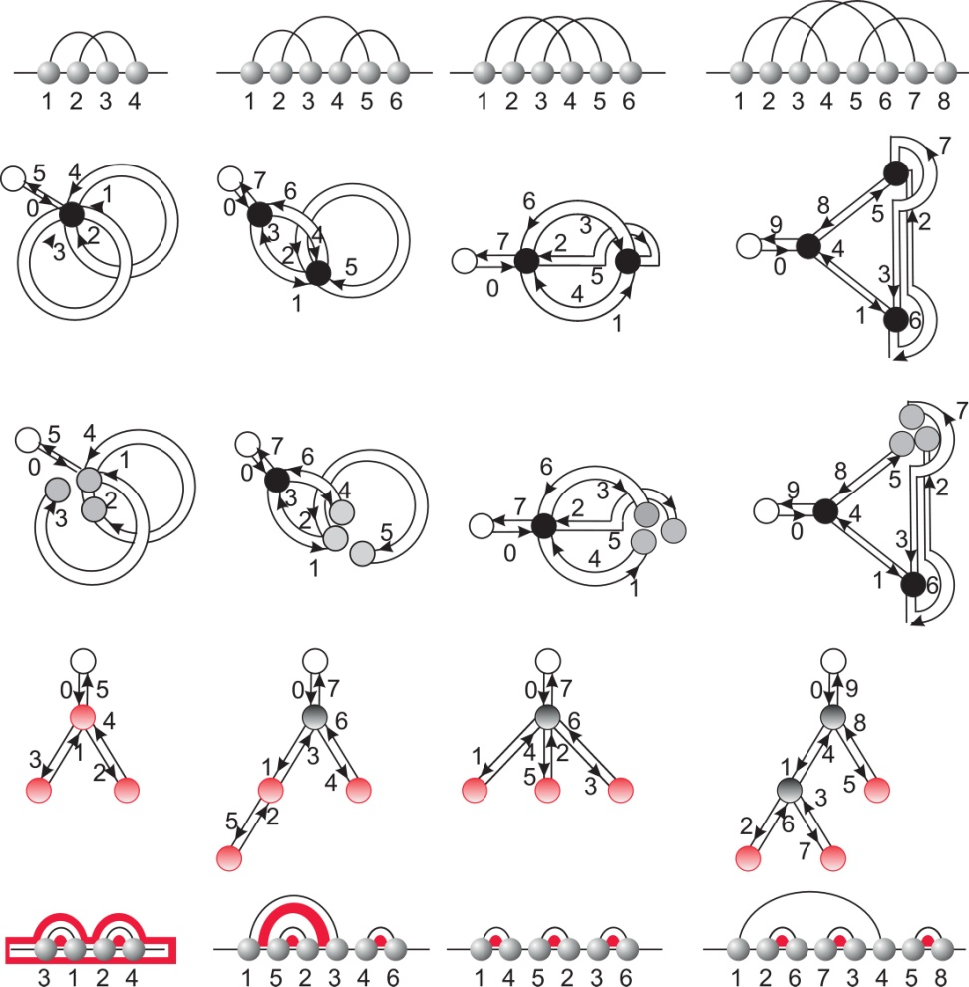
Notes:
FIGURE 14.18 The four shapes of genus 1 and corresponding secondary structure.

Slide 19
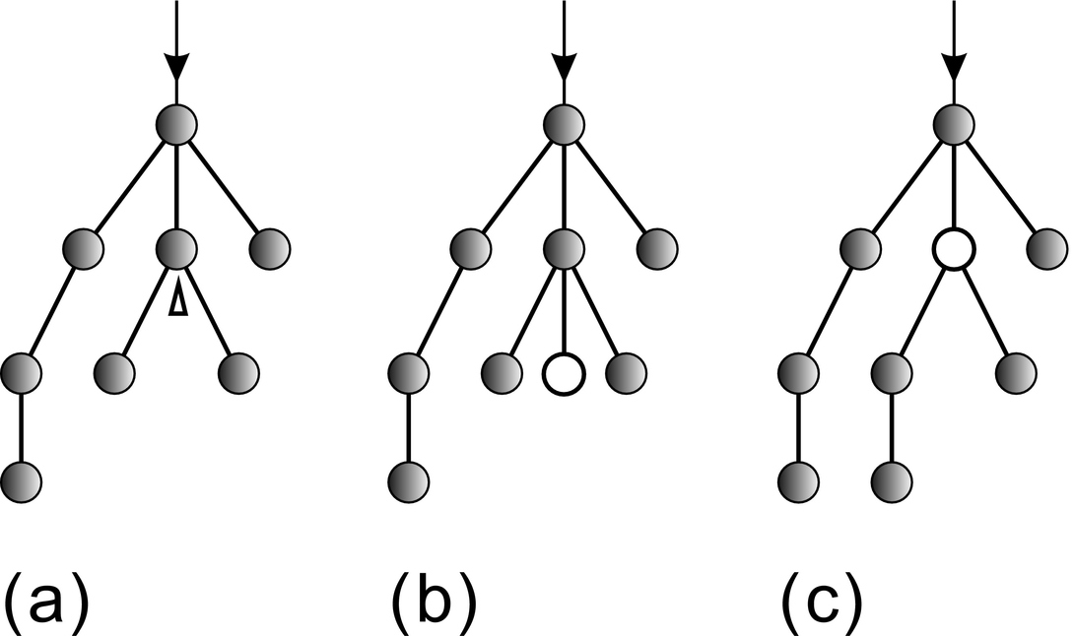
Notes:
FIGURE 14.19 Rémy’s bijection: two ways of obtaining a planar tree with n edges and a labeled vertex from a planar tree with n − 1
edges with a labeled sector. We pass from (a) to (b) by inserting a labeled vertex as a leaf to the labeled sector and from (a) to (c) by
replacing the vertex containing the sector by the labeled vertex, and carrying the subtree on the left of the sector as its leftmost subtree.
This case applies if the labeled vertex is not a leaf.

Slide 20
Notes:
FIGURE 14.20 How to construct nonshape-sectors via Rémy’s procedure. The following insertions produce an unlabeled vertex of
degree 2: (a) the sector is in a labeled vertex and {vl+1, . . . , vm} = ∅, (b) (l= 0), and (c) (l= 1) if the sector is in an unlabeled vertex.

