Slide 1
Chapter-1 Introduction

Slide 2
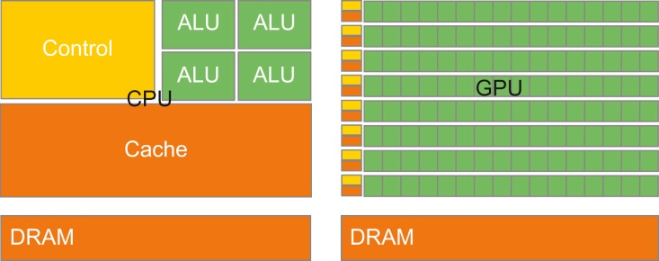
FIGURE 1.1: CPUs and GPUs have fundamentally different design philosophies.

Slide 3
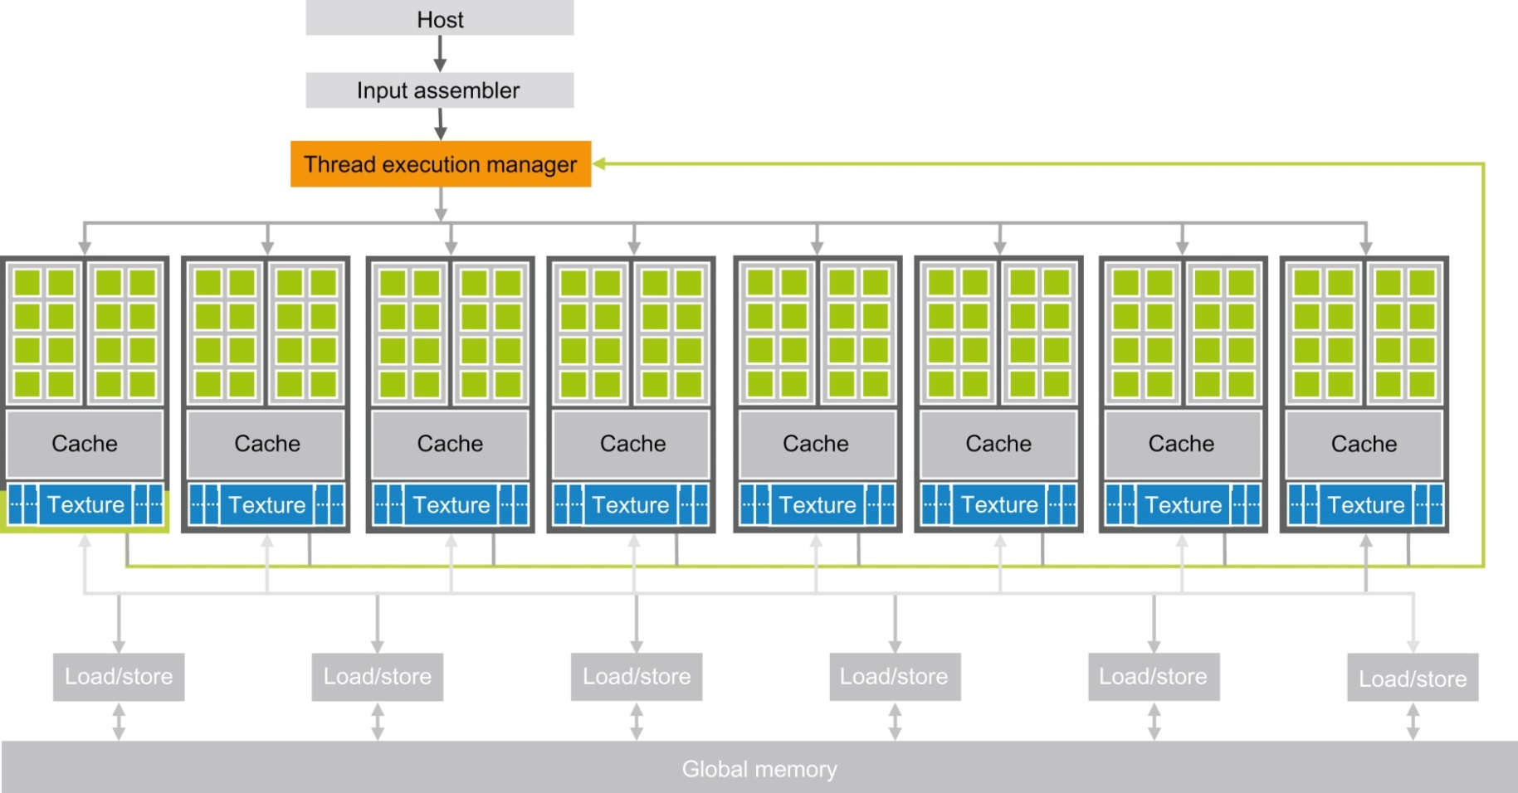
FIGURE 1.2: Architecture of a CUDA-capable GPU.

Slide 4
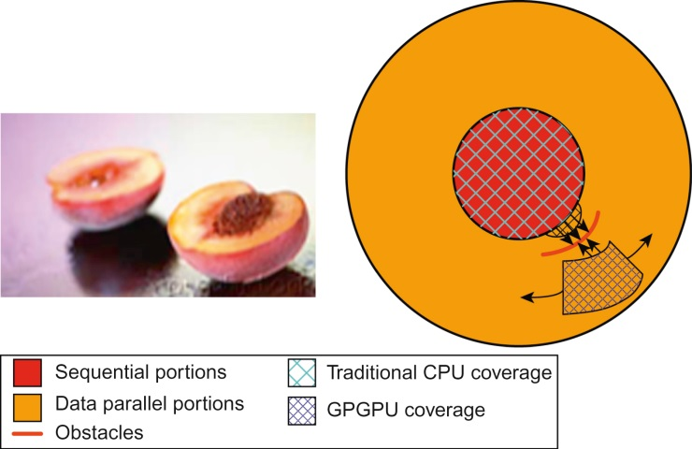
FIGURE 1.3: Coverage of sequential and parallel application portions.

