Slide 1
Chapter-2 Data parallel computing

Slide 2
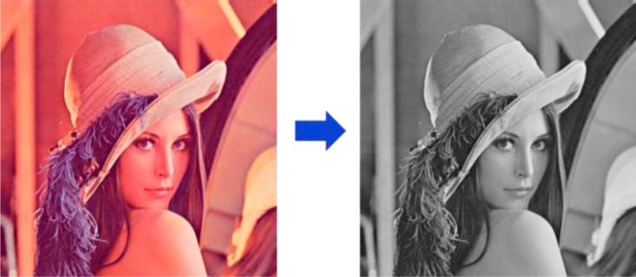
FIGURE 2.1: Conversion of a color image to a greyscale image.

Slide 3
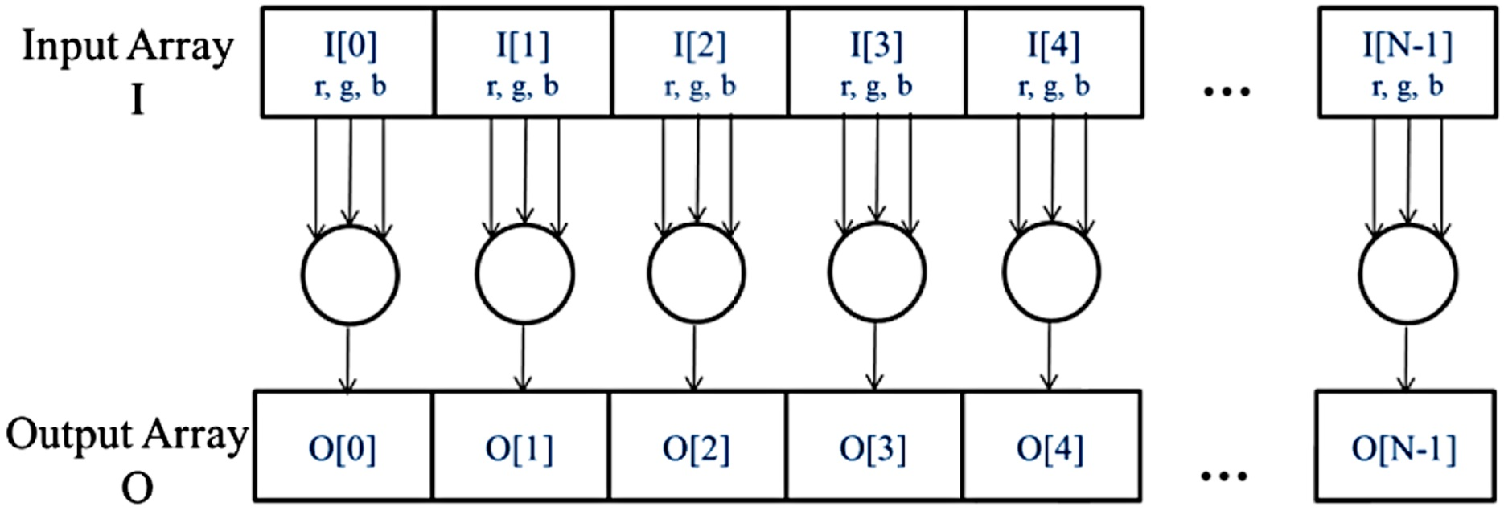
FIGURE 2.2: The pixels can be calculated independently of each other during color to greyscale conversion.

Slide 4
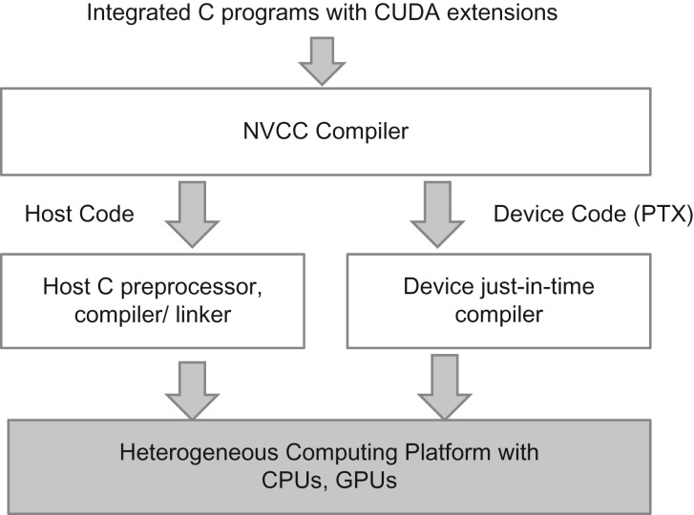
FIGURE 2.3: Overview of the compilation process of a CUDA C Program.

Slide 5
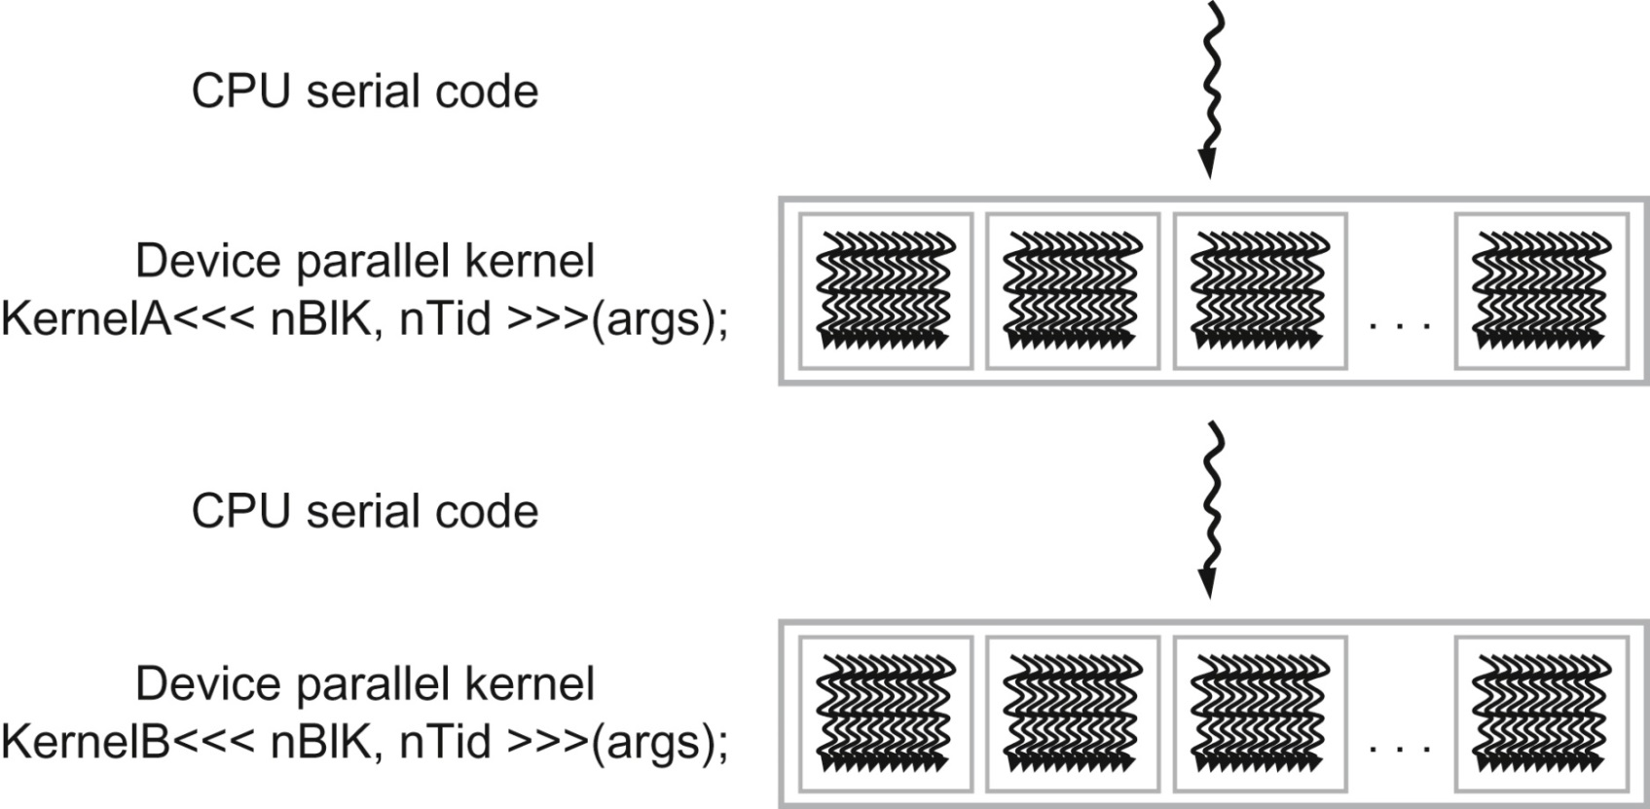
FIGURE 2.4: Execution of a CUDA program.

Slide 6
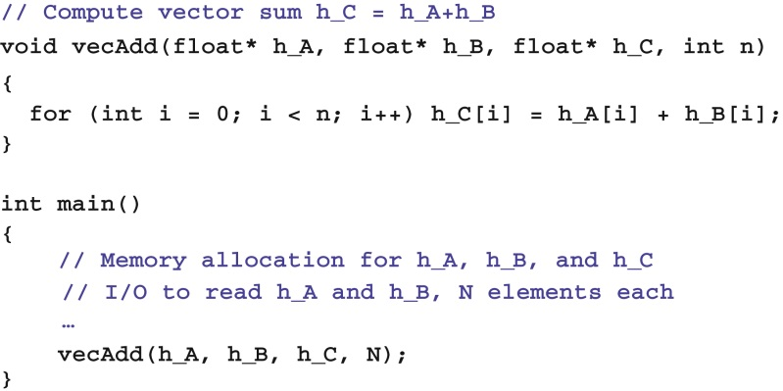
FIGURE 2.5: A simple traditional vector addition C code example.

Slide 7
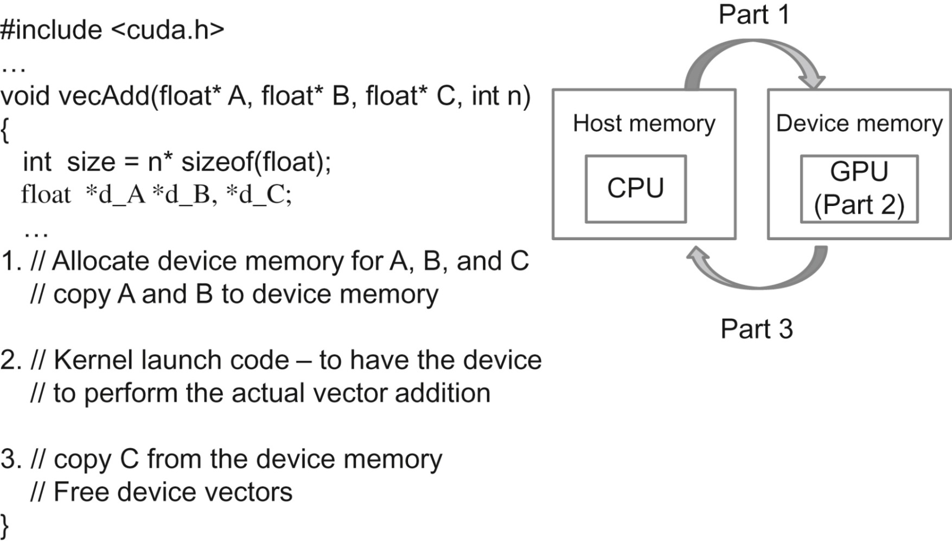
FIGURE 2.6: Outline of a revised vecAdd function that moves the work to a device.

Slide 8
FIGURE 2.7: Host memory and device global memory.

Slide 9
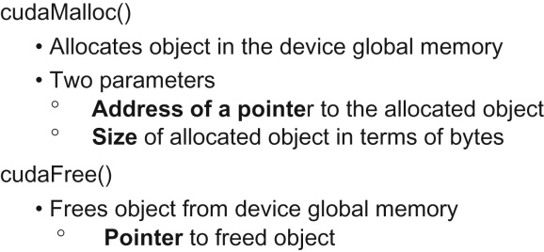
FIGURE 2.8: CUDA API functions for managing device global memory.

Slide 10
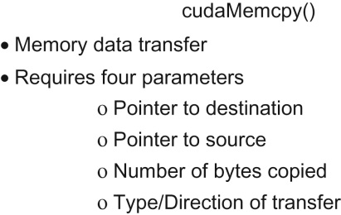
FIGURE 2.9: CUDA API function for data transfer between host and device.

Slide 11
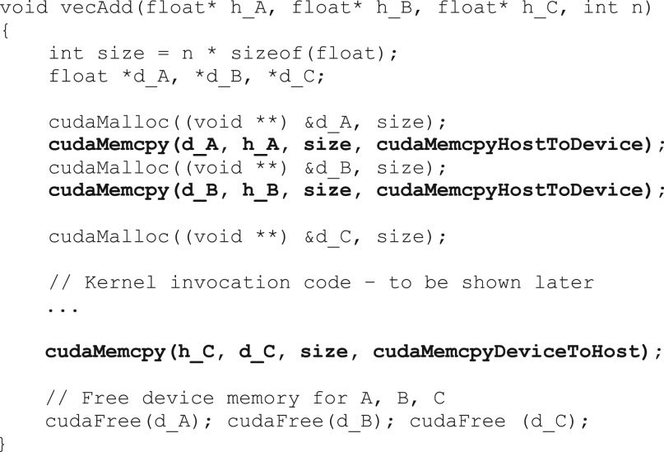
FIGURE 2.10: A more complete version of vecAdd().

Slide 12
FIGURE 2.11: All threads in a grid execute the same kernel code.

Slide 13
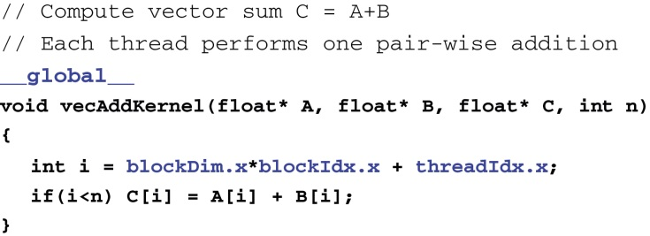
FIGURE 2.12: A vector addition kernel function.

Slide 14
FIGURE 2.13: CUDA C keywords for function declaration.

Slide 15
FIGURE 2.14: A vector addition kernel launch statement

Slide 16
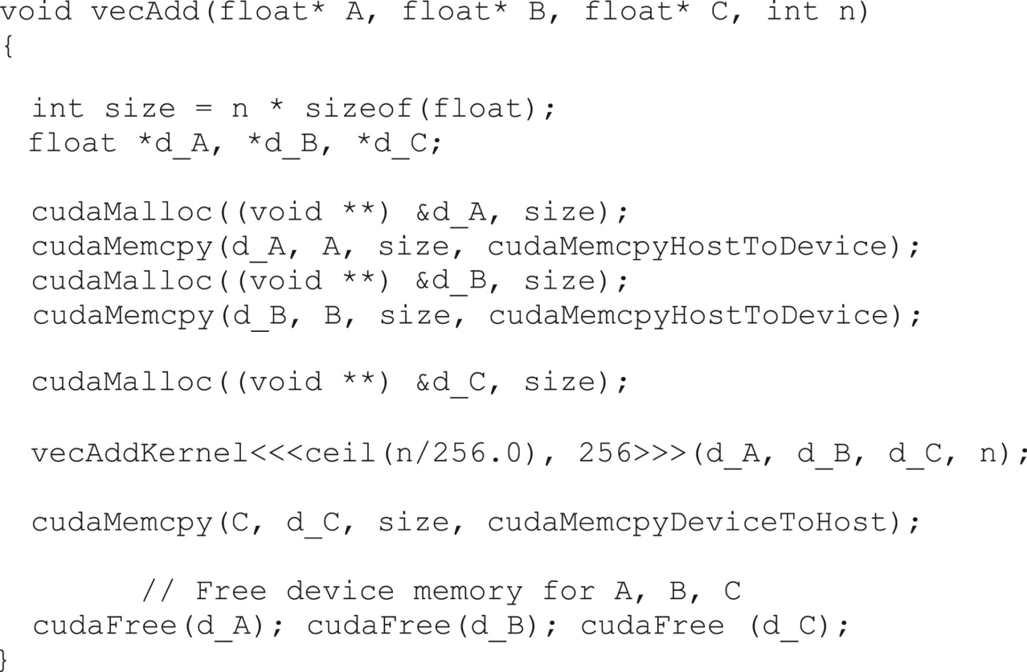
FIGURE 2.15: A complete version of the host code in the vecAdd.function.

Slide 17
