Slide 1
Chapter-3 Scalable parallel execution

Slide 2
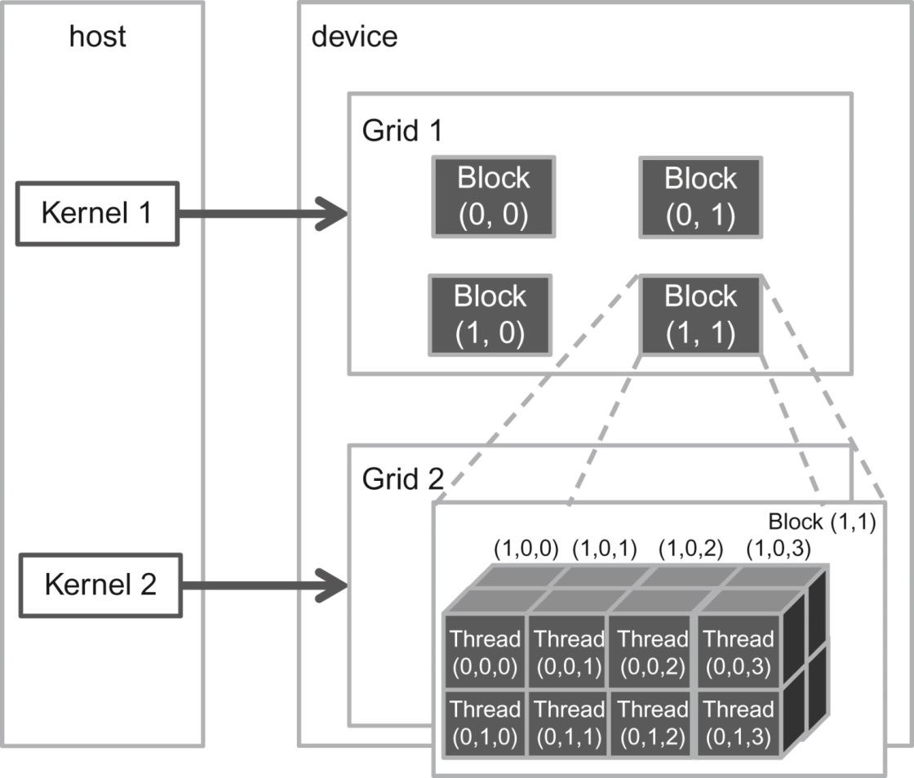
FIGURE 3.1: A multidimensional example of CUDA grid organization.

Slide 3
FIGURE 3.2: Using a 2D thread grid to process a 76 × 62 picture P.

Slide 4
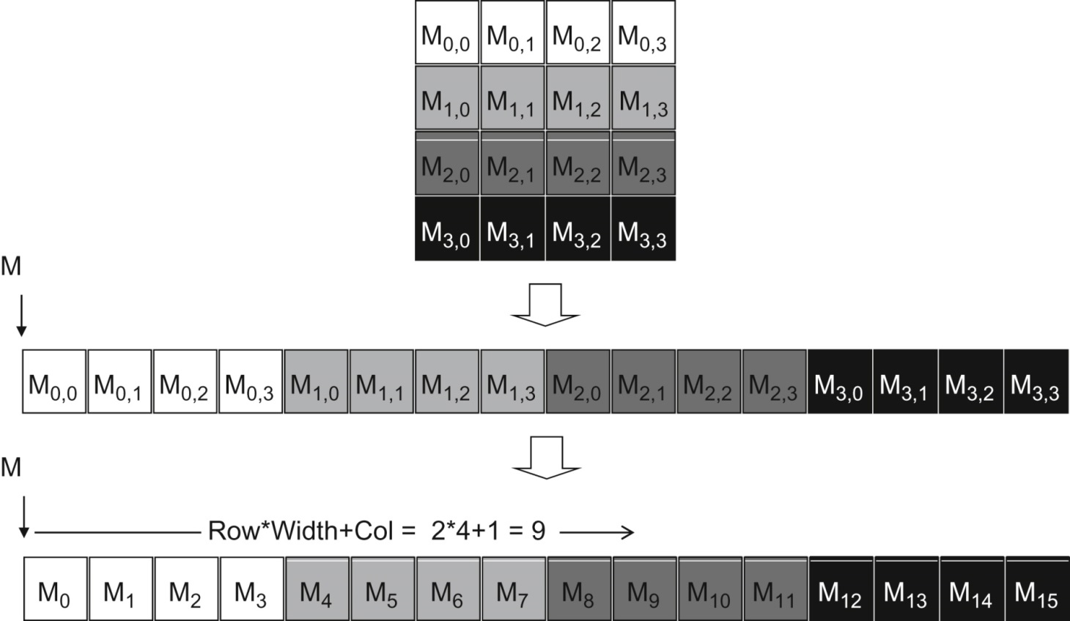
FIGURE 3.3: Row-major layout for a 2D C array. The result is an equivalent 1D array accessed by an index expression j*Width+ i for an element that is in the j th row and i th column of an array of Width elements in each row.

Slide 5
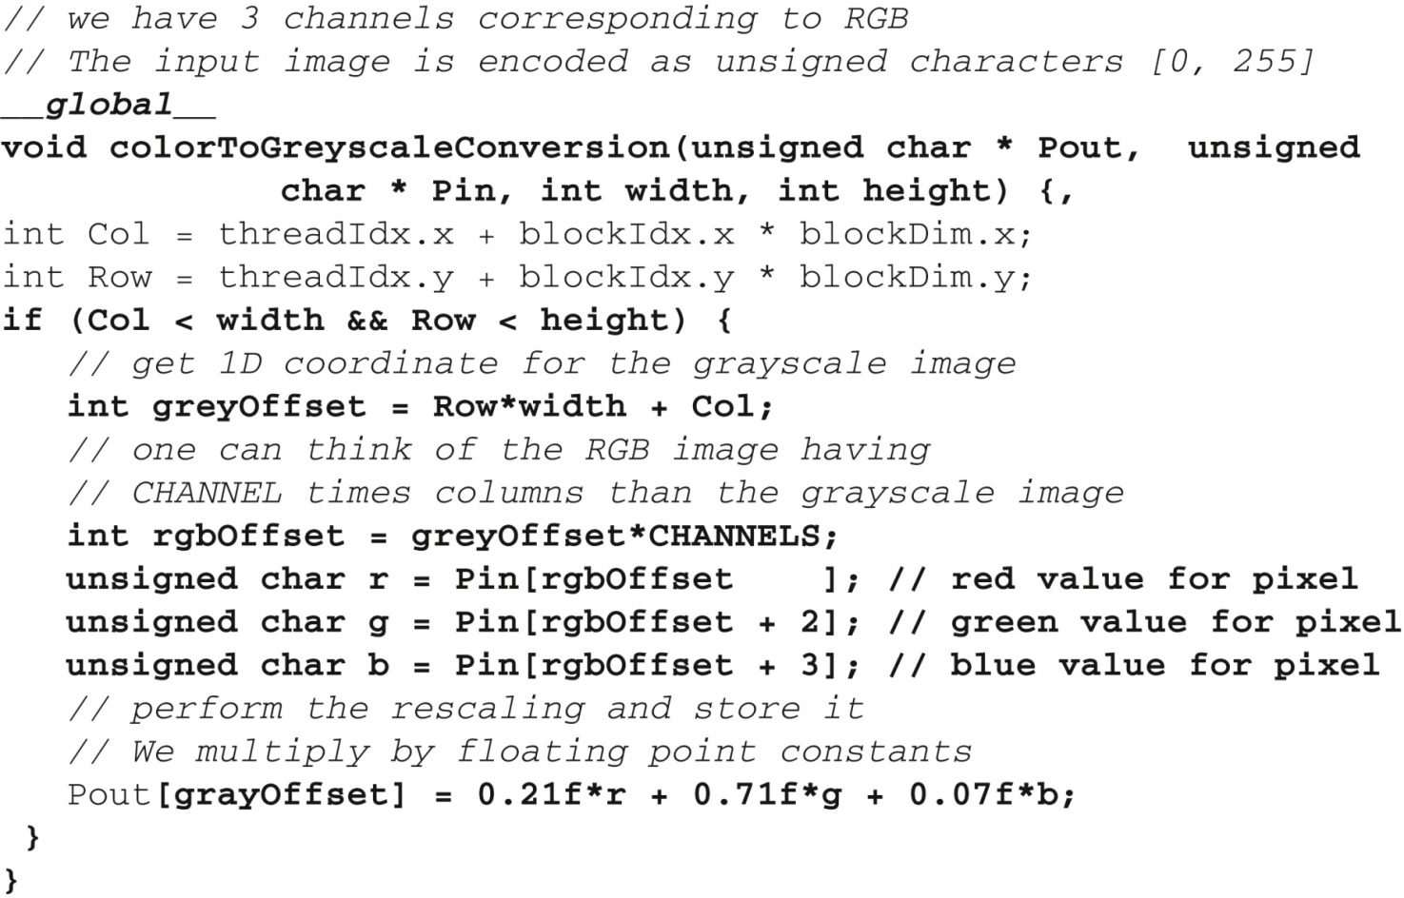
FIGURE 3.4: Source code of colorToGreyscaleConversion showing 2D thread mapping to data.

Slide 6
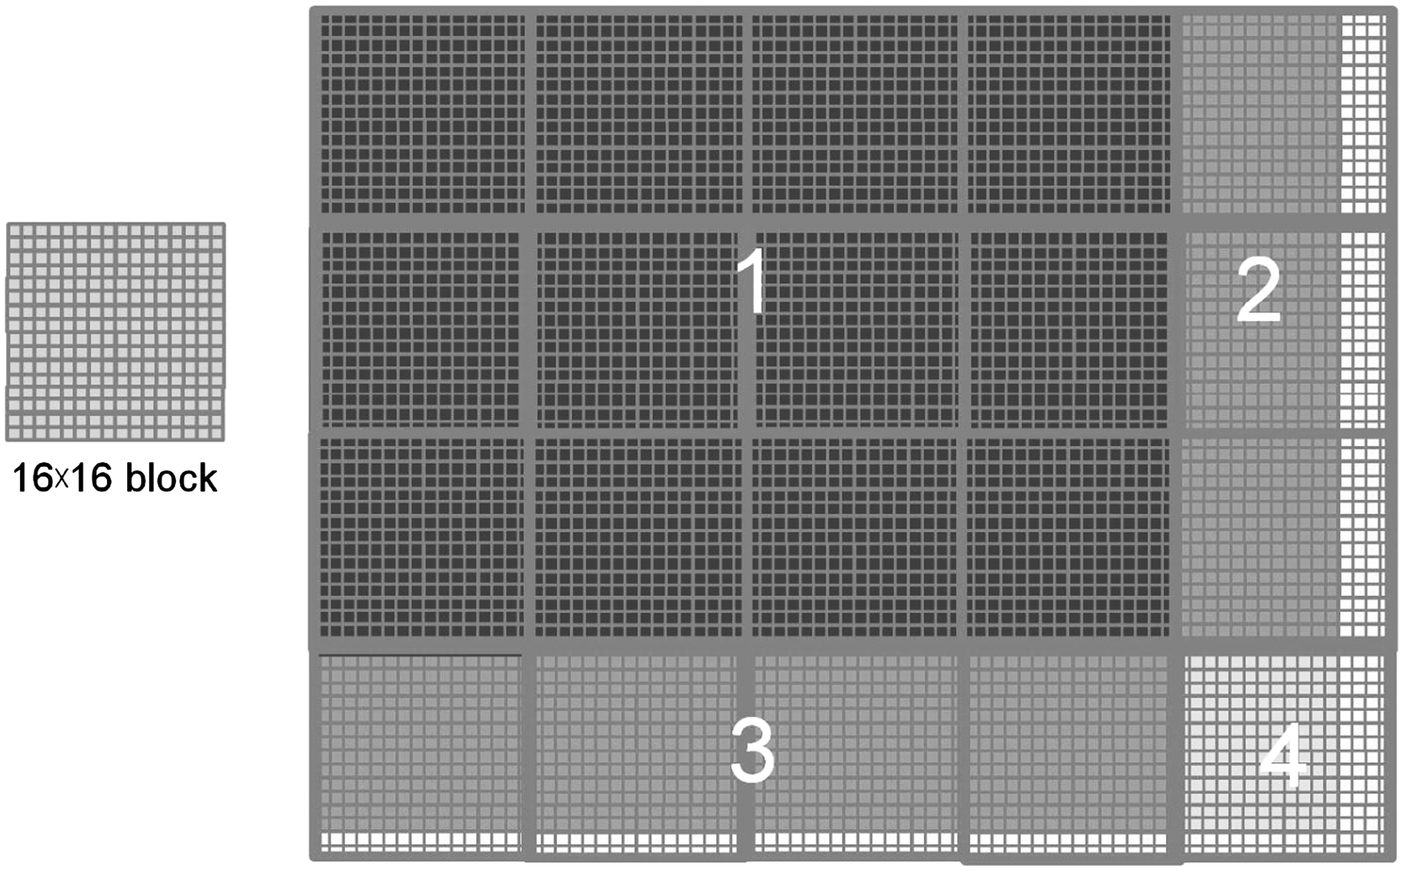
FIGURE 3.5: Covering a 76 × 62 picture with 16 × 16 blocks.

Slide 7
FIGURE 3.6: An original image and a blurred version.

Slide 8
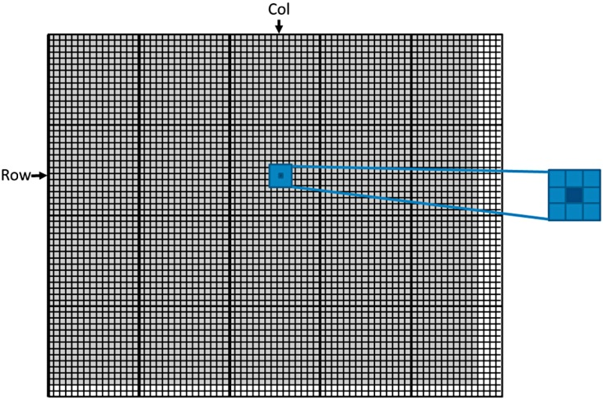
FIGURE 3.7: Each output pixel is the average of a patch of pixels in the input image.

Slide 9
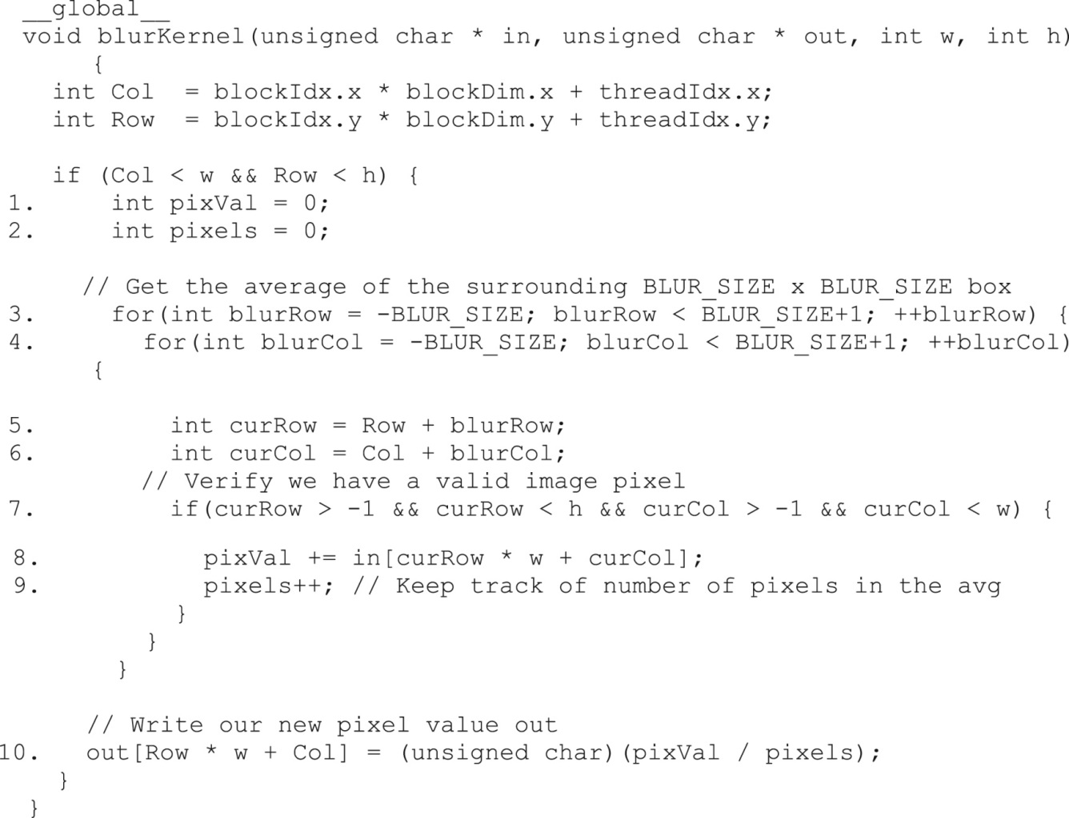
FIGURE 3.8: An image blur kernel.

Slide 10
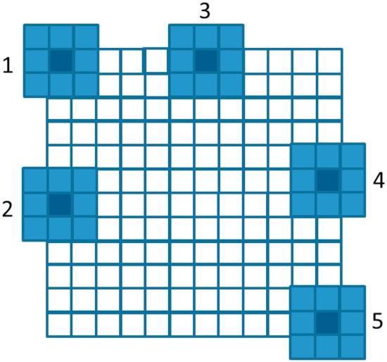
FIGURE 3.9: Handling boundary conditions for pixels near the edges of the image.

Slide 11
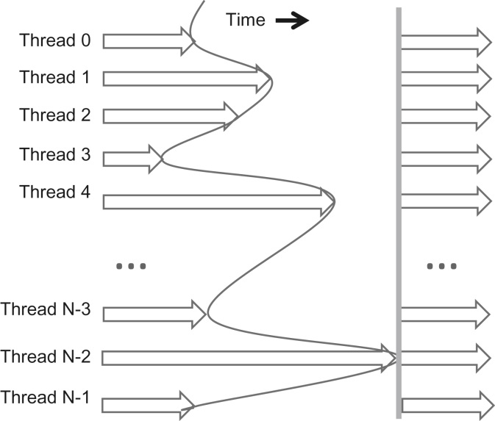
FIGURE 3.10: An example execution timing of barrier synchronization.

Slide 12
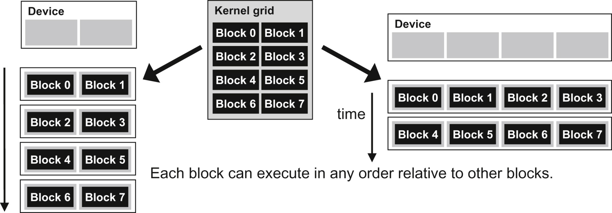
FIGURE 3.11: Lack of synchronization constraints between blocks enables transparent scalability for CUDA programs.

Slide 13
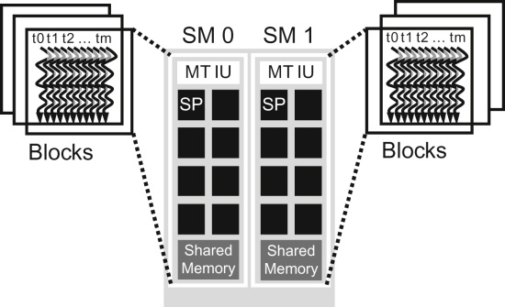
FIGURE 3.12: Thread block assignment to Streaming Multiprocessors (SMs).

Slide 14
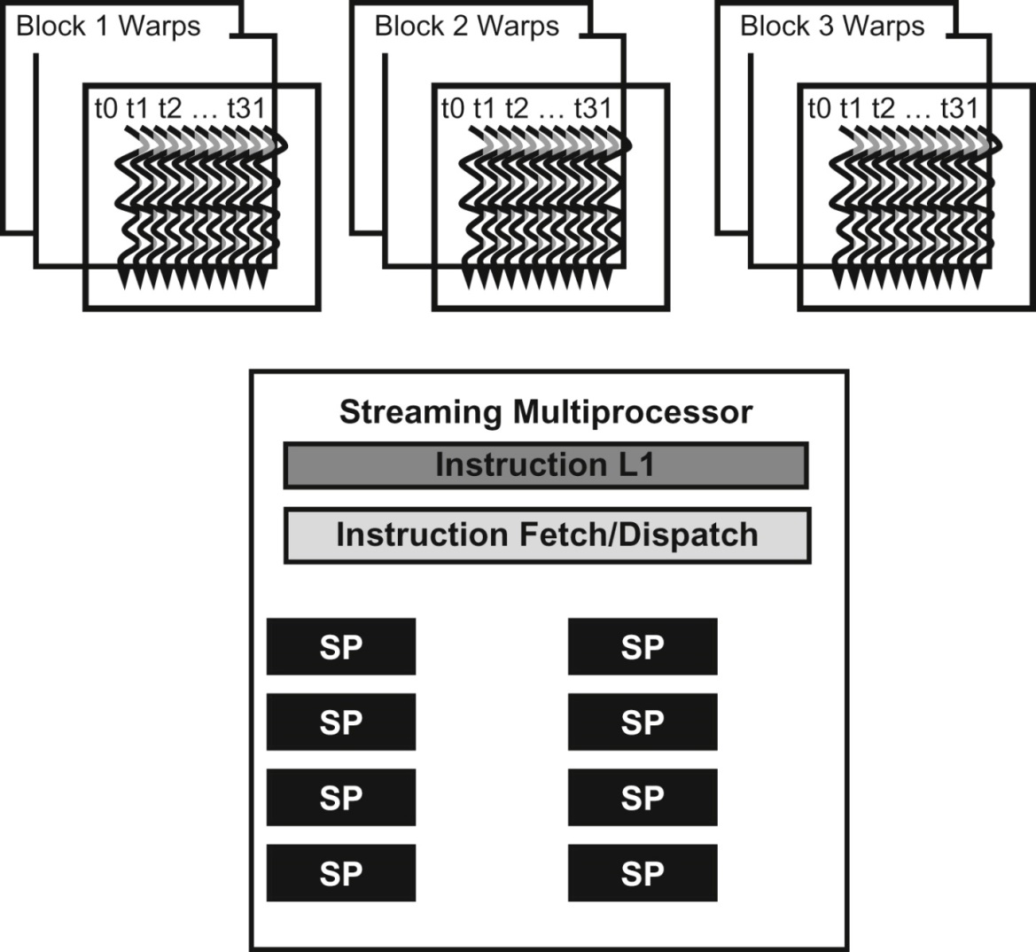
FIGURE 3.13: Blocks are partitioned into warps for thread scheduling.

