Slide 1
Chapter-4 Memory and data locality

Slide 2
FIGURE 4.1: The most executed part of the image blurring kernel in Fig. 3.8.

Slide 3
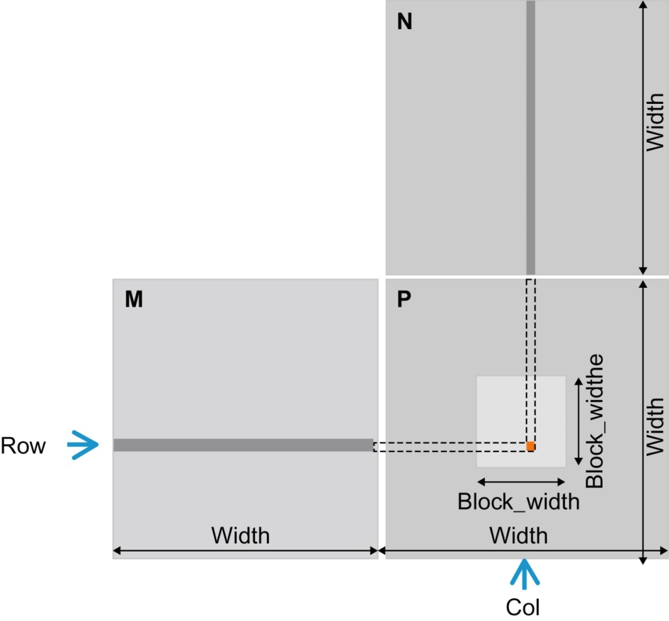
FIGURE 4.2: Matrix multiplication using multiple blocks by tiling P.

Slide 4
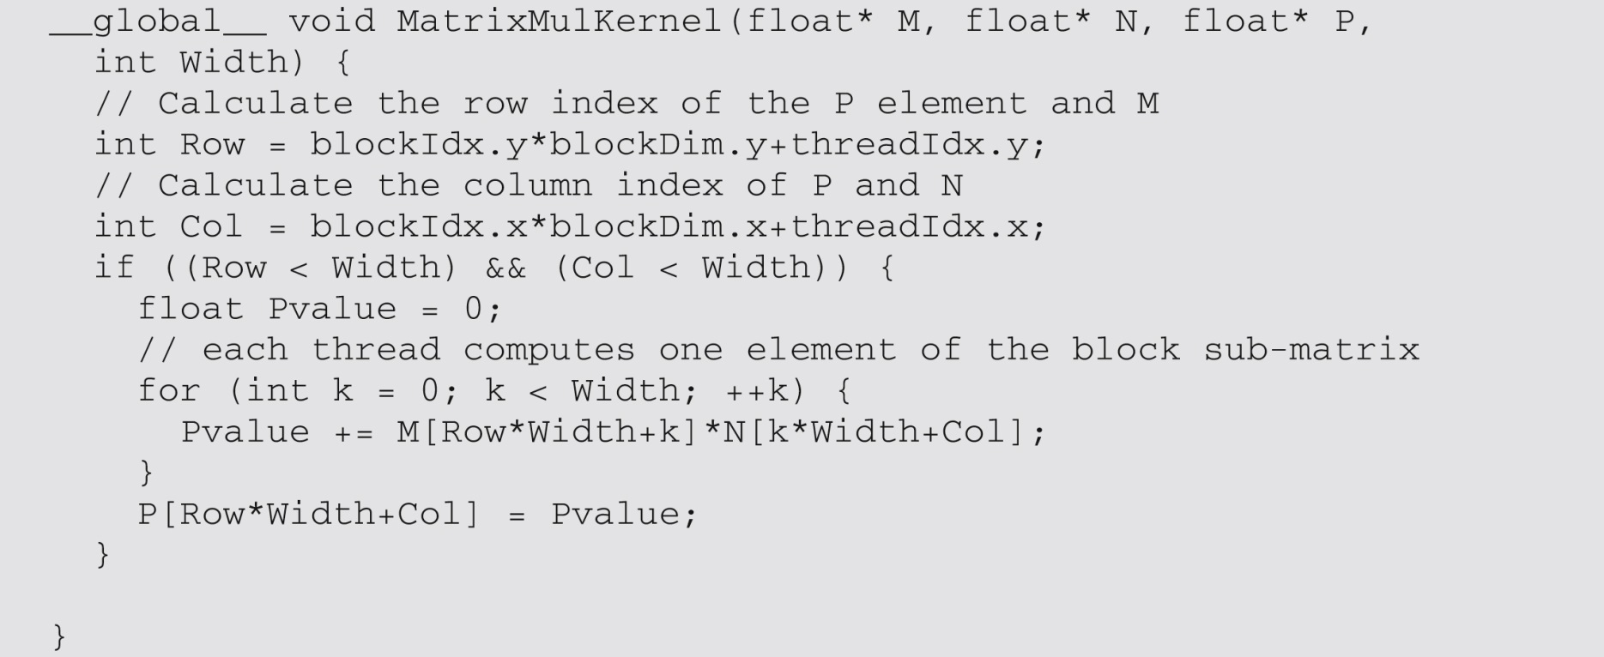
FIGURE 4.3: A simple matrix multiplication kernel using one thread to compute one P element.

Slide 5
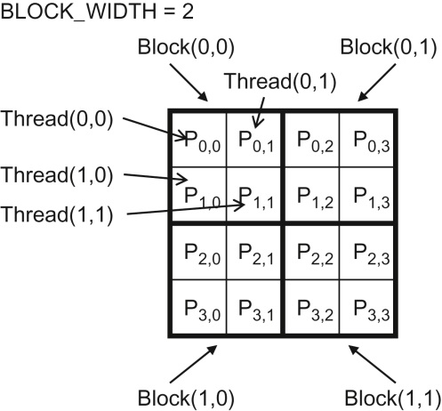
FIGURE 4.4: A small execution example of matrixMulKernel.

Slide 6
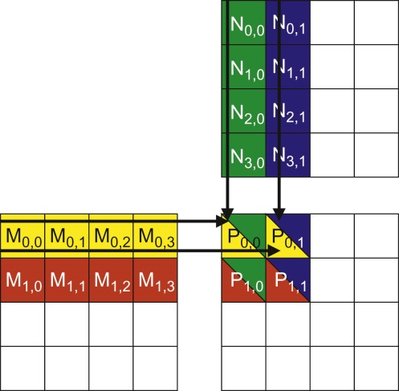
FIGURE 4.5: Matrix multiplication actions of one thread block.

Slide 7
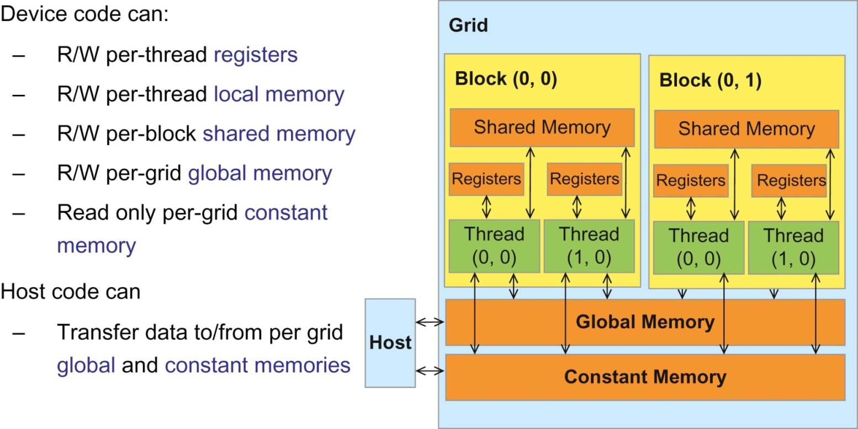
FIGURE 4.6: Overview of the CUDA device memory model.

Slide 8
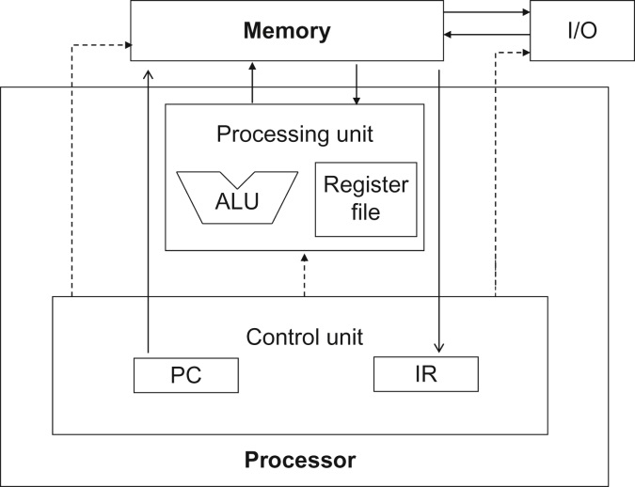
FIGURE 4.7: Memory vs. registers in a modern computer based on the von Neumann model.

Slide 9
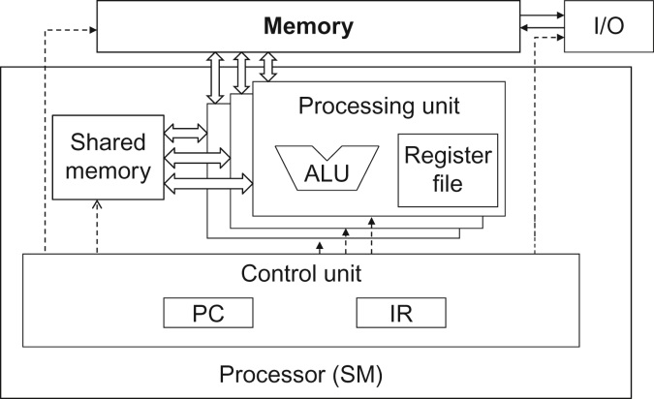
FIGURE 4.8: Shared memory vs. registers in a CUDA device SM.

Slide 10
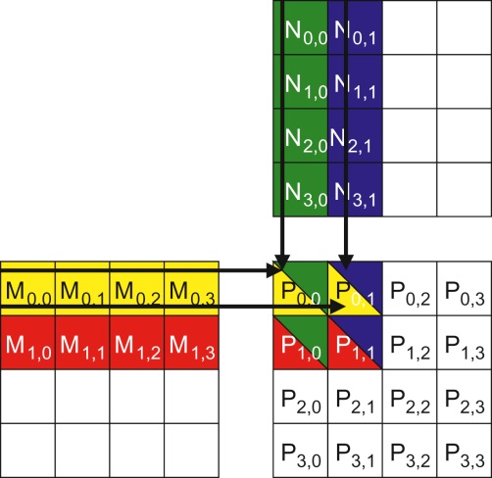
FIGURE 4.9: A small example of matrix multiplication. For brevity, we show M[y*Width+ x], N[y*Width + x], P[y*Width+ x] as My,x, Ny,x Py,x.

Slide 11
FIGURE 4.10: Global memory accesses performed by threads in block0,0.

Slide 12
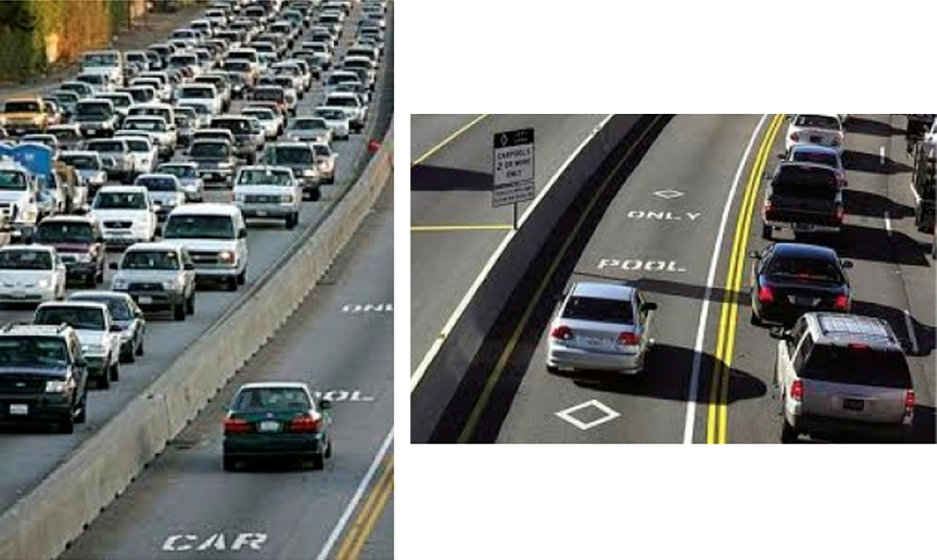
FIGURE 4.11: Reducing traffic congestion in highway systems.

Slide 13
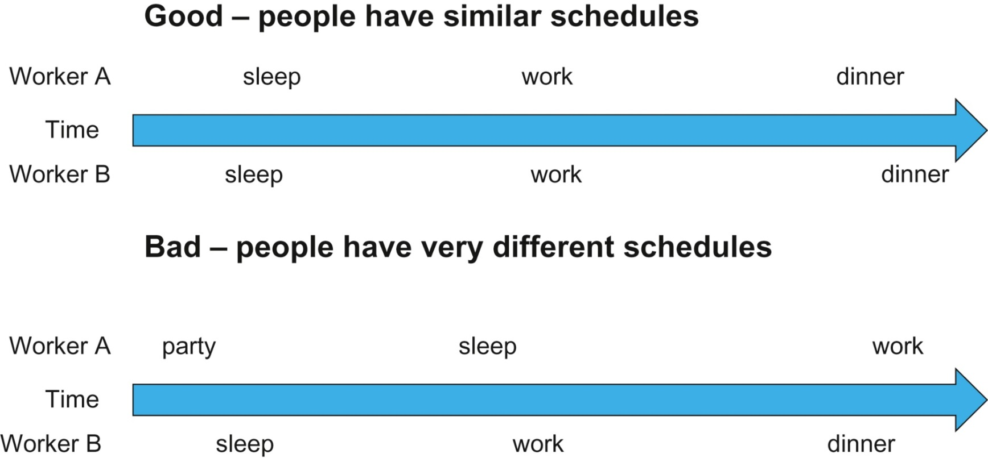
FIGURE 4.12: Carpooling requires synchronization among people.

Slide 14
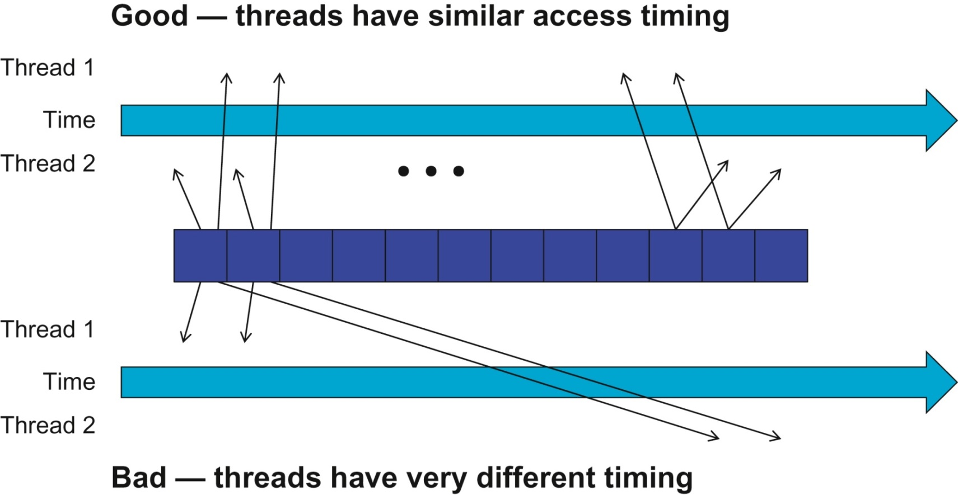
FIGURE 4.13: Tiled Algorithms require synchronization among threads.

Slide 15
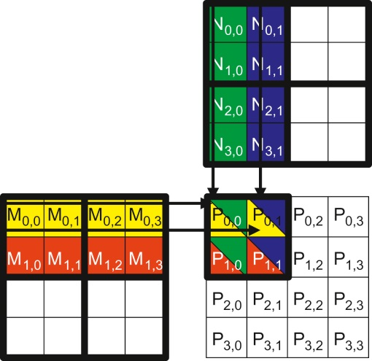
FIGURE 4.14: Tiling M and N to utilize shared memory.

Slide 16
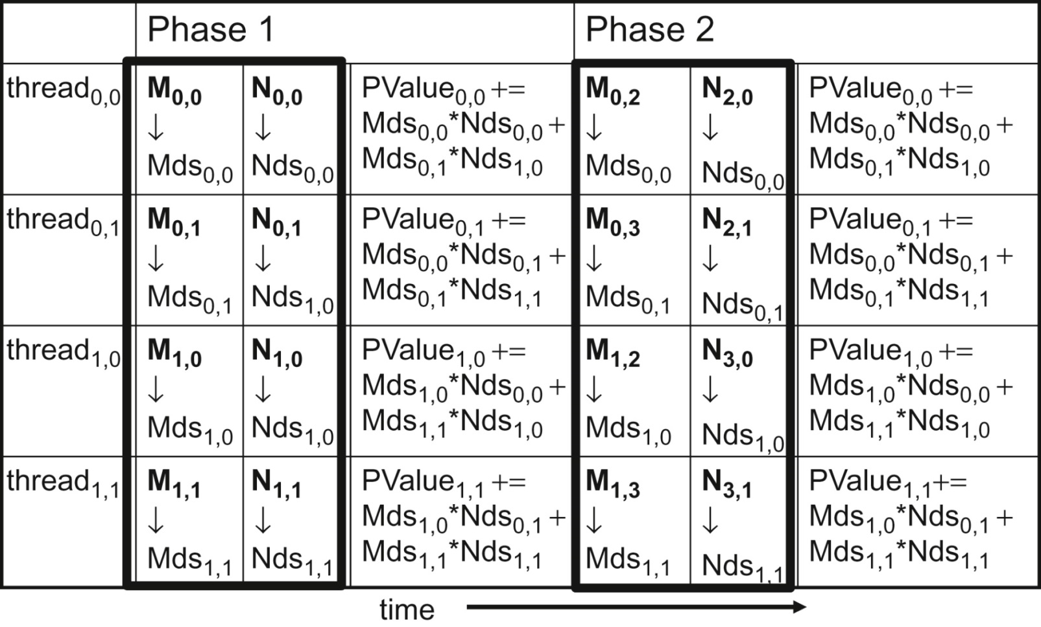
FIGURE 4.15: Execution phases of a tiled matrix multiplication.

Slide 17
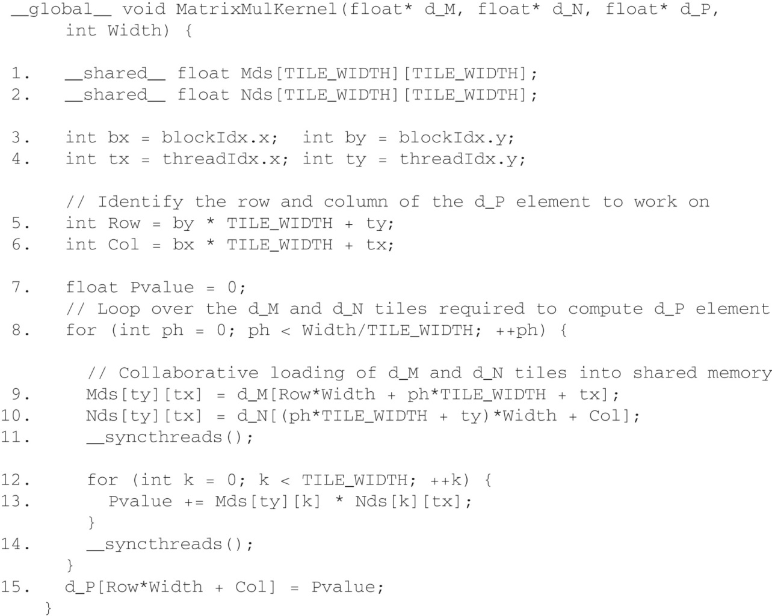
FIGURE 4.16: A tiled Matrix Multiplication Kernel using shared memory.

Slide 18
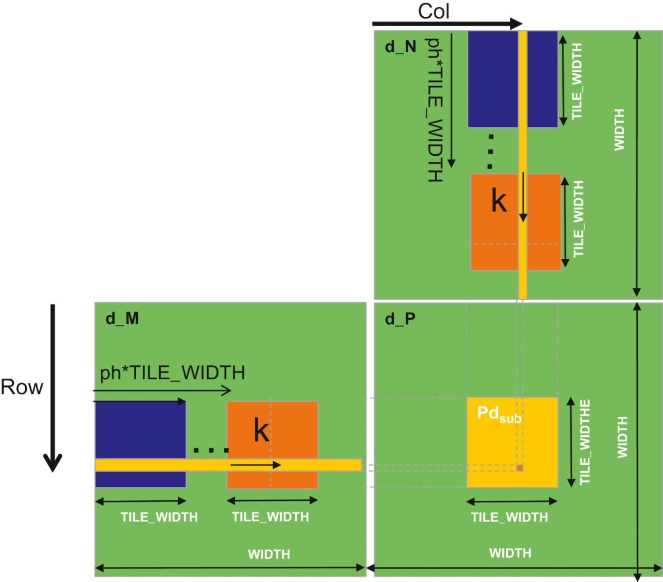
FIGURE 4.17: Calculation of the matrix indexes in tiled multiplication.

Slide 19
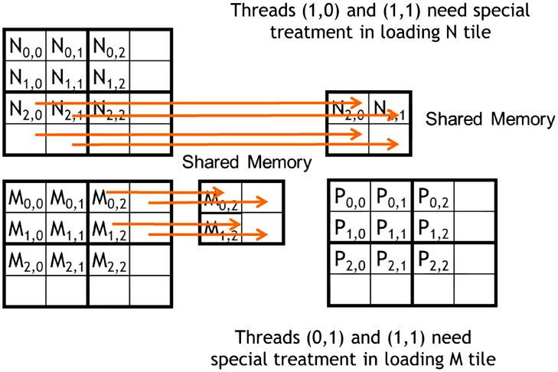
FIGURE 4.18: Loading input matrix elements that are close to the edge–phase 1 of Block0,0.

Slide 20
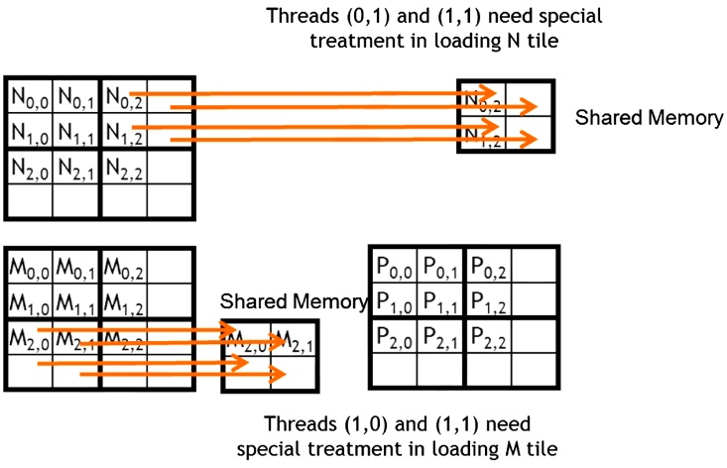
FIGURE 4.19: Loading input elements during phase 0 of block1,0.

Slide 21
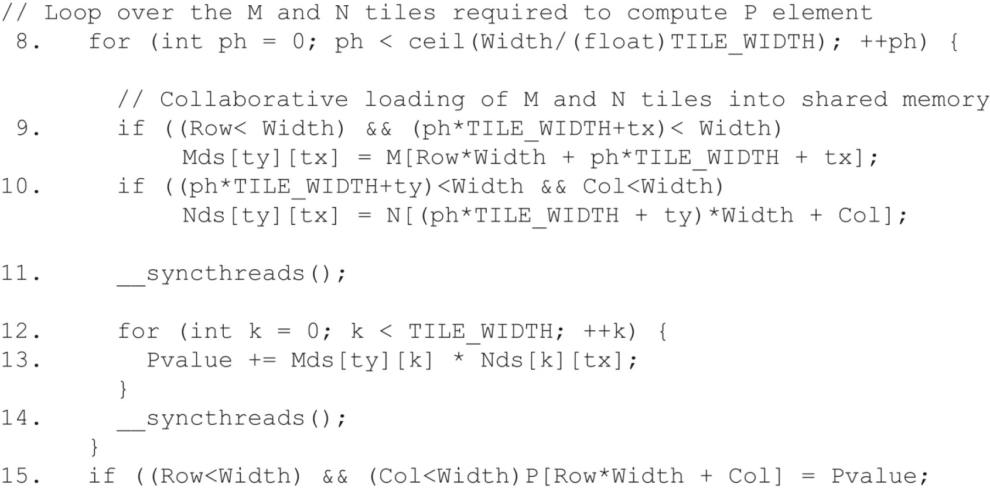
FIGURE 4.20: Tiled matrix multiplication kernel with boundary condition checks.

