Slide 1
Chapter-5 Performance considerations

Slide 2
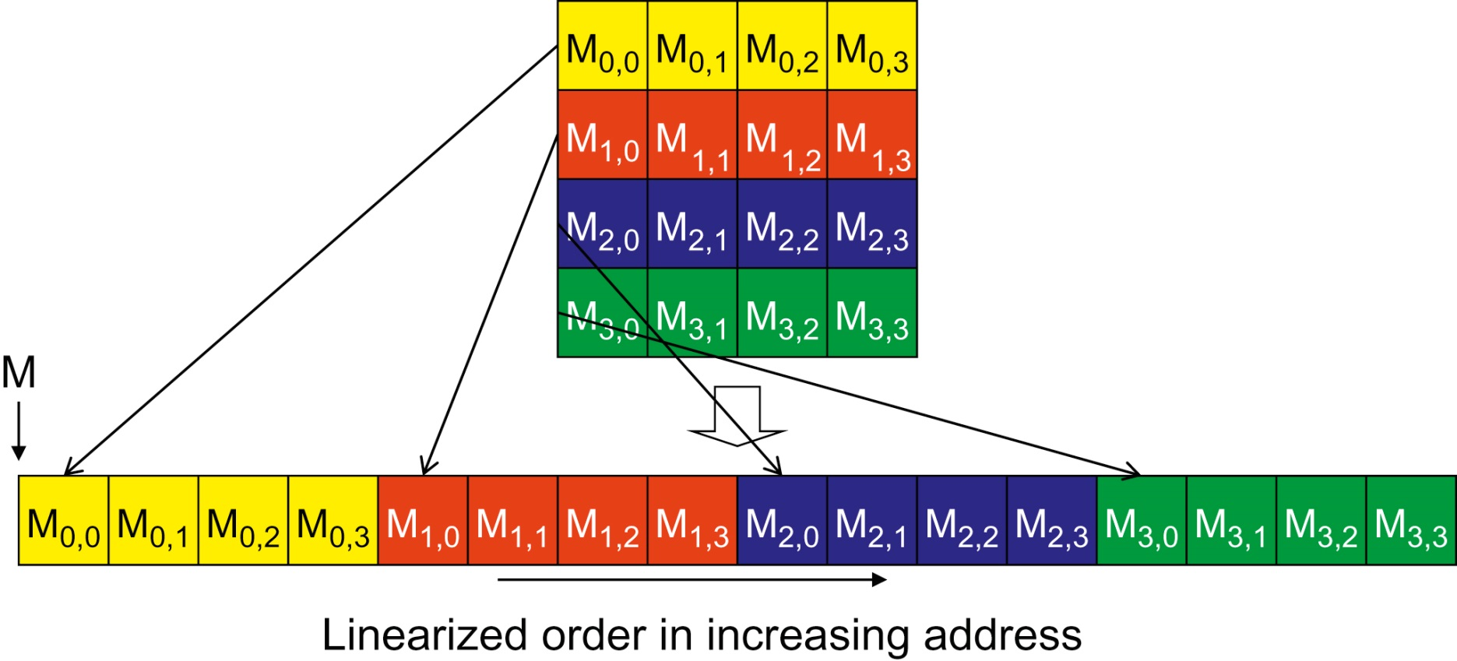
FIGURE 5.1: Placing matrix elements into linear order.

Slide 3
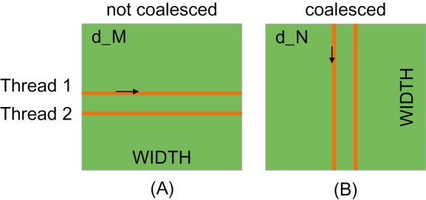
FIGURE 5.2: Memory access patterns in C 2D arrays for coalescing.

Slide 4
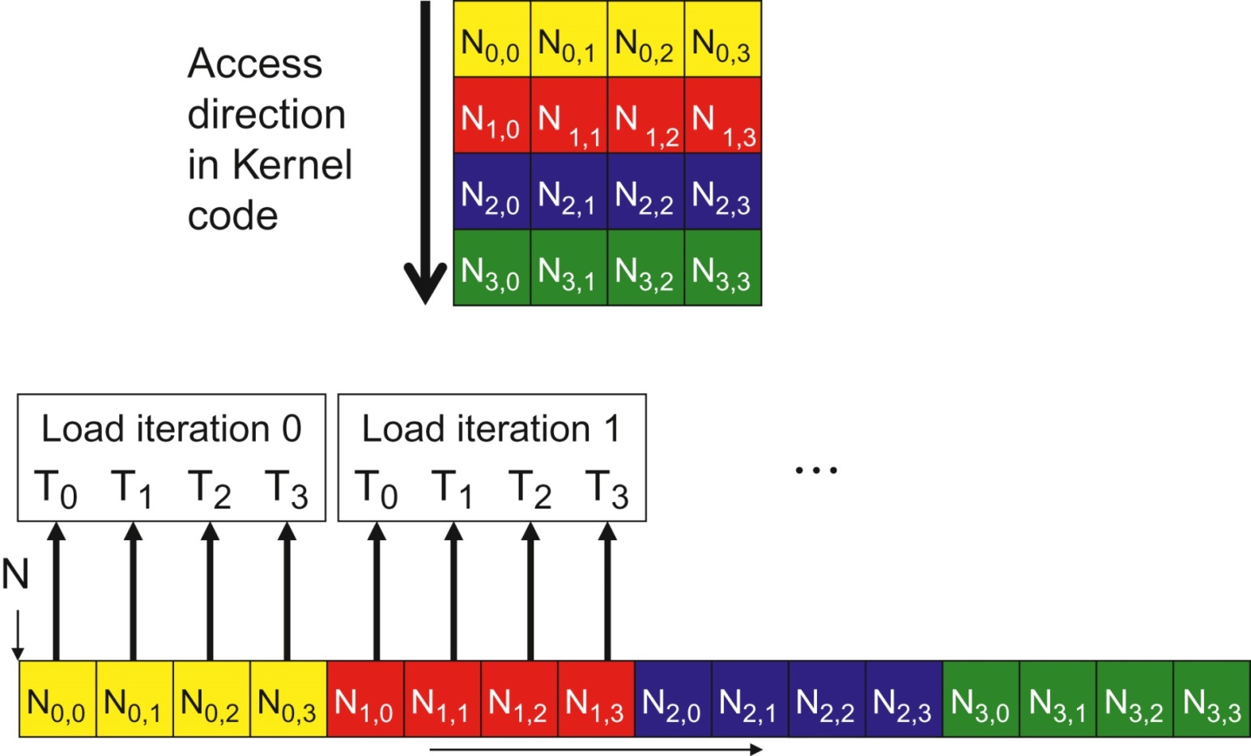
FIGURE 5.3: A coalesced access pattern.

Slide 5
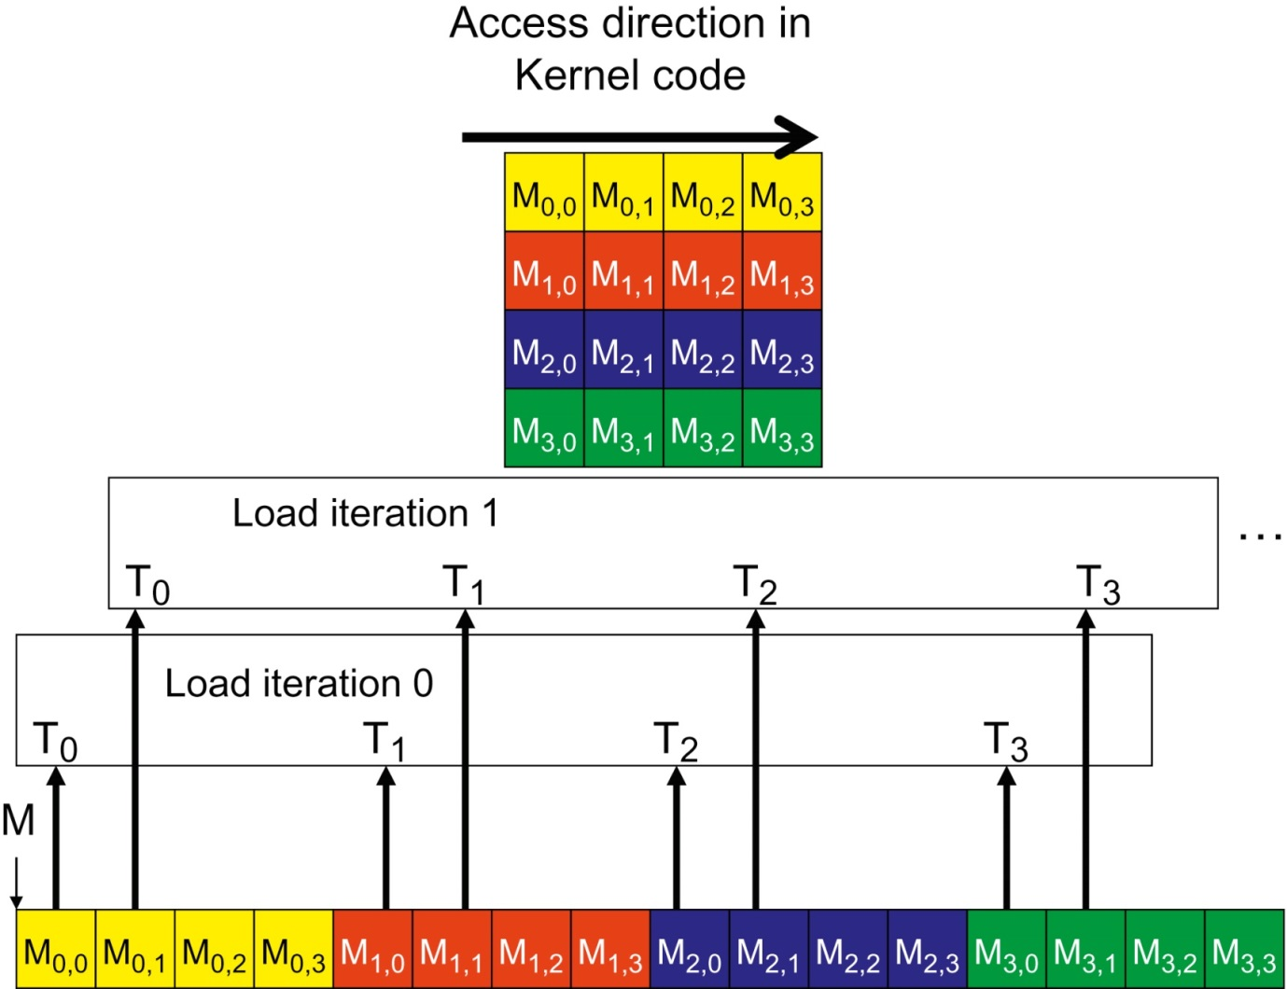
FIGURE 5.4: An un-coalesced access pattern.

Slide 6
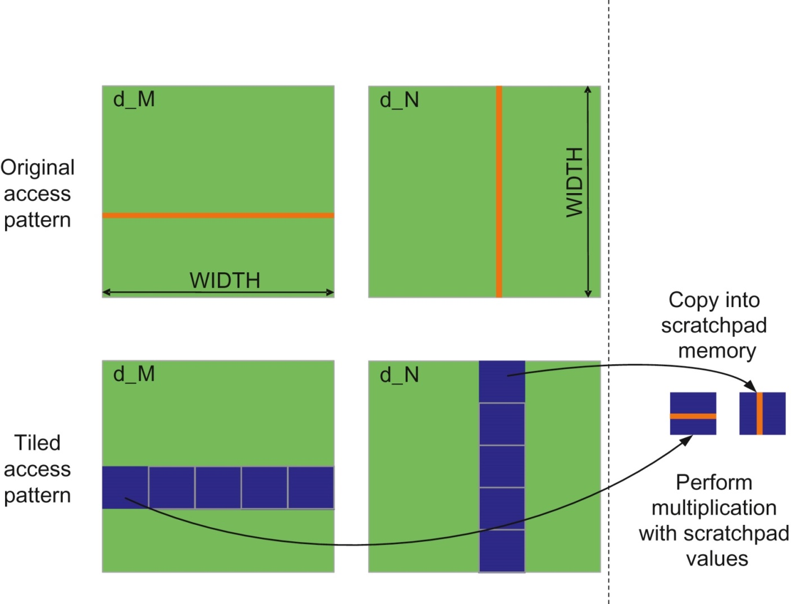
FIGURE 5.5: Using shared memory to enable coalescing.

Slide 7
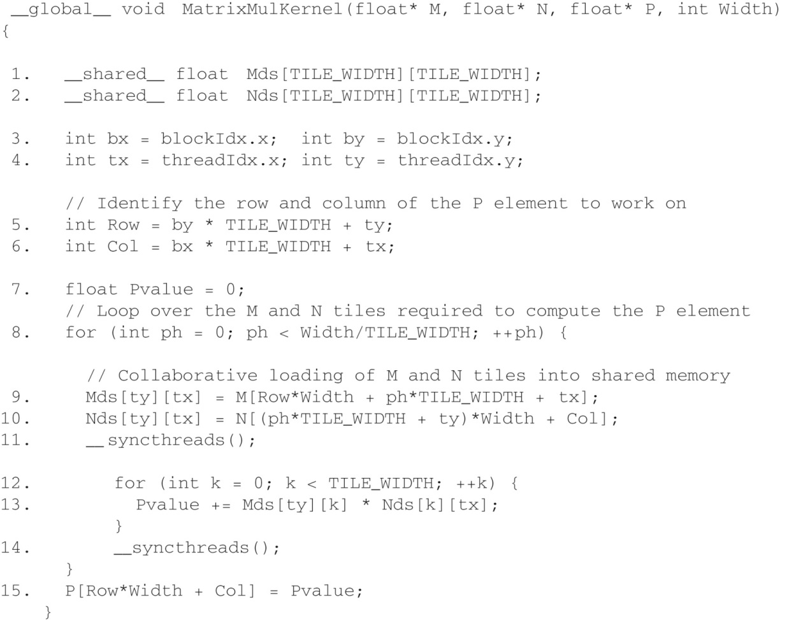
FIGURE 5.6: Tiled Matrix Multiplication Kernel using shared memory.

Slide 8
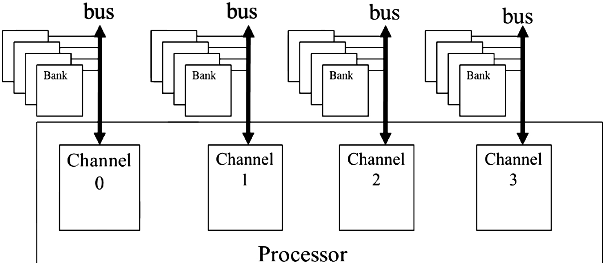
FIGURE 5.7: Channels and banks in DRAM systems.

Slide 9
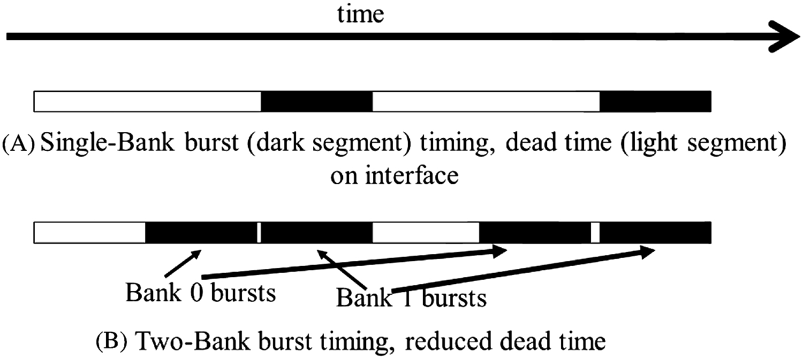
FIGURE 5.8: Banking improves the utilization of data transfer bandwidth of a channel.

Slide 10
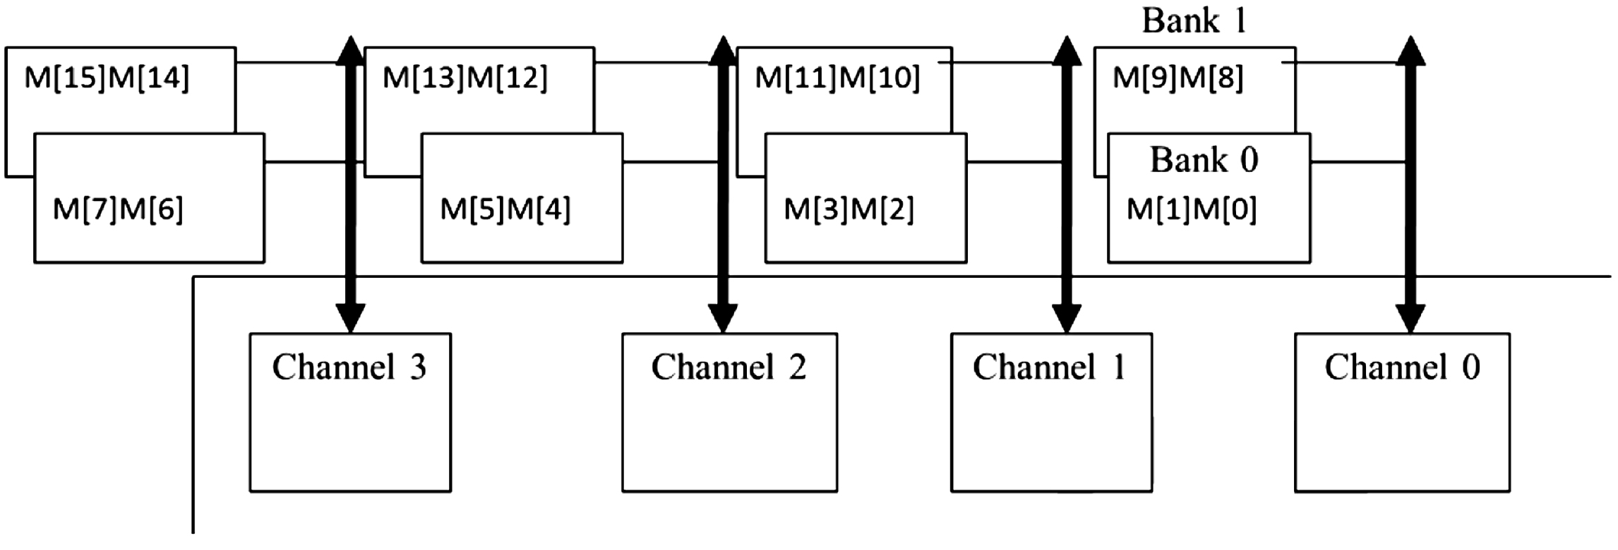
FIGURE 5.9: Distributing array elements into channels and banks.

Slide 11
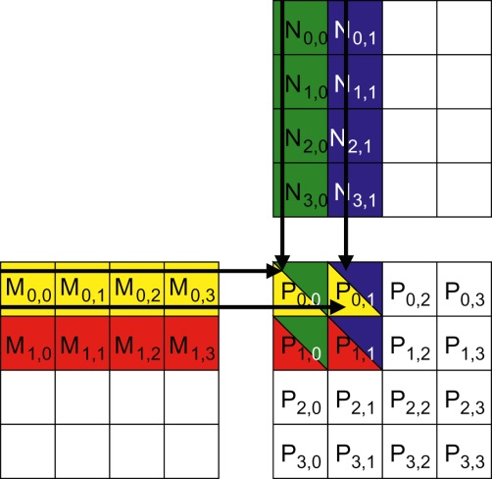
FIGURE 5.10: A small example of matrix multiplication (replicated from Fig. 4.9).

Slide 12
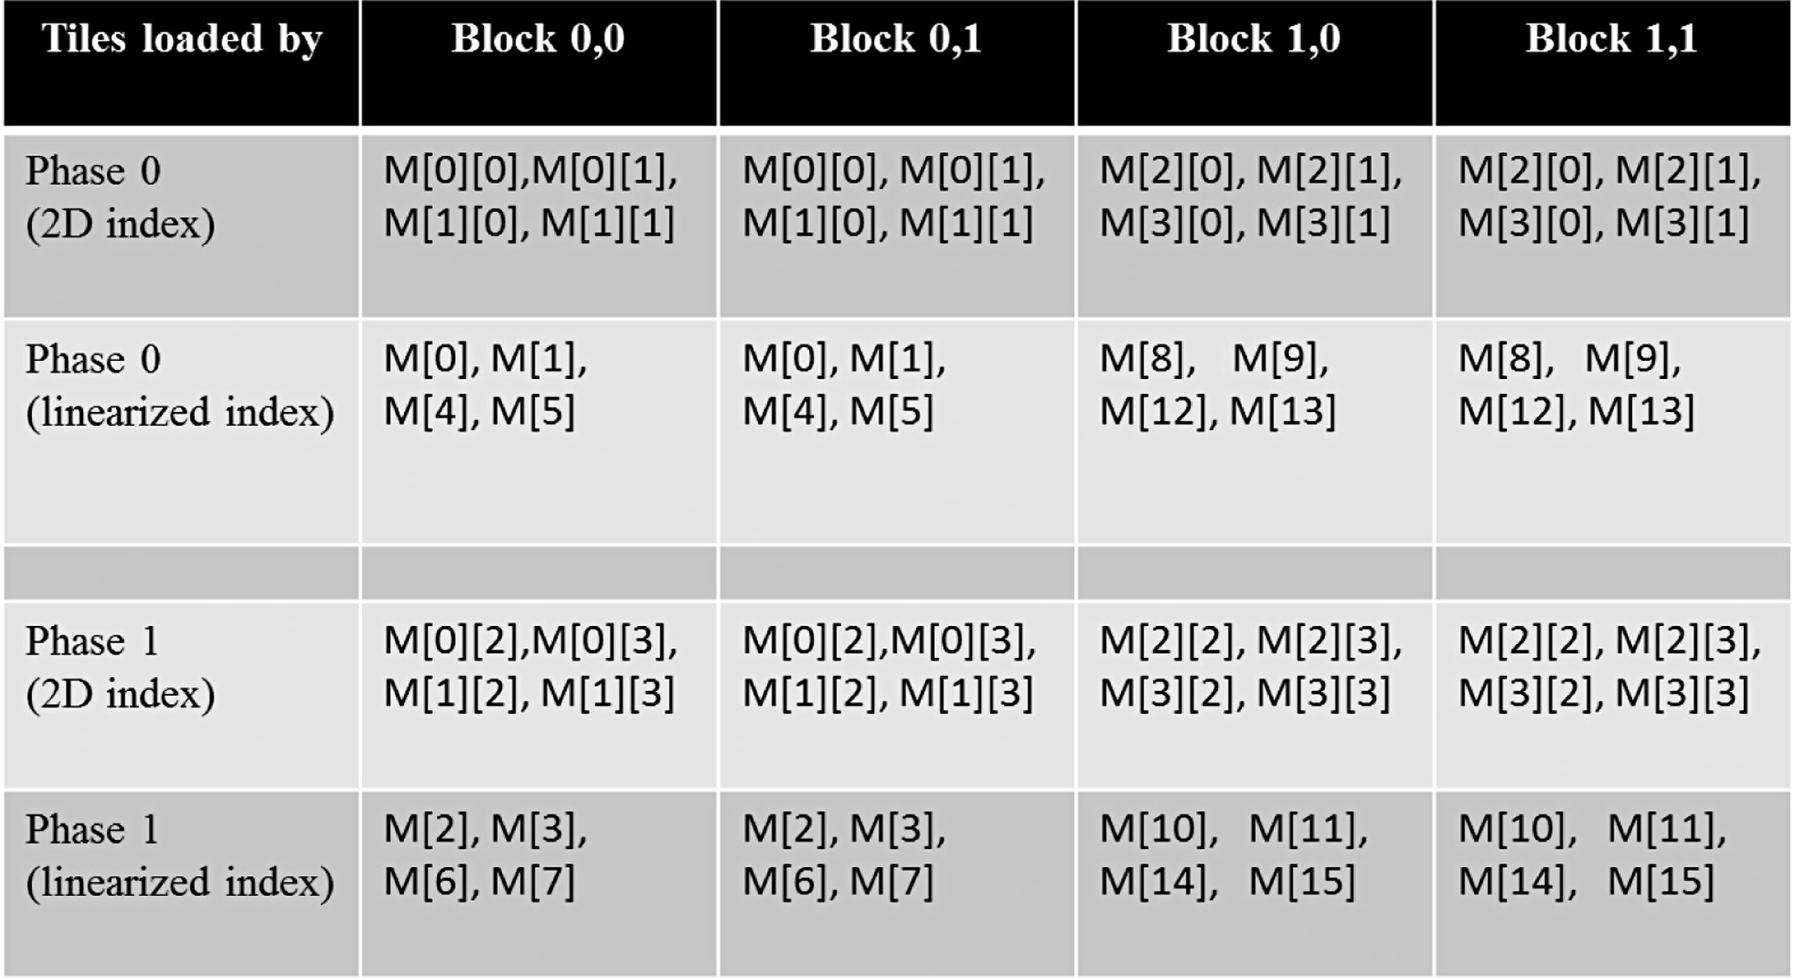
FIGURE 5.11: M elements loaded by thread blocks in each phase.

Slide 13
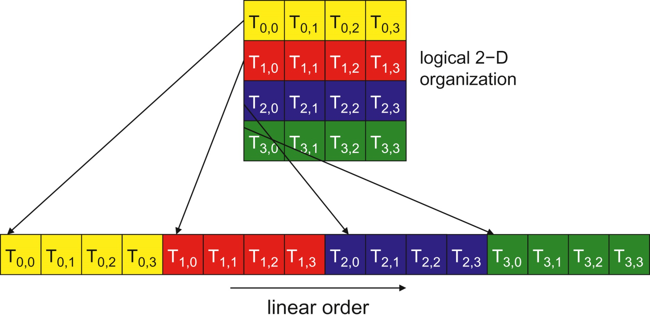
FIGURE 5.12: Placing 2D threads into linear order.

Slide 14
FIGURE 5.13: A simple sum reduction kernel.

Slide 15
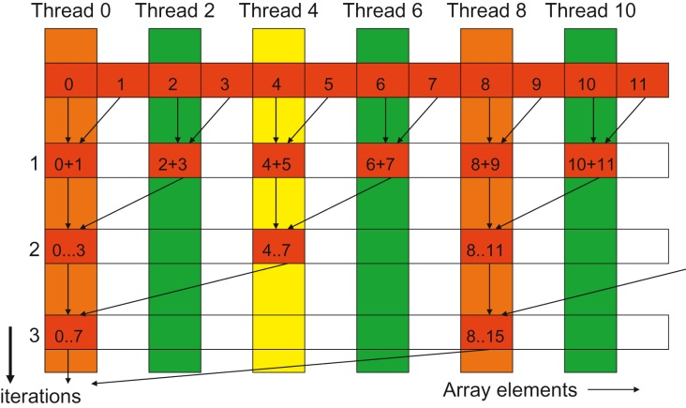
FIGURE 5.14: Execution of the sum reduction kernel.

Slide 16
FIGURE 5.15: A kernel with fewer thread divergence.

Slide 17
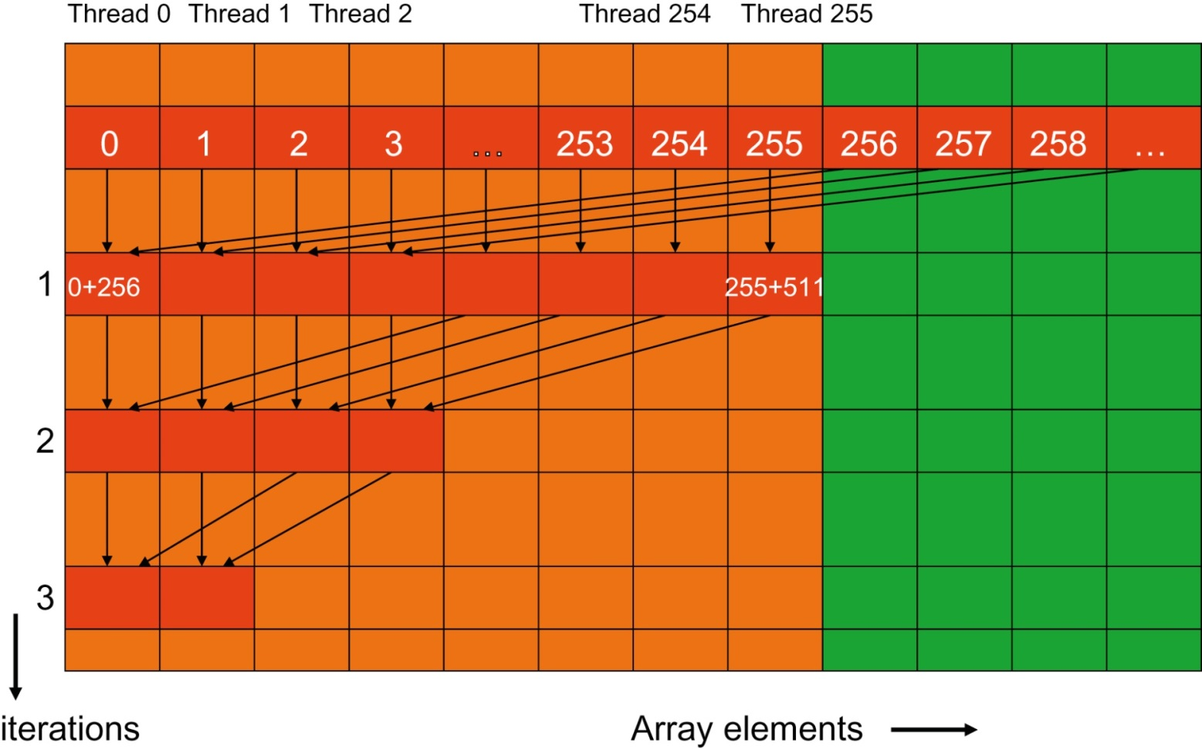
FIGURE 5.16: Execution of the revised algorithm.

Slide 18
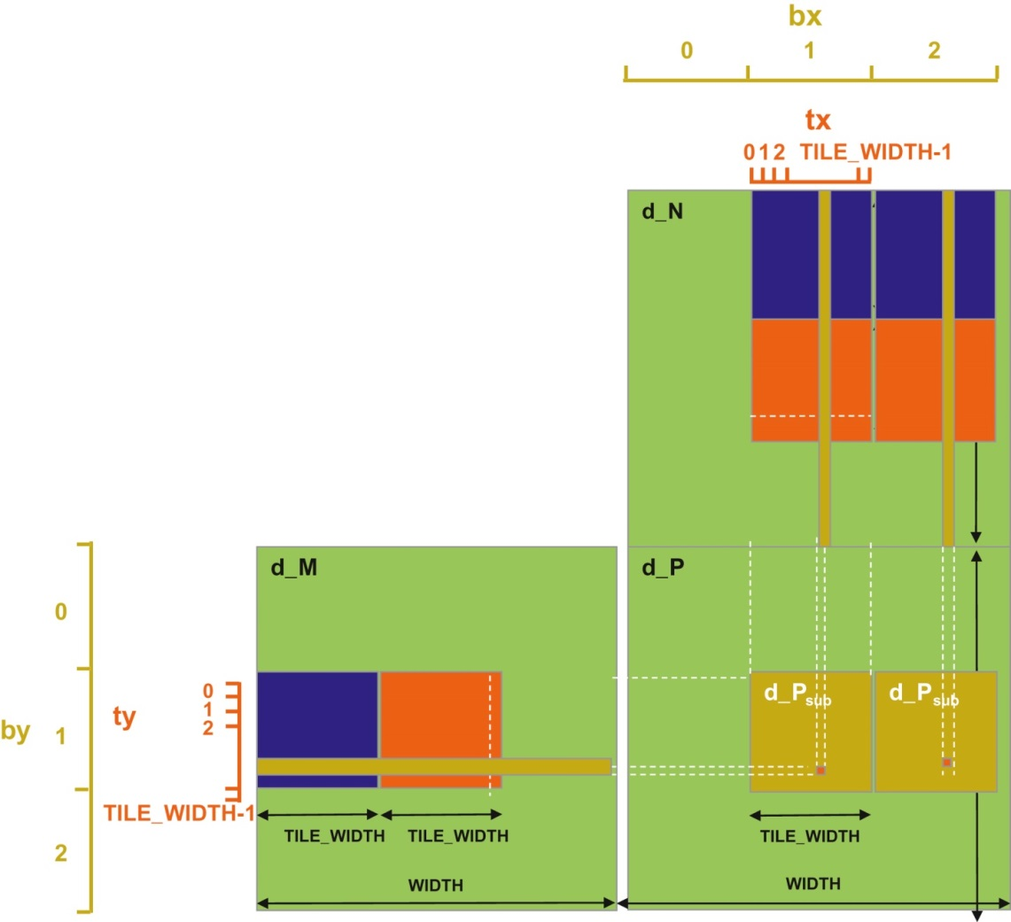
FIGURE 5.17: Increased thread granularity with rectangular tiles.

Slide 19
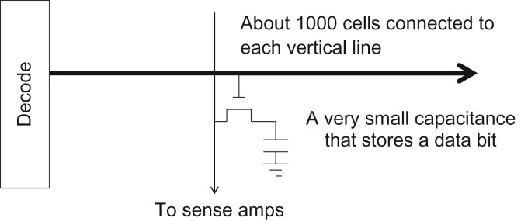

Slide 20
