Slide 1
Chapter-11 Parallel patterns: merge sort An introduction to tiling with dynamic input data identification

Slide 2
FIGURE 11.1: Examples of sorted versus unsorted lists.

Slide 3
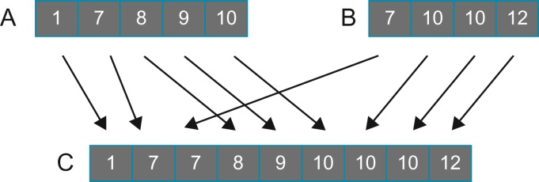
FIGURE 11.2: Example of a merge operation.

Slide 4
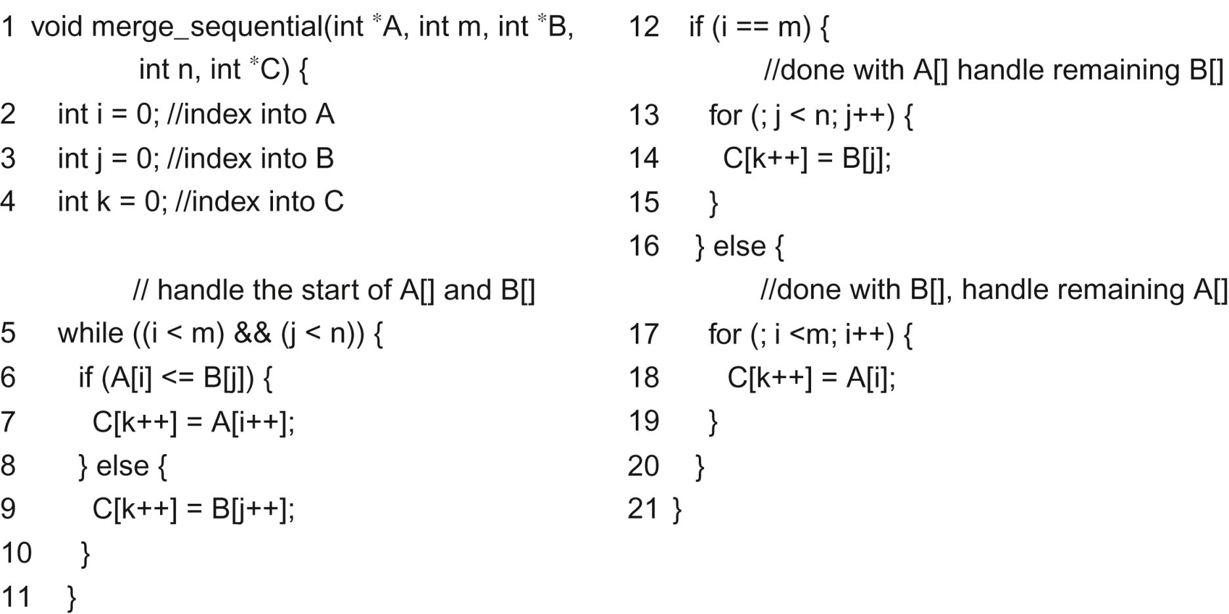
FIGURE 11.3: A sequential merge function.

Slide 5
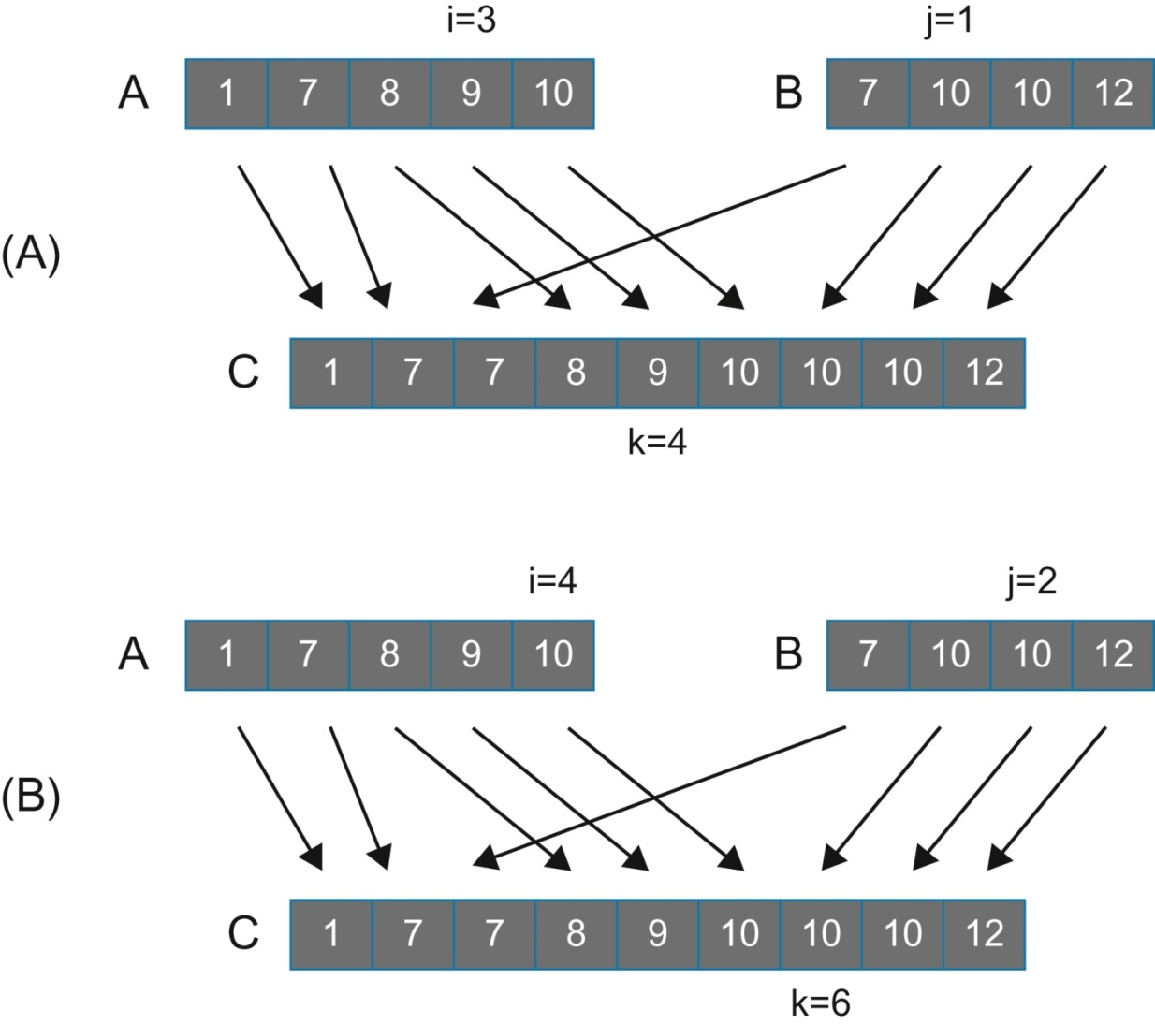
FIGURE 11.4: Examples of observation (1). (A) shows case 1 and (B) shows case 2.

Slide 6
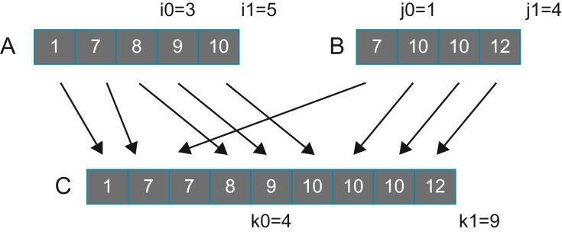
FIGURE 11.5: Example of co-rank function execution.

Slide 7
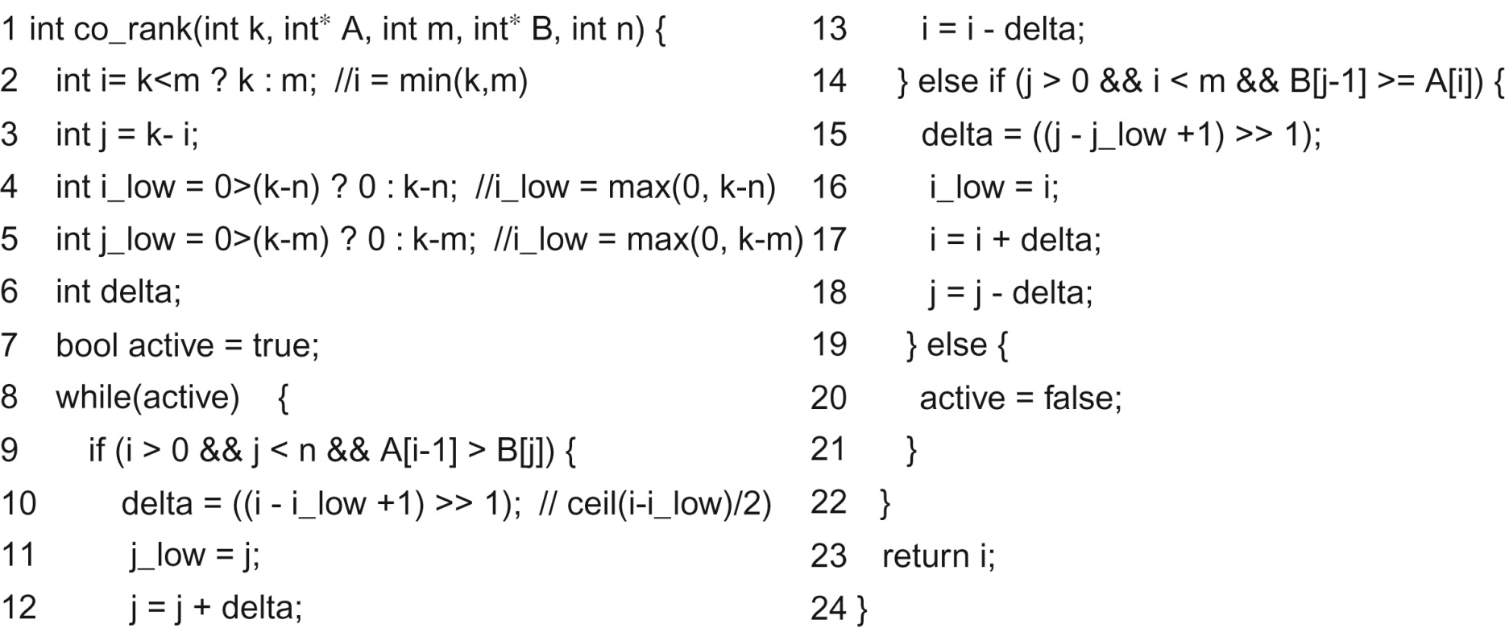
FIGURE 11.6: A co-rank function based on binary search.

Slide 8
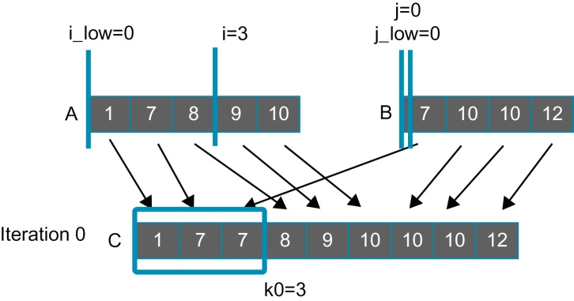
FIGURE 11.7: Iteration 0 of the co-rank function operation example for thread 0.

Slide 9
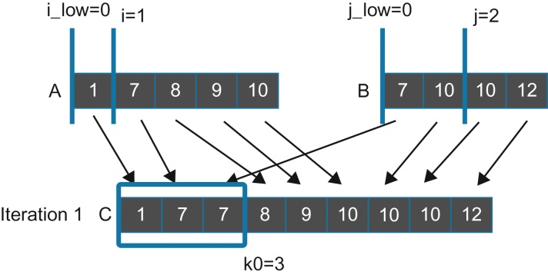
FIGURE 11.8: Iteration 1 of the co-rank function operation example for thread 0.

Slide 10
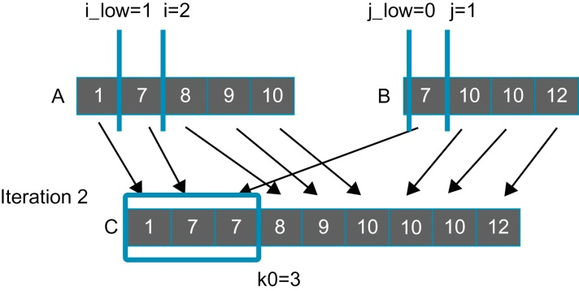
FIGURE 11.9: Iteration 2 of the co-rank function operation example for thread 0.

Slide 11
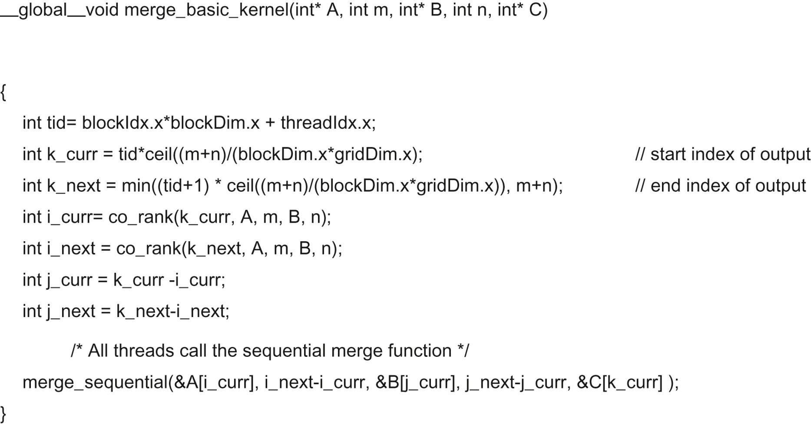
FIGURE 11.10: A basic merge kernel.

Slide 12
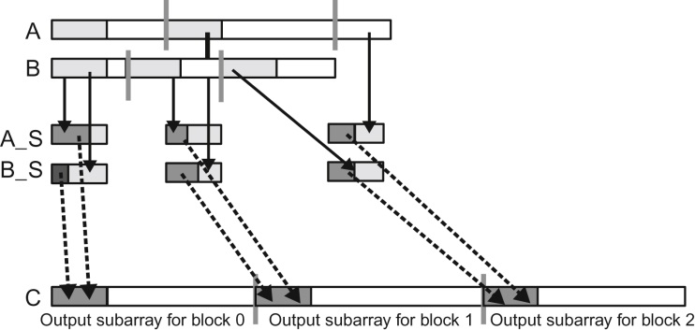
FIGURE 11.11: Design of a tiled merge kernel

Slide 13
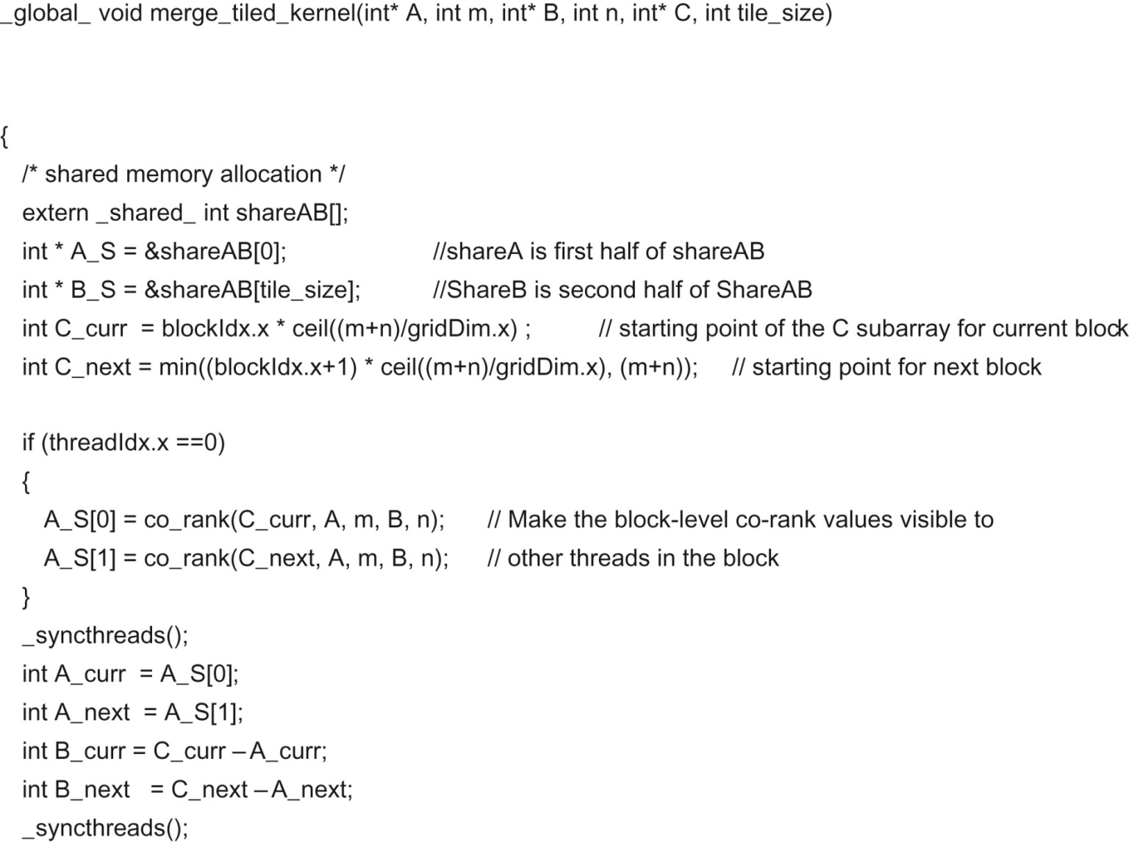
FIGURE 11.12: Part 1—identifying block-level output and input subarrays.

Slide 14
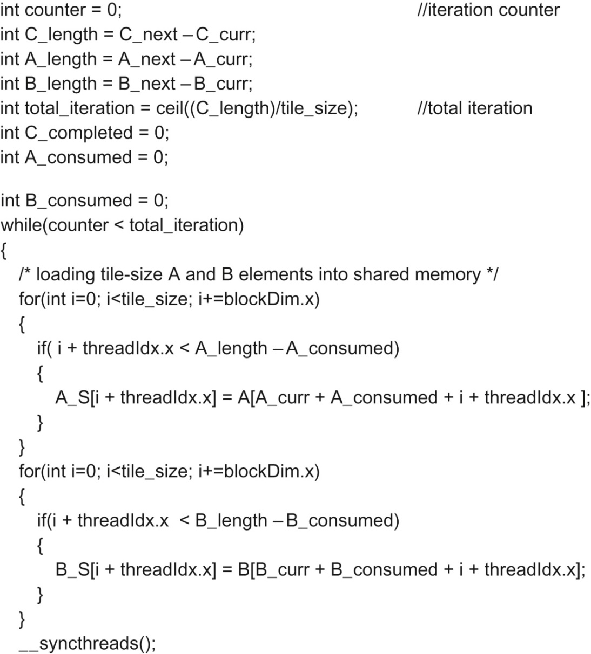
FIGURE 11.13: Part 2—loading A and B elements into the shared memory.

Slide 15
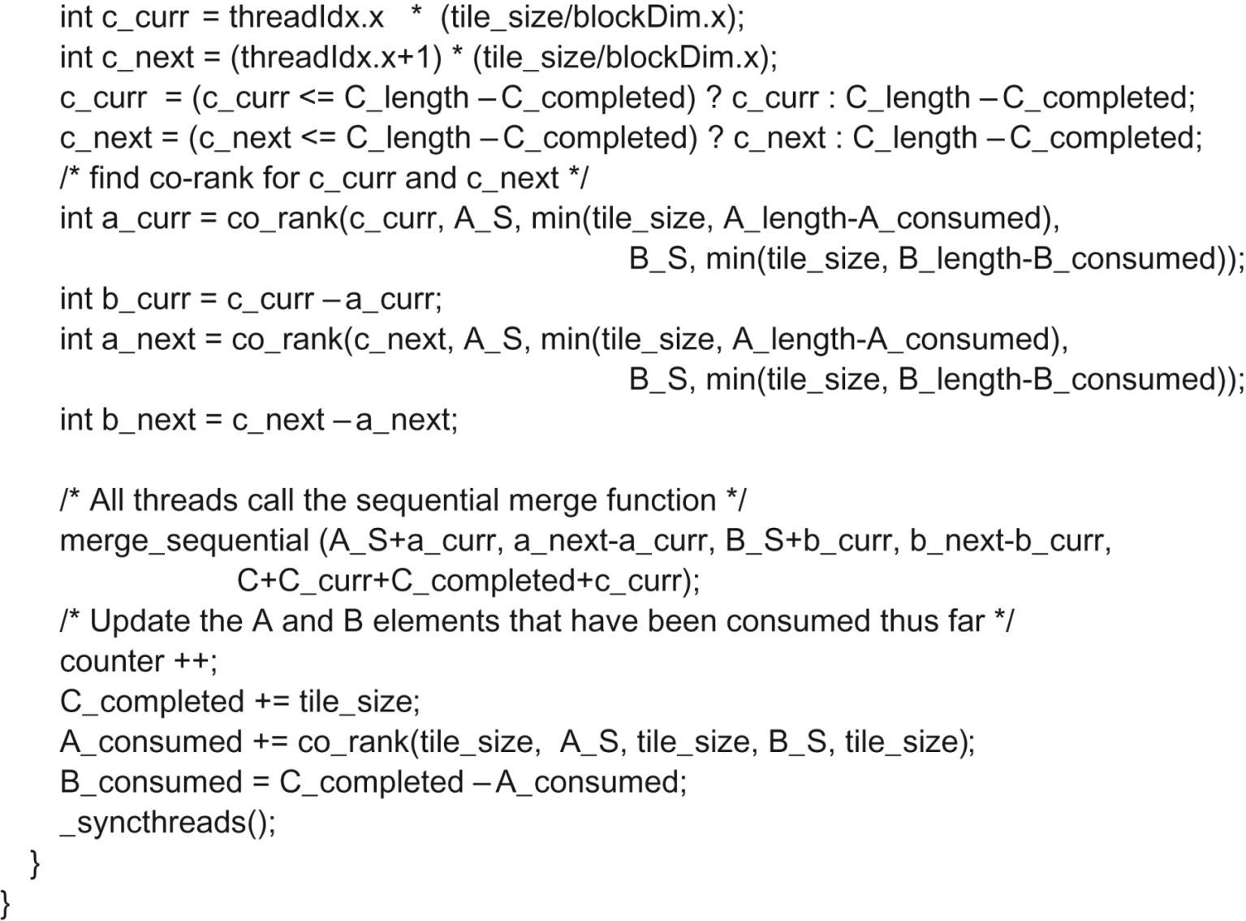
FIGURE 11.14: Part 3—all threads merge their individual subarrays in parallel

Slide 16
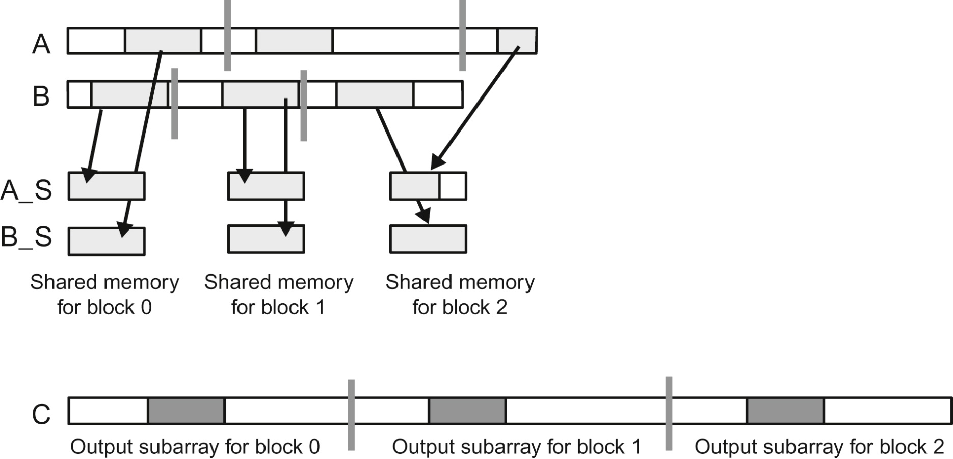
FIGURE 11.15: Iteration 1 of the running example.

Slide 17
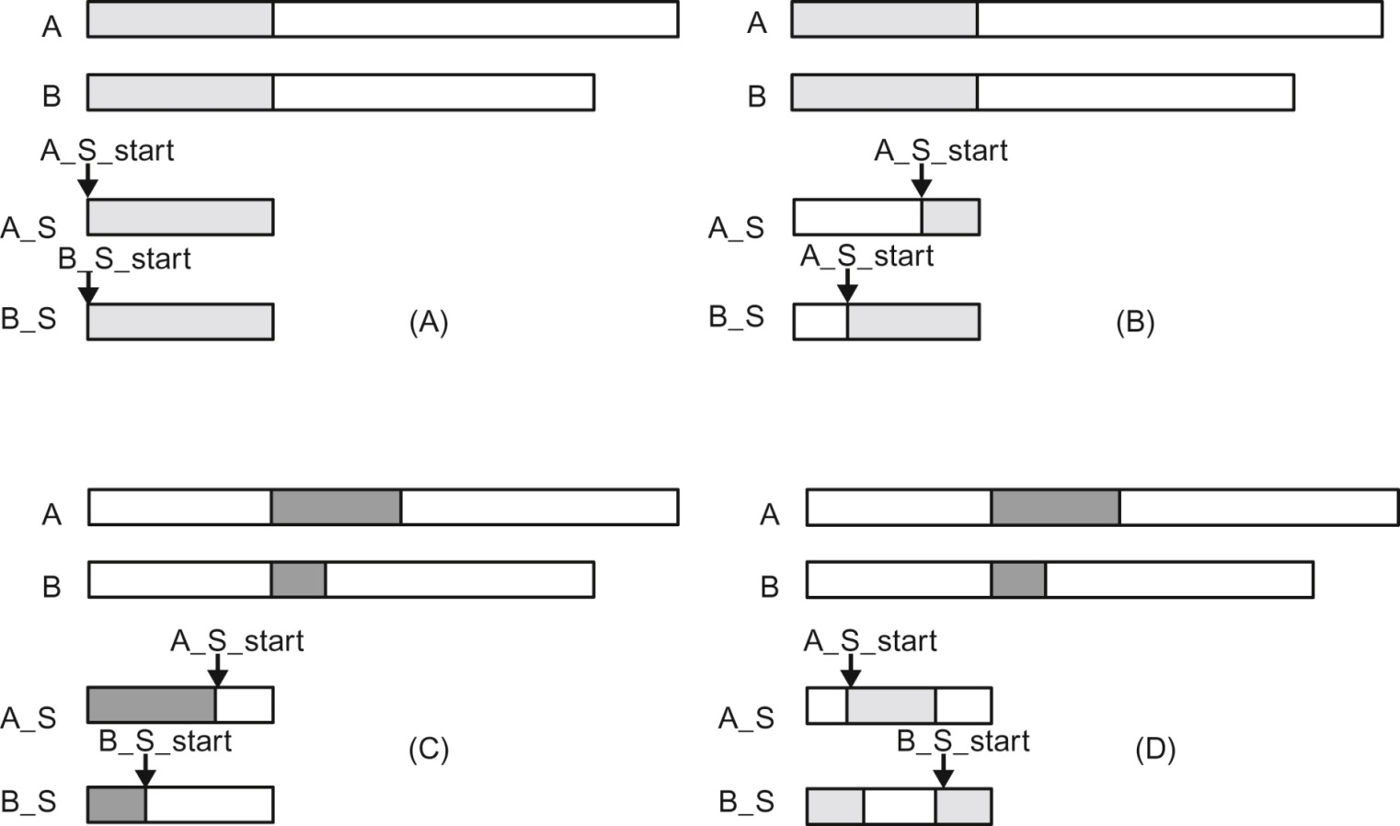
FIGURE 11.16: A circular buffer scheme for managing the shared memory tiles.

Slide 18
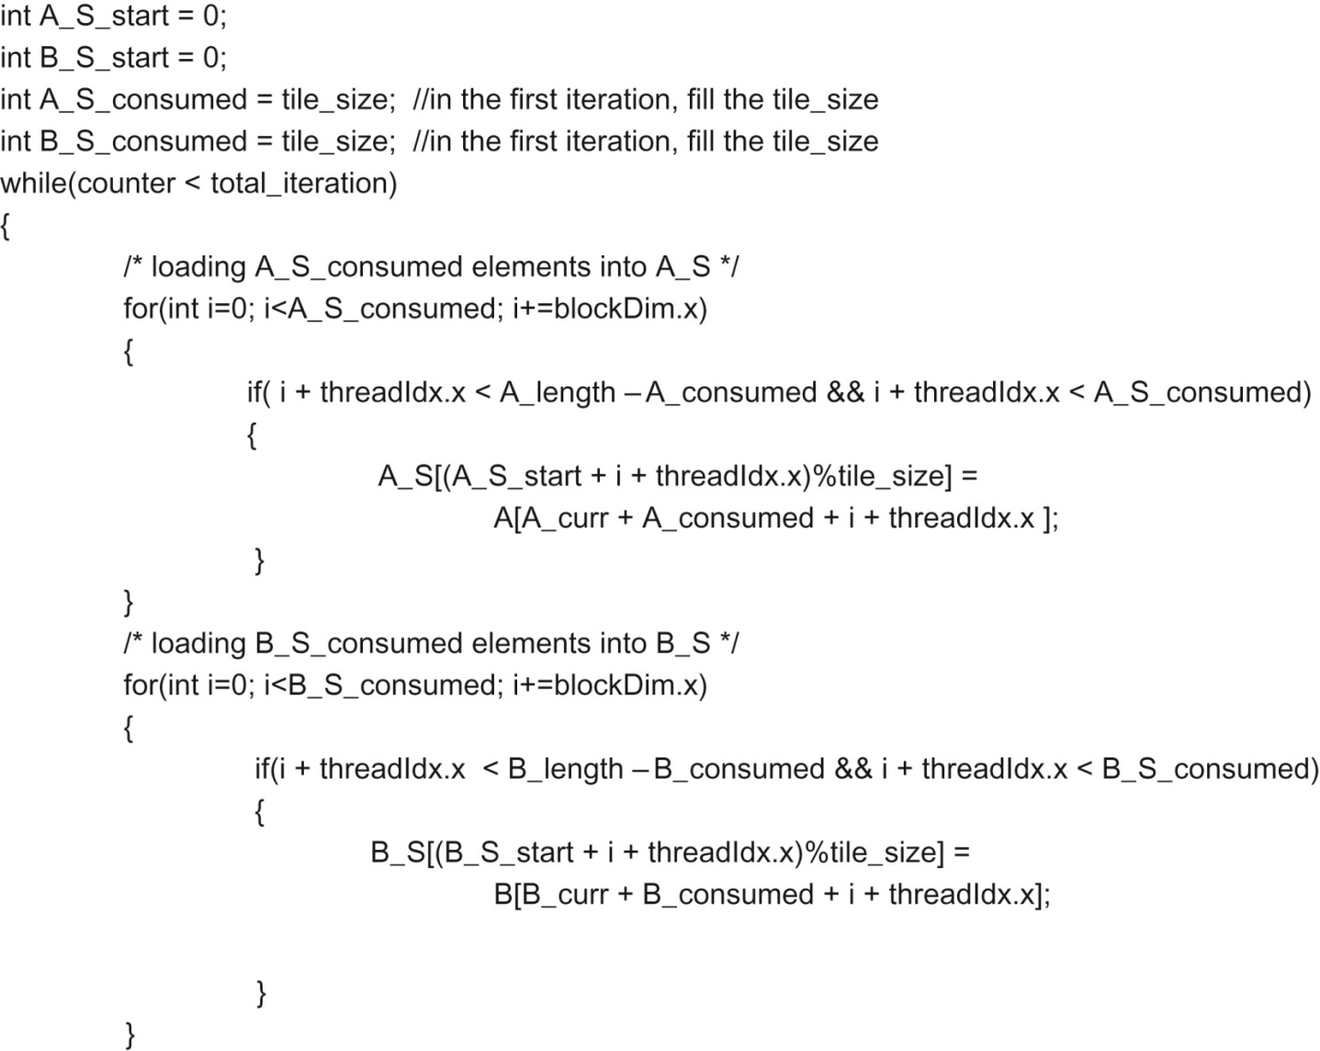
FIGURE 11.17: Part 2 of a circular-buffer merge kernel.

Slide 19
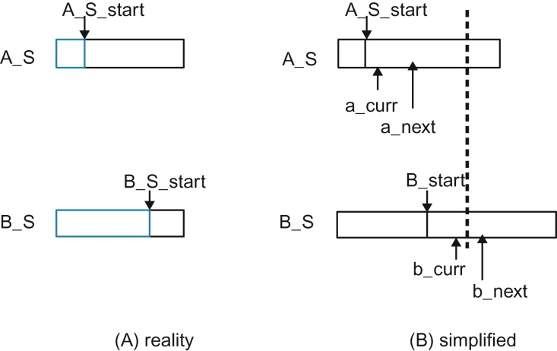
FIGURE 11.18: A simplified model for the co-rank values when using a circular buffer.

Slide 20
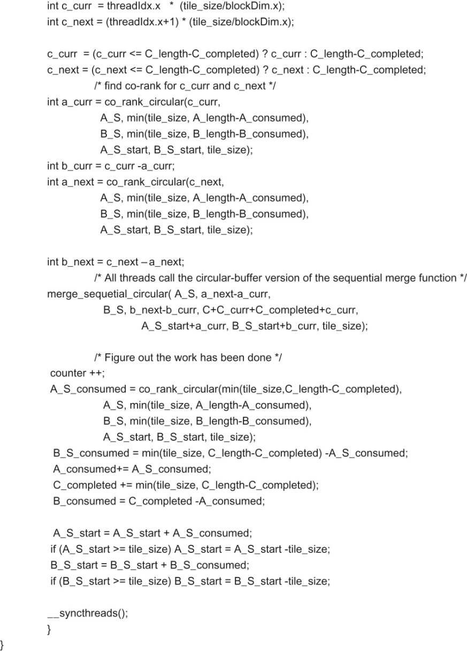
FIGURE 11.19: Part 3 of a circular-buffer merge kernel.

Slide 21
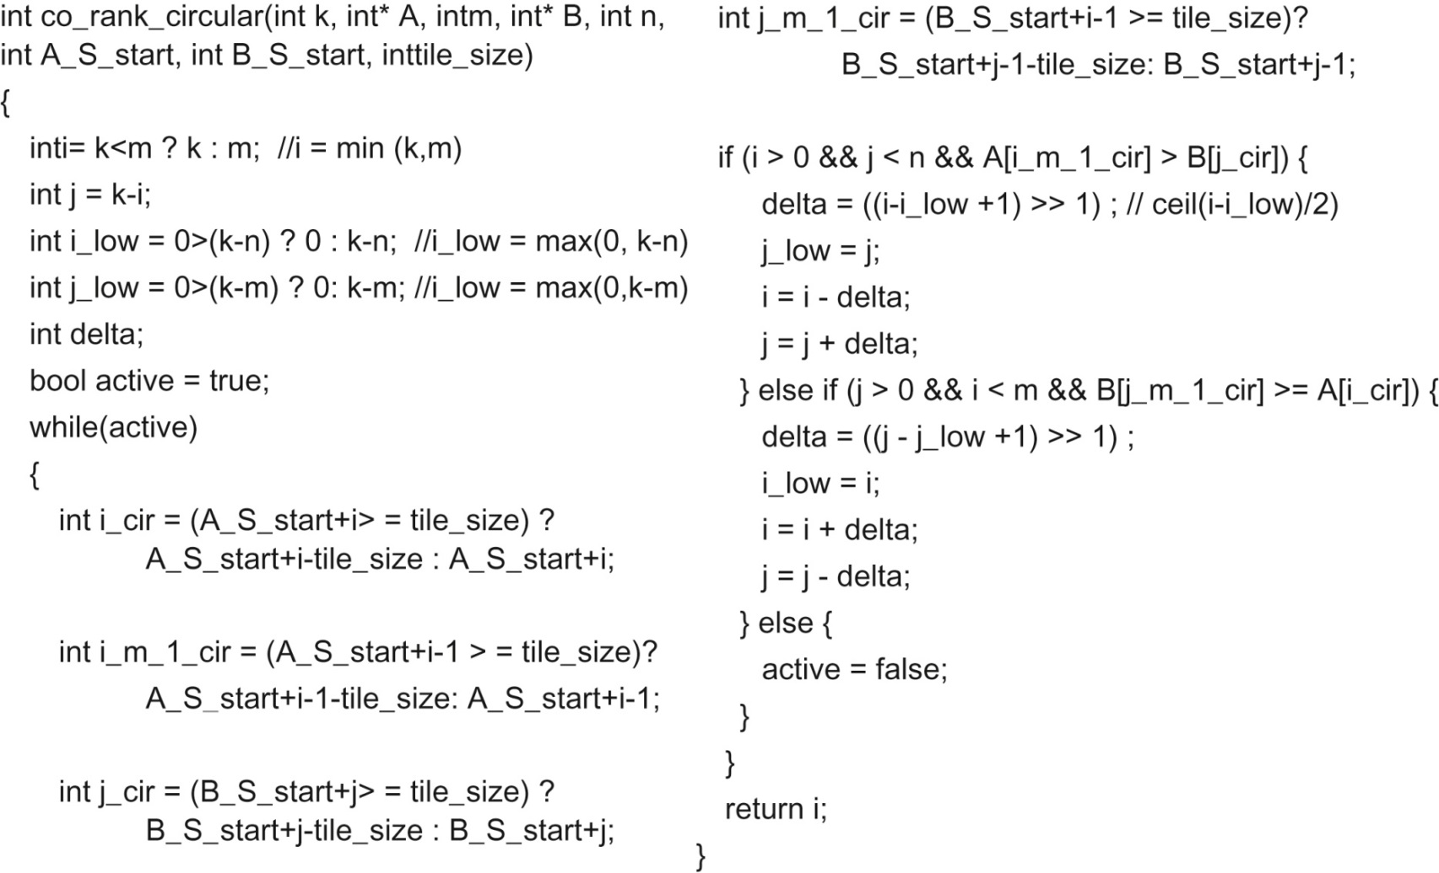
FIGURE 11.20: A co_rank_circular function that operates on circular buffers.

Slide 22
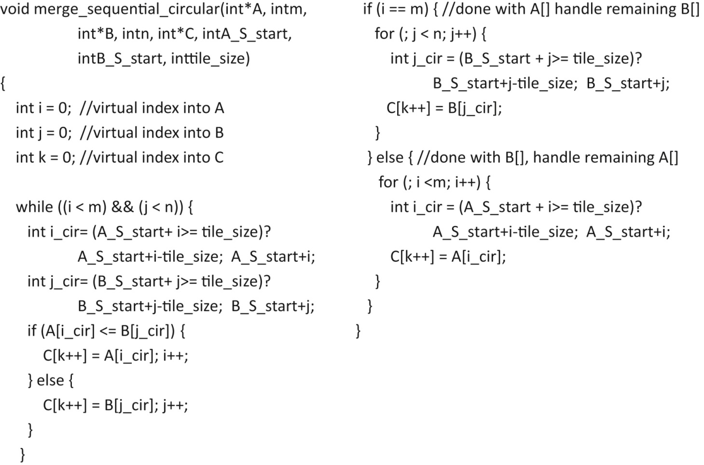
FIGURE 11.21: Implementation of the merge_sequential_circular function.

