Slide 1
Chapter-13 CUDA dynamic parallelism

Slide 2
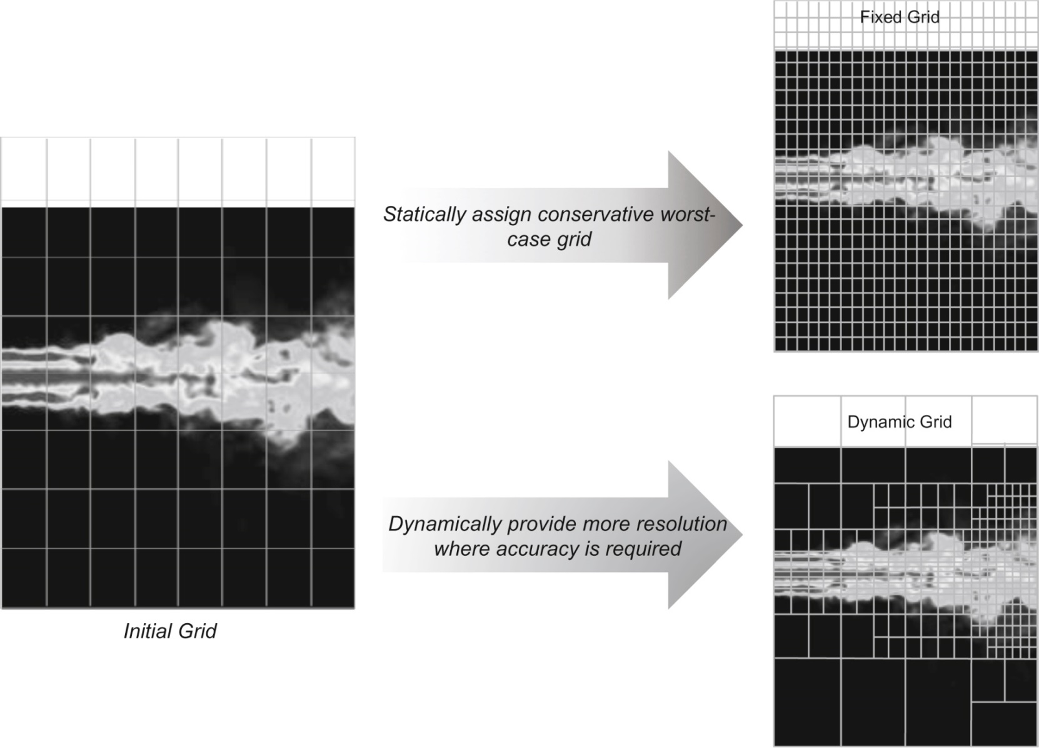
FIGURE 13.1: Fixed versus dynamic grids for a turbulence simulation model.

Slide 3
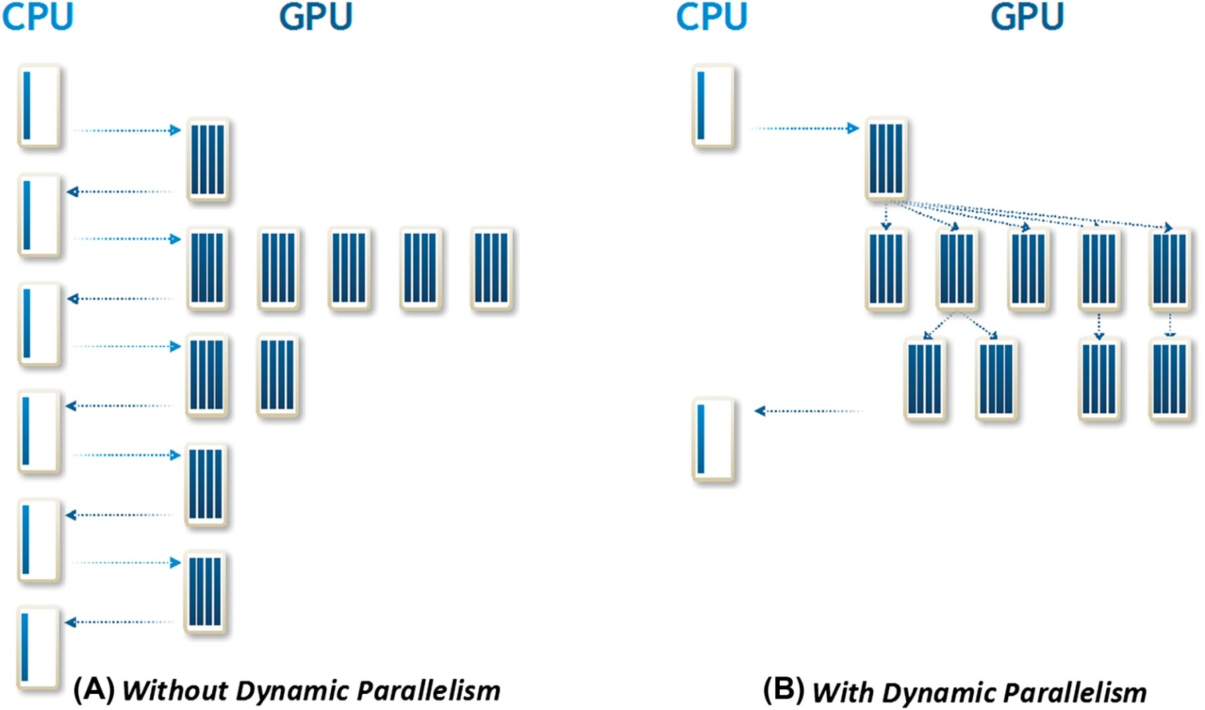
FIGURE 13.2: Kernel launch patterns for algorithms with dynamic work variation, with and without dynamic parallelism.

Slide 4
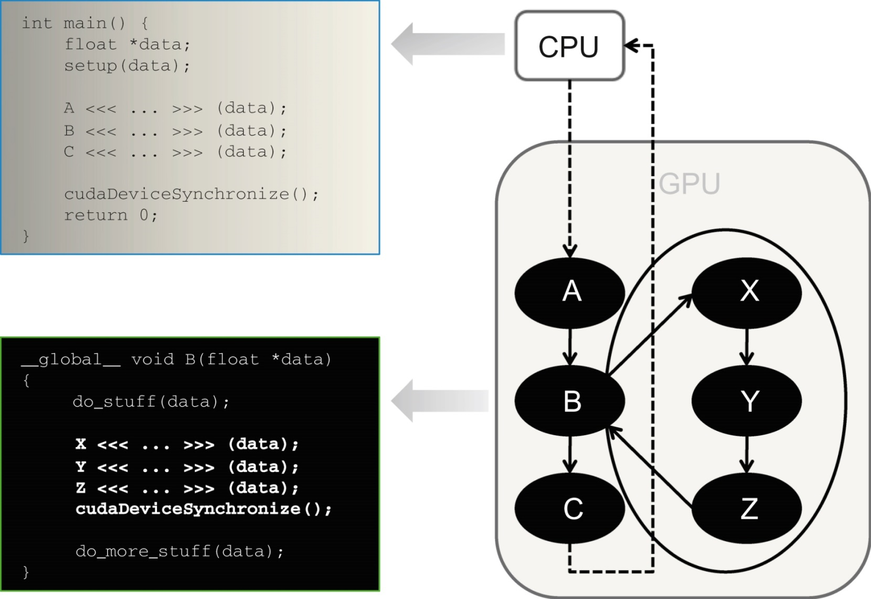
FIGURE 13.3: A simple example of a kernel (B) launching three kernels (X, Y, and Z).

Slide 5
FIGURE 13.4: A simple example of a hypothetical parallel algorithm coded in CUDA without dynamic parallelism.

Slide 6
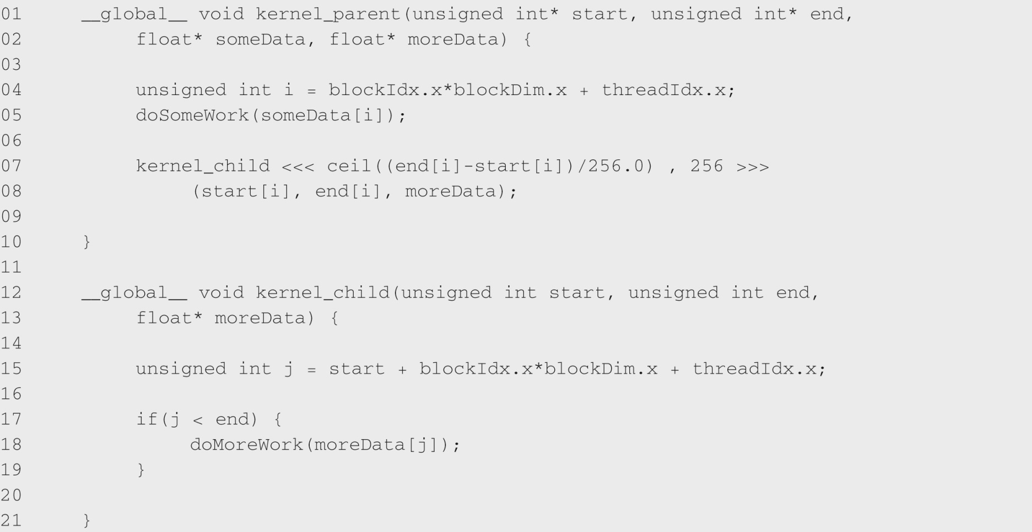
FIGURE 13.5: A revised example using CUDA dynamic parallelism.

Slide 7
FIGURE 13.6: Passing a pointer as an argument to a child kernel.

Slide 8
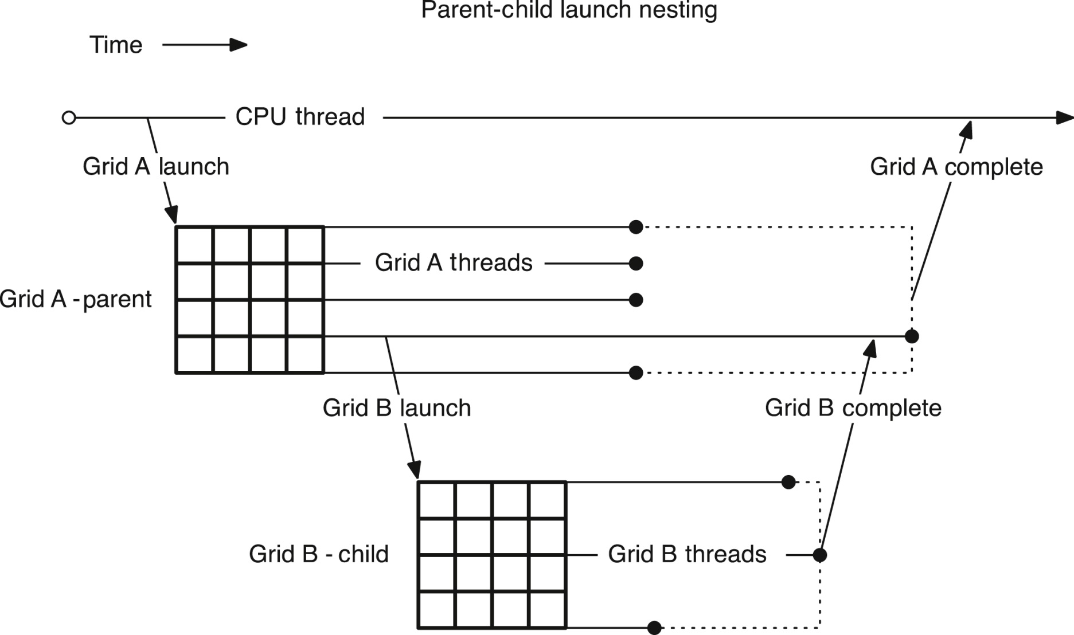
FIGURE 13.7: Completion sequence for parent and child grids.

Slide 9
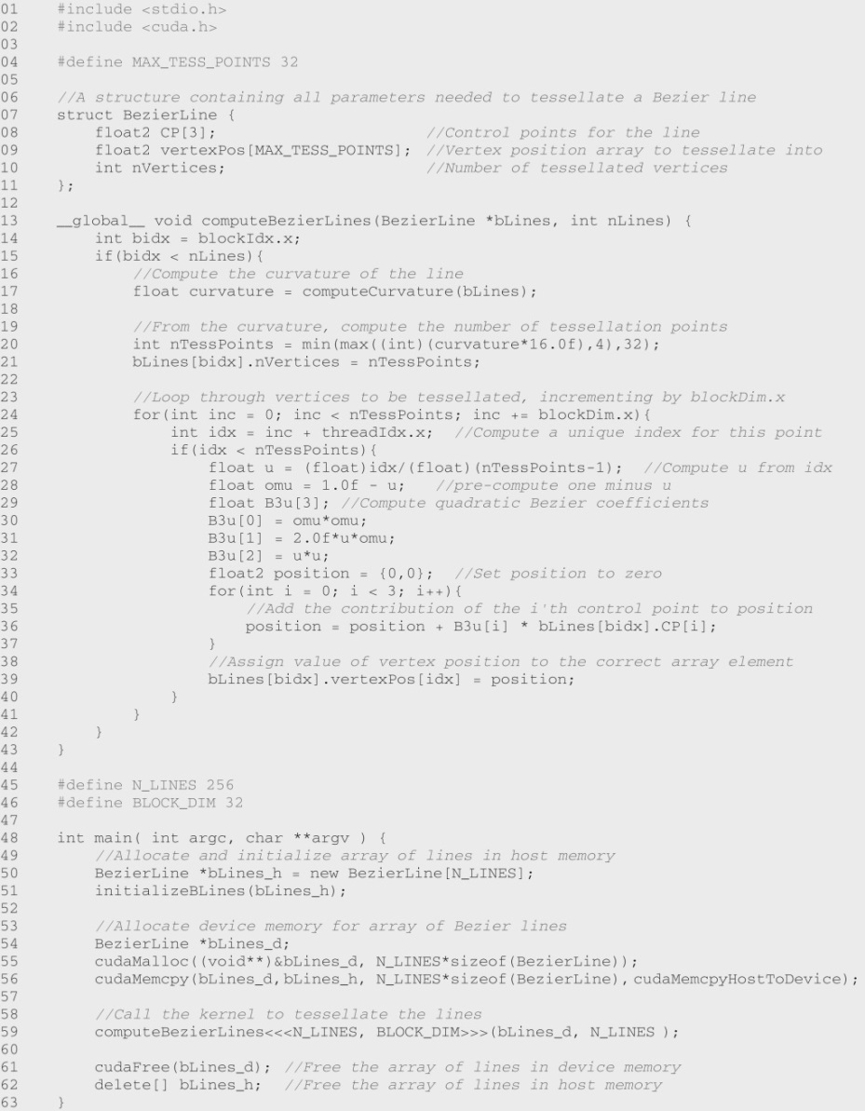
FIGURE 13.8: Bezier curve calculation without dynamic parallelism (support code in Fig. A13.8).

Slide 10
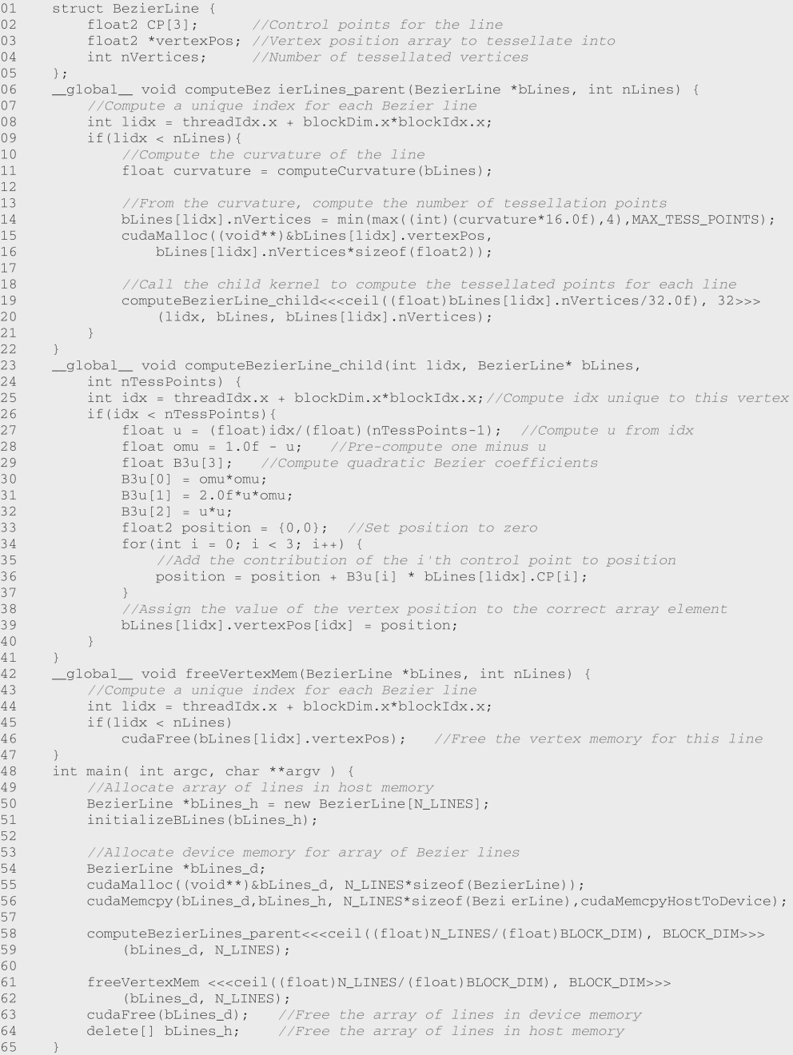
FIGURE 13.9: Bezier calculation with dynamic parallelism (support code in Fig. A13.8).

Slide 11
FIGURE 13.10: Child kernel launch with named streams.

Slide 12
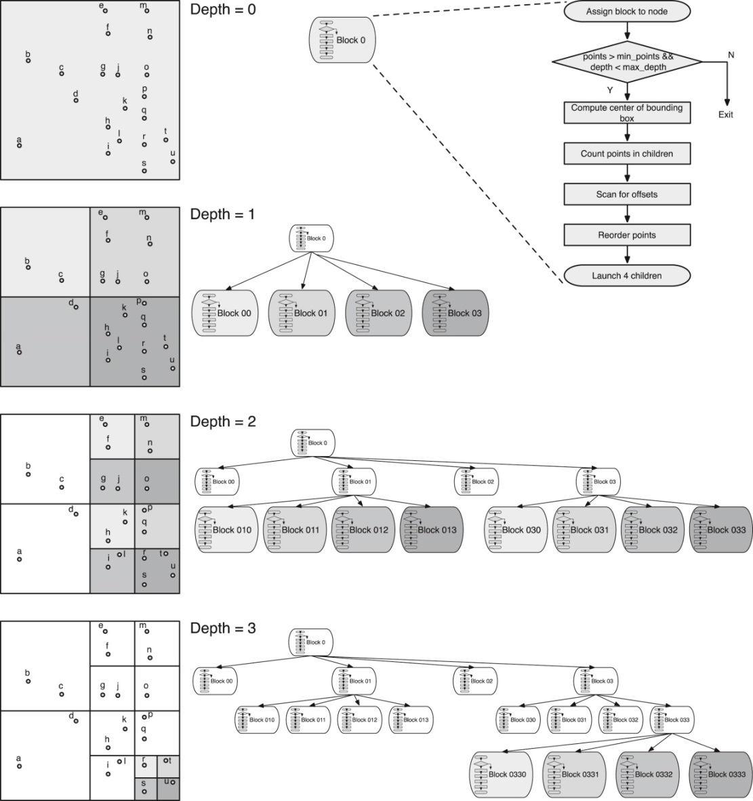
FIGURE 13.11: Quadtree example. Each thread-block is assigned to one quadrant. If the number of points in a quadrant is more than 2, the block launches 4 child blocks. Shadowed blocks are active blocks in each level of depth.

Slide 13
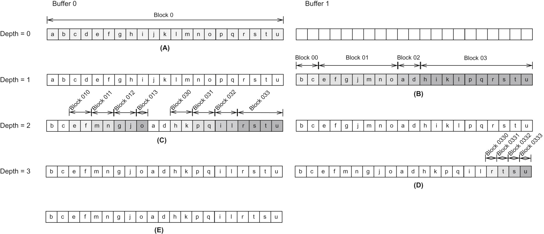
FIGURE 13.12: Quadtree example. At each level of depth, a block groups all points in the same quadrant together.

Slide 14
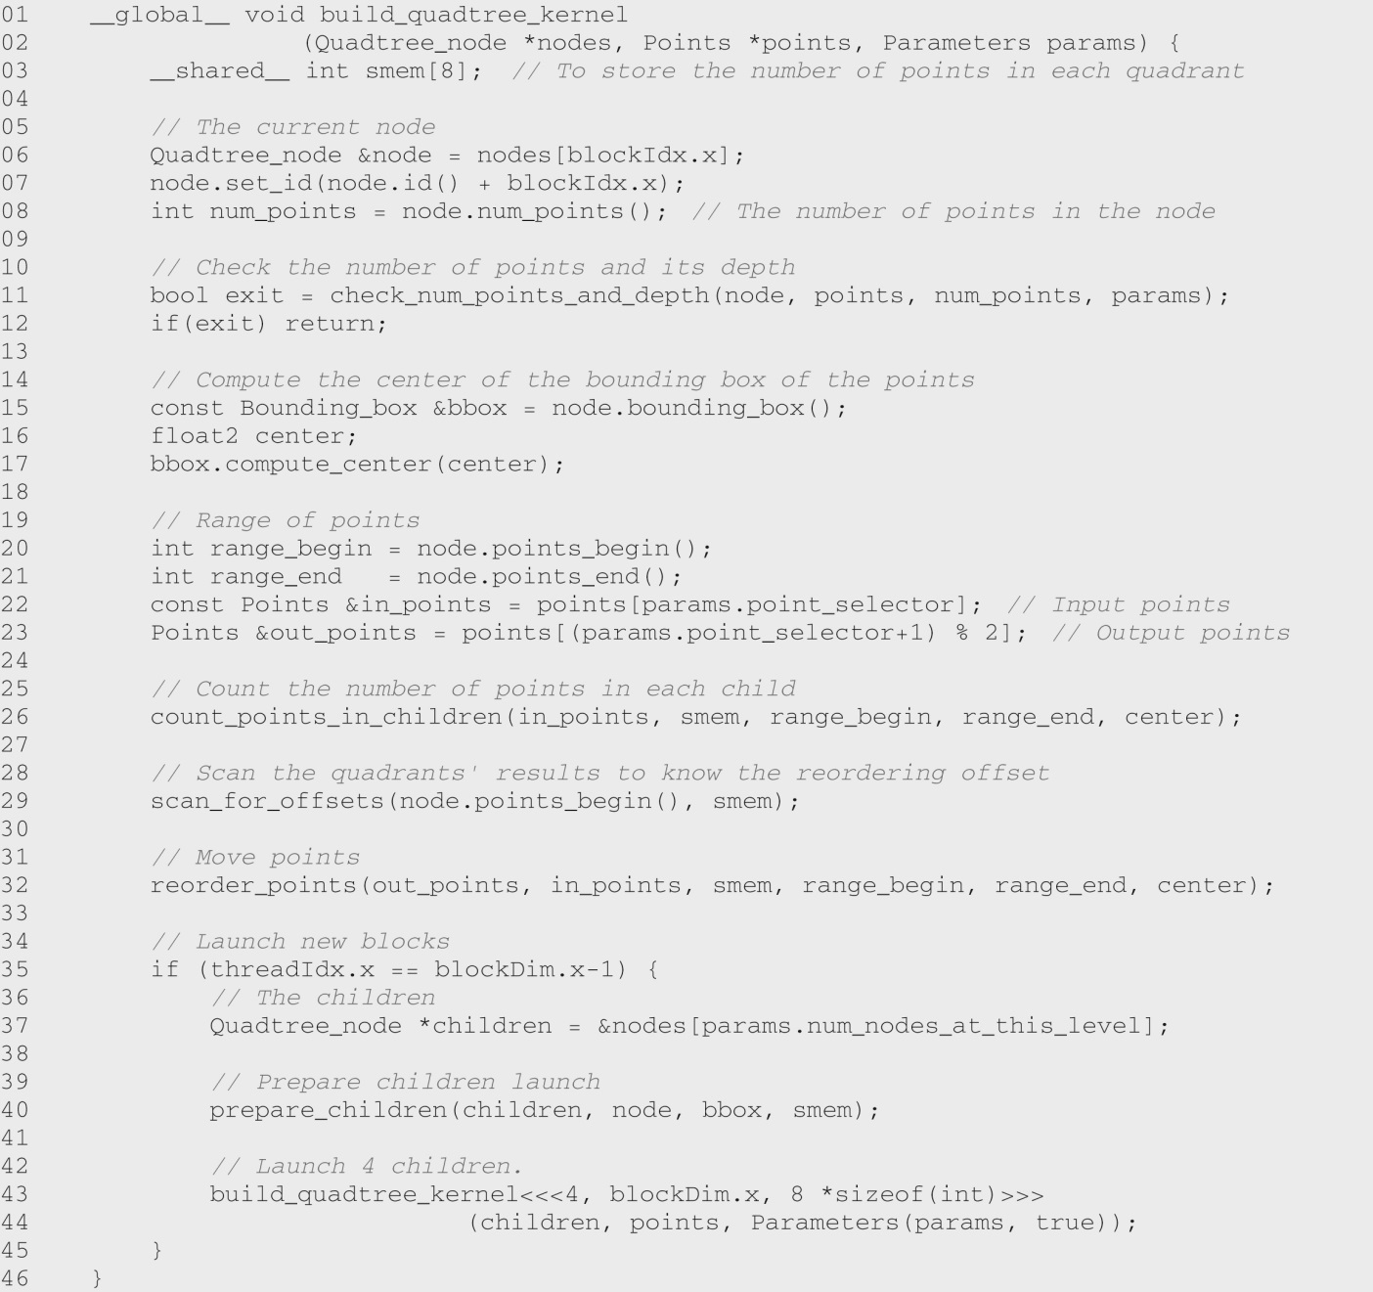
FIGURE 13.13: Quadtree with dynamic parallelism: recursive kernel (support code in Fig. A13.13).

Slide 15
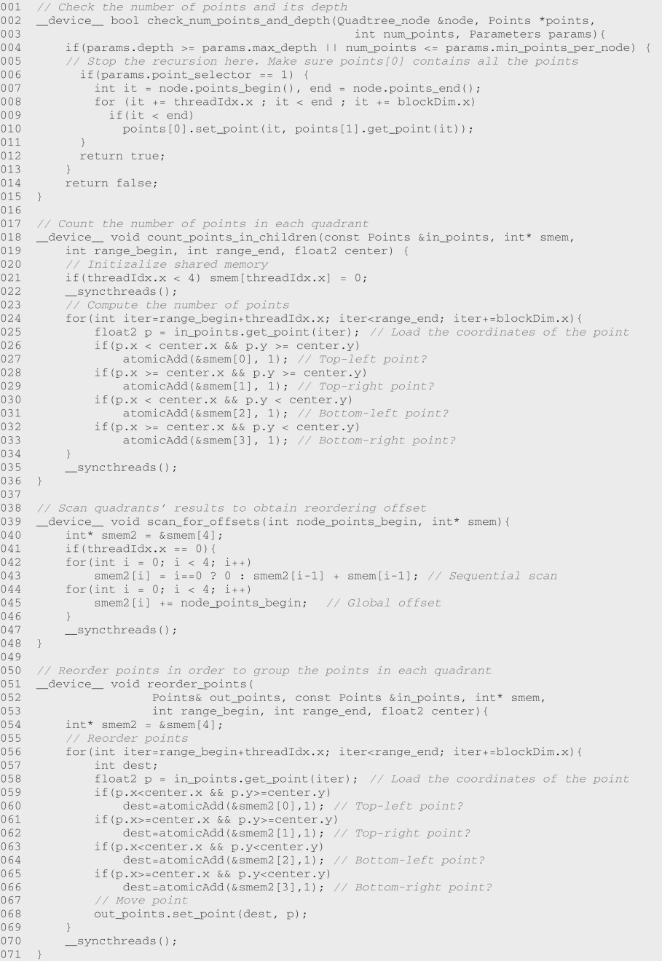
FIGURE 13.14: Quadtree with dynamic parallelism: device functions (support code in Fig. A13.14).

Slide 16
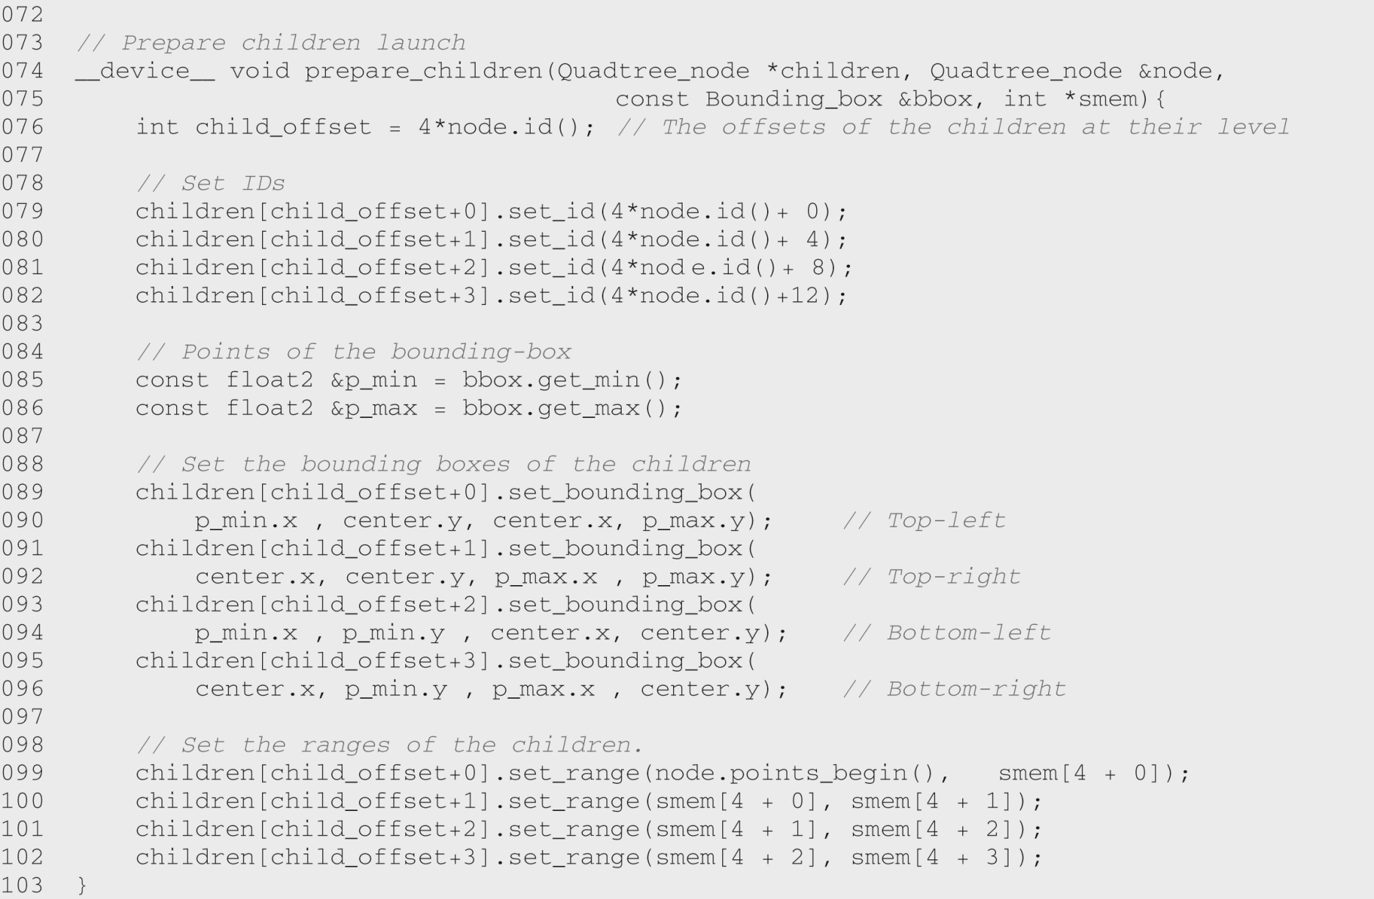
FIGURE 13.14: (Continued)

Slide 17
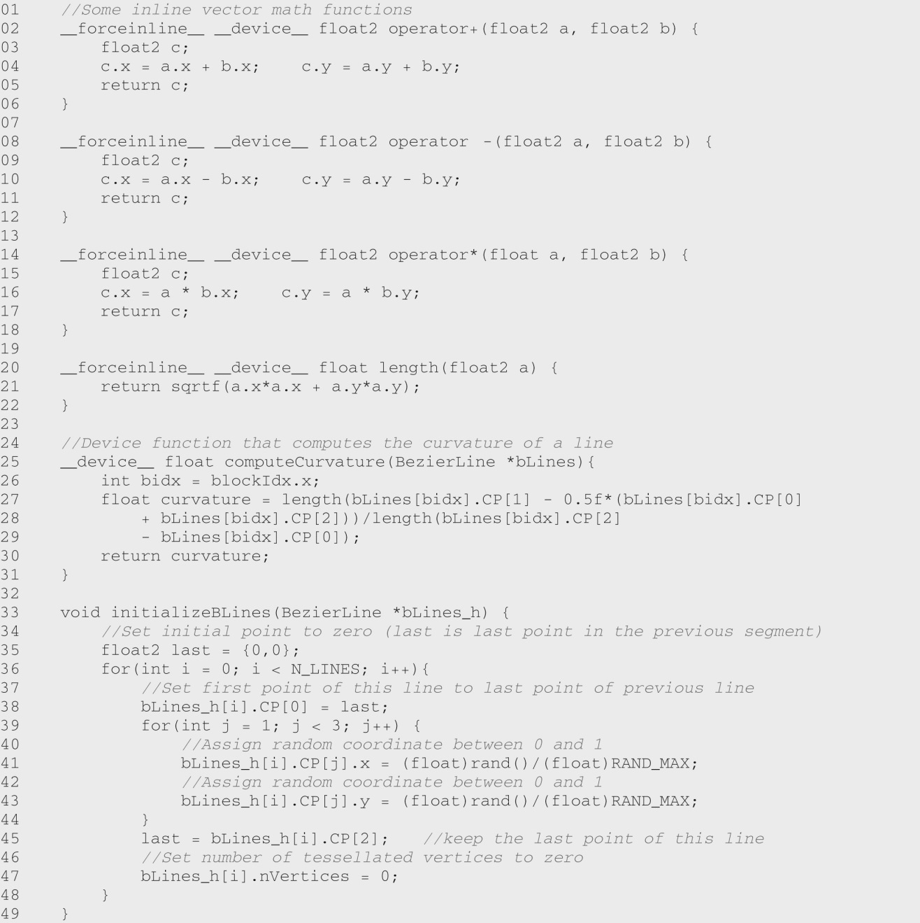
FIGURE A13.8 : Support code for Bezier Curve calculation without dynamic parallelism.

Slide 18
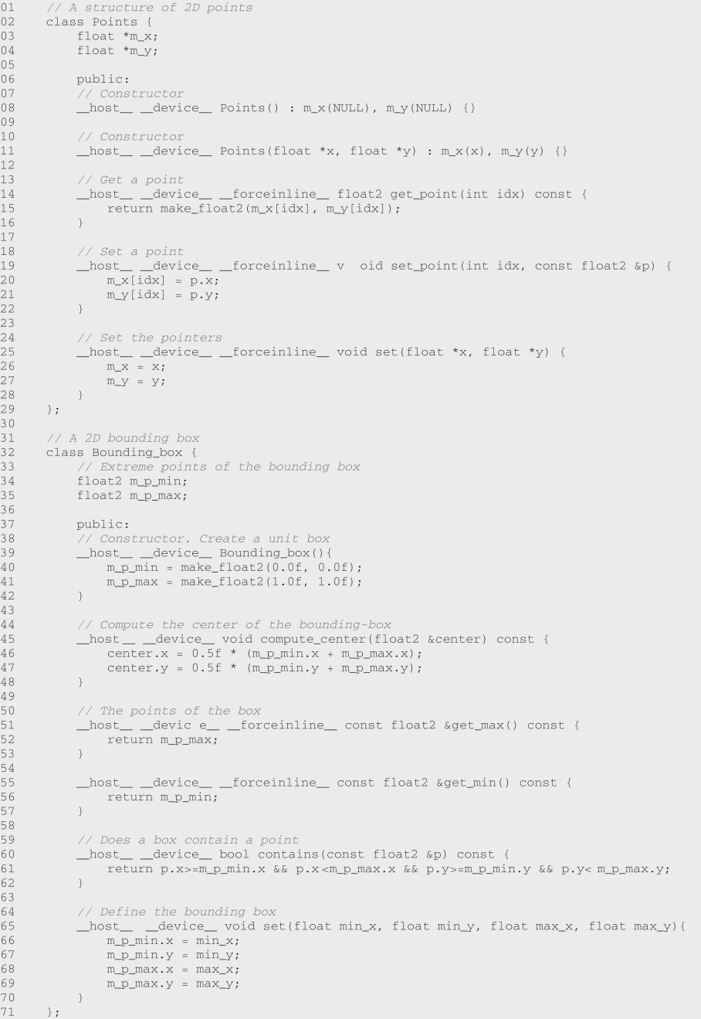
FIGURE A13.13 : Support code for quadtree with dynamic parallelism: definition of points and bounding box.

Slide 19
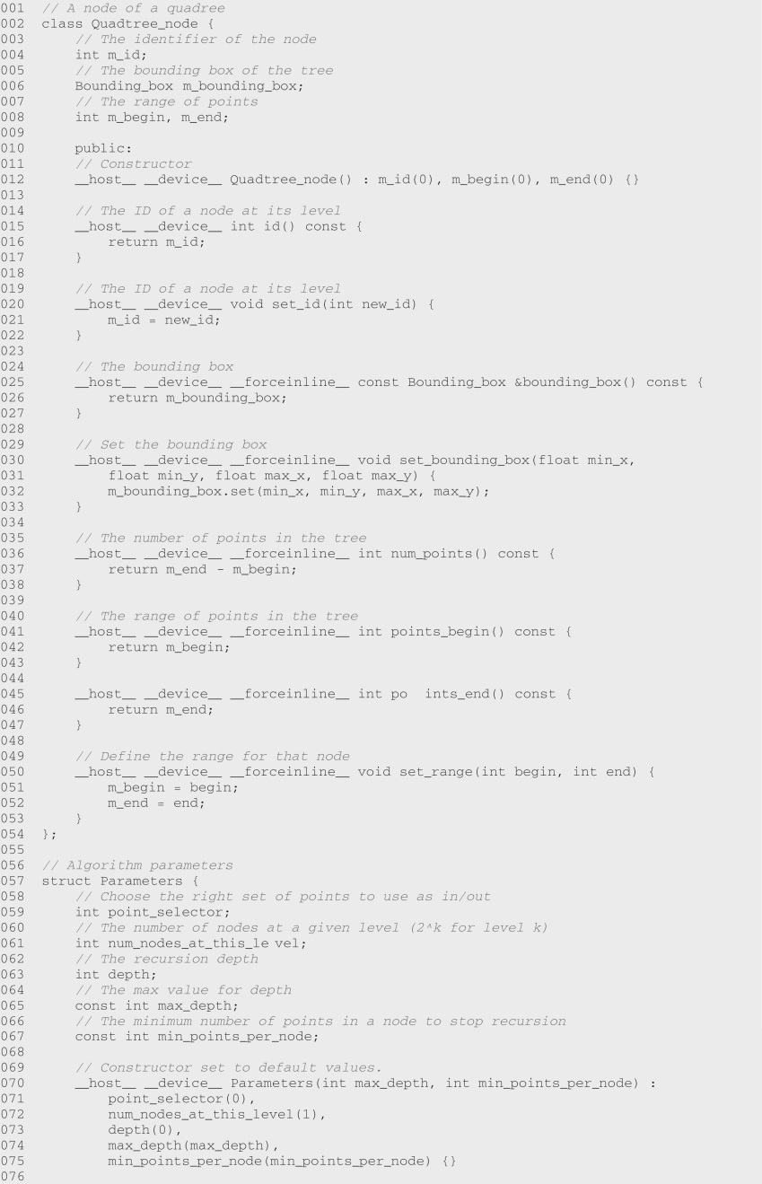
FIGURE A13.14: Support code for quadtree with dynamic parallelism: definitions and main function.

Slide 20
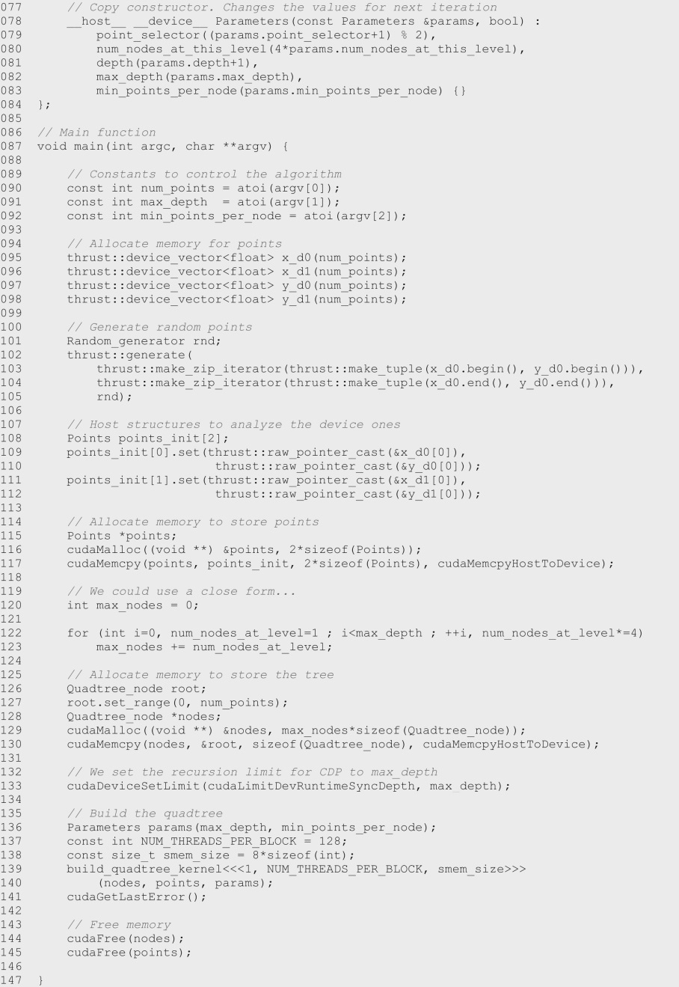
FIGURE A13.14: (Continued)

Slide 21
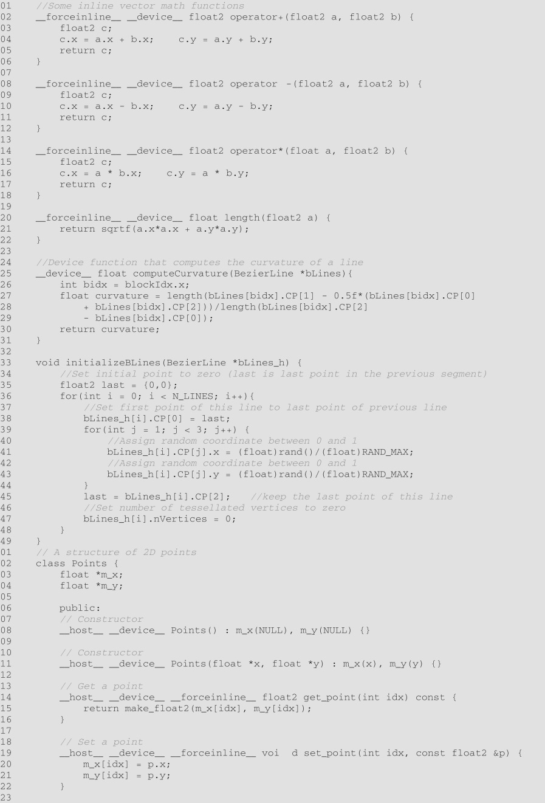

Slide 22
