Slide 1
Chapter-16 Application case study— machine learning

Slide 2
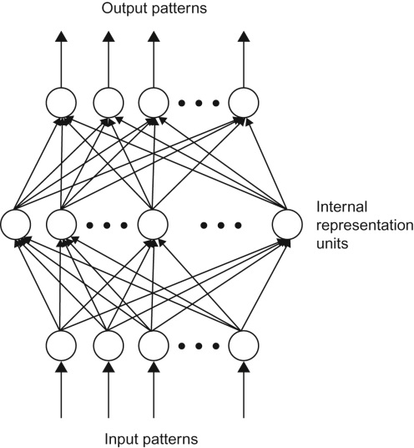
FIGURE 16.1: A multilayer feedforward network.

Slide 3
FIGURE 16.2: LeNet-5, a convolutional neural network for handwritten digit recognition.

Slide 4
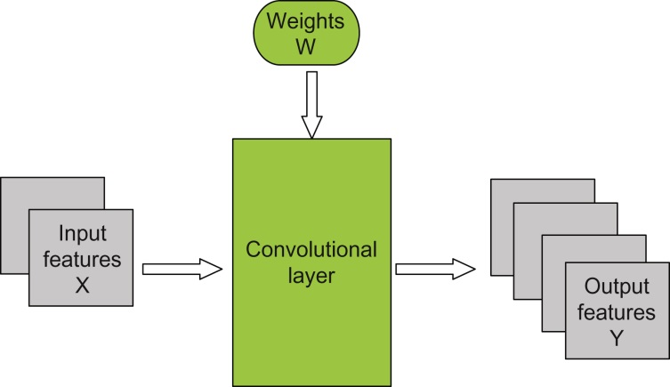
FIGURE 16.3: Overview of the forward propagation path of a convolution layer.

Slide 5
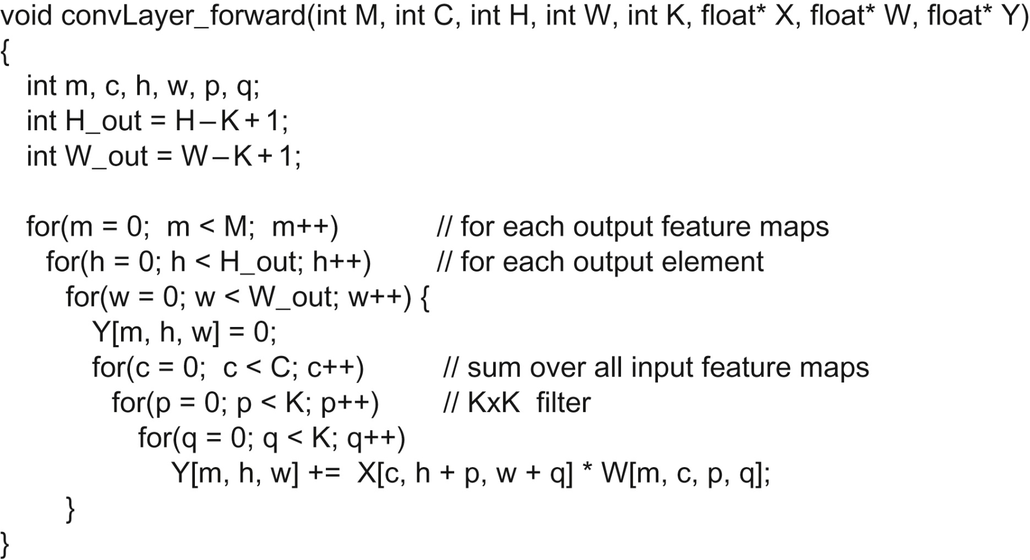
FIGURE 16.4: A sequential implementation of the forward propagation path of a convolution layer.

Slide 6
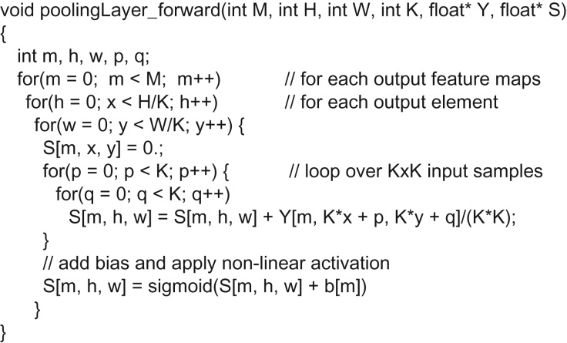
FIGURE 16.5: A sequential C implementation of the forward propagation path of a subsampling layer.

Slide 7
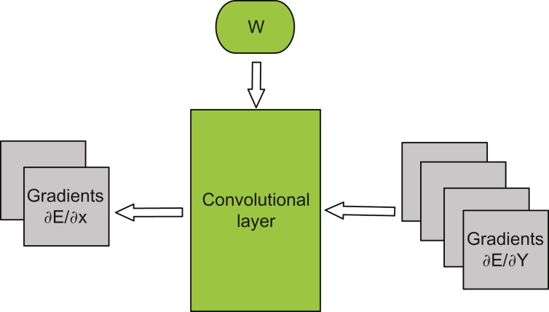
FIGURE 16.6: Convolutional layer: Backpropagation of ∂E/∂X.

Slide 8
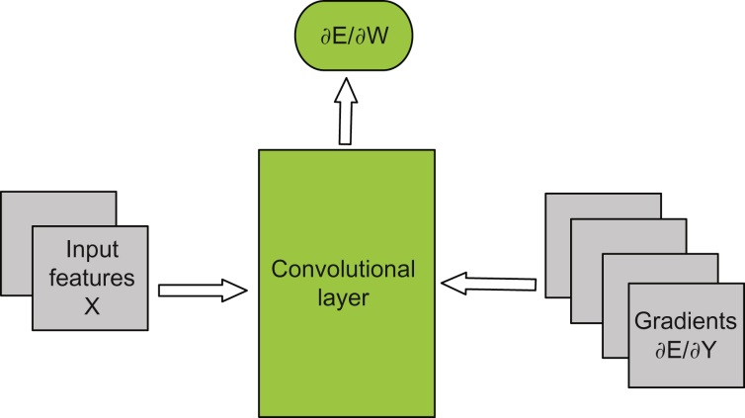
FIGURE 16.7: Convolutional layer: Backpropagation of ∂E/∂w.

Slide 9
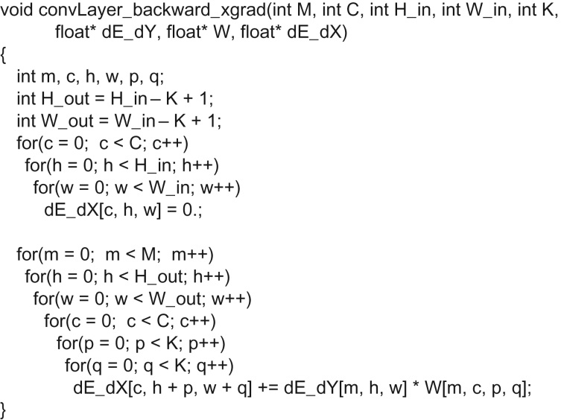
FIGURE 16.8: dE/dX calculation of the backward path of a convolution layer.

Slide 10
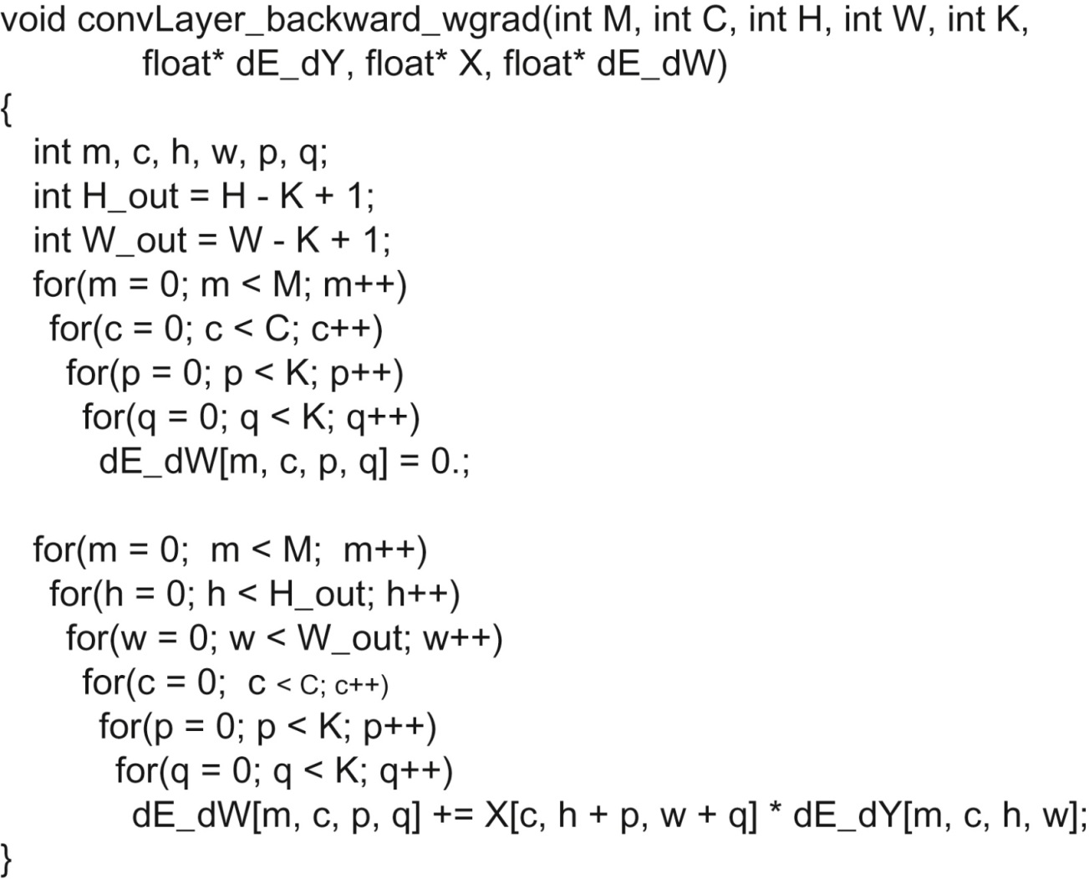
FIGURE 16.9: dE/dW calculation of the backward path of a convolutional layer.

Slide 11
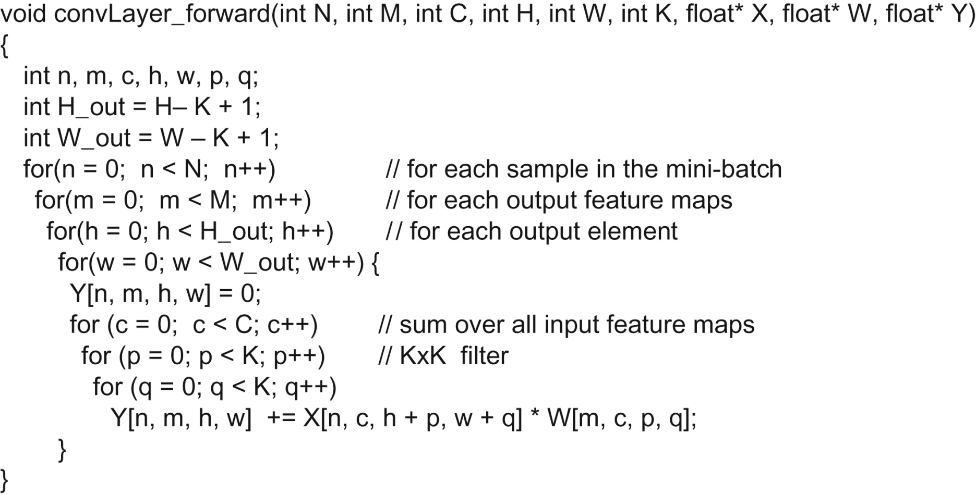
FIGURE 16.10: Forward path of a convolutional layer with mini-batch training.

Slide 12
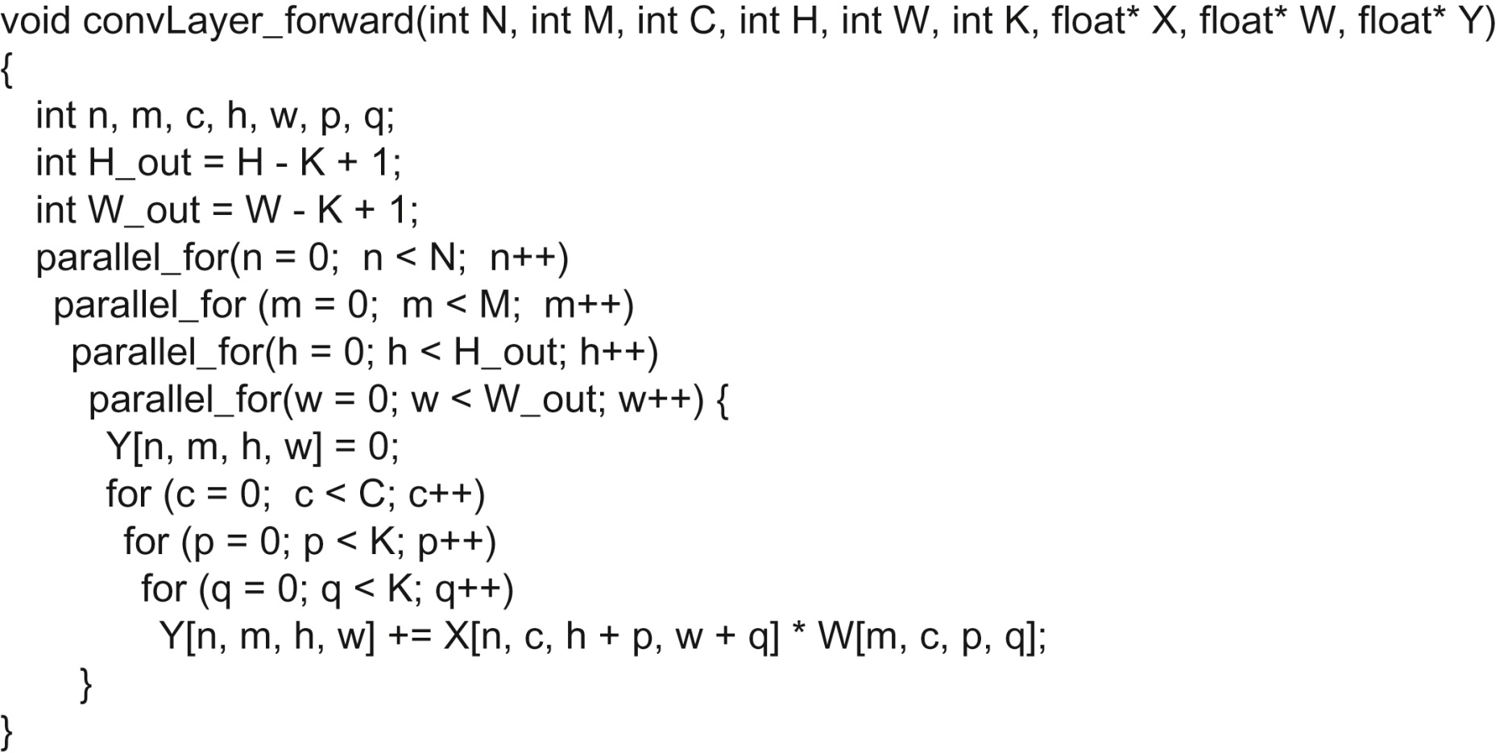
FIGURE 16.11: Parallelization of the forward path of a convolutional layer with mini-batch training.

Slide 13
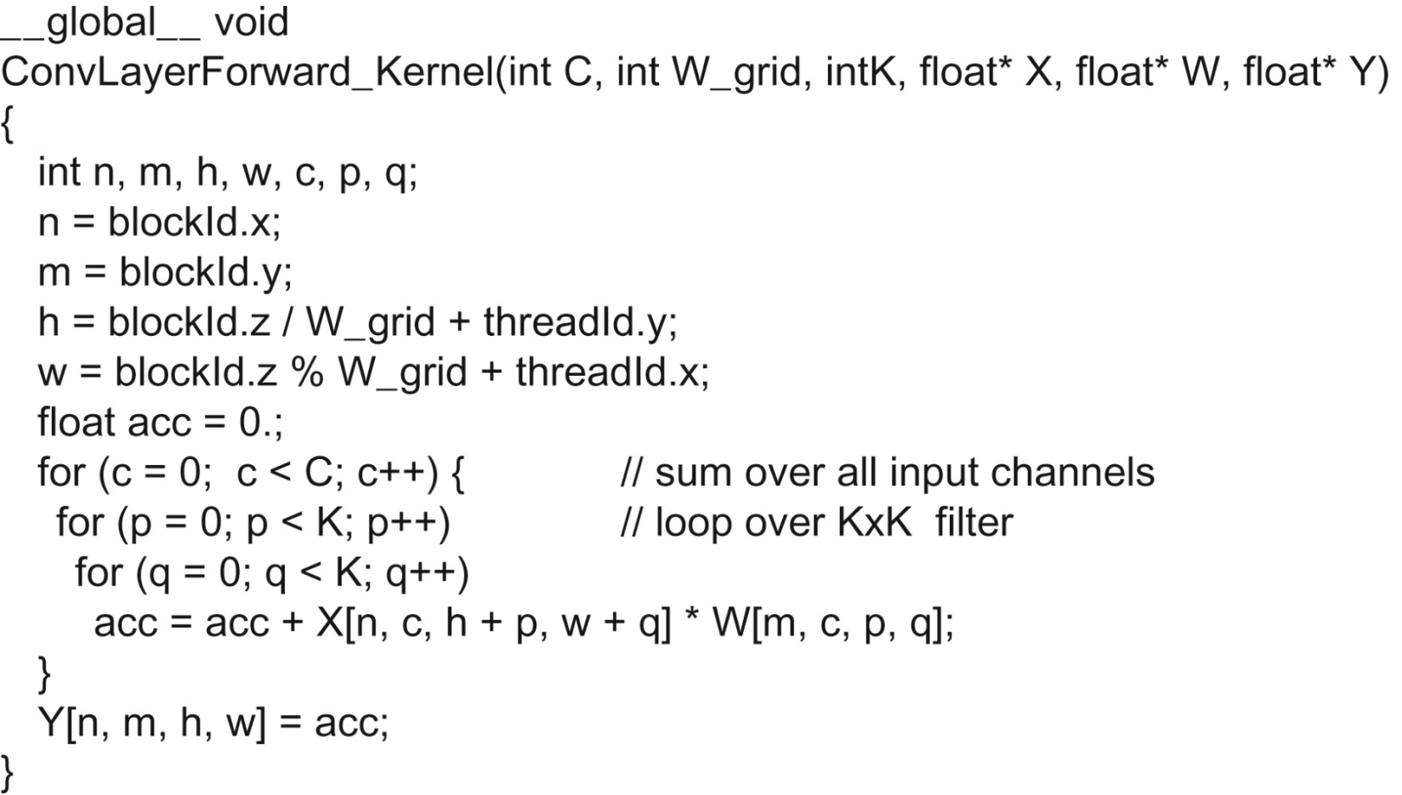
FIGURE 16.12: Kernel for the forward path of a convolution layer.

Slide 14
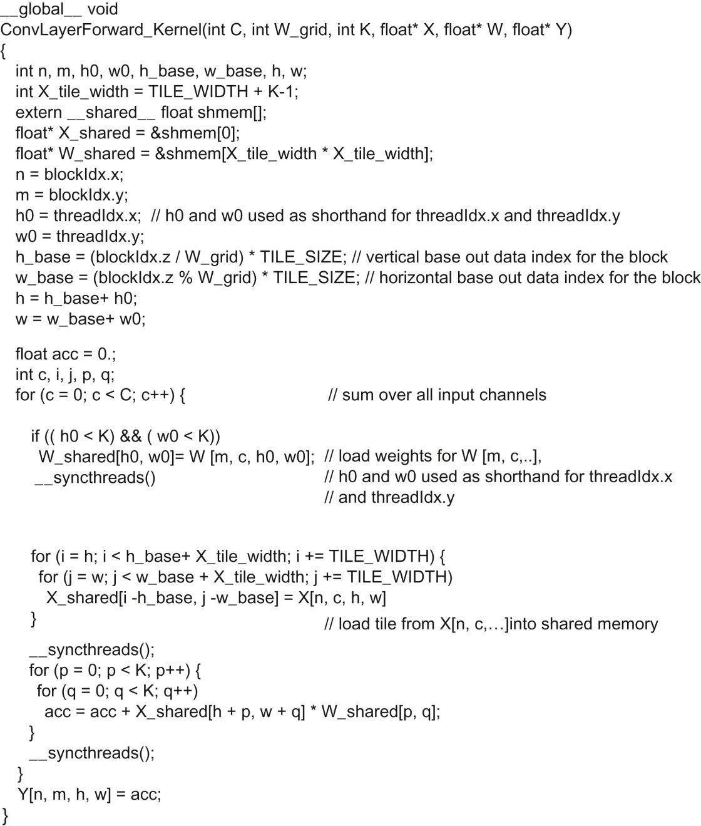
FIGURE 16.13: A kernel that uses shared memory tiling to reduce the global memory traffic of the forward path of the convolutional layer.

Slide 15
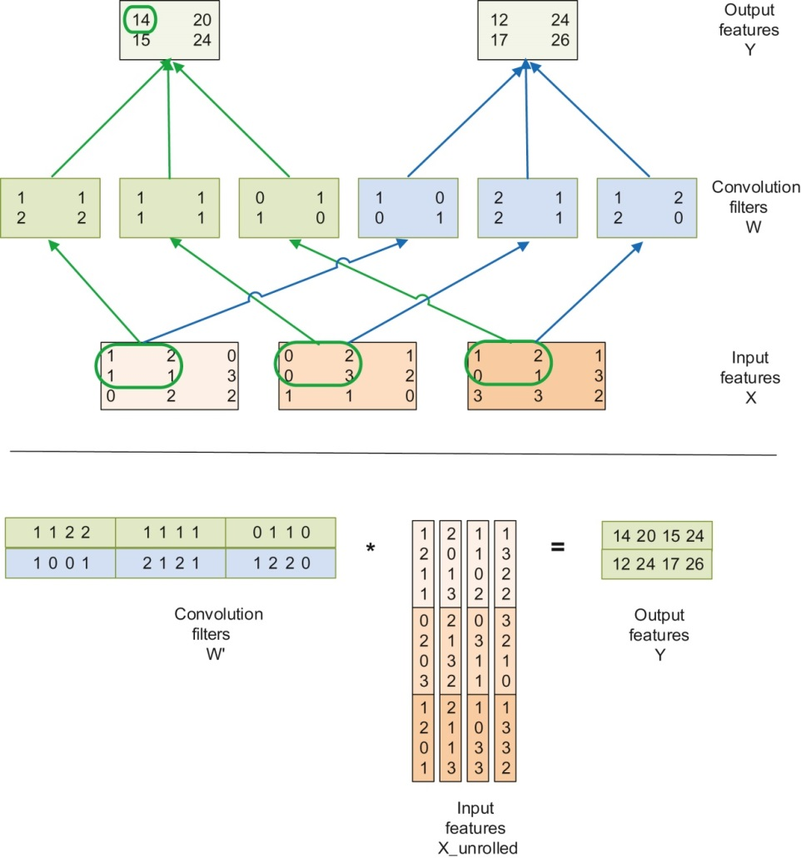
FIGURE 16.14: Reduction of a convolutional layer to GEMM.

Slide 16
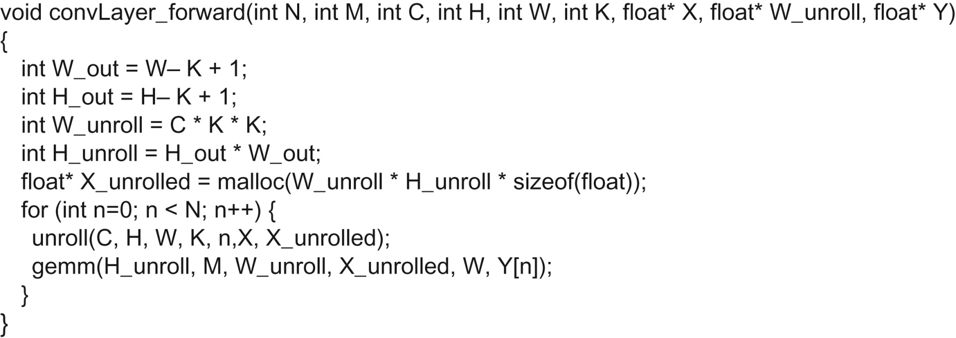
FIGURE 16.15: Implementing the forward path of a convolutional layer with matrix multiplication.

Slide 17
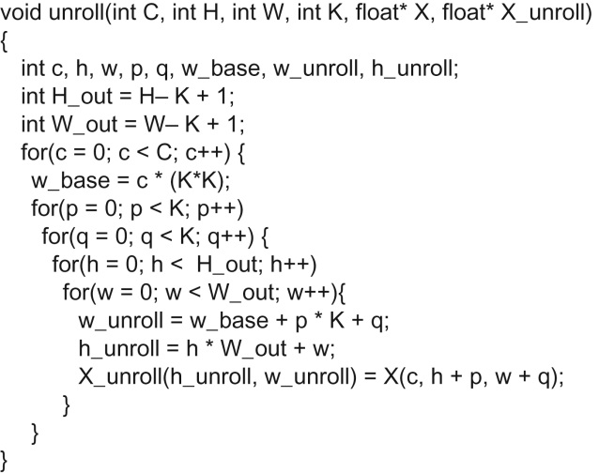
FIGURE 16.16: The function that generates the unrolled X matrix.

Slide 18
FIGURE 16.17: Host code for invoking the unroll kernel.

Slide 19
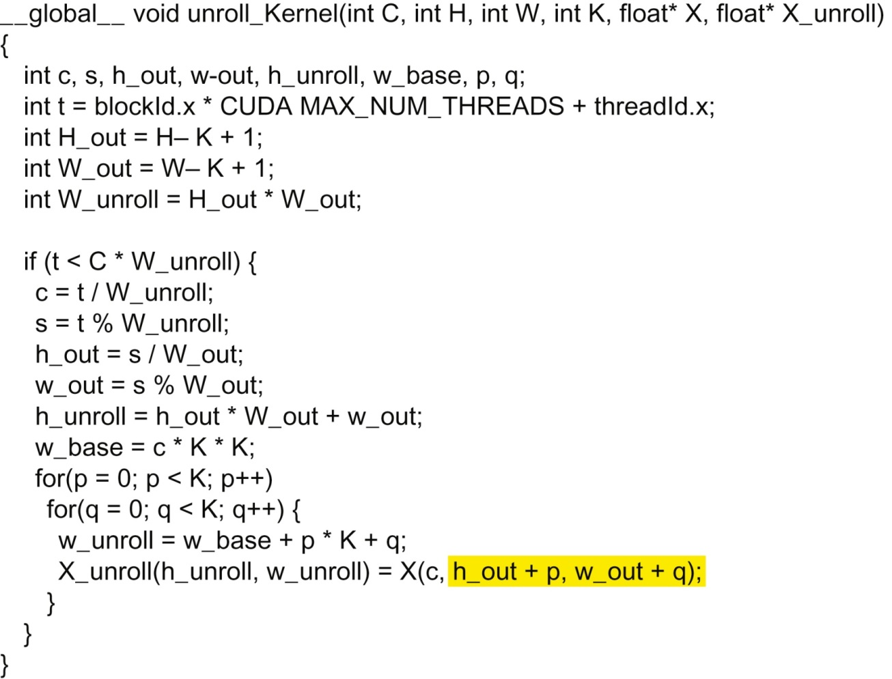
FIGURE 16.18: High-performance implementation of the unroll kernel.

