Slide 1
Chapter-18 Programming a heterogeneous computing cluster

Slide 2
FIGURE 18.1:Programer’s view of MPI processes.

Slide 3
FIGURE 18.2: A 25-stencil computation example, with neighbors in the x, y, z directions.

Slide 4
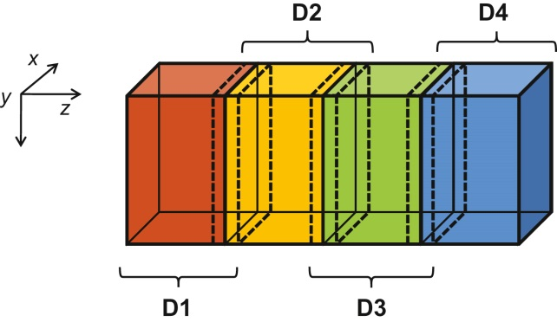
FIGURE 18.3: 3D grid array for the modeling heat transfer in a duct.

Slide 5
FIGURE 18.4: A small example of memory layout for the 3D grid.

Slide 6
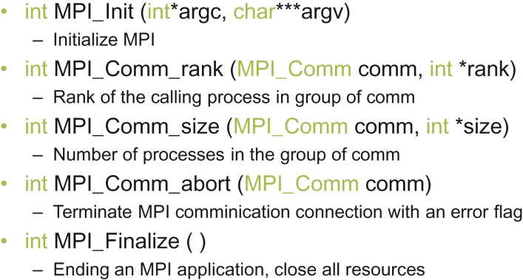
FIGURE 18.5: Five basic MPI functions for establishing and closing a communication system.

Slide 7
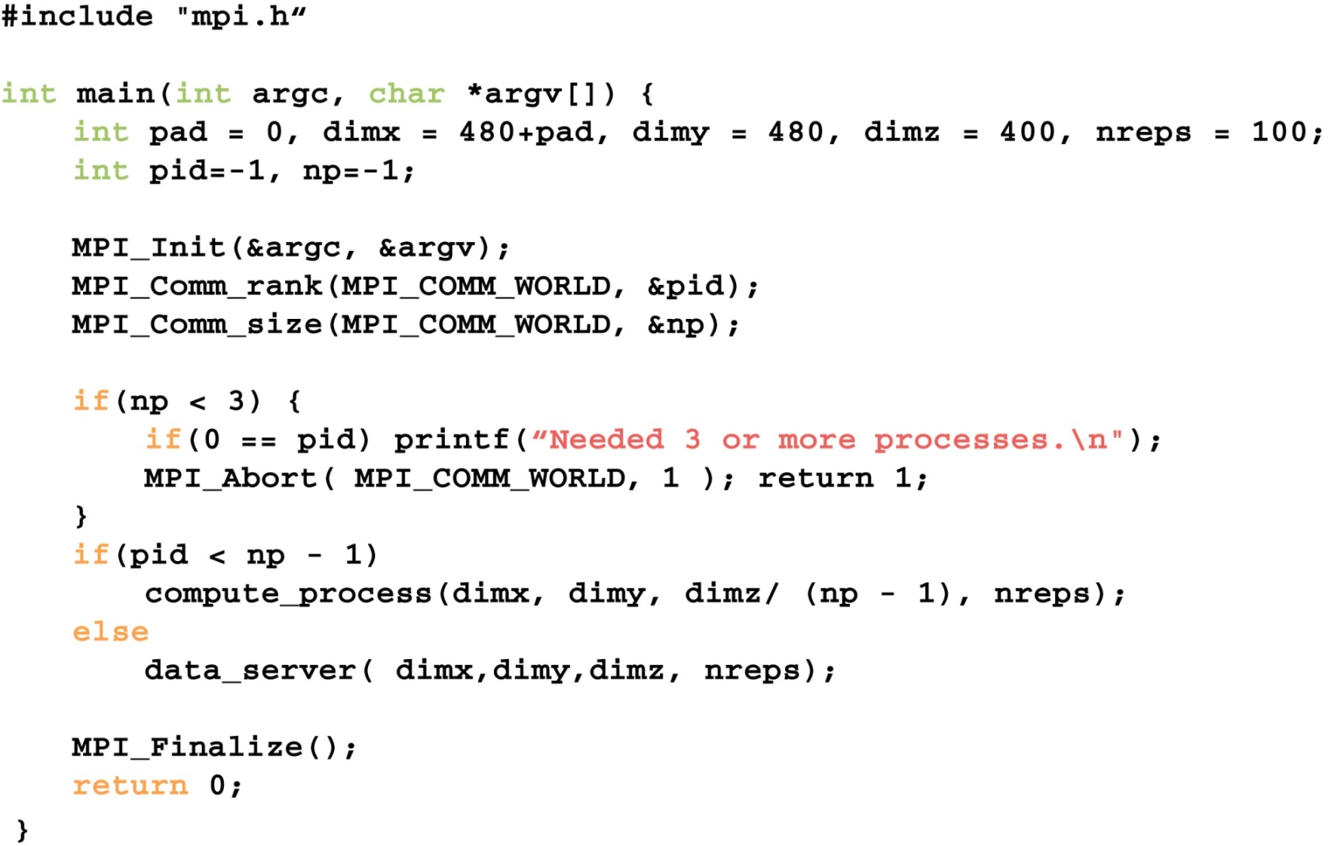
FIGURE 18.6: A simple MPI main program.

Slide 8
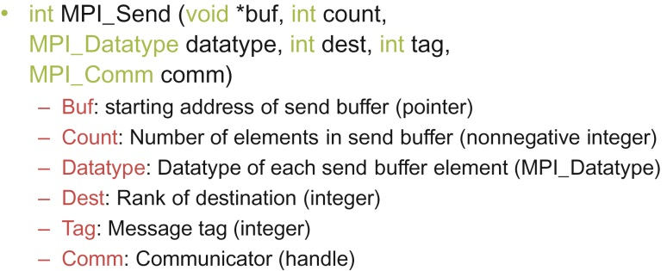
FIGURE 18.7: Syntax for the MPI_Send() function.

Slide 9
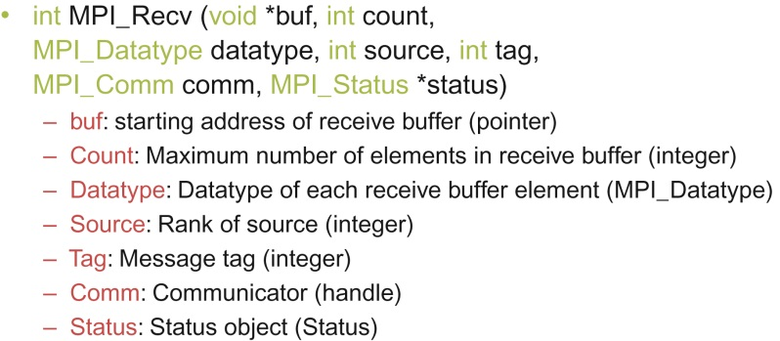
FIGURE 18.8: Syntax for the MPI_Recv() function.

Slide 10
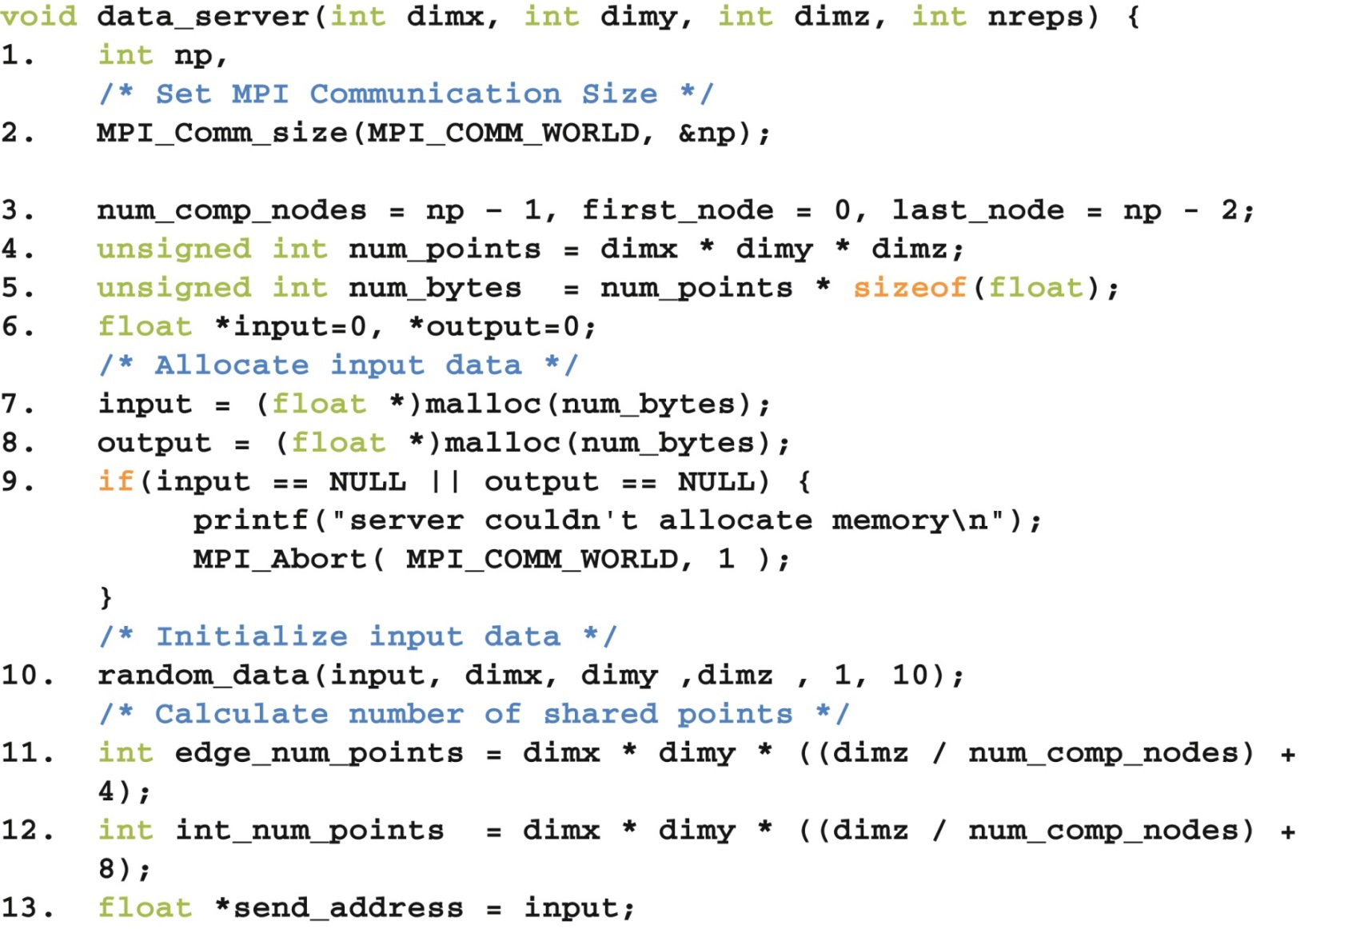
FIGURE 18.9: Data server process code (Part 1).

Slide 11
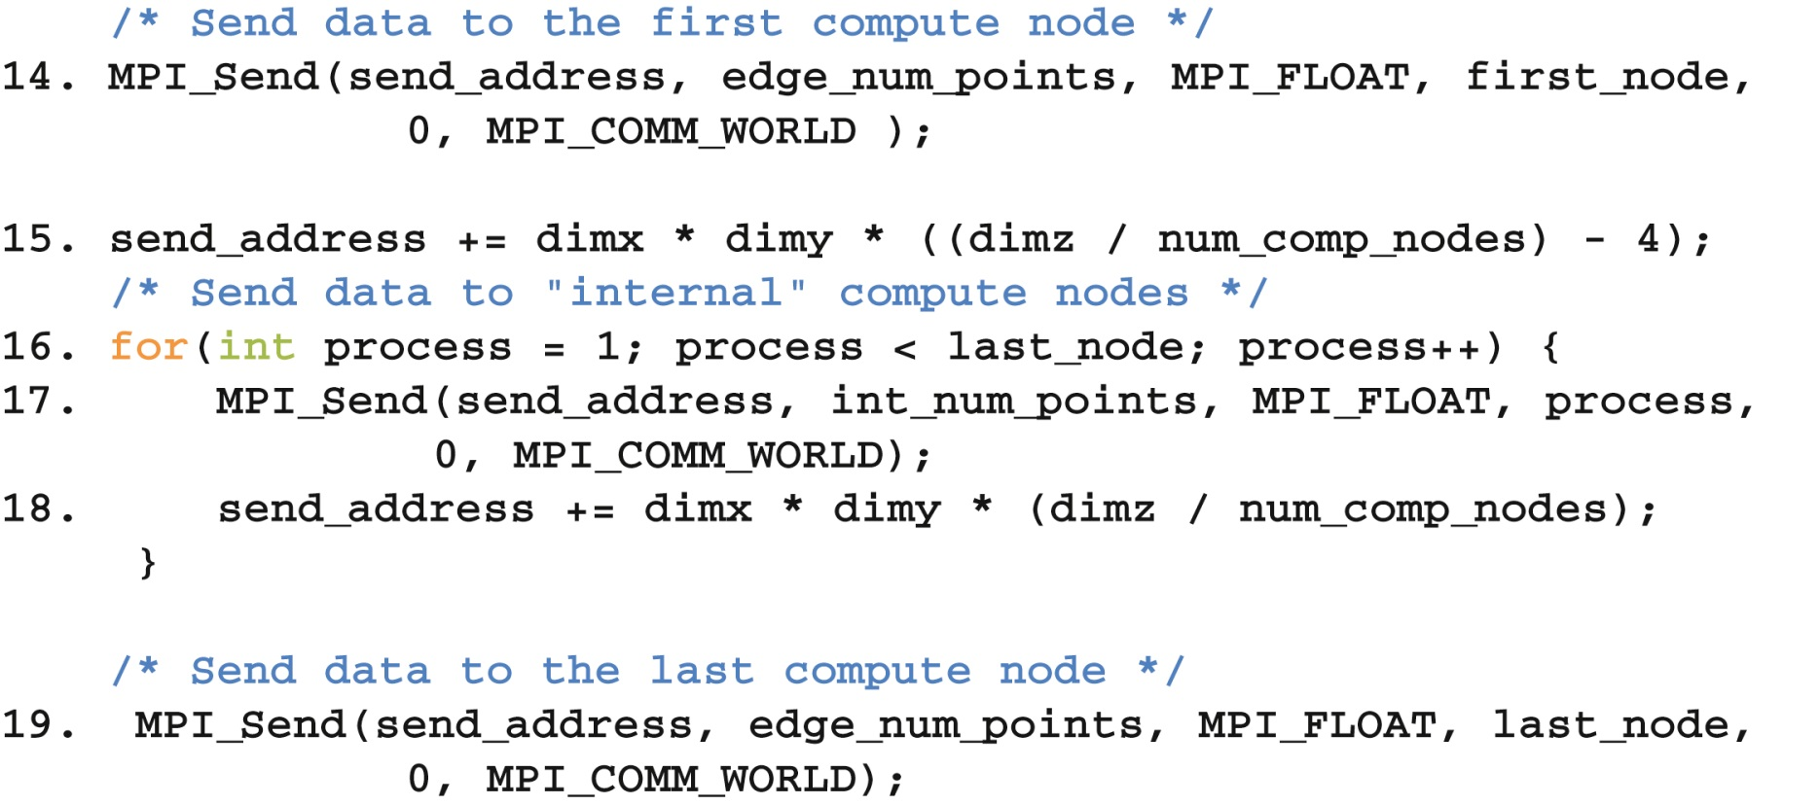
FIGURE 18.10: Data server process code (Part 2).

Slide 12
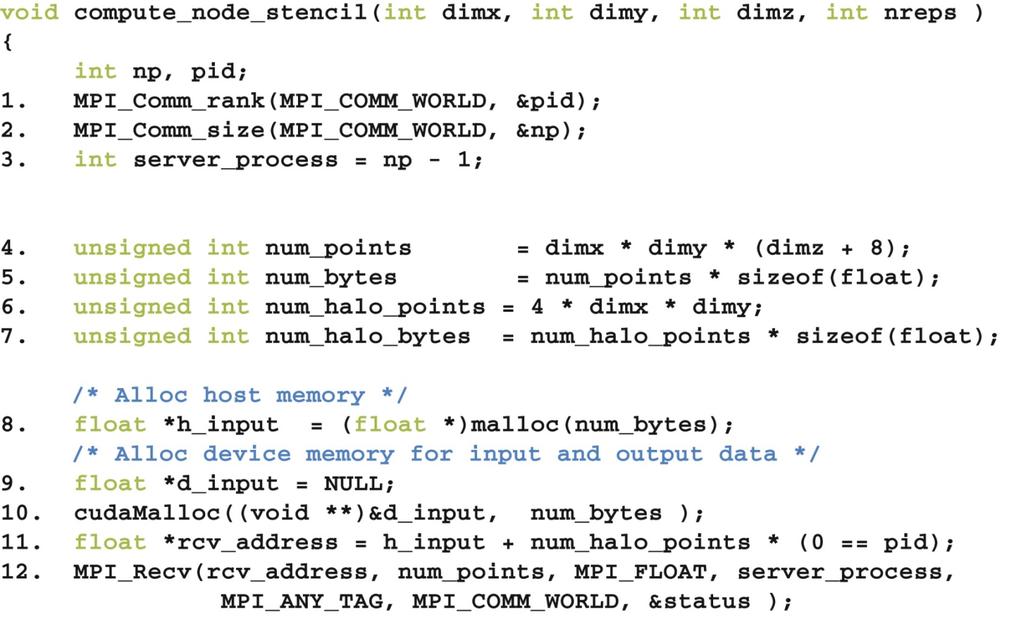
FIGURE 18.11: Compute process code (Part 1).

Slide 13
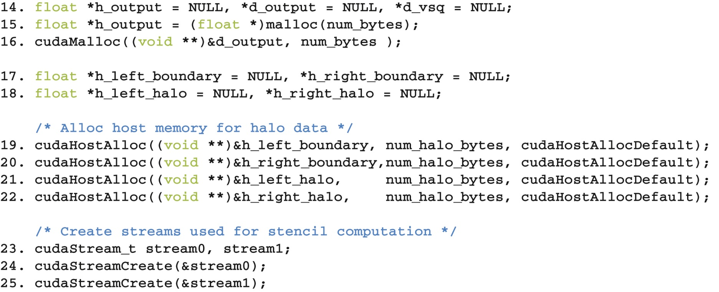
FIGURE 18.12: Compute process code (Part 2).

Slide 14
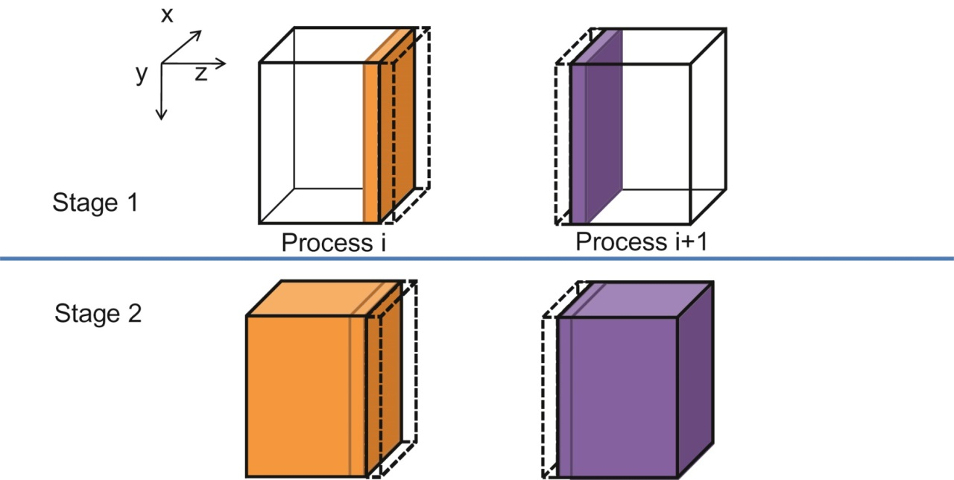
FIGURE 18.13: A two-stage strategy for overlapping computation with communication.

Slide 15
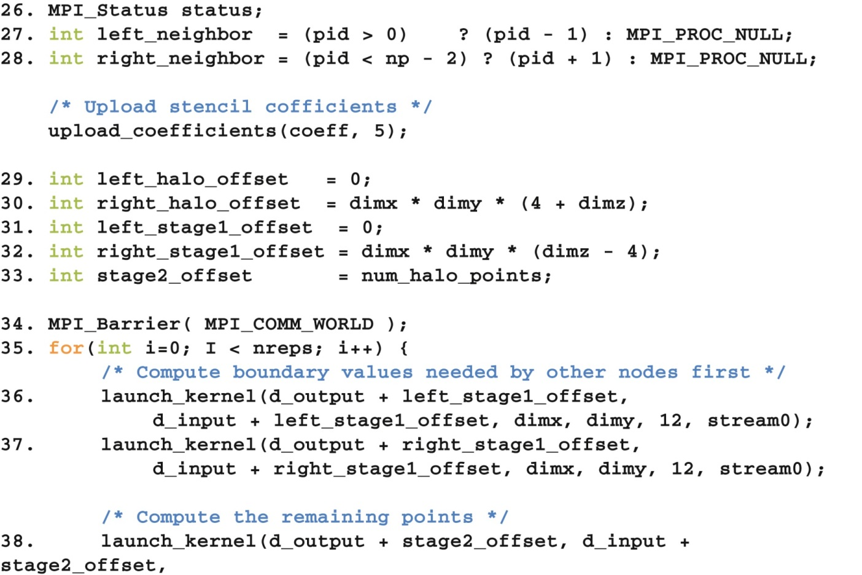
FIGURE 18.14: Compute process code (Part 3).

Slide 16
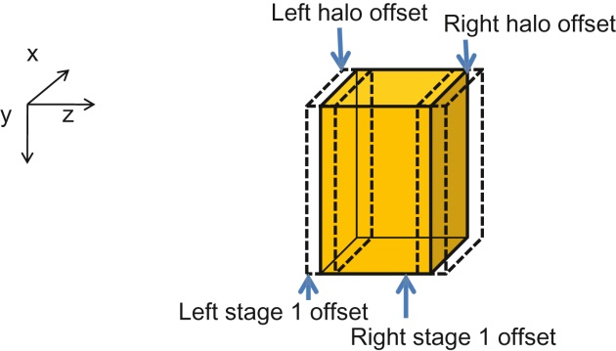
FIGURE 18.15: Device memory offsets used for data exchange with neighbor processes.

Slide 17
FIGURE 18.16: Compute process code (Part 4).

Slide 18
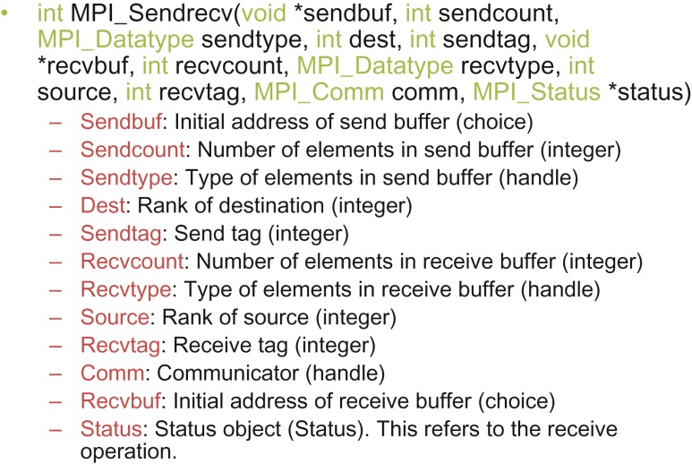
FIGURE 18.17: Syntax for the MPI_Sendrecv() function.

Slide 19
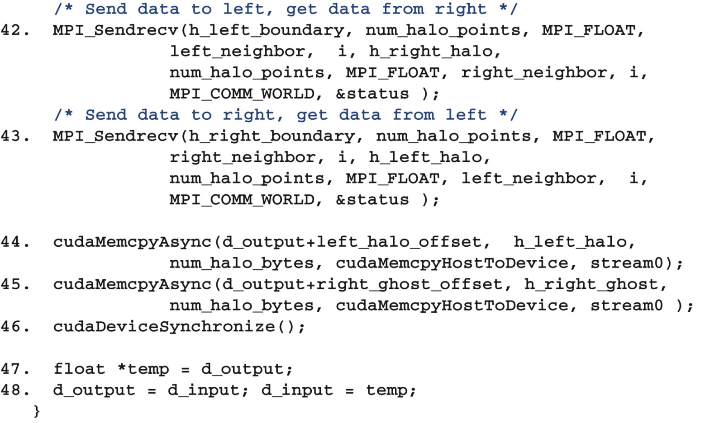
FIGURE 18.18: Compute process code (Part 5).

Slide 20
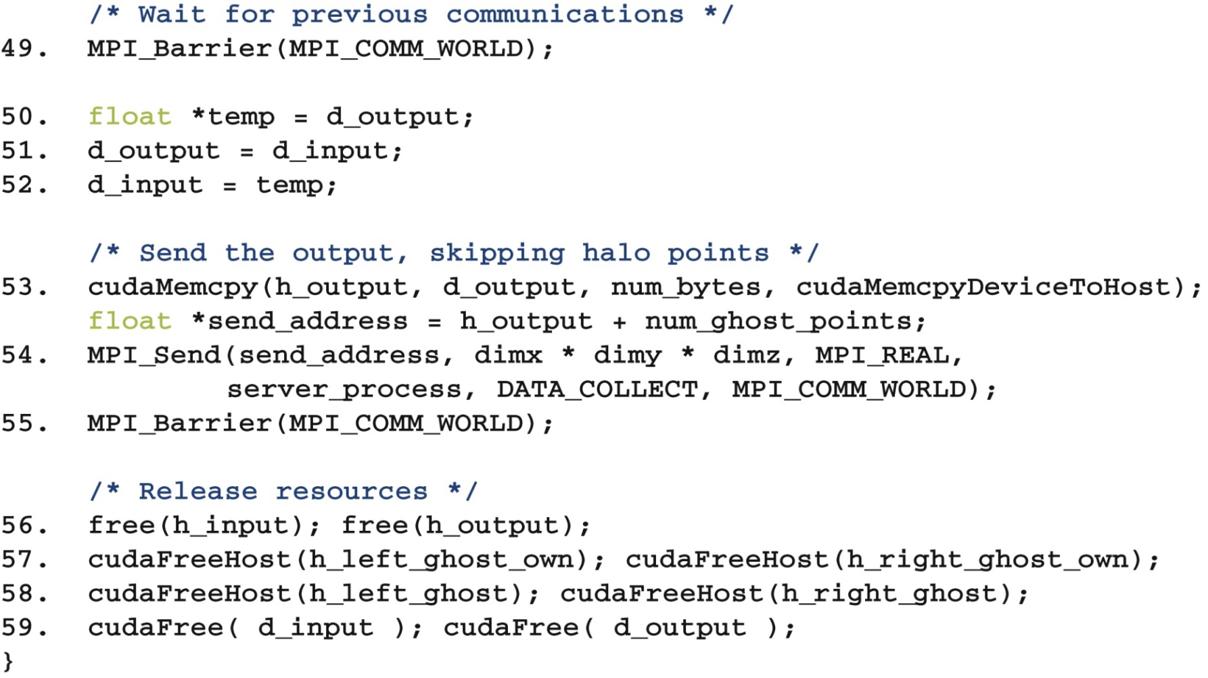
FIGURE 18.19: Compute process code (Part 6).

Slide 21
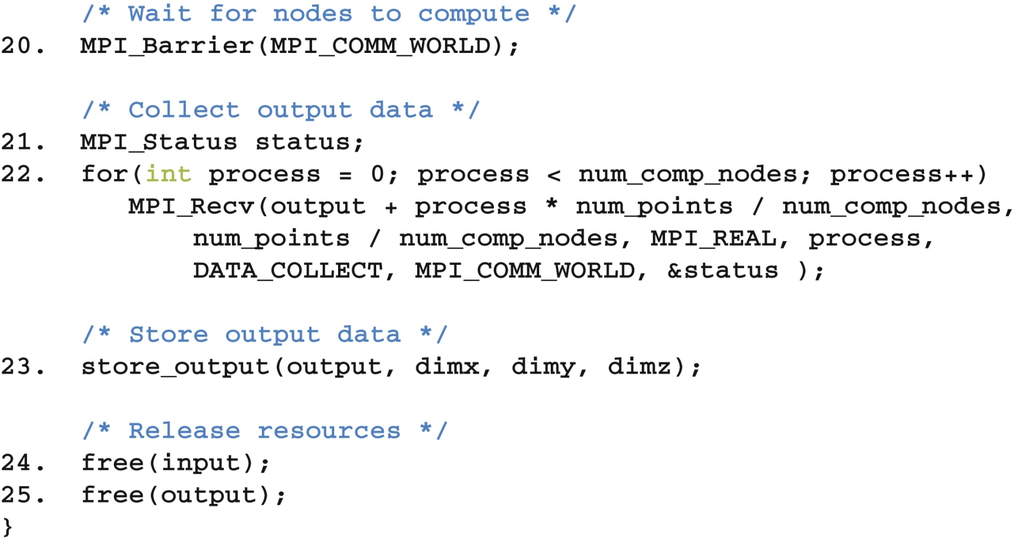
FIGURE 18.20: Data server code (Part 3).

Slide 22
FIGURE 18.21: Revised MPI SendRec calls when using CUDA-aware MPI.

