Slide 1
Chapter-19 Parallel programming with OpenACC

Slide 2
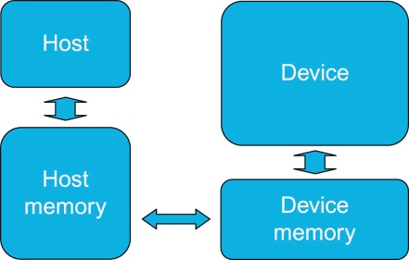
FIGURE 19.1: OpenACC abstract machine model.

Slide 3
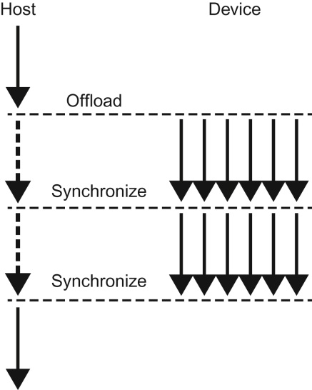
FIGURE 19.2: The OpenACC offloading execution model.

Slide 4
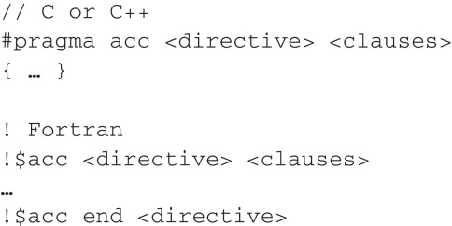
FIGURE 19.3: Basic format for OpenACC directives.

Slide 5
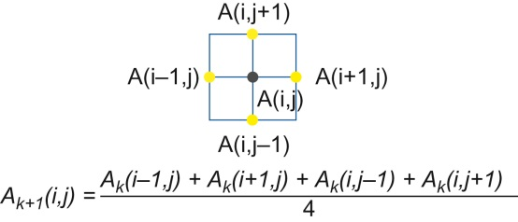
FIGURE 19.4: A Laplace equation example.

Slide 6
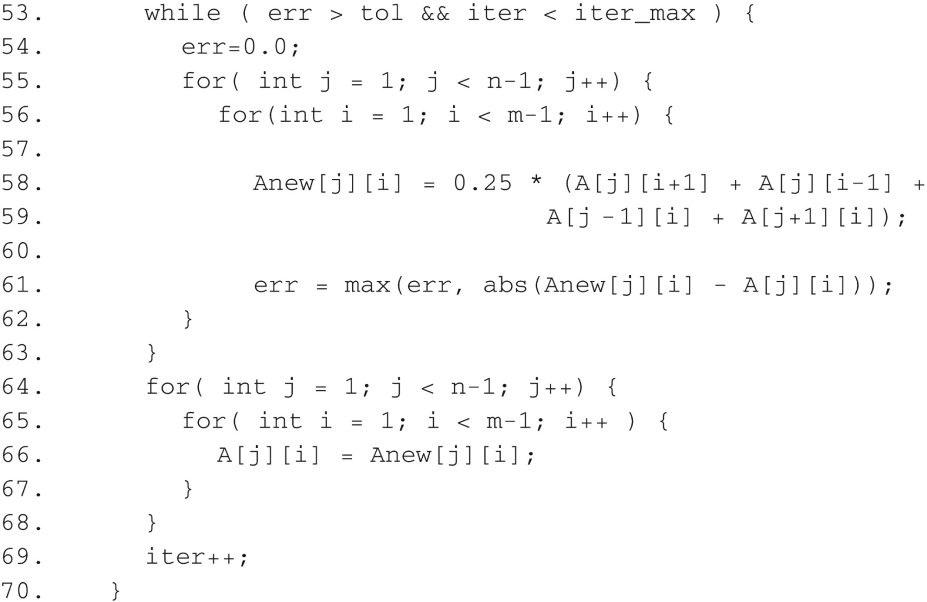
FIGURE 19.5: Jacobi Iterative Method example code.

Slide 7
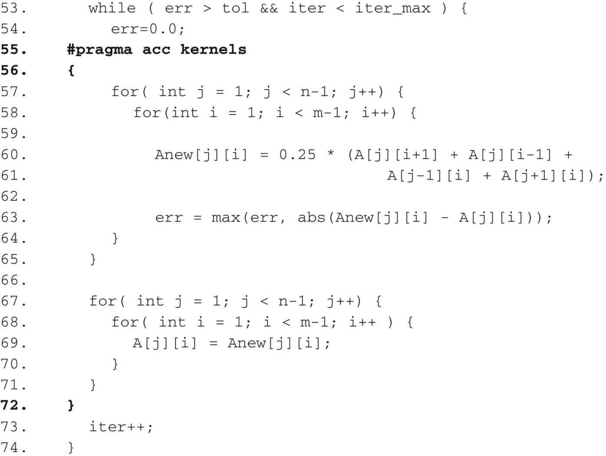
FIGURE 19.6: Example code with OpenACC kernels directive.

Slide 8
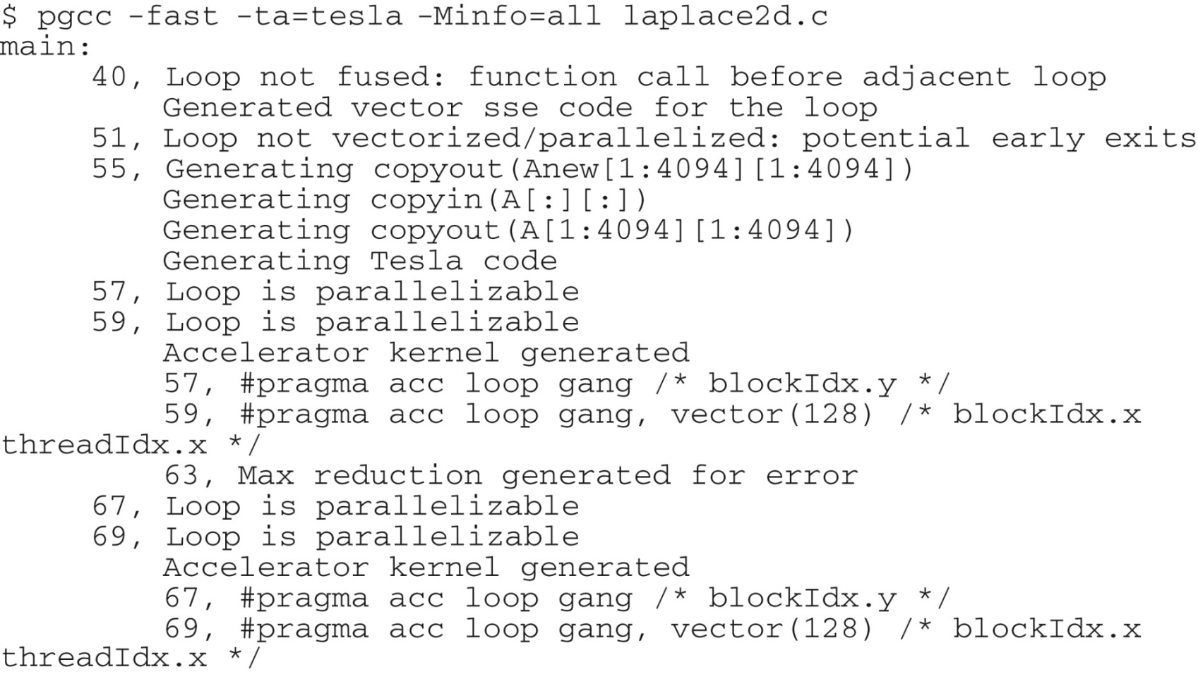
FIGURE 19.7: Compiler output from example kernels code.

Slide 9
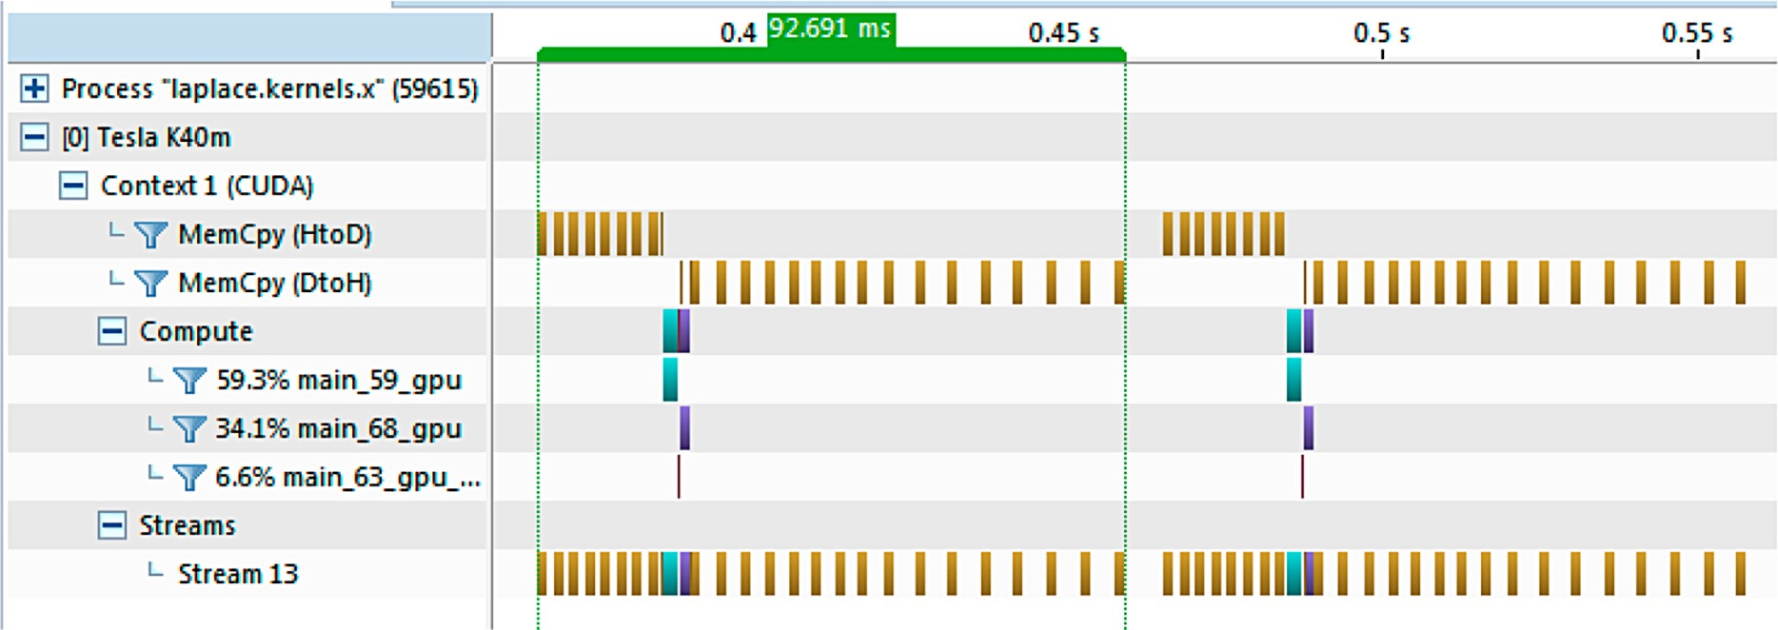
FIGURE 19.8: GPU timeline of kernels directive example code.

Slide 10
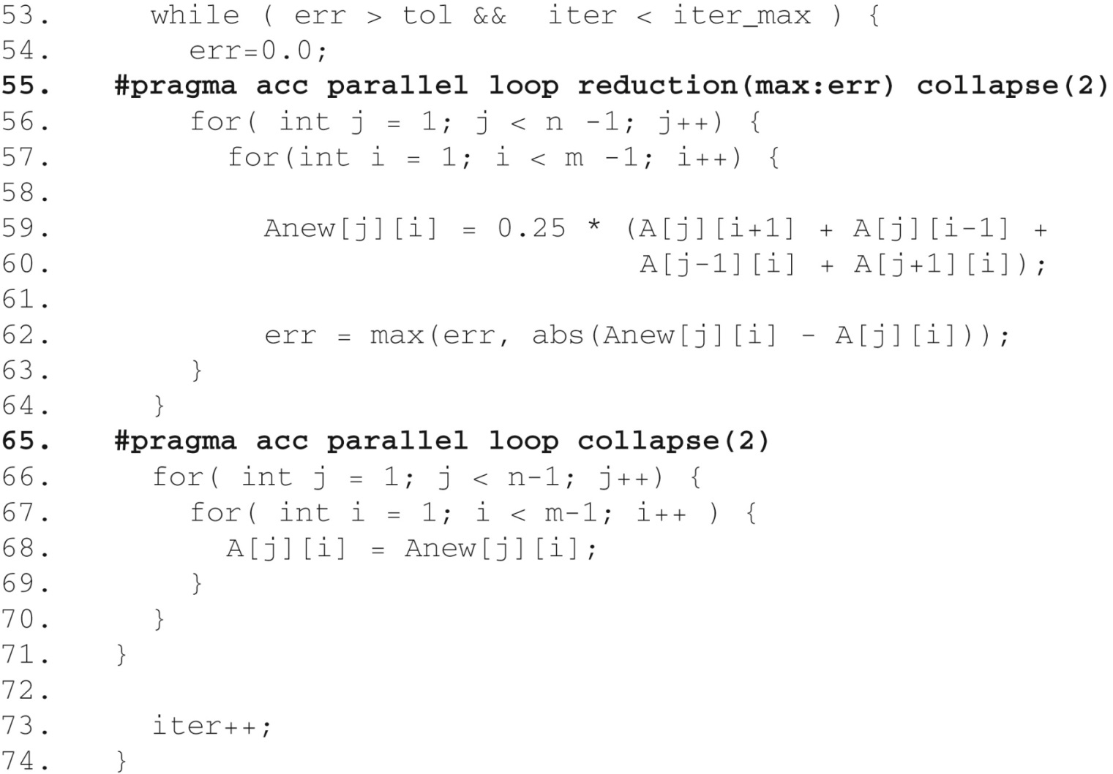
FIGURE 19.9: Jacobi Iterative Method code using parallel directive.

Slide 11
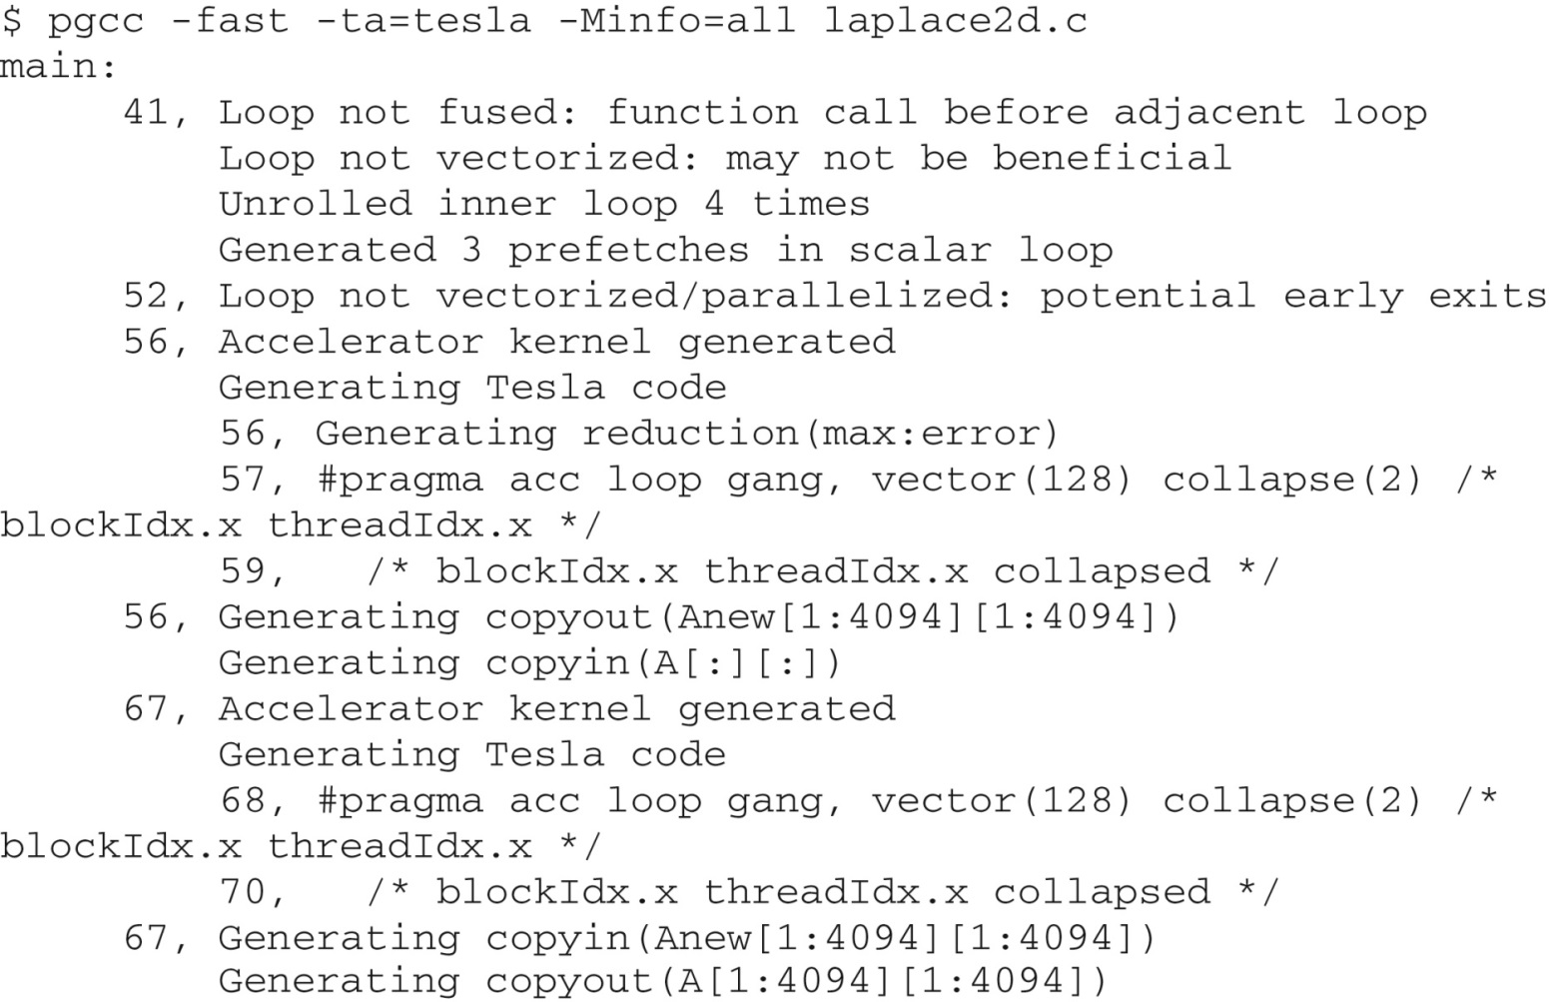
FIGURE 19.10: Compiler feedback for Jacobi Iterative Method using parallel directive.

Slide 12
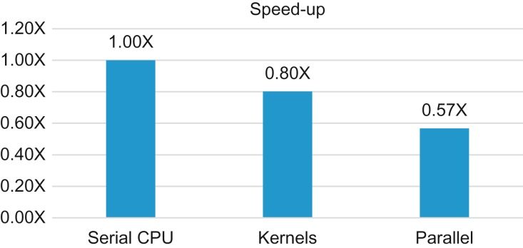
FIGURE 19.11: Performance speed-up from OpenACC kernels and parallel (higher is better).

Slide 13
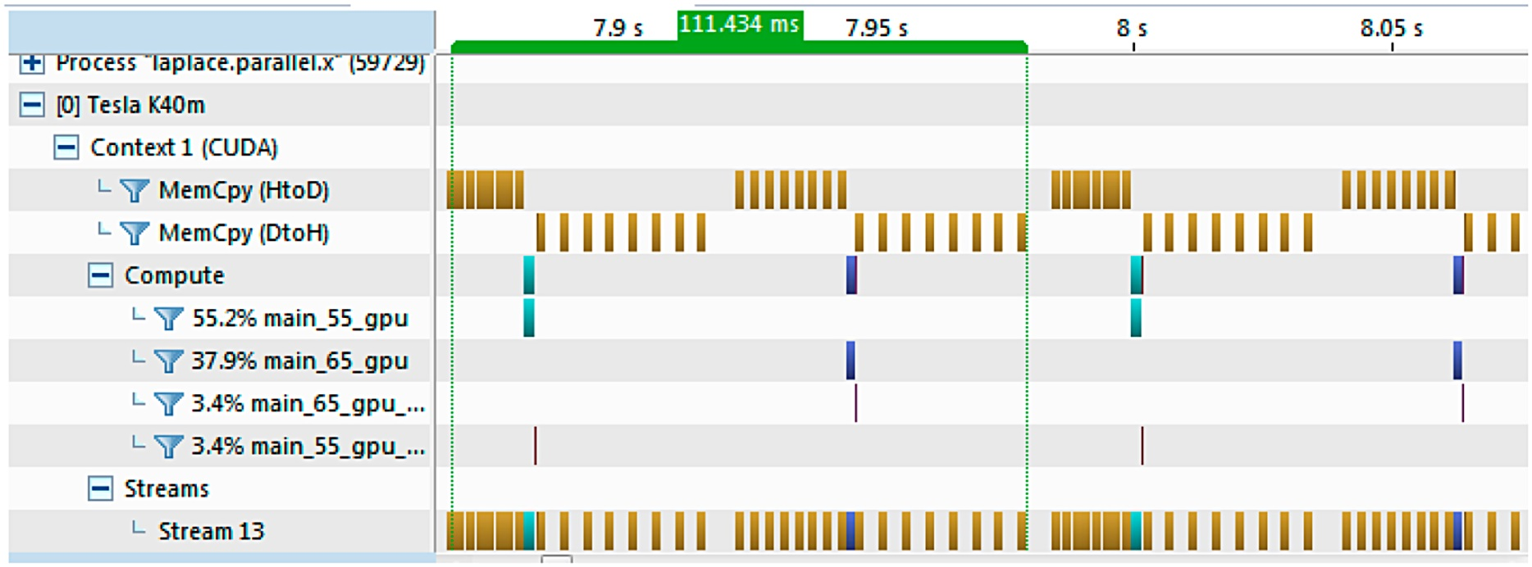
FIGURE 19.12: GPU timeline of parallel loop code.

Slide 14
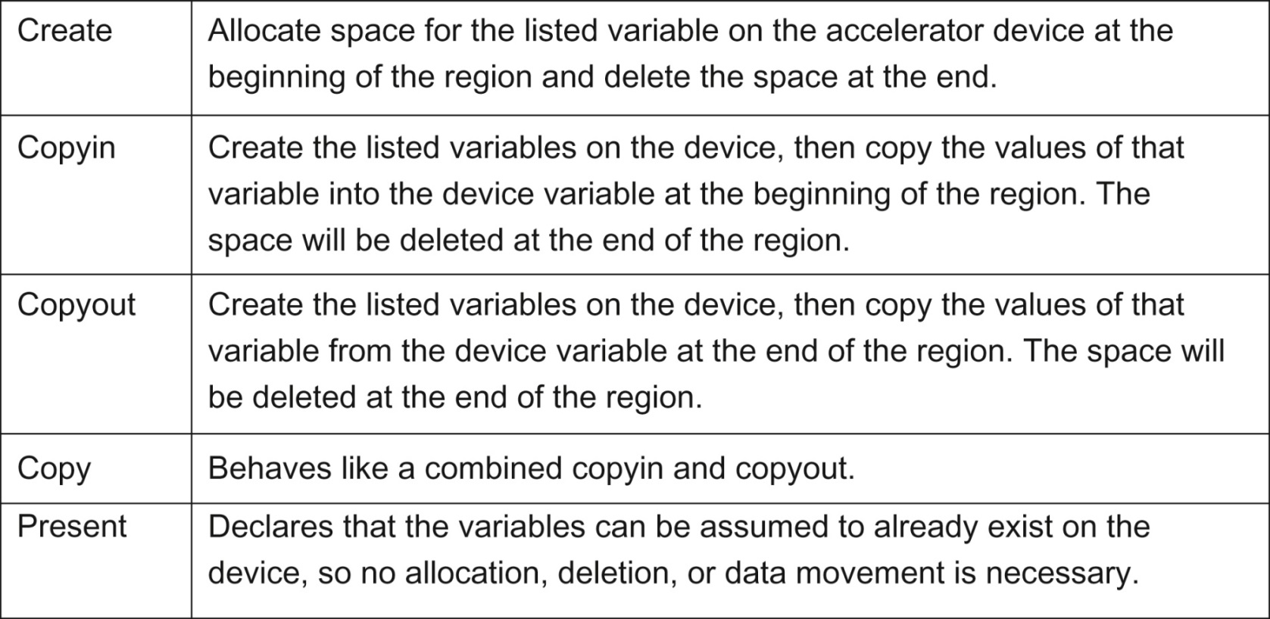
FIGURE 19.13: Five common data clauses and their meanings.

Slide 15
FIGURE 19.14: Data clause array size notation.

Slide 16
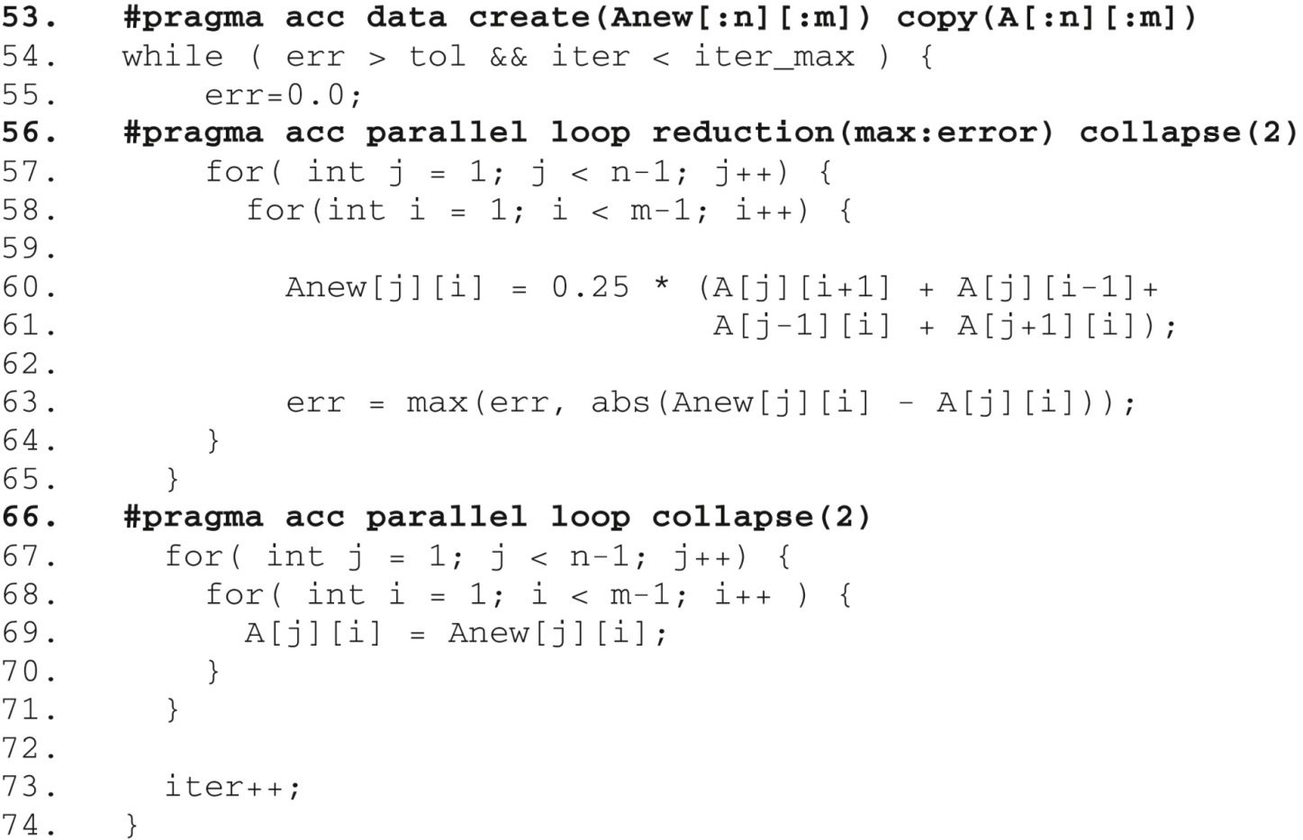
FIGURE 9.15: Jacobi Iterative Method with data region.

Slide 17
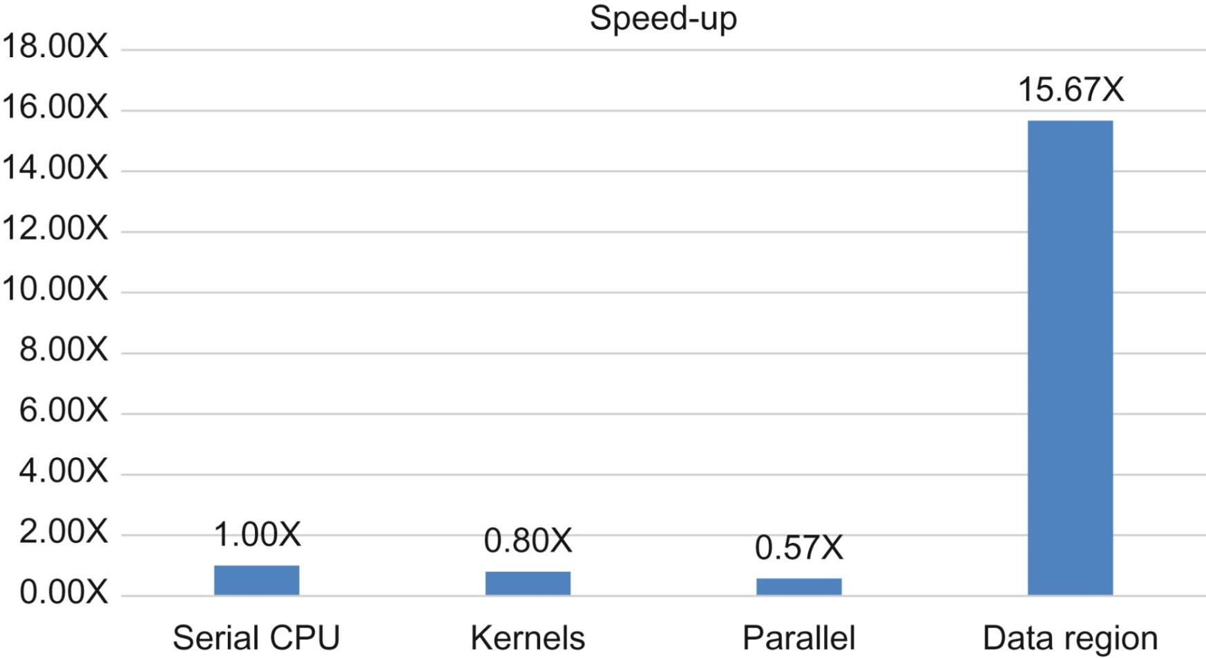
FIGURE 19.16: Speed-up with addition of data directive (higher is better).

Slide 18
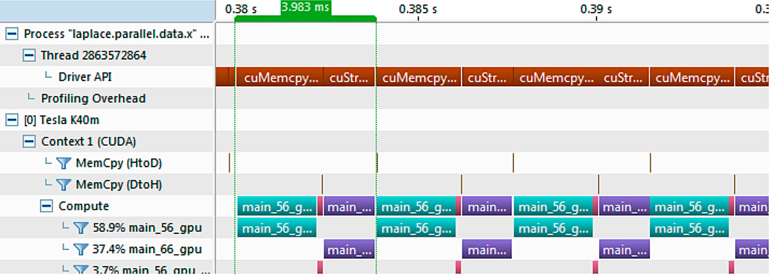
FIGURE 19.17: GPU timeline after optimizing data motion.

Slide 19
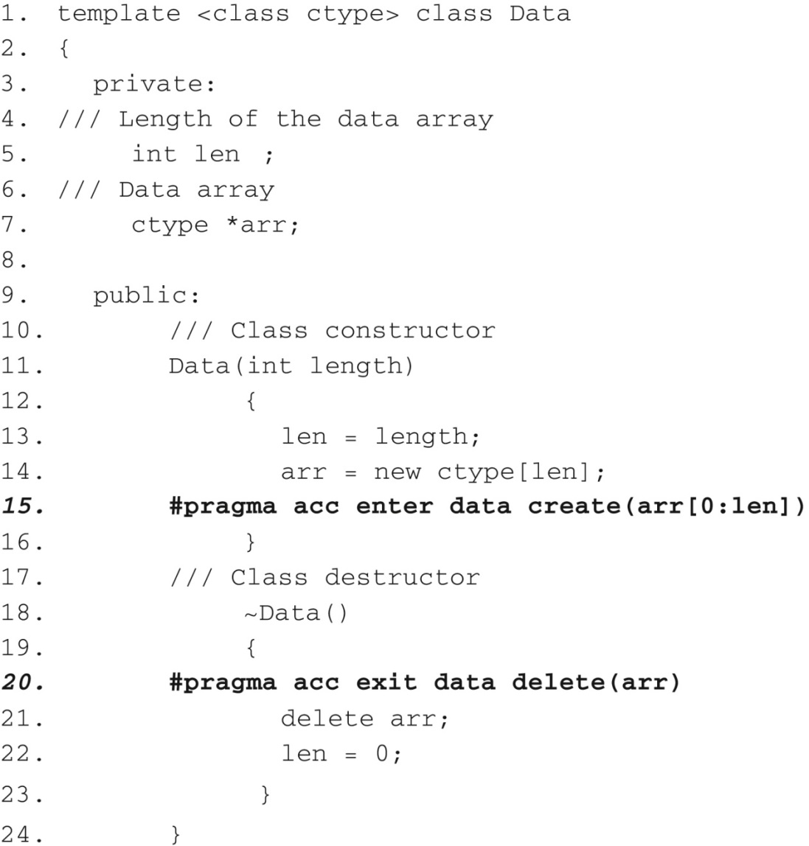
FIGURE 19.18: Example of unstructured data directives in C++ class.

Slide 20
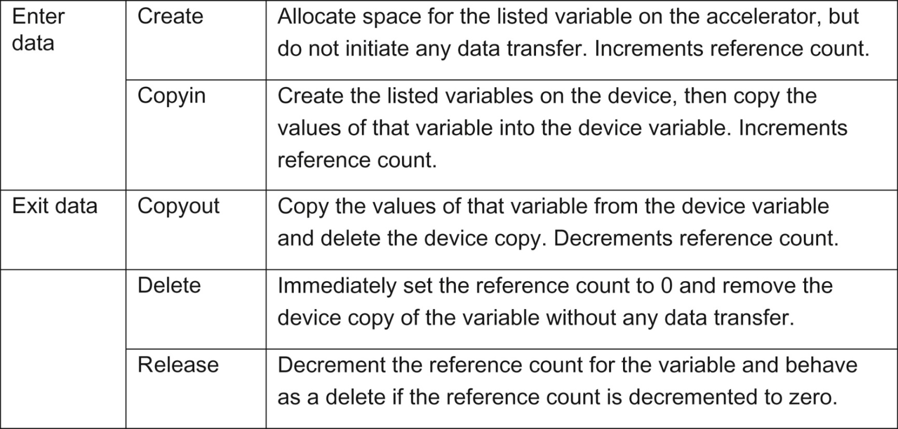
FIGURE 19.19: Data clauses for unstructured data directives.

Slide 21
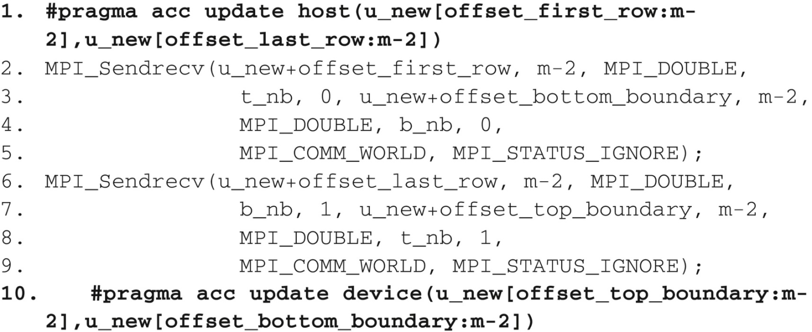
FIGURE 19.20: Example of update directive with MPI halo exchange.

Slide 22
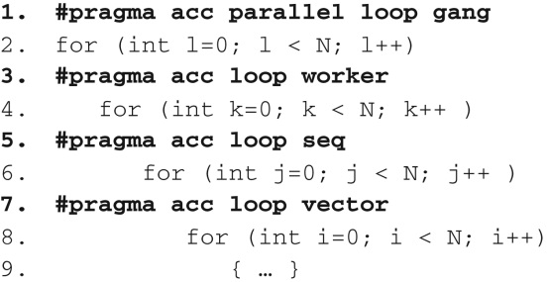
FIGURE 19.21: Example of loop directive specifying levels of parallelism.

Slide 23
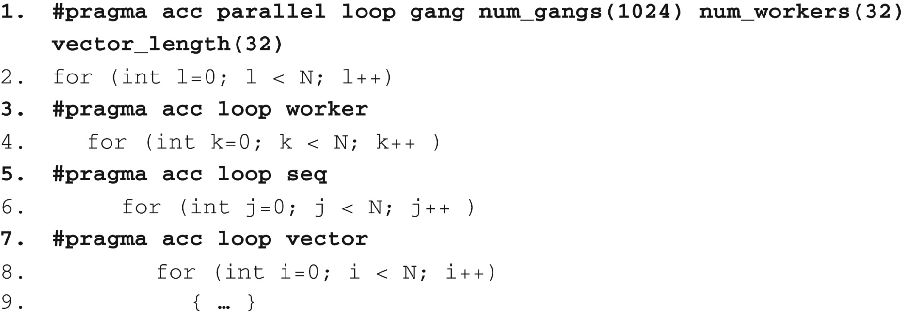
FIGURE 19.22: Adjusting loop parameters within a parallel region.

Slide 24
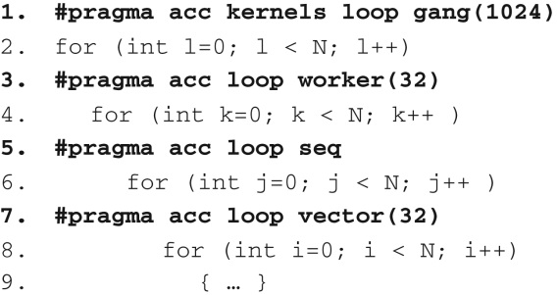
FIGURE 19.23: Adjusting loop parameters within a kernels region.

Slide 25
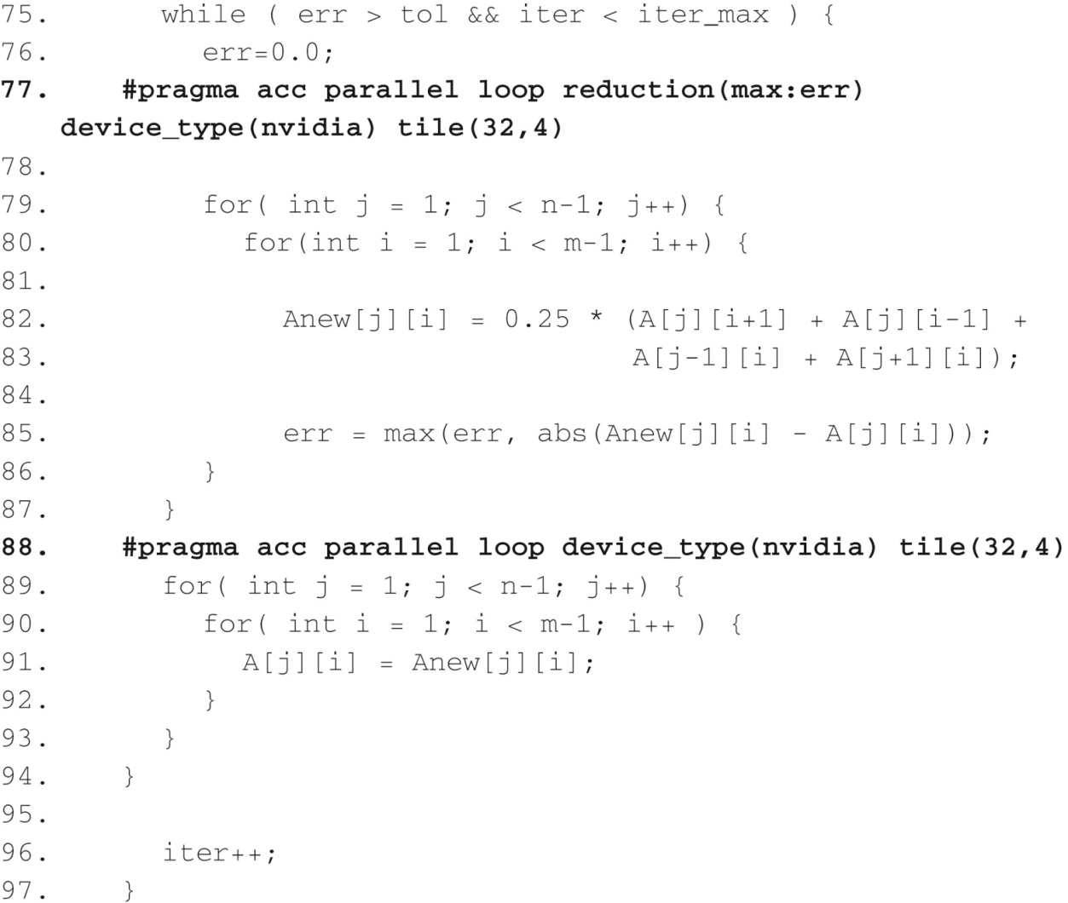
FIGURE 19.24: Jacobi Iterative Method code with loop tile clause.

Slide 26
FIGURE 19.25: Example of the routine directive.

Slide 27
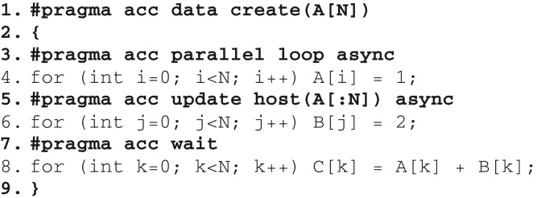
FIGURE 19.26: Example of async and wait.

Slide 28
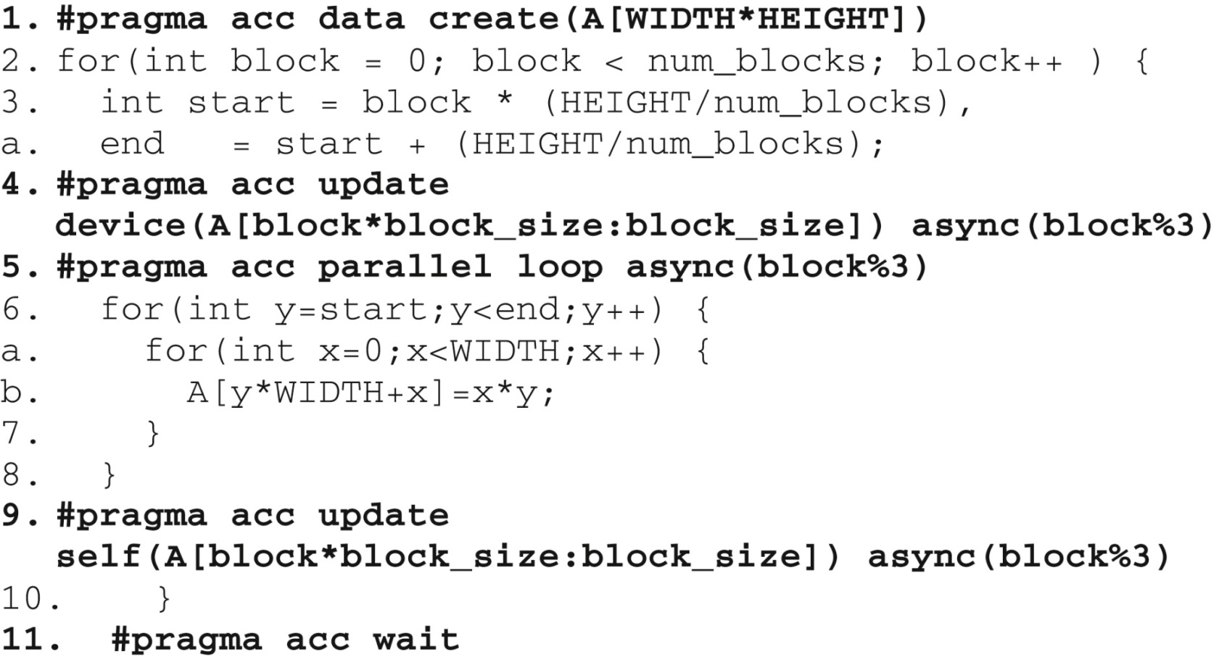
FIGURE 19.27: Example of pipelining with async and wait.

Slide 29
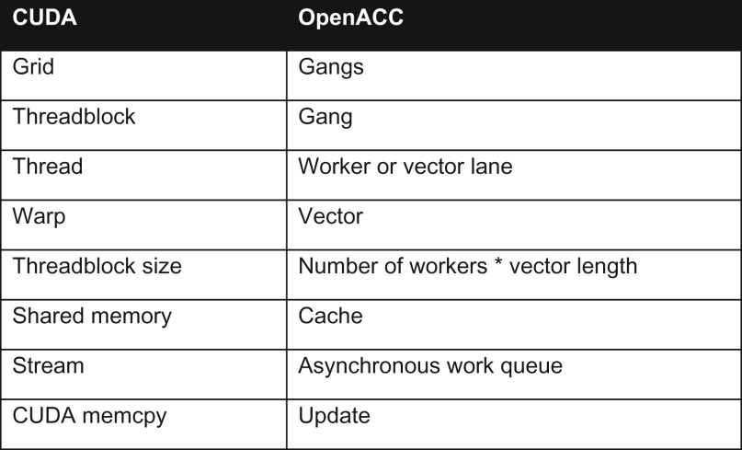
FIGURE 19.28: Table of CUDA and OpenACC terminology.

Slide 30
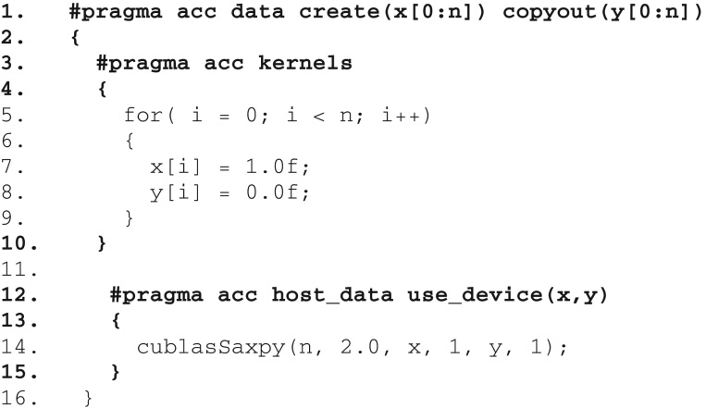
FIGURE 19.29: Example using host_data with NVIDIA cuBLAS.

Slide 31
FIGURE 19.30: Example of device ptr clause.

Slide 32
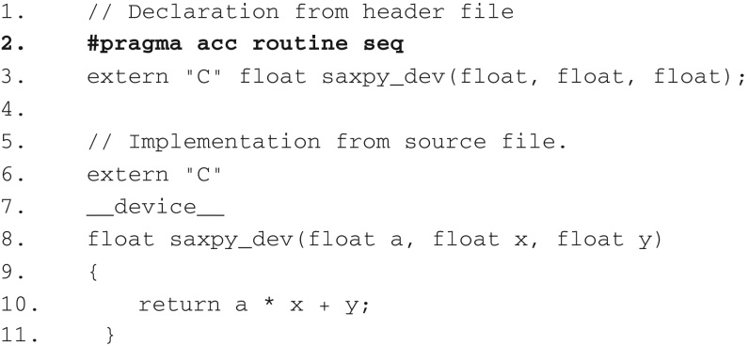
FIGURE 19.31: Example using OpenACC routine directive with CUDA device kernel.

Slide 33
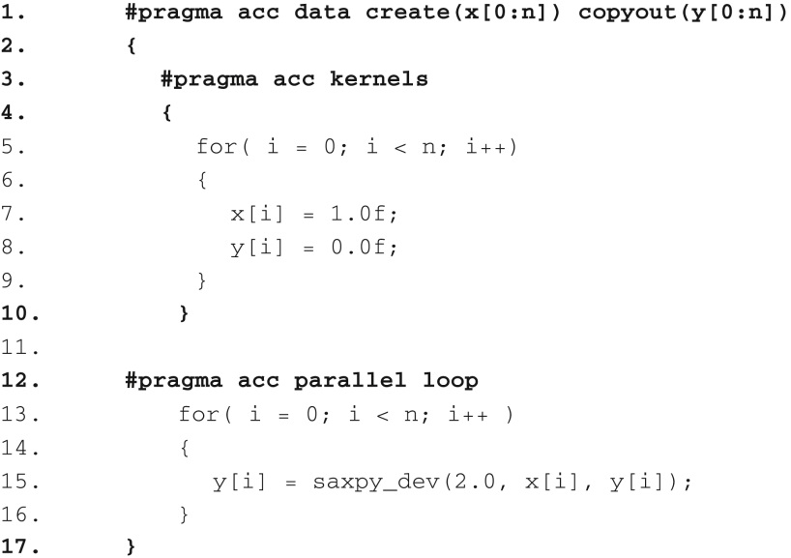
FIGURE 19.32: Example calling CUDA device kernel from OpenACC.

