Slide 1
Chapter 4
Cholinergic Signaling and Muscle Contraction

Slide 2
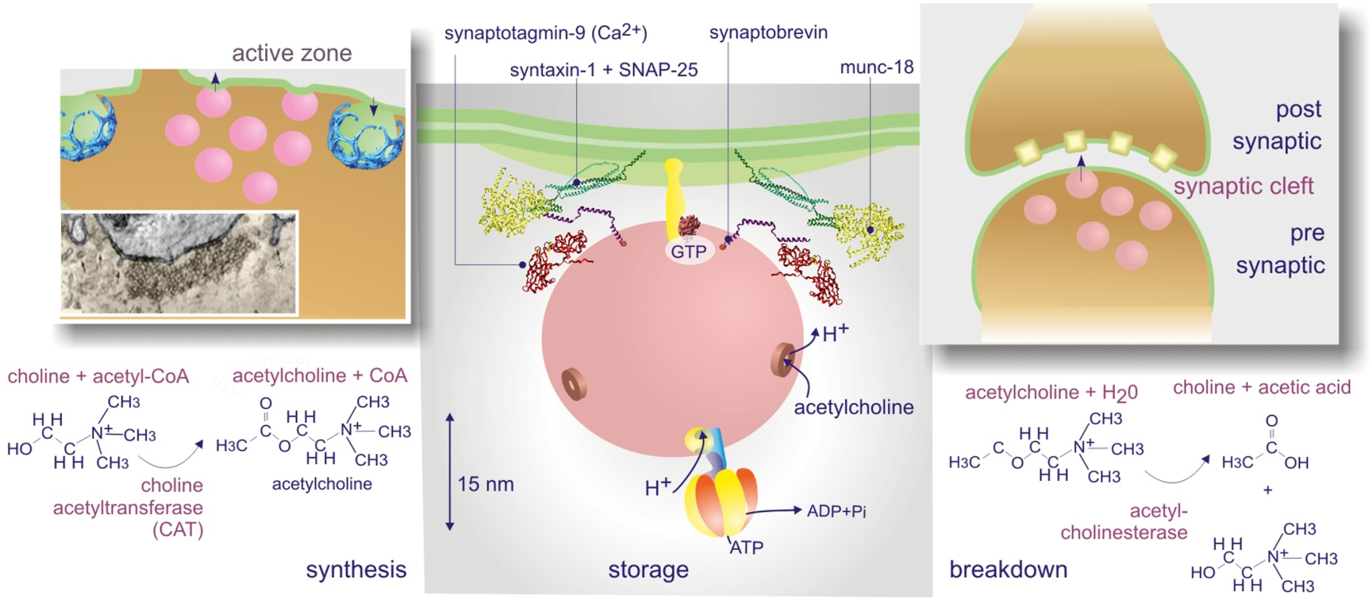
Figure 4.01

Slide 3
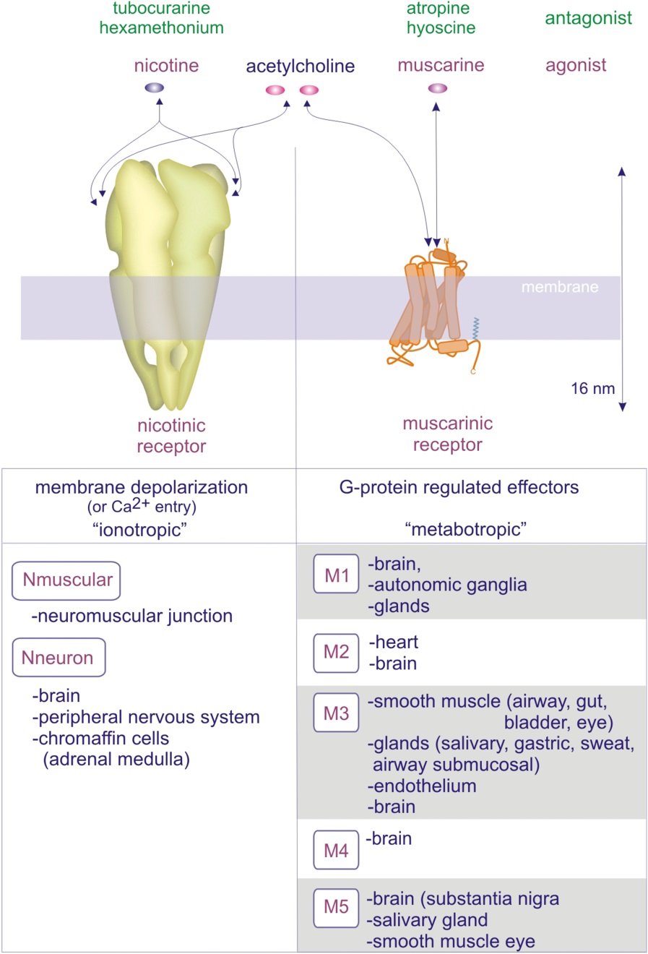
Figure 4.02

Slide 4
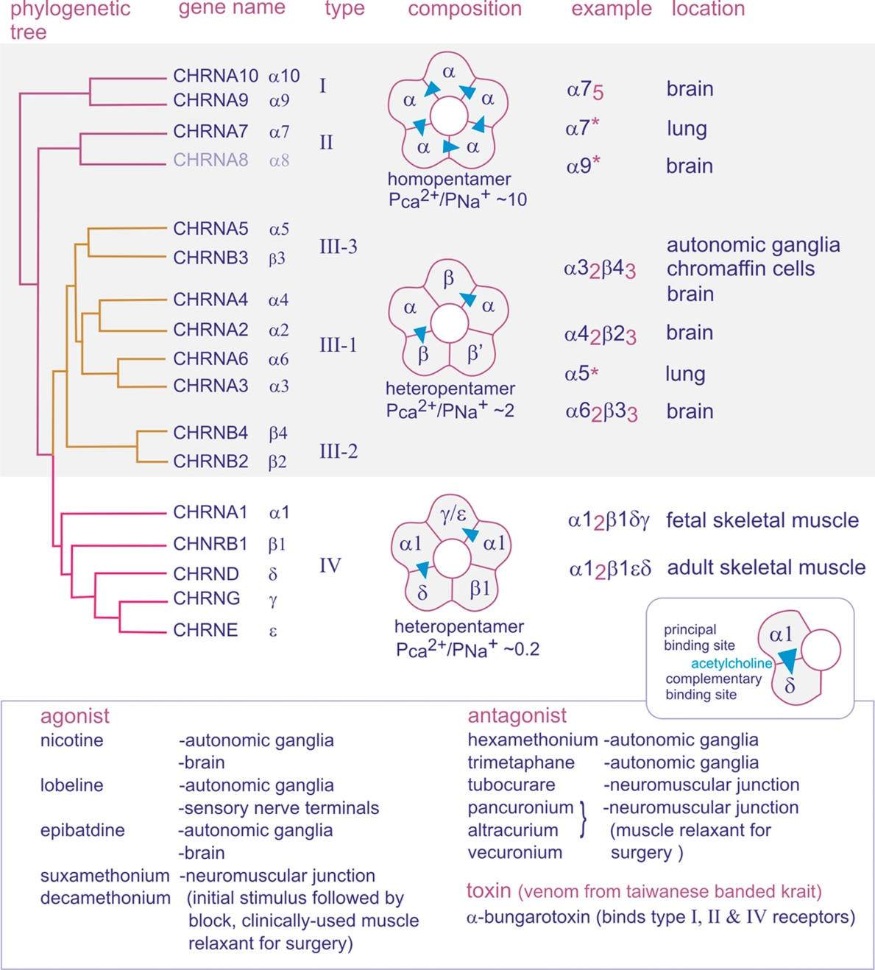
Figure 4.03

Slide 5
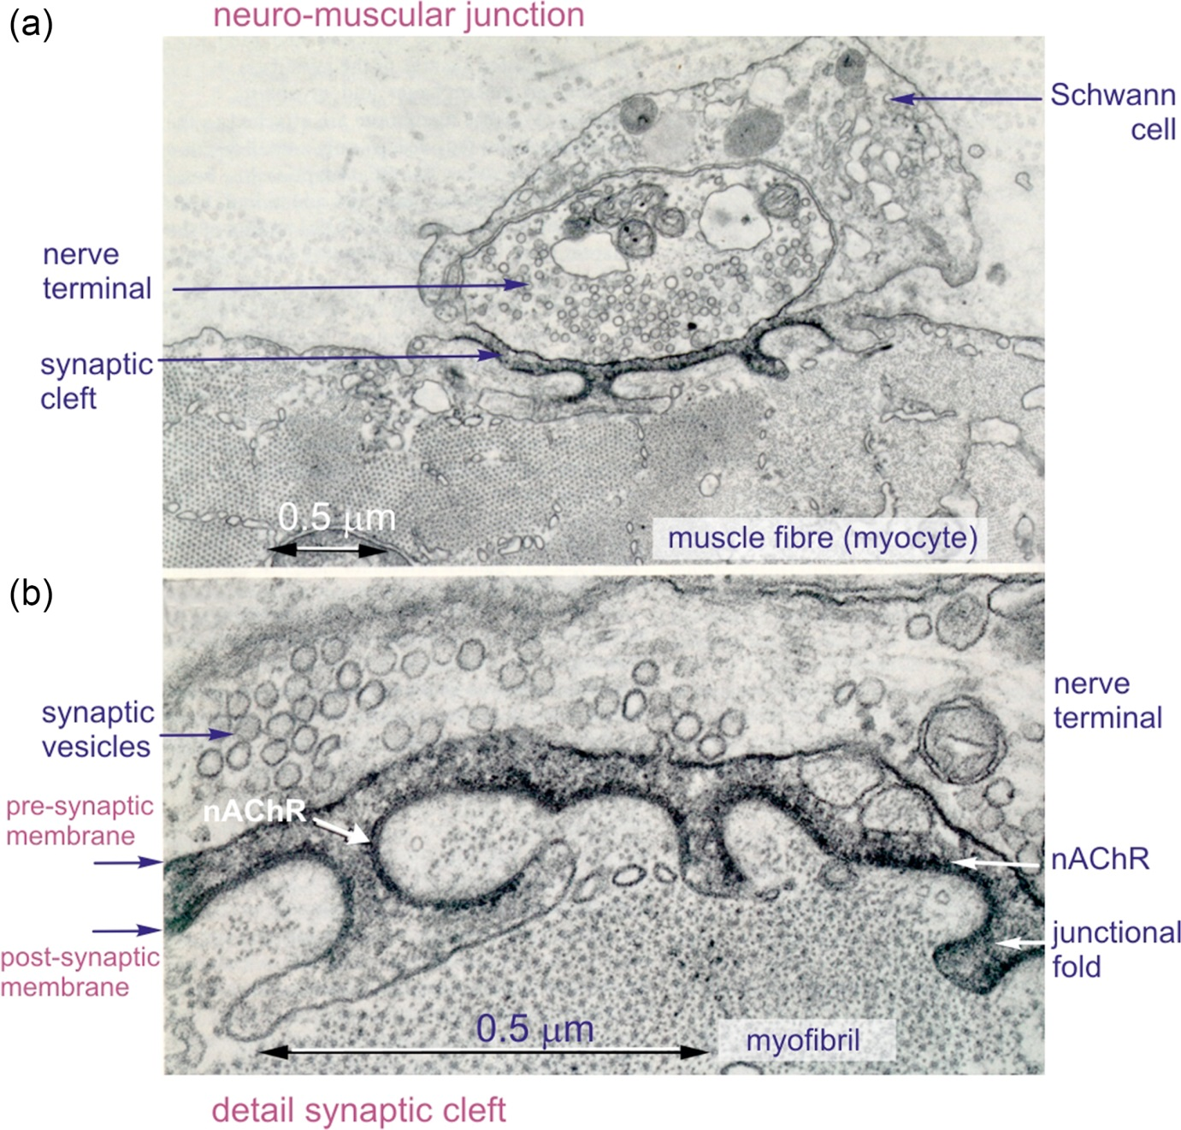
Figure 4.04

Slide 6
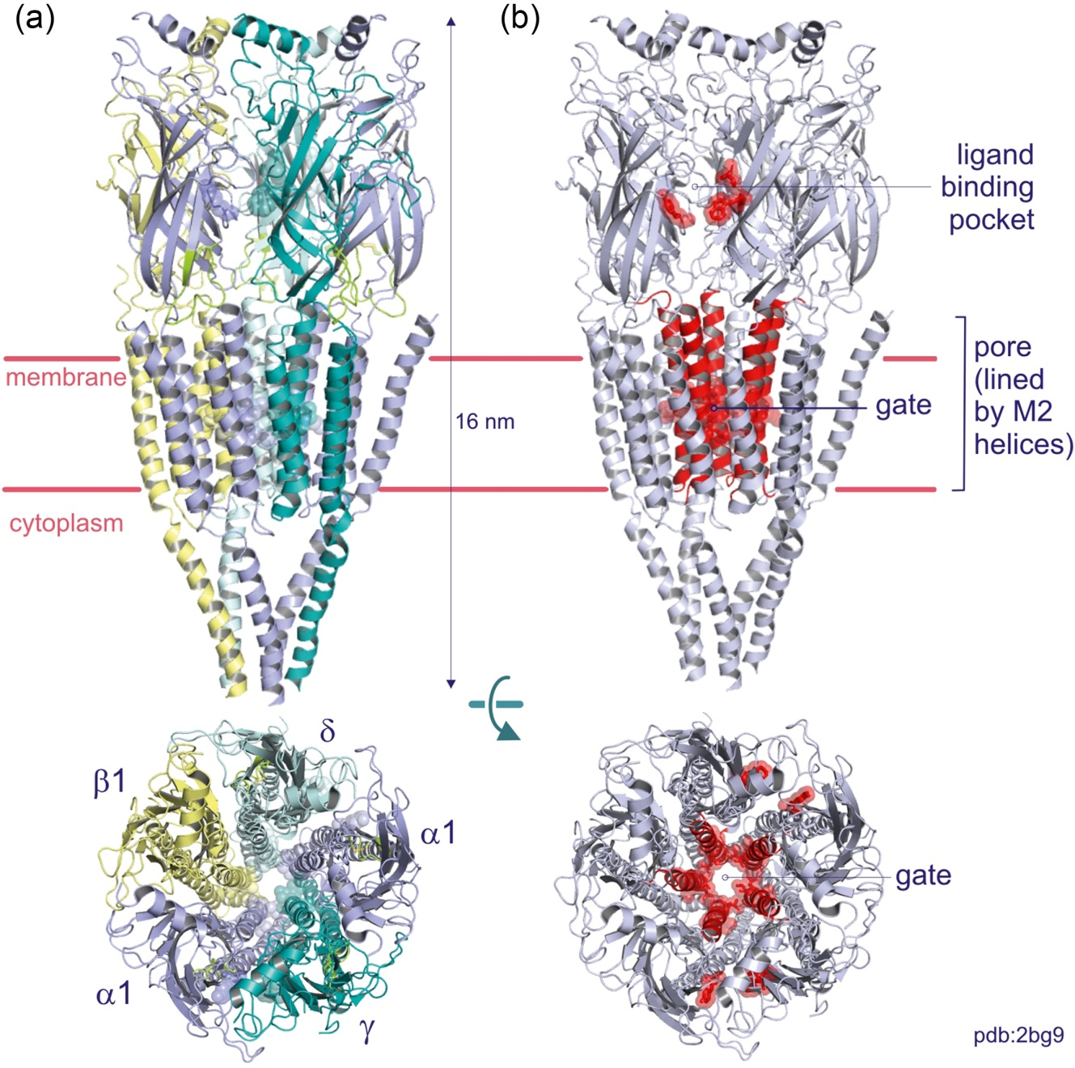
Figure 4.05

Slide 7
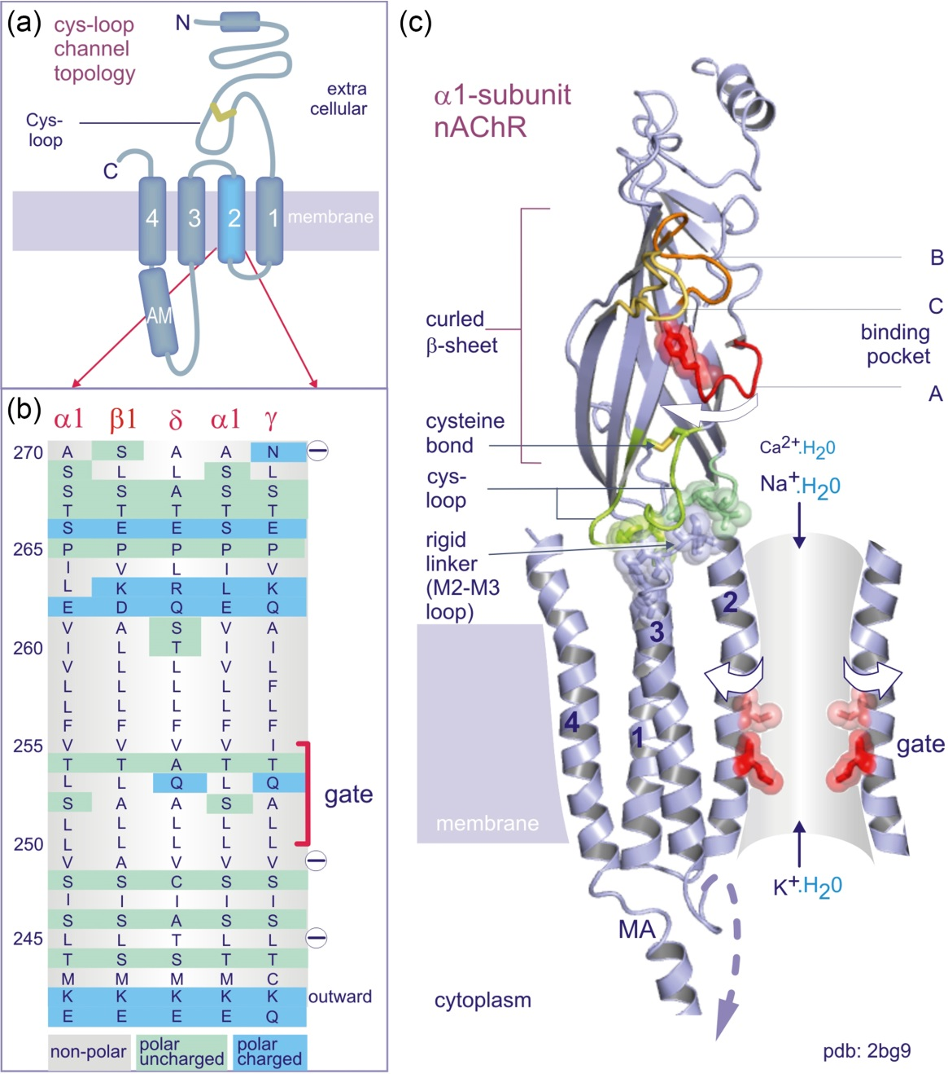
Figure 4.06

Slide 8
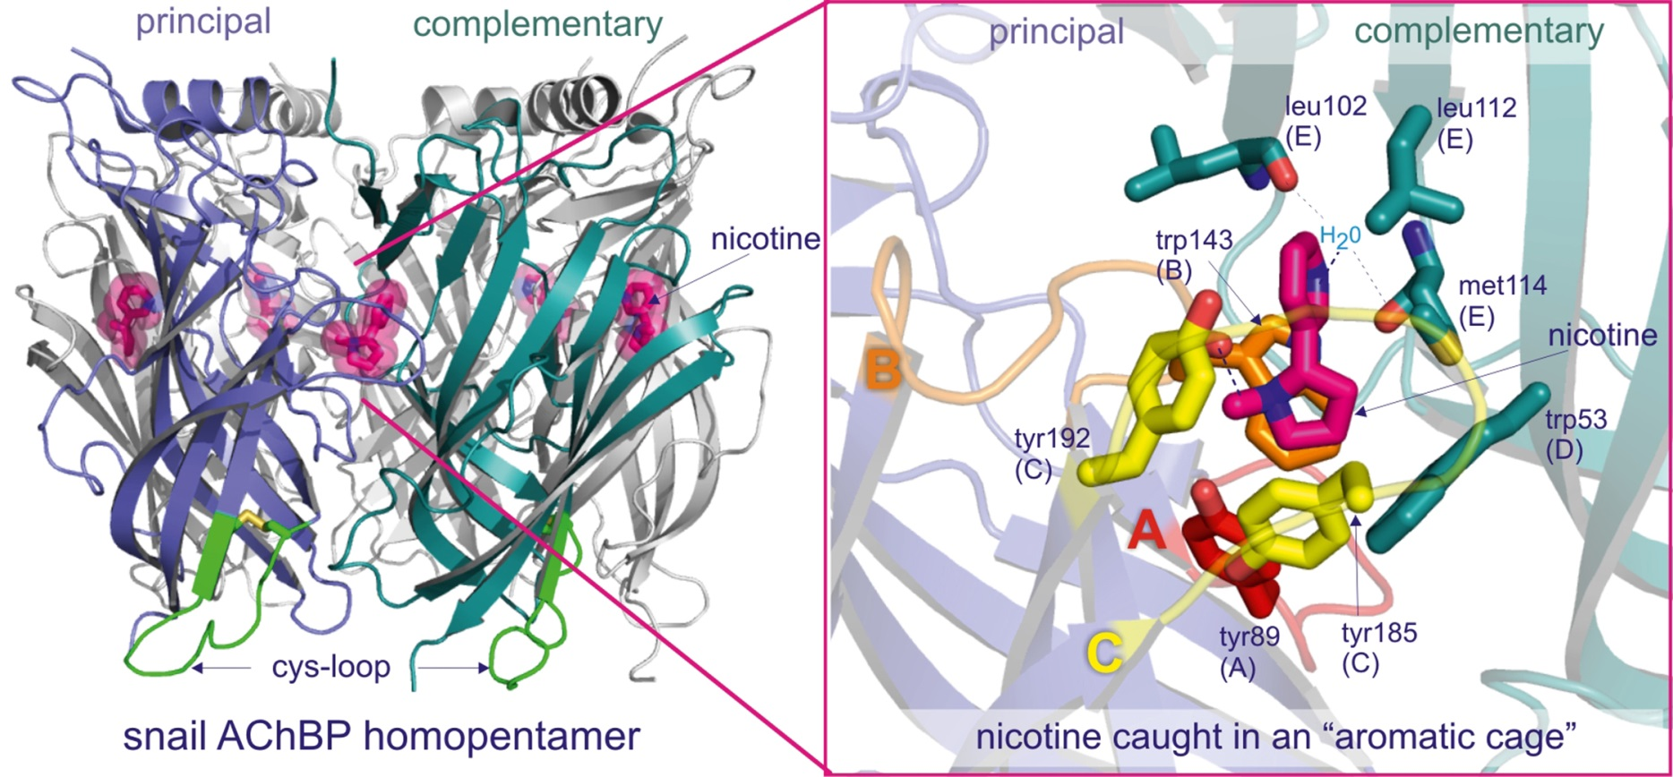
Figure 4.07

Slide 9
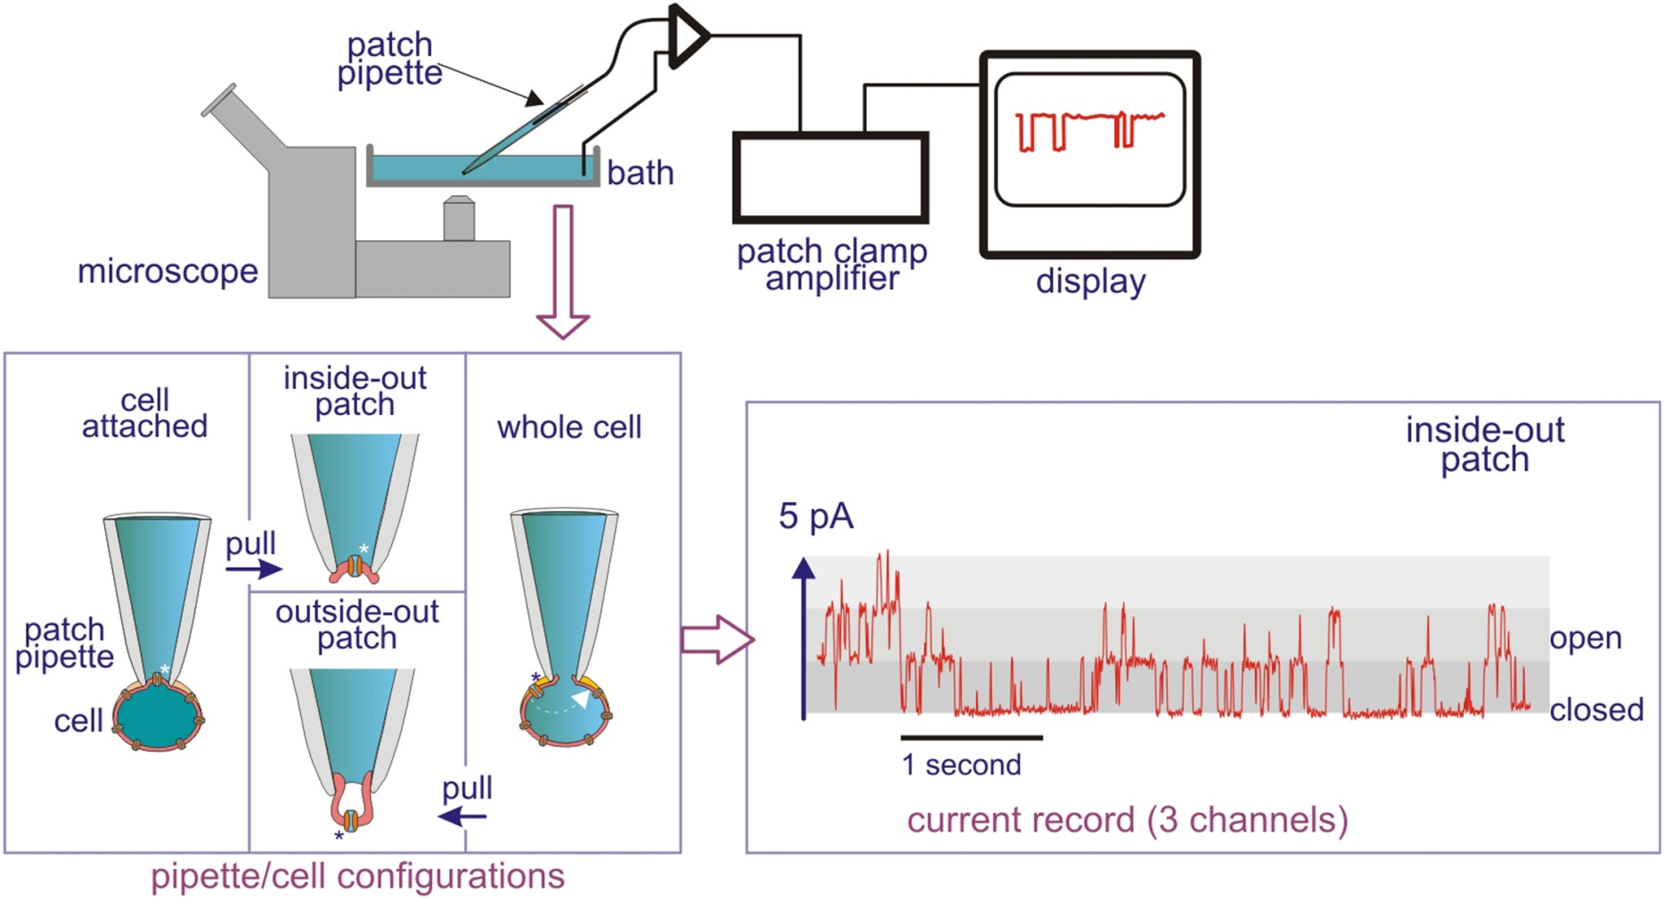
Figure 4.08

Slide 10
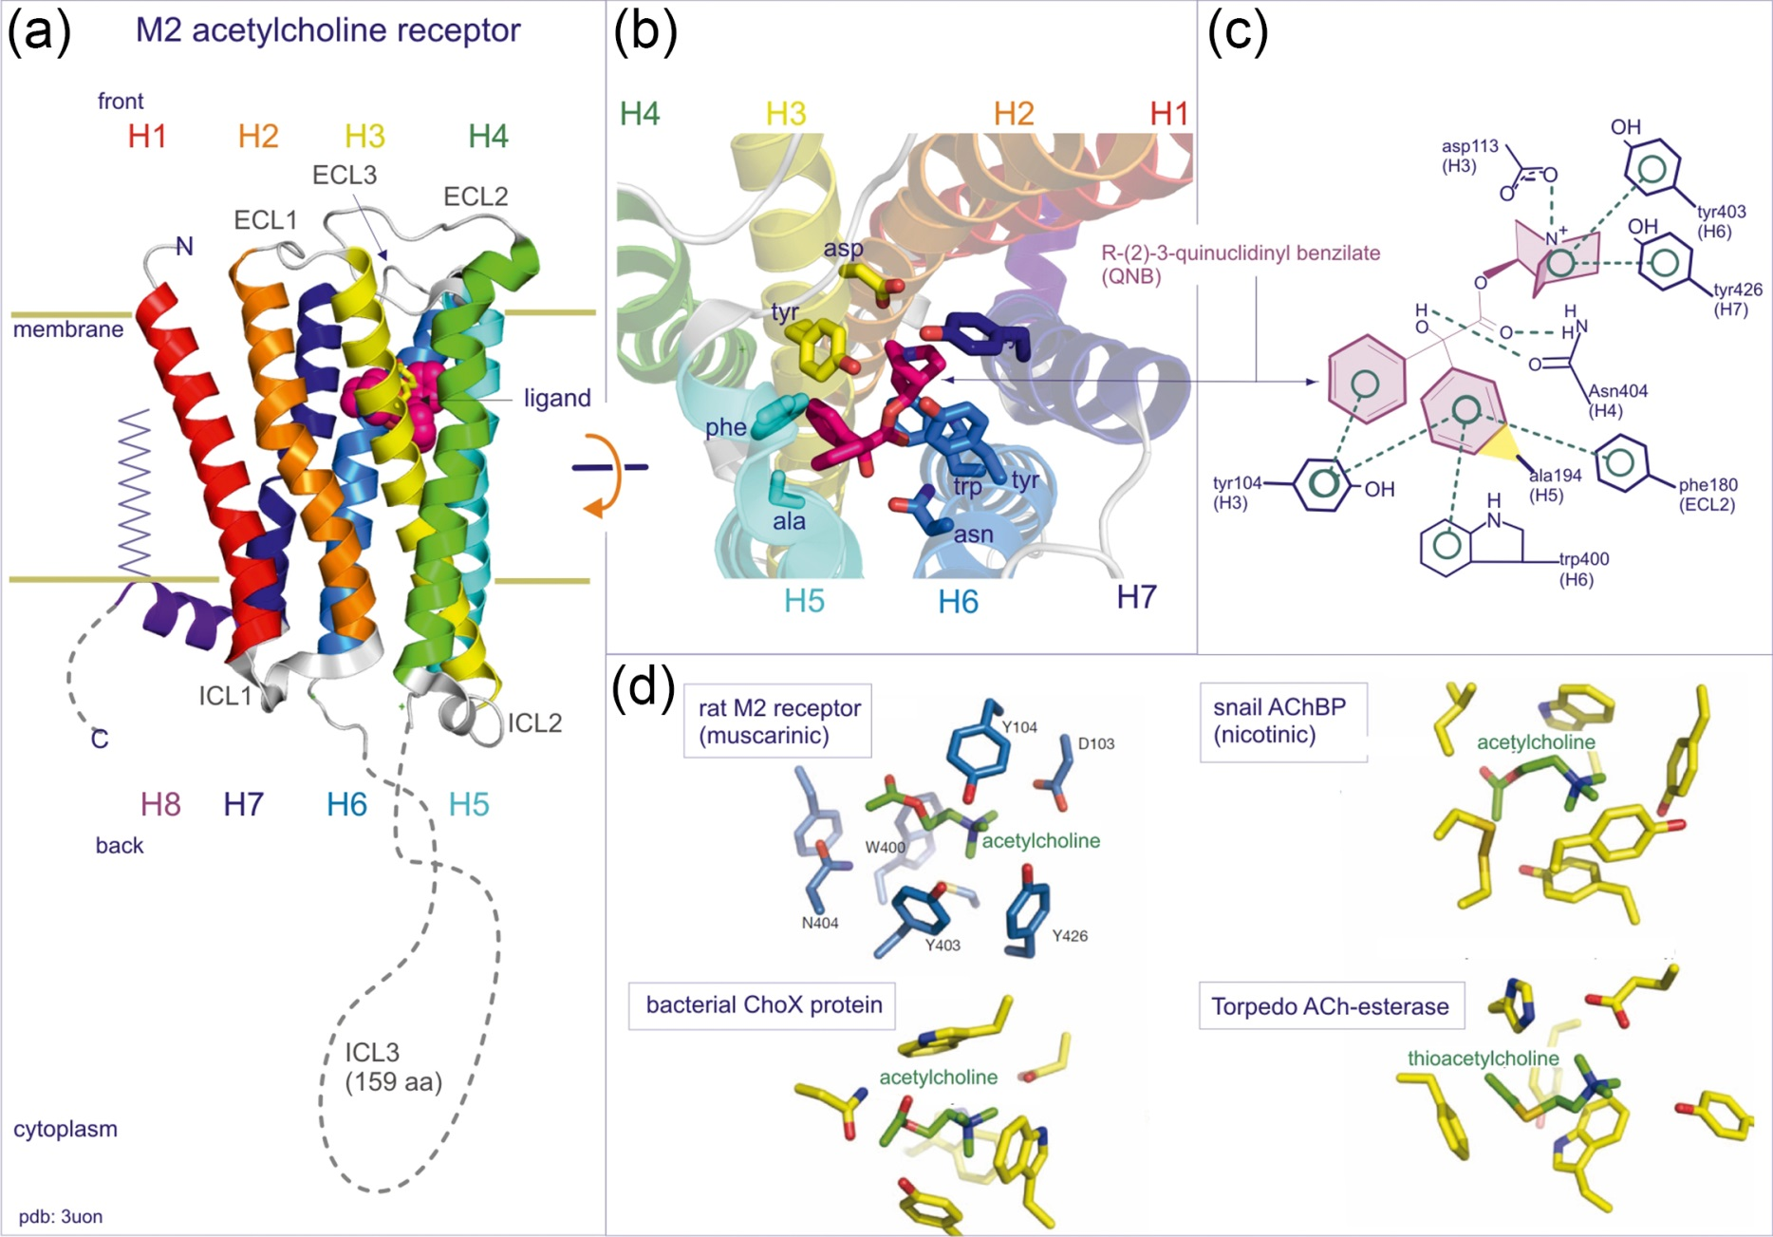
Figure 4.09

Slide 11
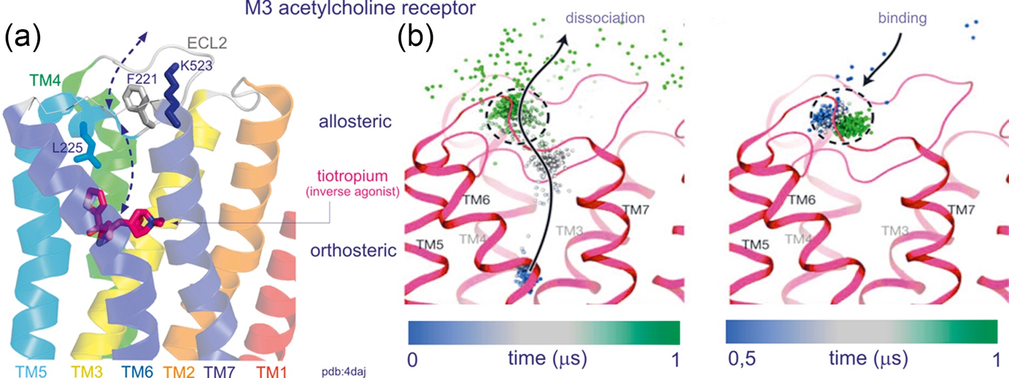
Figure 4.10

Slide 12
Figure 4.11

Slide 13
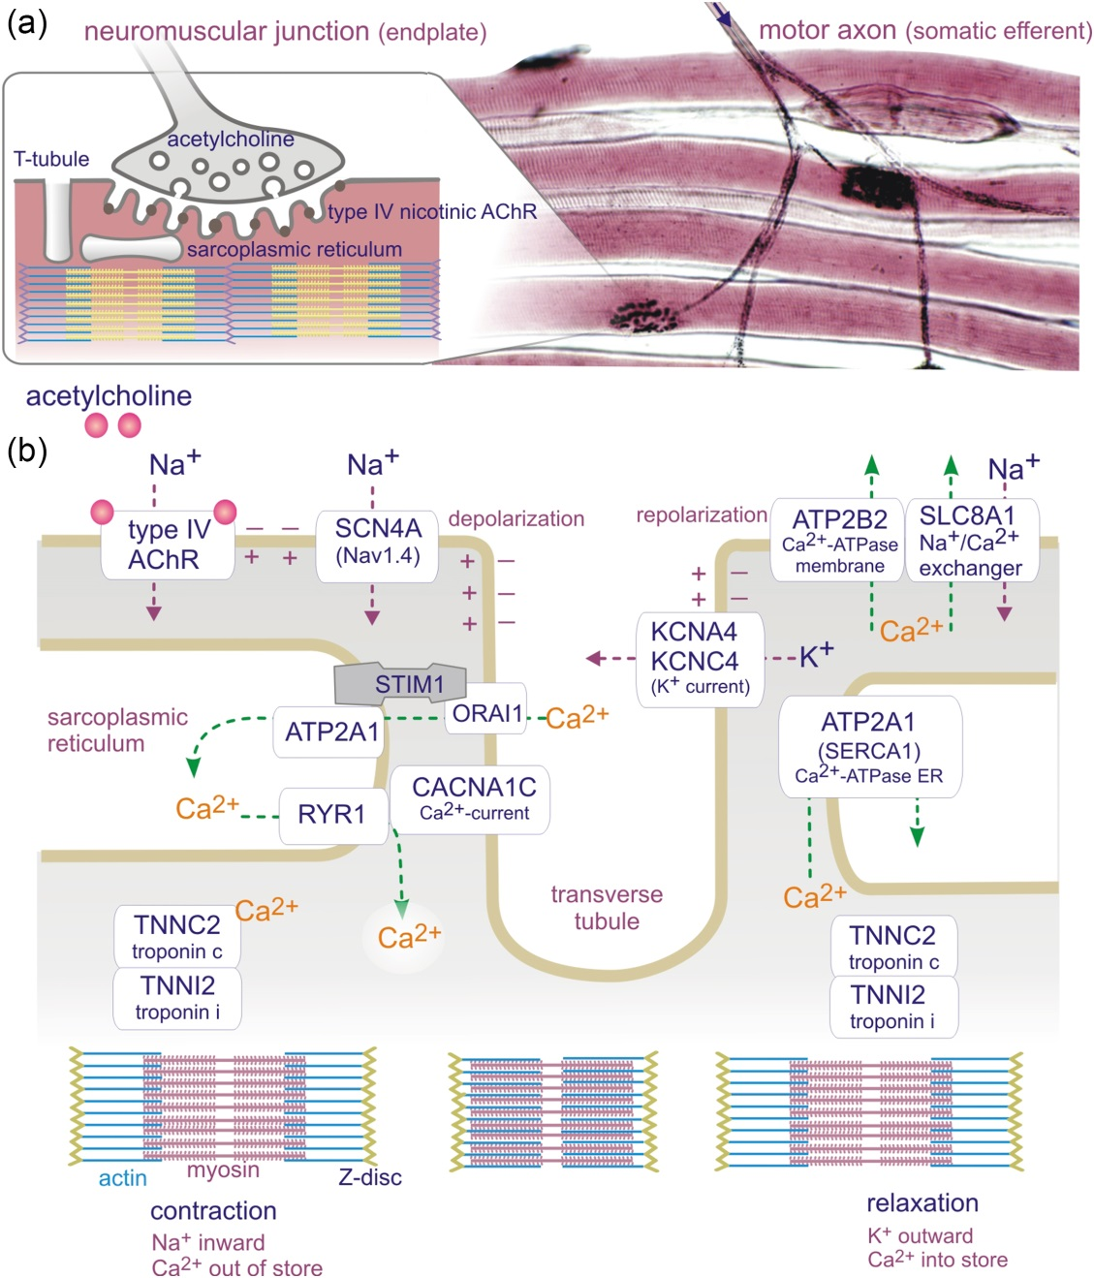
Figure 4.12

Slide 14
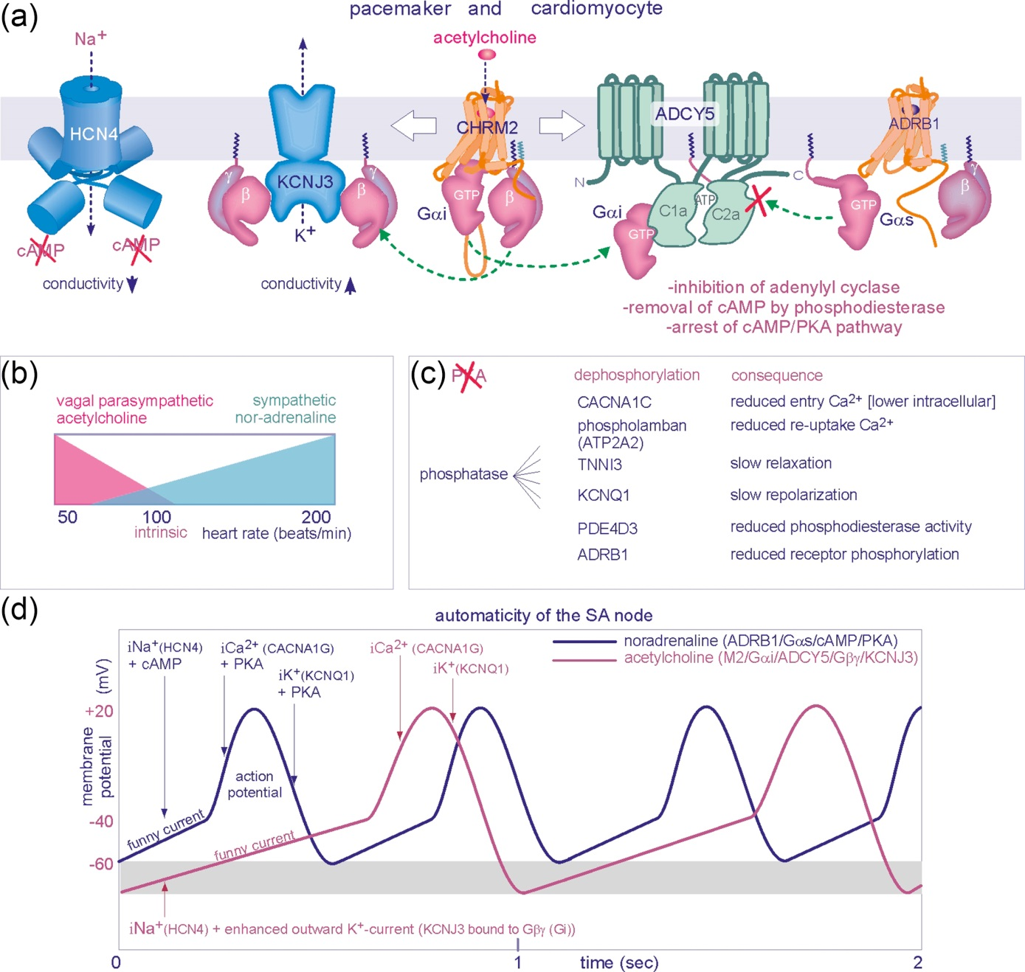
Figure 4.13

Slide 15
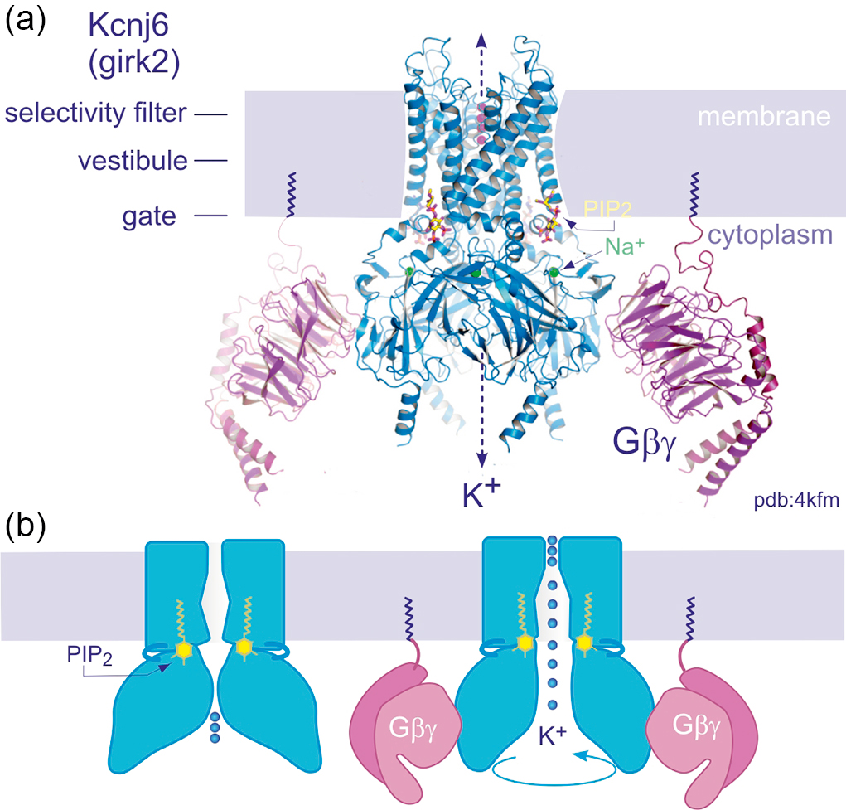
Figure 4.14

Slide 16
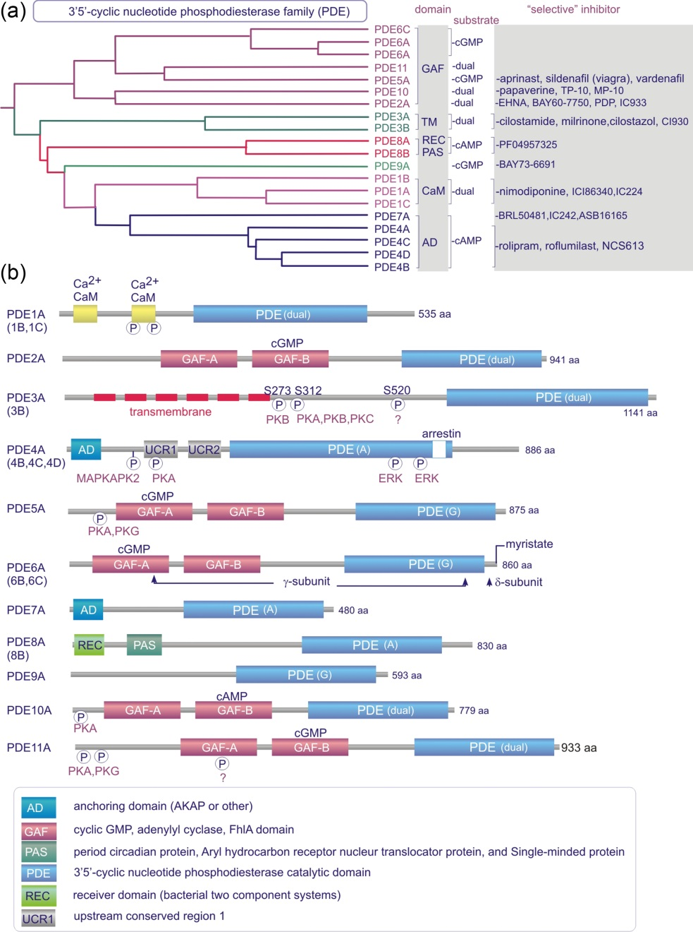
Figure 4.15

Slide 17
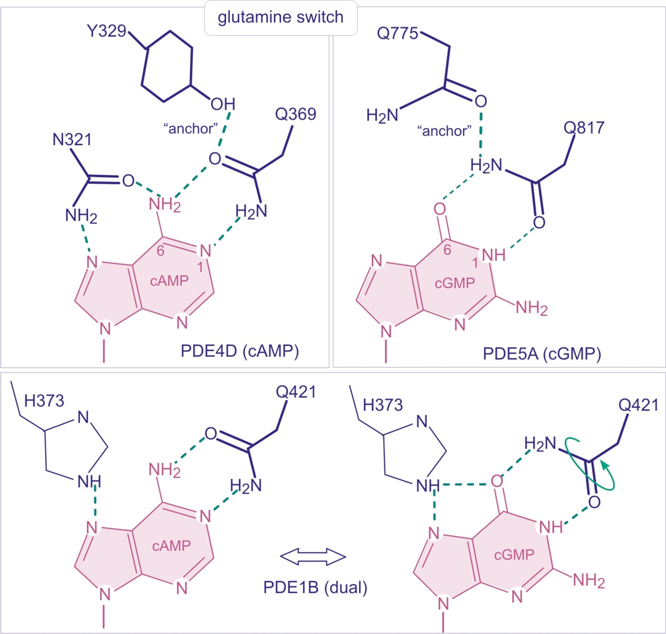
Figure 4.16

Slide 18
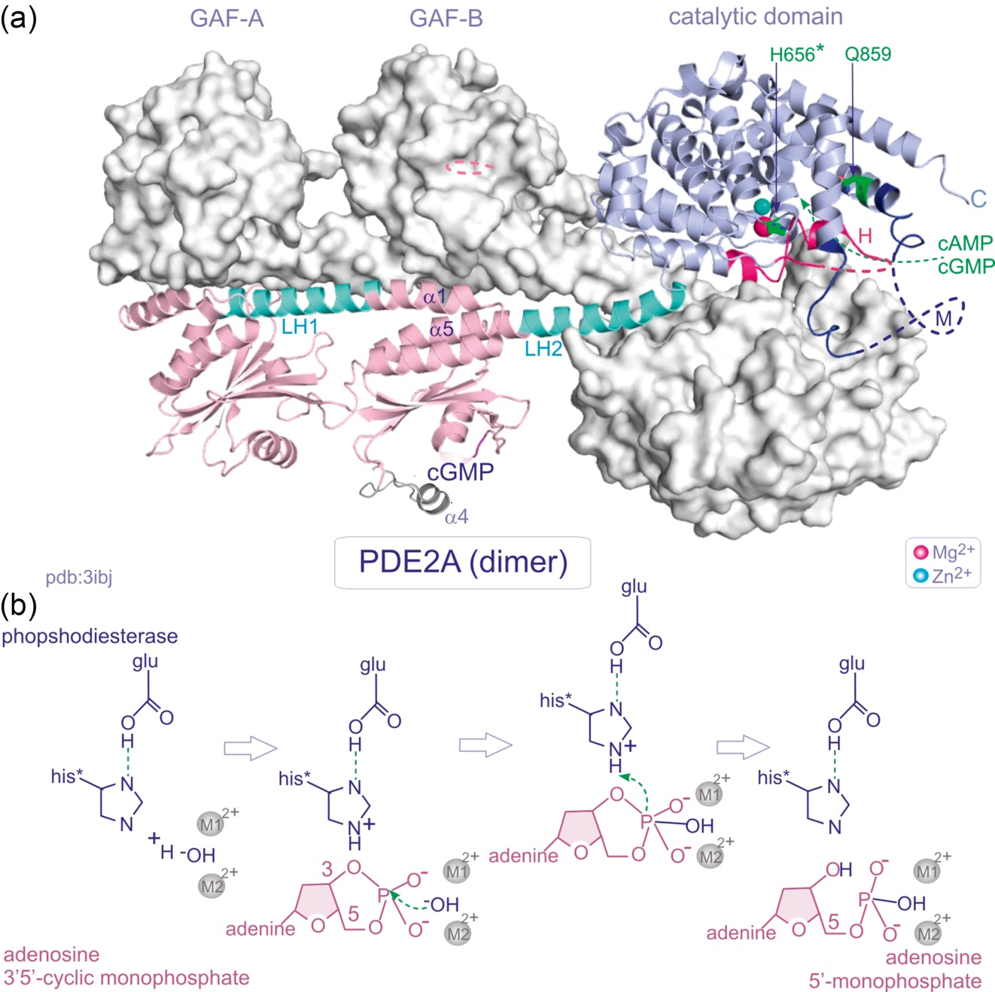
Figure 4.17

Slide 19
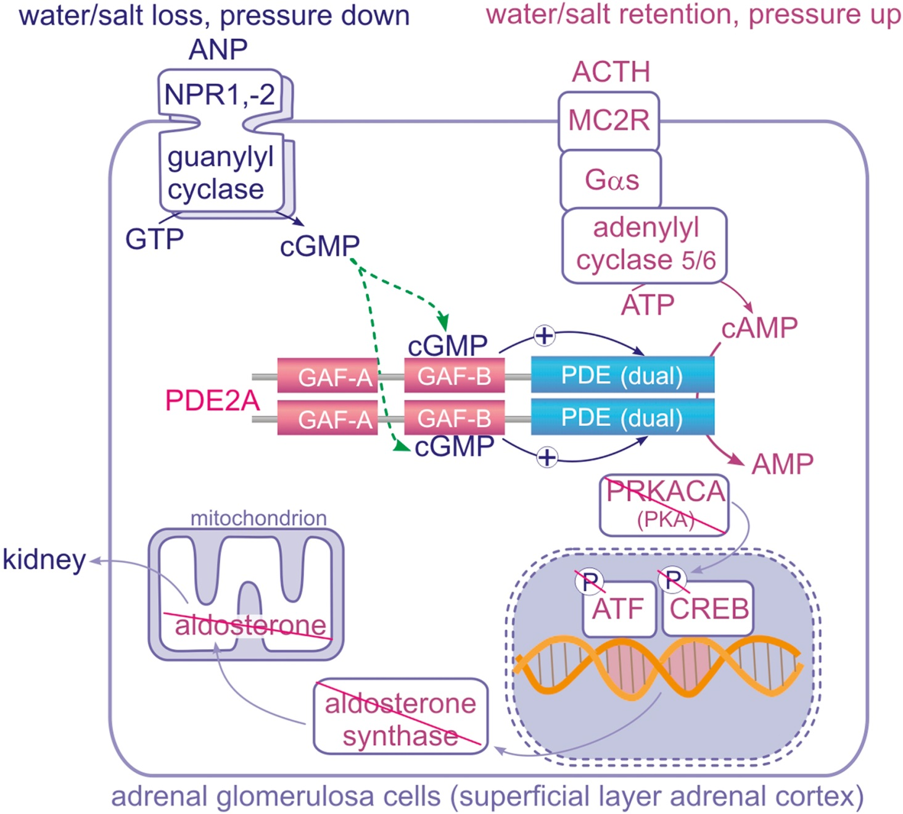
Figure 4.18

Slide 20
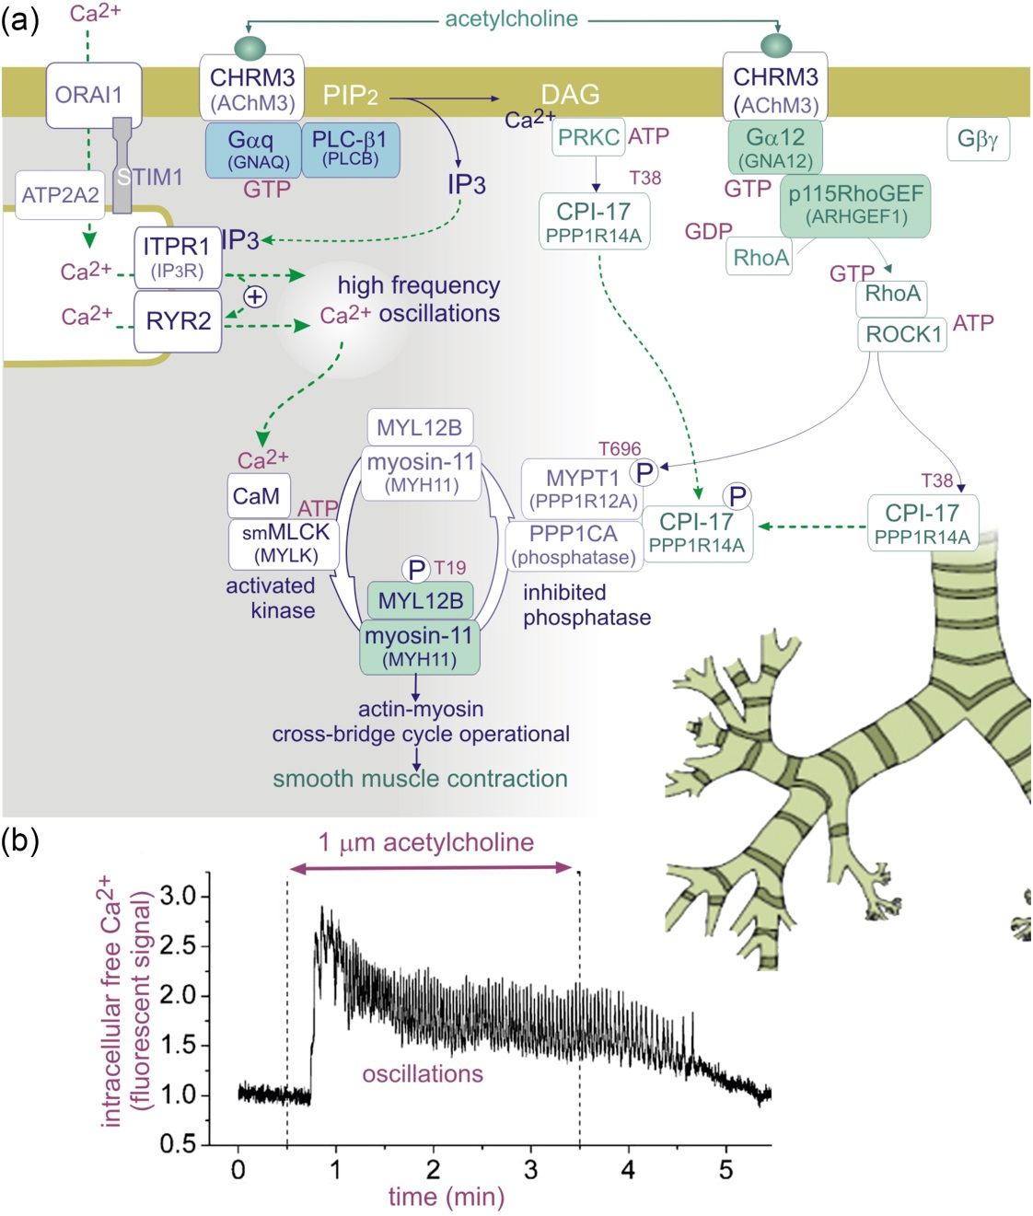
Figure 4.19

Slide 21
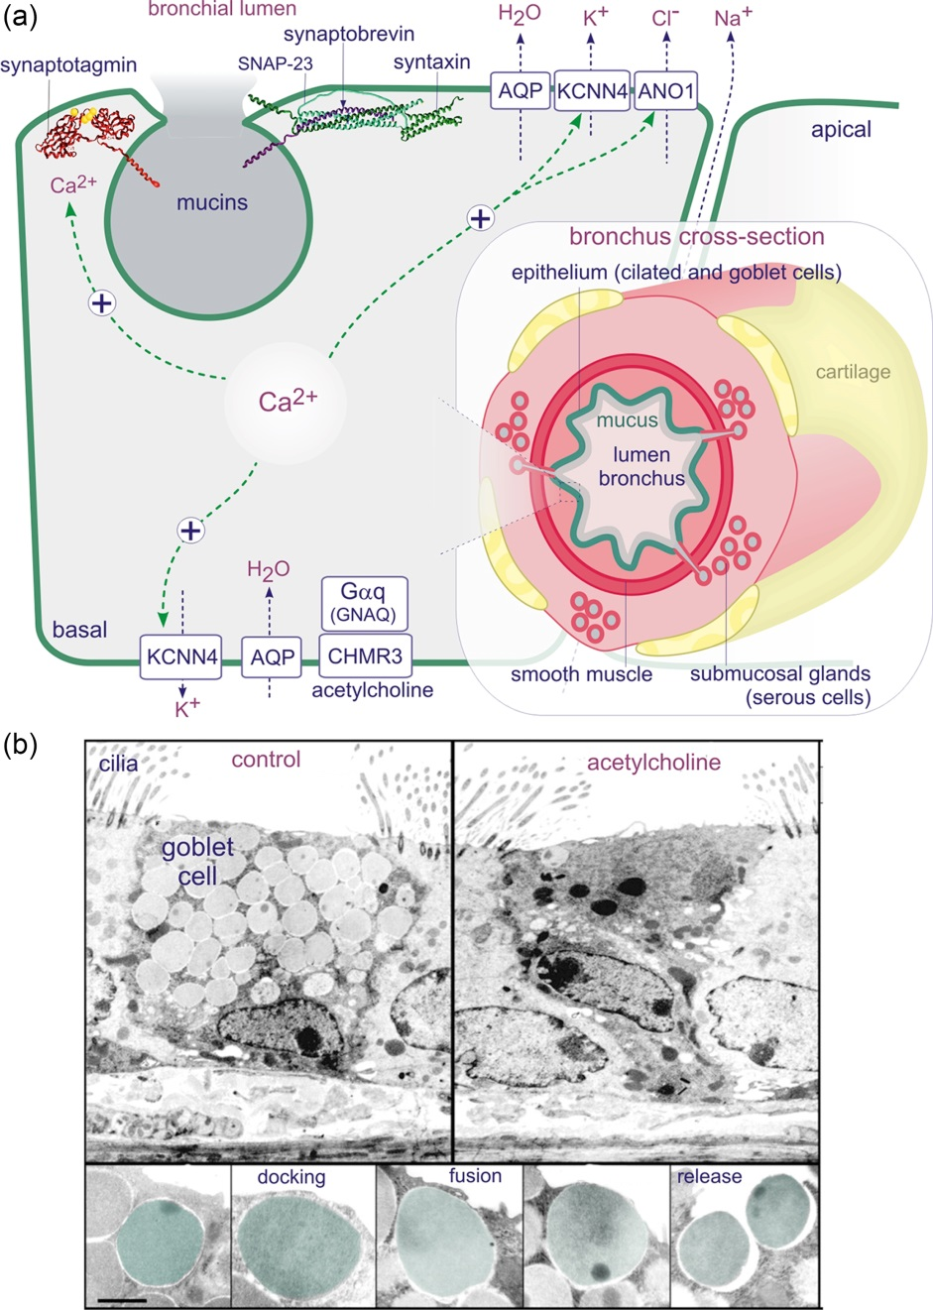
Figure 4.20

Slide 22
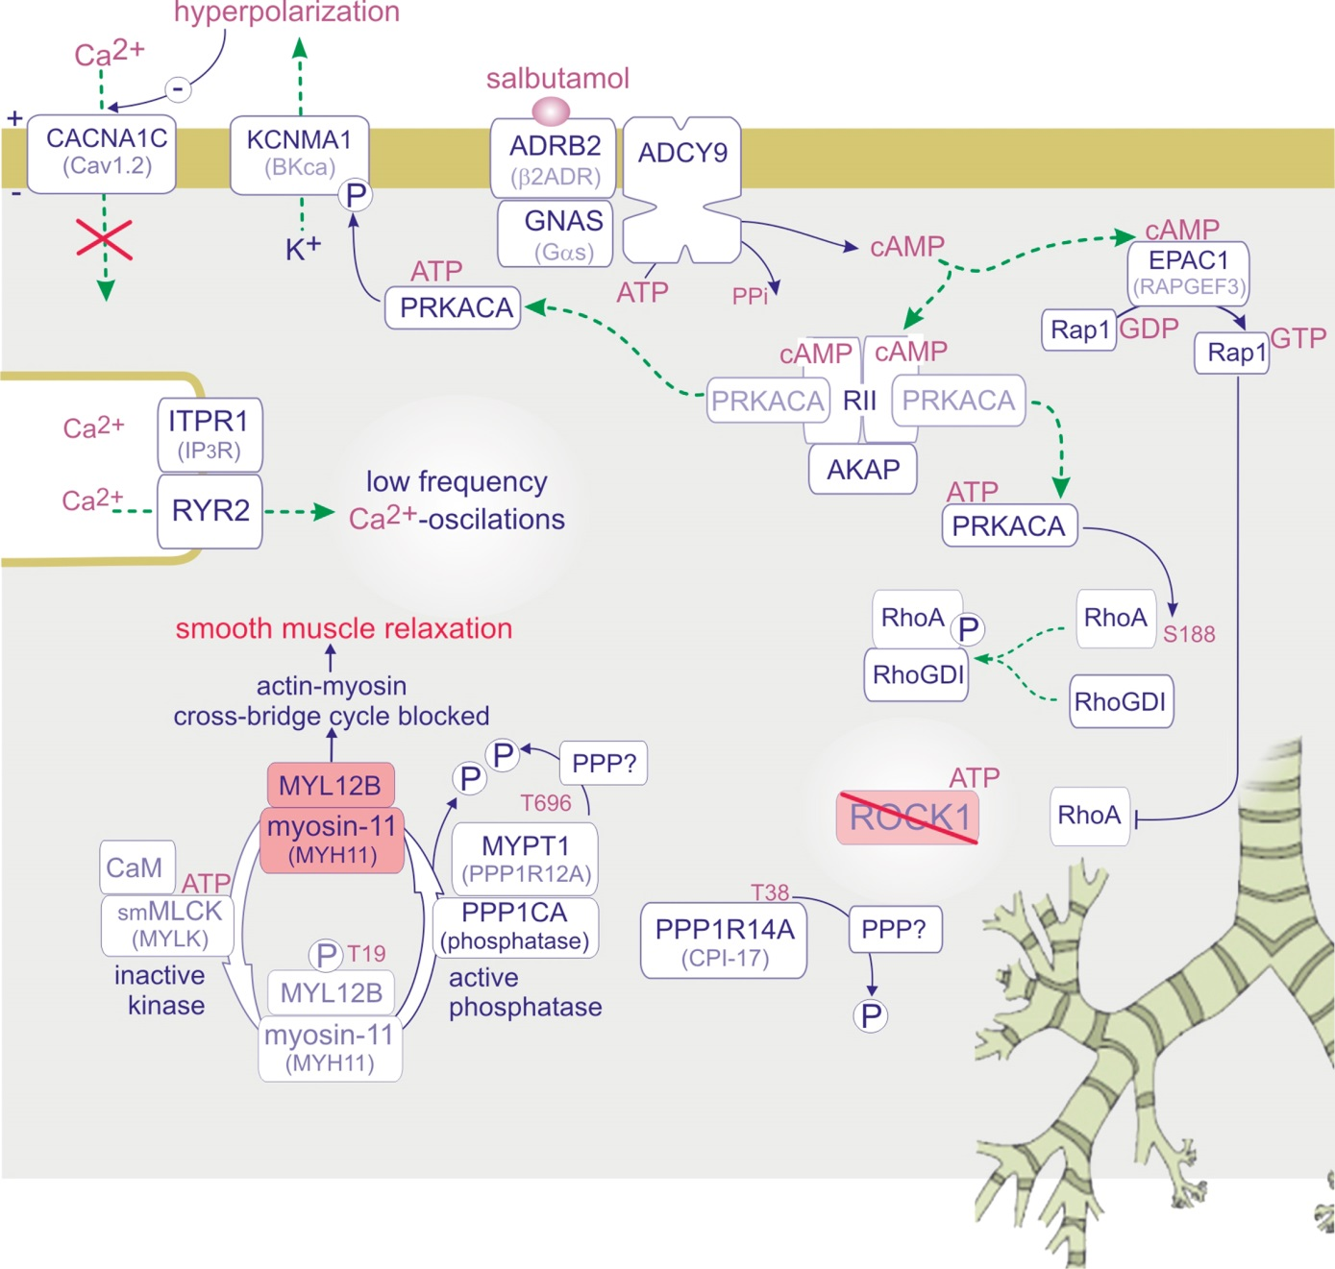
Figure 4.21

Slide 23
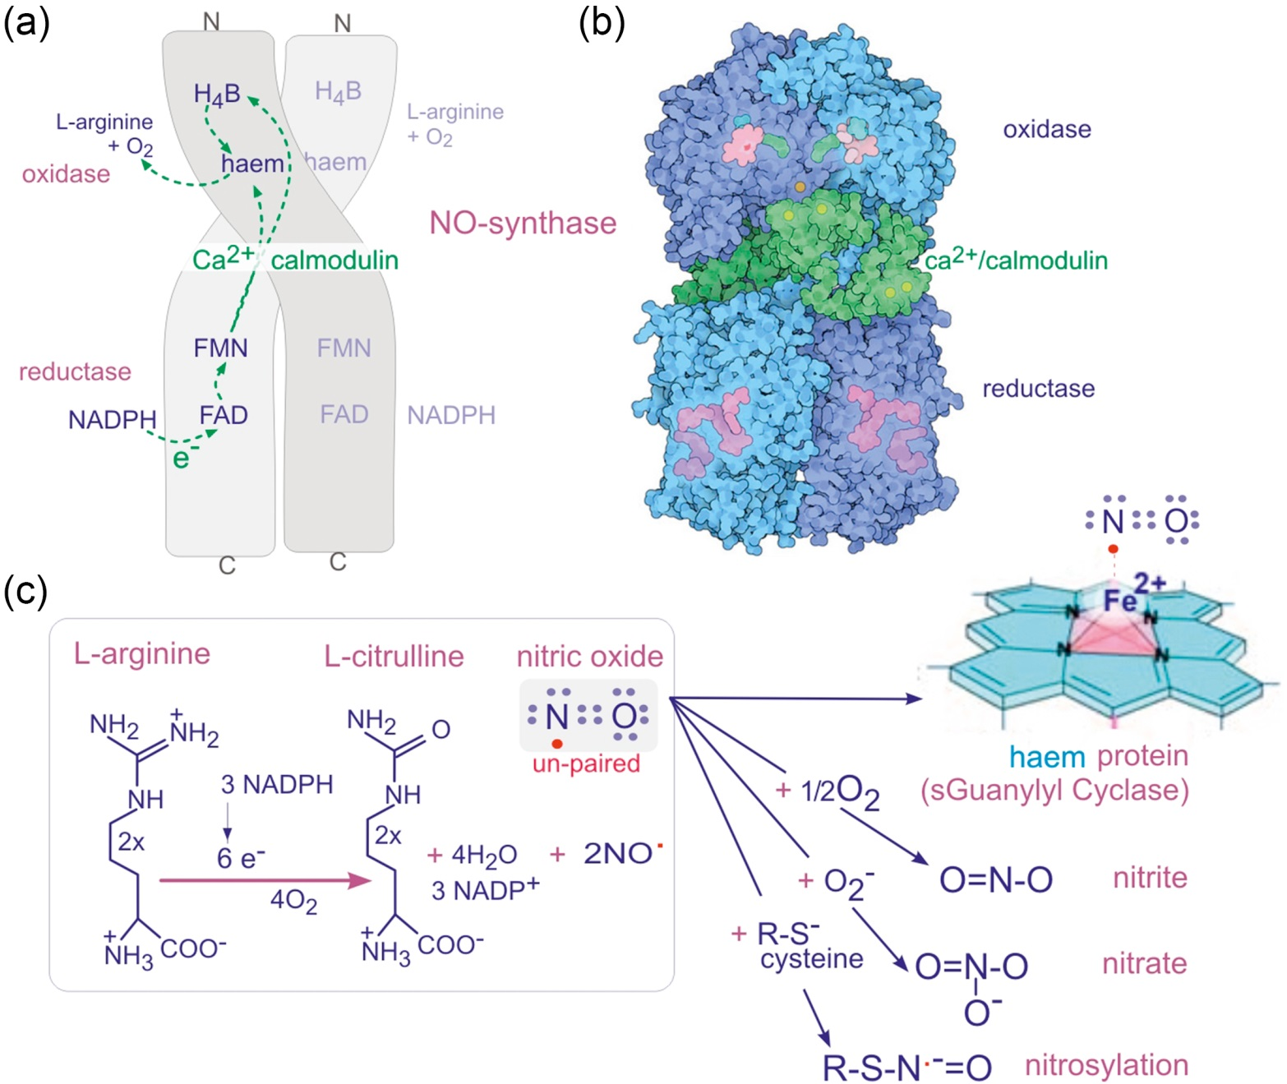
Figure 4.22

Slide 24
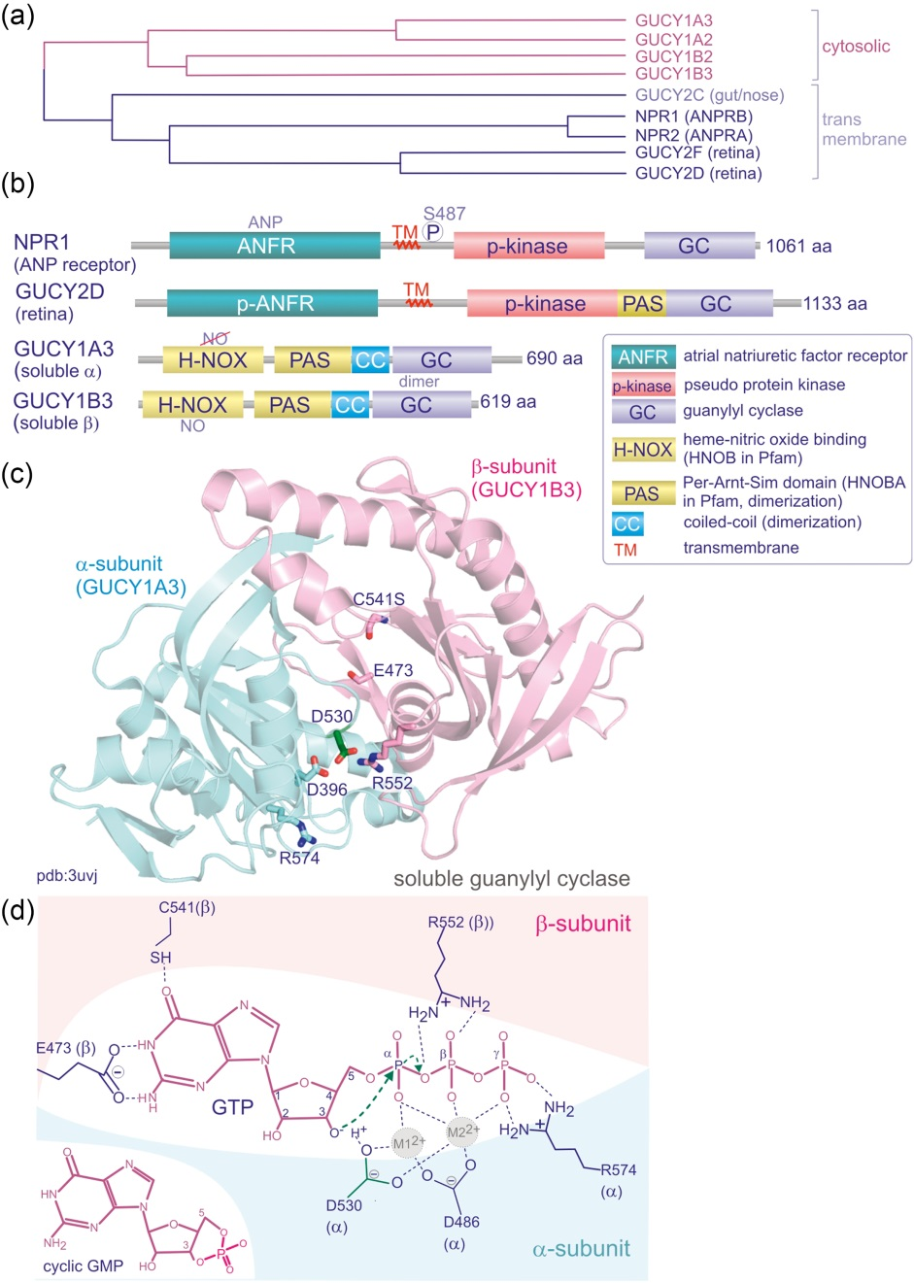
Figure 4.23

Slide 25
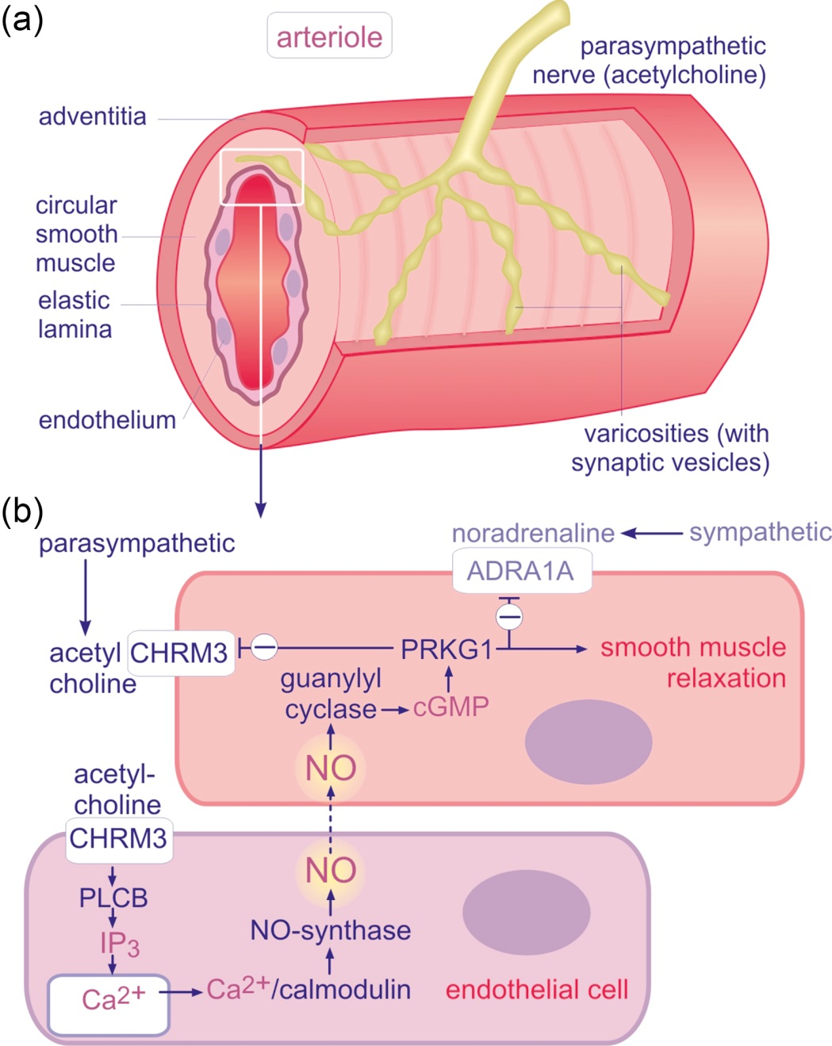
Figure 4.24

Slide 26
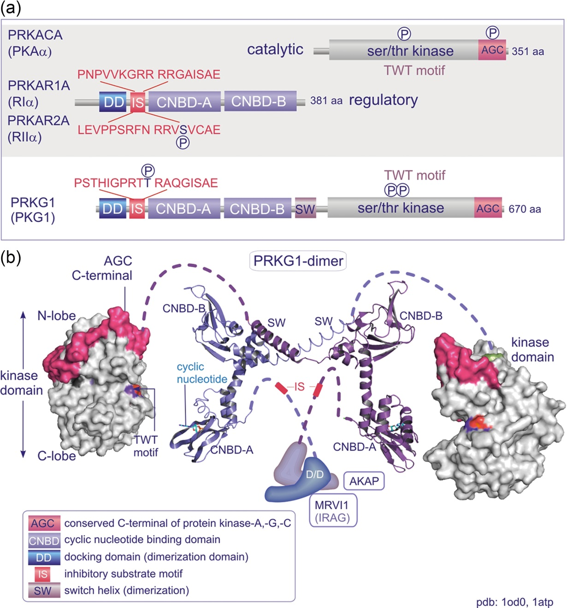
Figure 4.25

Slide 27
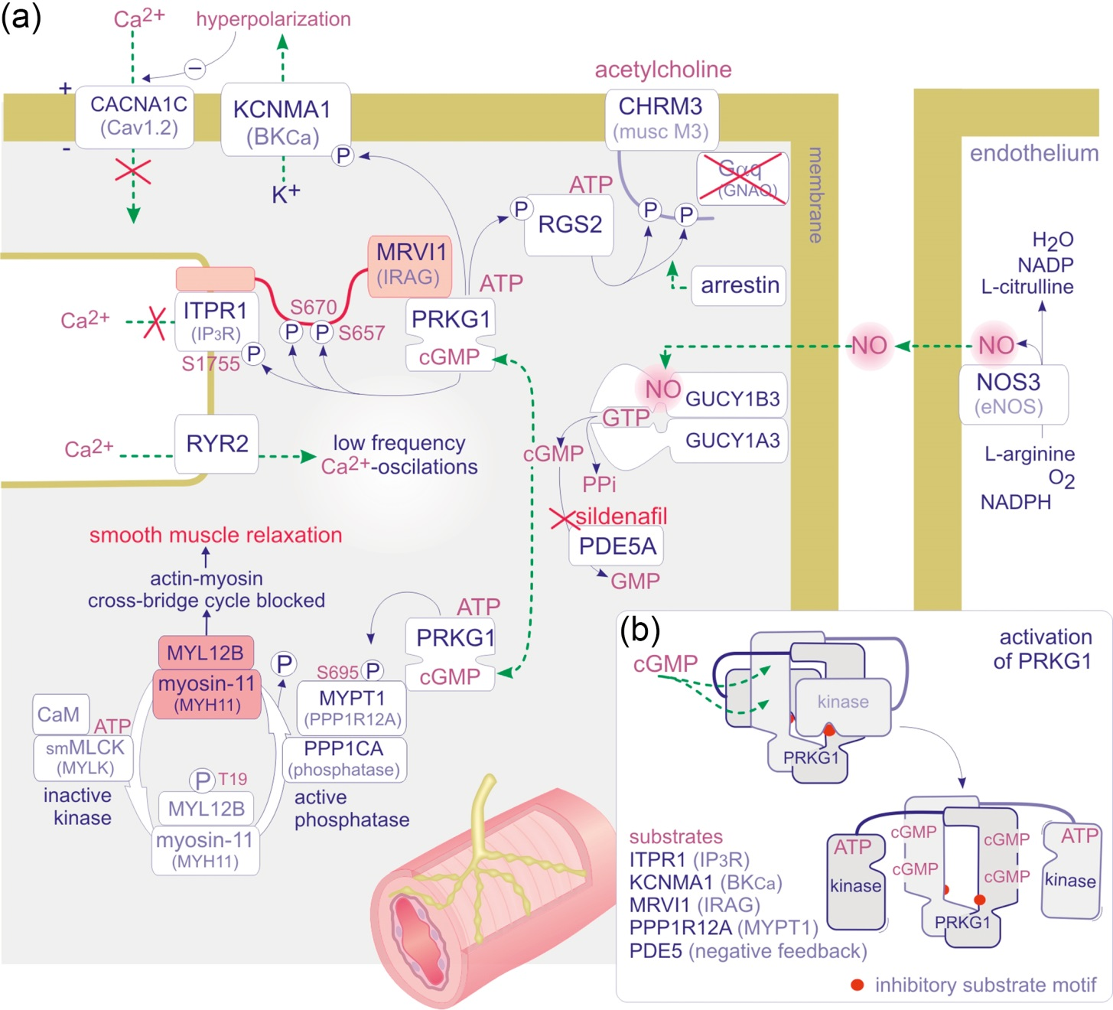
Figure 4.26

Slide 28
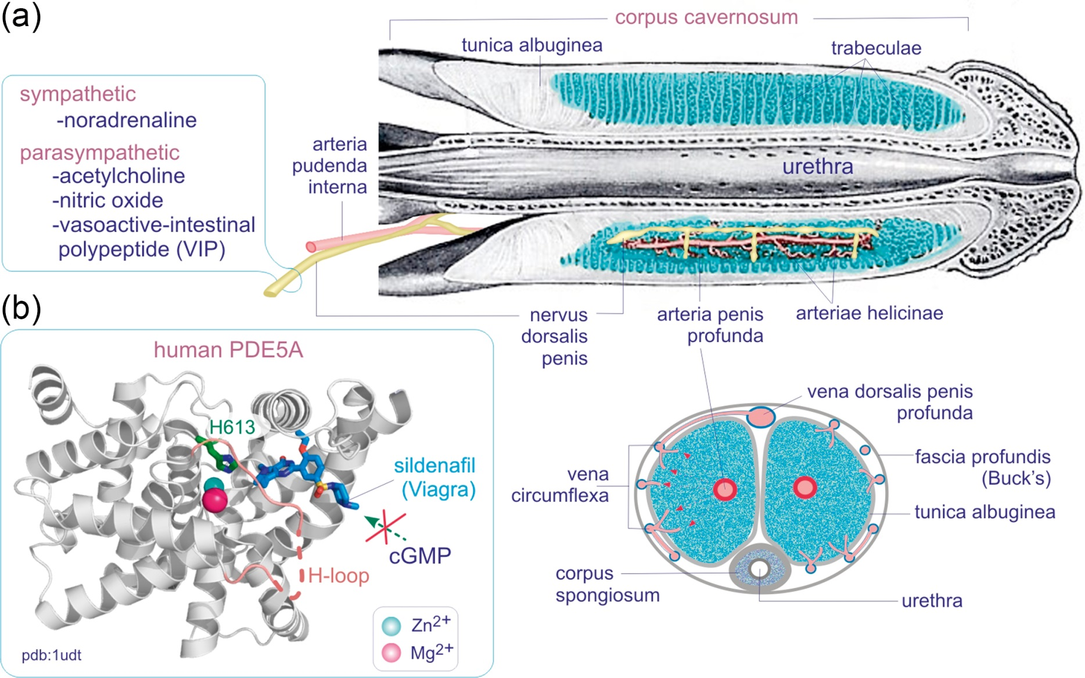
Figure 4.27

Slide 29
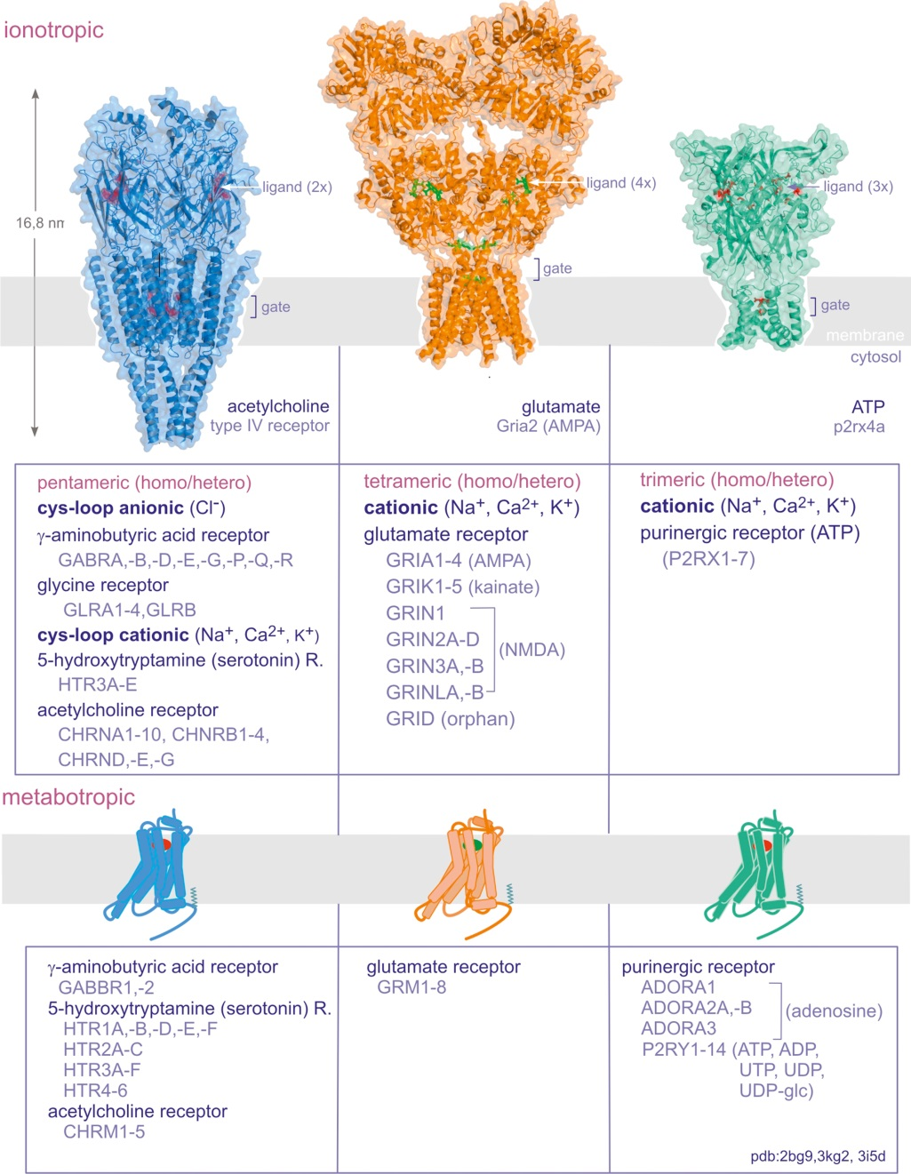
Figure 4.28

