Slide 1
Chapter 2

Slide 2
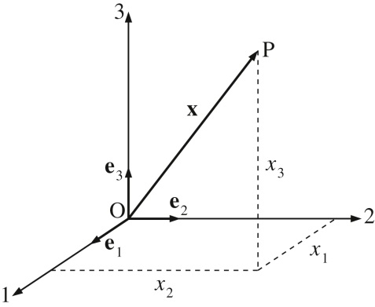
Figure 2.1

Slide 3
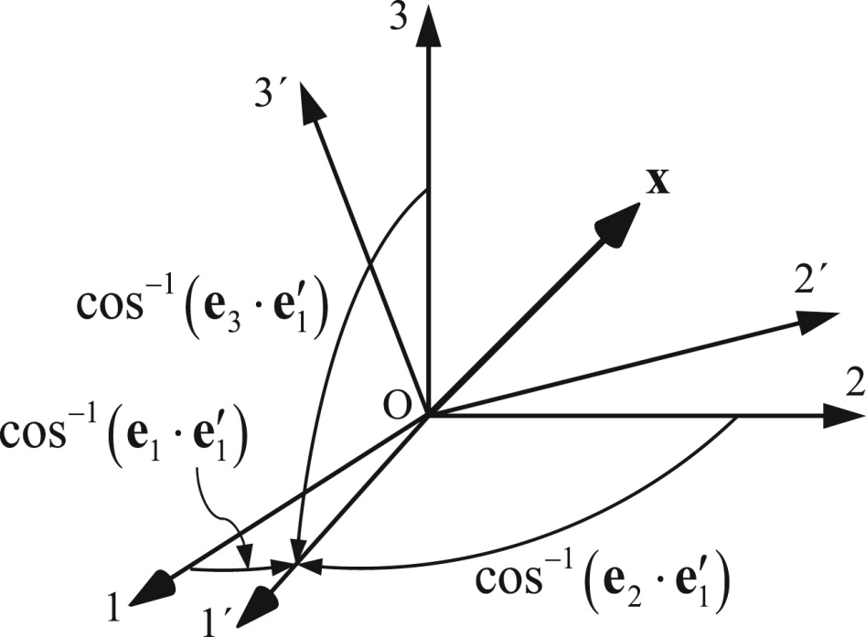
Figure 2.2

Slide 4
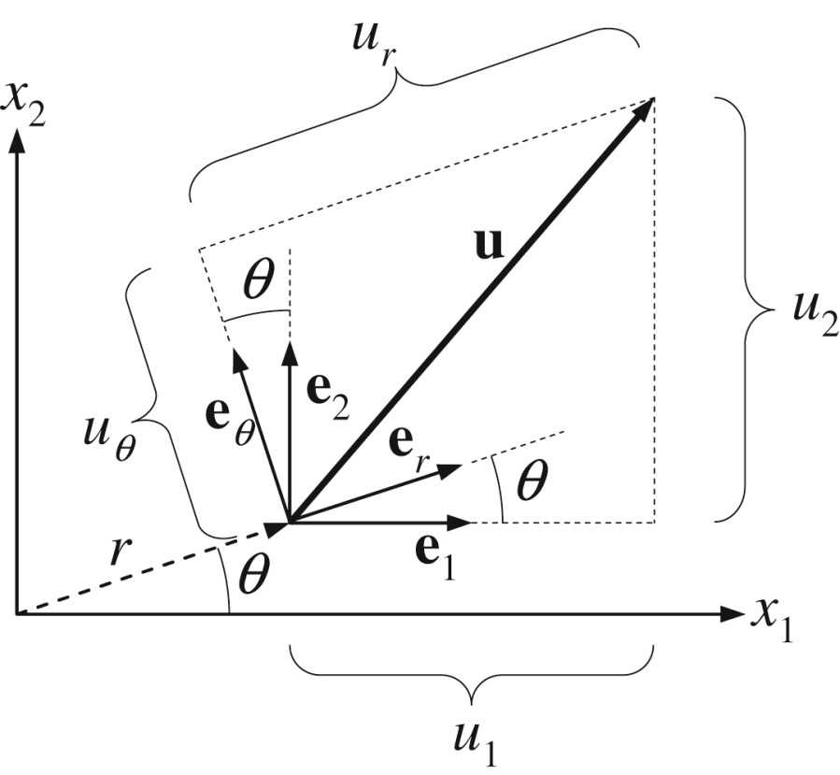
Figure 2.3

Slide 5
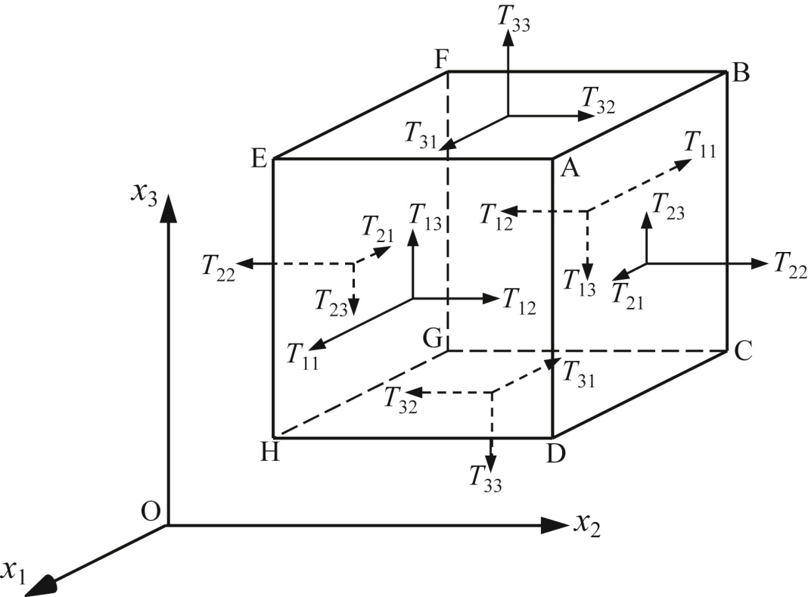
Figure 2.4

Slide 6
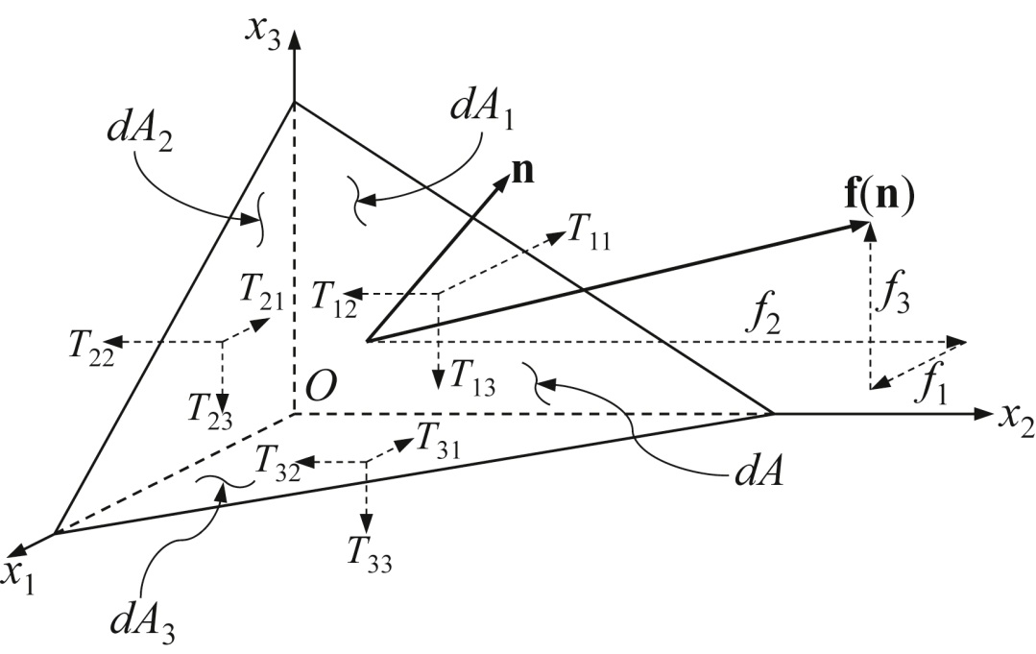
Figure 2.5

Slide 7
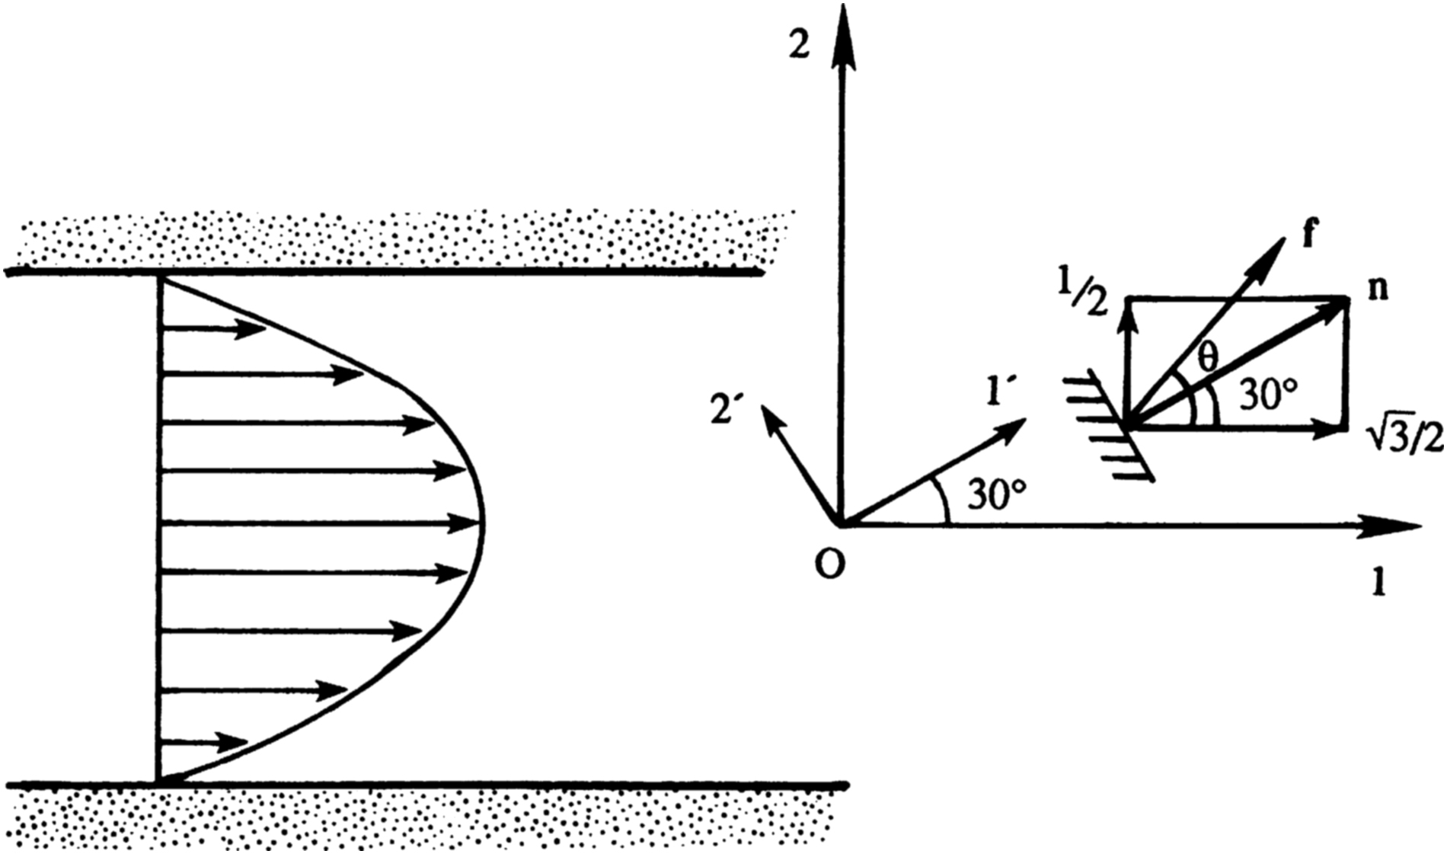
Figure 2.6

Slide 8
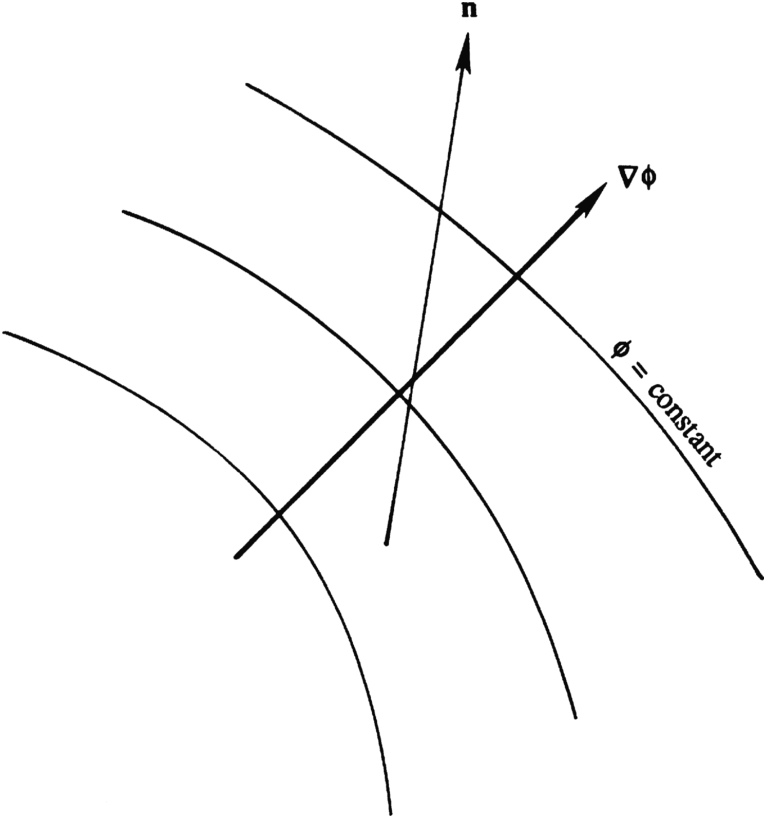
Figure 2.7

Slide 9
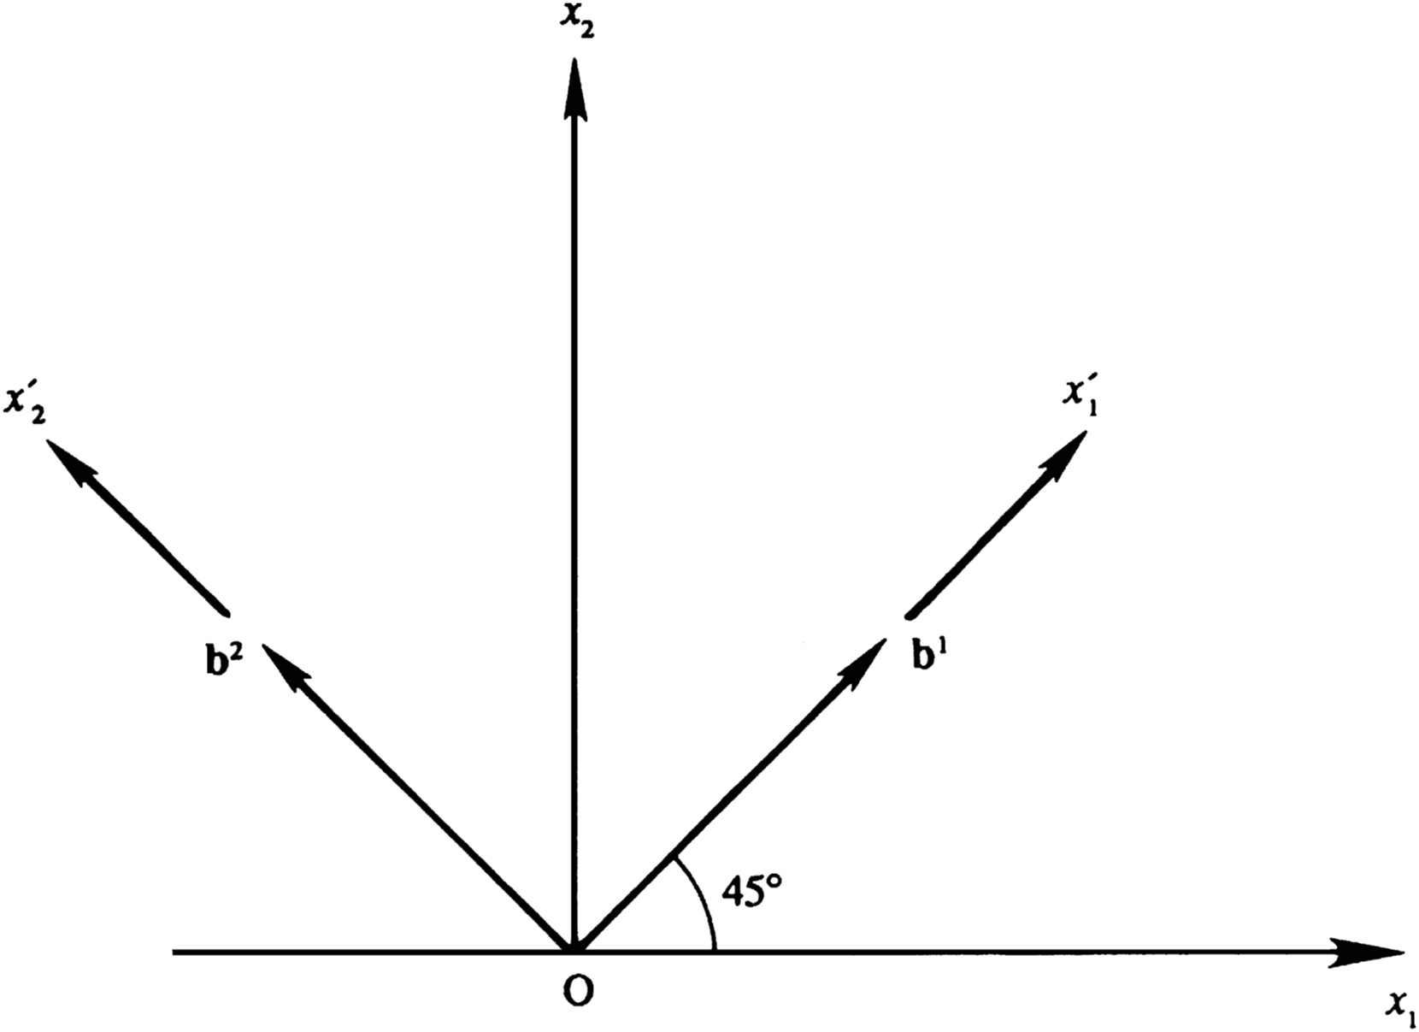
Figure 2.8

Slide 10
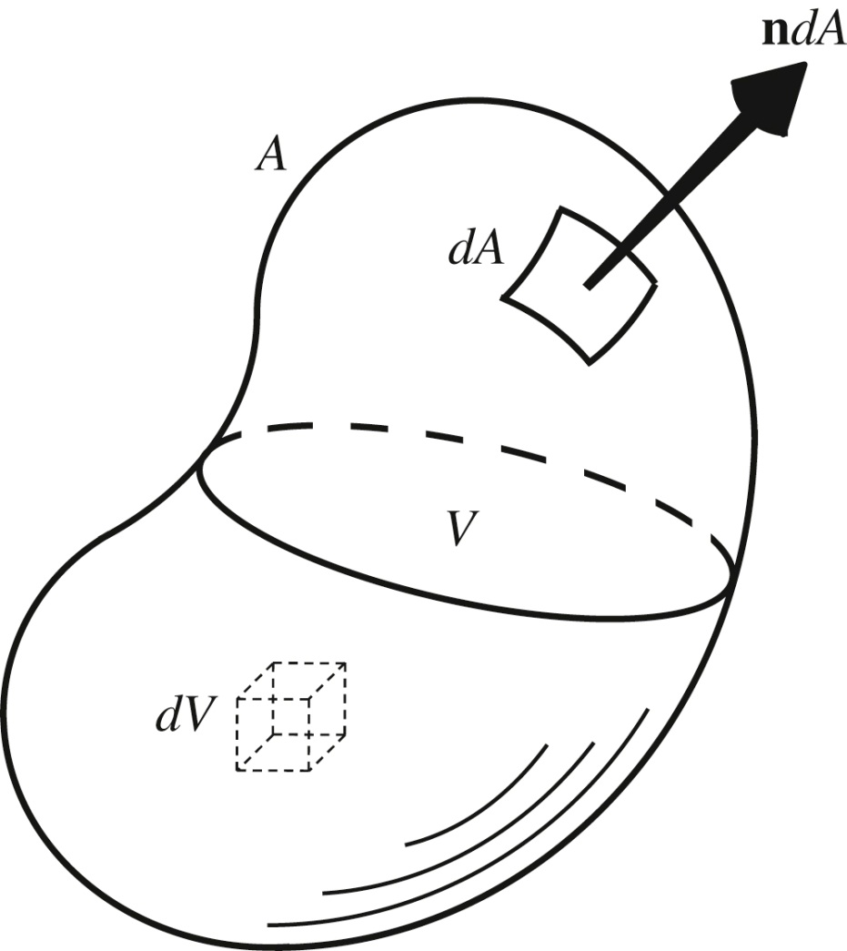
Figure 2.9

Slide 11
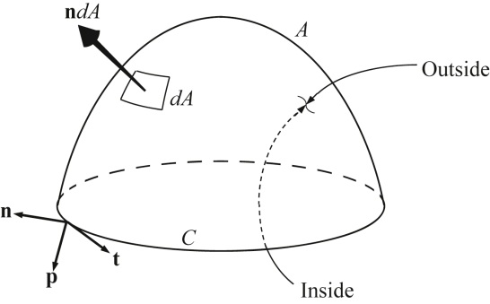
Figure 2.10

Slide 12
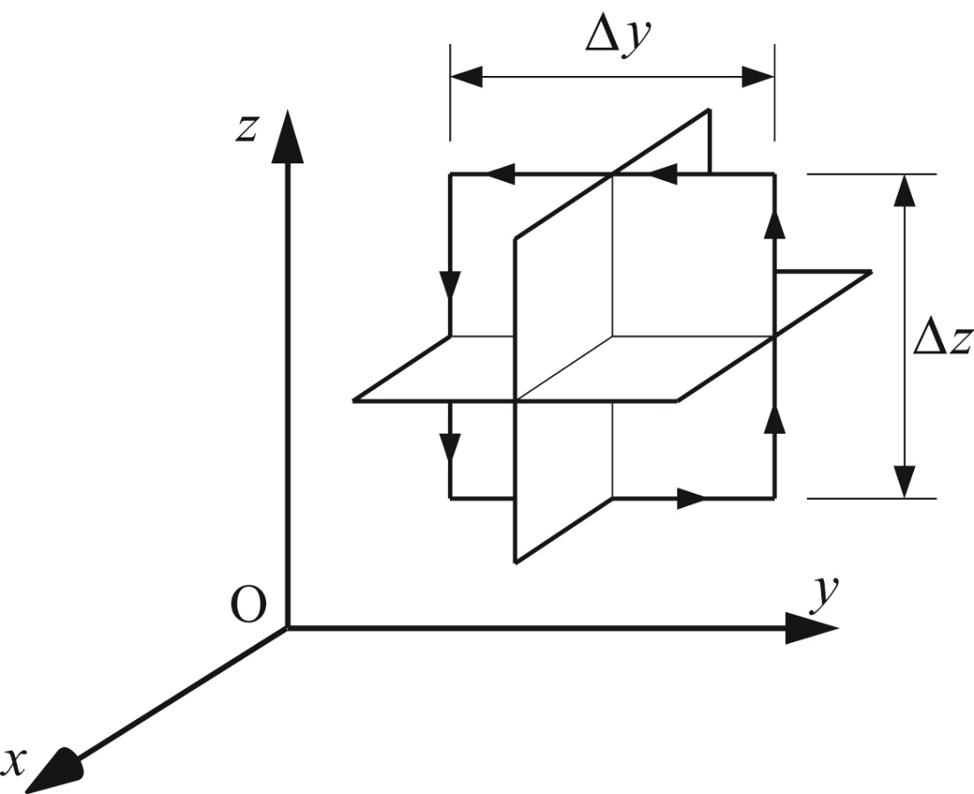
Figure 2.11

Slide 13
UnnFigure 2.1

