Slide 1
Chapter 3

Slide 2
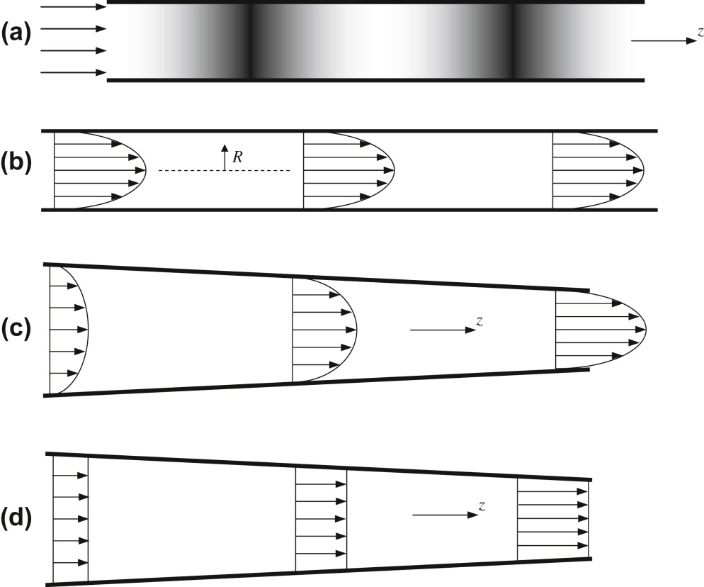
Figure 3.1

Slide 3
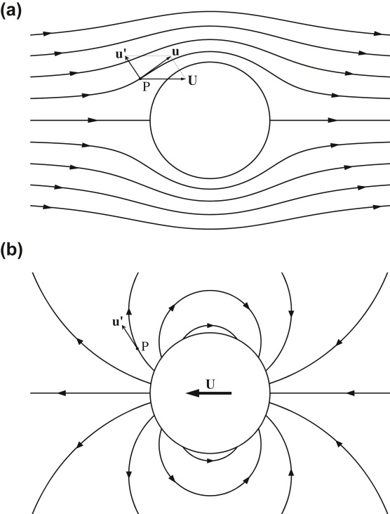
Figure 3.2

Slide 4
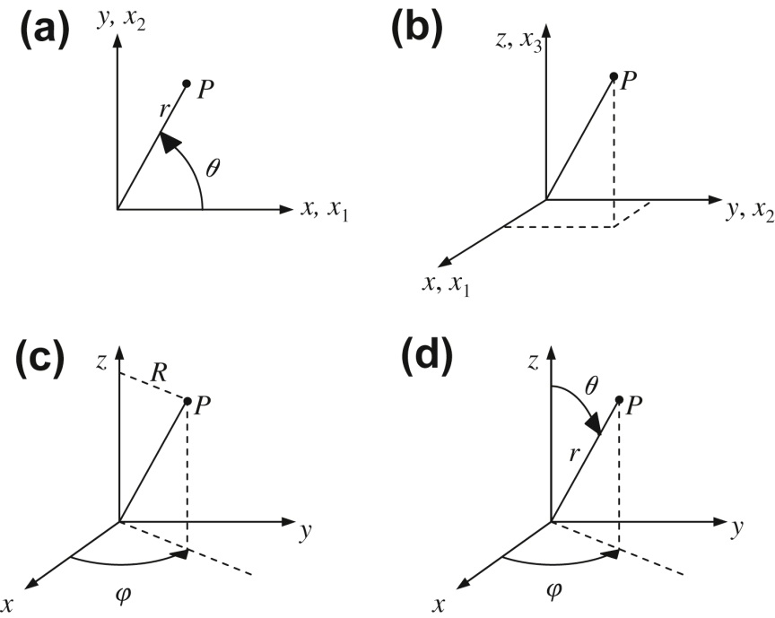
Figure 3.3

Slide 5
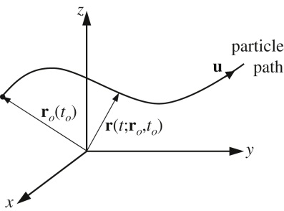
Figure 3.4

Slide 6
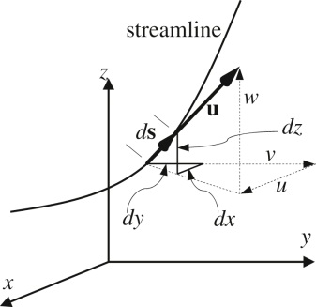
Figure 3.5

Slide 7
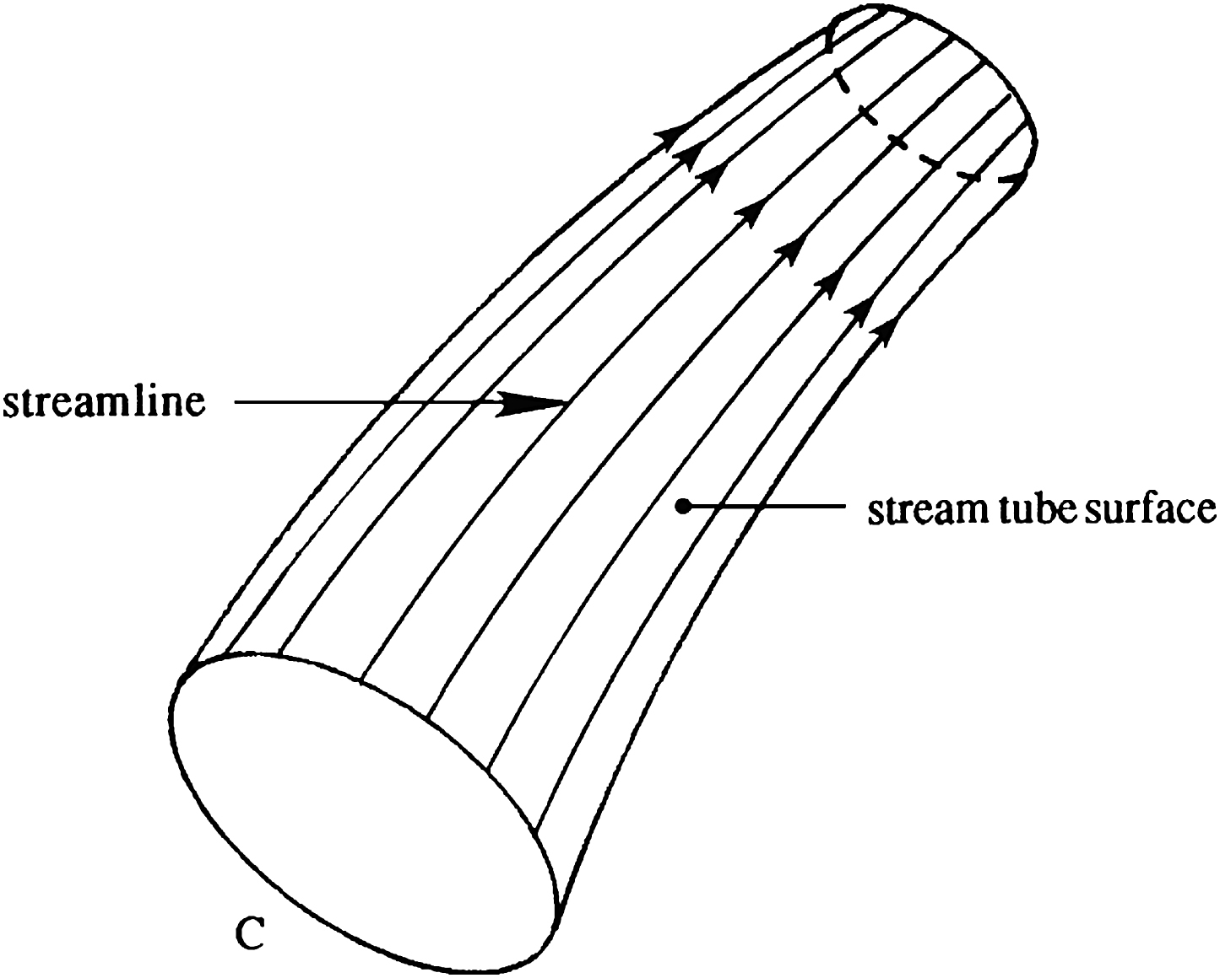
Figure 3.6

Slide 8
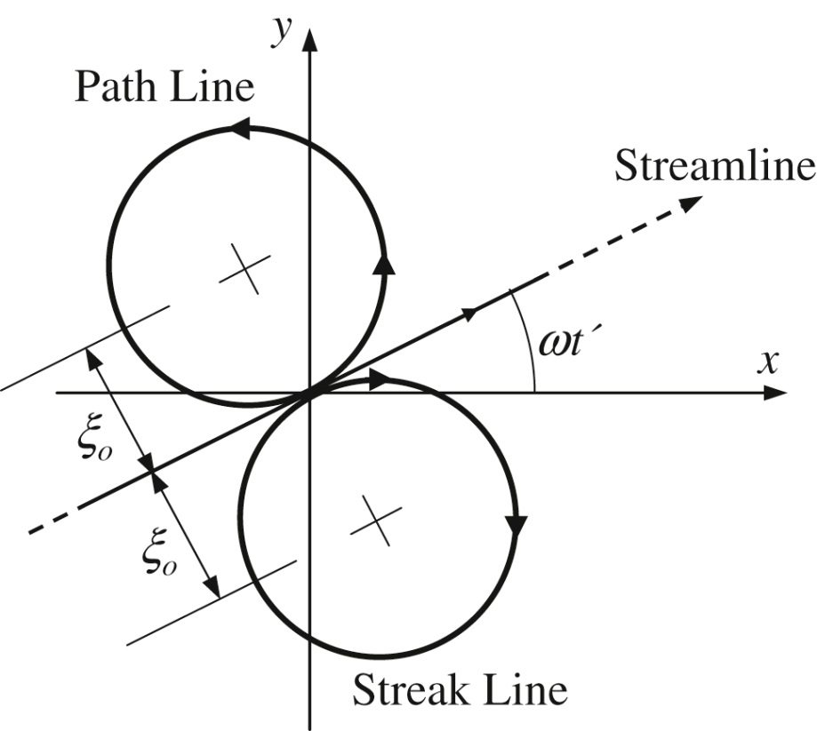
Figure 3.7

Slide 9
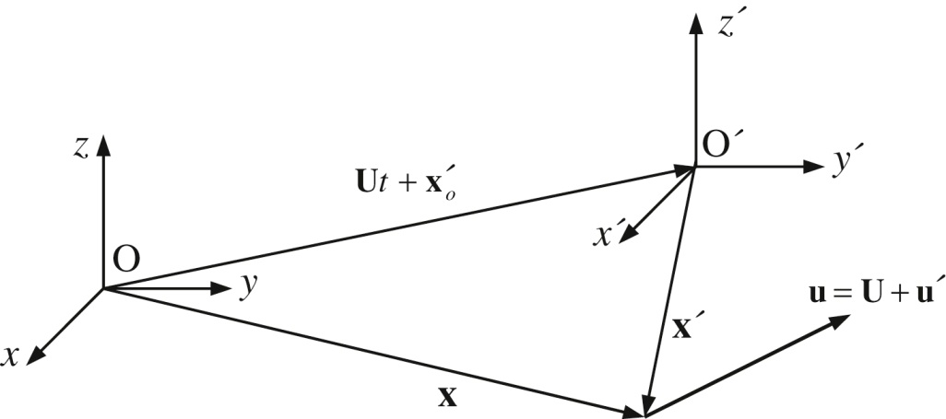
Figure 3.8

Slide 10
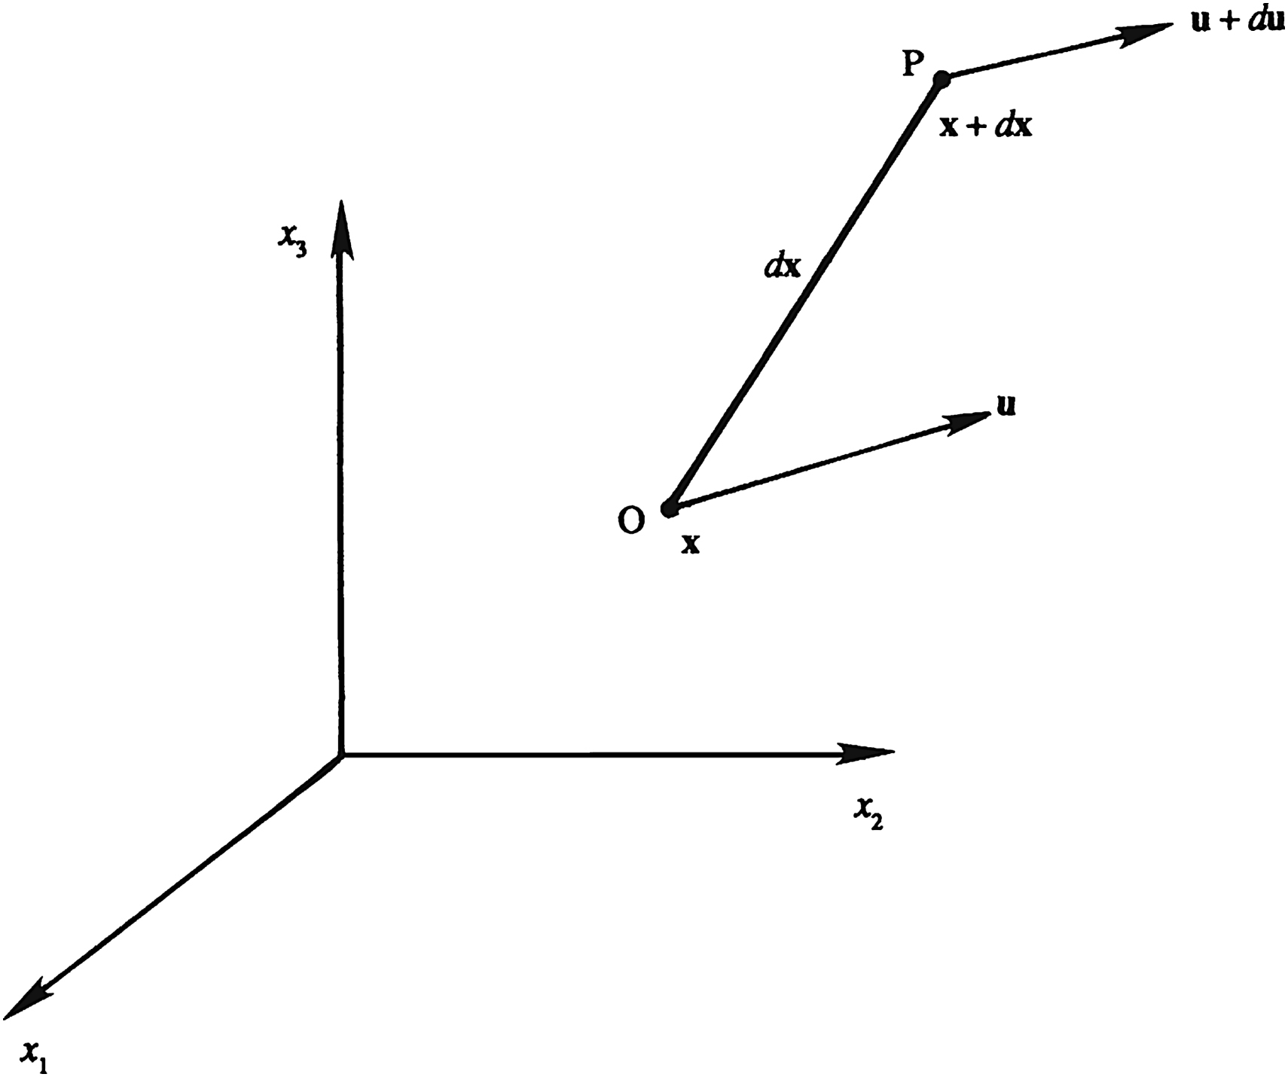
Figure 3.9

Slide 11
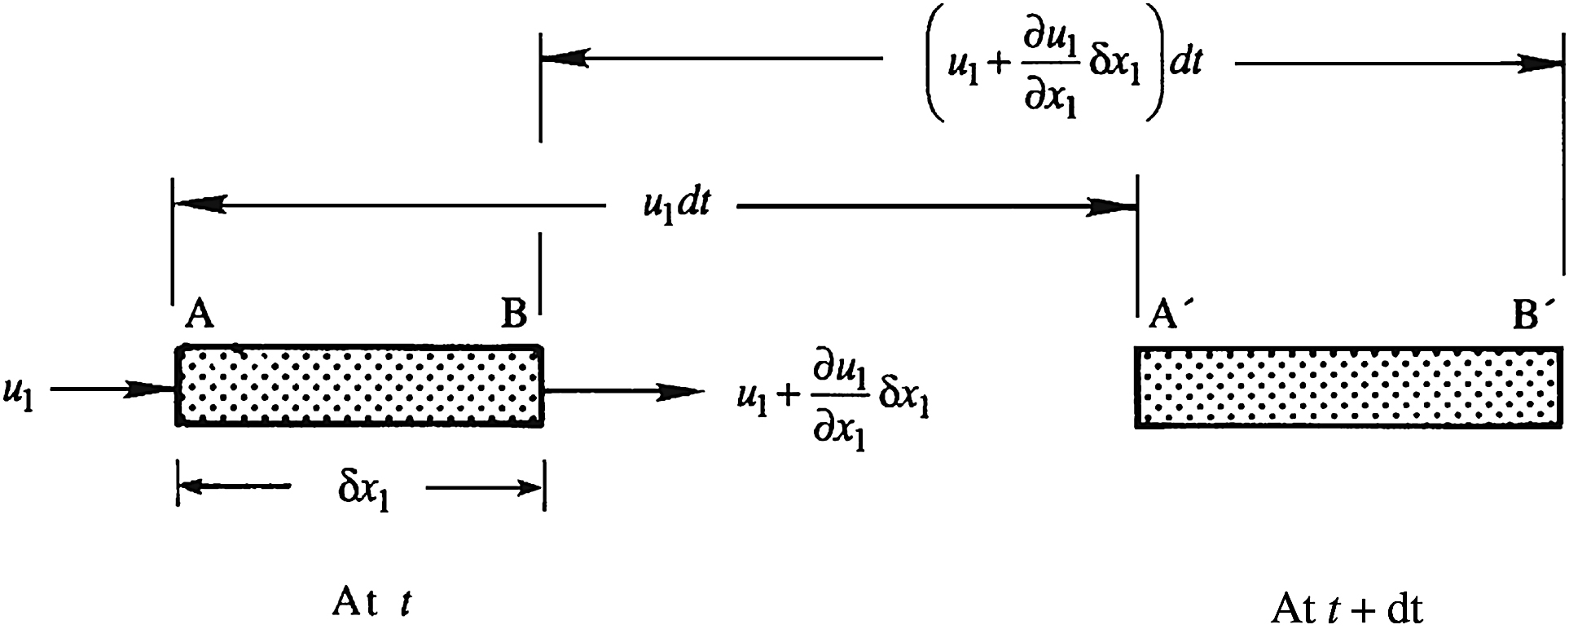
Figure 3.10

Slide 12
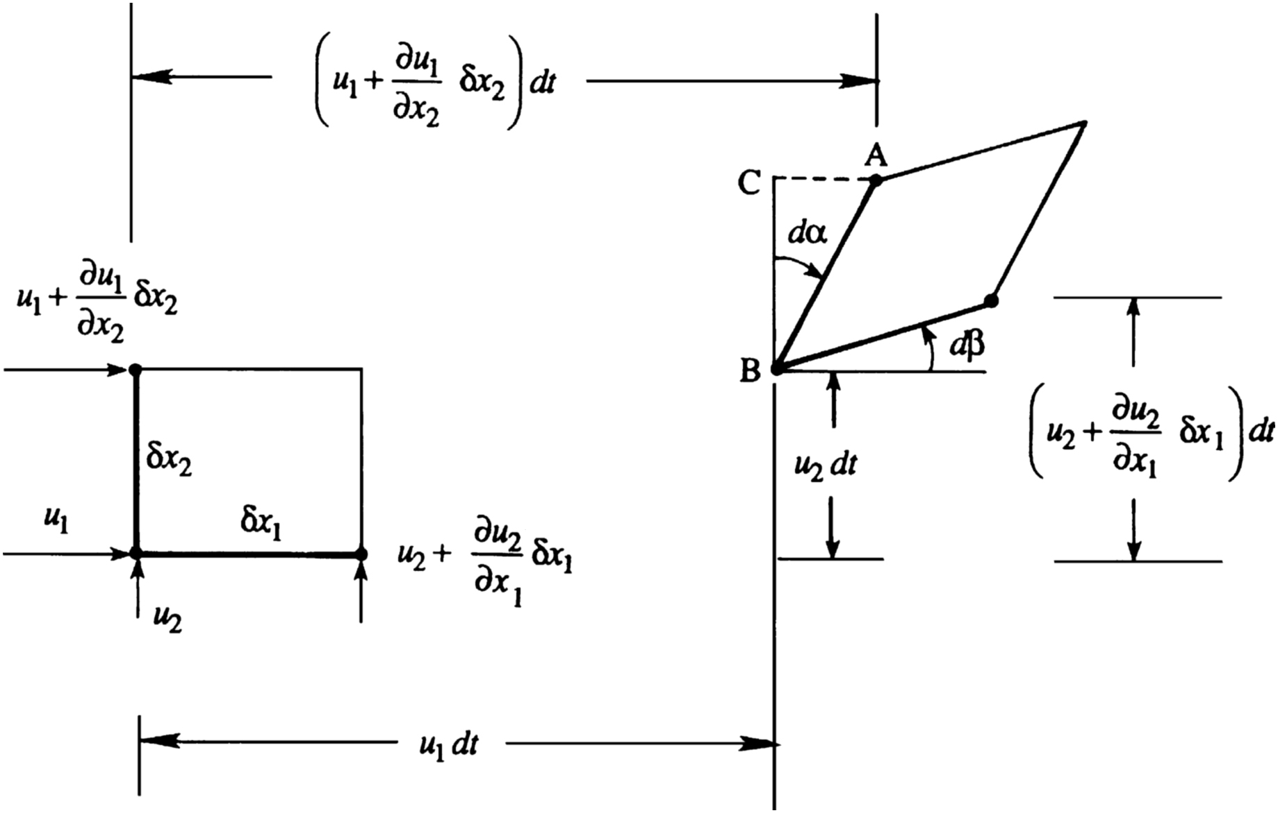
Figure 3.11

Slide 13
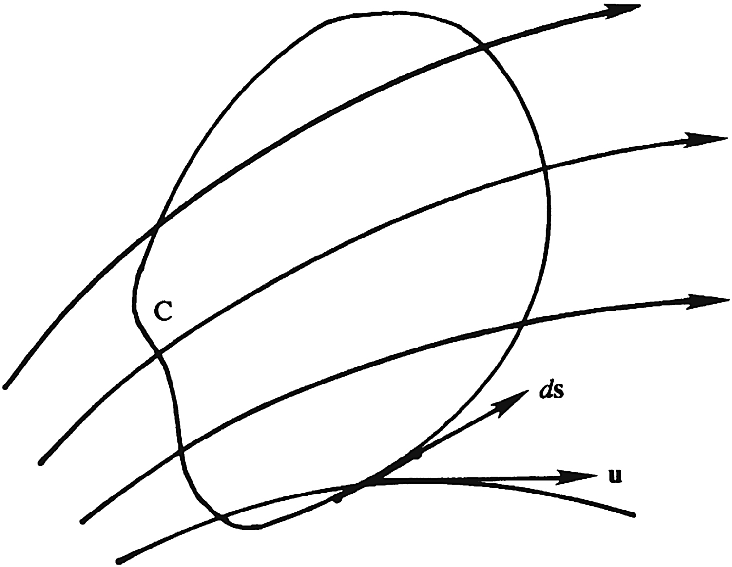
Figure 3.12

Slide 14
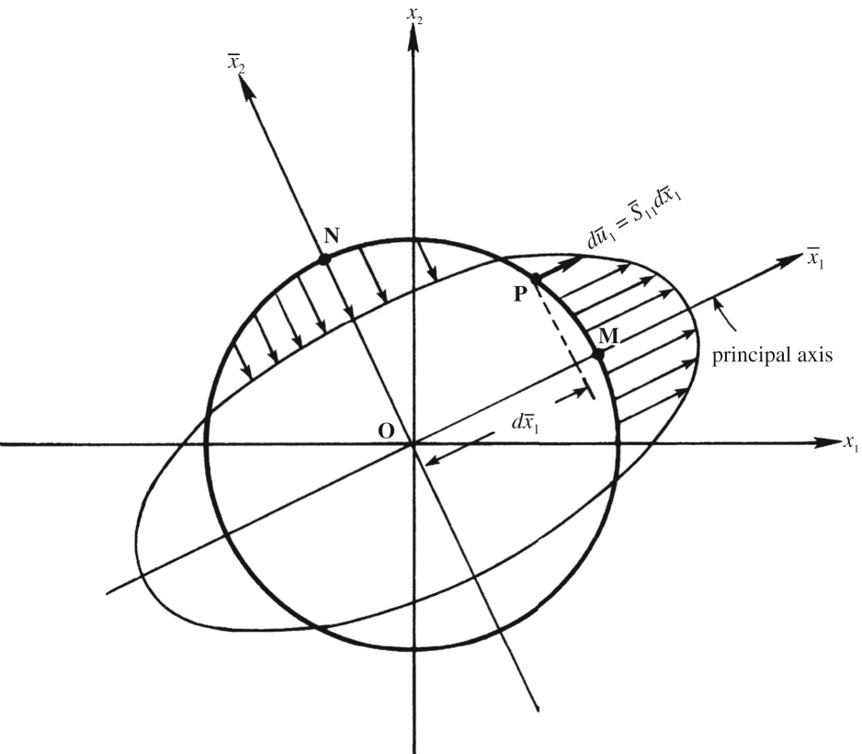
Figure 3.13

Slide 15
Figure 3.14

Slide 16
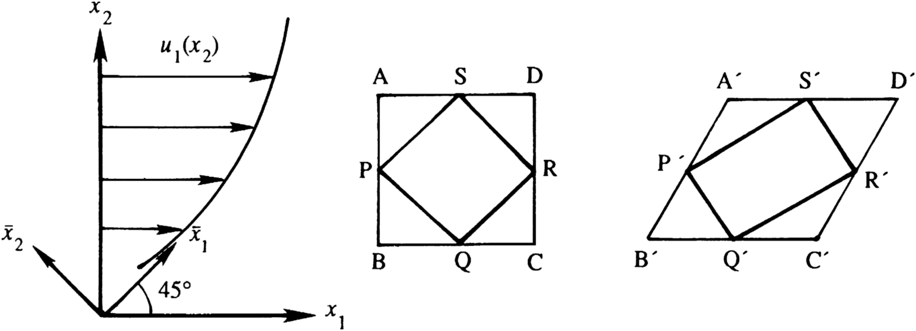
Figure 3.15

Slide 17
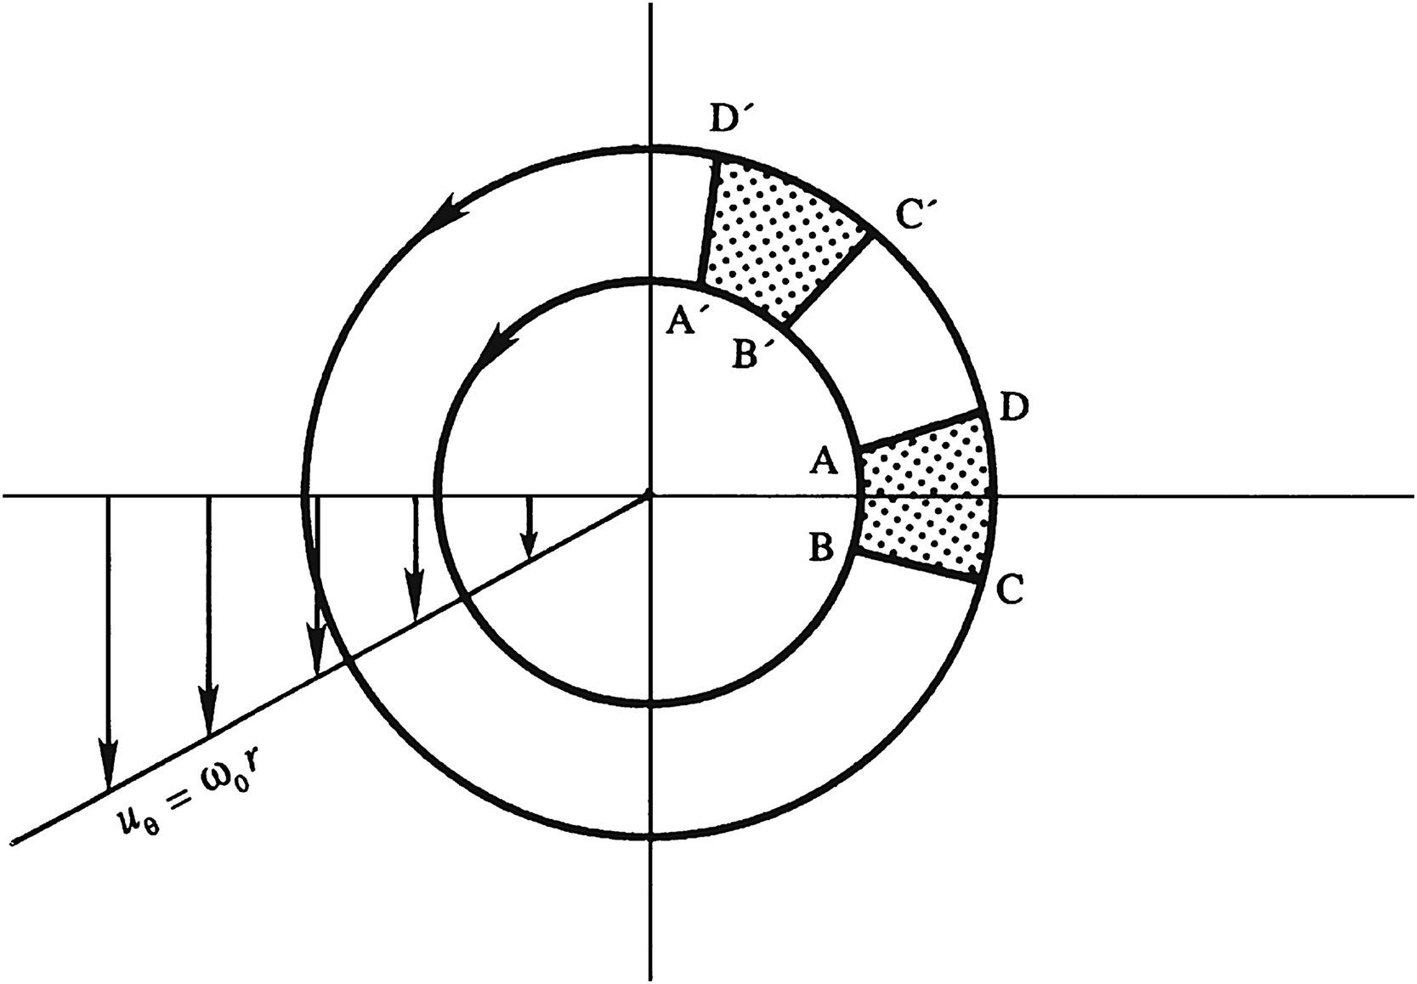
Figure 3.16

Slide 18
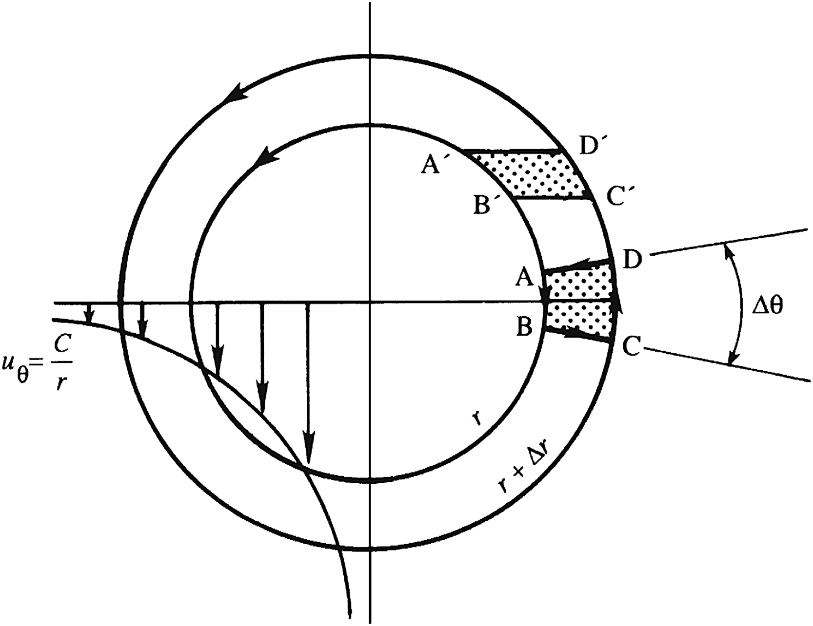
Figure 3.17

Slide 19
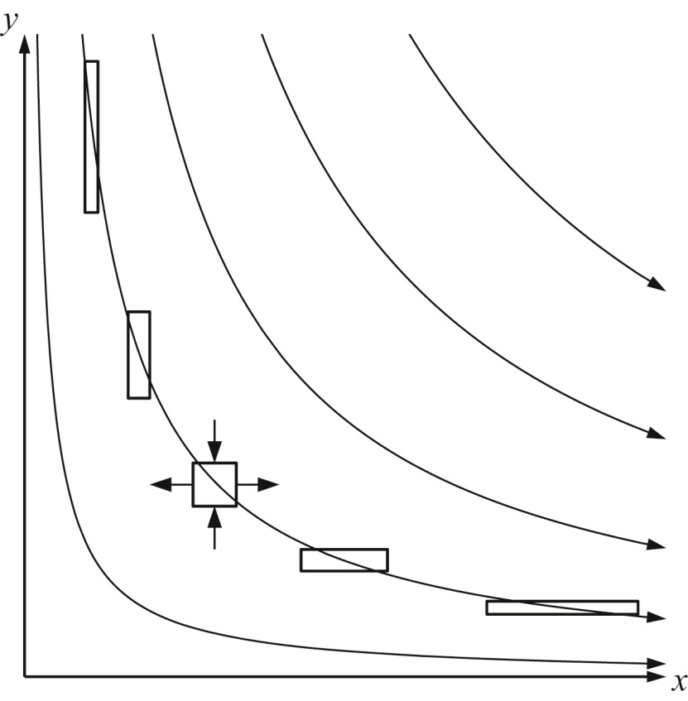
Figure 3.18

Slide 20
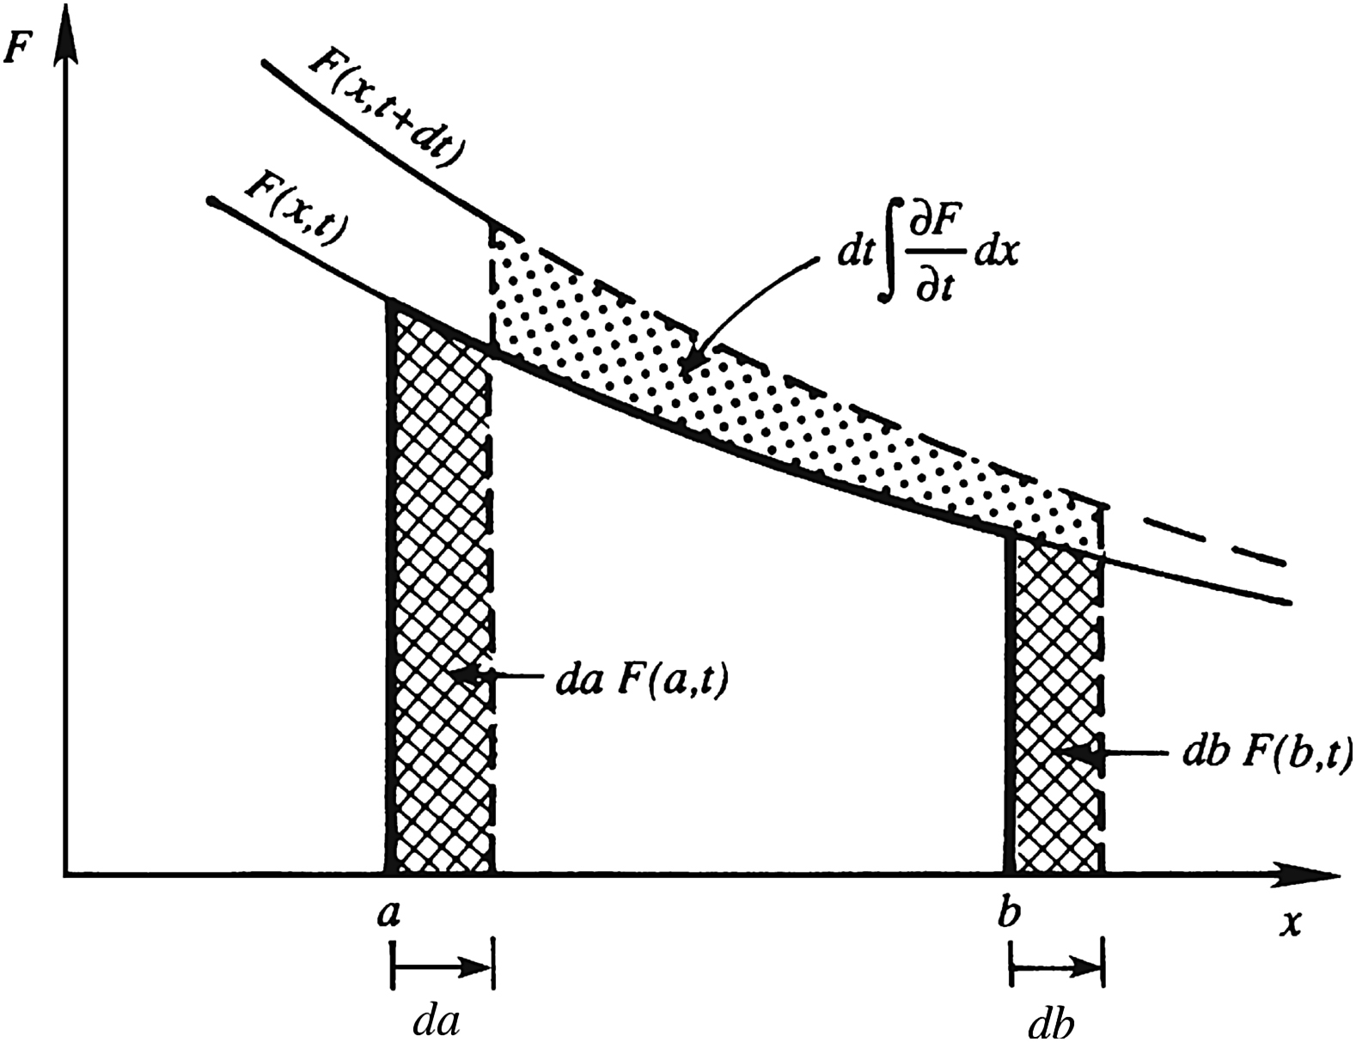
Figure 3.19

Slide 21
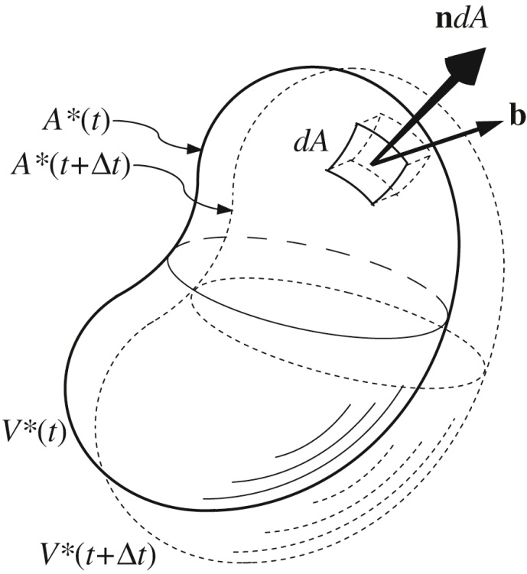
Figure 3.20

Slide 22
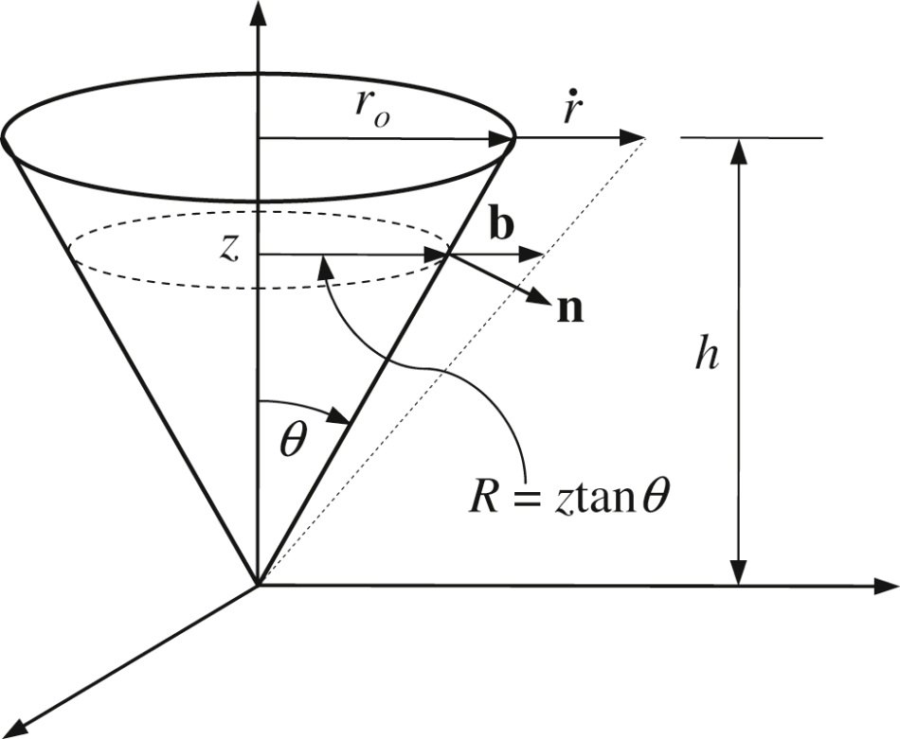
Figure 3.21

Slide 23
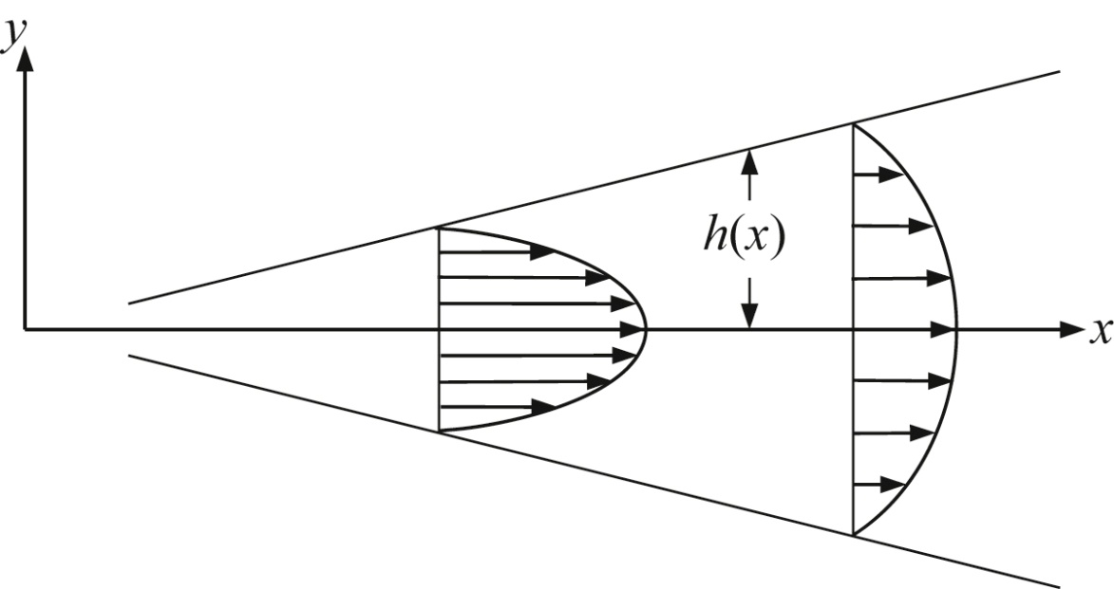
UnnFigure 3.1

Slide 24
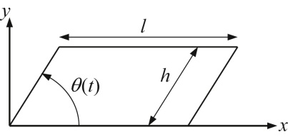
UnnFigure 3.2

Slide 25
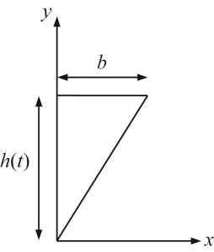
UnnFigure 3.3

Slide 26
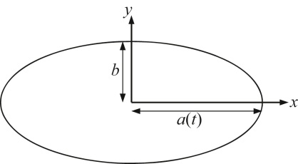
UnnFigure 3.4

