Slide 1
Chapter 7

Slide 2
Figure 7.1

Slide 3
Figure 7.2

Slide 4
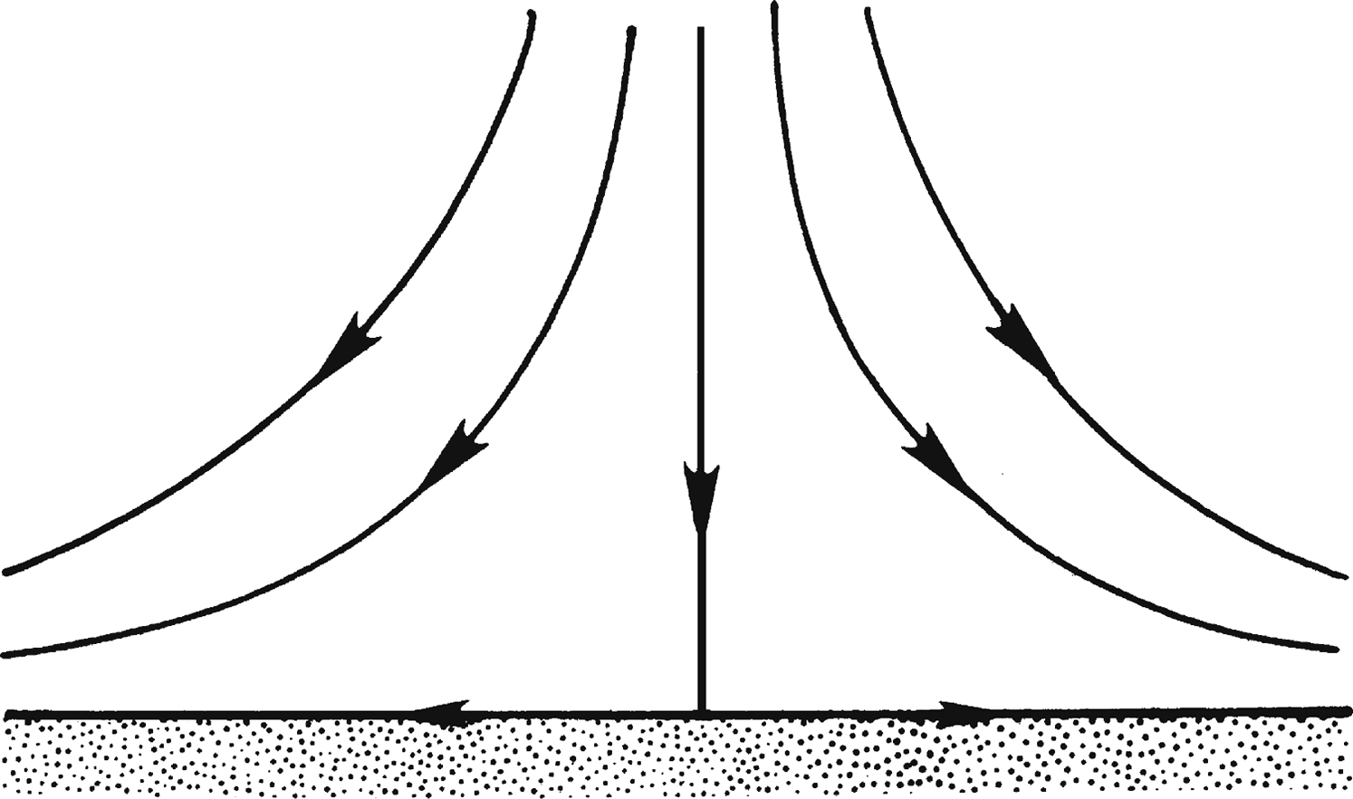
Figure 7.3

Slide 5
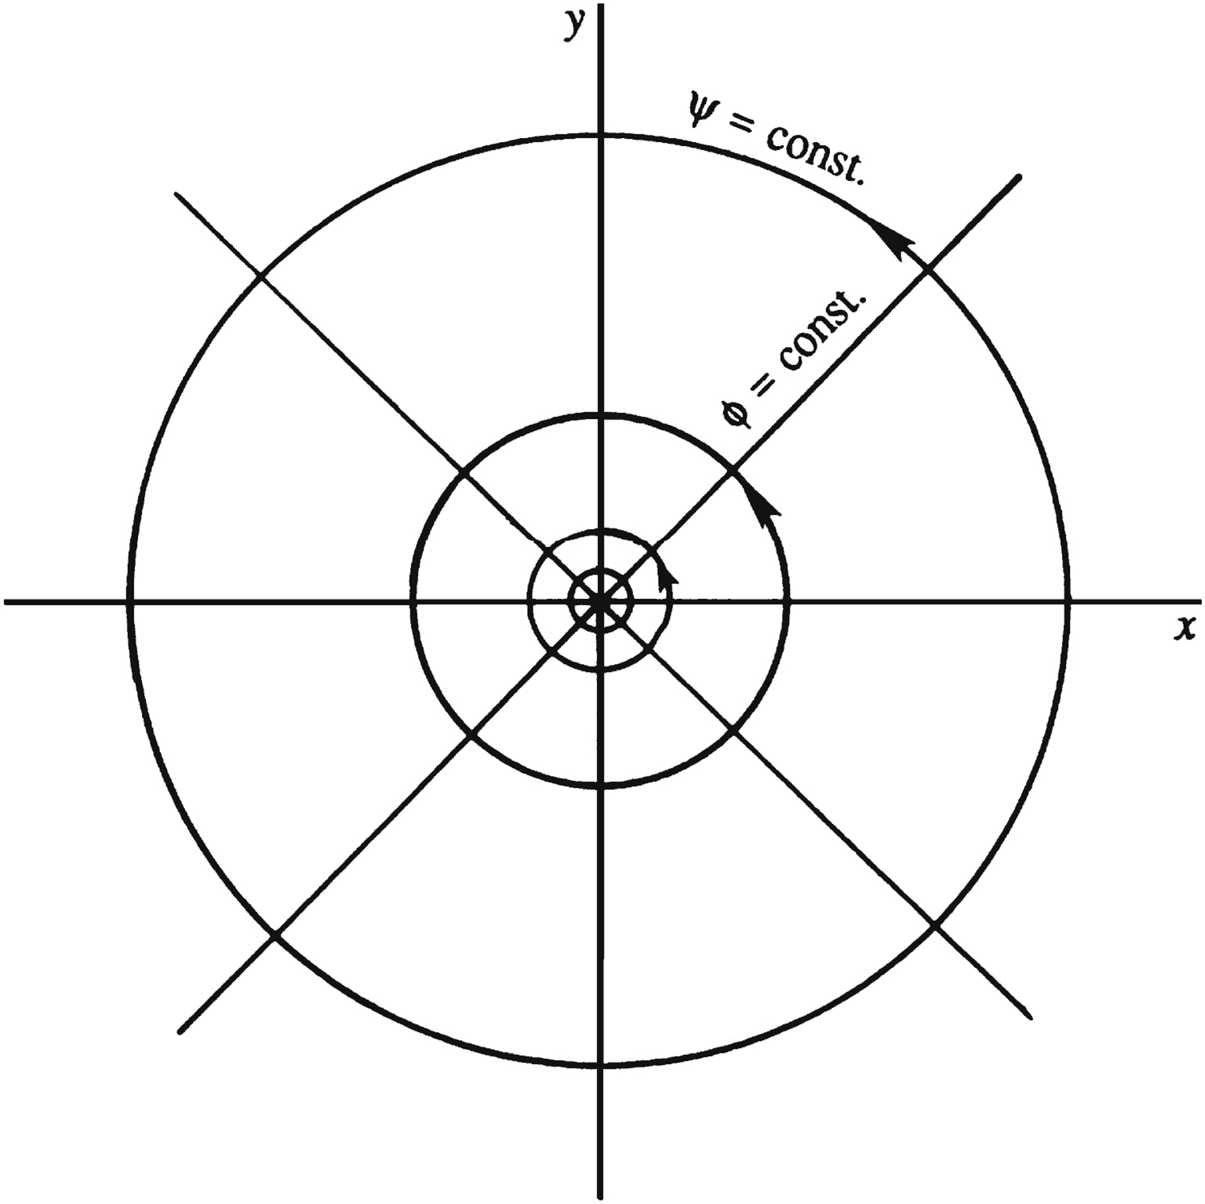
Figure 7.4

Slide 6
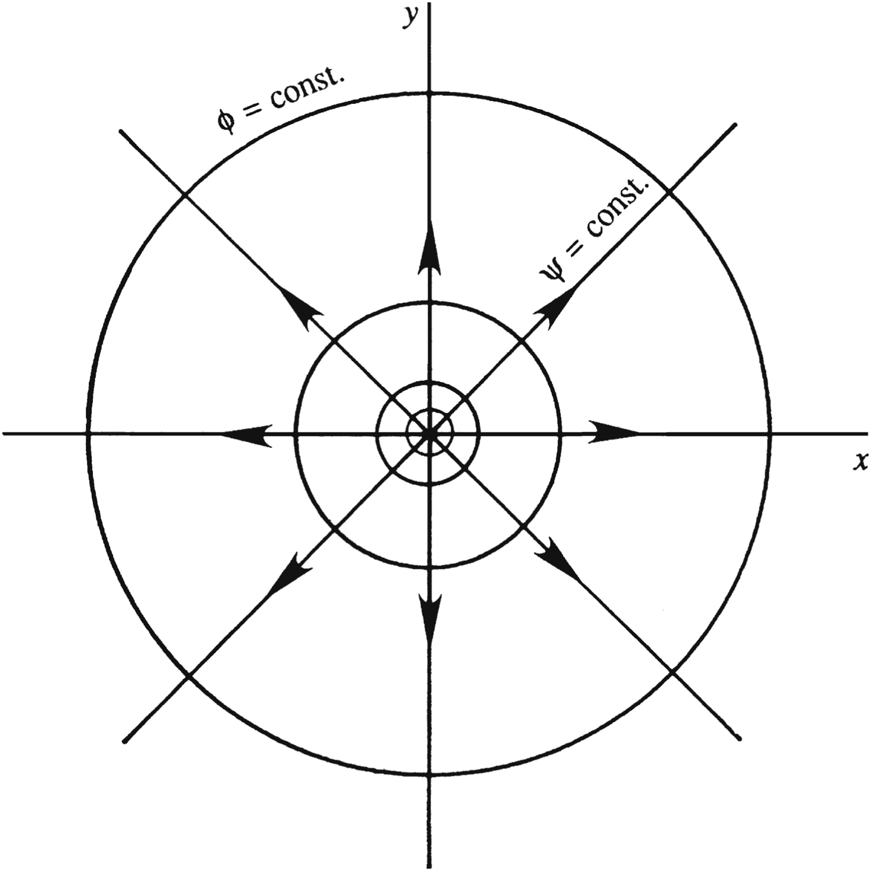
Figure 7.5

Slide 7
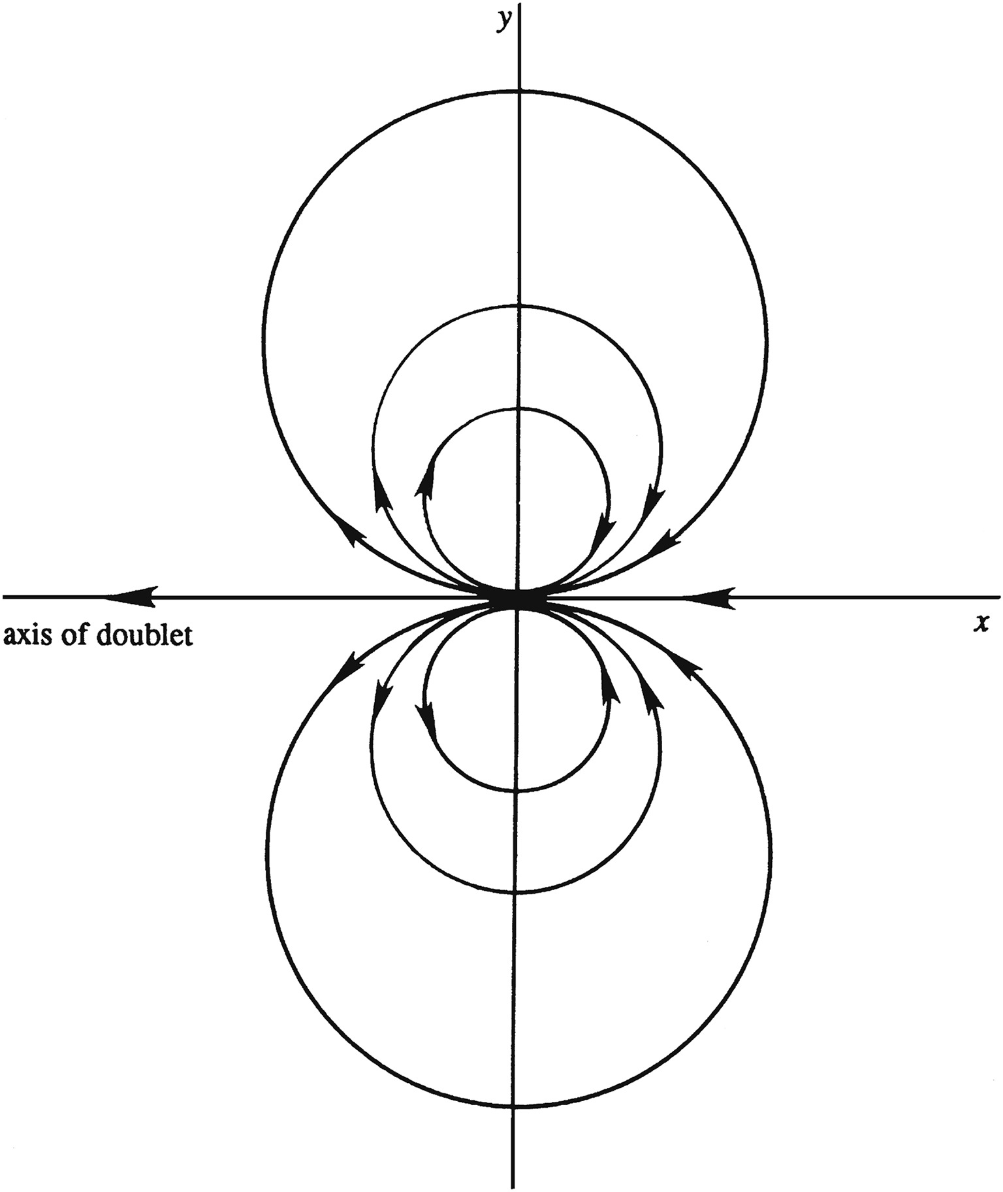
Figure 7.6

Slide 8
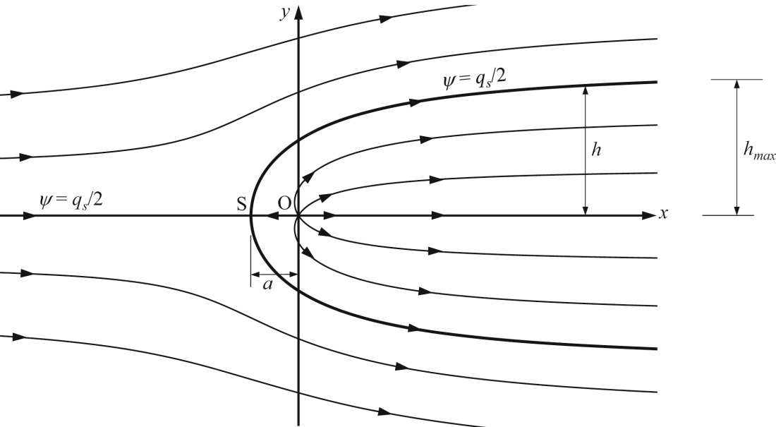
Figure 7.7

Slide 9
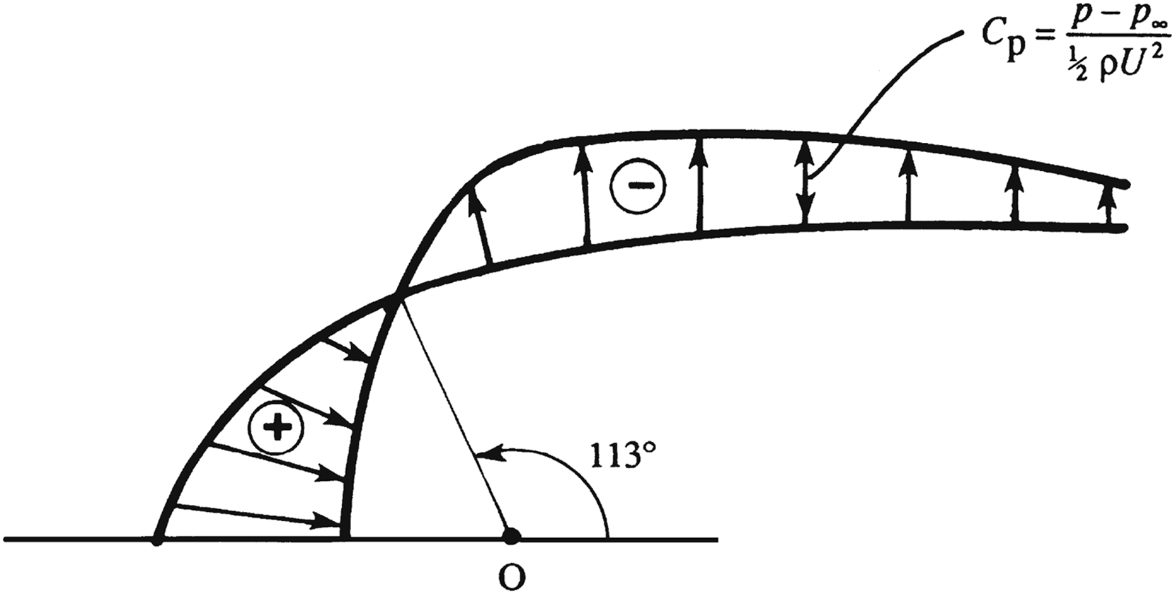
Figure 7.8

Slide 10
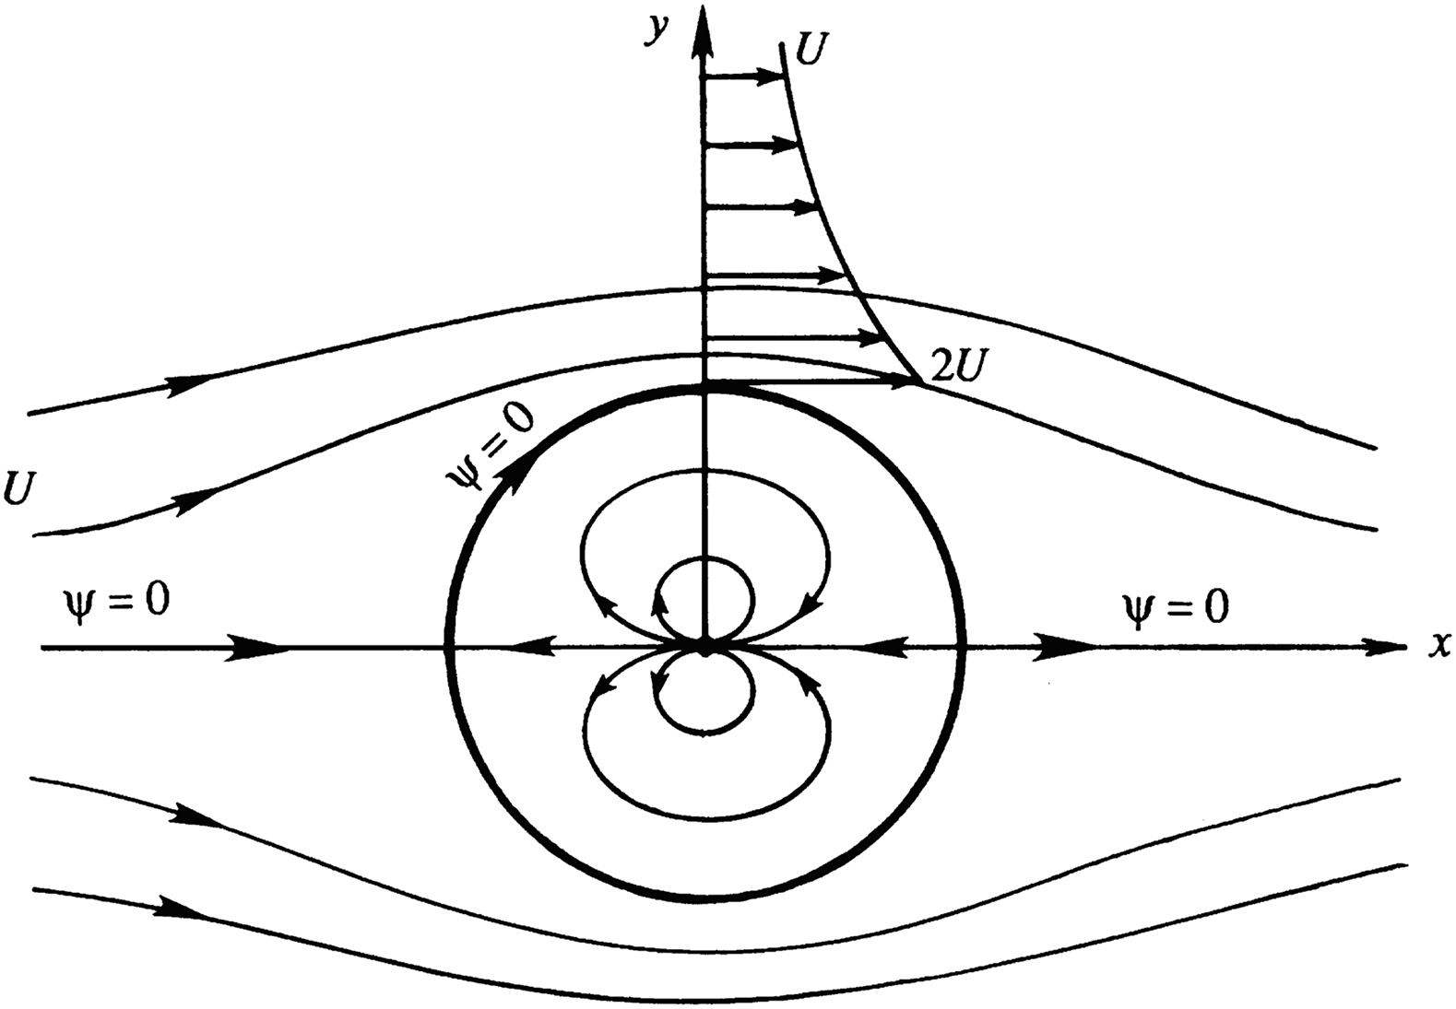
Figure 7.9

Slide 11
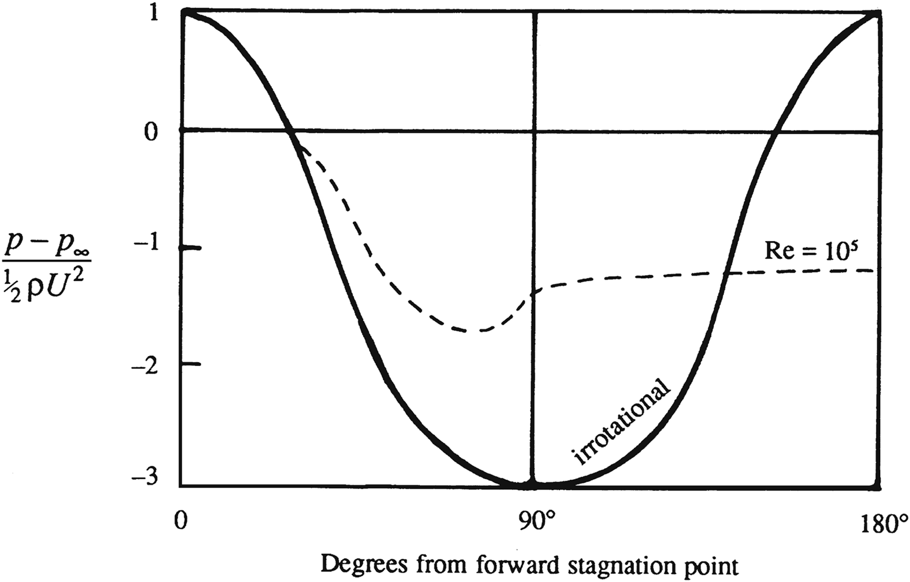
Figure 7.10

Slide 12
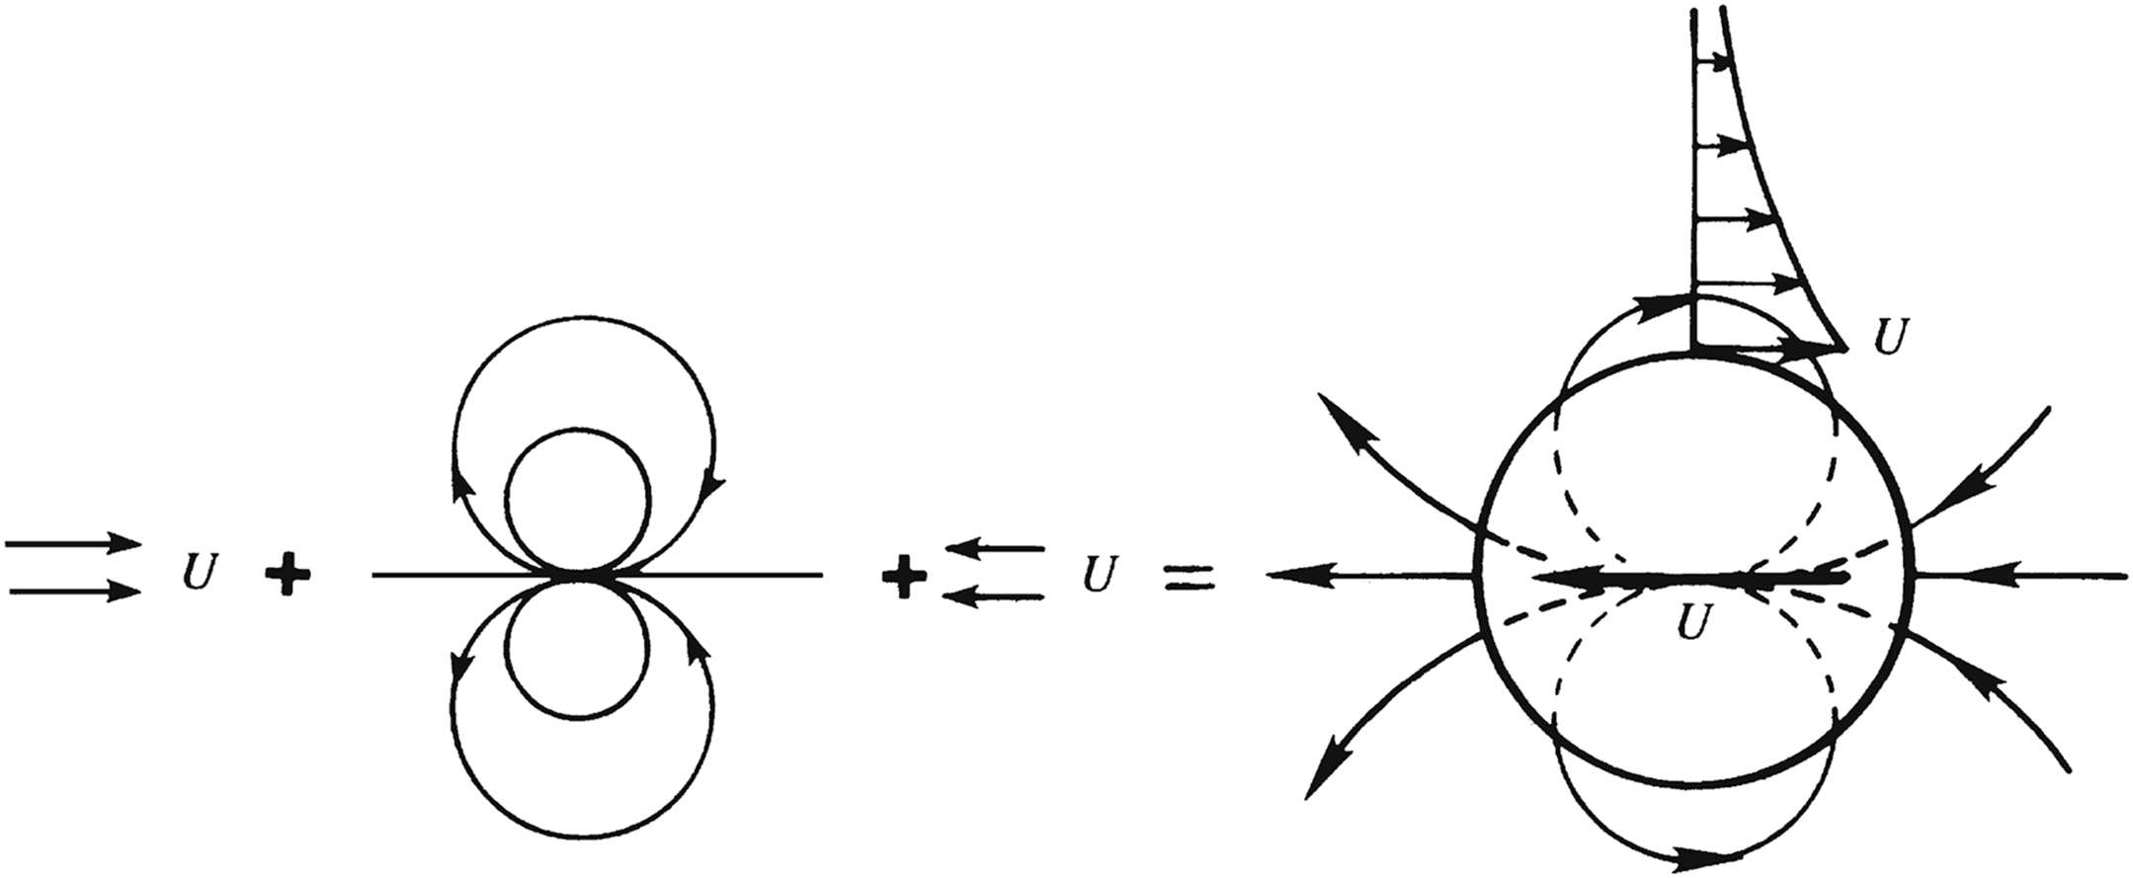
Figure 7.11

Slide 13
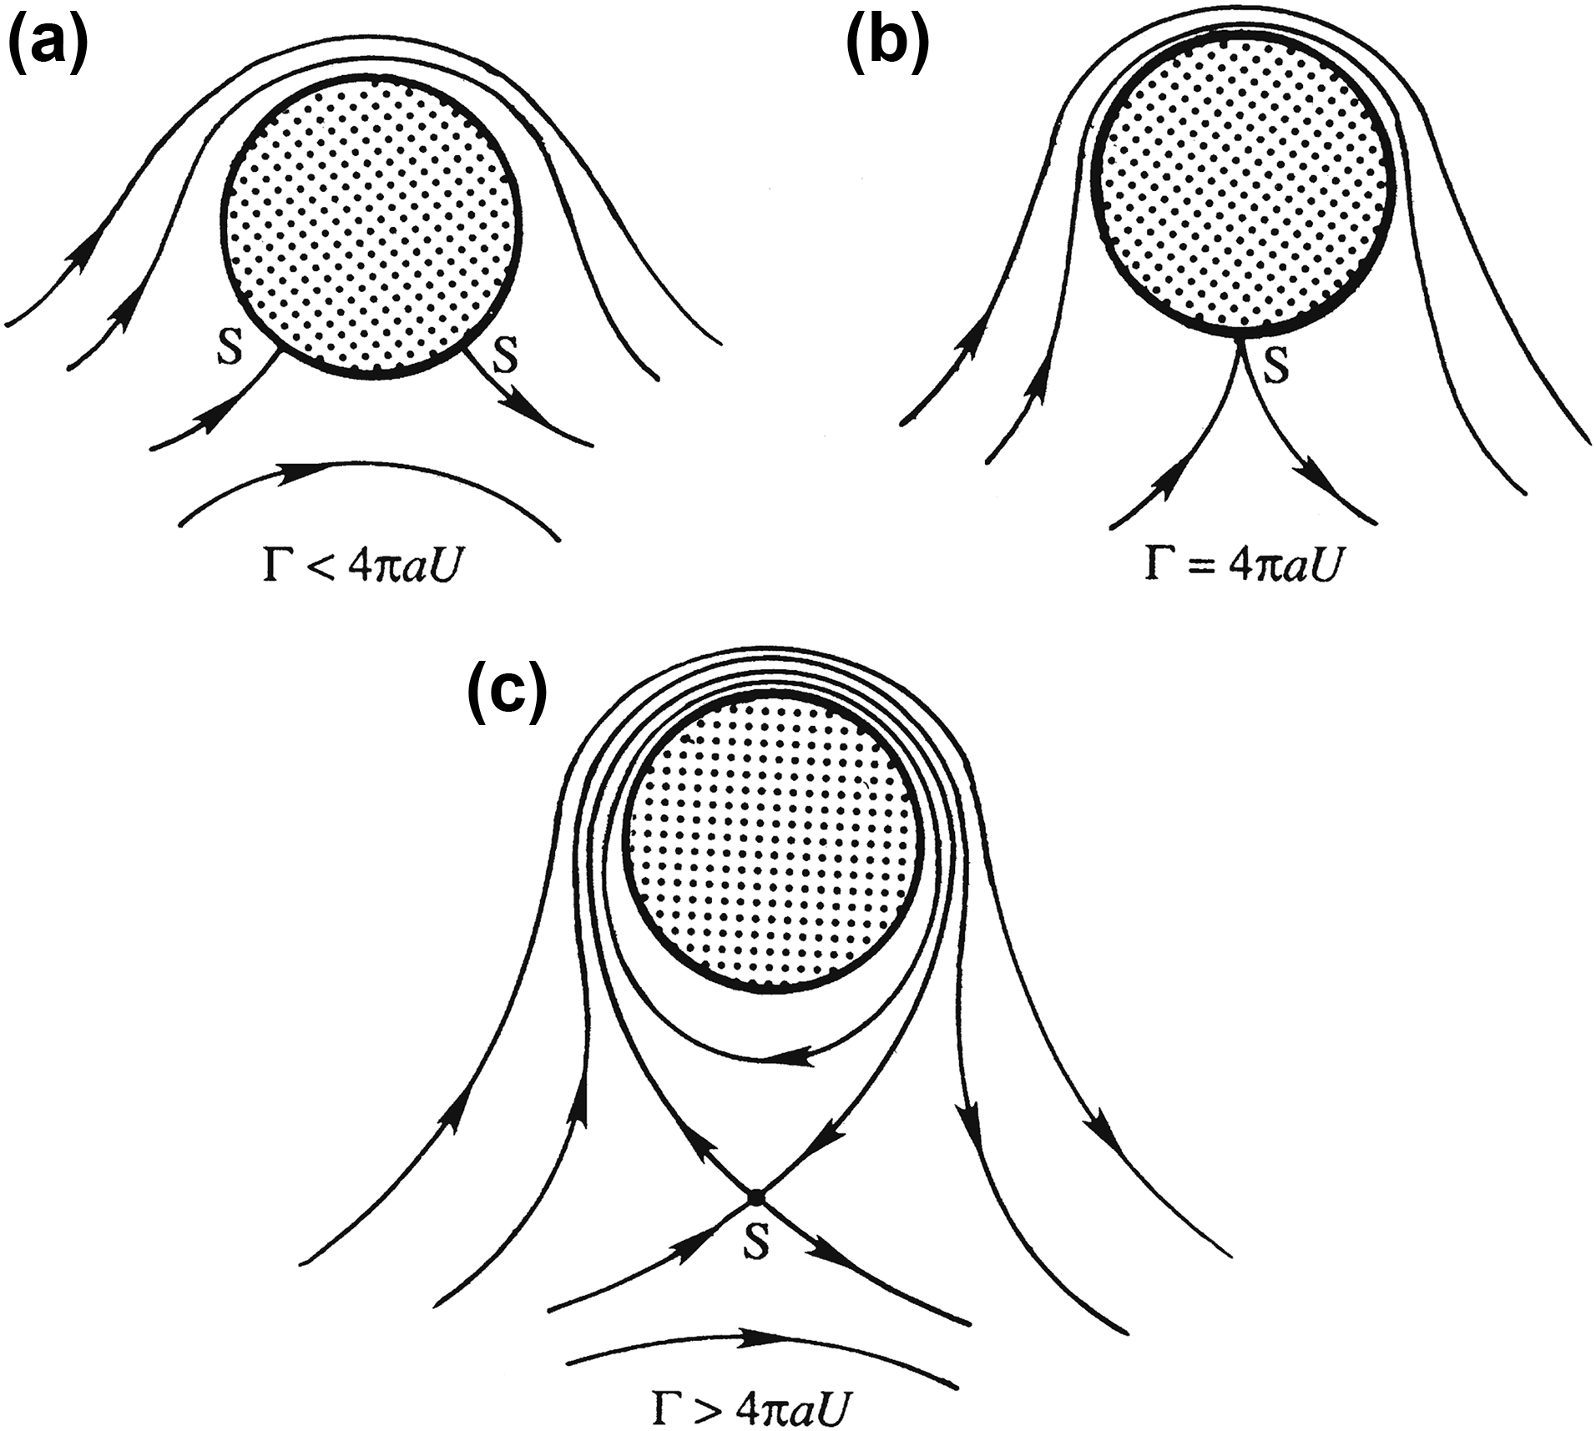
Figure 7.12

Slide 14
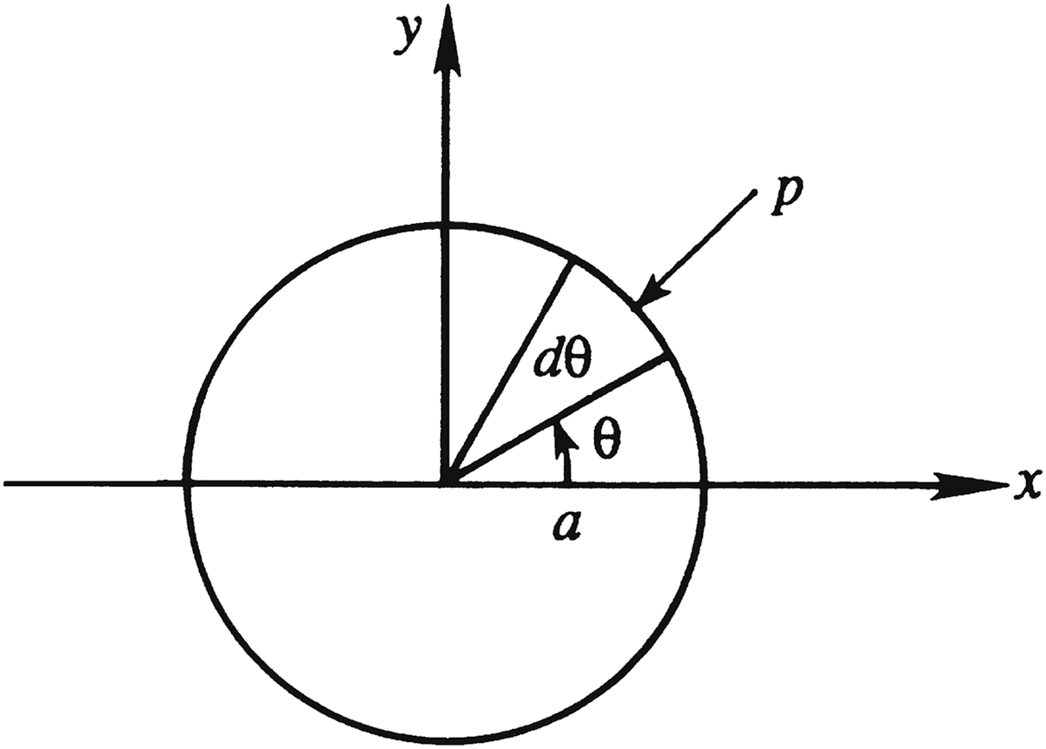
Figure 7.13

Slide 15
Figure 7.14

Slide 16
Figure 7.15

Slide 17
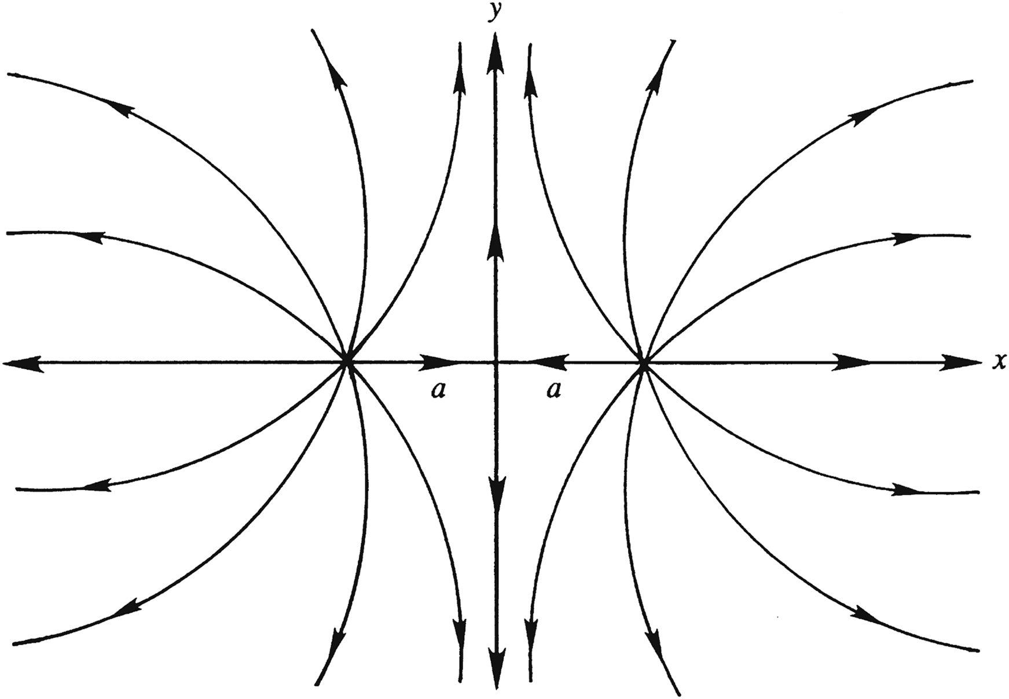
Figure 7.16

Slide 18
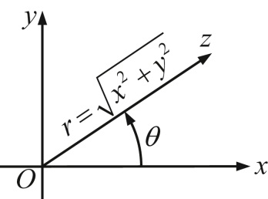
Figure 7.17

Slide 19
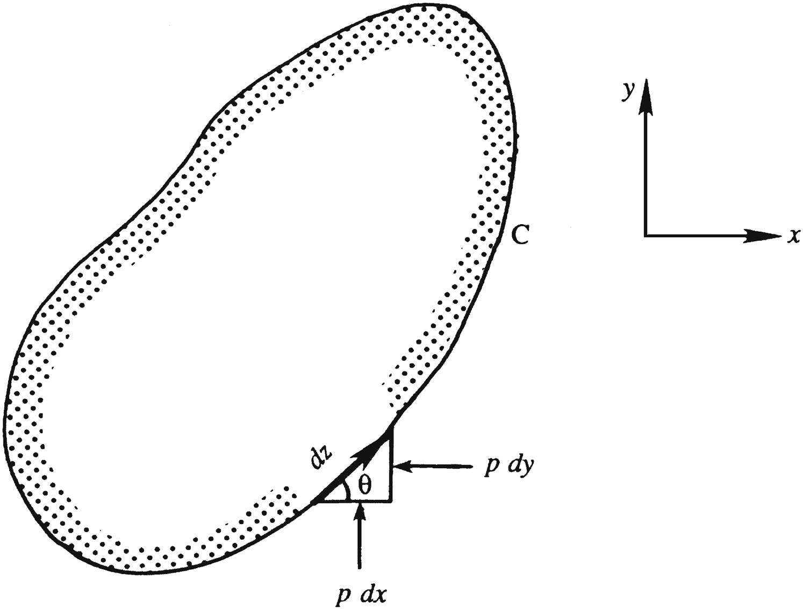
Figure 7.18

Slide 20
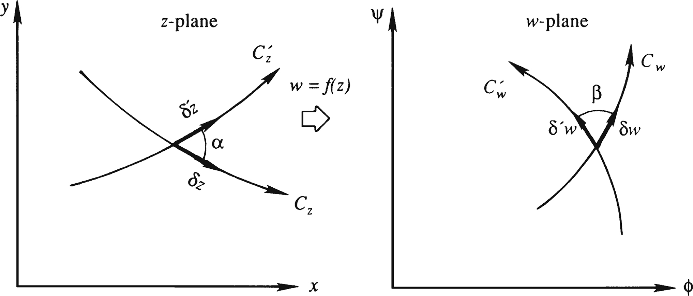
Figure 7.19

Slide 21
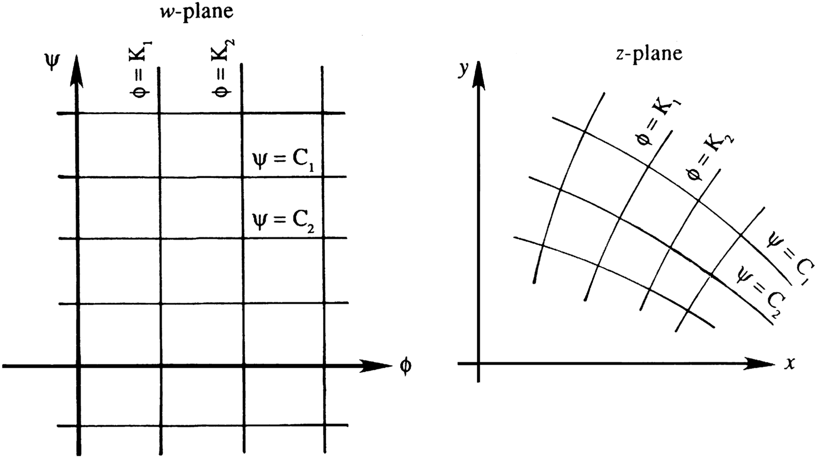
Figure 7.20

Slide 22
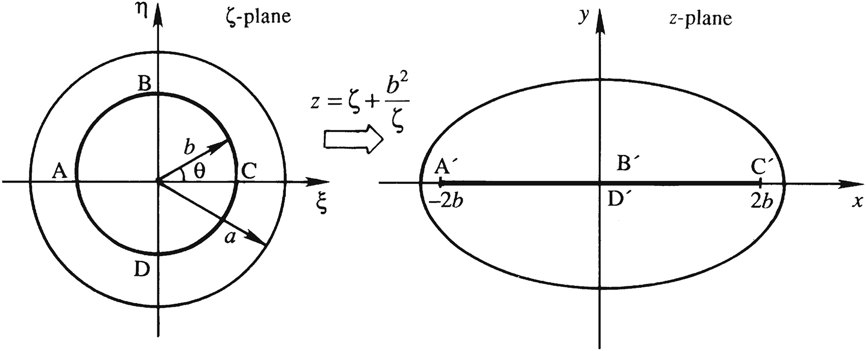
Figure 7.21

Slide 23
Figure 7.22

Slide 24
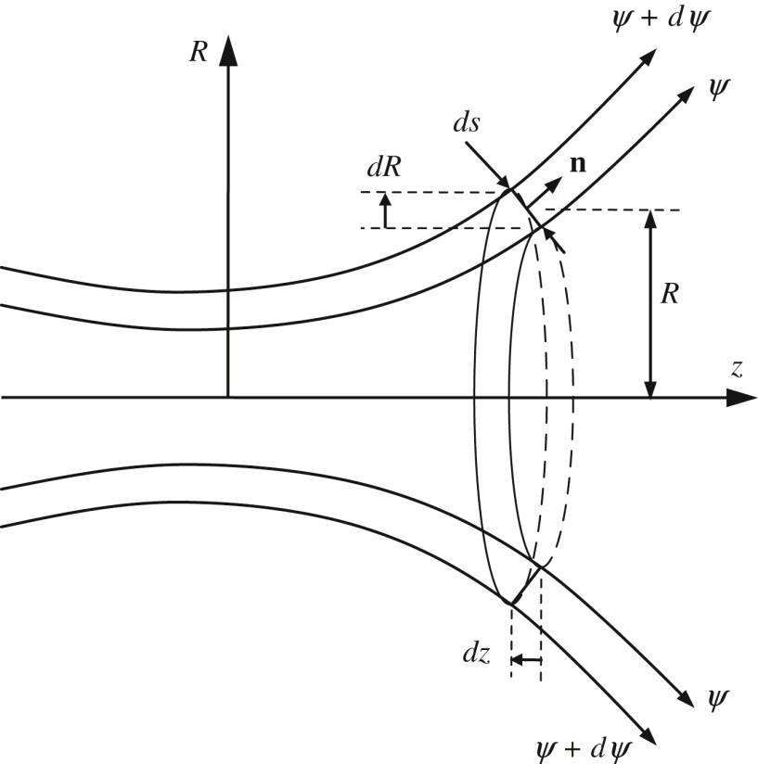
Figure 7.23

Slide 25
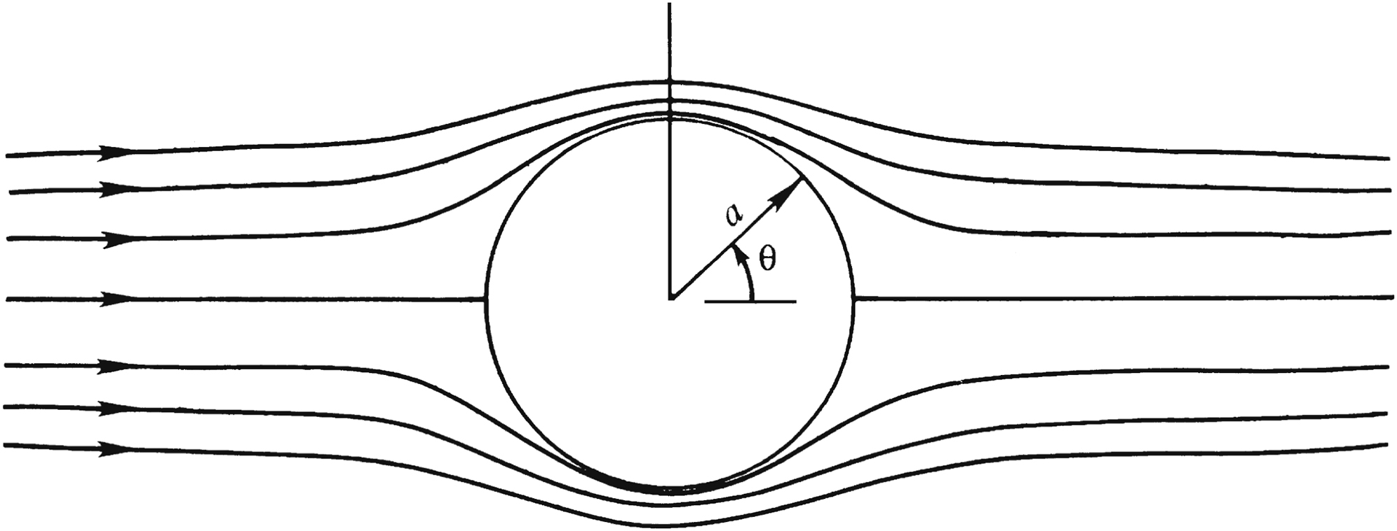
Figure 7.24

Slide 26
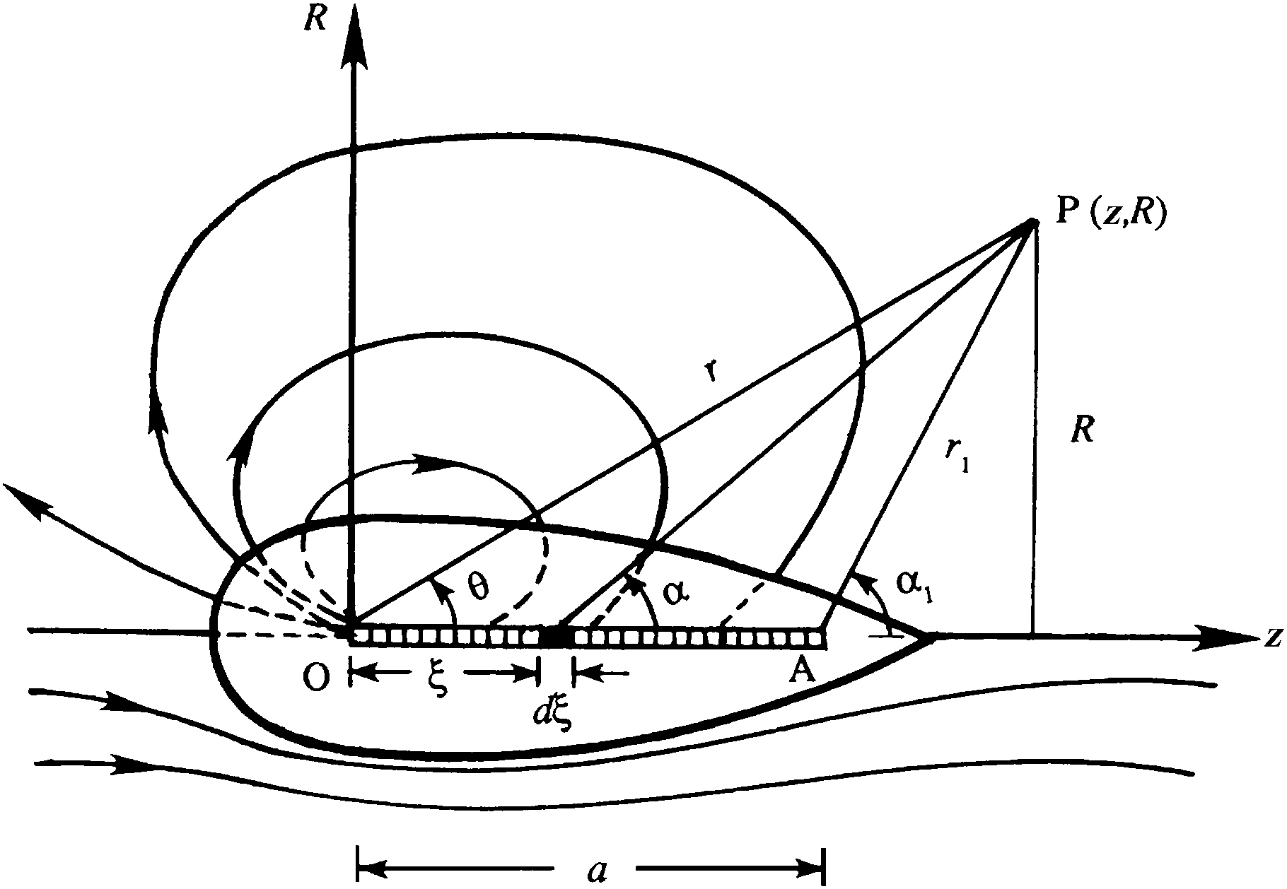
Figure 7.25

Slide 27
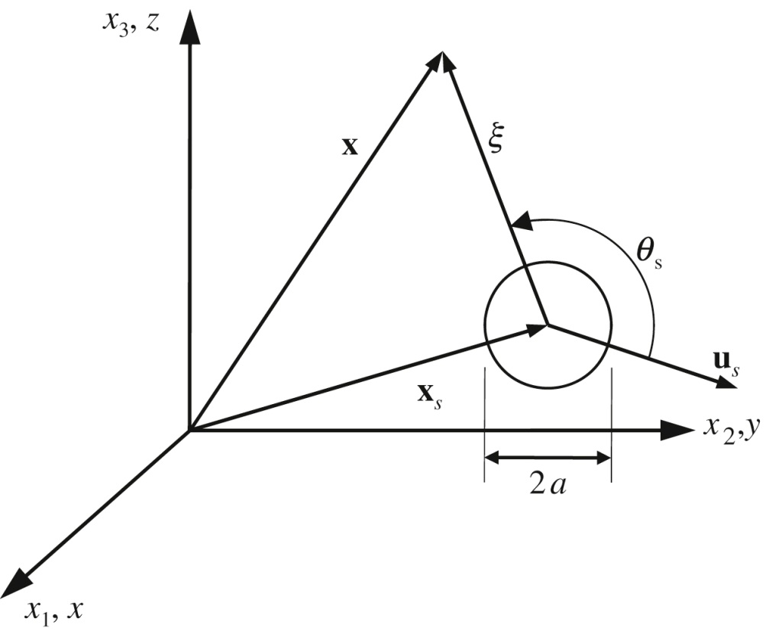
Figure 7.26

Slide 28
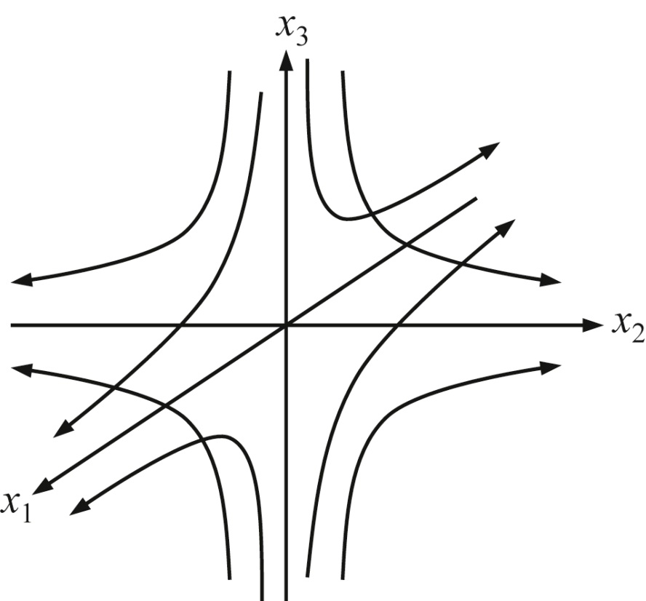
Figure 7.27

Slide 29
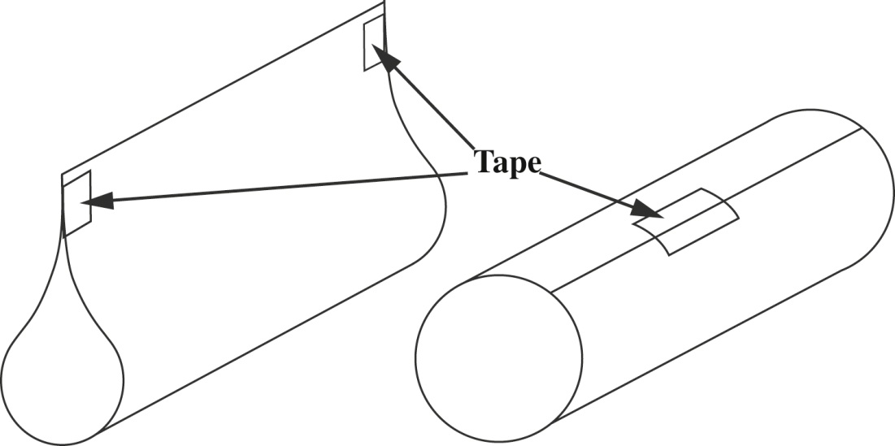
UnnFigure 7.1

Slide 30
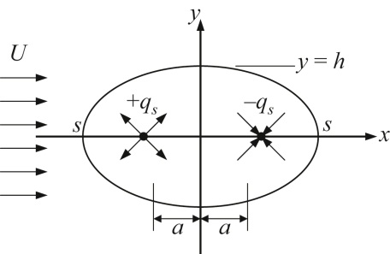
UnnFigure 7.2

Slide 31
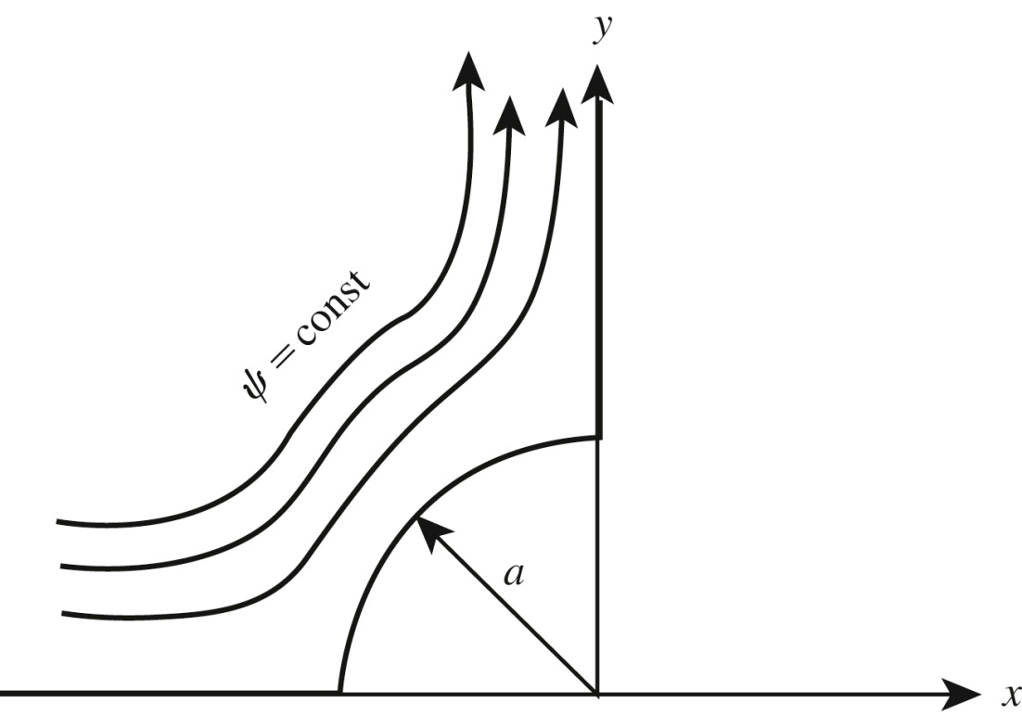
UnnFigure 7.3

Slide 32
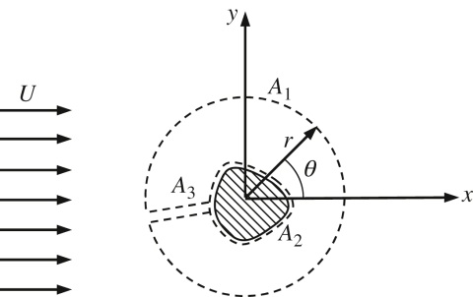
UnnFigure 7.4

Slide 33
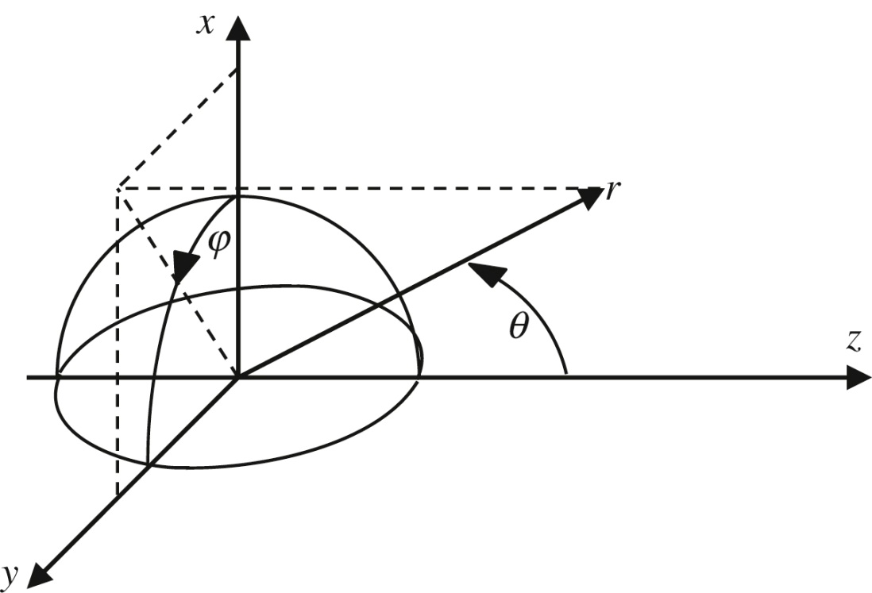
UnnFigure 7.5

Slide 34
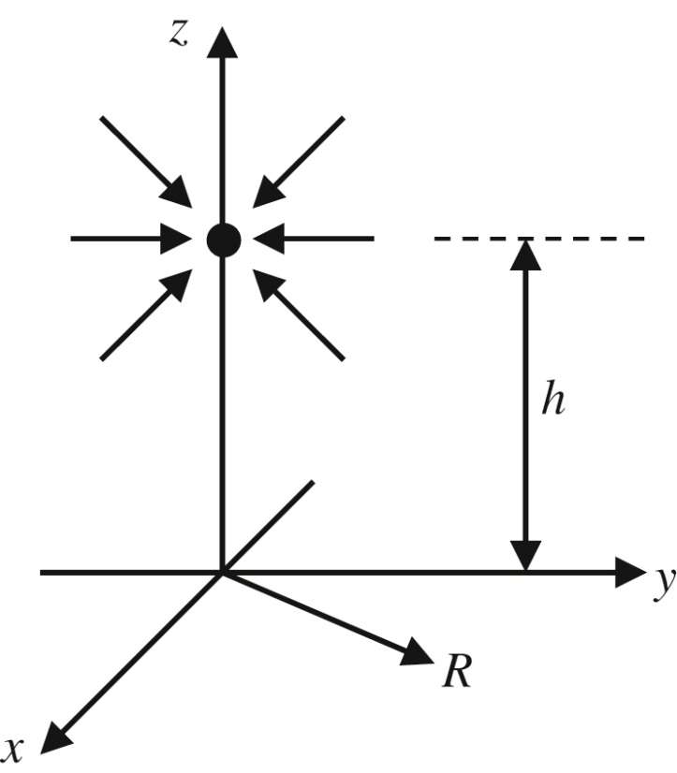
UnnFigure 7.6

Slide 35
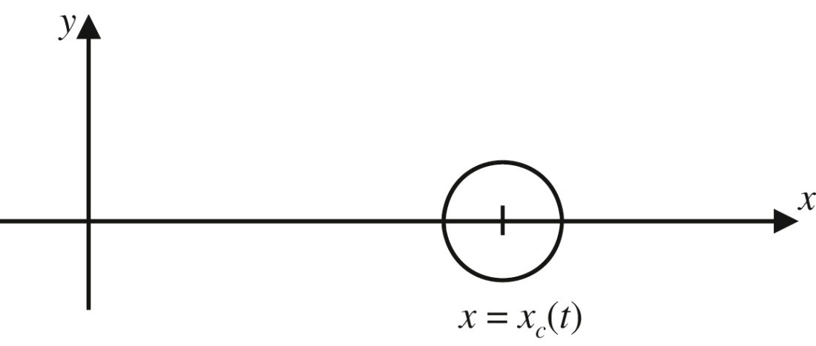
UnnFigure 7.7

Slide 36
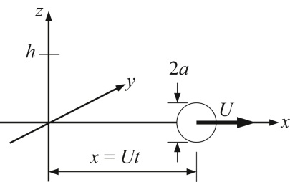
UnnFigure 7.8

