Slide 1
Chapter 14

Slide 2
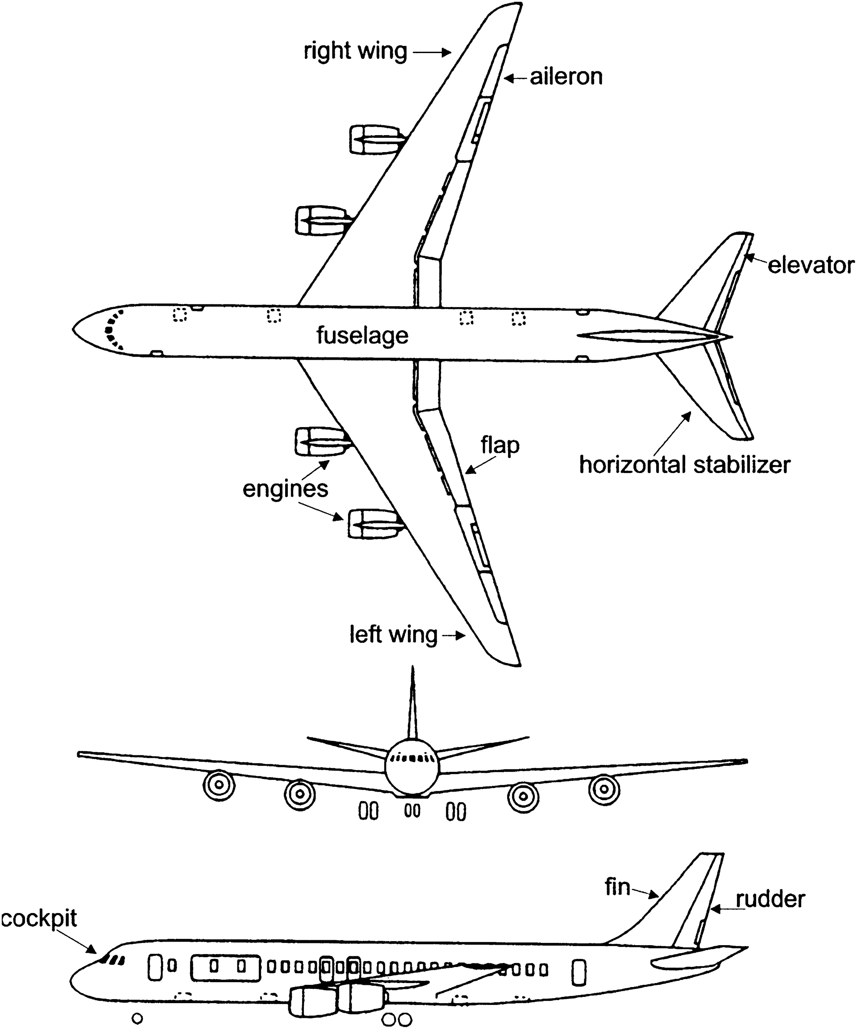
Figure 14.1

Slide 3
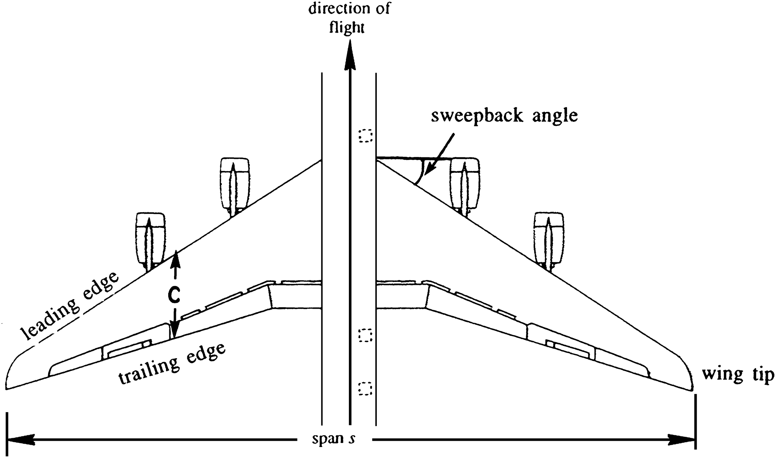
Figure 14.2

Slide 4
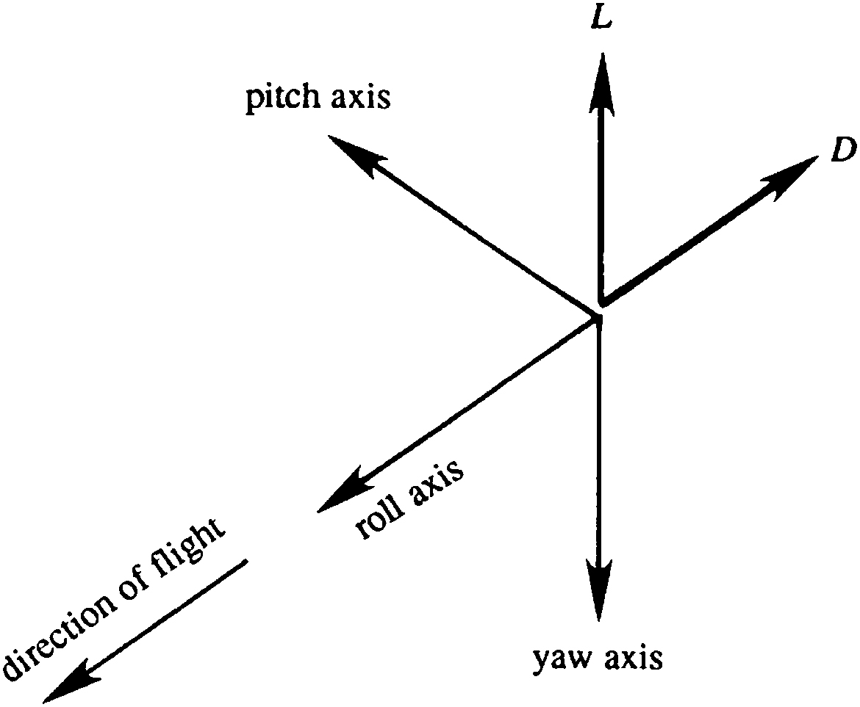
Figure 14.3

Slide 5
Figure 14.4

Slide 6
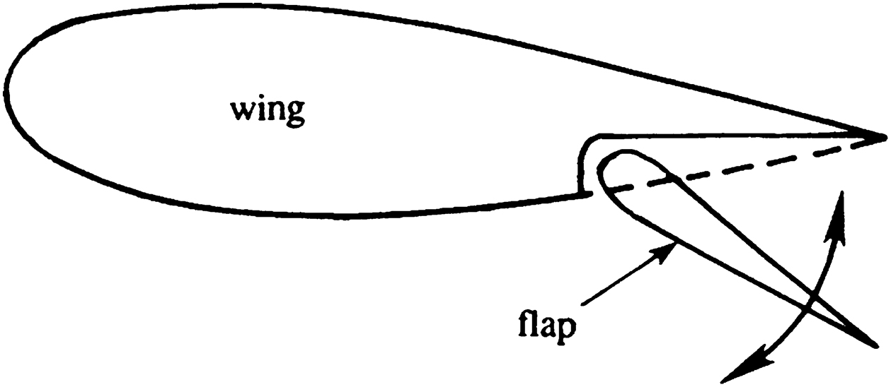
Figure 14.5

Slide 7
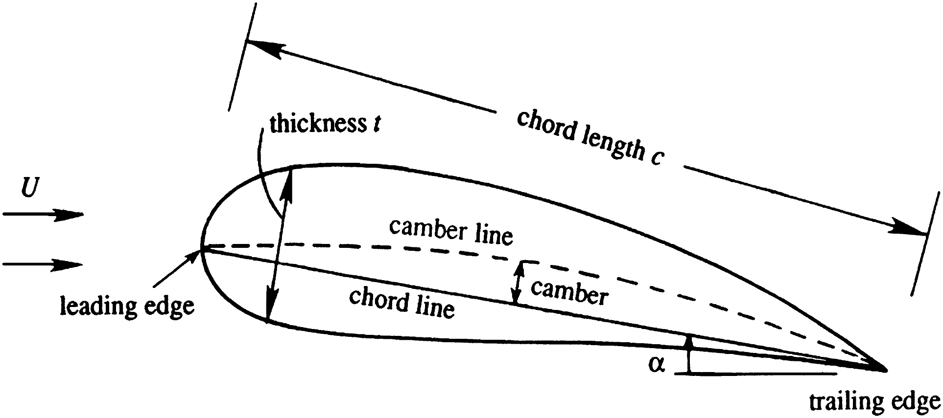
Figure 14.6

Slide 8
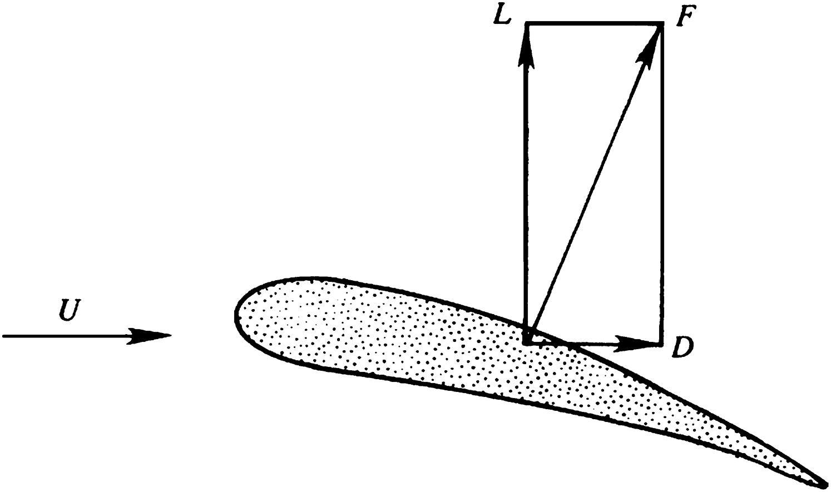
Figure 14.7

Slide 9
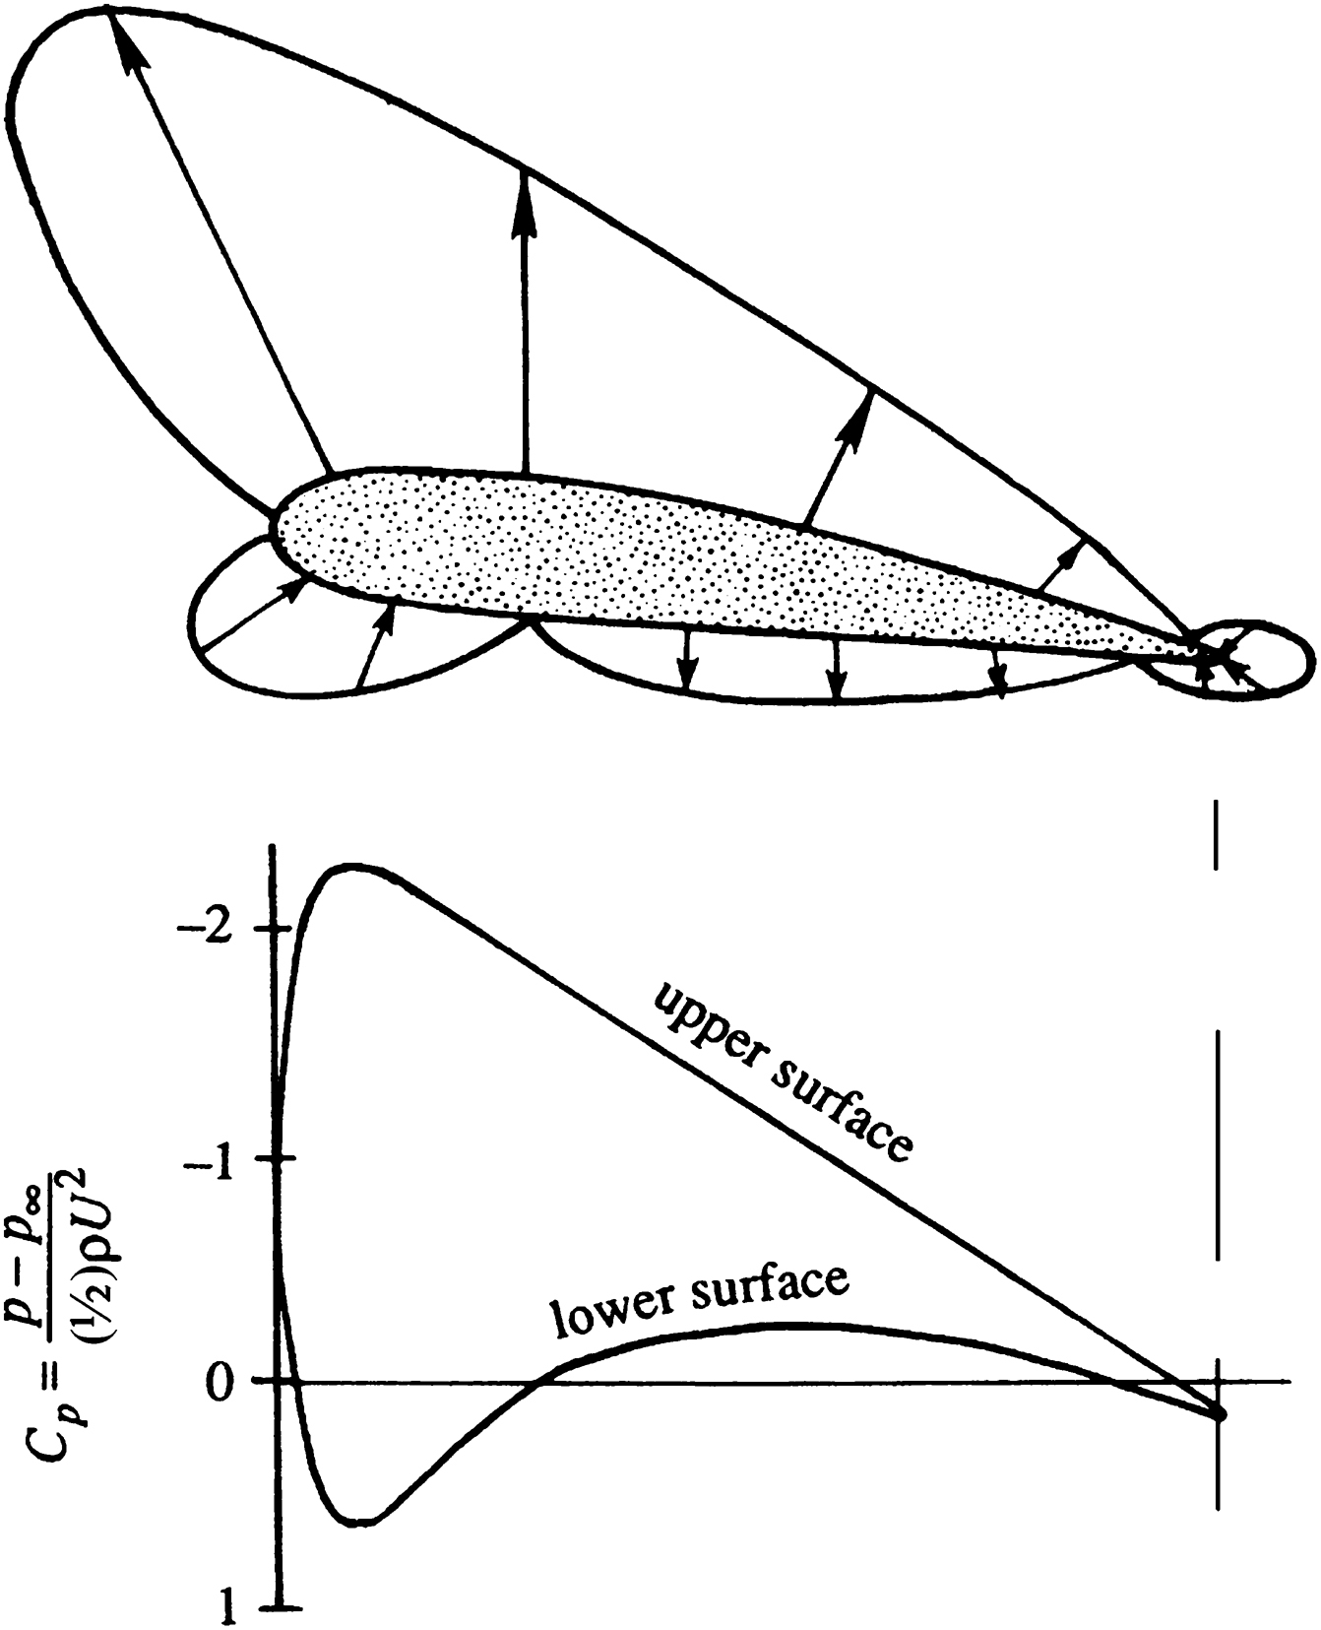
Figure 14.8

Slide 10
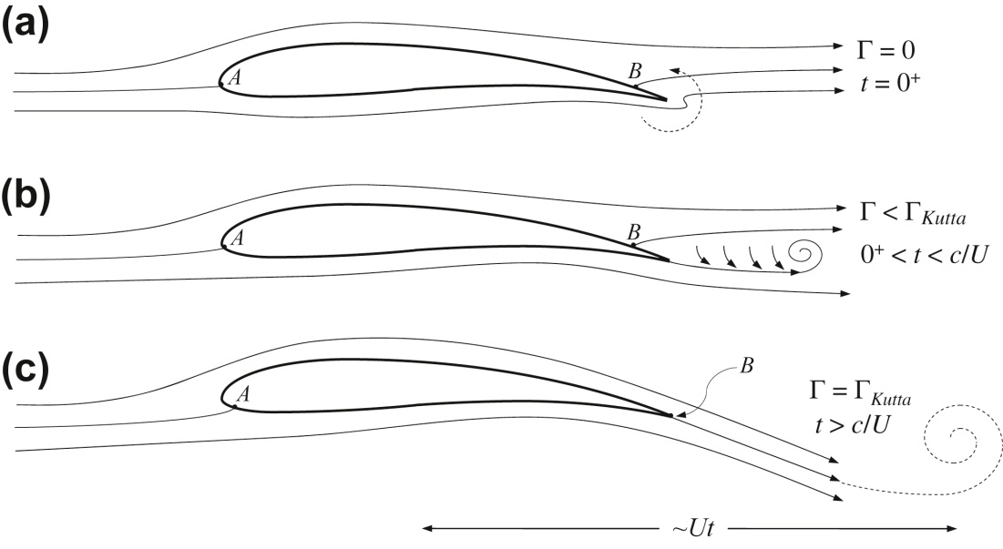
Figure 14.9

Slide 11
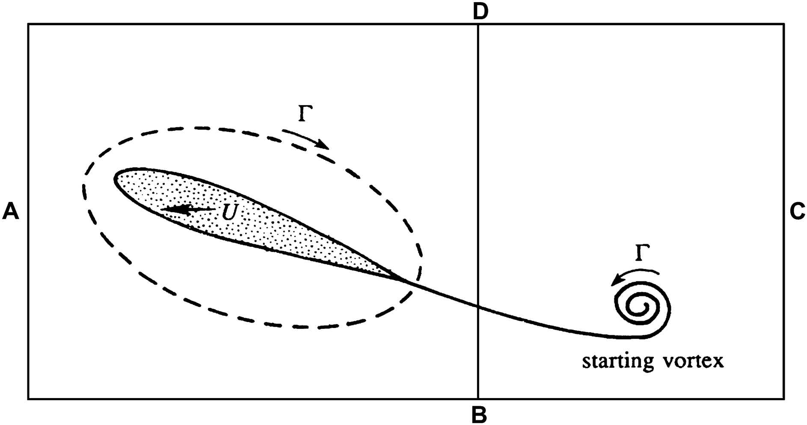
Figure 14.10

Slide 12
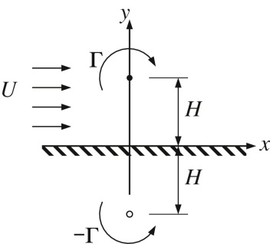
Figure 14.11

Slide 13
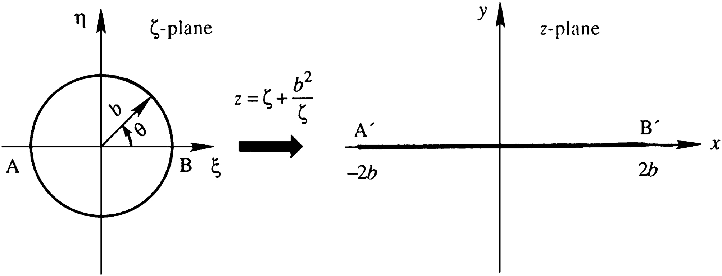
Figure 14.12

Slide 14
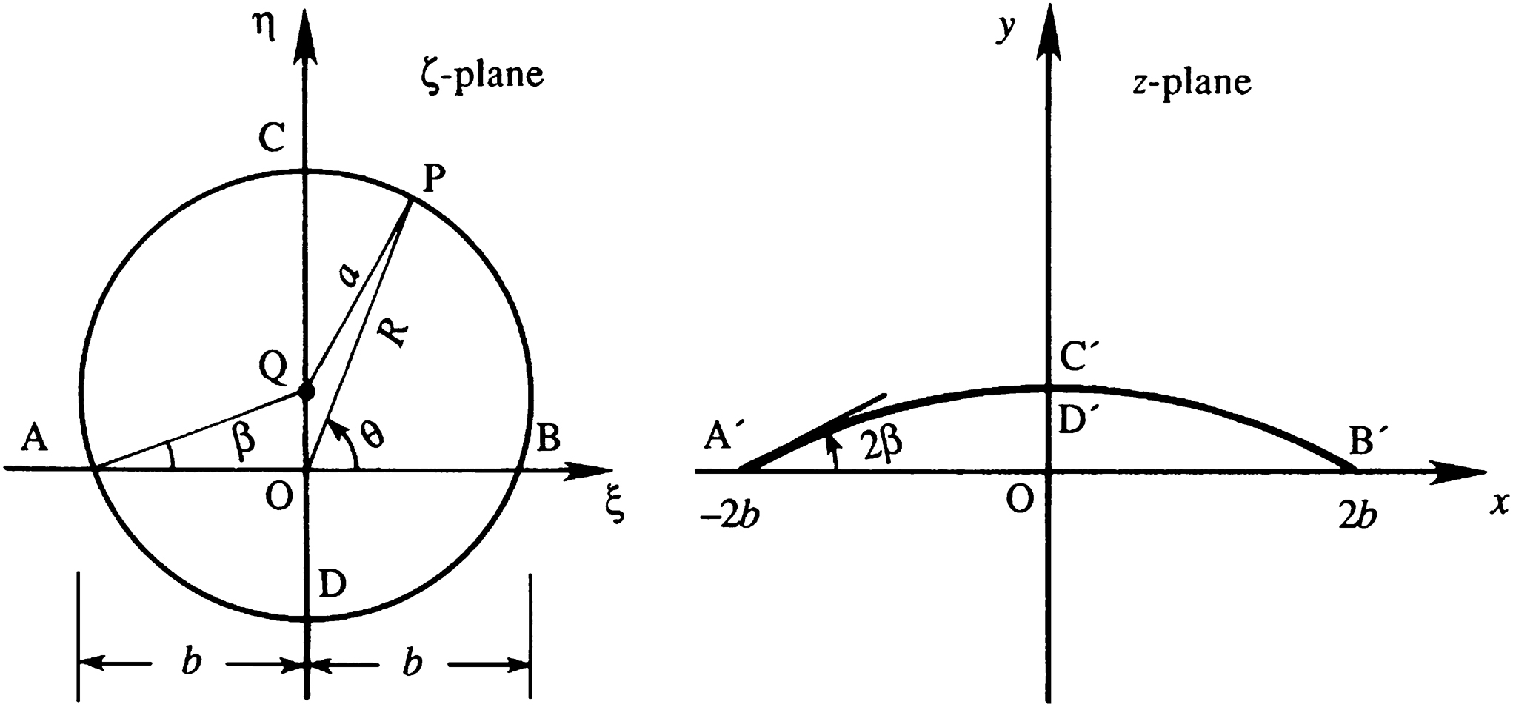
Figure 14.13

Slide 15
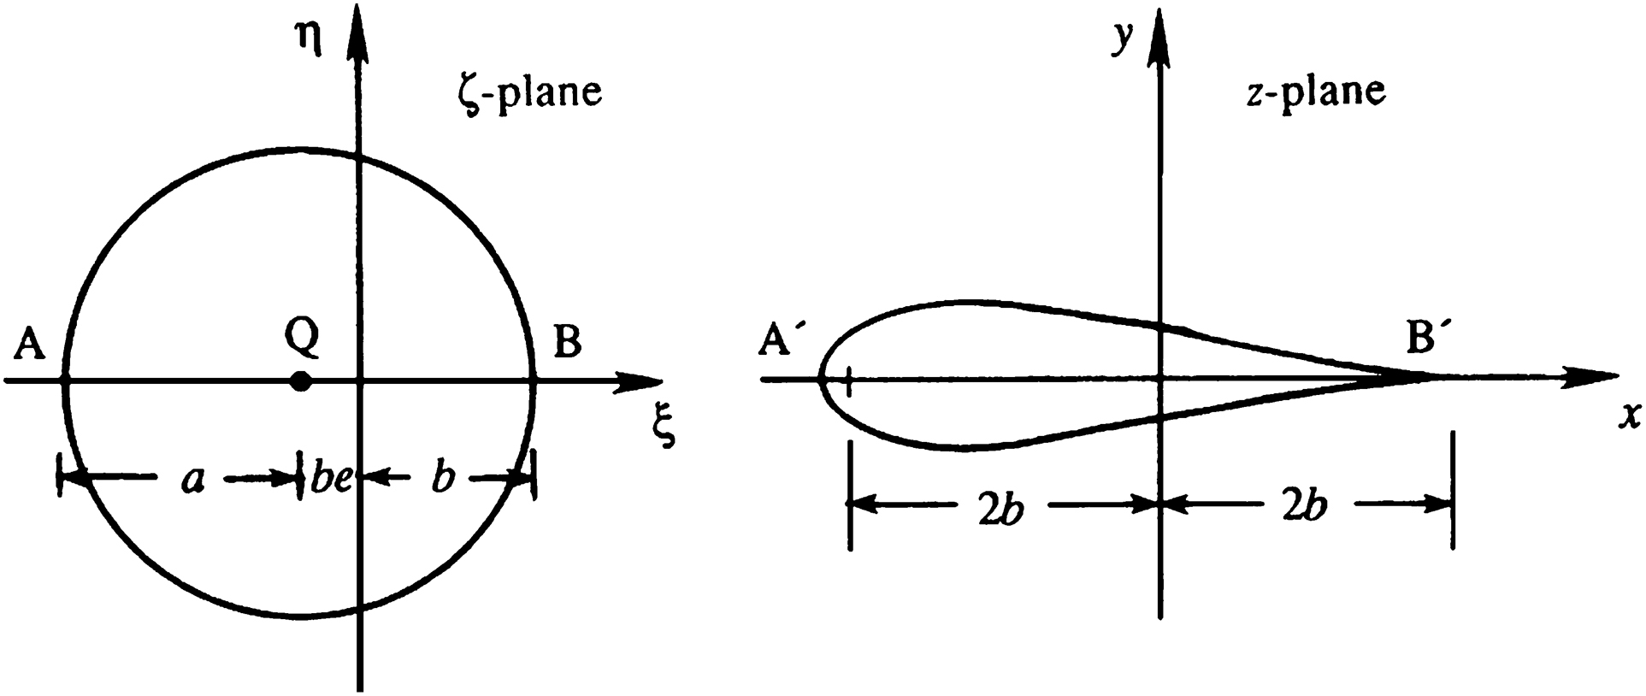
Figure 14.14

Slide 16
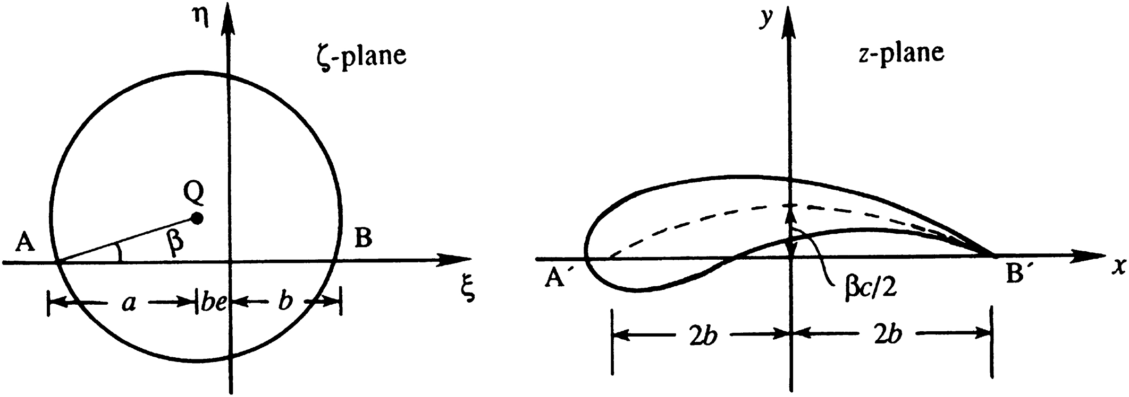
Figure 14.15

Slide 17
Figure 14.16

Slide 18
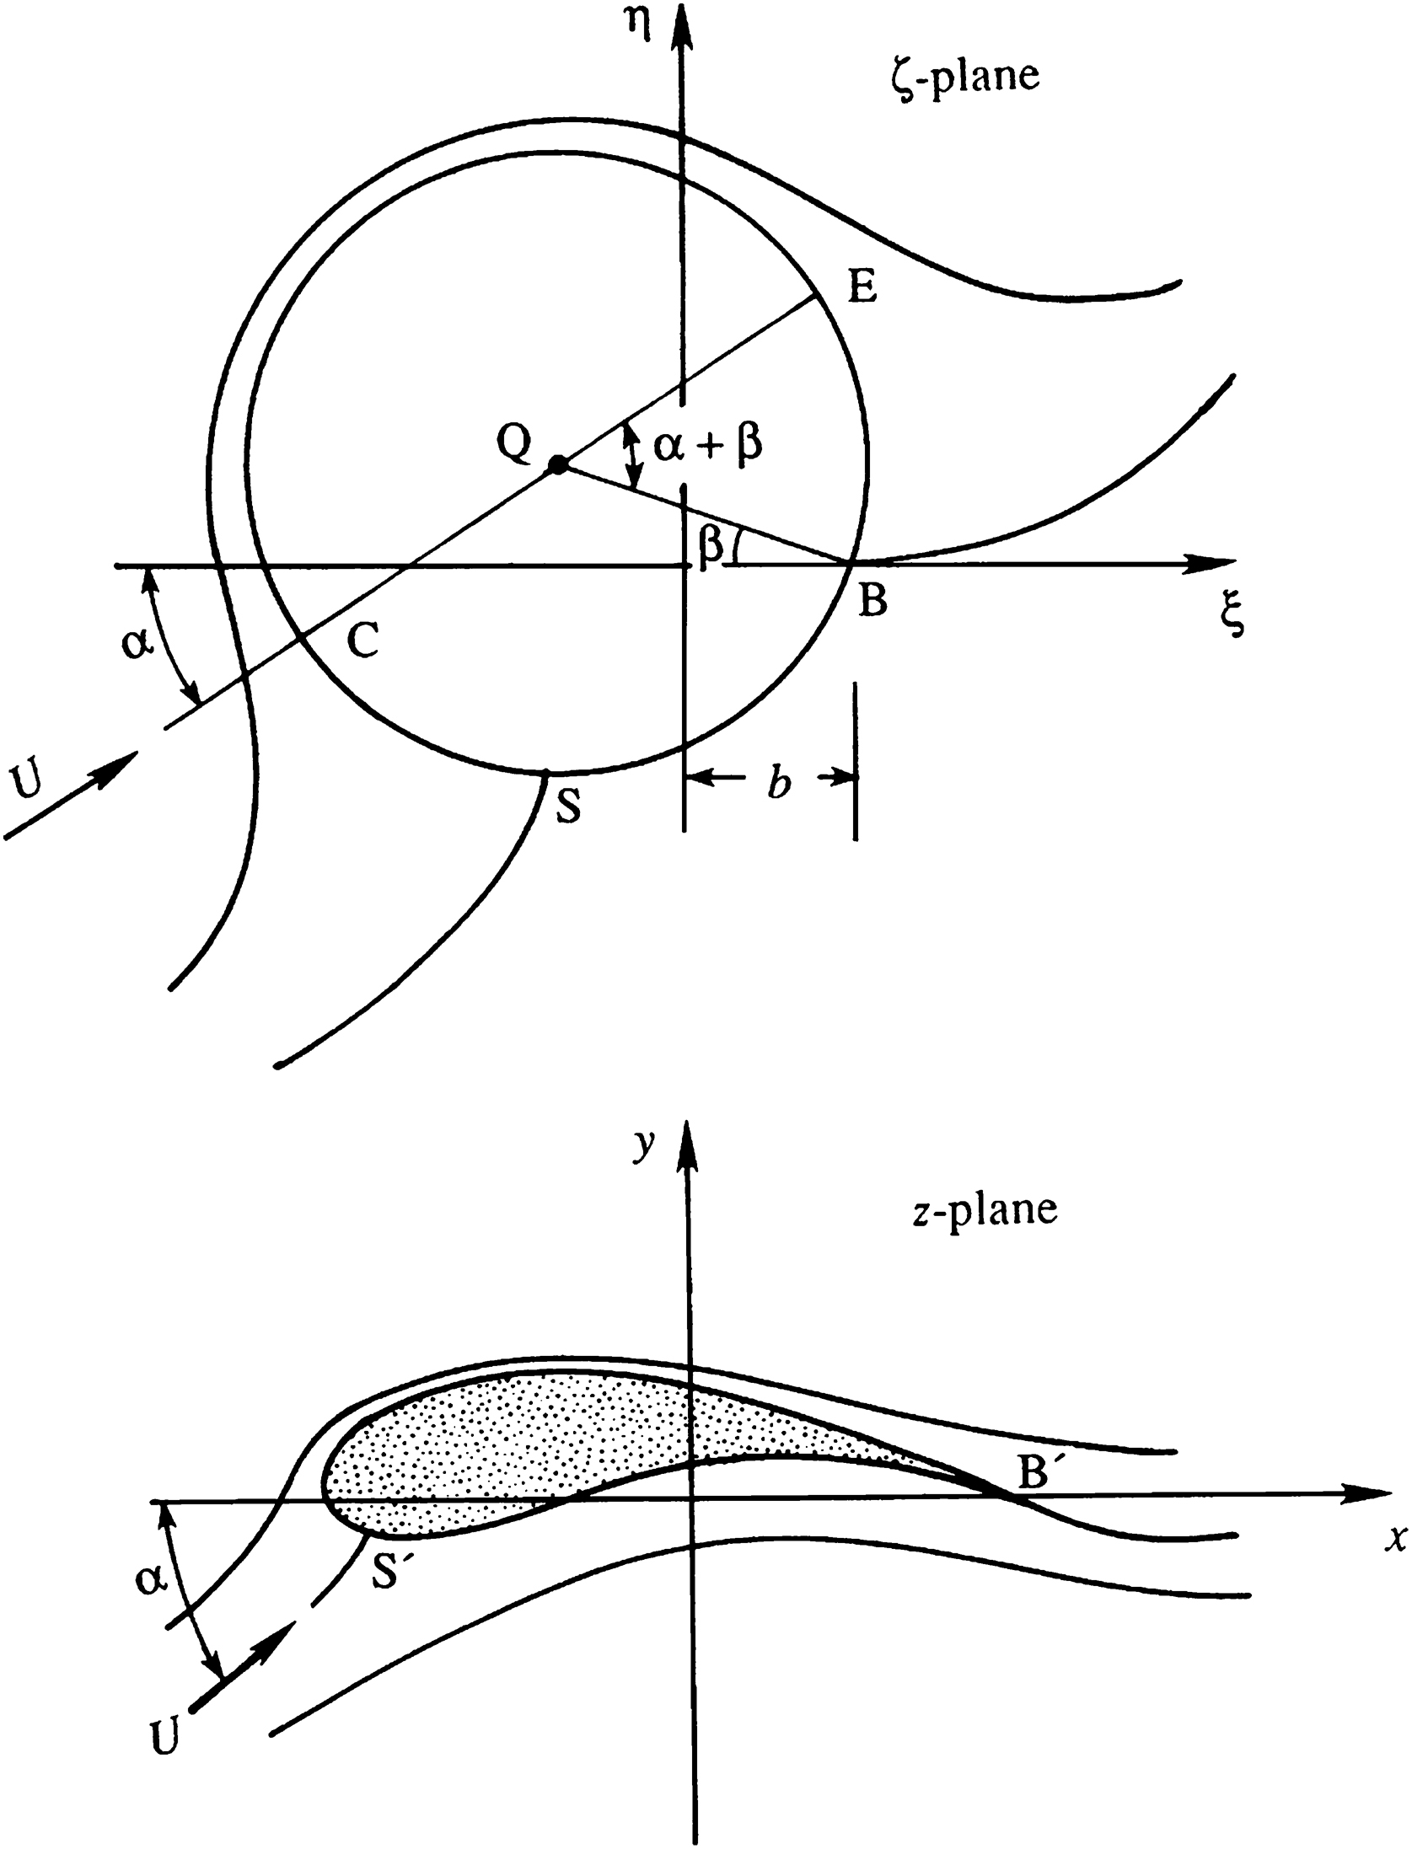
Figure 14.17

Slide 19
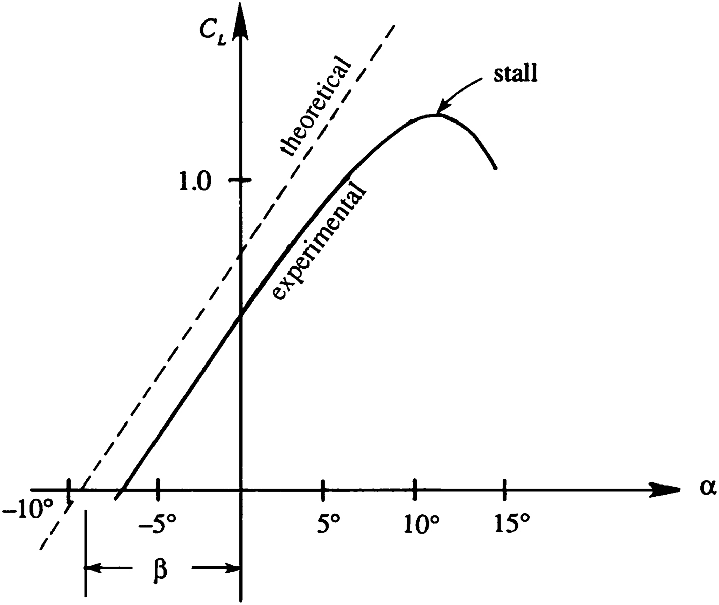
Figure 14.18

Slide 20
Figure 14.19

Slide 21
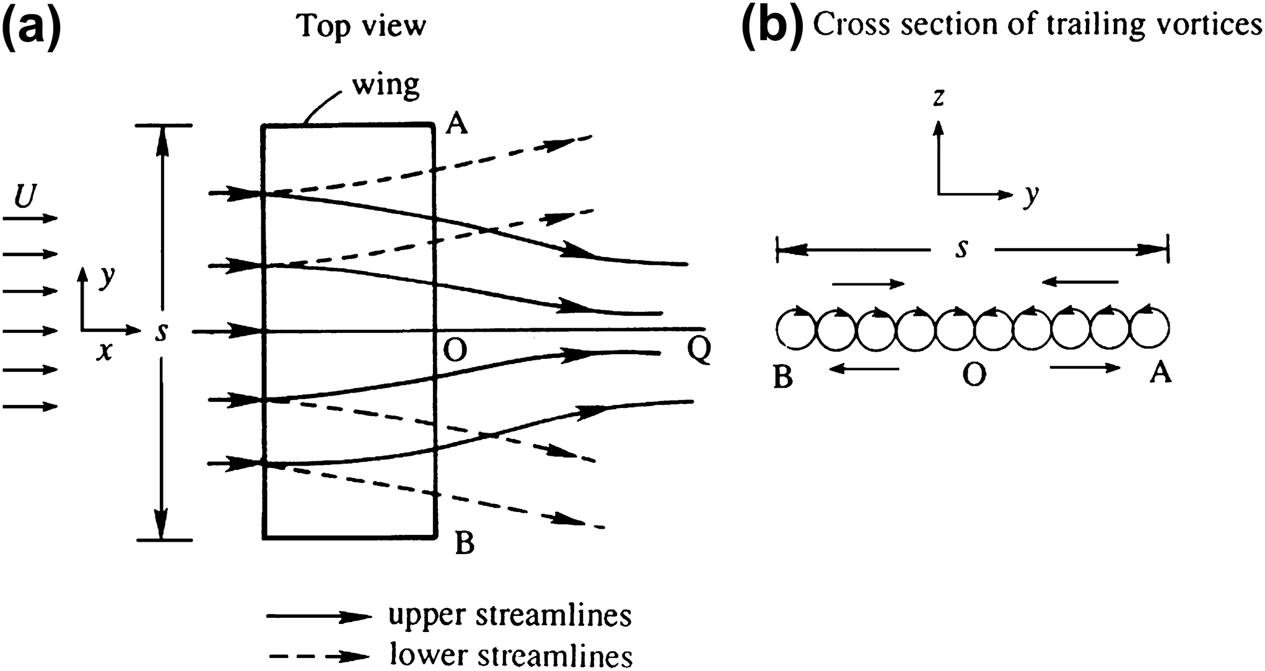
Figure 14.20

Slide 22
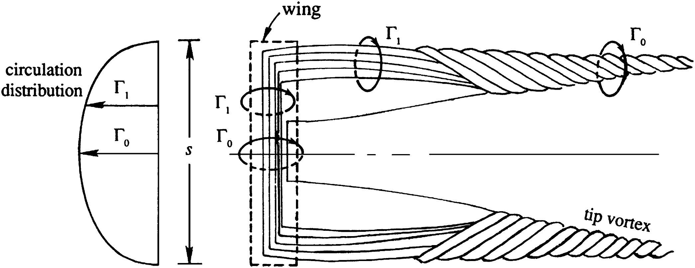
Figure 14.21

Slide 23
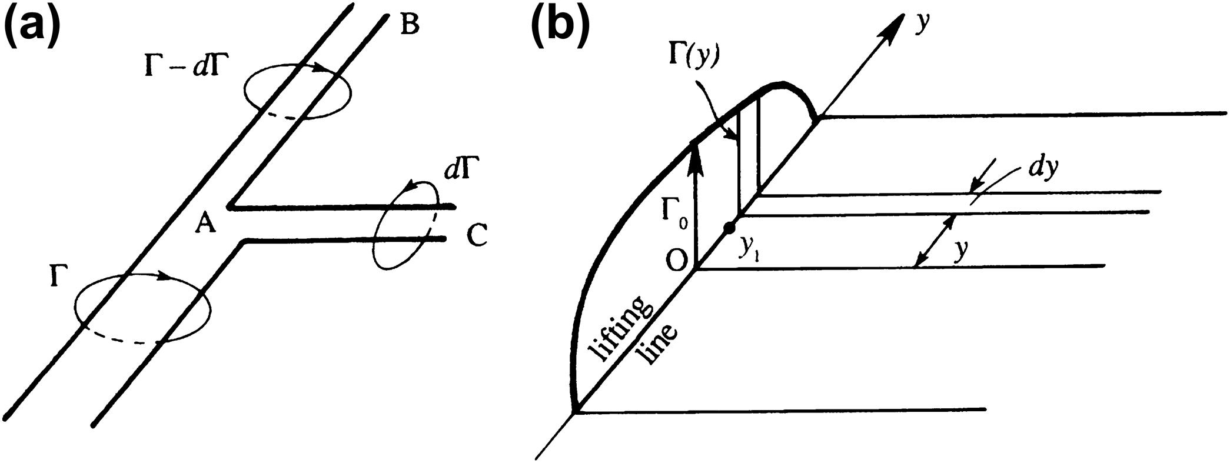
Figure 14.22

Slide 24
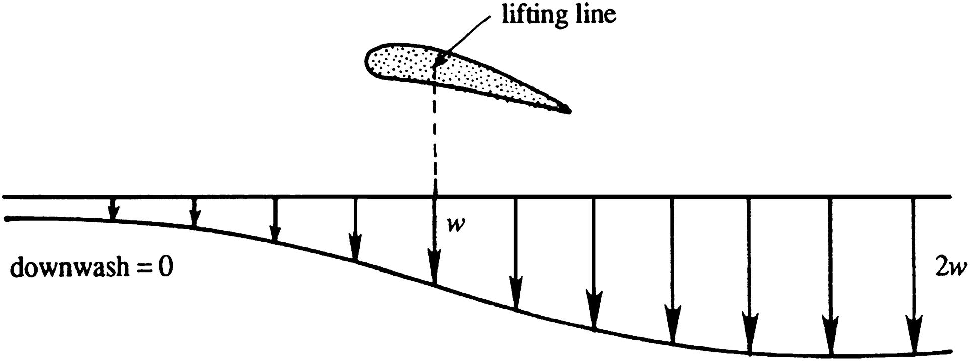
Figure 14.23

Slide 25
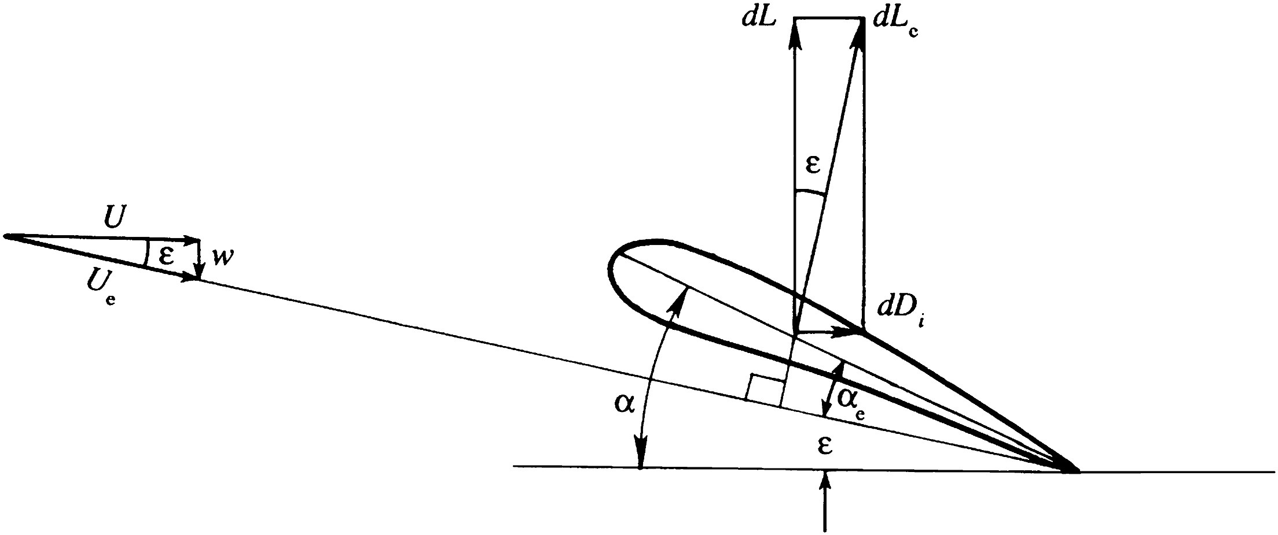
Figure 14.24

Slide 26
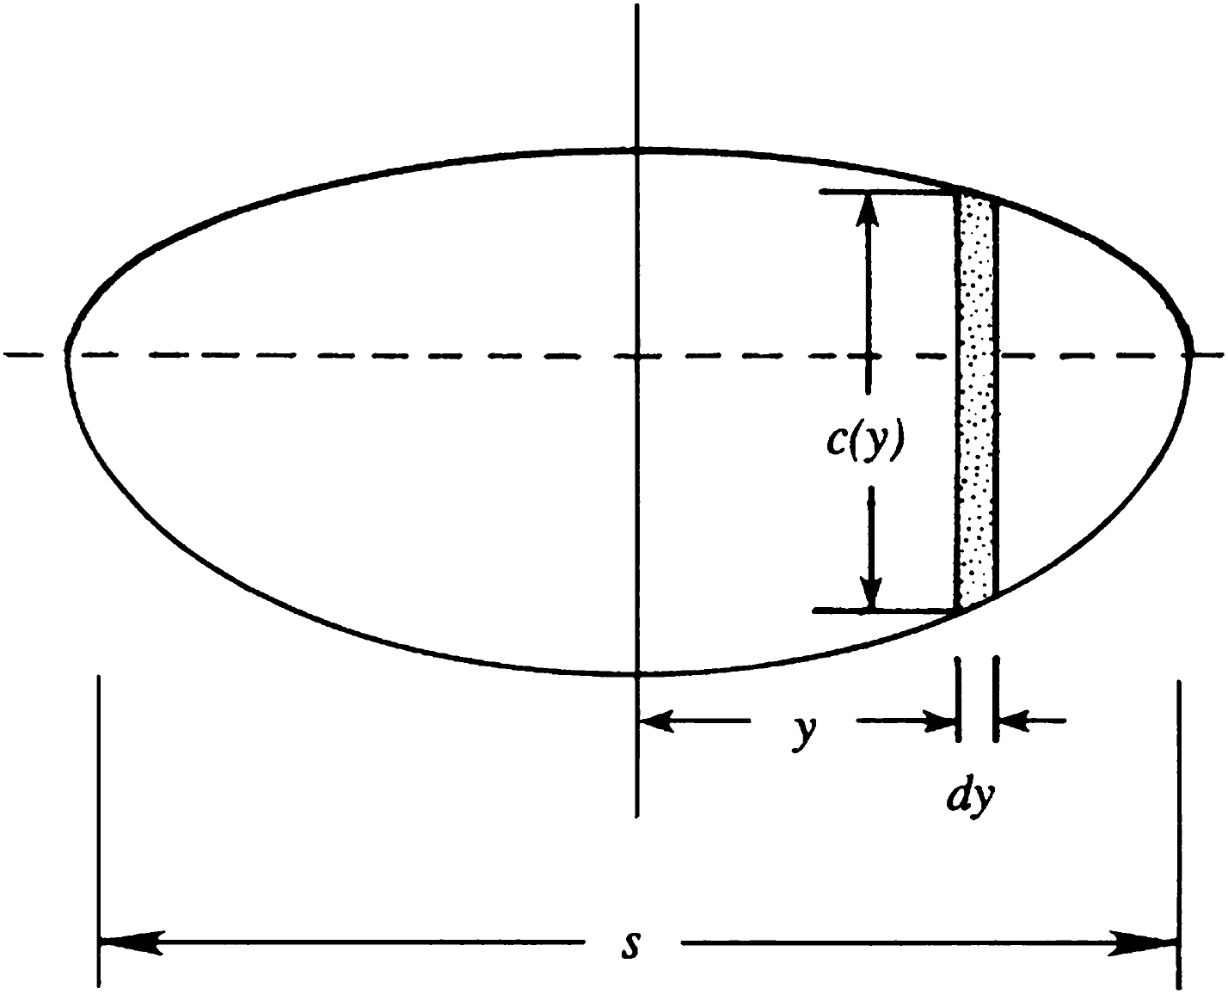
Figure 14.25

Slide 27
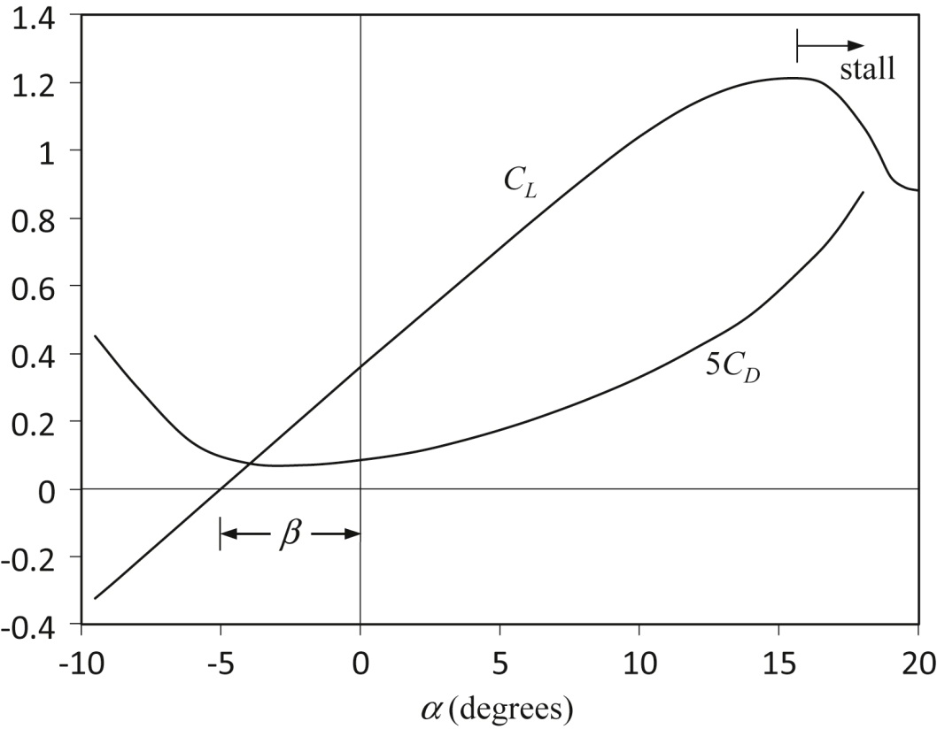
Figure 14.26

Slide 28
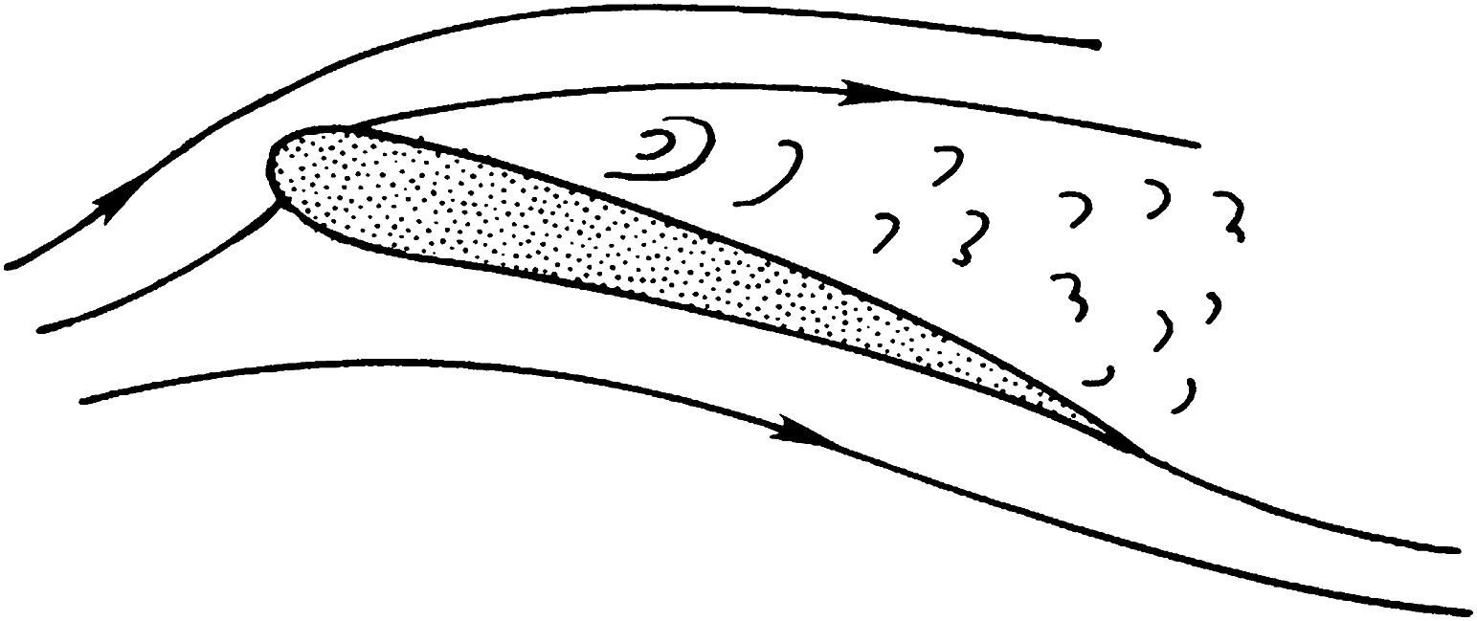
Figure 14.27

Slide 29
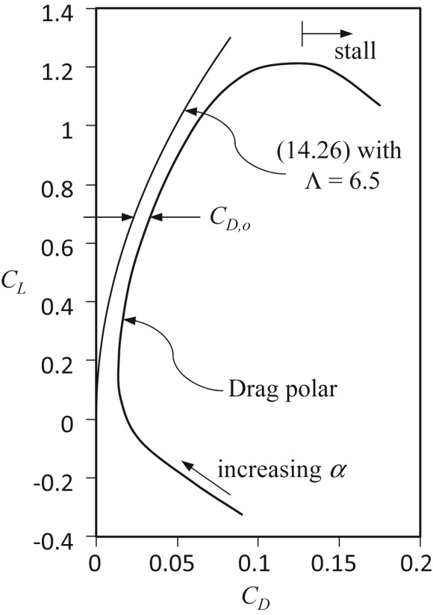
Figure 14.28

Slide 30
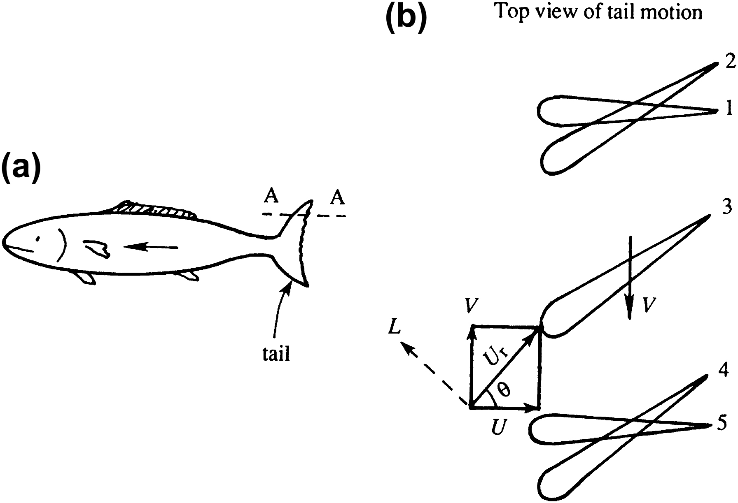
Figure 14.29

Slide 31
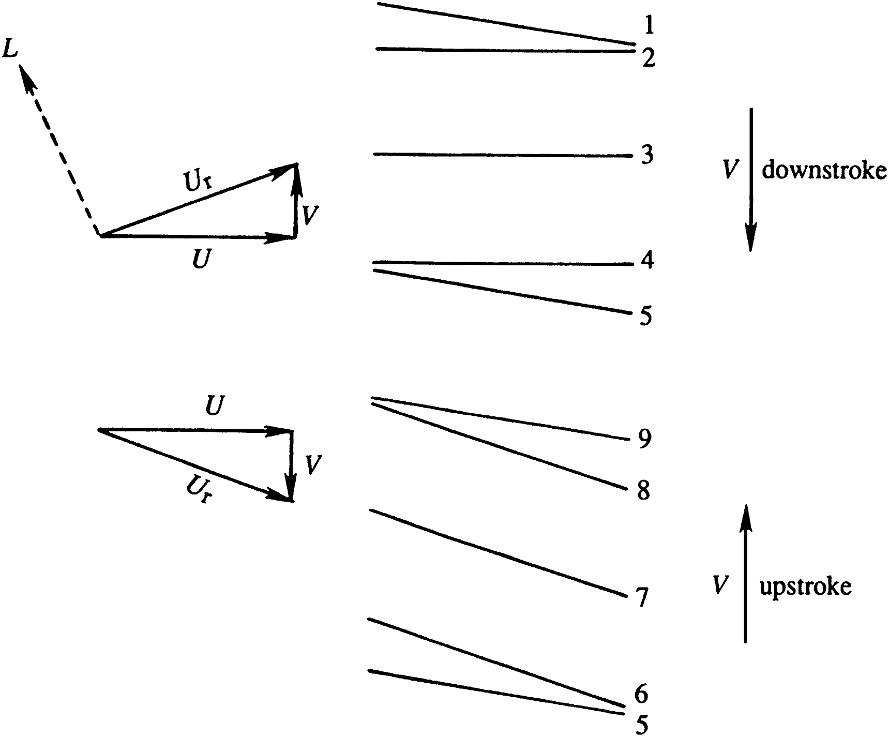
Figure 14.30

Slide 32
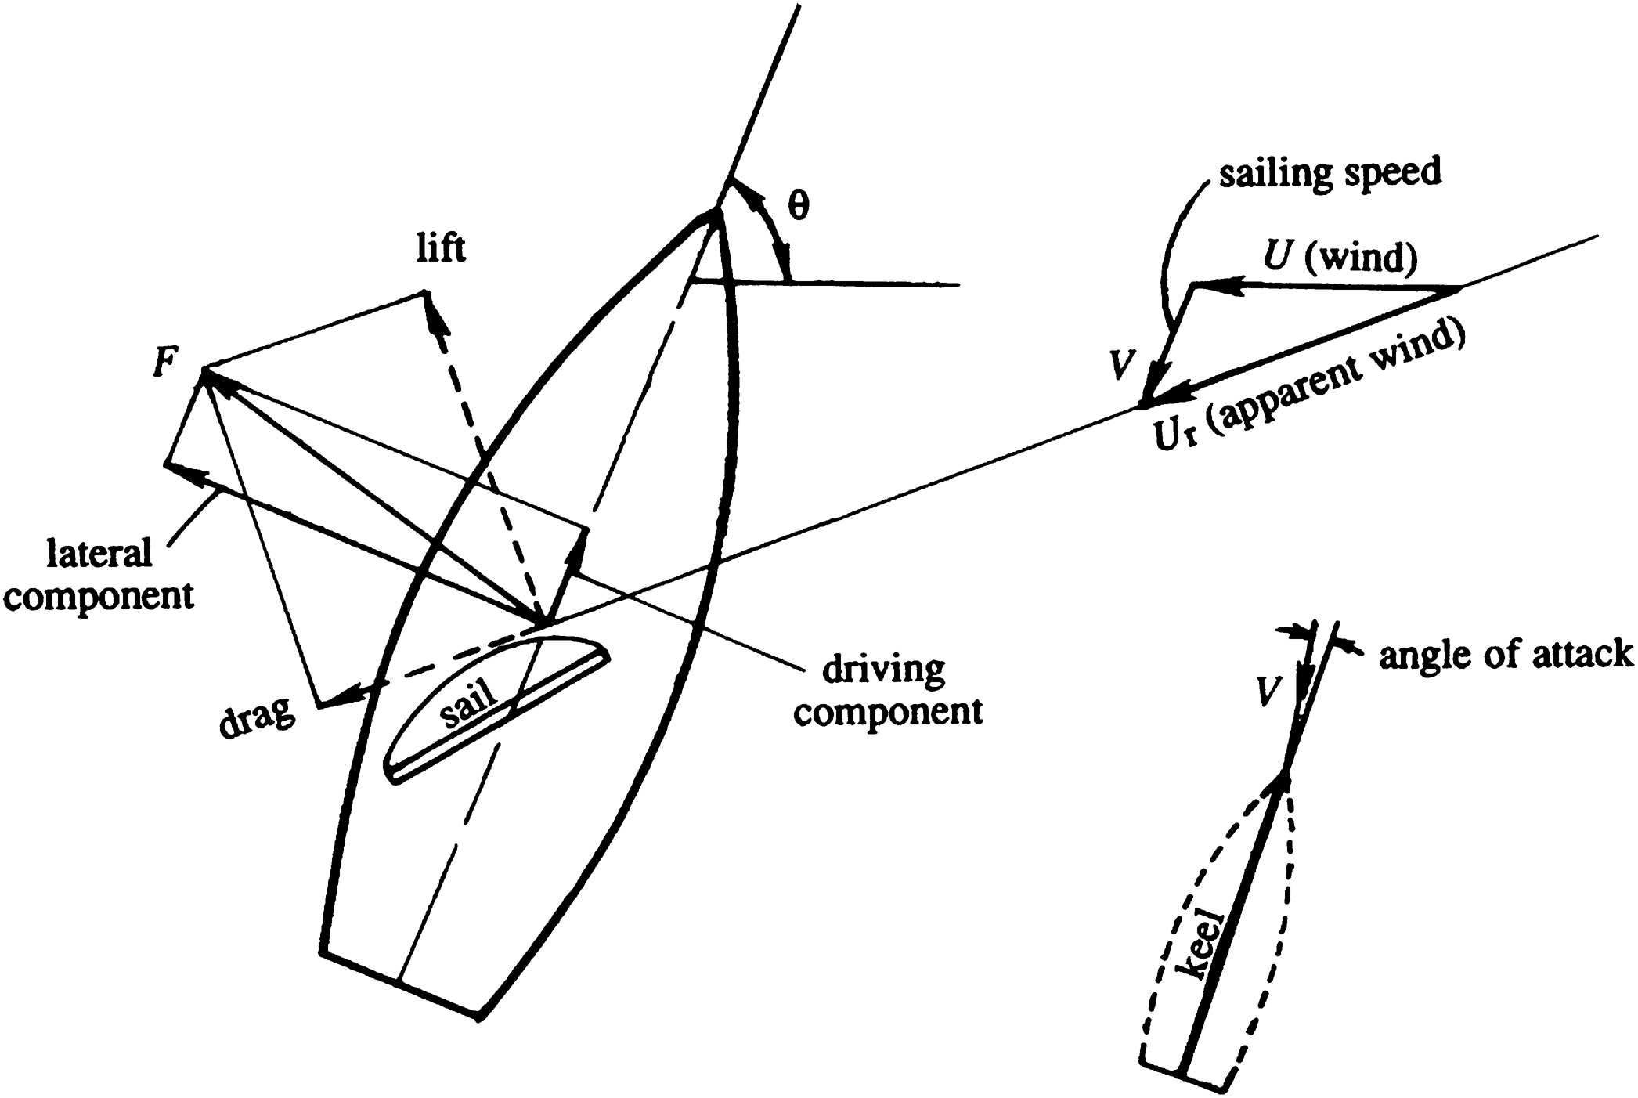
Figure 14.31

Slide 33
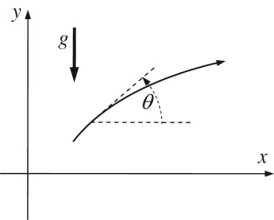
UnnFigure 14.1

Slide 34
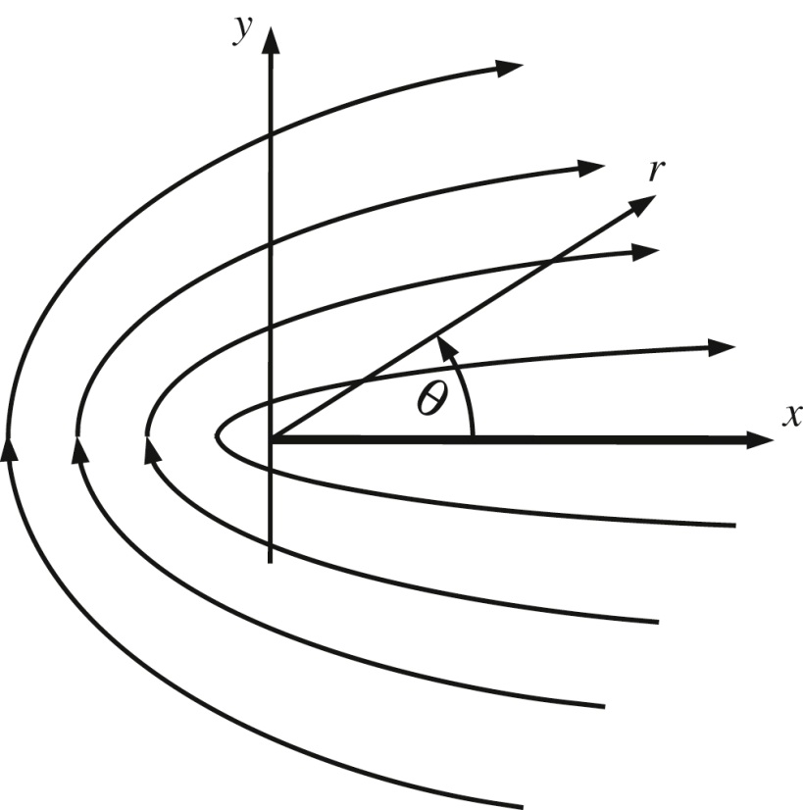
UnnFigure 14.2

Slide 35
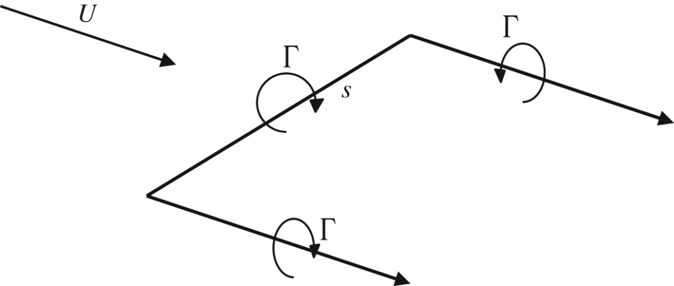
UnnFigure 14.3

Slide 36
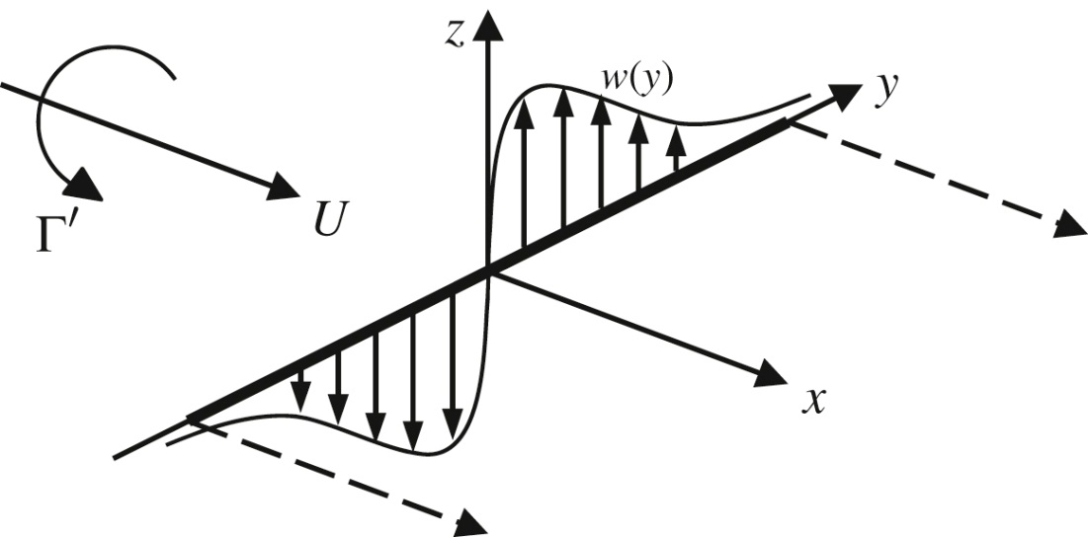
UnnFigure 14.4

Slide 37
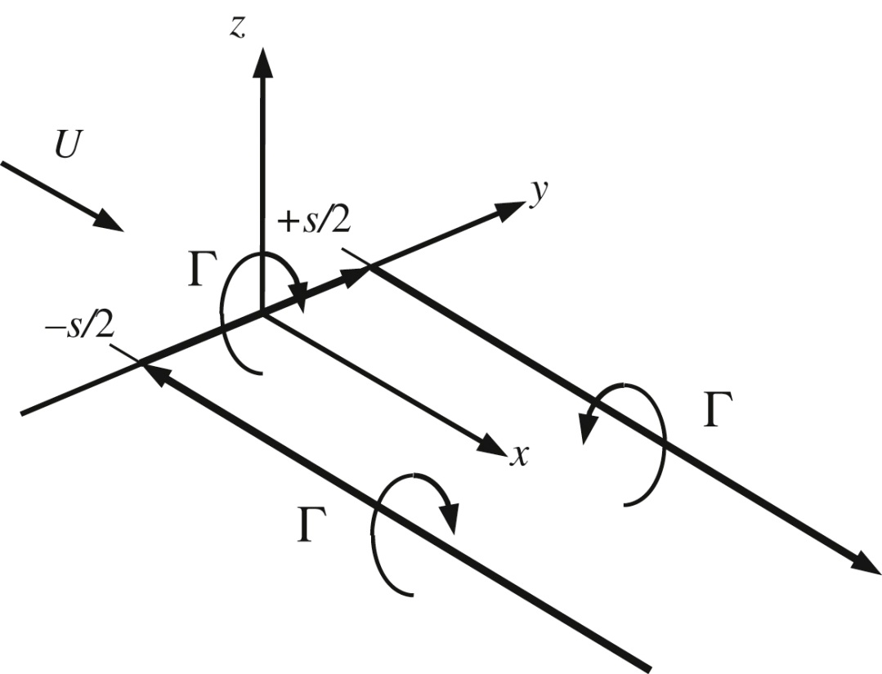
UnnFigure 14.5

Slide 38
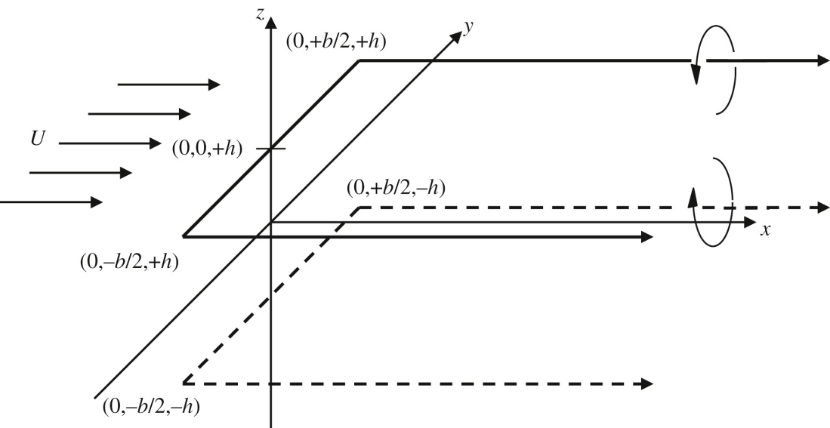
UnnFigure 14.6

