Slide 1
Chapter 01
The Human Organism: Organ Systems, Cells, Organelles, and Our Microbiota

Slide 2
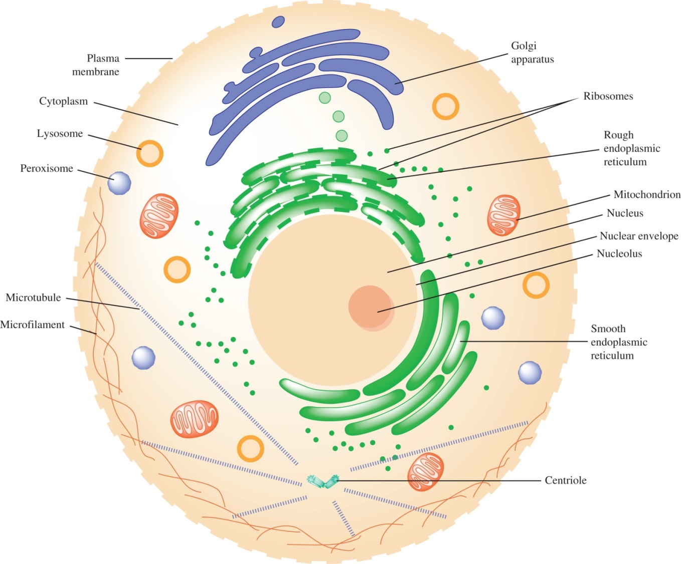
Figure 1.1

Slide 3
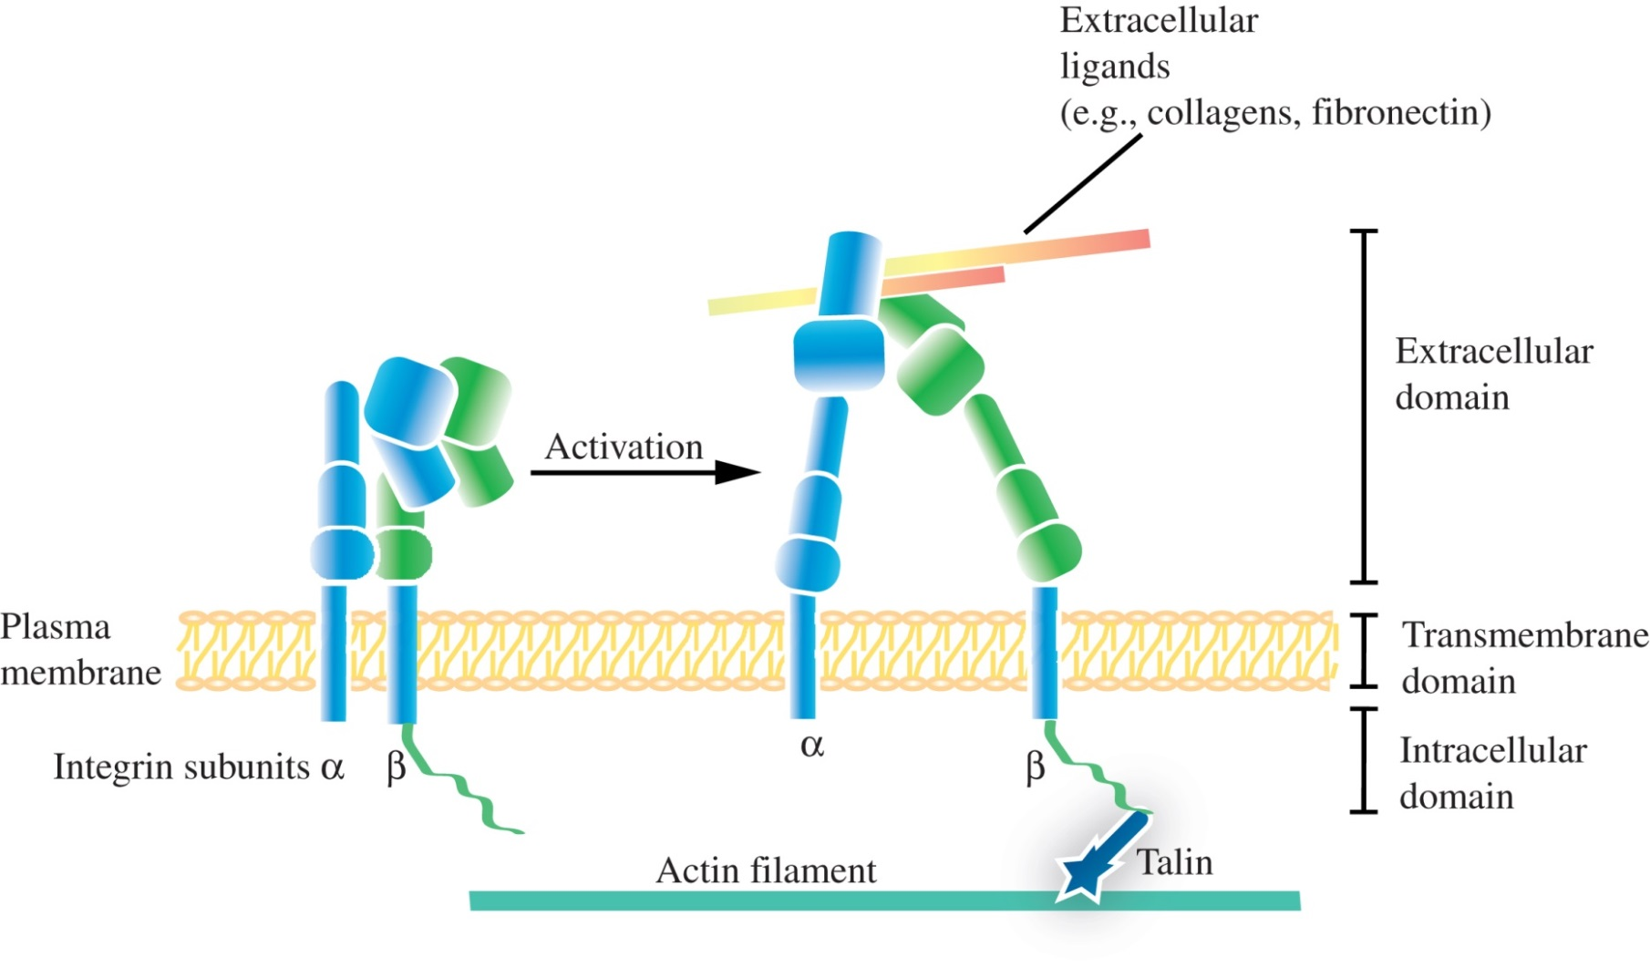
Figure 1.2

Slide 4
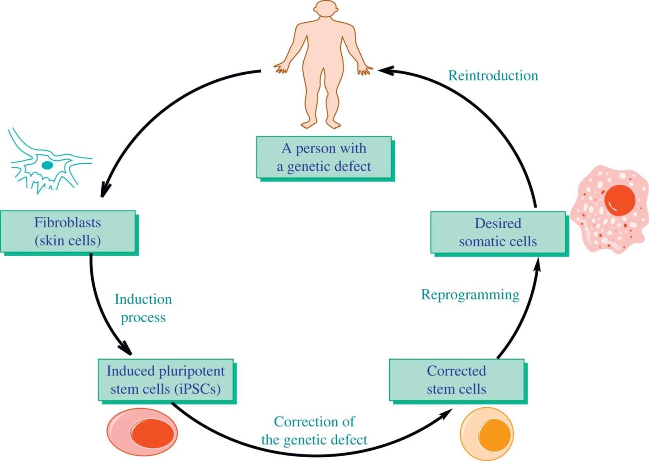
Figure 1.3

Slide 5
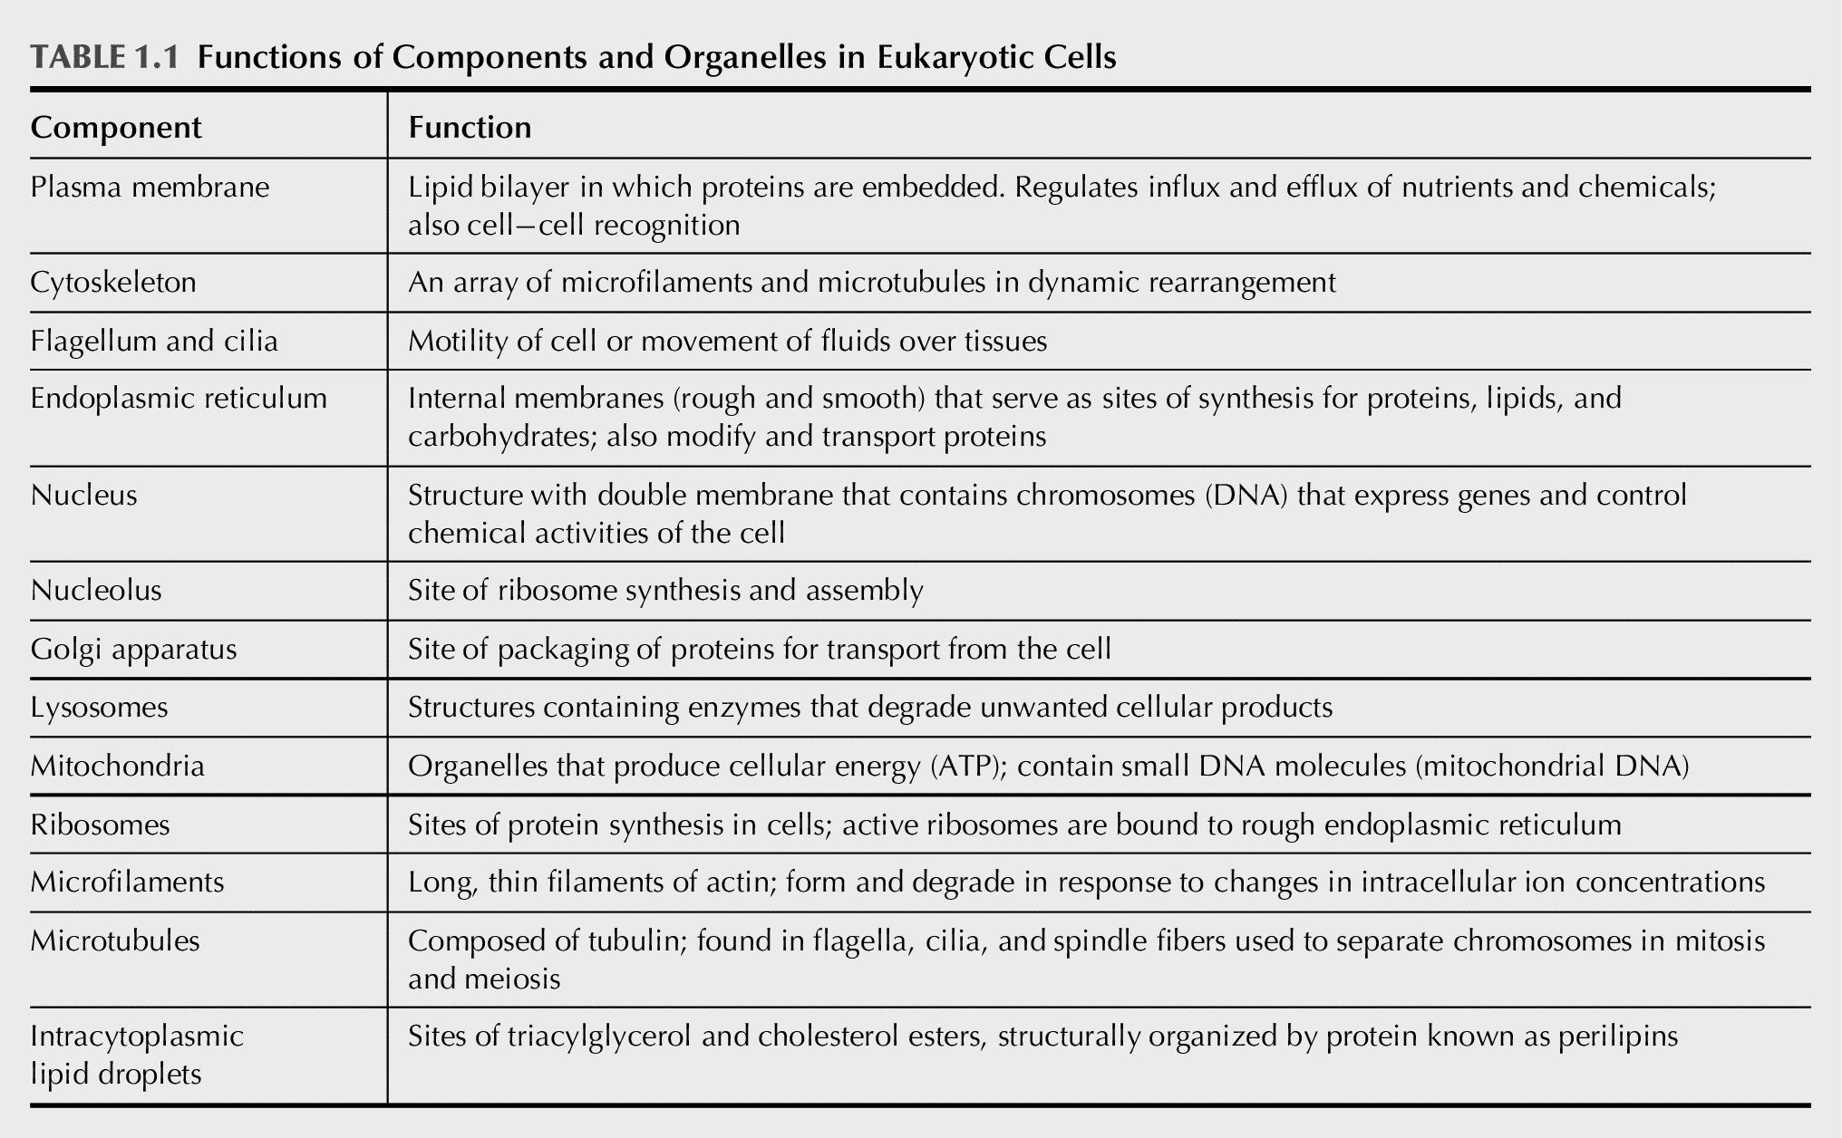
Table 1.1

