Slide 1
Chapter 03
Amino Acids

Slide 2
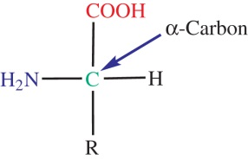
Figure 3.1

Slide 3
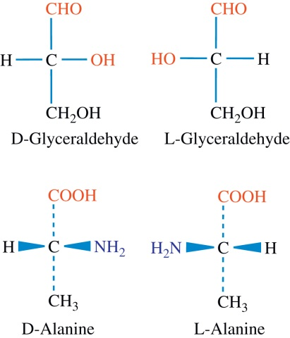
Figure 3.2

Slide 4
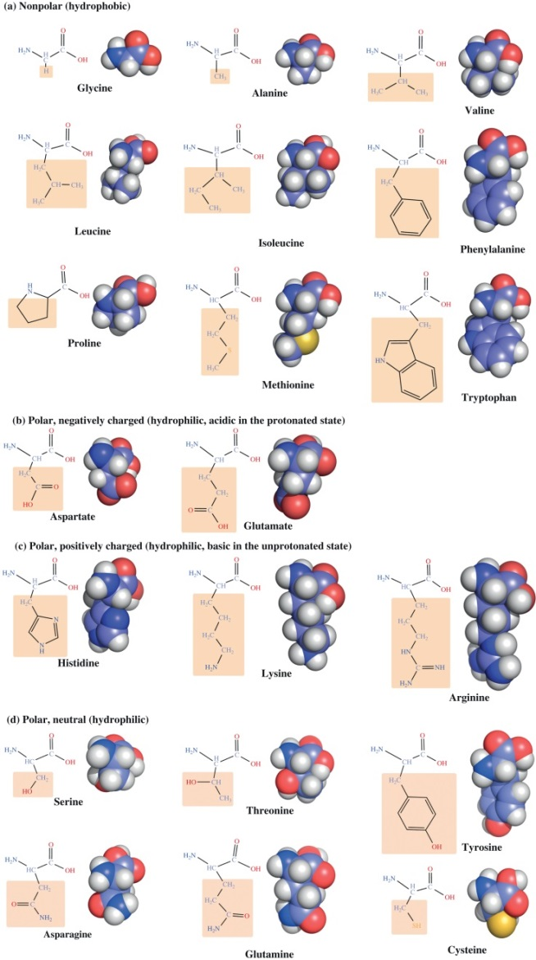
Figure 3.3

Slide 5
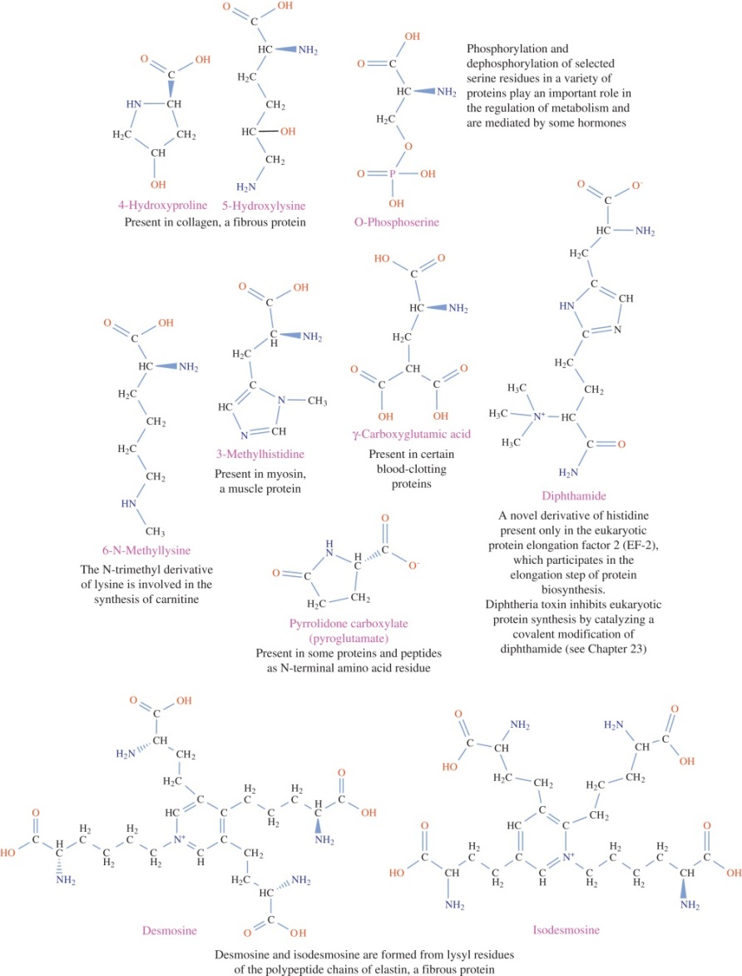
Figure 3.4

Slide 6
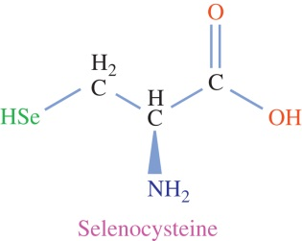
Figure 3.5

Slide 7
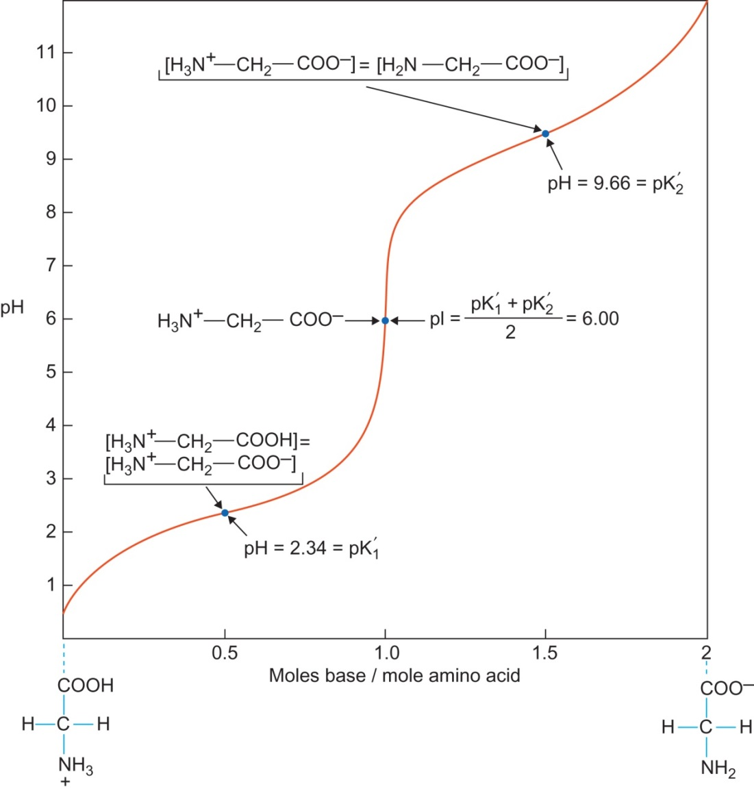
Figure 3.6

Slide 8
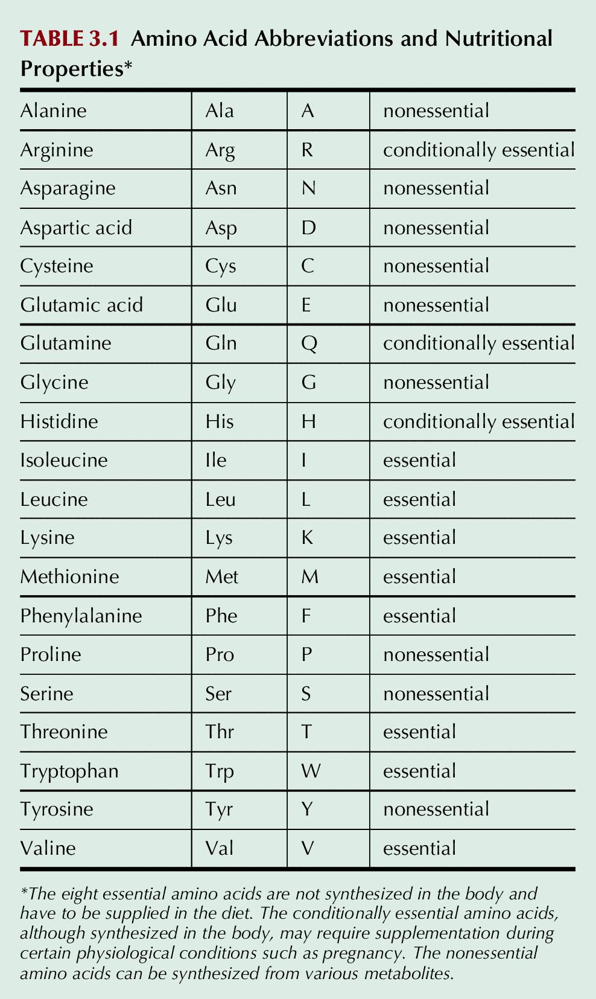
Table 3.1

Slide 9
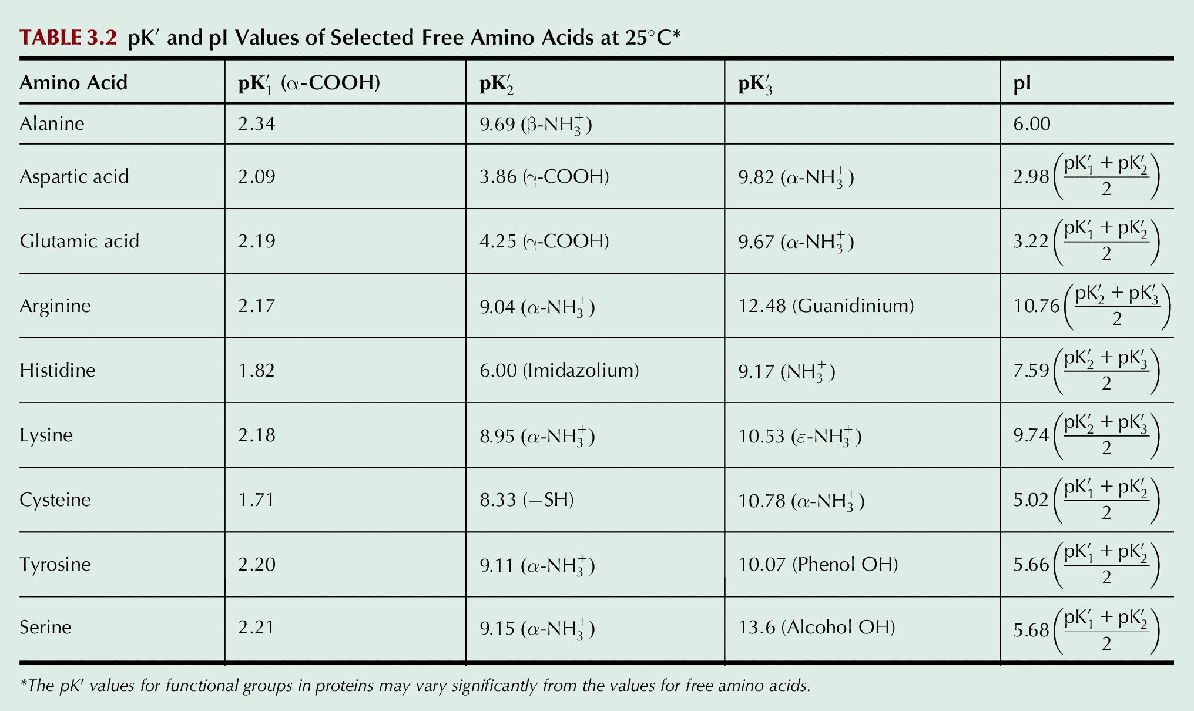
Table 3.2

