Slide 1
Chapter 06
Enzymes and Enzyme Regulation

Slide 2
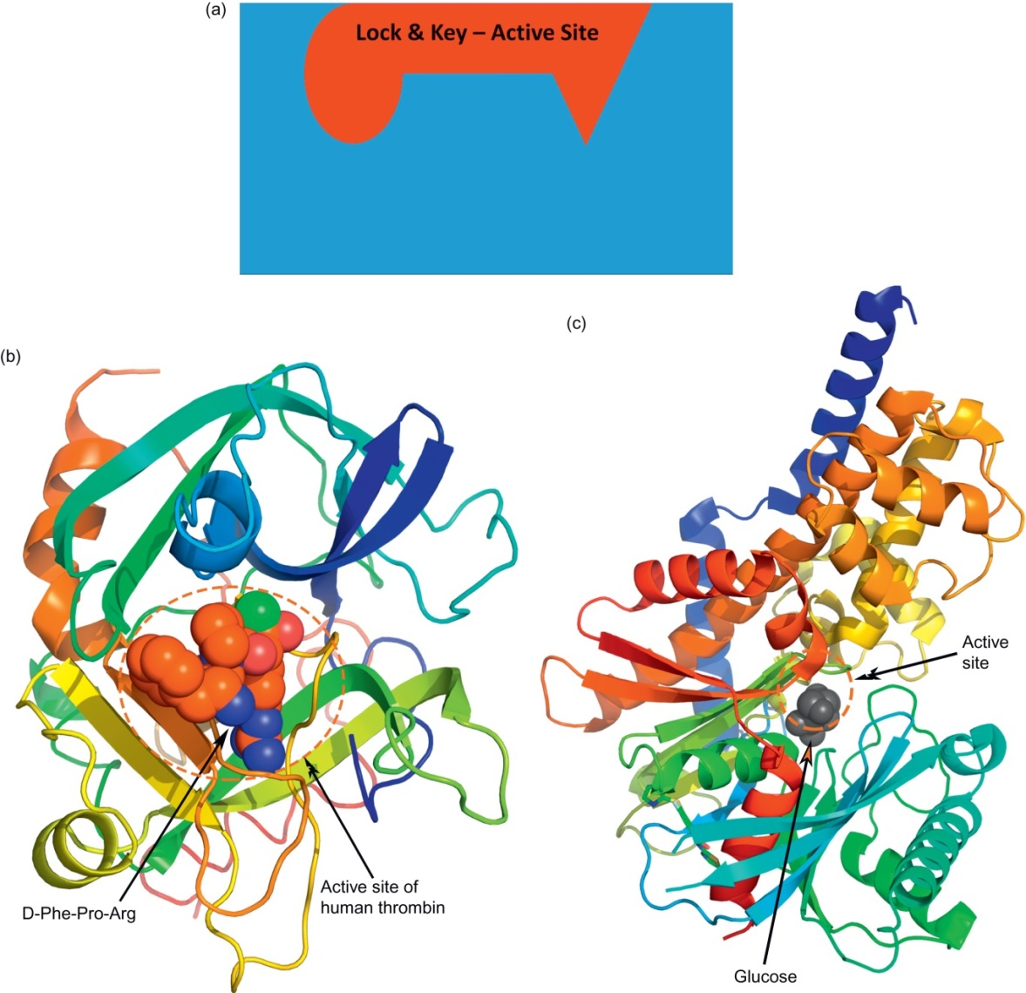
Figure 6.1

Slide 3
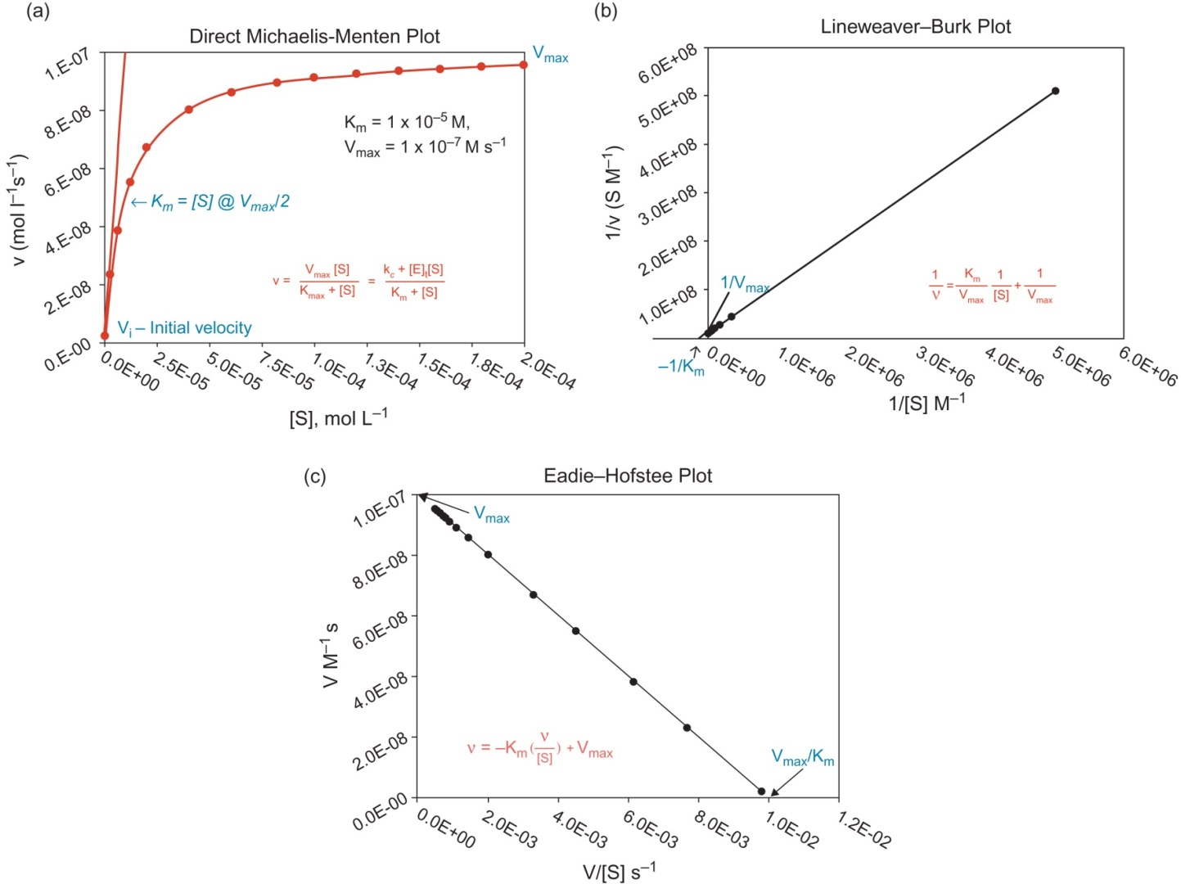
Figure 6.2

Slide 4
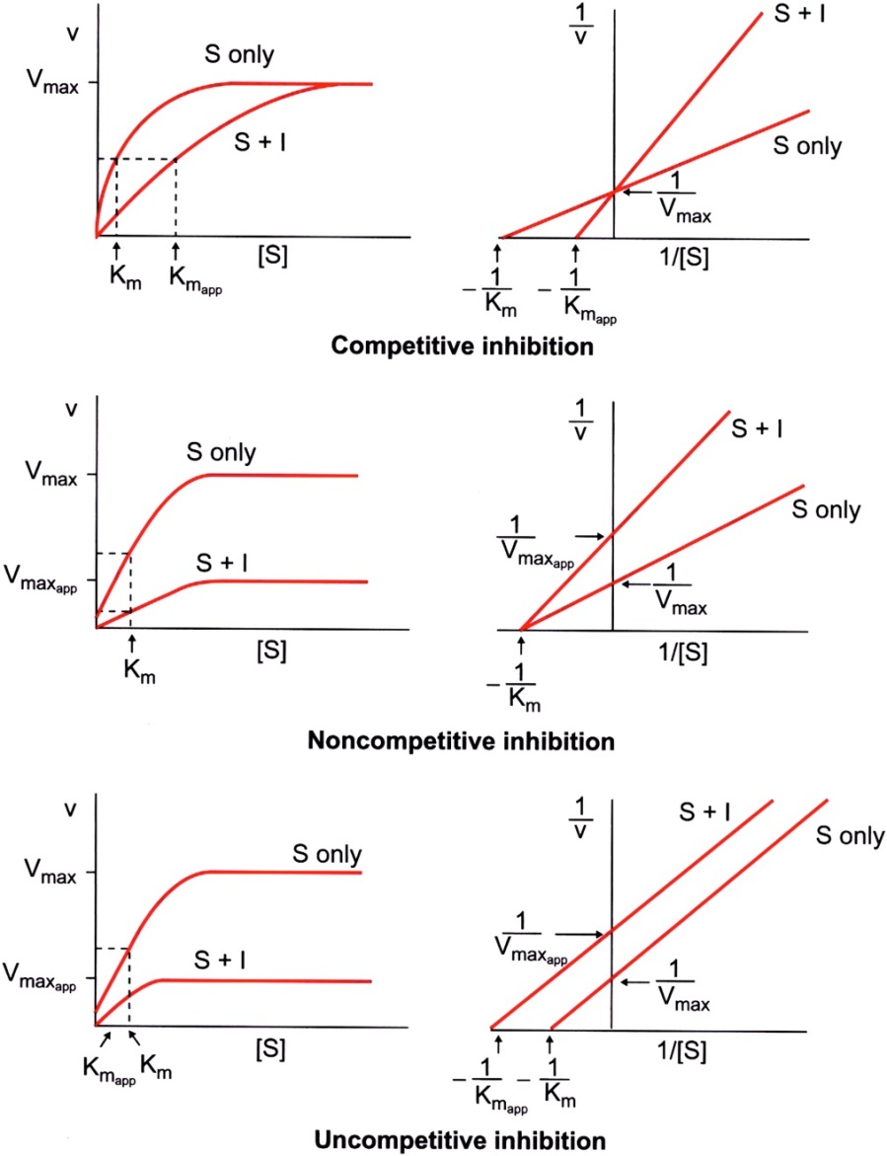
Figure 6.3

Slide 5
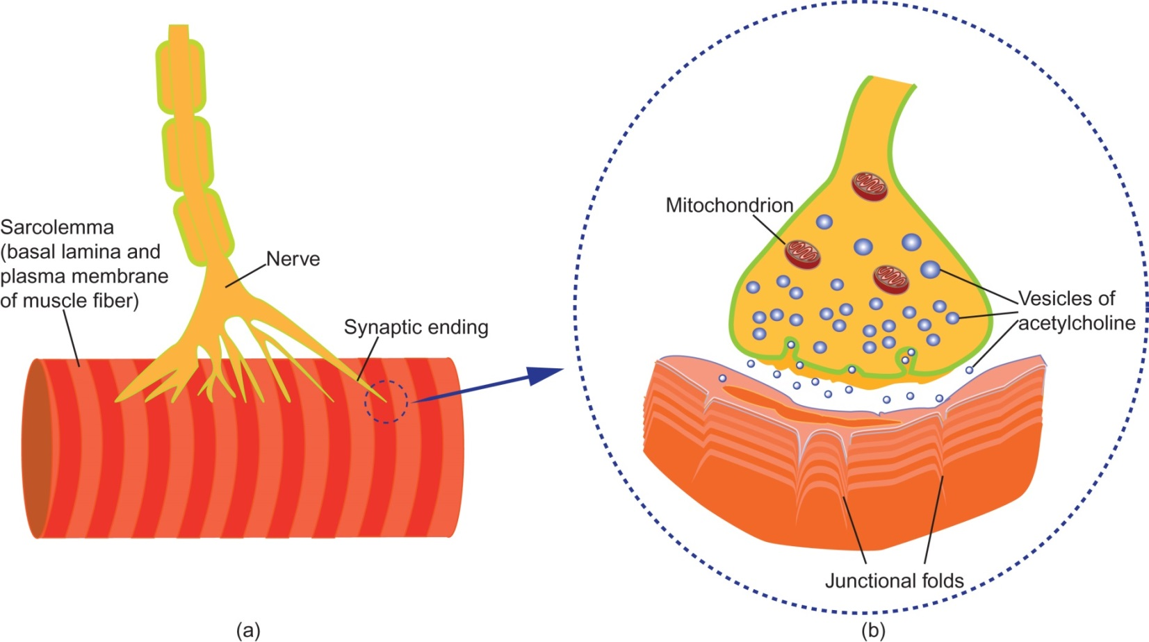
Figure 6.4

Slide 6
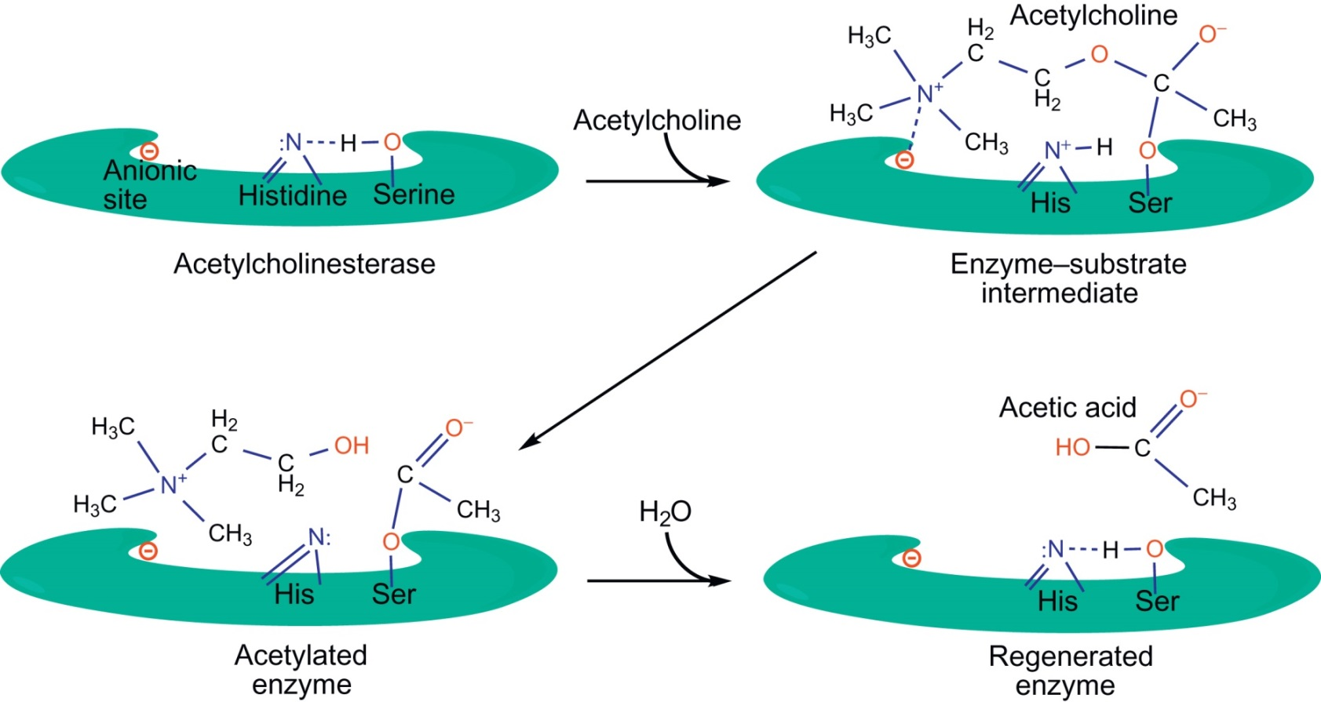
Figure 6.5

Slide 7
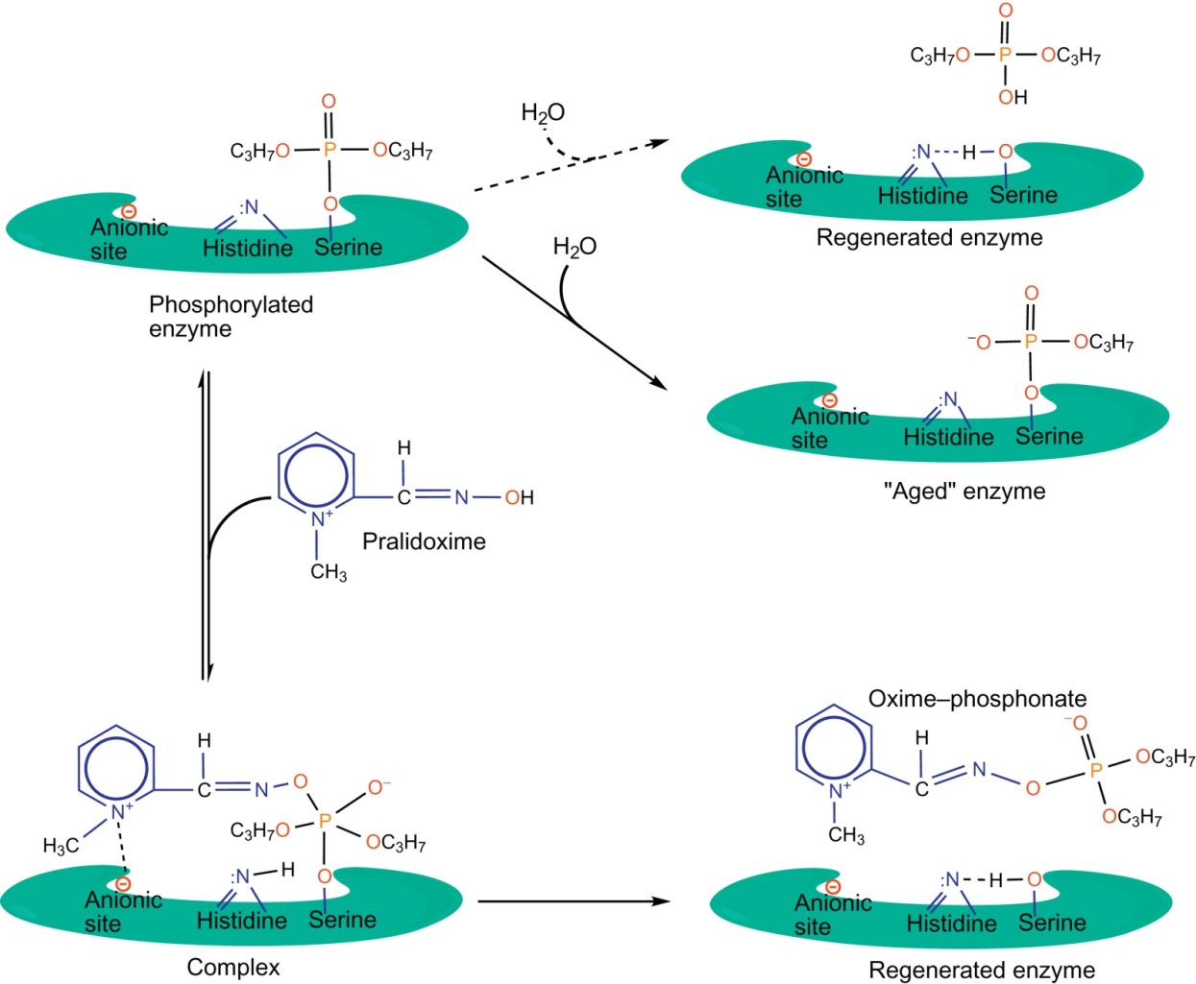
Figure 6.6

Slide 8
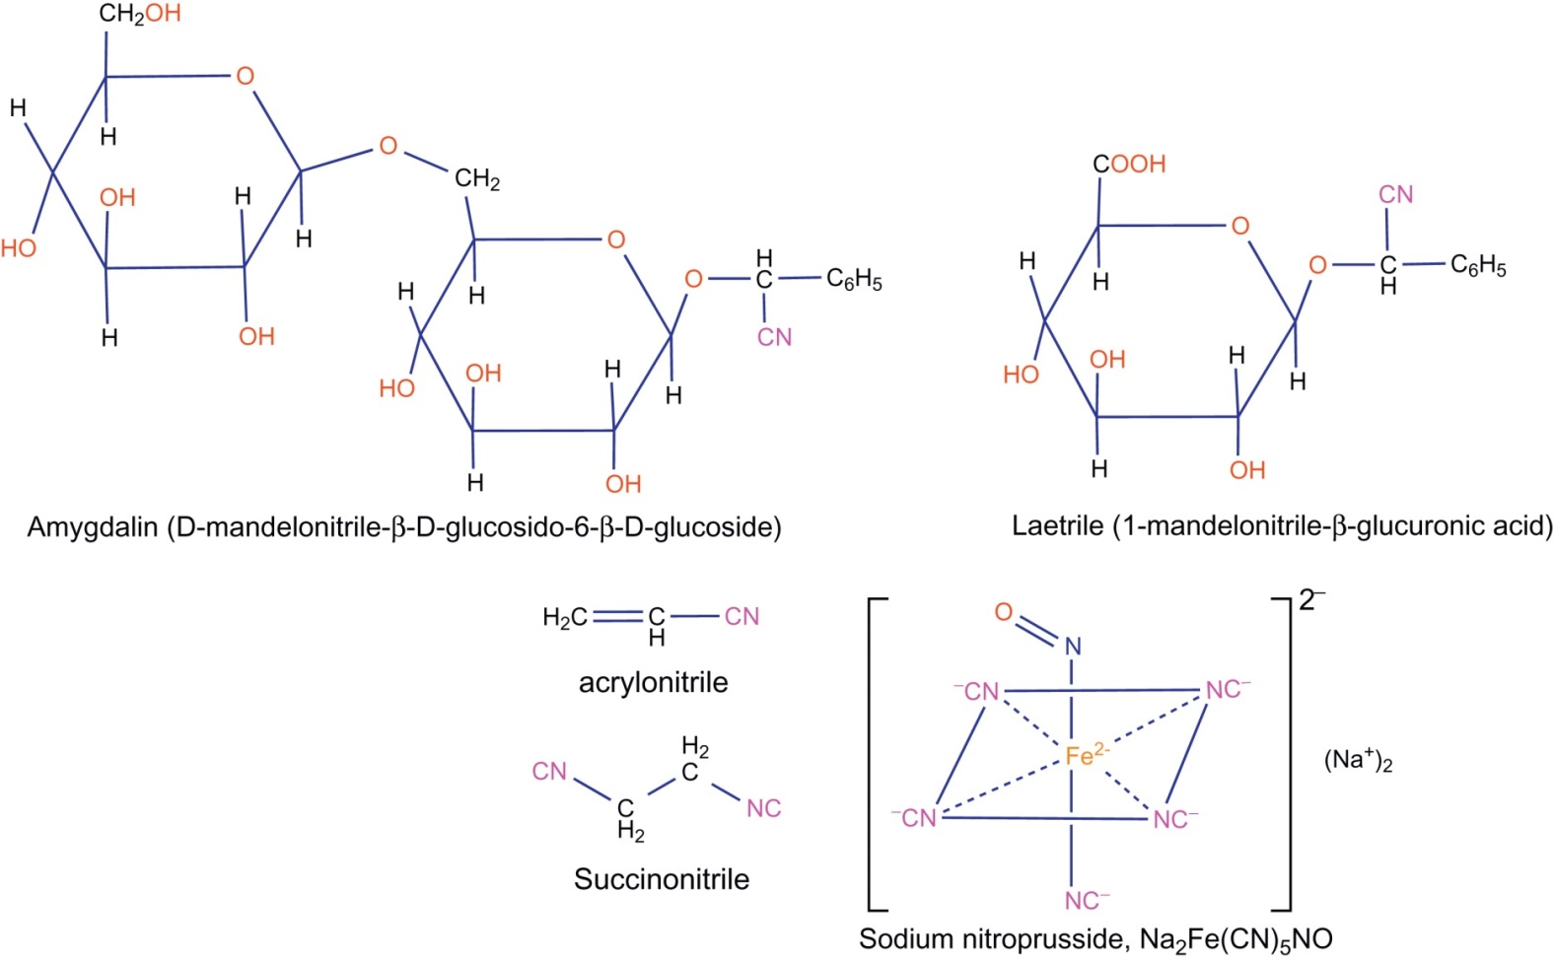
Figure 6.7

Slide 9
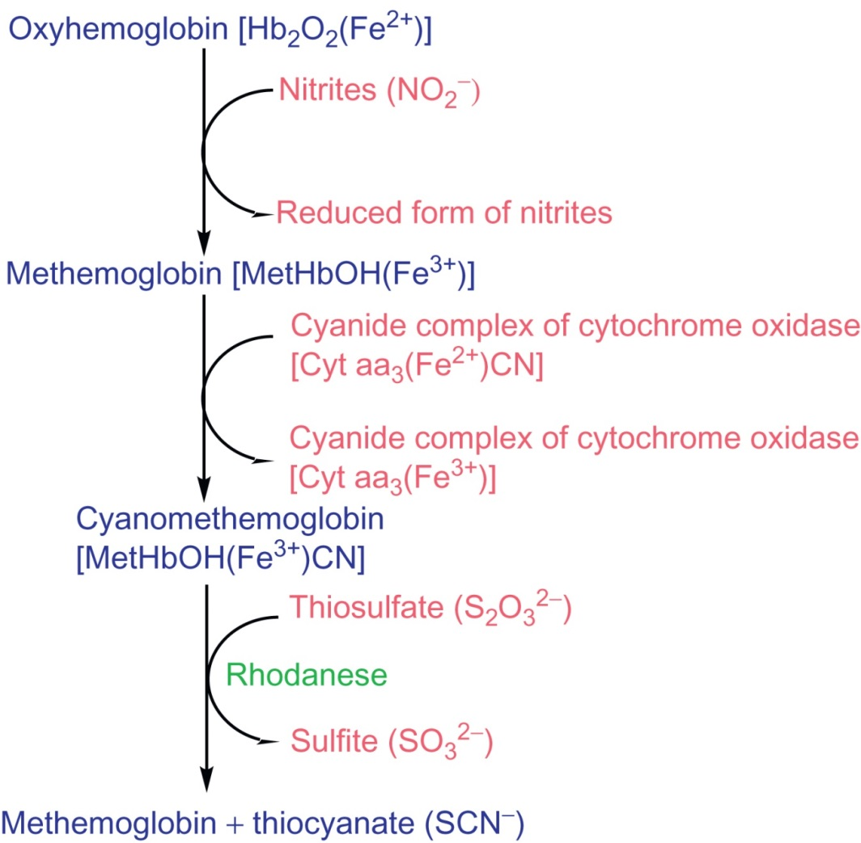
Figure 6.8

Slide 10
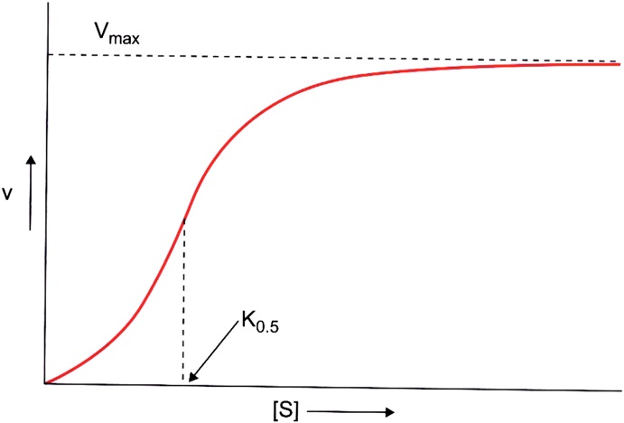
Figure 6.9

Slide 11
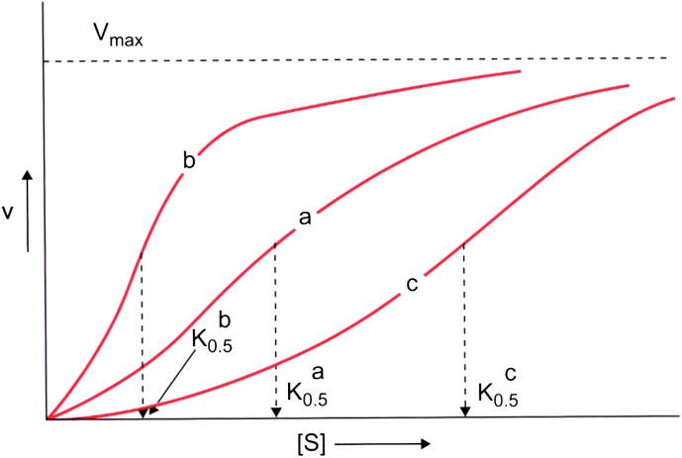
Figure 6.10

Slide 12
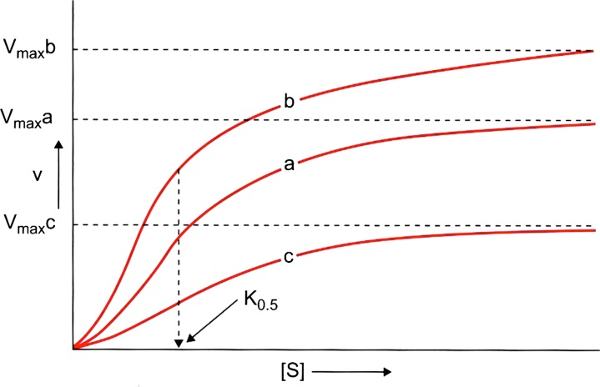
Figure 6.11

Slide 13
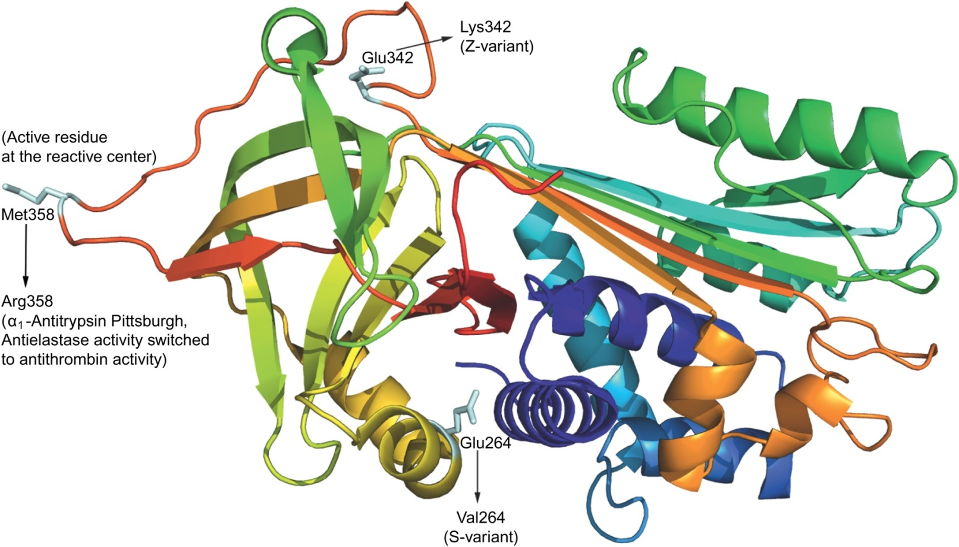
Figure 6.12

Slide 14
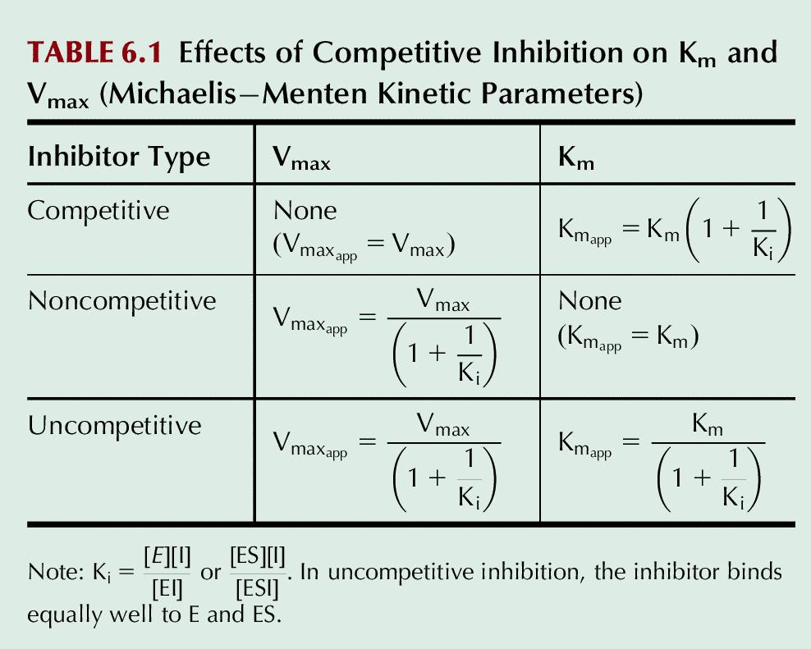
Table 6.1

Slide 15
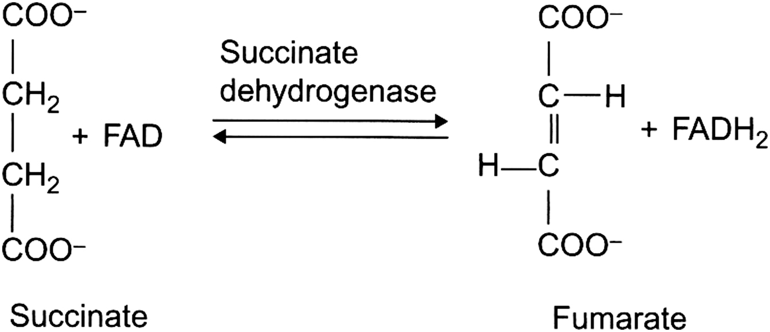
UnFig 6.1

Slide 16
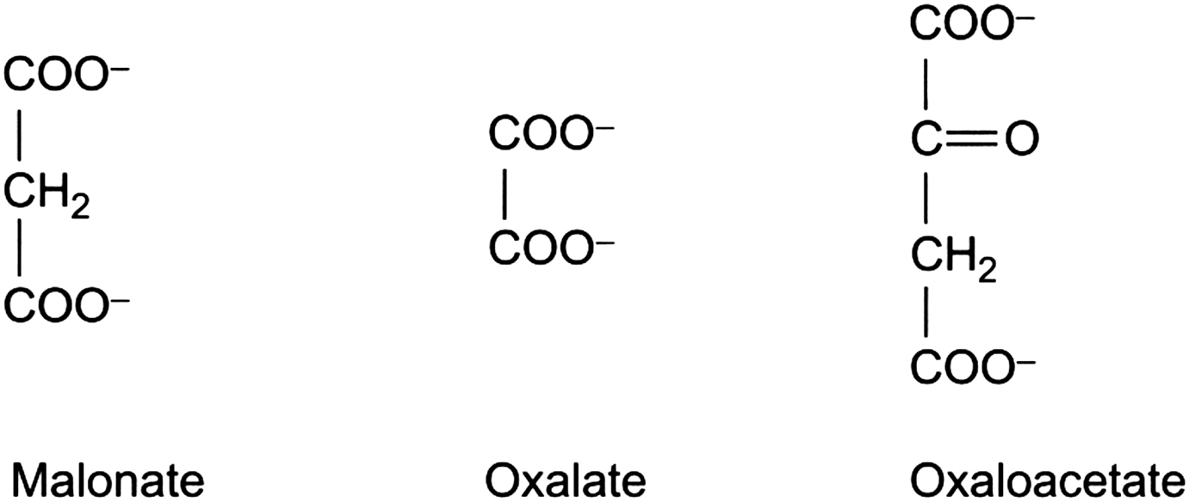
UnFig 6.2

Slide 17
UnFig 6.3

Slide 18
UnFig 6.4

Slide 19
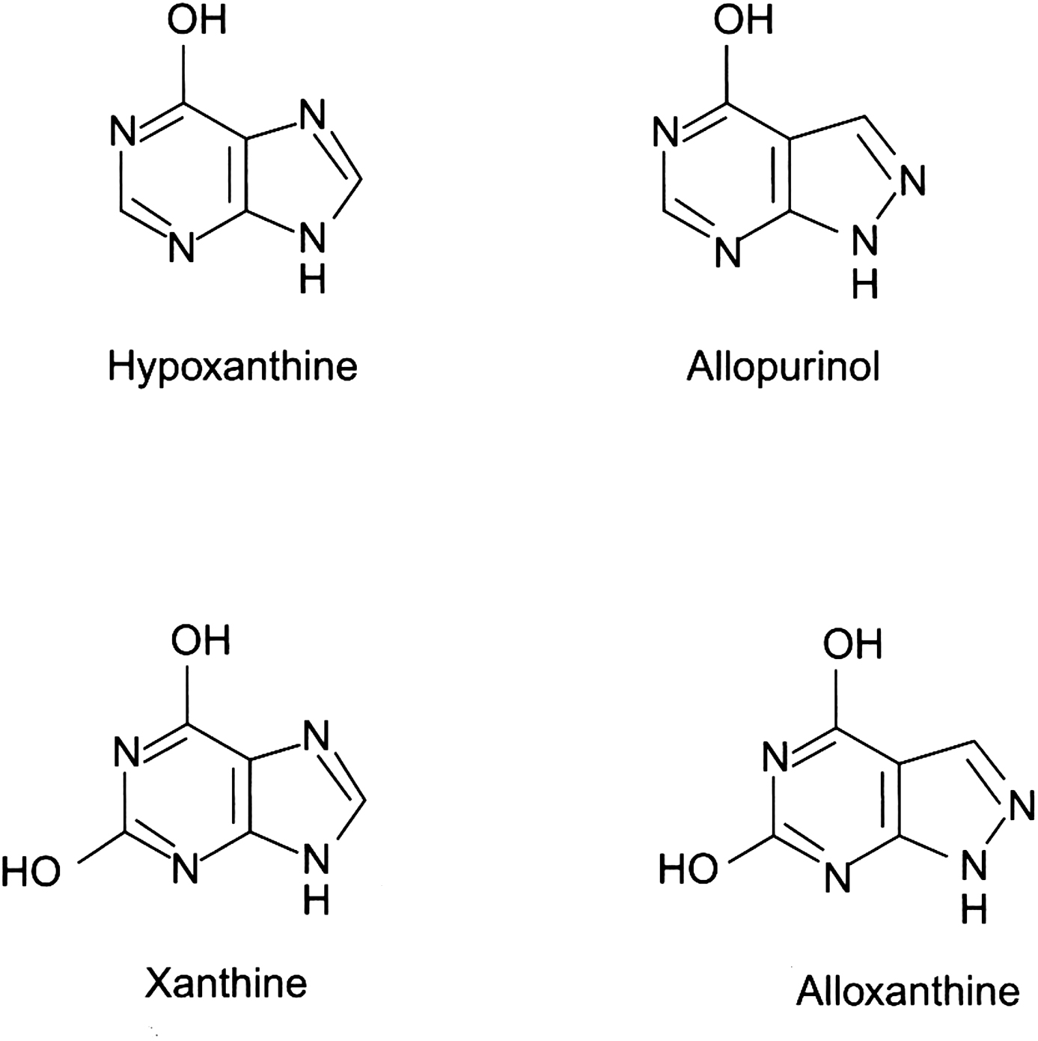
UnFig 6.5

Slide 20
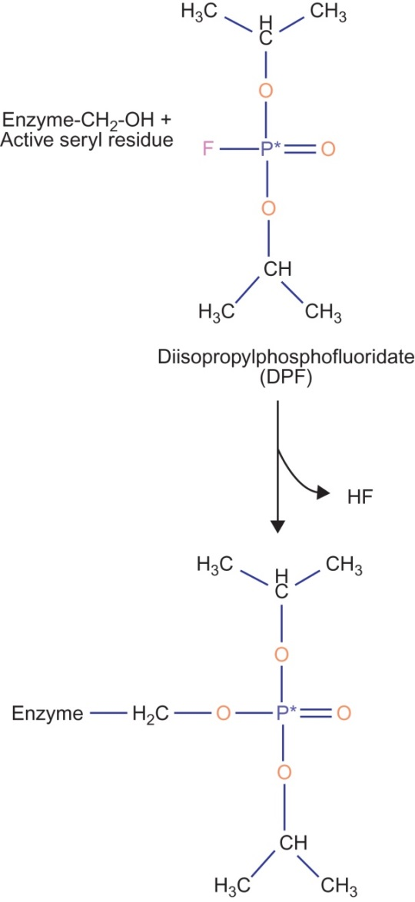
UnFig 6.6

Slide 21
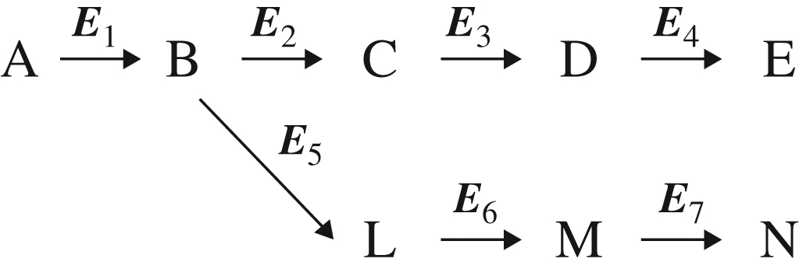
UnFig 6.7

