Slide 1
Chapter 07
Clinical Enzymology and Biomarkers of Tissue Injury

Slide 2
Figure 7.1

Slide 3
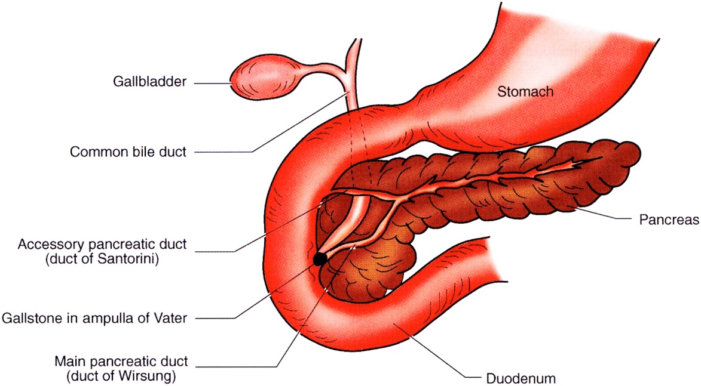
Figure 7.2

Slide 4
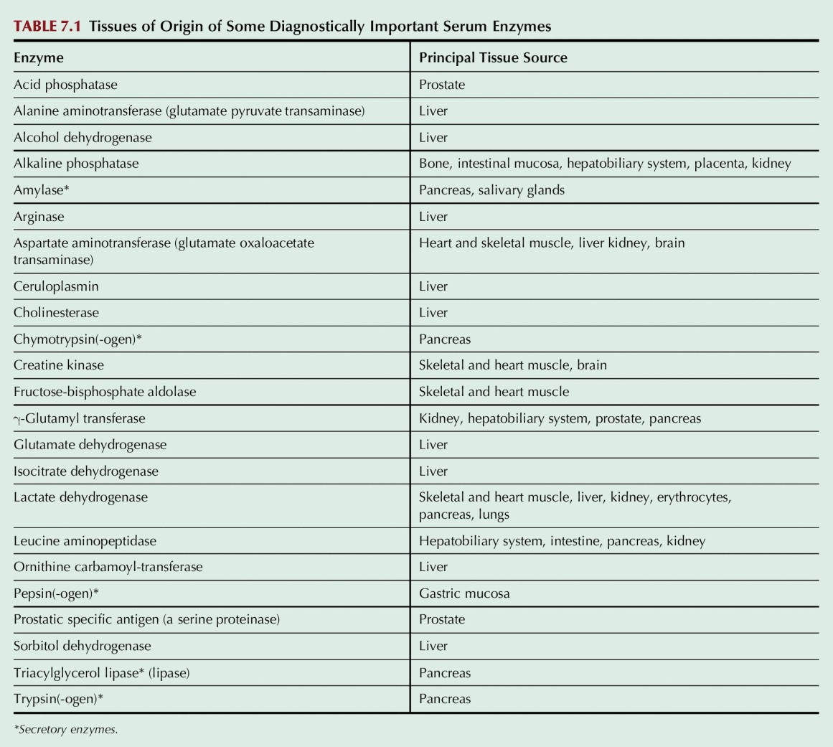
Table 7.1

