Slide 1
Chapter 08
Simple Carbohydrates

Slide 2
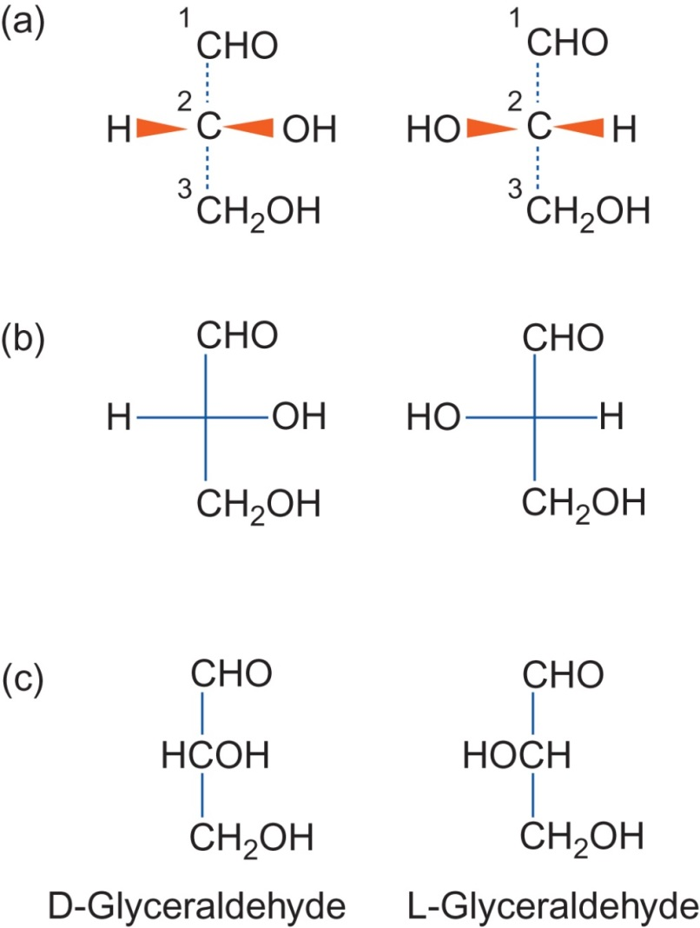
Figure 8.1

Slide 3
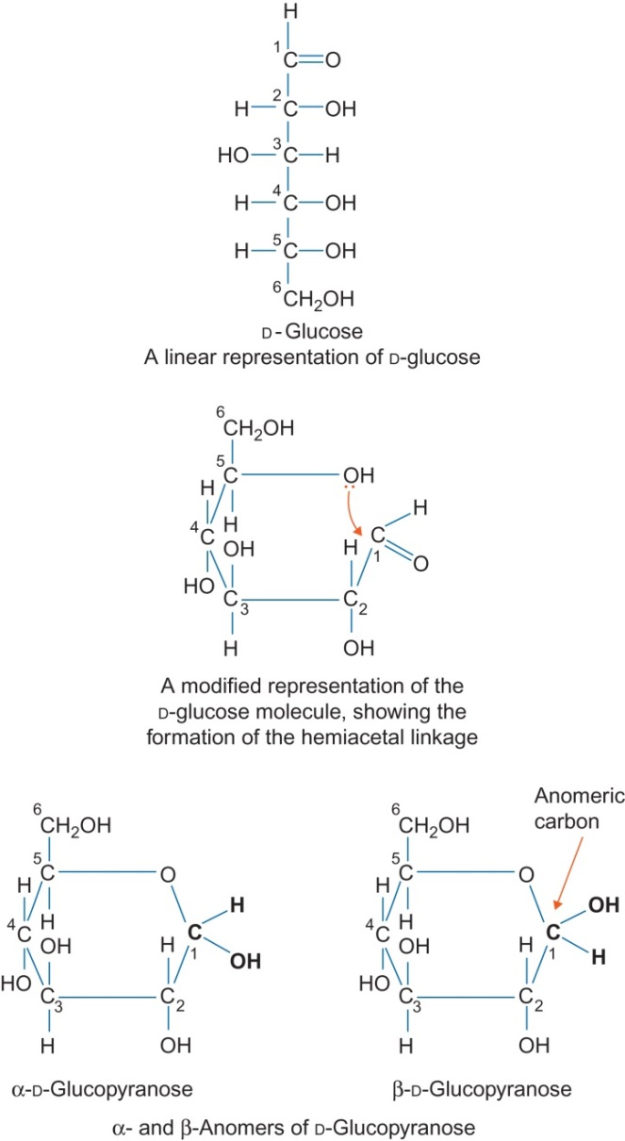
Figure 8.2

Slide 4
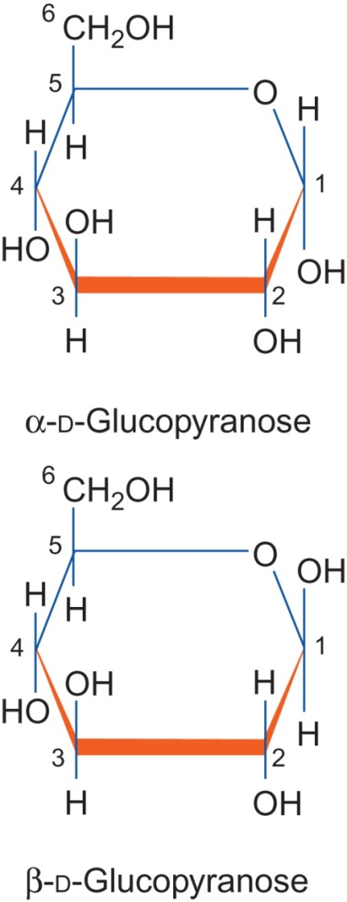
Figure 8.3

Slide 5
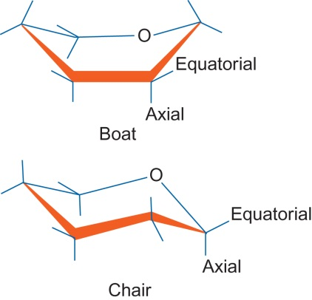
Figure 8.4

Slide 6
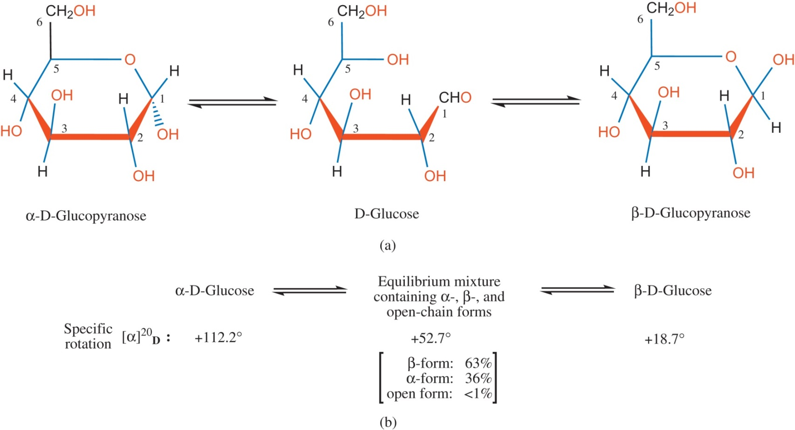
Figure 8.5

Slide 7
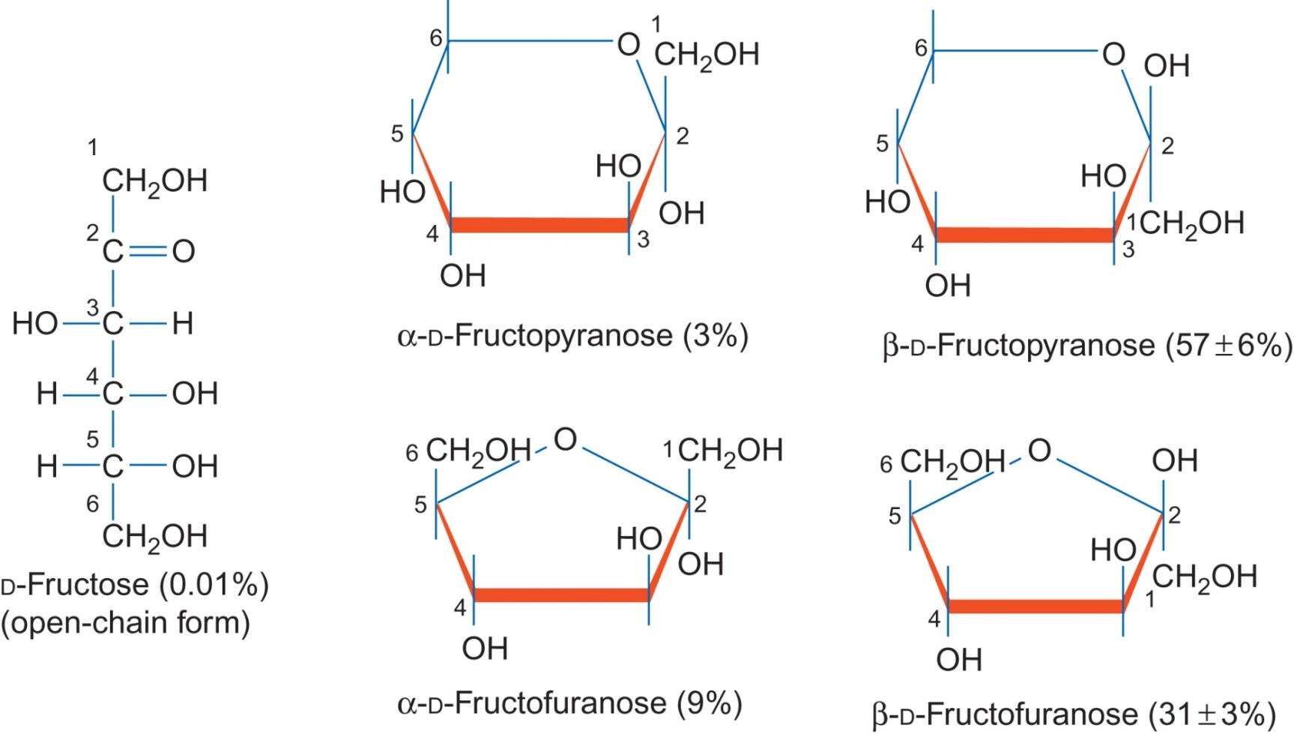
Figure 8.6

Slide 8
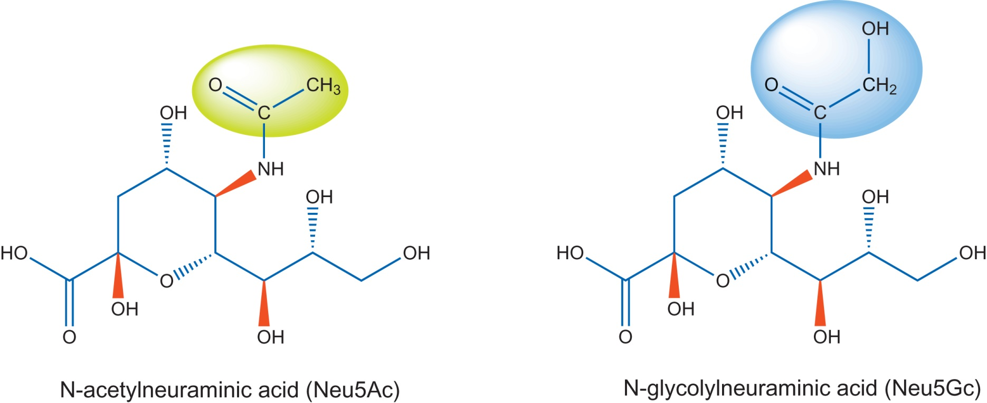
Figure 8.7

Slide 9
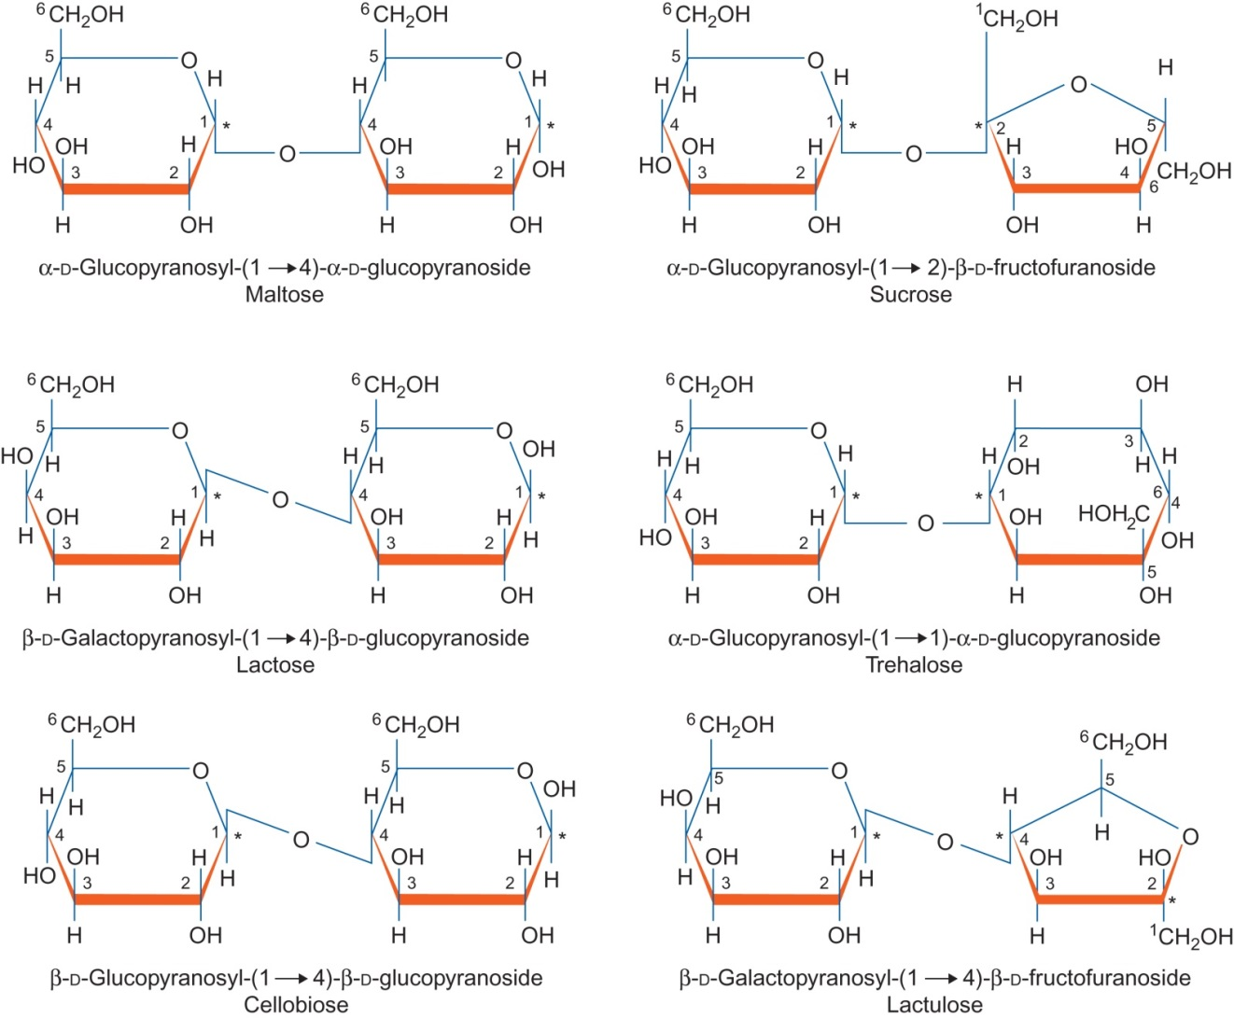
Figure 8.8

Slide 10
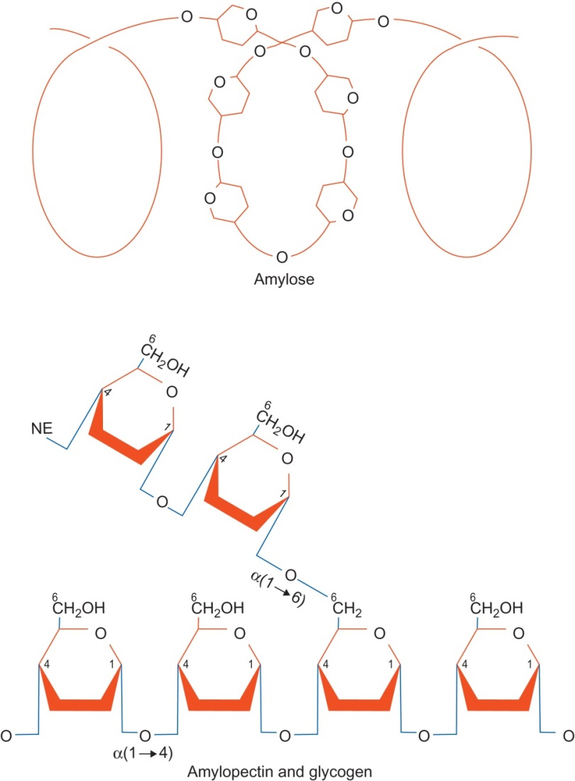
Figure 8.9

Slide 11
Figure 8.10

Slide 12
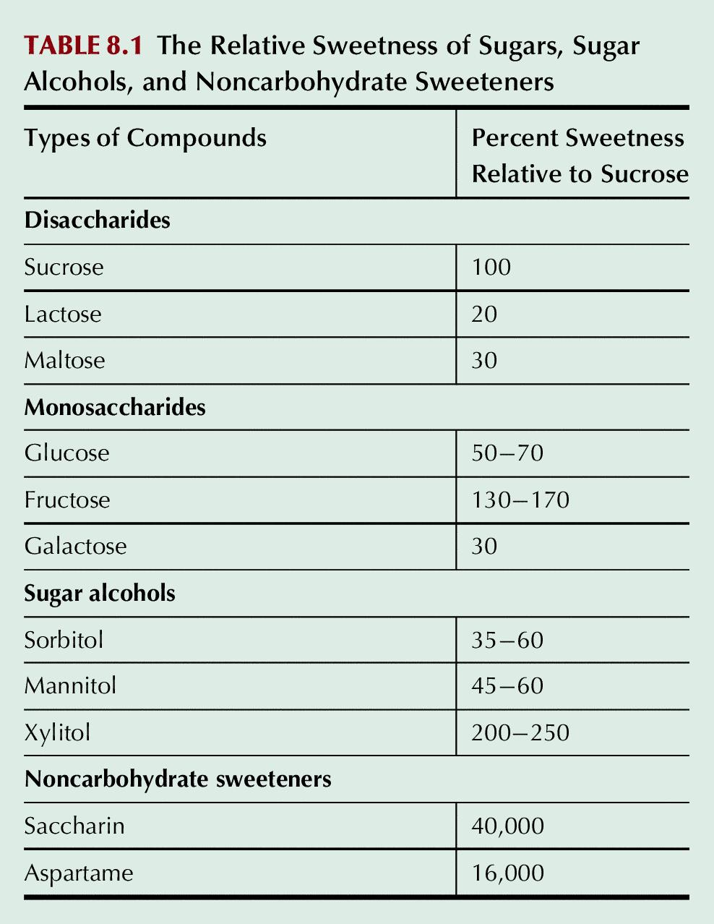
Table 8.1

Slide 13
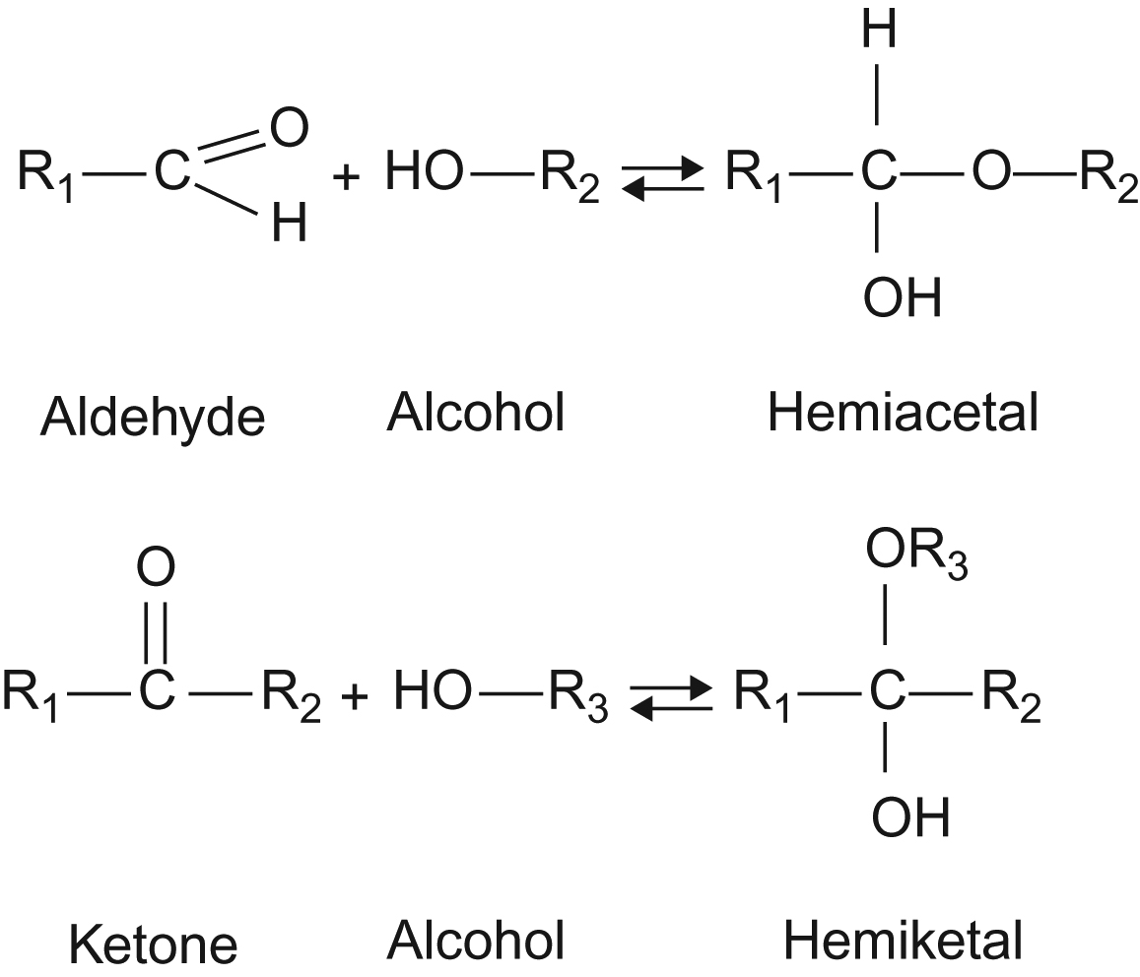
UnFig 8.1

Slide 14
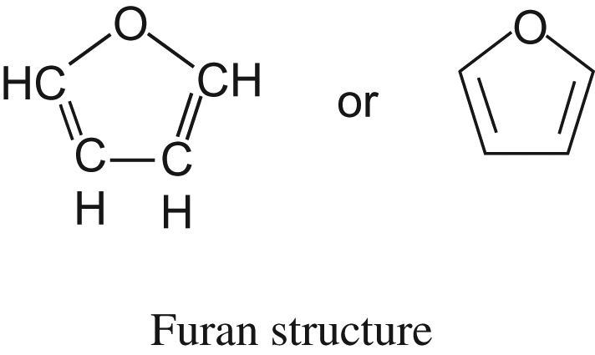
UnFig 8.2

Slide 15
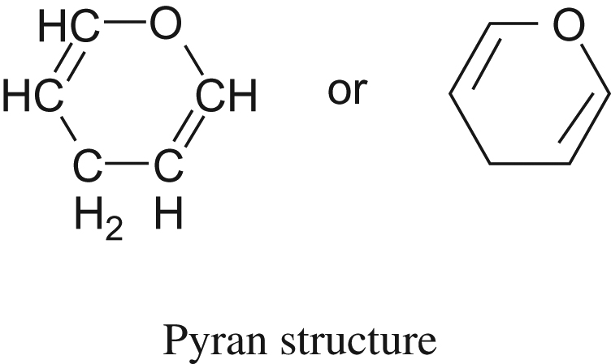
UnFig 8.3

Slide 16
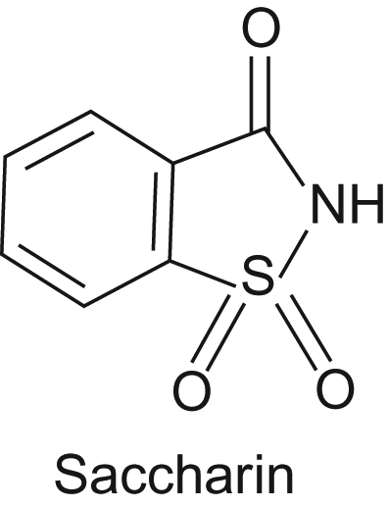
UnFig 8.4

