Slide 1
Chapter 12
Carbohydrate Metabolism I: Glycolysis and the Tricarboxylic Acid Cycle

Slide 2
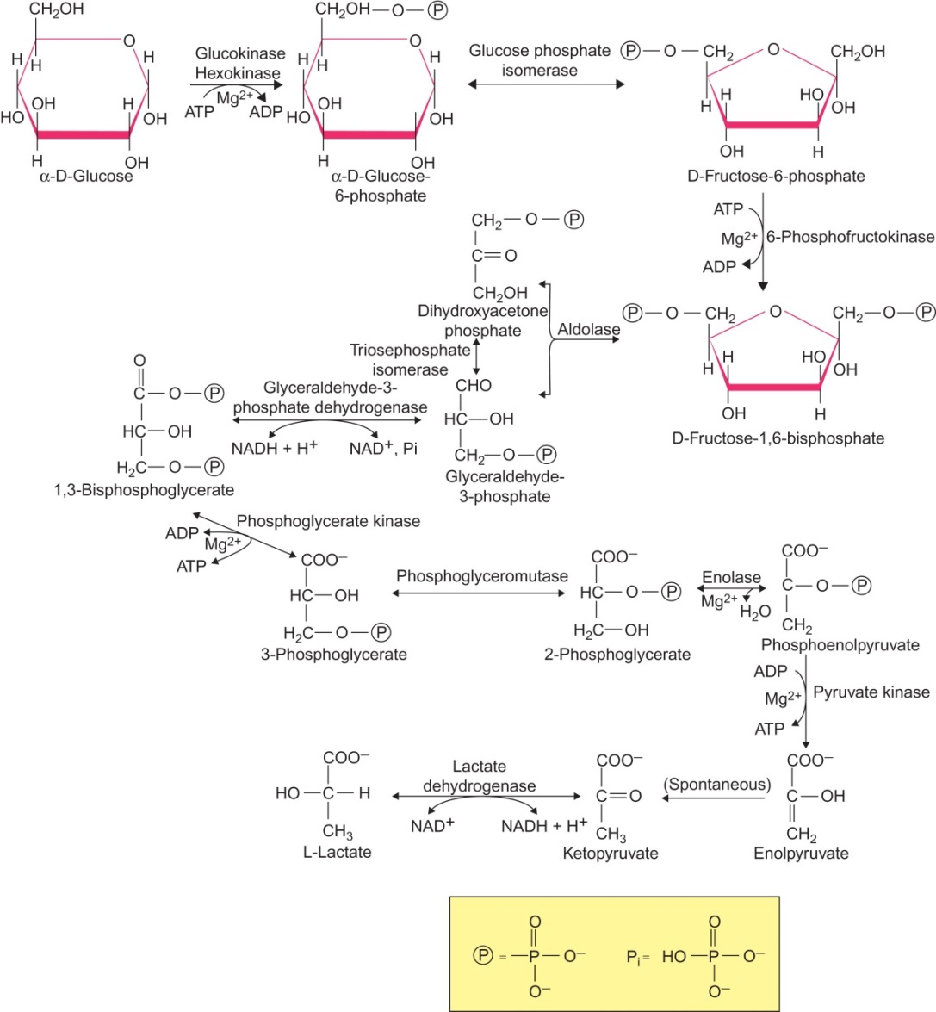
Figure 12.1

Slide 3
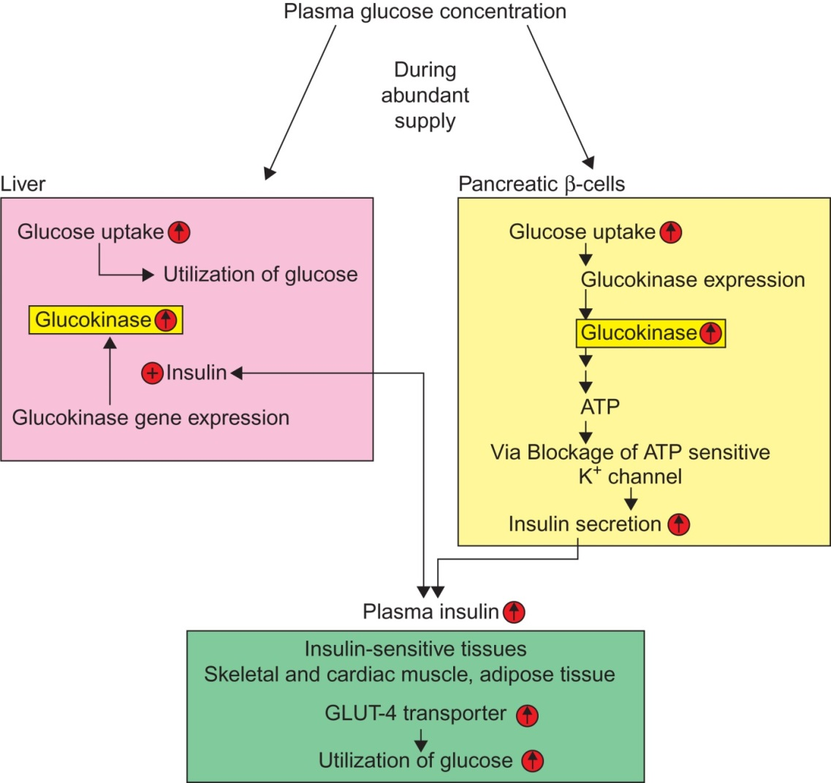
Figure 12.2

Slide 4
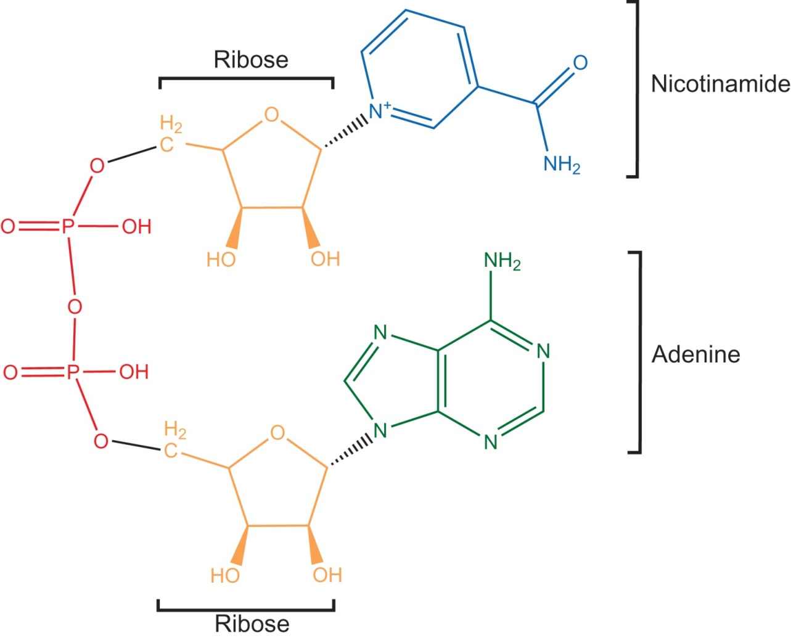
Figure 12.3

Slide 5
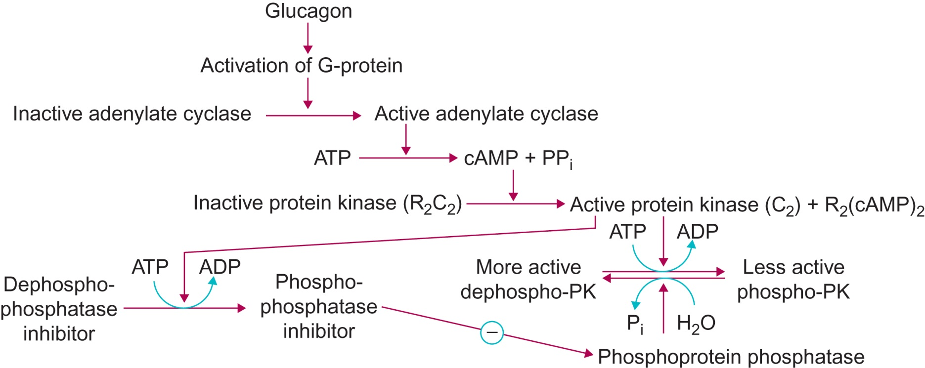
Figure 12.4

Slide 6
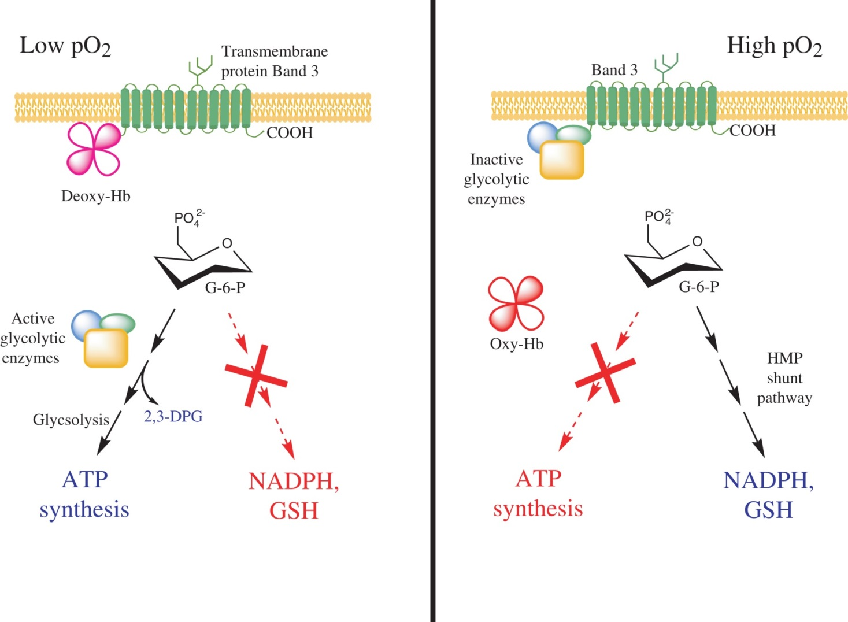
Figure 12.5

Slide 7
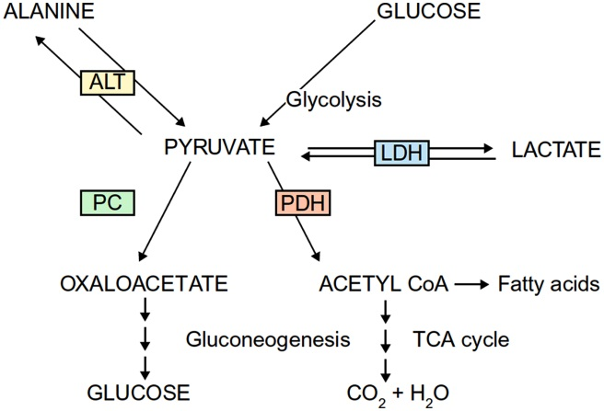
Figure 12.6

Slide 8
Figure 12.7

Slide 9
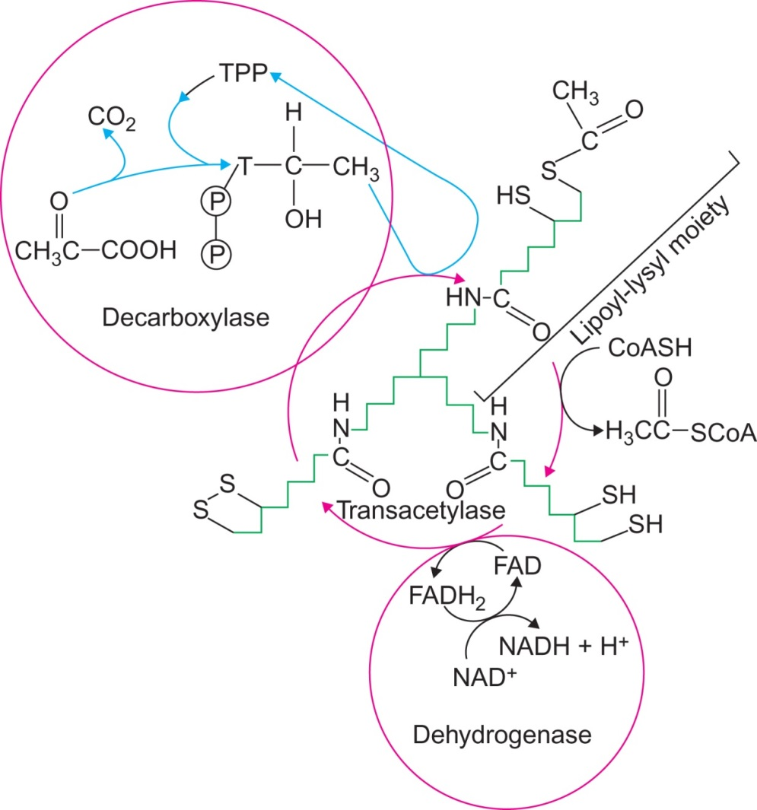
Figure 12.8

Slide 10
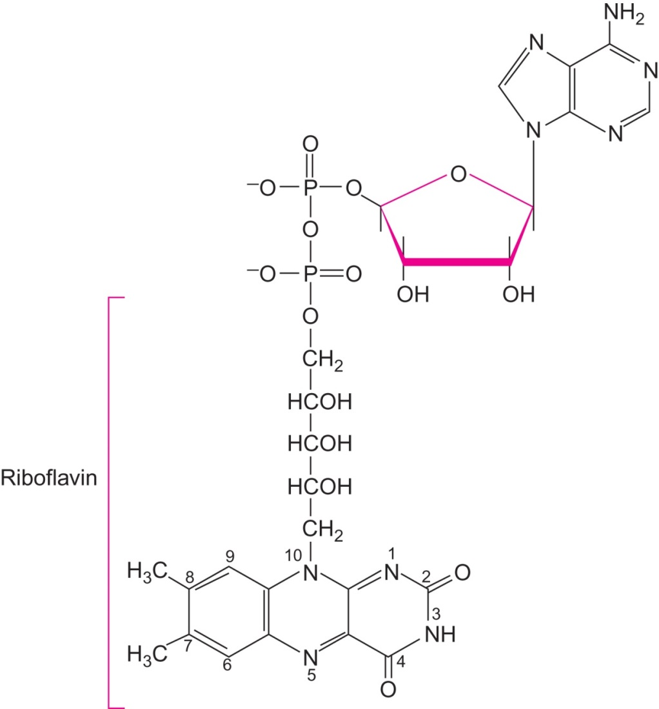
Figure 12.9

Slide 11
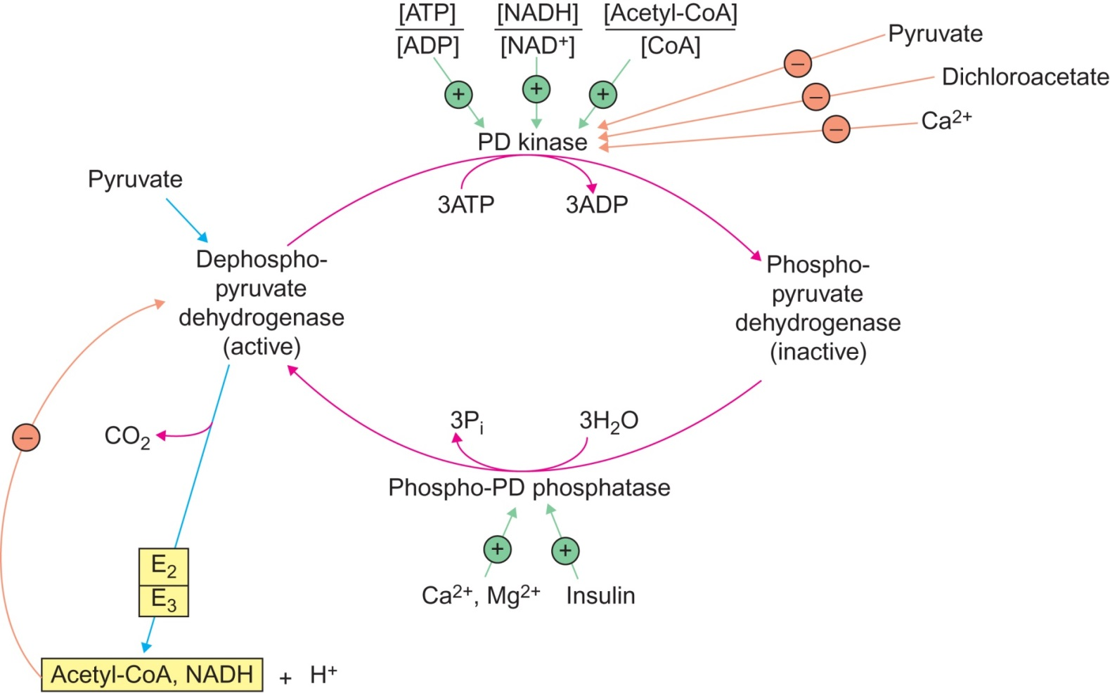
Figure 12.10

Slide 12
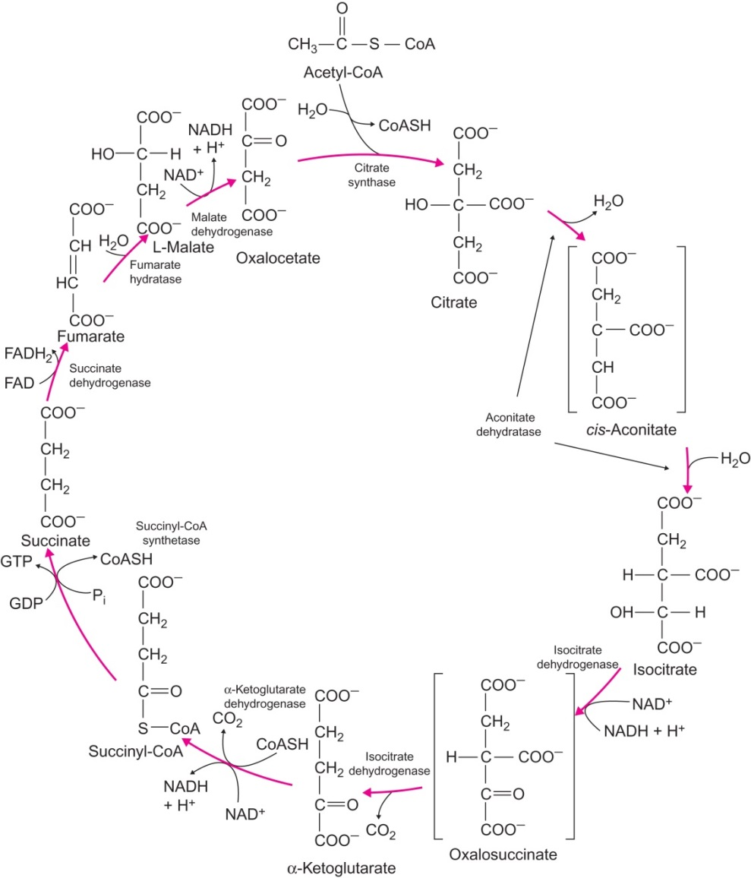
Figure 12.11

Slide 13
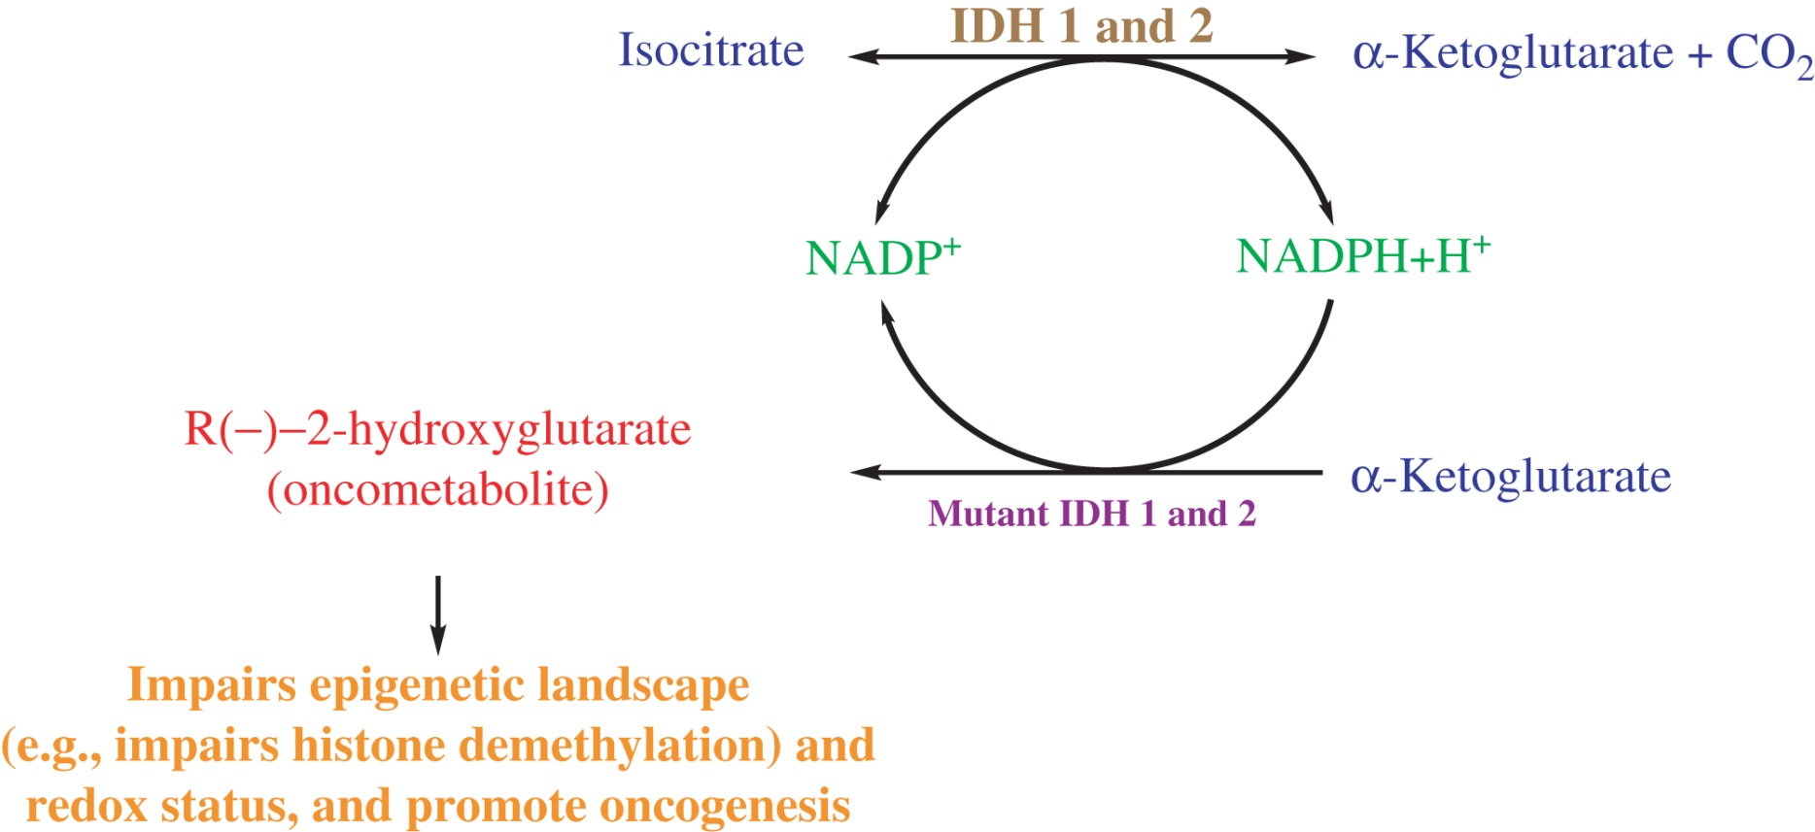
Figure 12.12

Slide 14
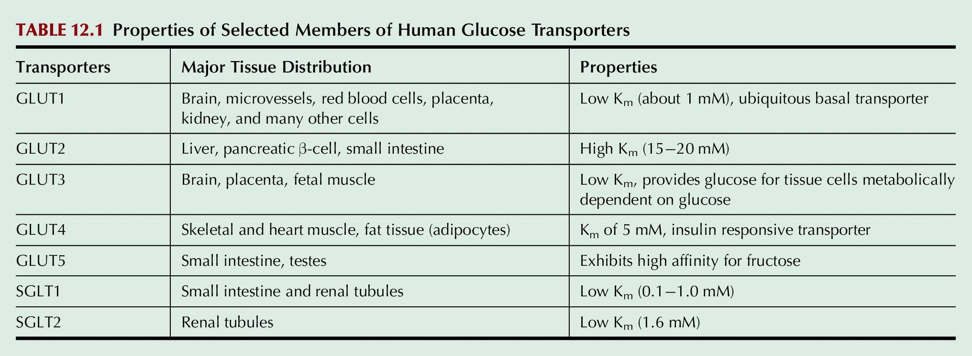
Table 12.1

Slide 15
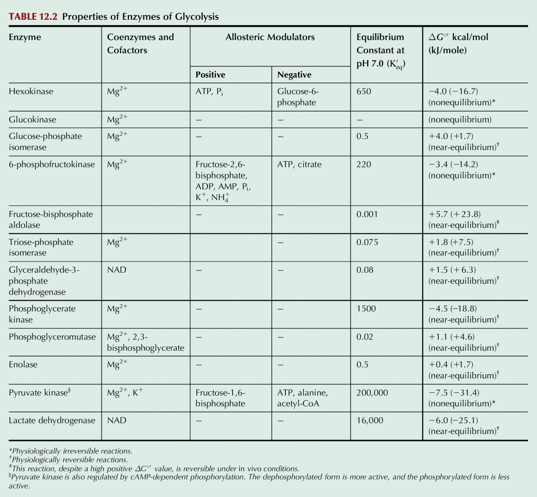
Table 12.2

Slide 16
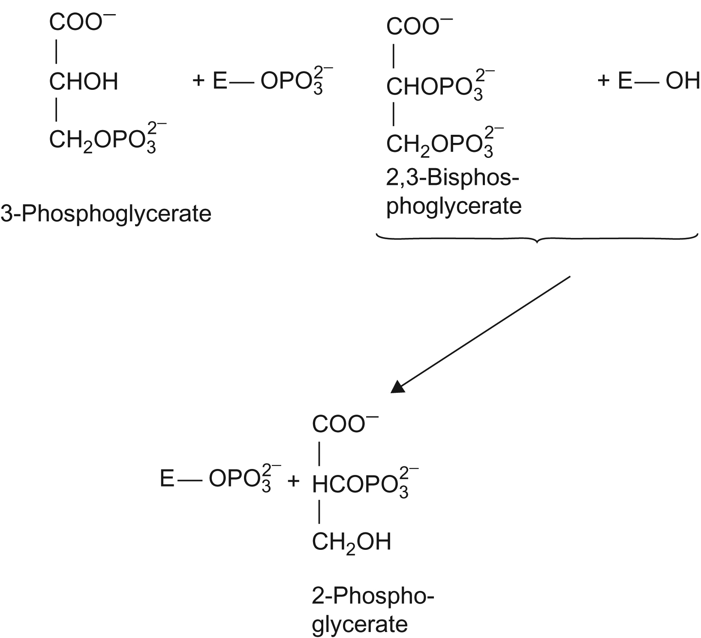
UnFig 12.1

Slide 17
UnFig 12.2

Slide 18
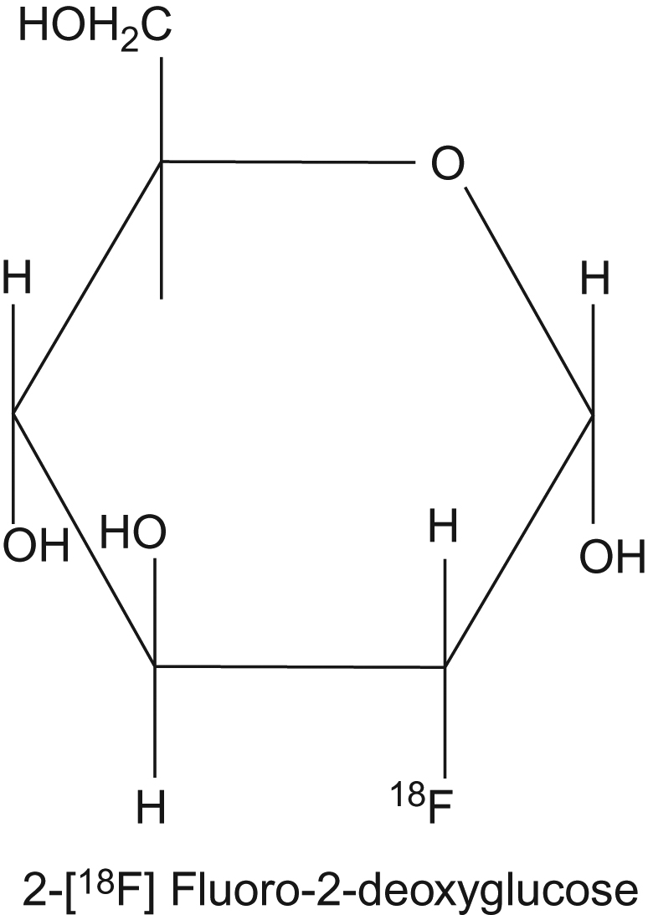
UnFig 12.3

Slide 19
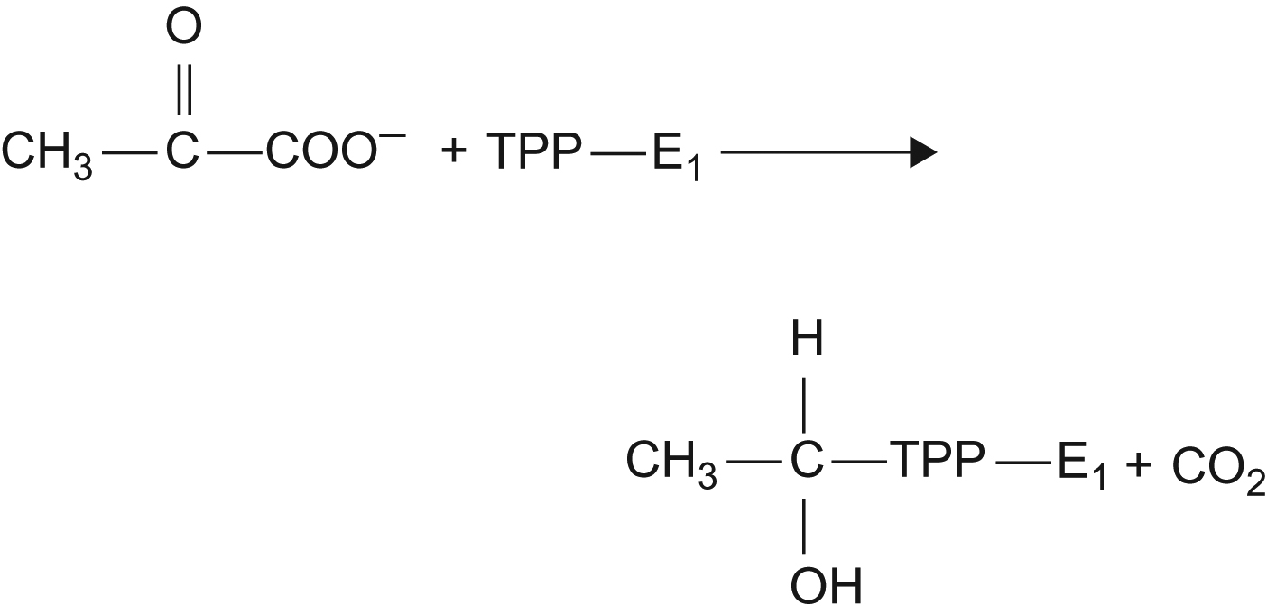
UnFig 12.4

Slide 20
UnFig 12.5

Slide 21
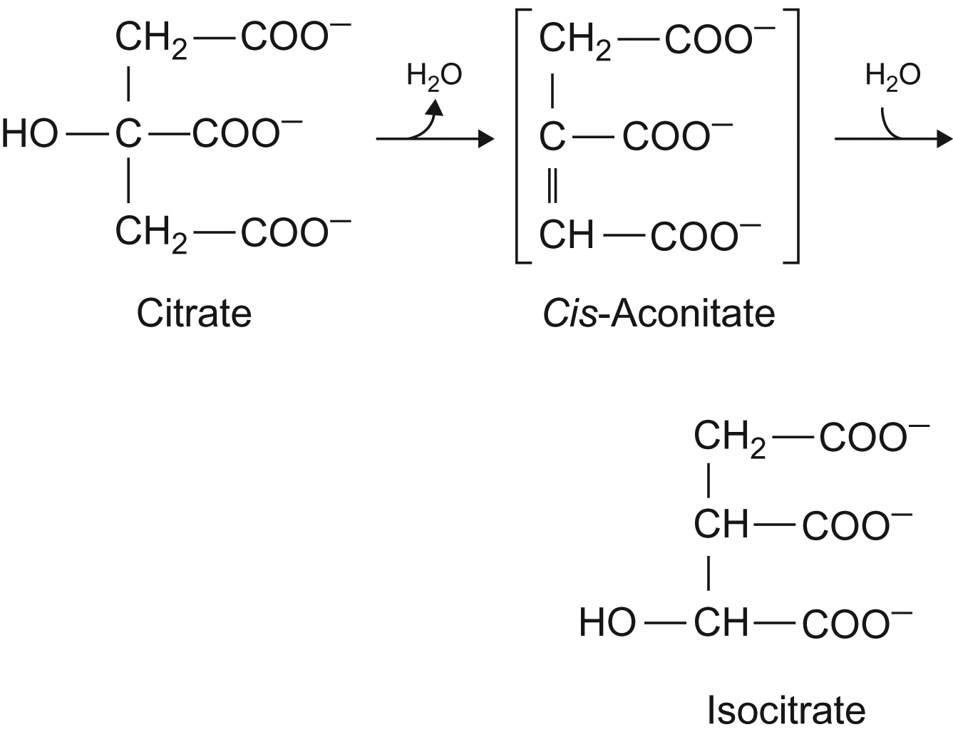
UnFig 12.6

Slide 22
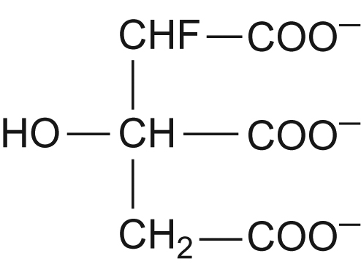
UnFig 12.7

Slide 23
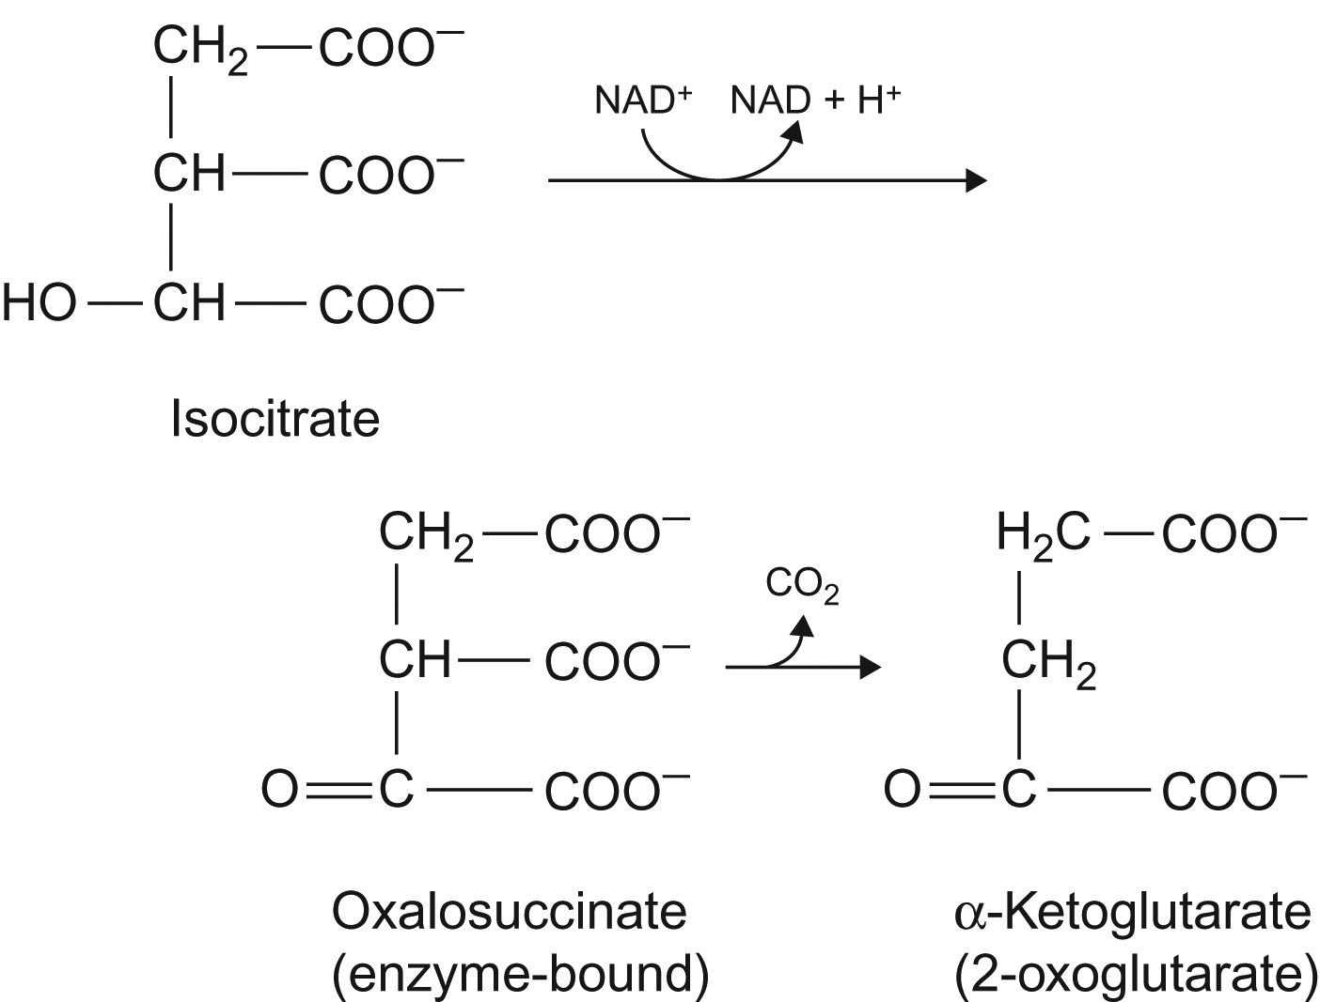
UnFig 12.8

Slide 24
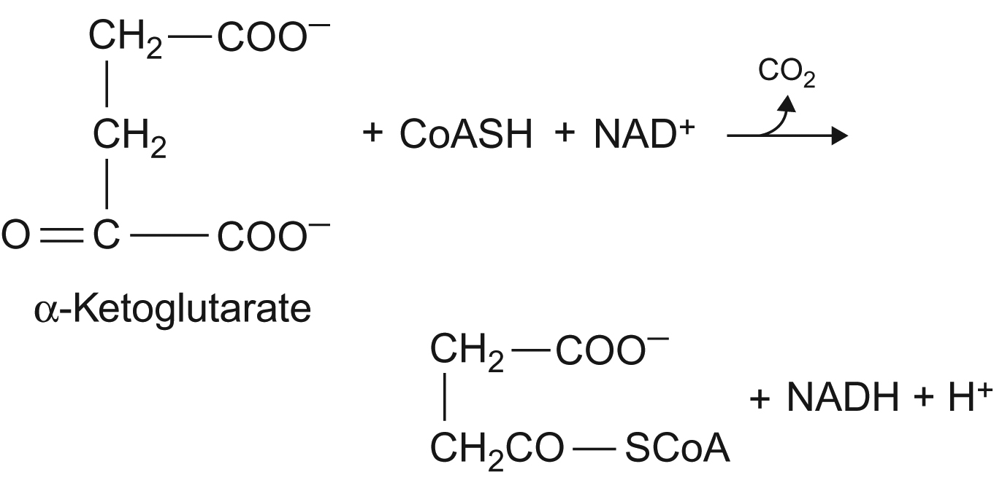
UnFig 12.9

Slide 25
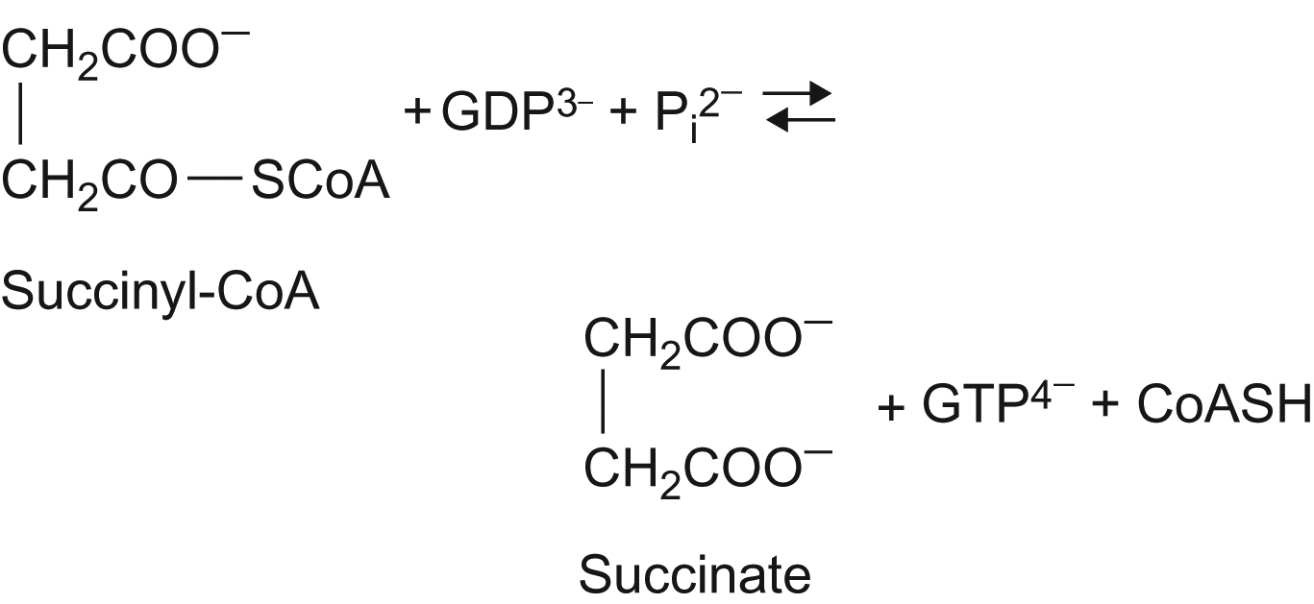
UnFig 12.10

Slide 26
UnFig 12.11

Slide 27
UnFig 12.12

Slide 28
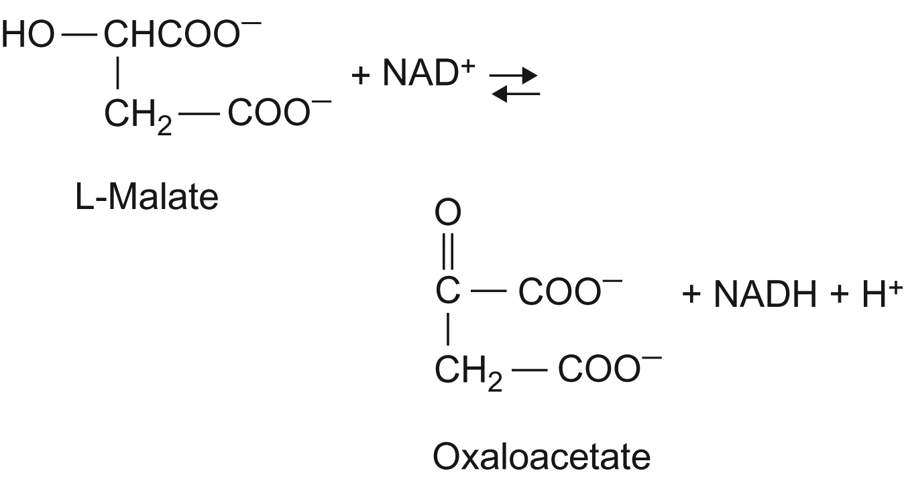
UnFig 12.13

Slide 29
UnFig 12.14

