Slide 1
Chapter 13
Electron Transport Chain, Oxidative Phosphorylation, and Other Oxygen-Consuming Systems

Slide 2
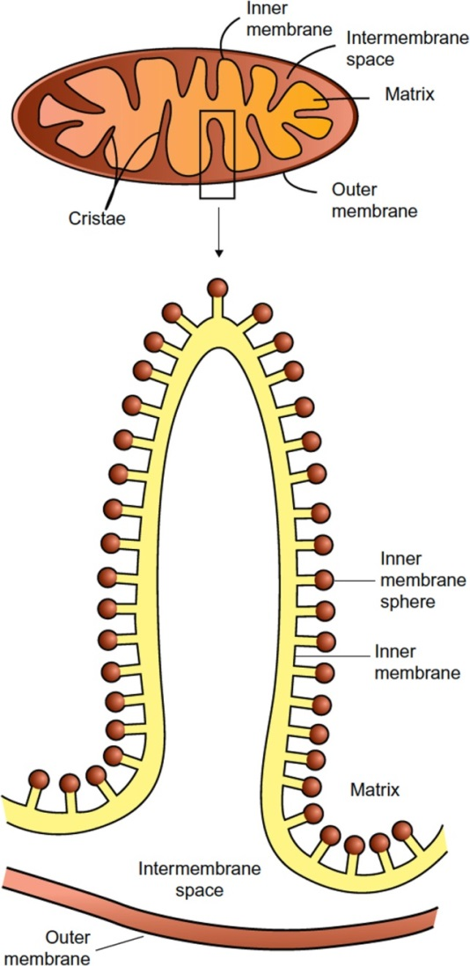
Figure 13.1

Slide 3
Figure 13.2

Slide 4
Figure 13.3

Slide 5
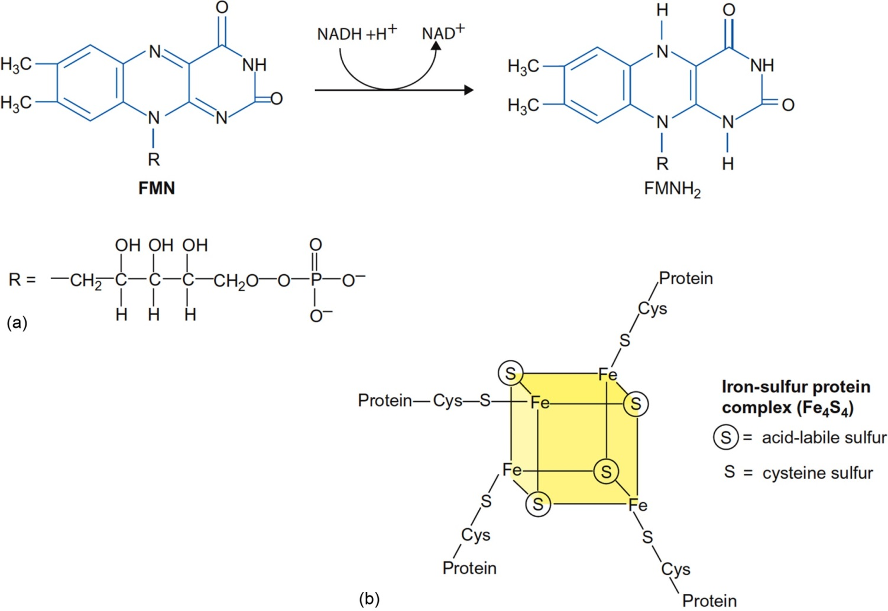
Figure 13.4

Slide 6
Figure 13.5

Slide 7
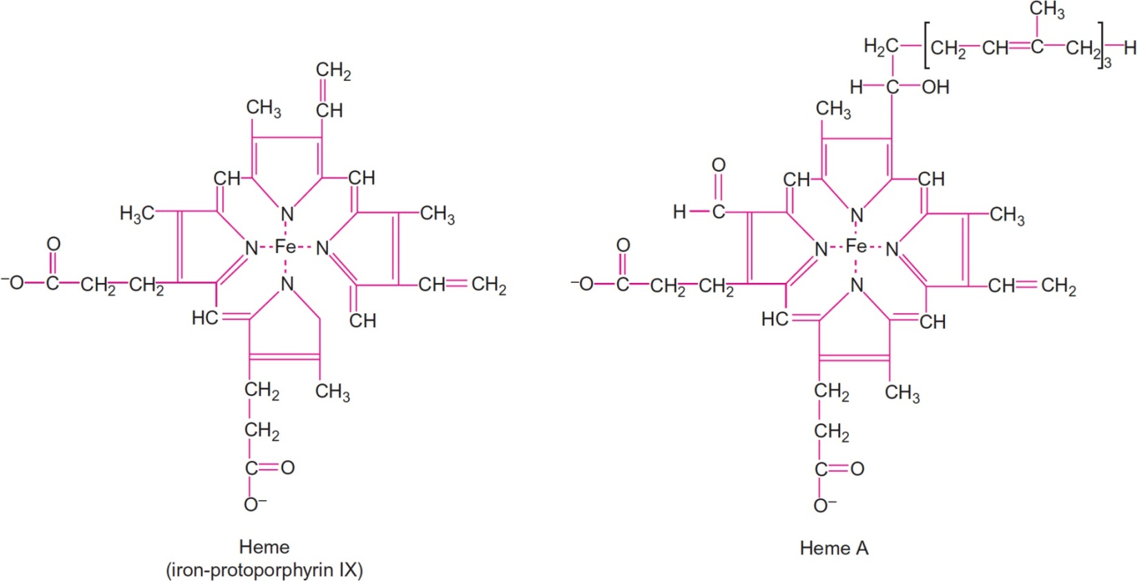
Figure 13.6

Slide 8
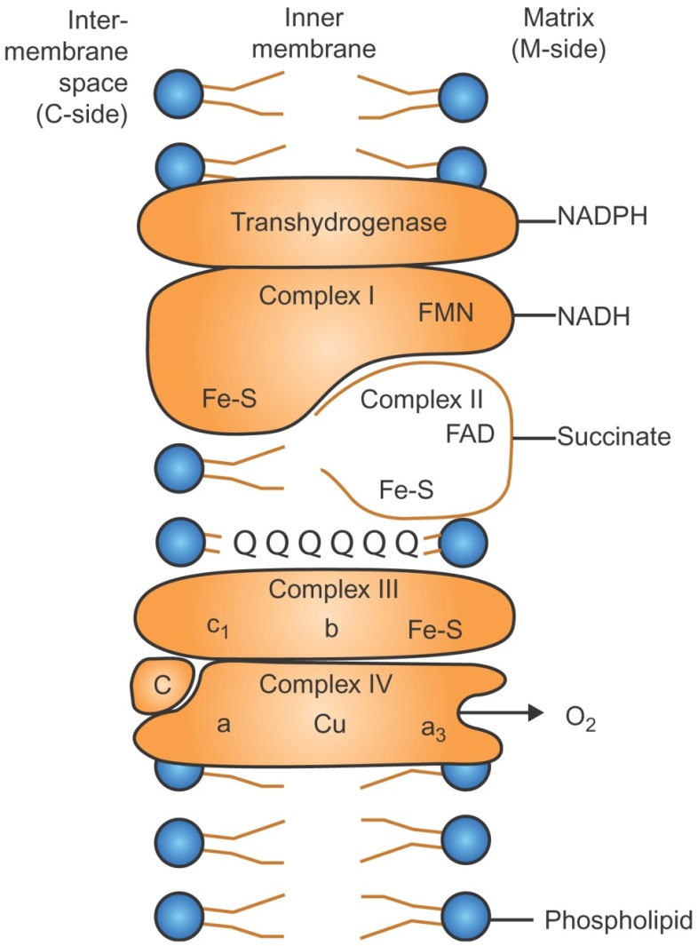
Figure 13.7

Slide 9
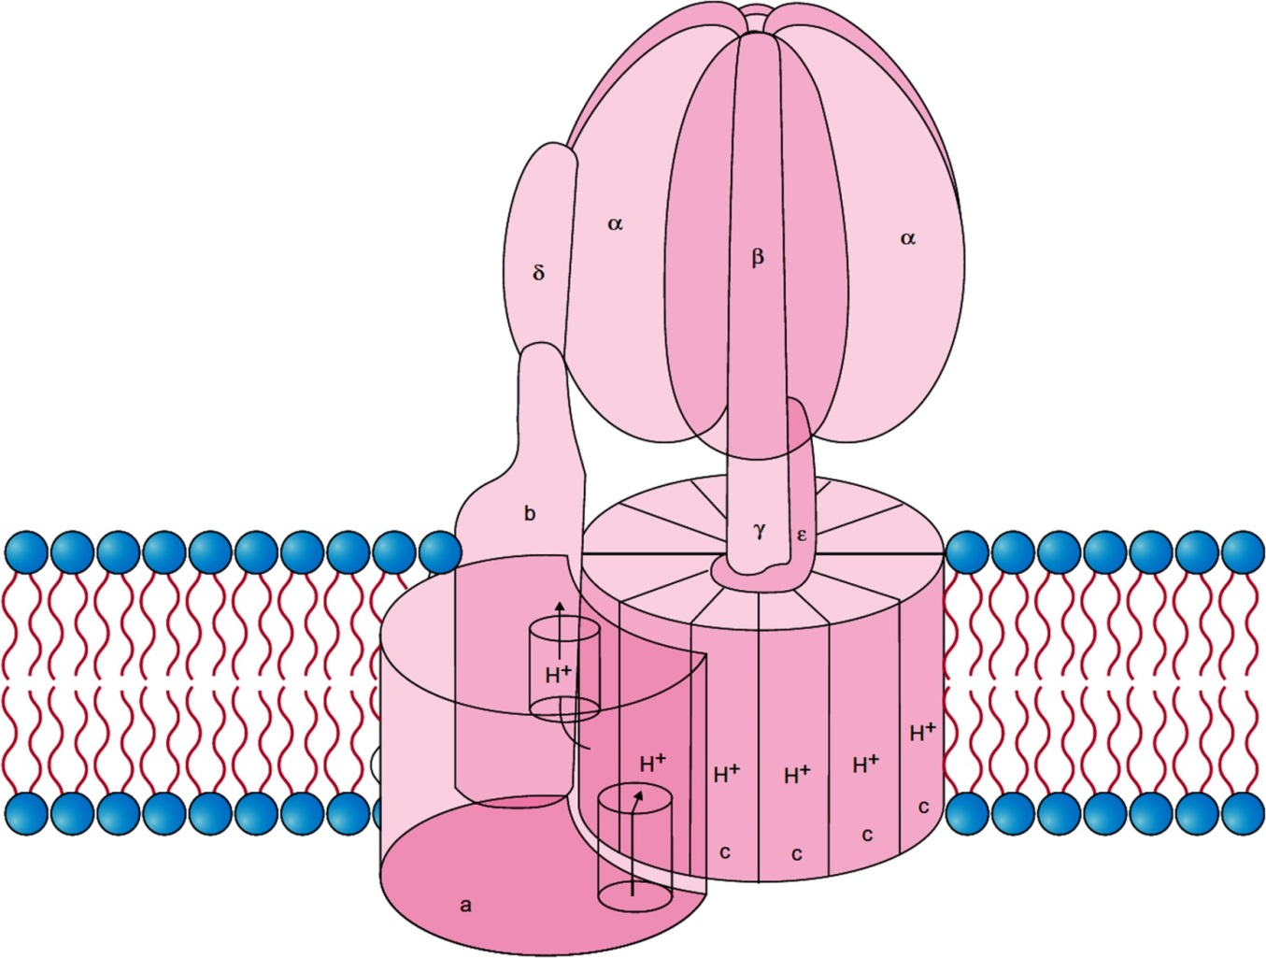
Figure 13.8

Slide 10
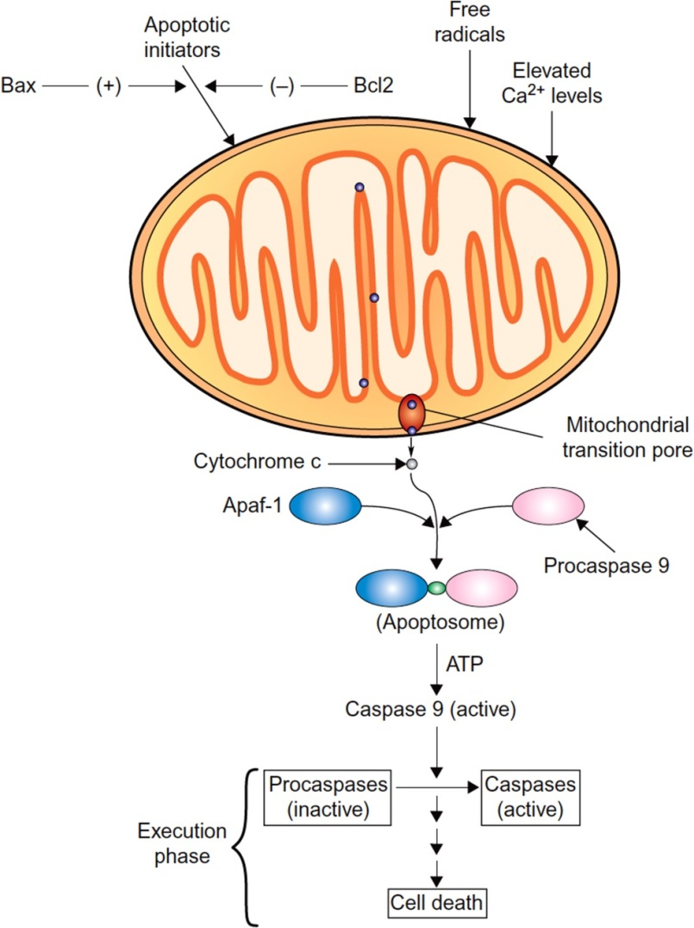
Figure 13.9

Slide 11
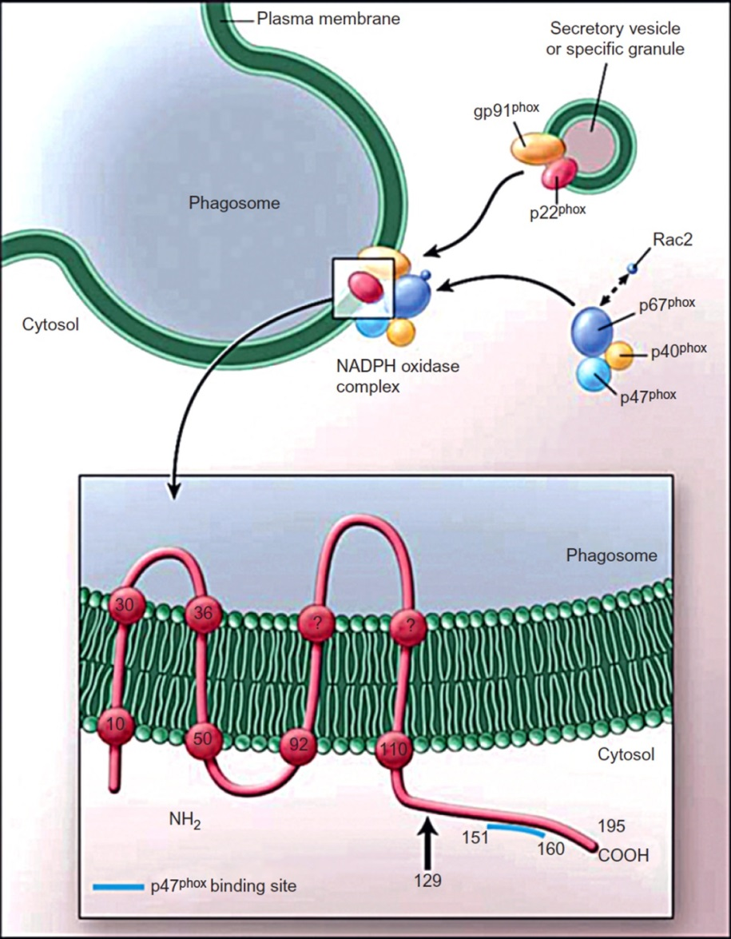
Figure 13.10

Slide 12
Figure 13.11

Slide 13
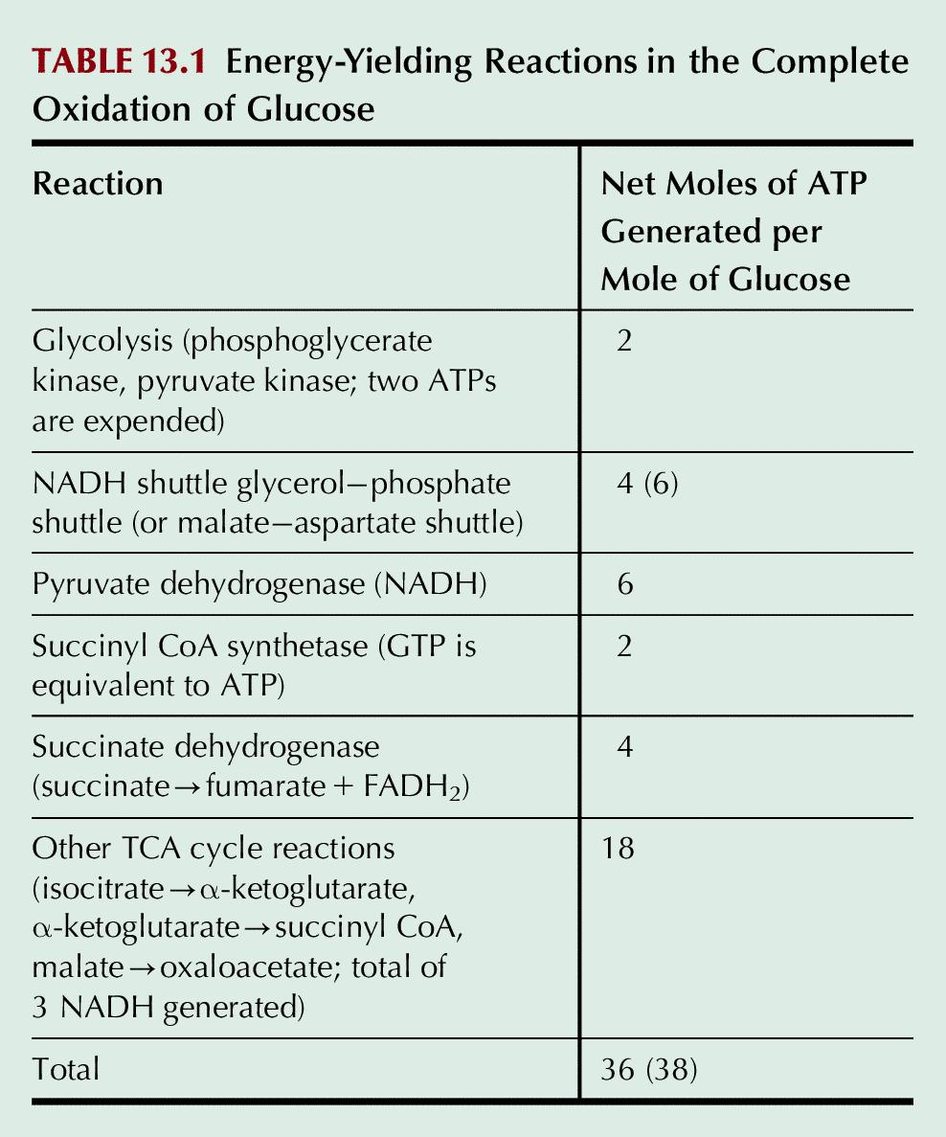
Table 13.1

Slide 14
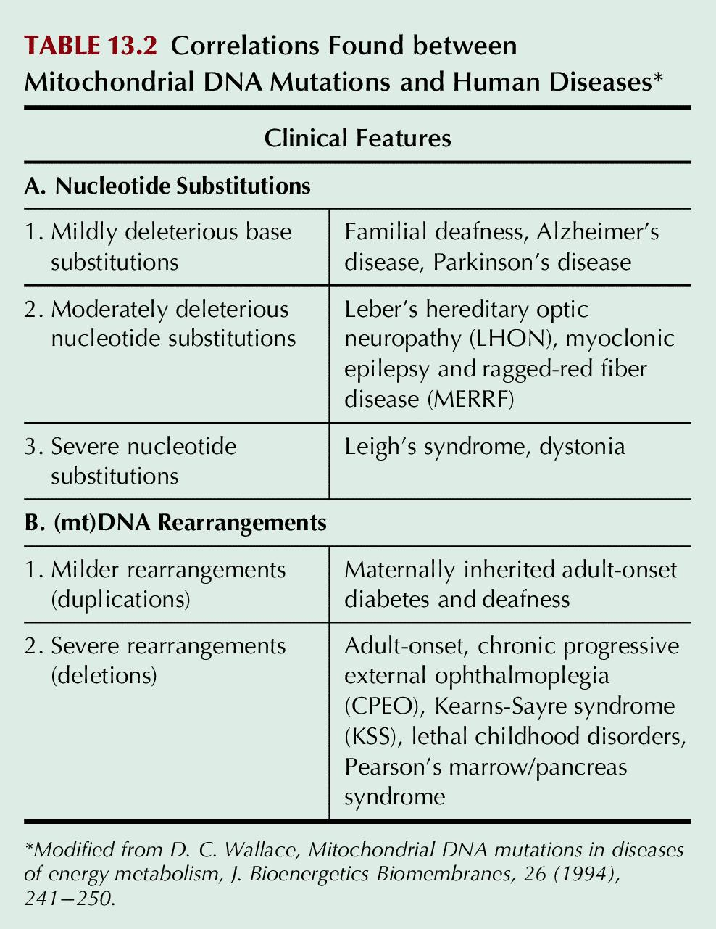
Table 13.2

Slide 15
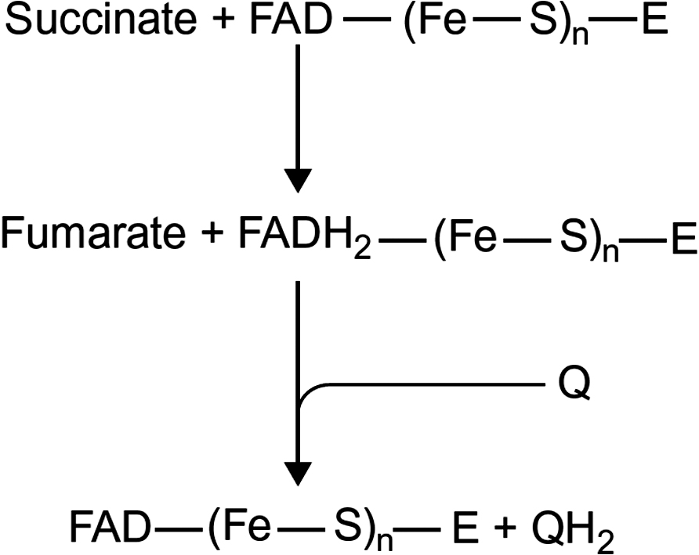
UnFig 12.1

Slide 16
UnFig 12.2

Slide 17
UnFig 12.3

Slide 18
UnFig 12.4

Slide 19
UnFig 12.5

Slide 20
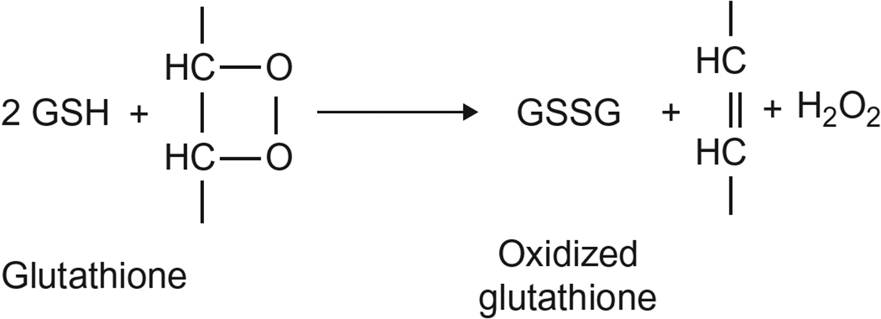
UnFig 12.6

Slide 21
UnFig 12.7

