Slide 1
Chapter 17
Lipids II: Phospholipids, Glycosphingolipids, and Cholesterol

Slide 2
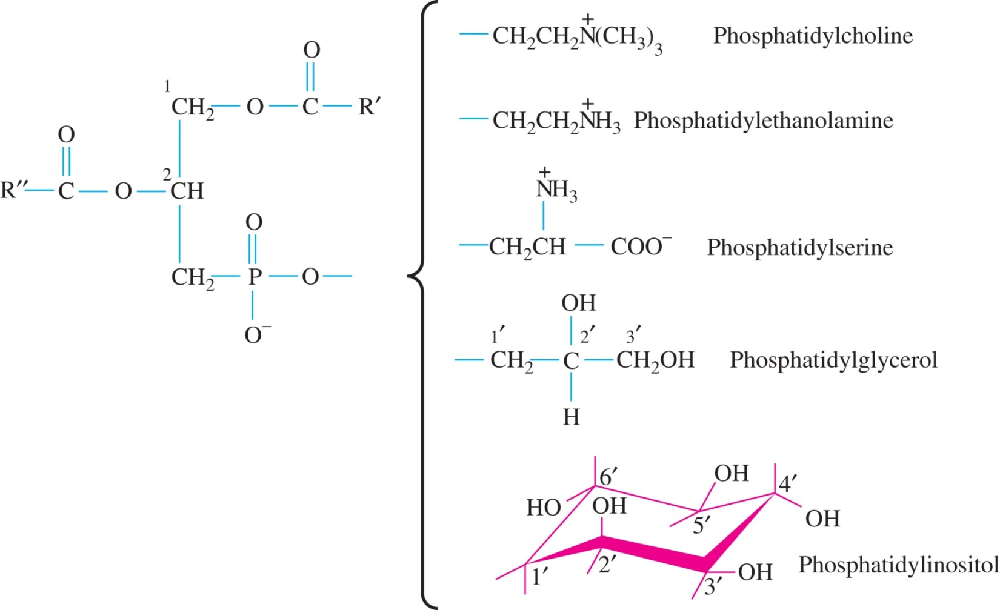
Figure 17.1

Slide 3
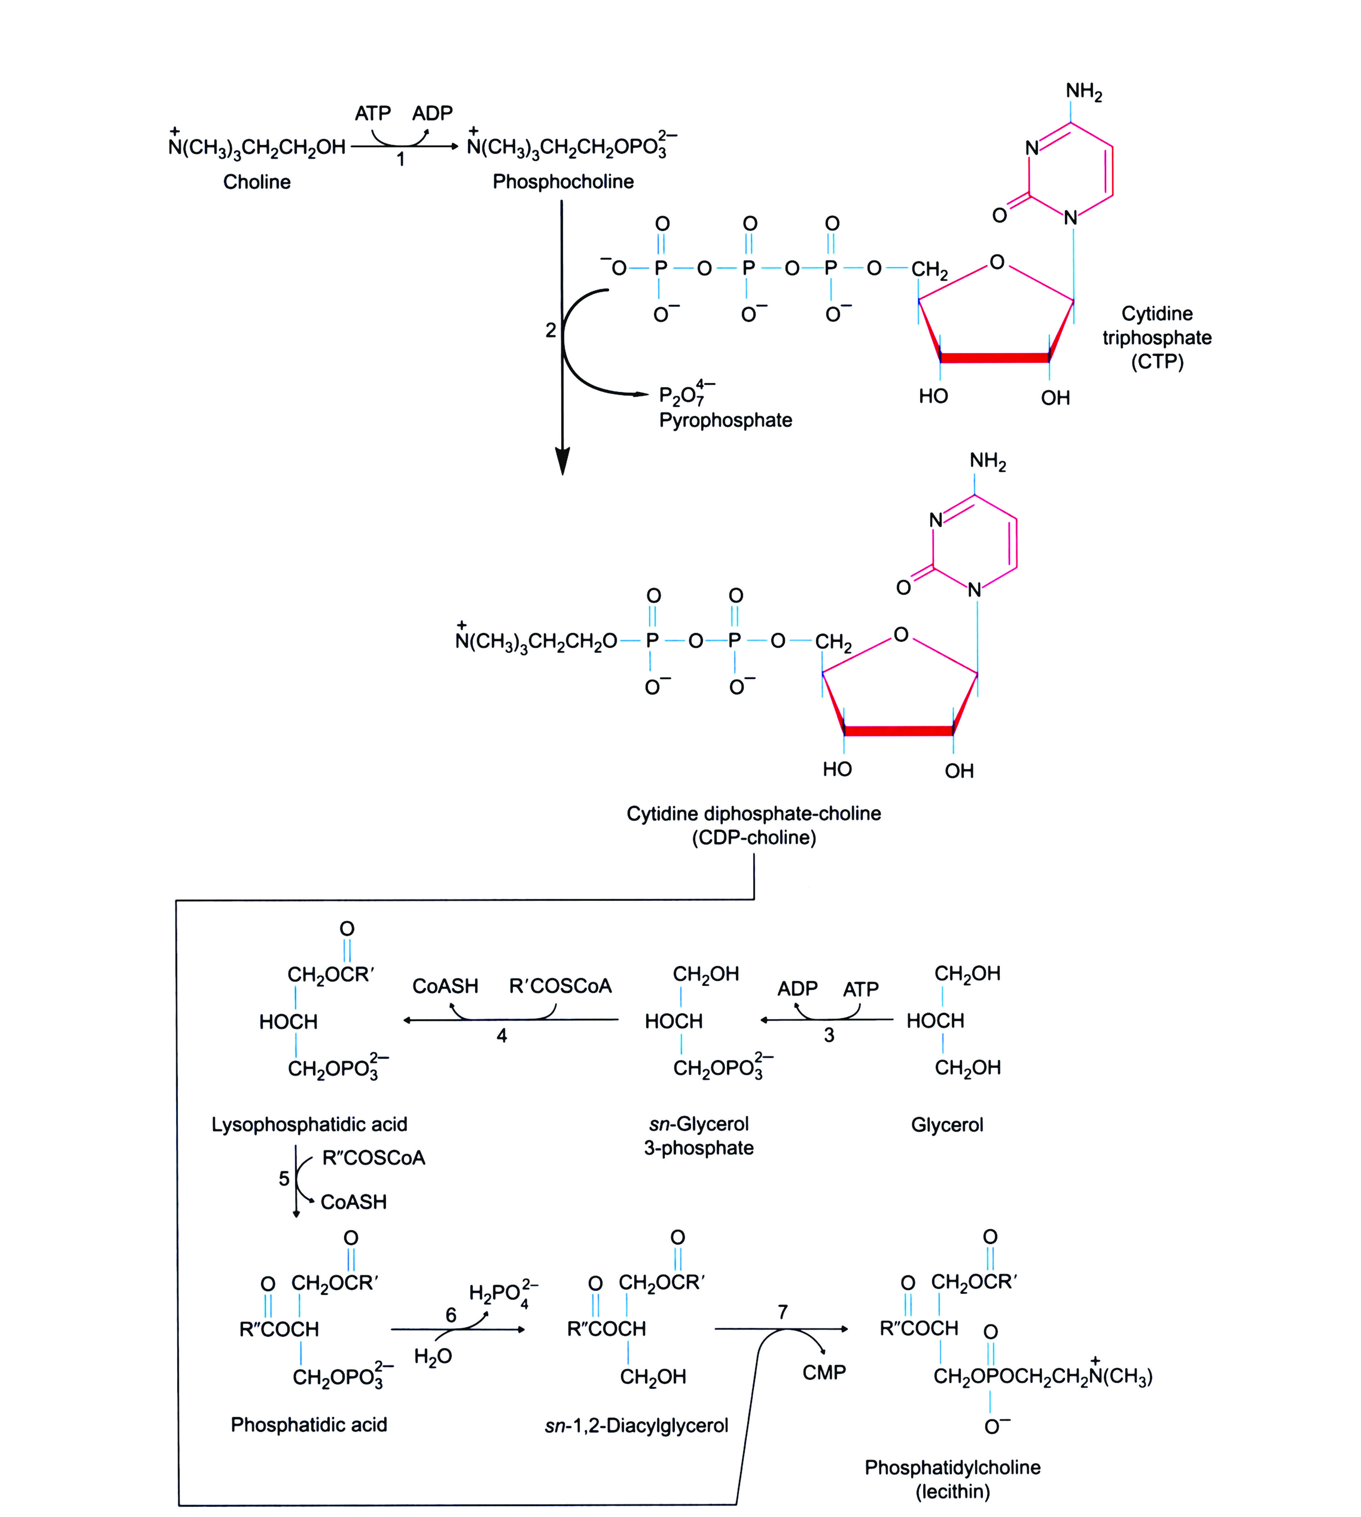
Figure 17.2

Slide 4
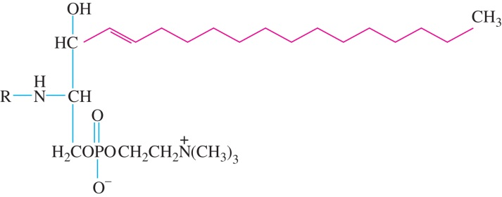
Figure 17.3

Slide 5
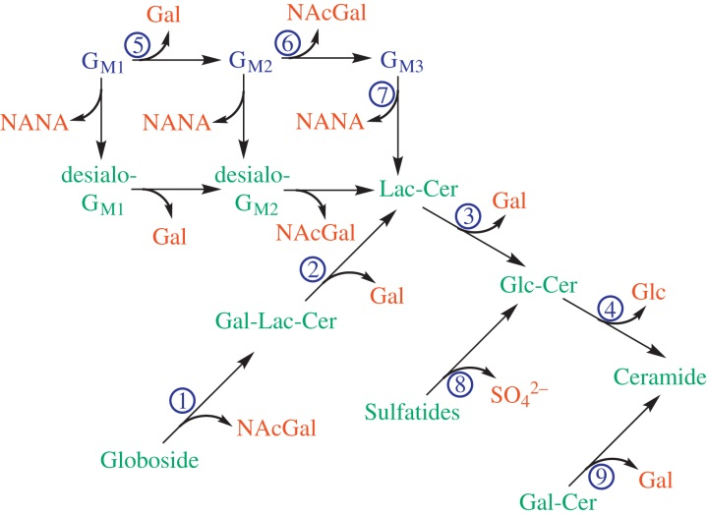
Figure 17.4

Slide 6
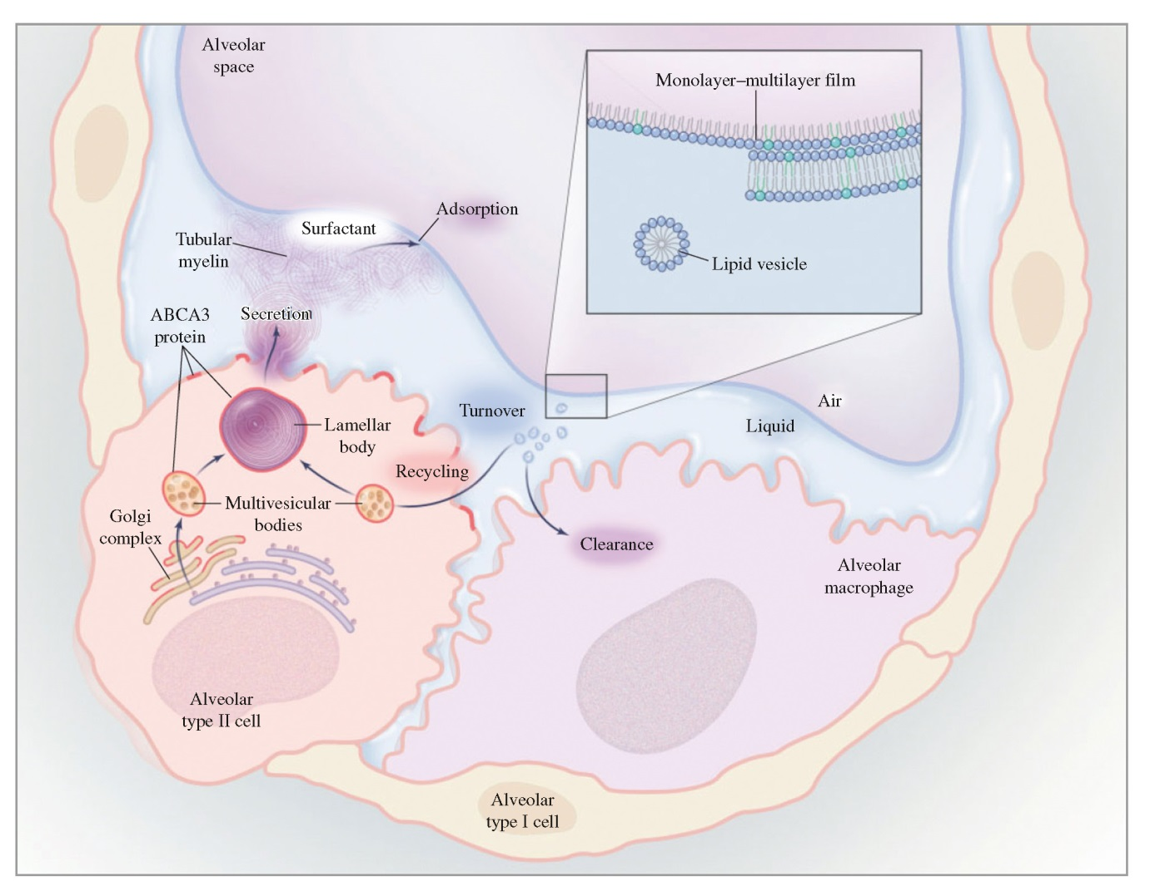
Figure 17.5

Slide 7
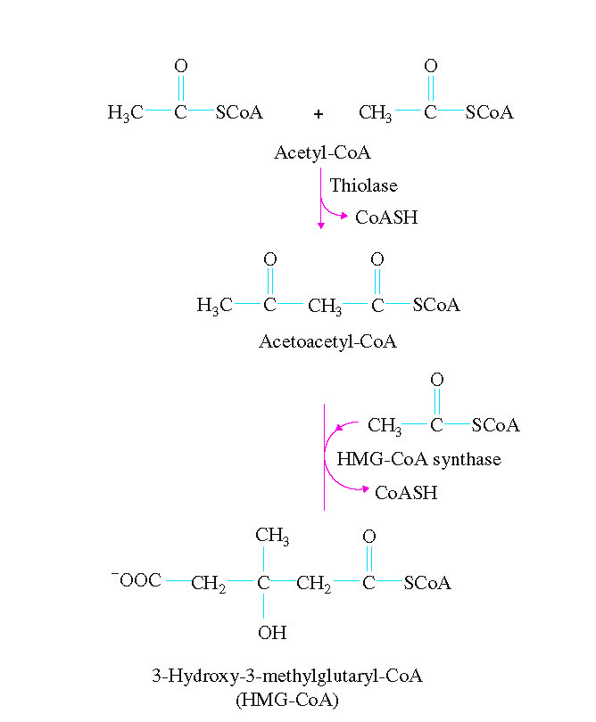
Figure 17.6

Slide 8
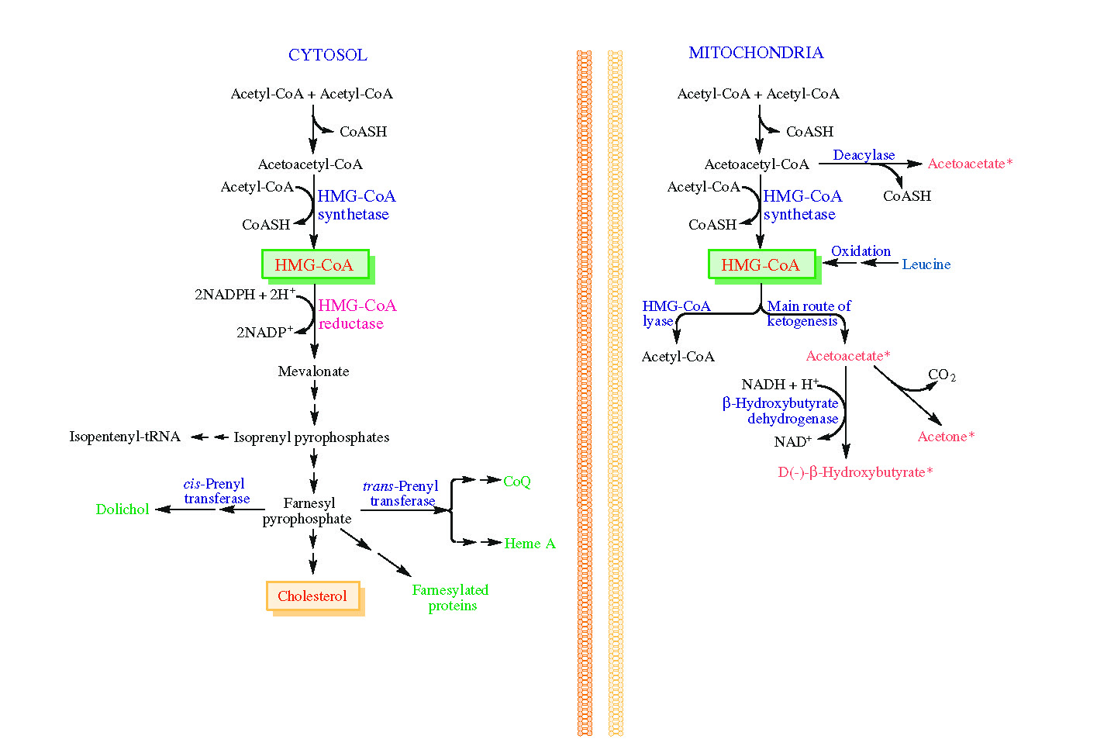
Figure 17.7

Slide 9
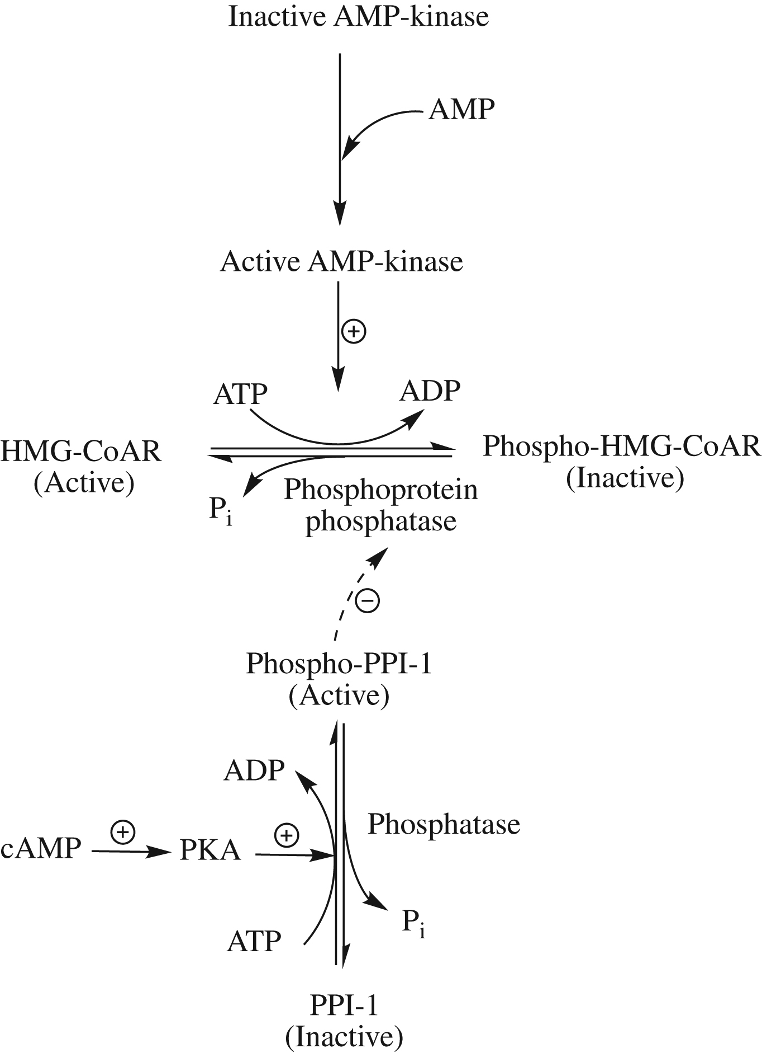
Figure 17.8

Slide 10
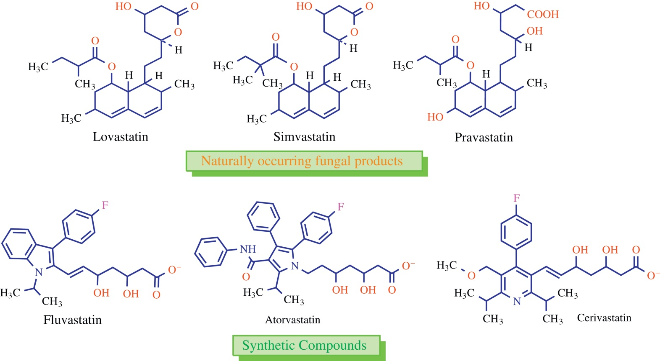
Figure 17.9

Slide 11
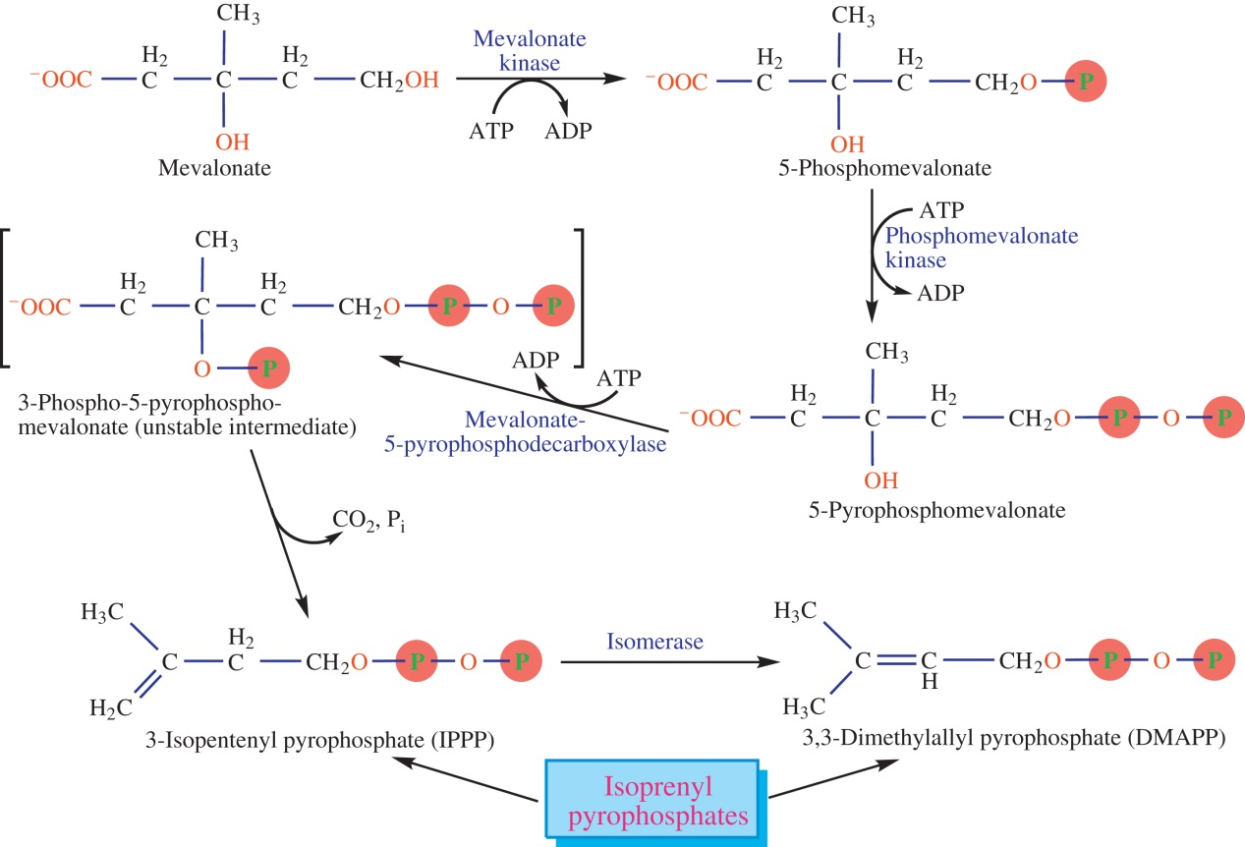
Figure 17.10

Slide 12
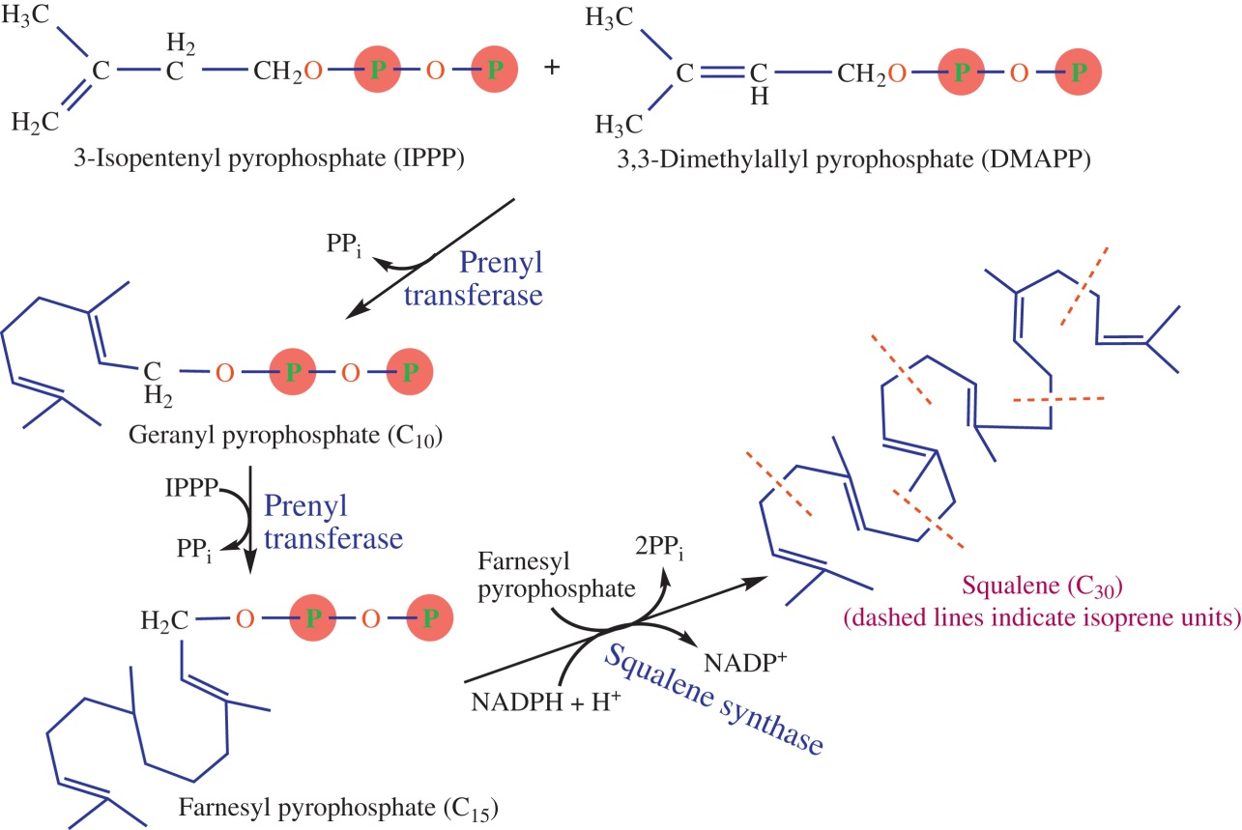
Figure 17.11

Slide 13
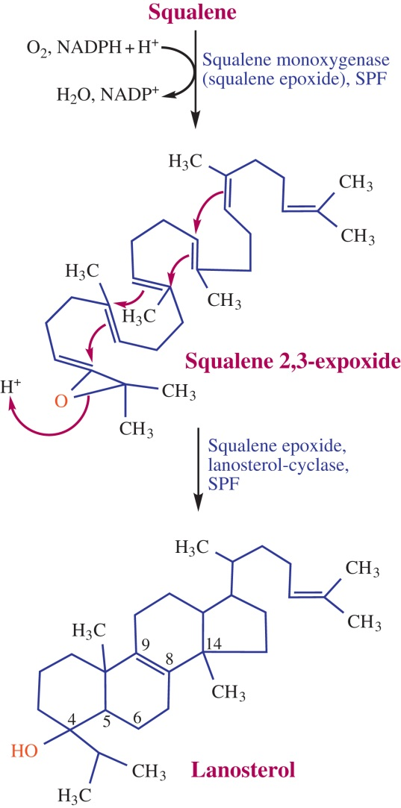
Figure 17.12

Slide 14
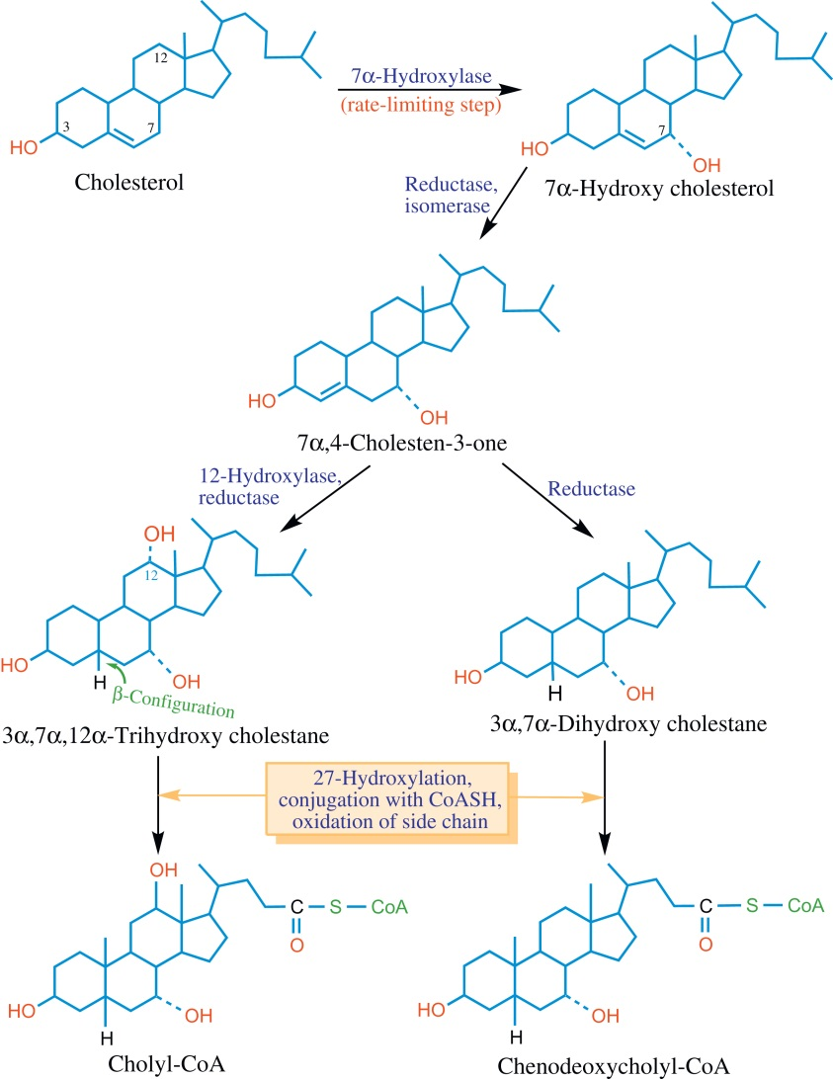
Figure 17.13

Slide 15
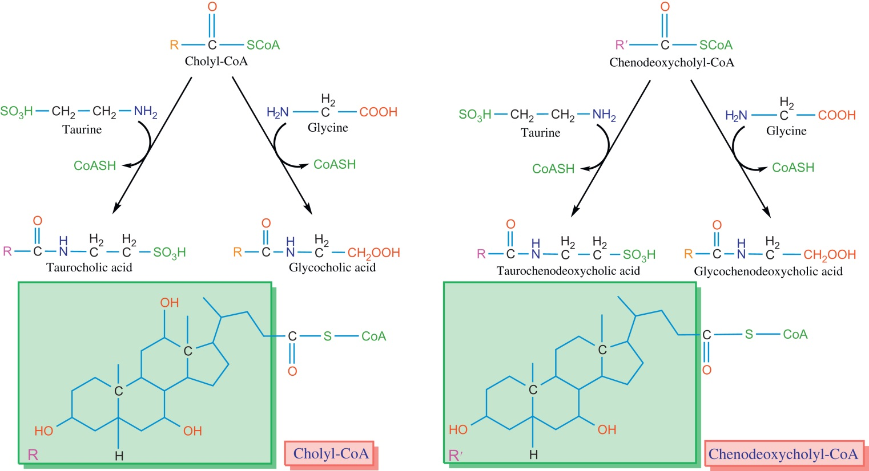
Figure 17.14

Slide 16
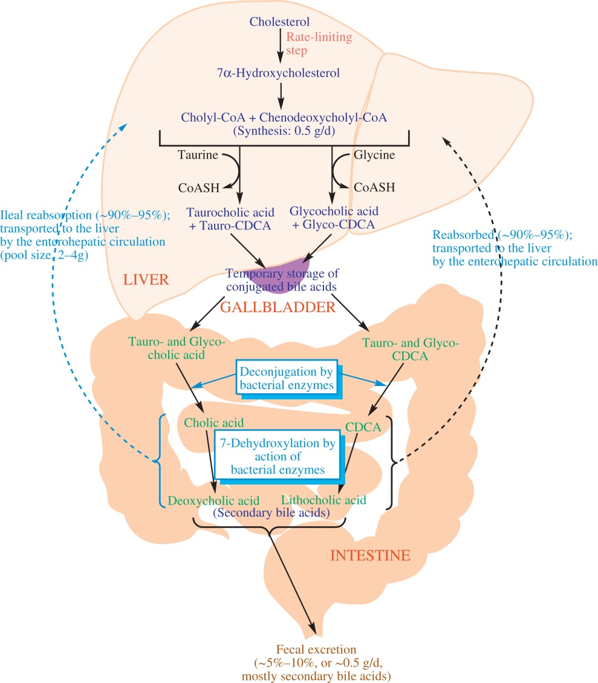
Figure 17.15

Slide 17
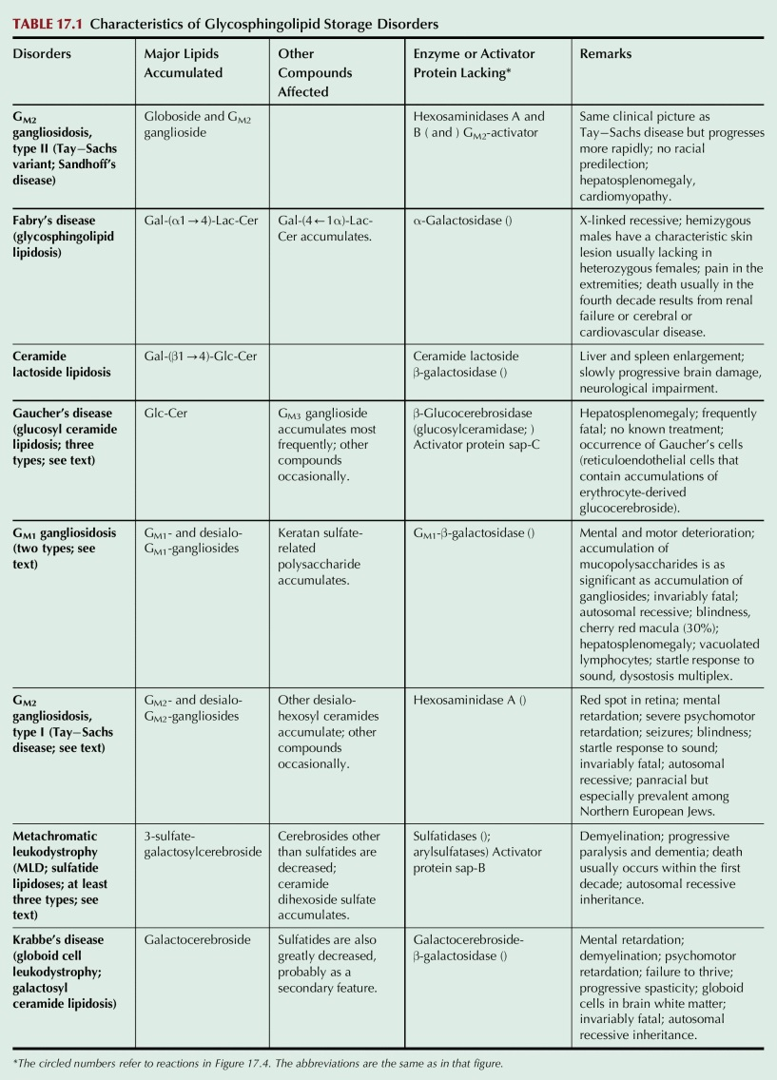
Table 17.1

Slide 18
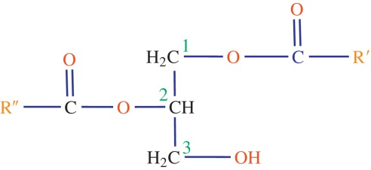
UnFig 17.1

Slide 19
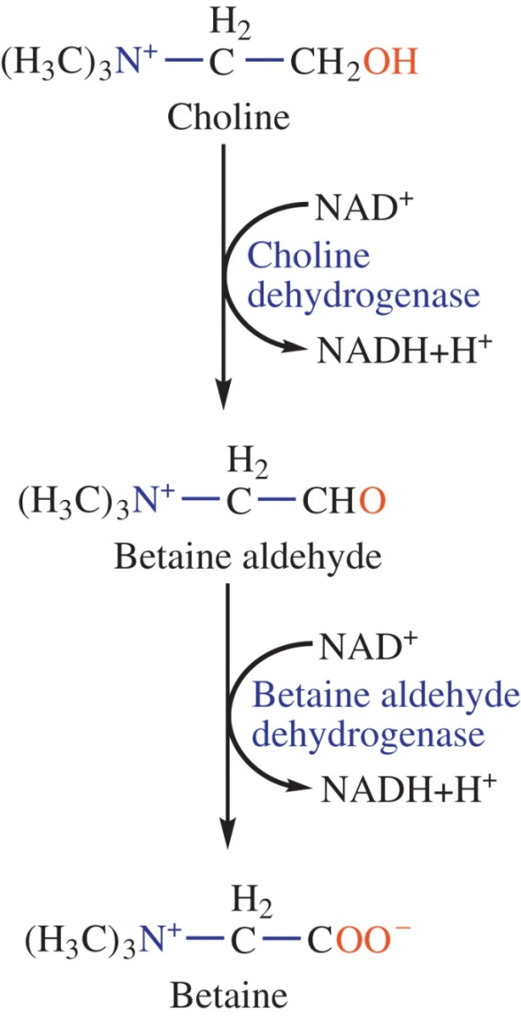
UnFig 17.2

Slide 20
UnFig 17.3

Slide 21
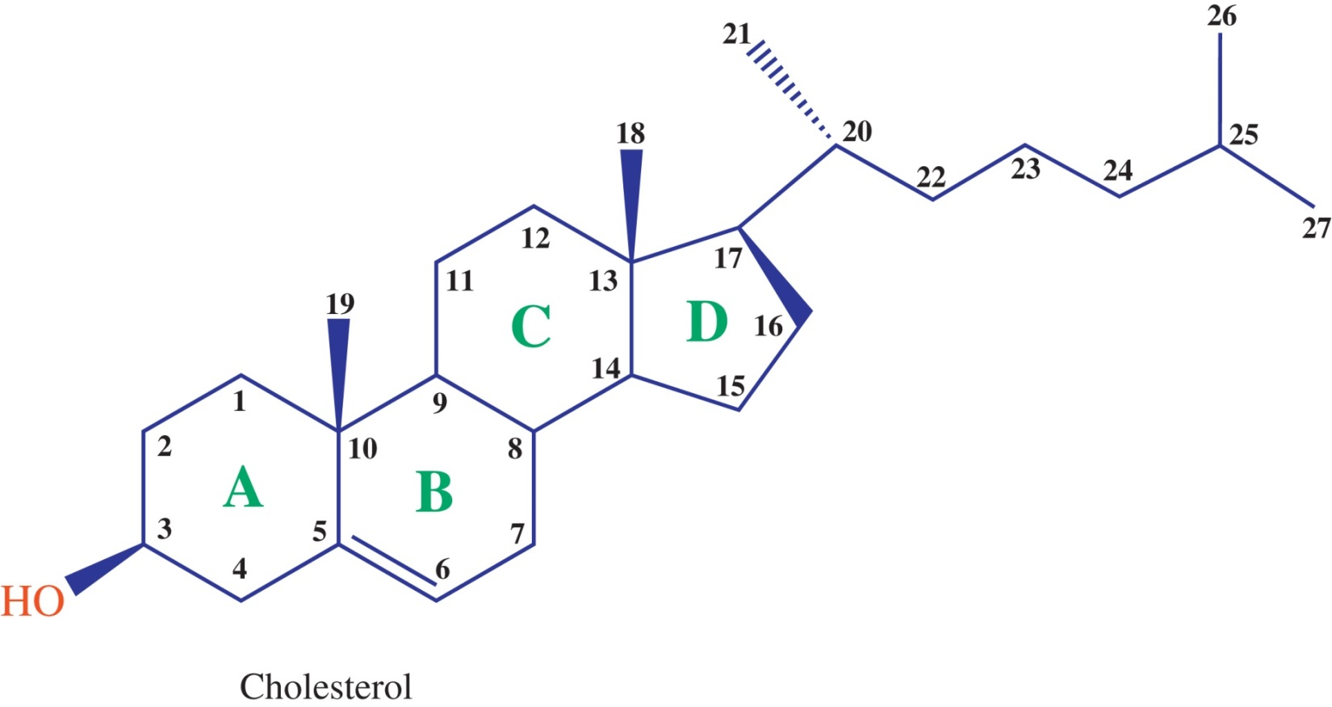
UnFig 17.4

Slide 22
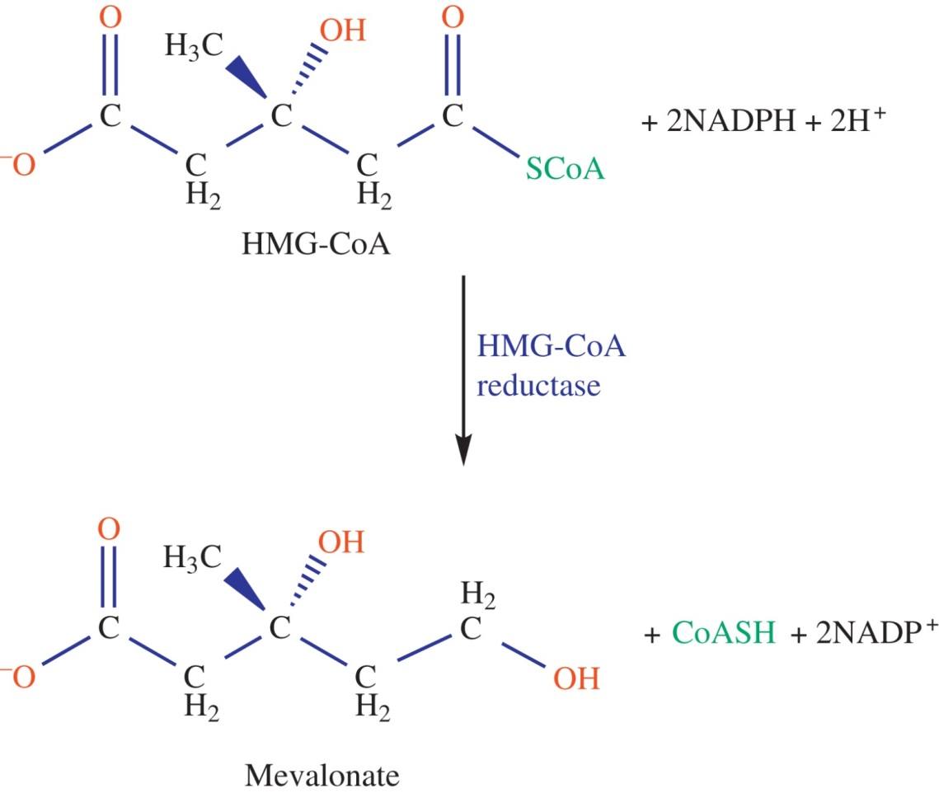
UnFig 17.5

Slide 23
UnFig 17.6

Slide 24
UnFig 17.7

Slide 25
UnFig 17.8

Slide 26
UnFig 17.9

Slide 27
UnFig 17.10

Slide 28
UnFig 17.11

Slide 29
UnFig 17.12

Slide 30
UnFig 17.13

Slide 31
UnFig 17.14

