Slide 1
Chapter 19
Contractile Systems

Slide 2
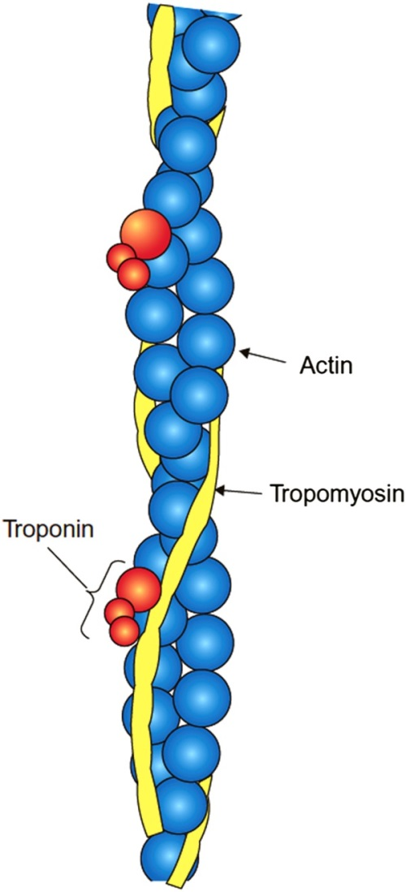
Figure 19.1

Slide 3
Figure 19.2

Slide 4
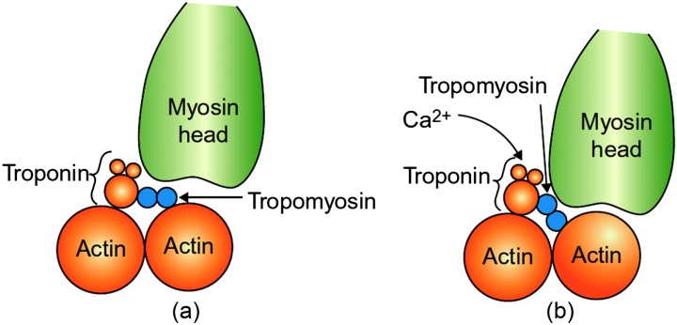
Figure 19.3

Slide 5
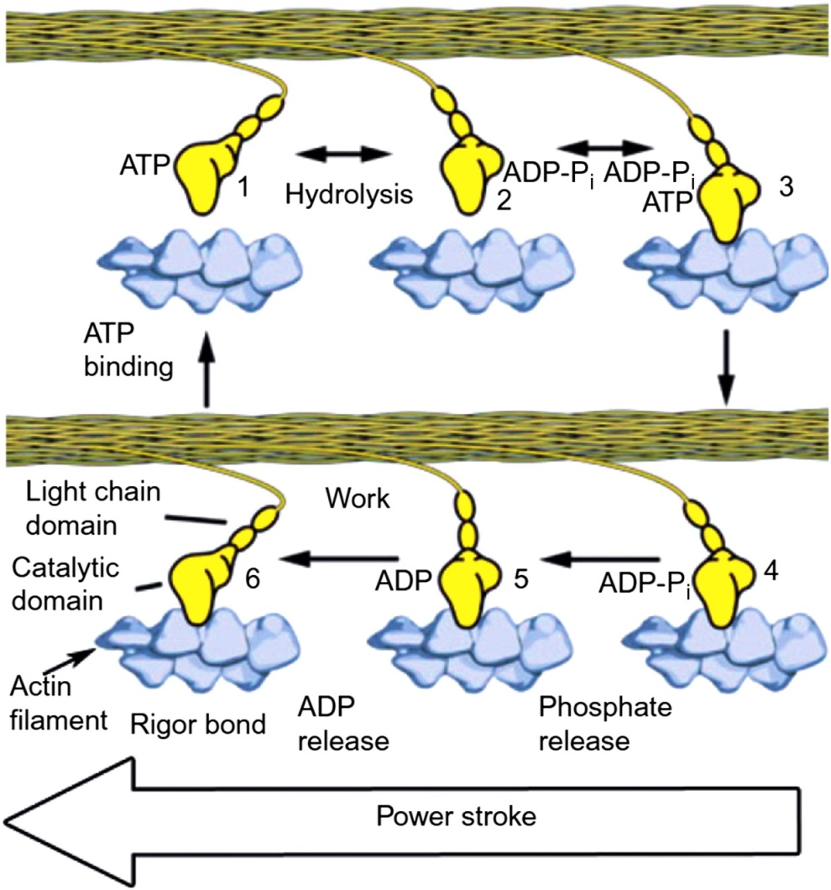
Figure 19.4

Slide 6
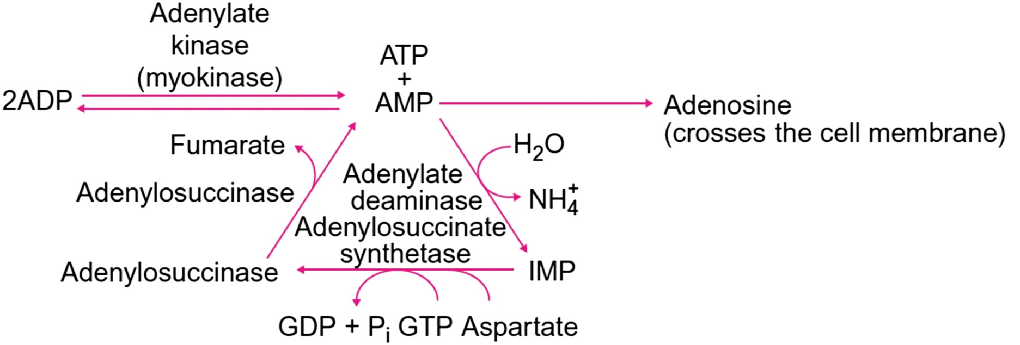
Figure 19.5

Slide 7
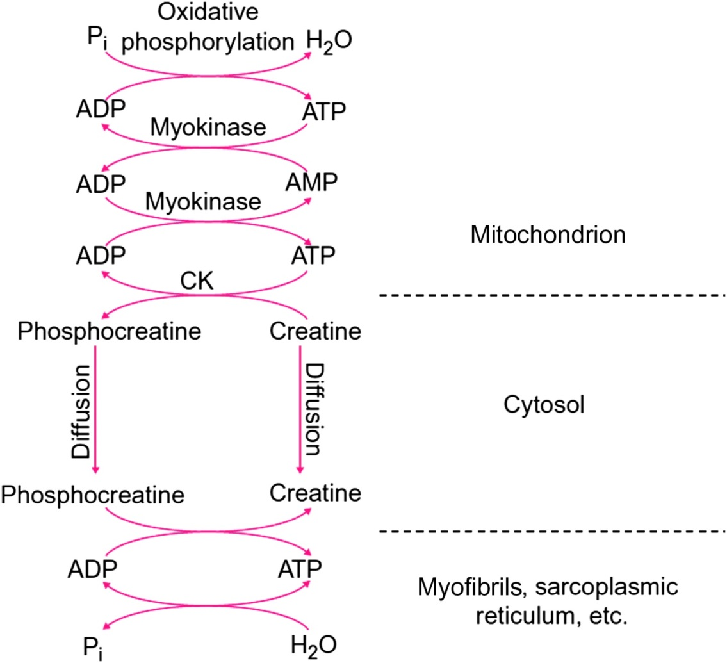
Figure 19.6

Slide 8
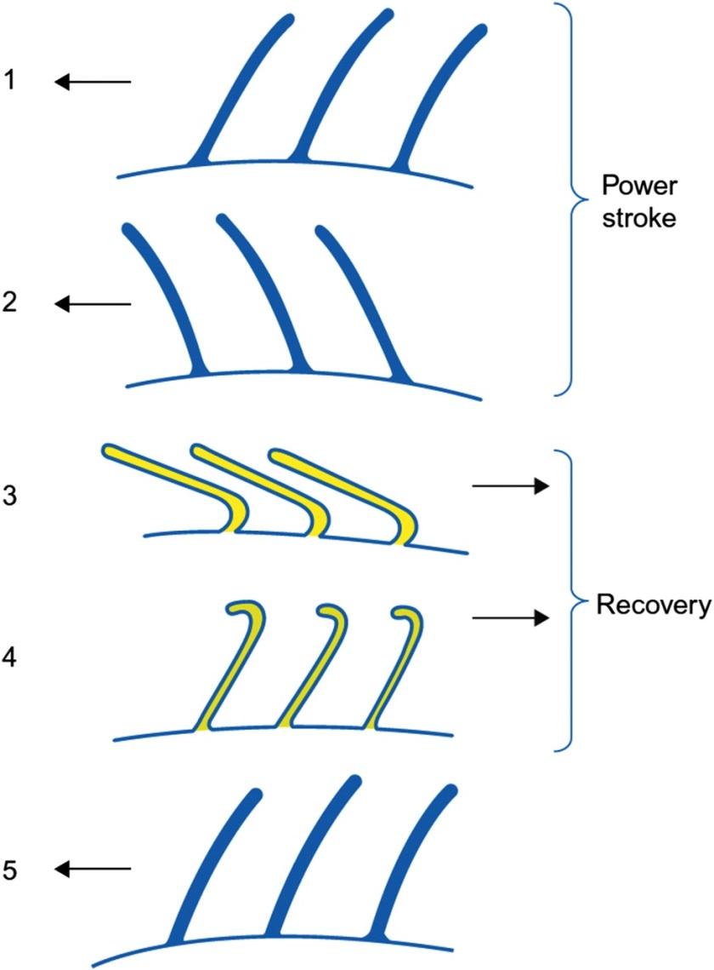
Figure 19.7

Slide 9
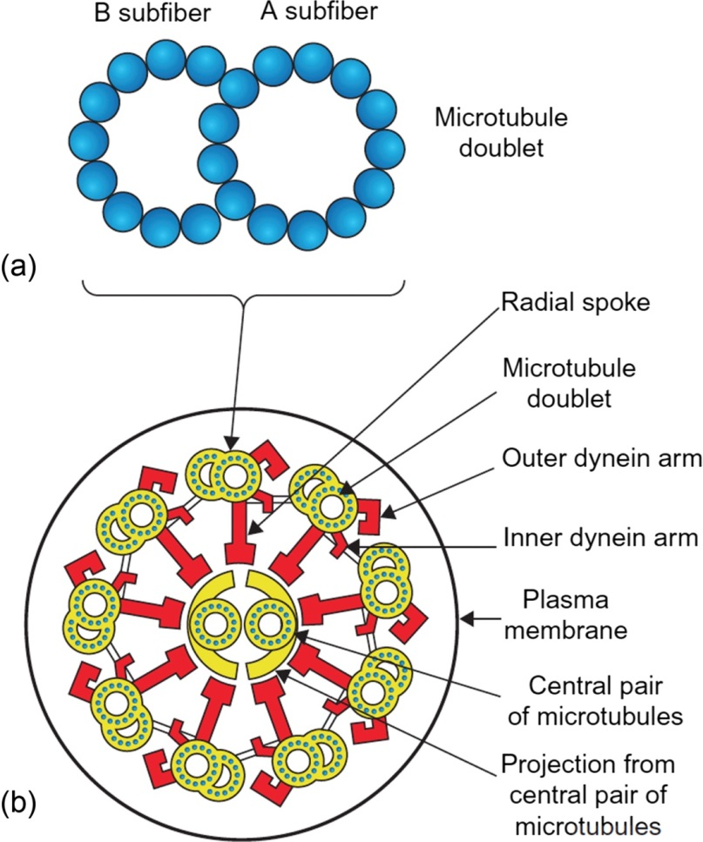
Figure 19.8

Slide 10
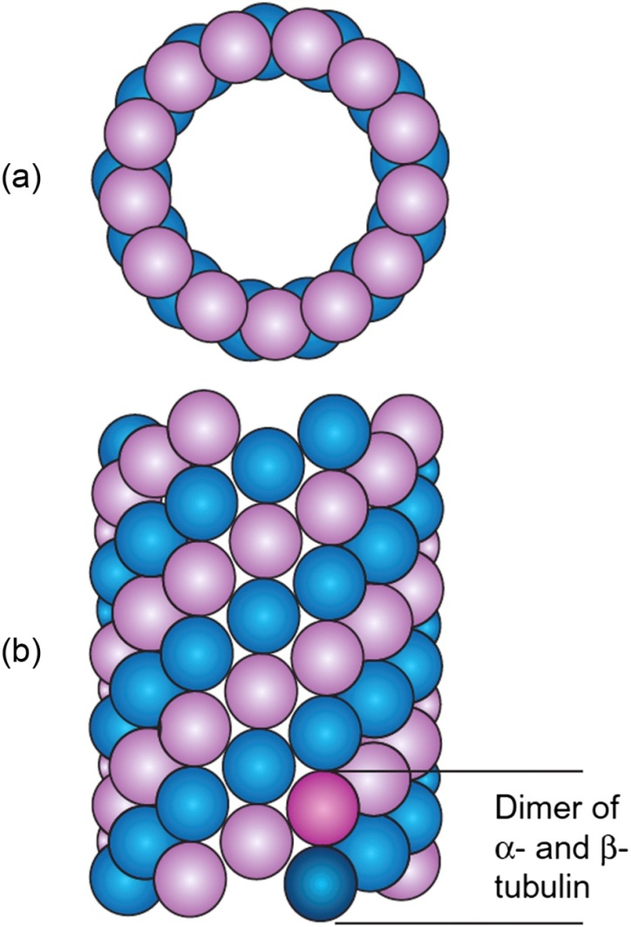
Figure 19.9

Slide 11
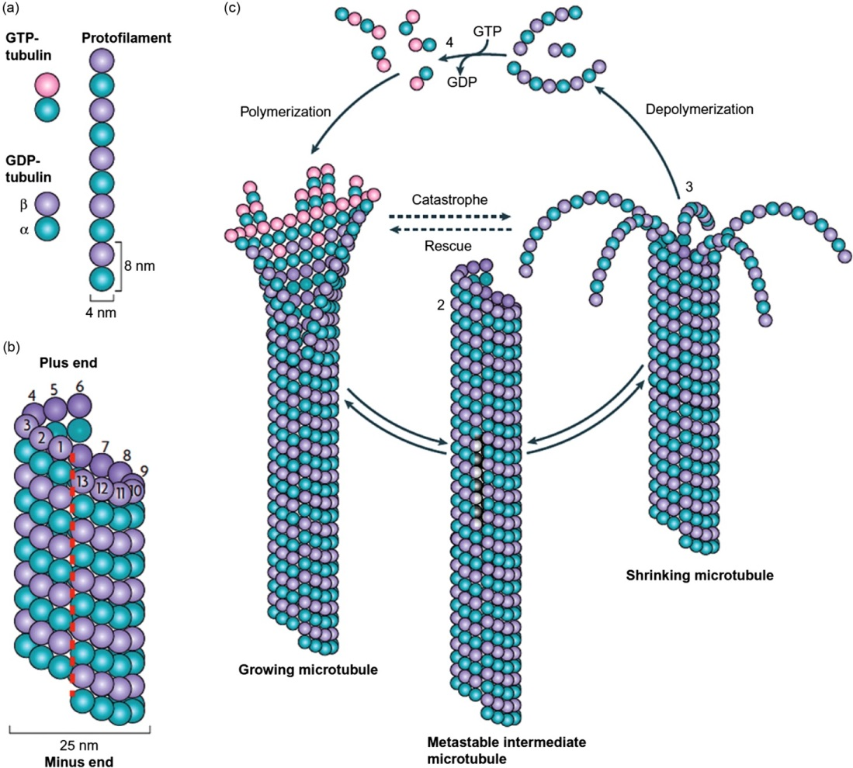
Figure 19.10

Slide 12
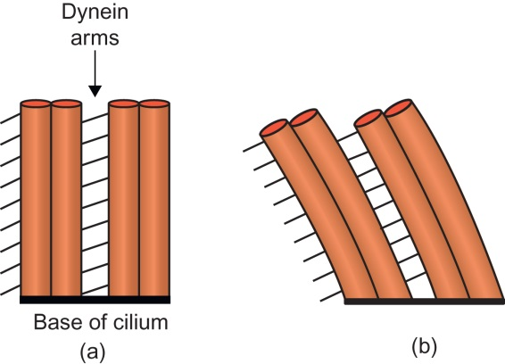
Figure 19.11

Slide 13
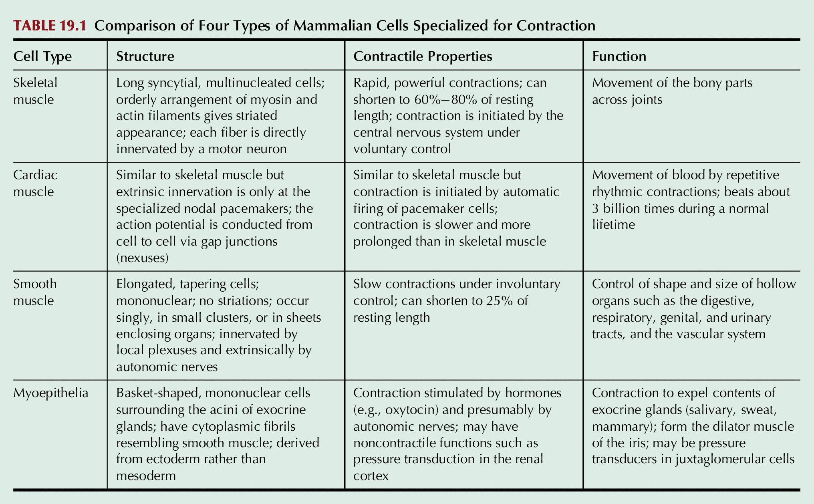
Table 19.1

Slide 14
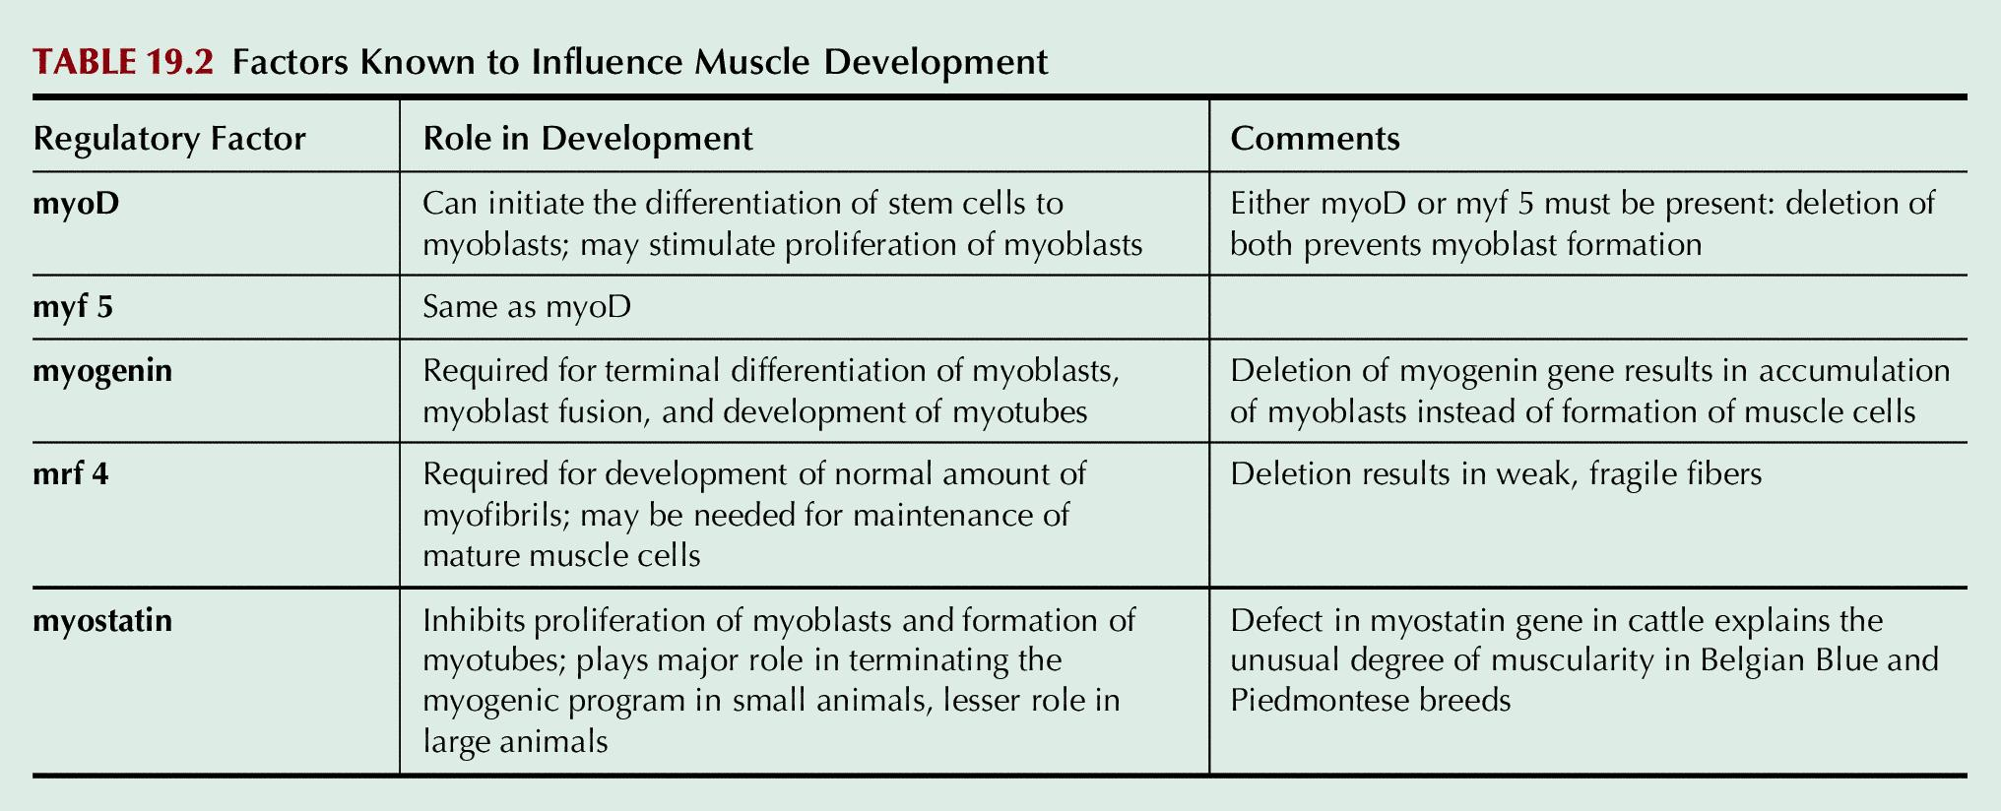
Table 19.2

