Slide 1
Chapter 22
DNA Replication, Repair, and Mutagenesis

Slide 2
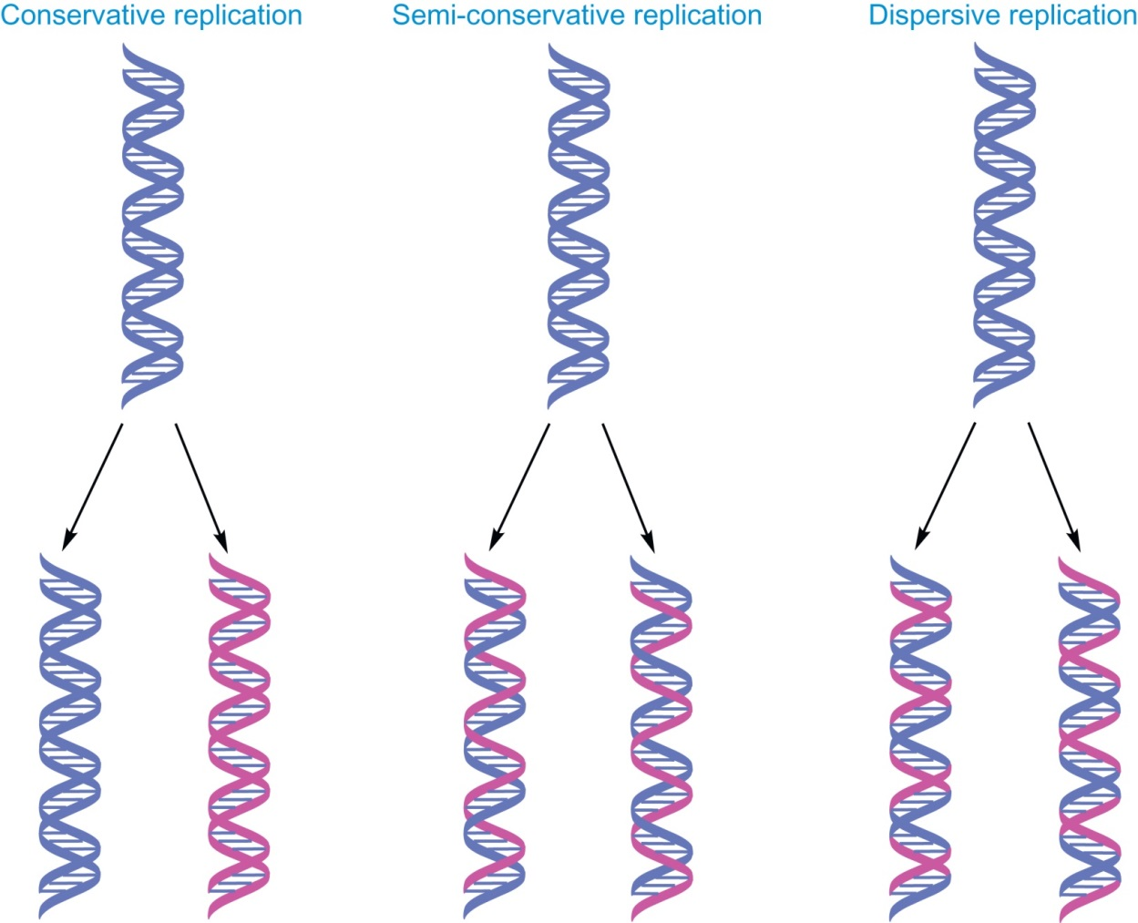
Figure 22.1

Slide 3
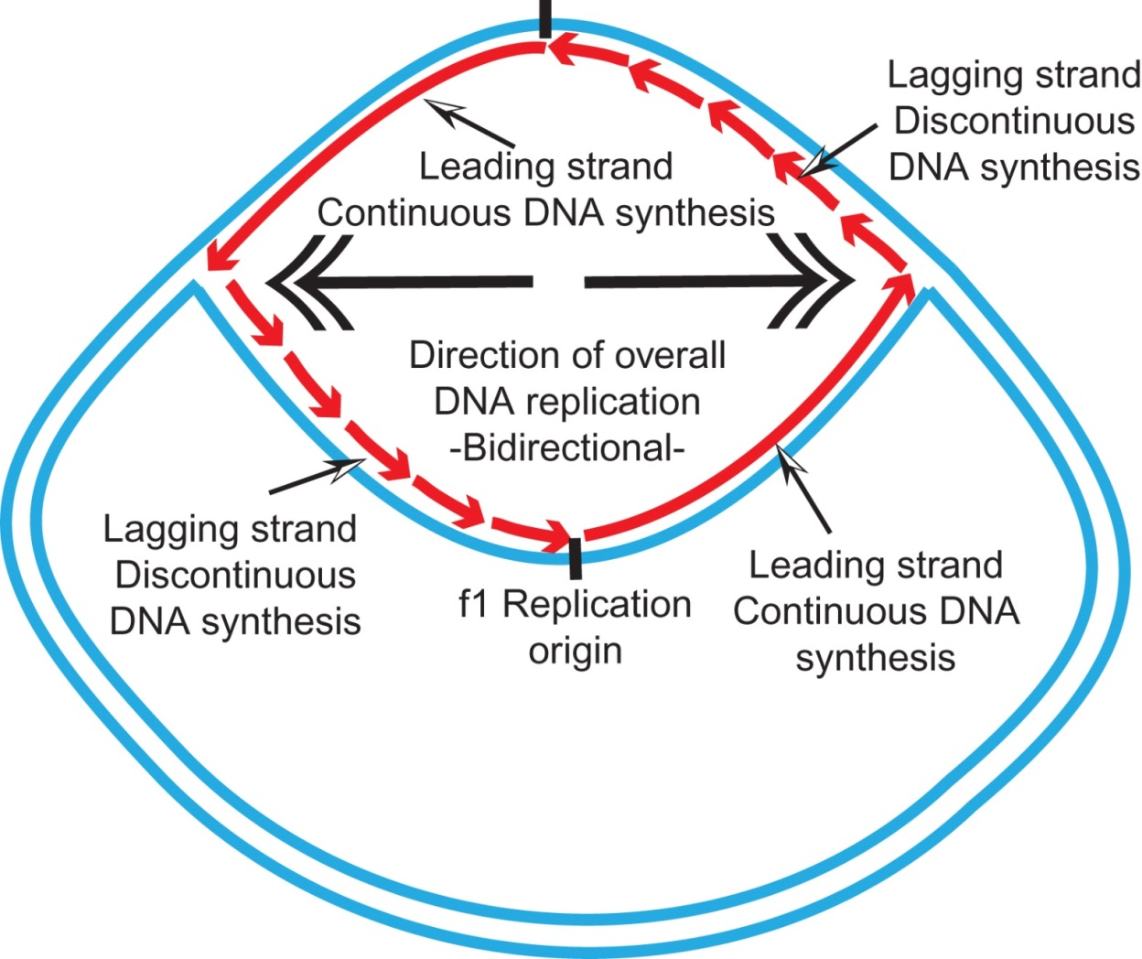
Figure 22.2

Slide 4
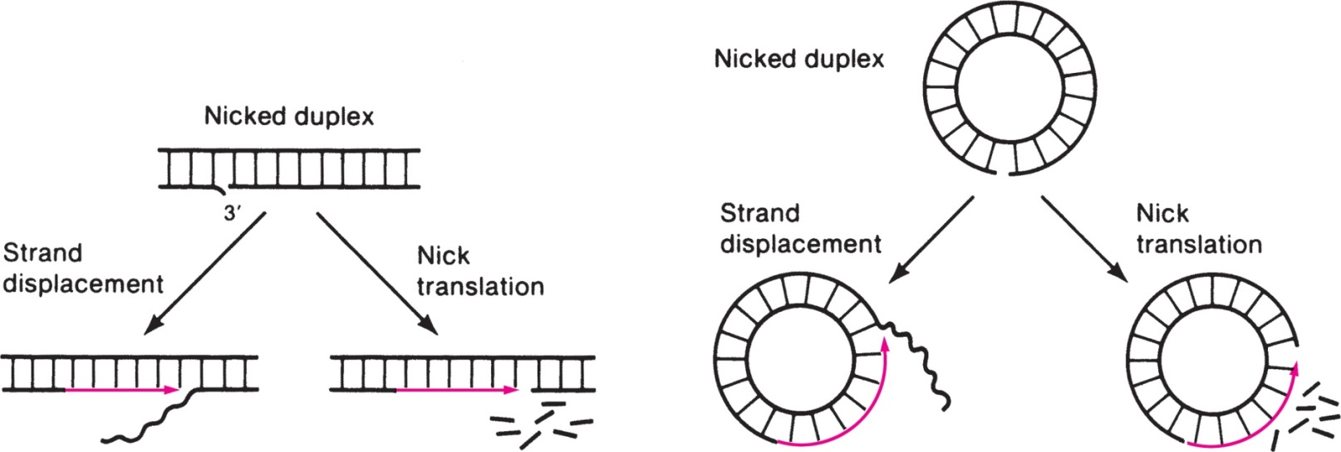
Figure 22.3

Slide 5
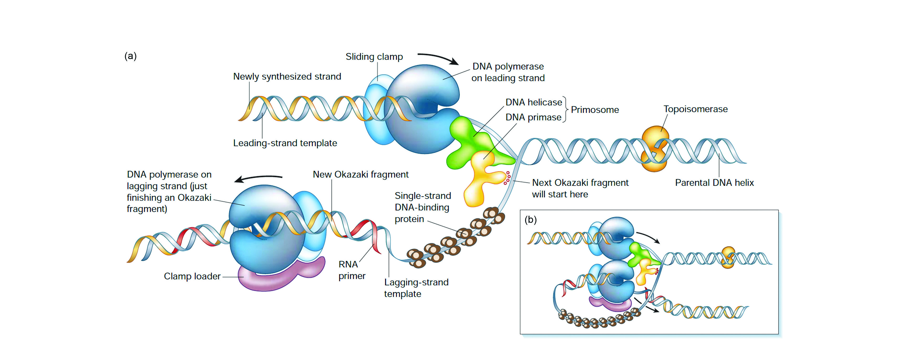
Figure 22.4
From Essentials of Medical Biochemistry: With Clinical Cases, Second Edition. Copyright © 2015 Elsevier Inc. All rights reserved.
5

Slide 6
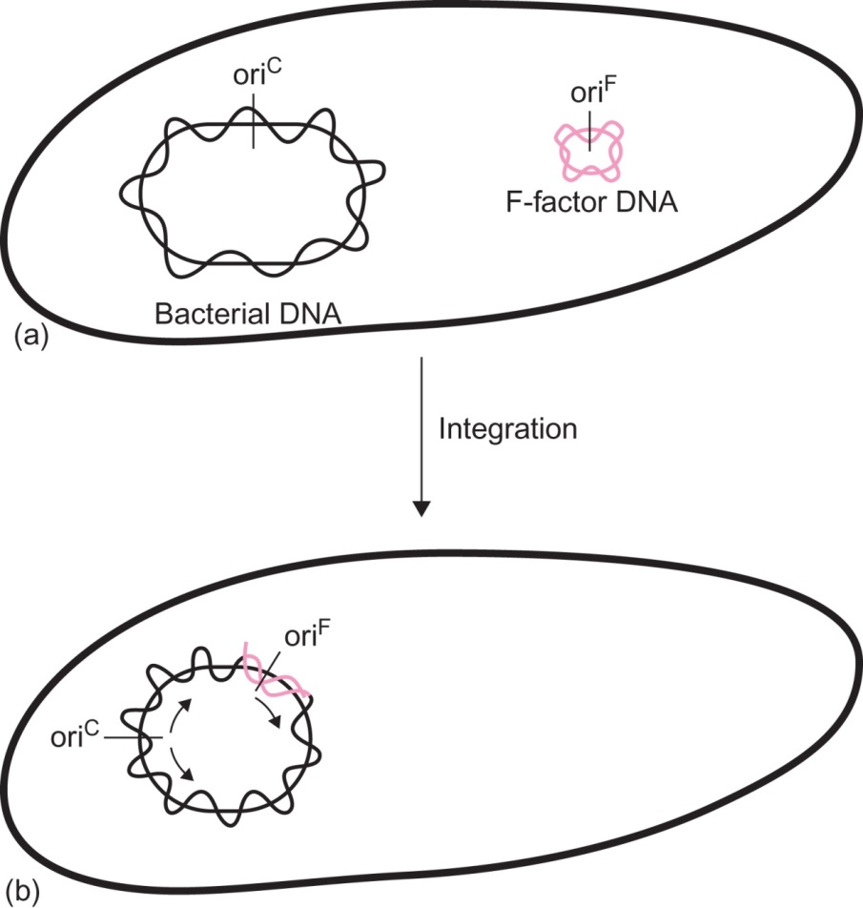
Figure 22.5

Slide 7
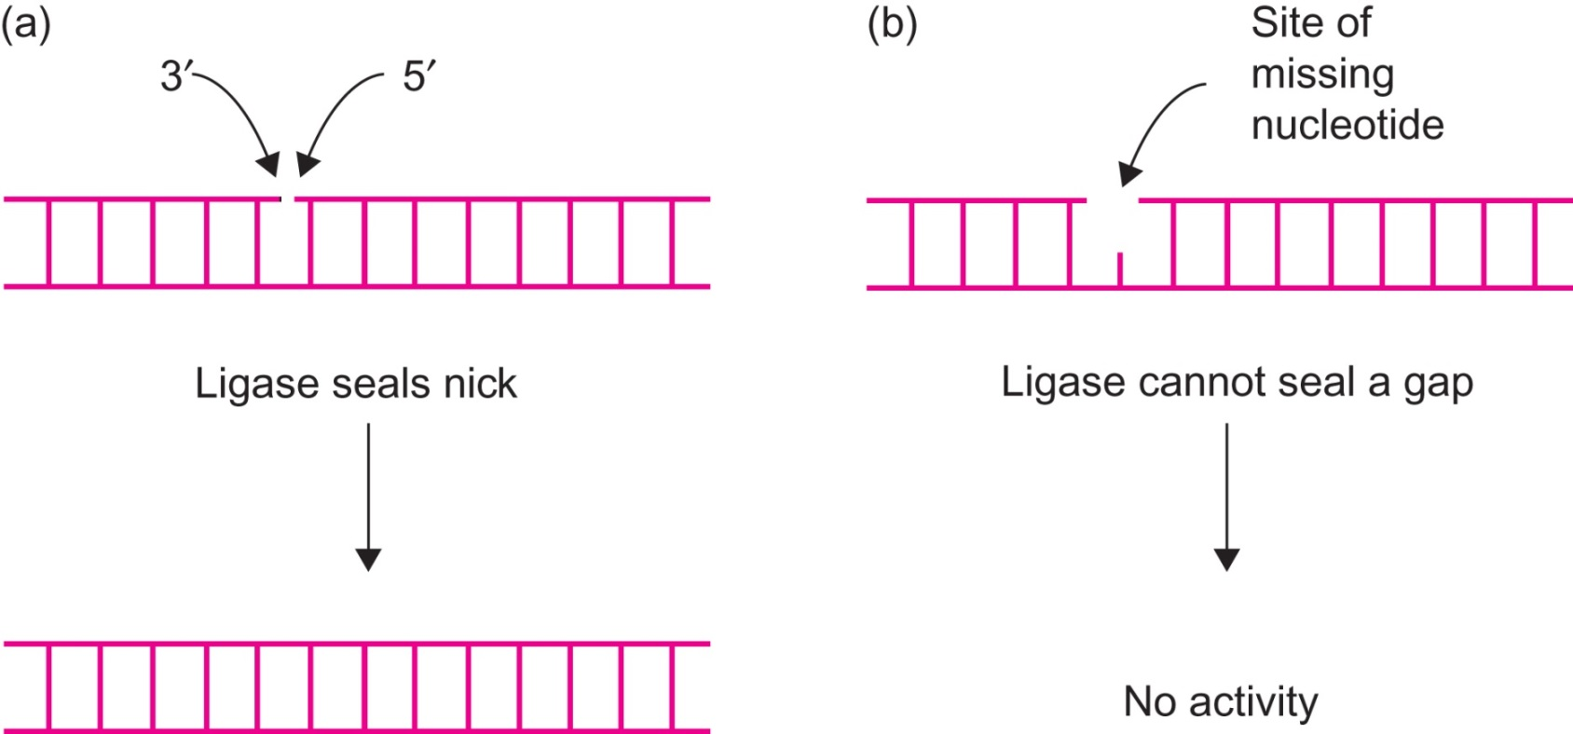
Figure 22.6

Slide 8
Figure 22.7

Slide 9
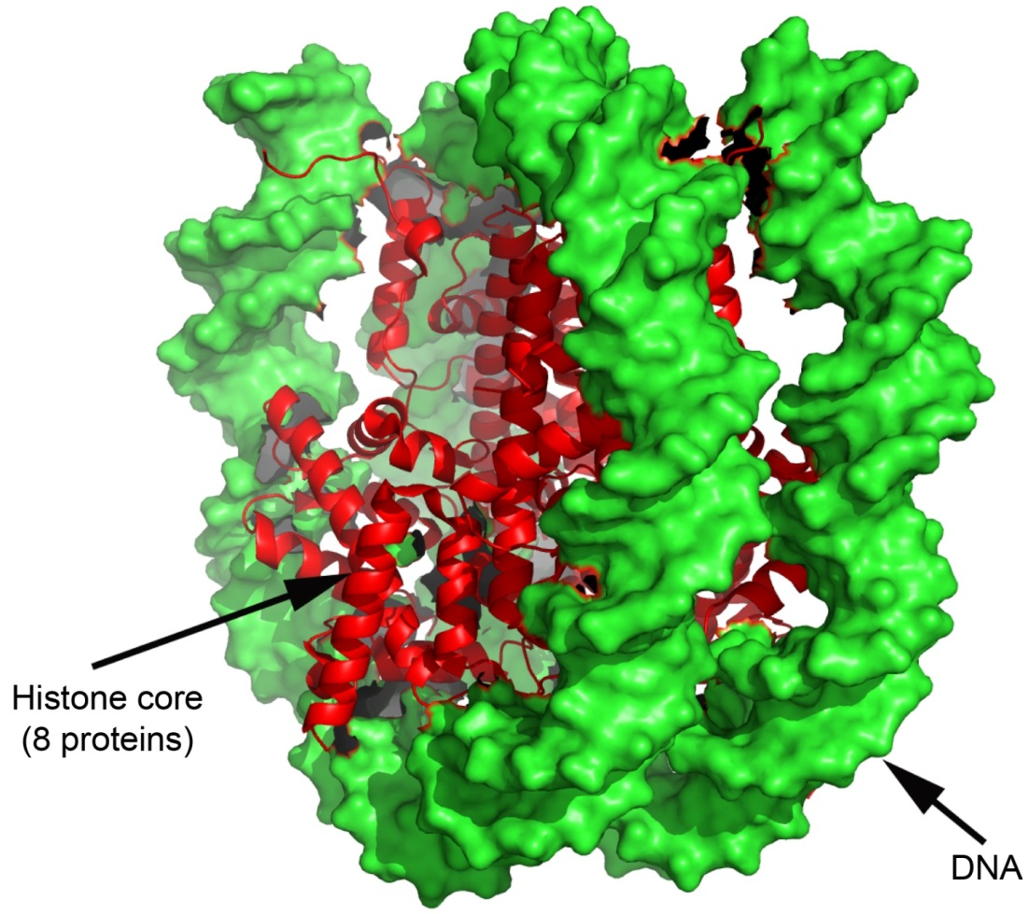
Figure 22.8

Slide 10
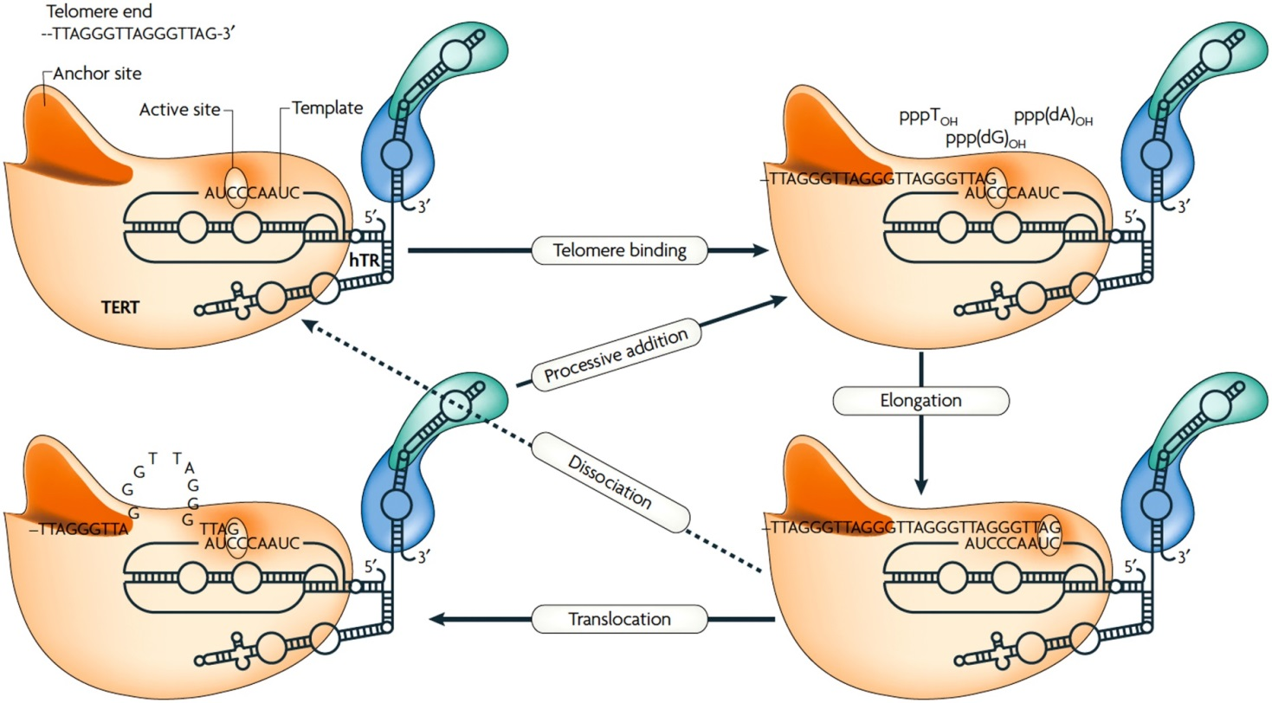
Figure 22.9

Slide 11
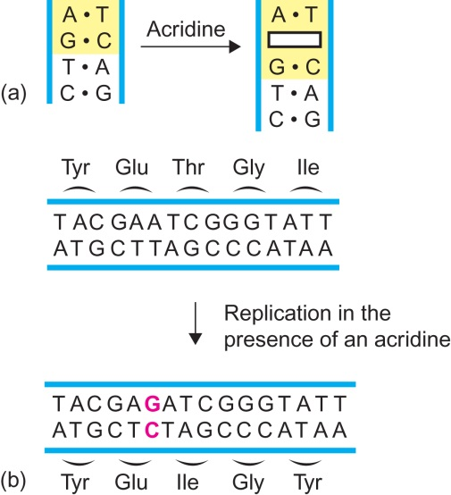
Figure 22.10

Slide 12
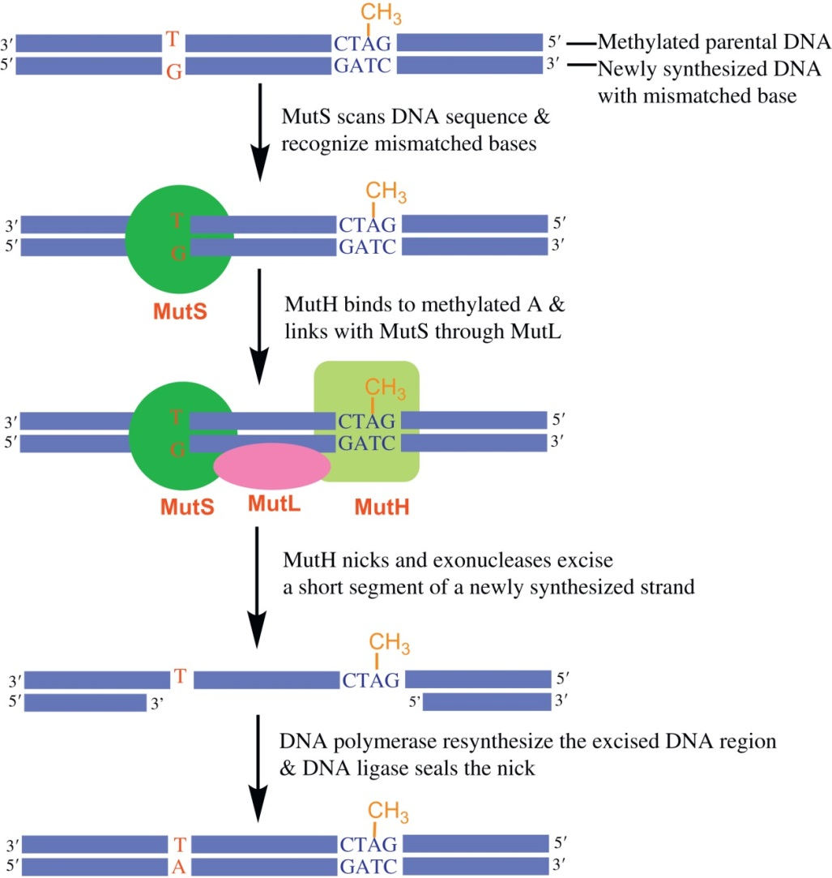
Figure 22.11

Slide 13
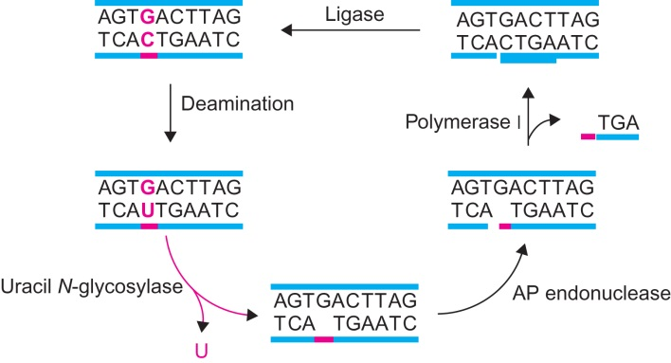
Figure 22.12

Slide 14
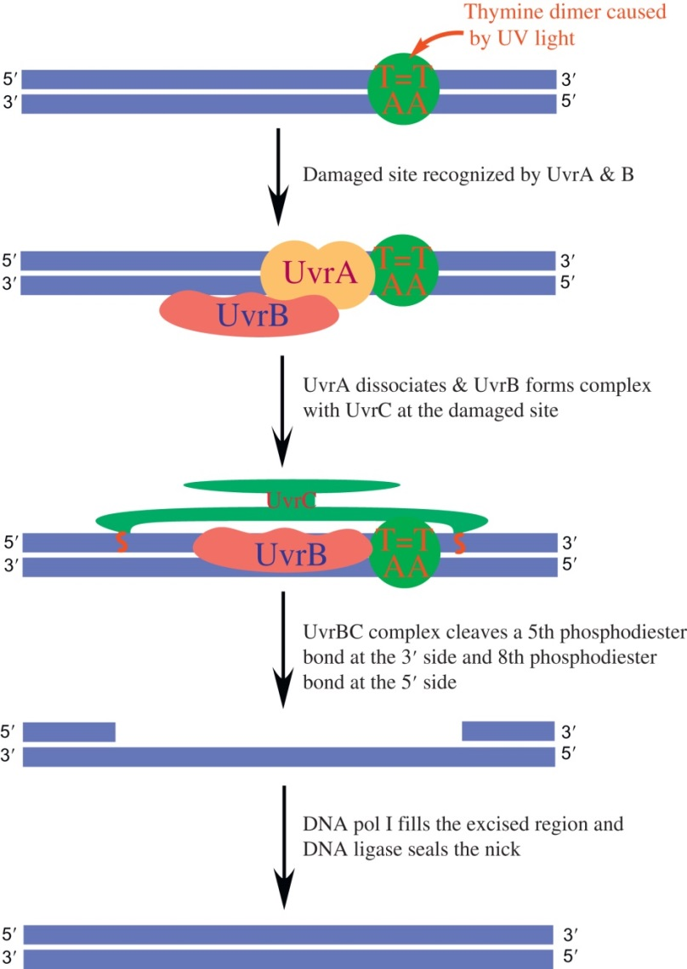
Figure 22.13

Slide 15
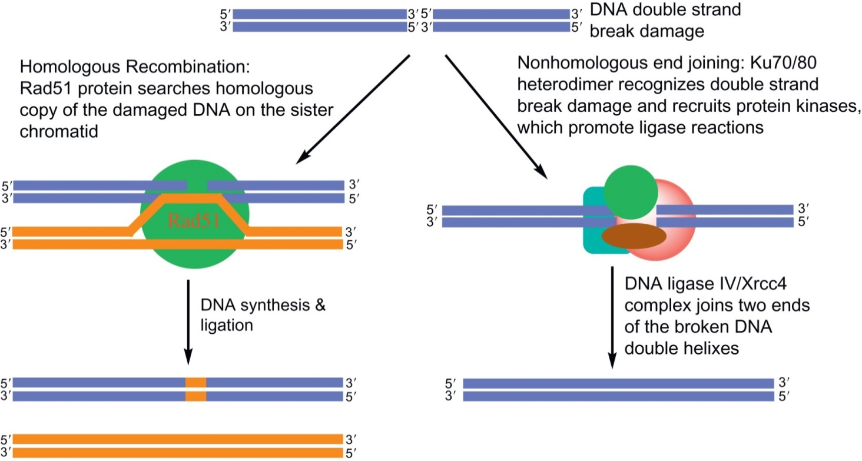
Figure 22.14

Slide 16
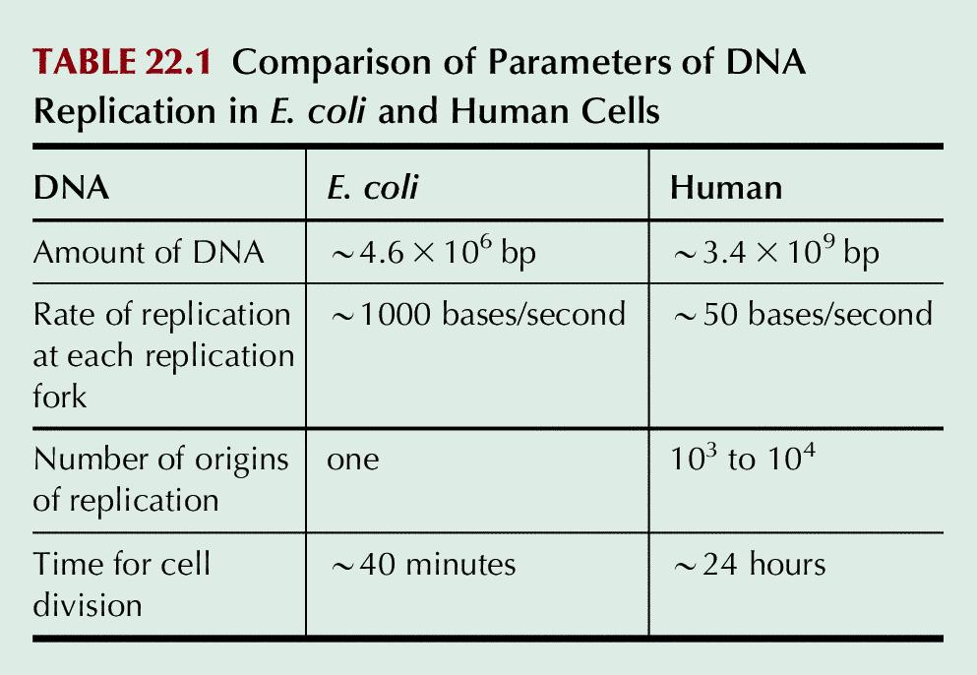
Table 22.1

Slide 17
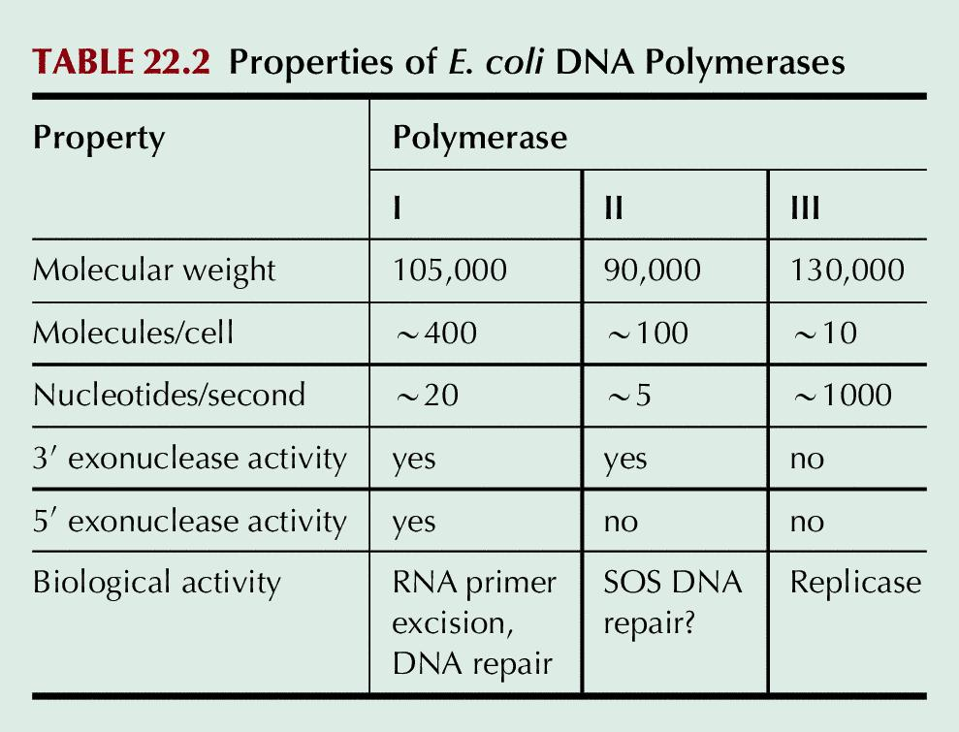
Table 22.2

Slide 18
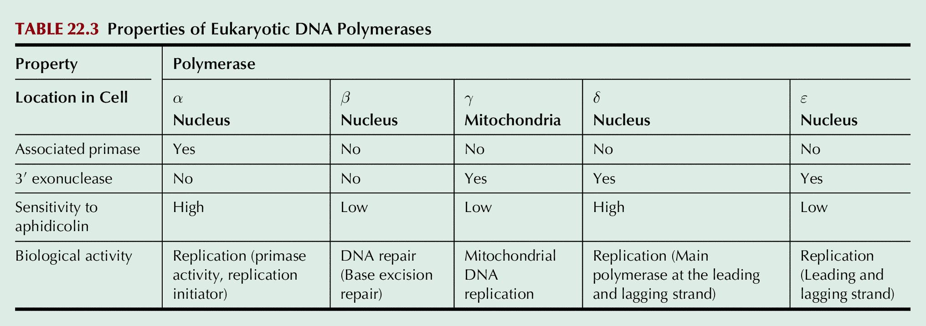
Table 22.3

Slide 19
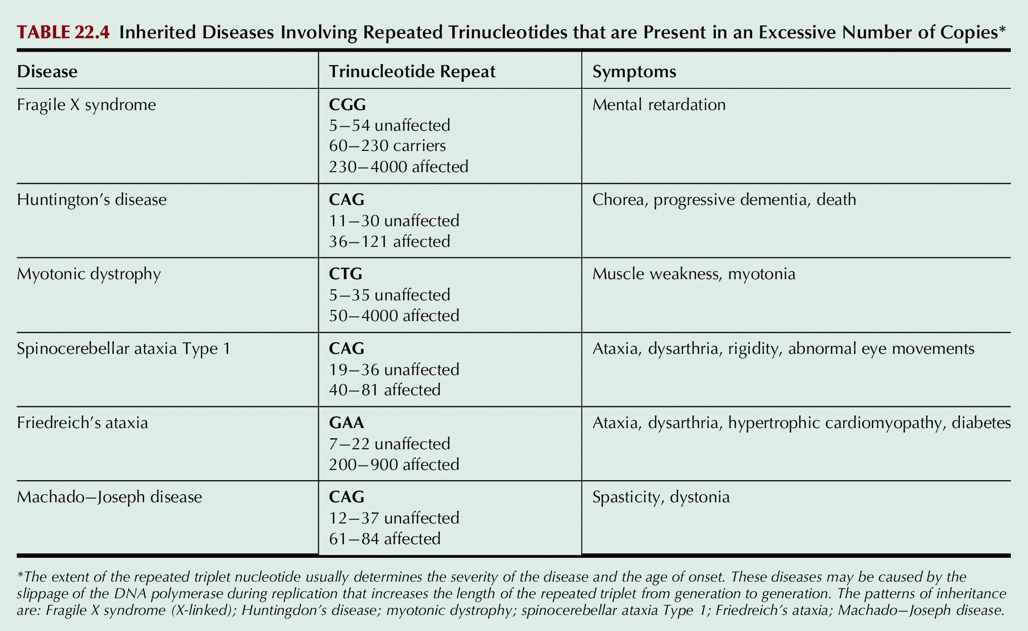
Table 22.4

