Slide 1
Chapter 23
RNA and Protein Synthesis

Slide 2
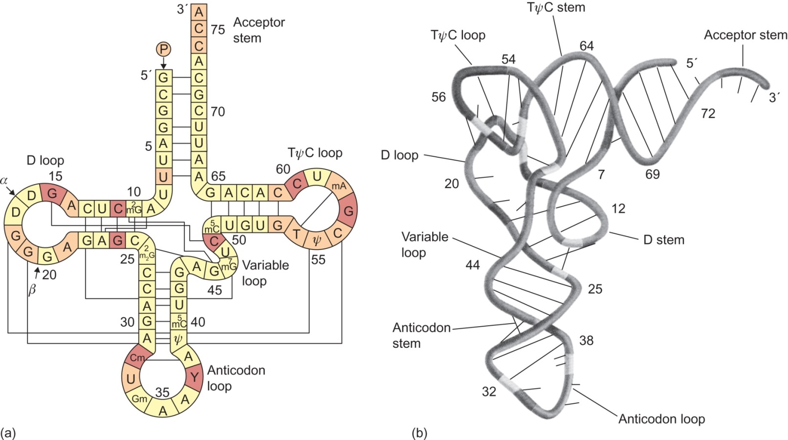
Figure 23.1

Slide 3
Figure 23.2

Slide 4
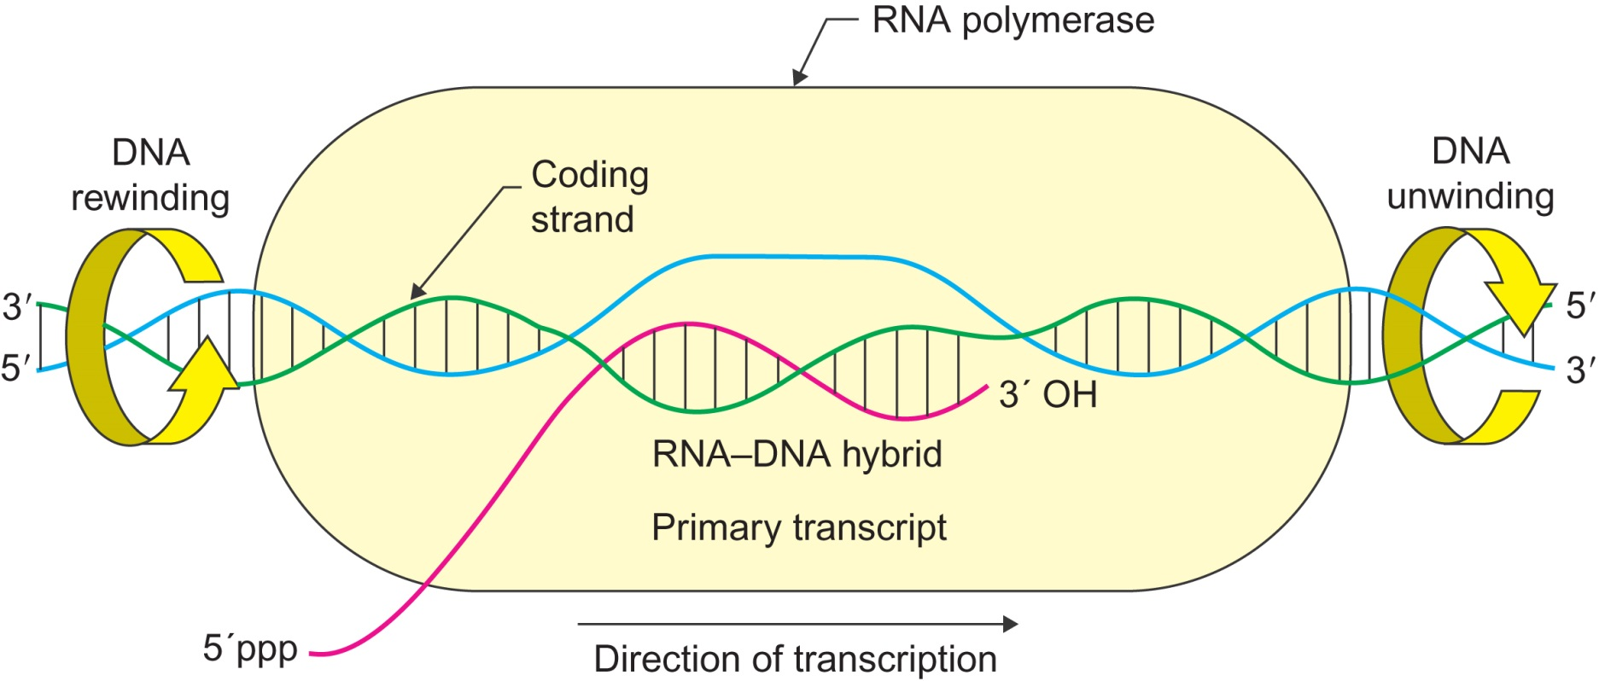
Figure 23.3

Slide 5
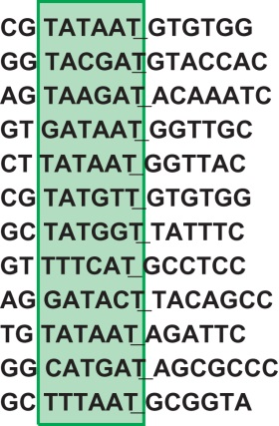
Figure 23.4

Slide 6
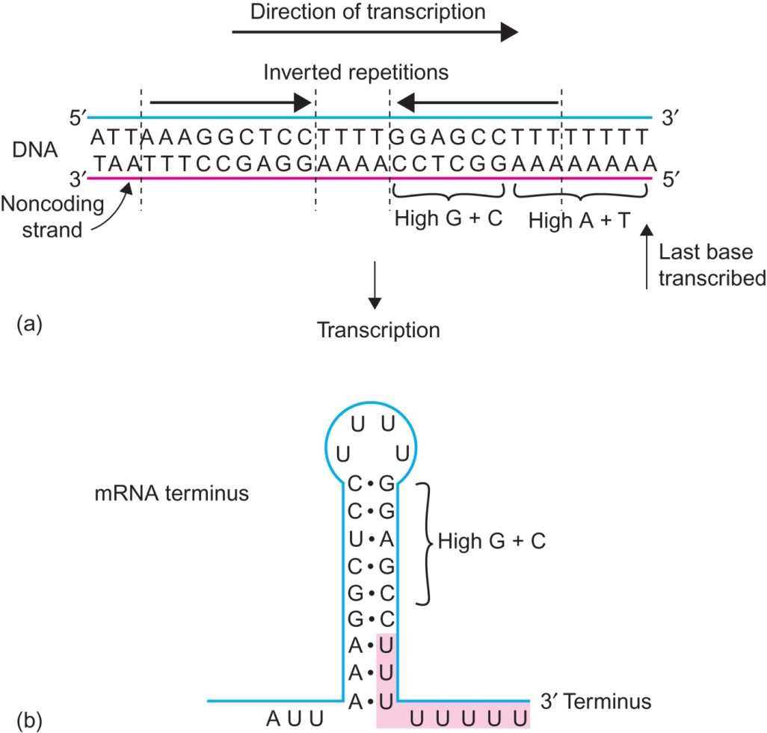
Figure 23.5

Slide 7
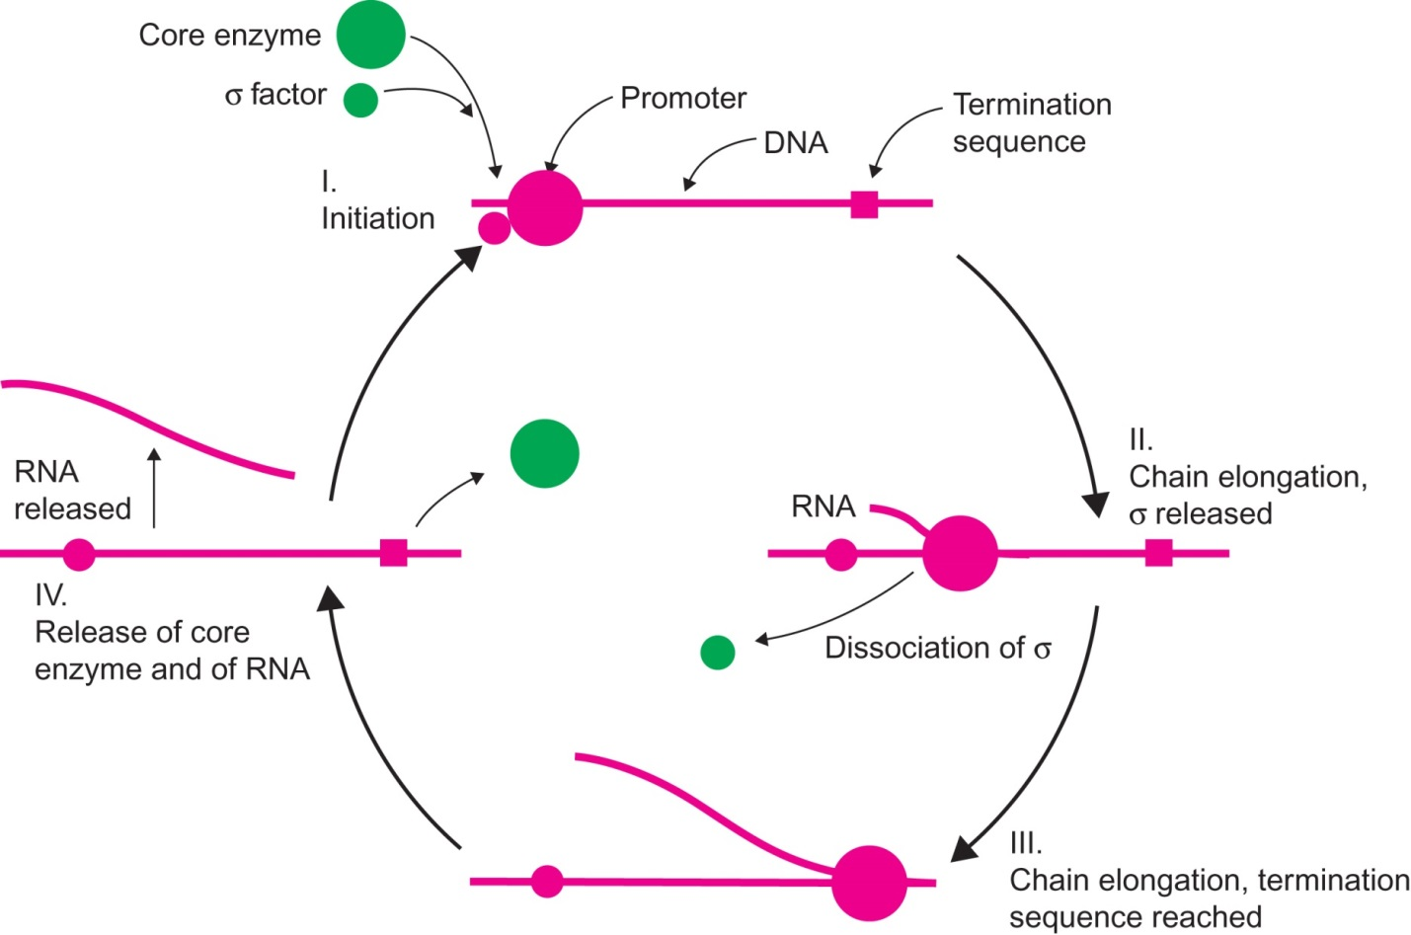
Figure 23.6

Slide 8
Figure 23.7

Slide 9
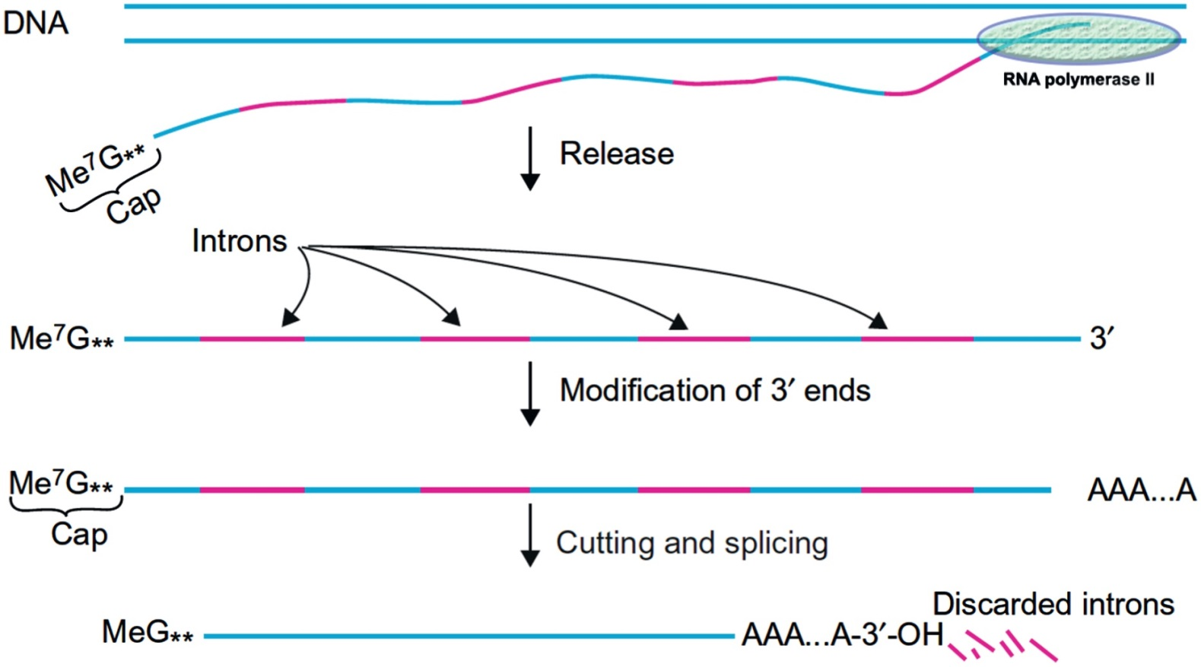
Figure 23.8

Slide 10
Figure 23.9

Slide 11
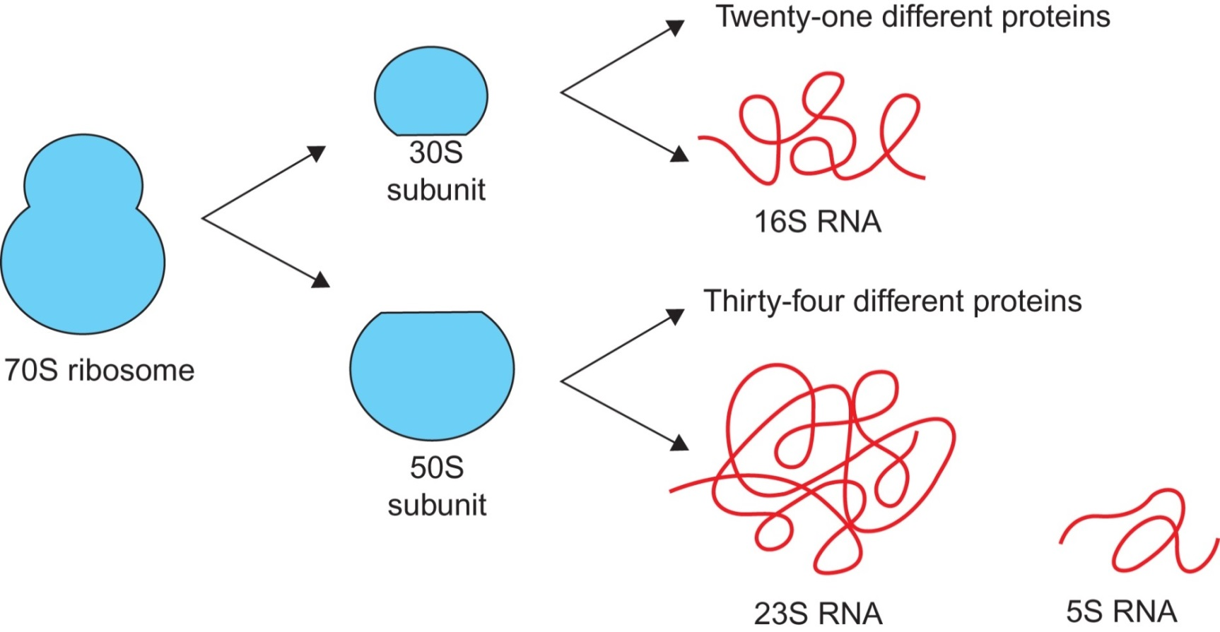
Figure 23.10

Slide 12
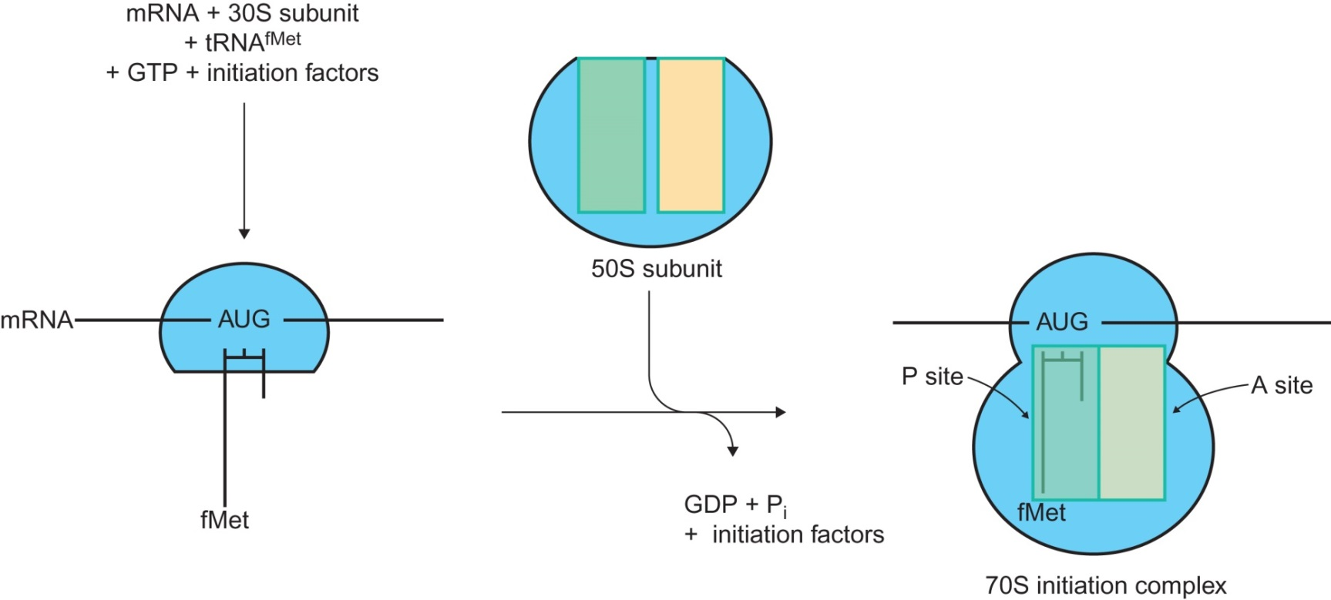
Figure 23.11

Slide 13
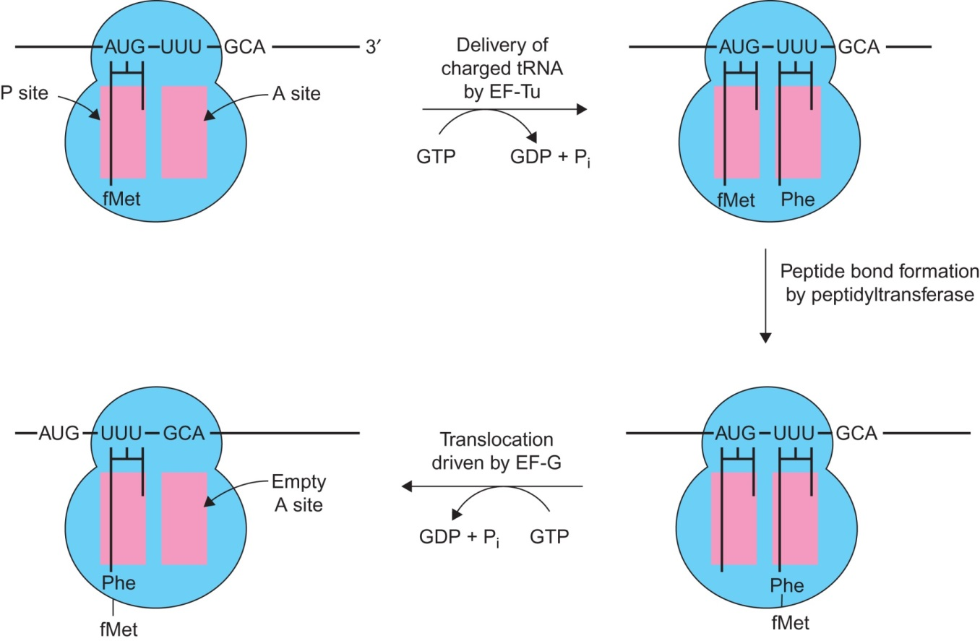
Figure 23.12

Slide 14
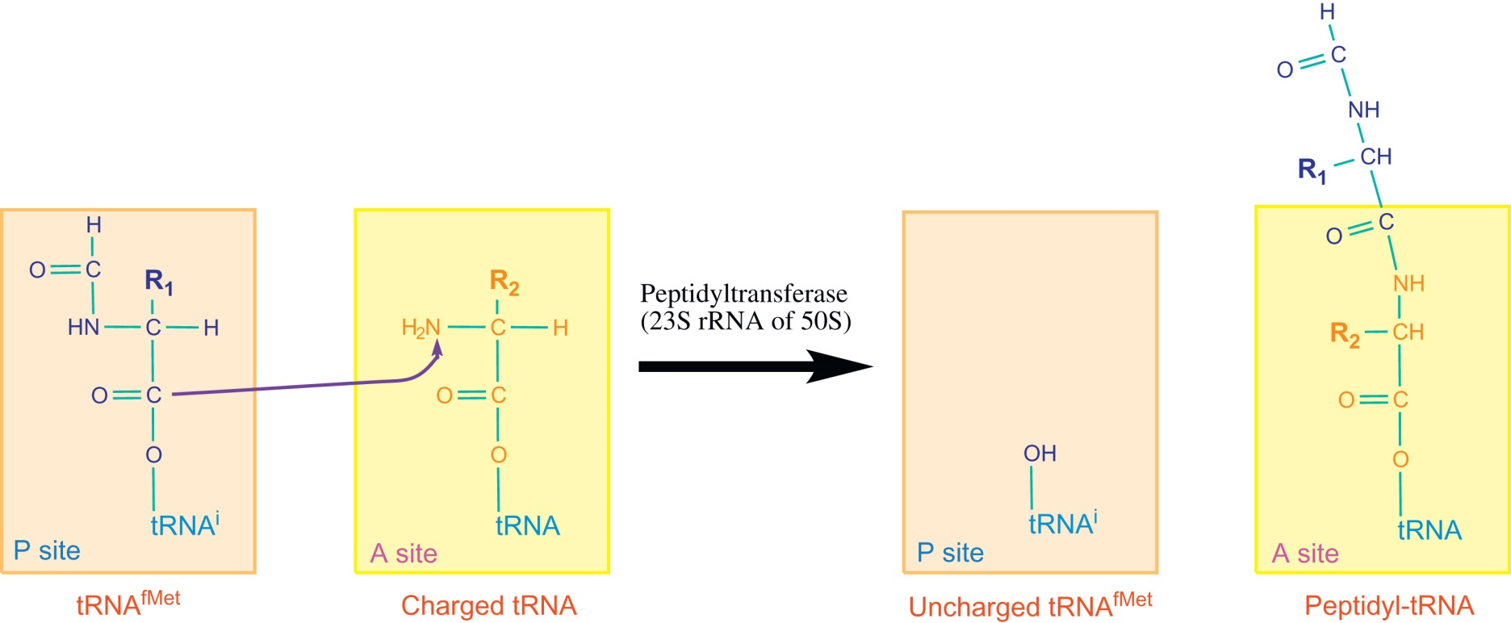
Figure 23.13

Slide 15
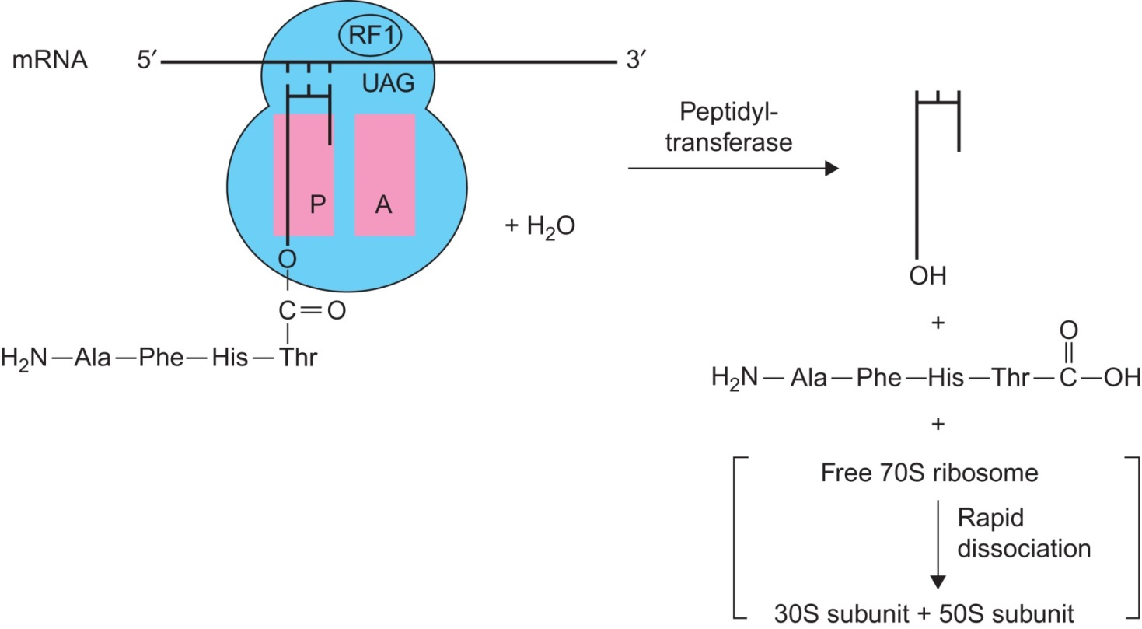
Figure 23.14

Slide 16
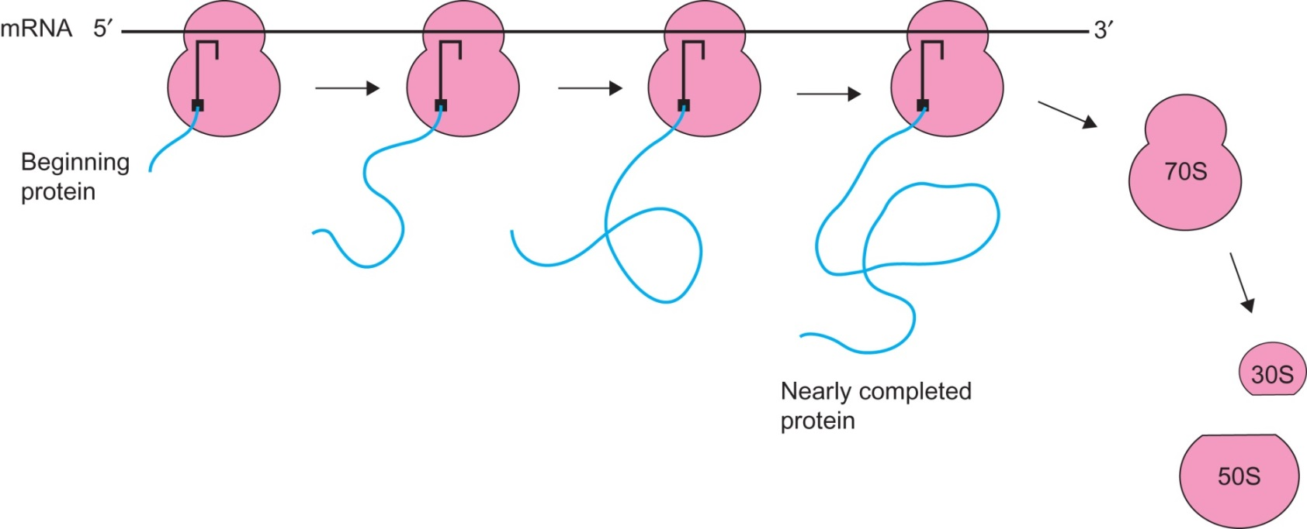
Figure 23.15

Slide 17
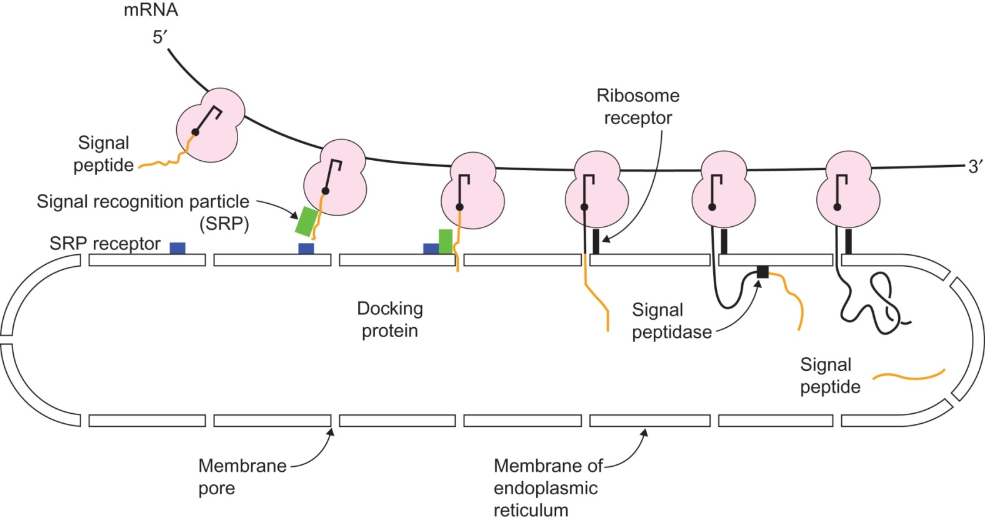
Figure 23.16

Slide 18
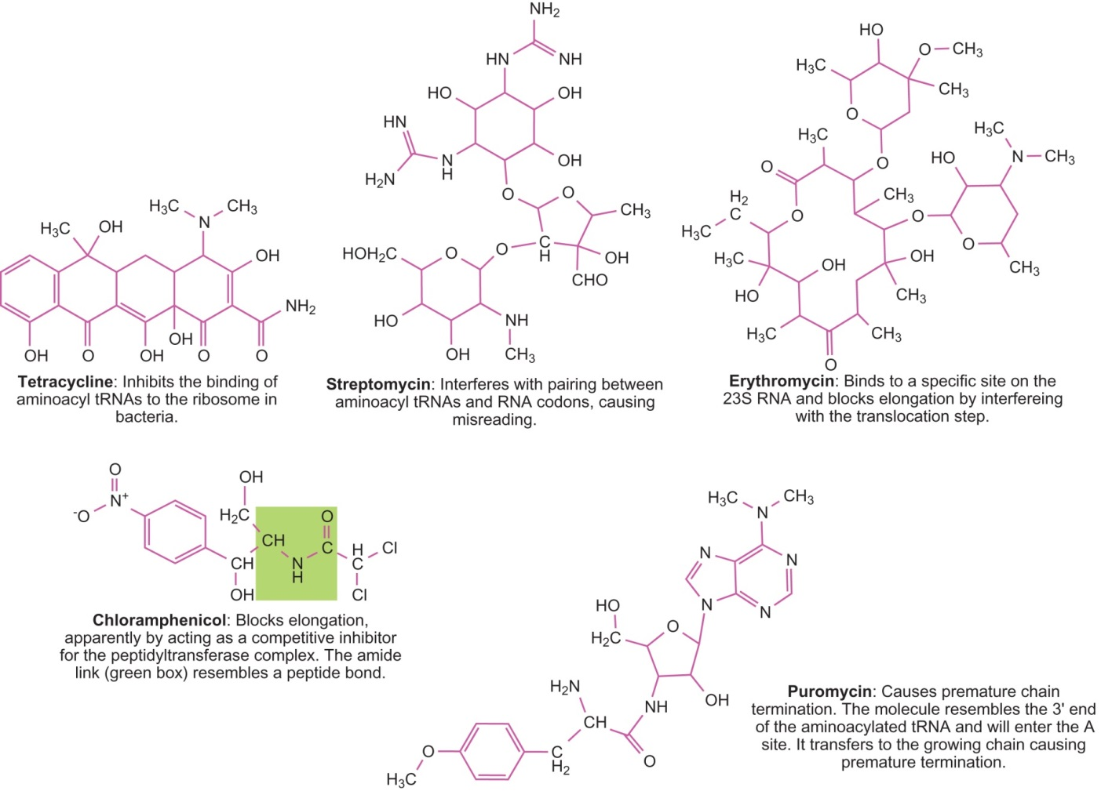
Figure 23.17

Slide 19
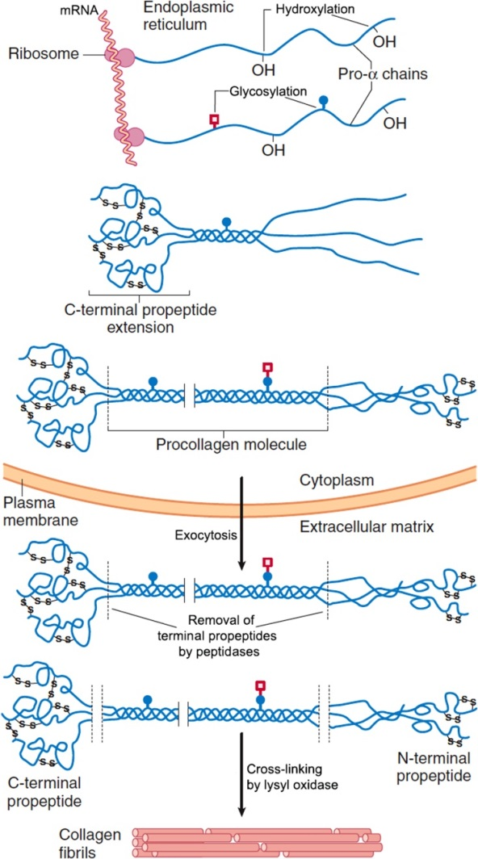
Figure 23.18

Slide 20
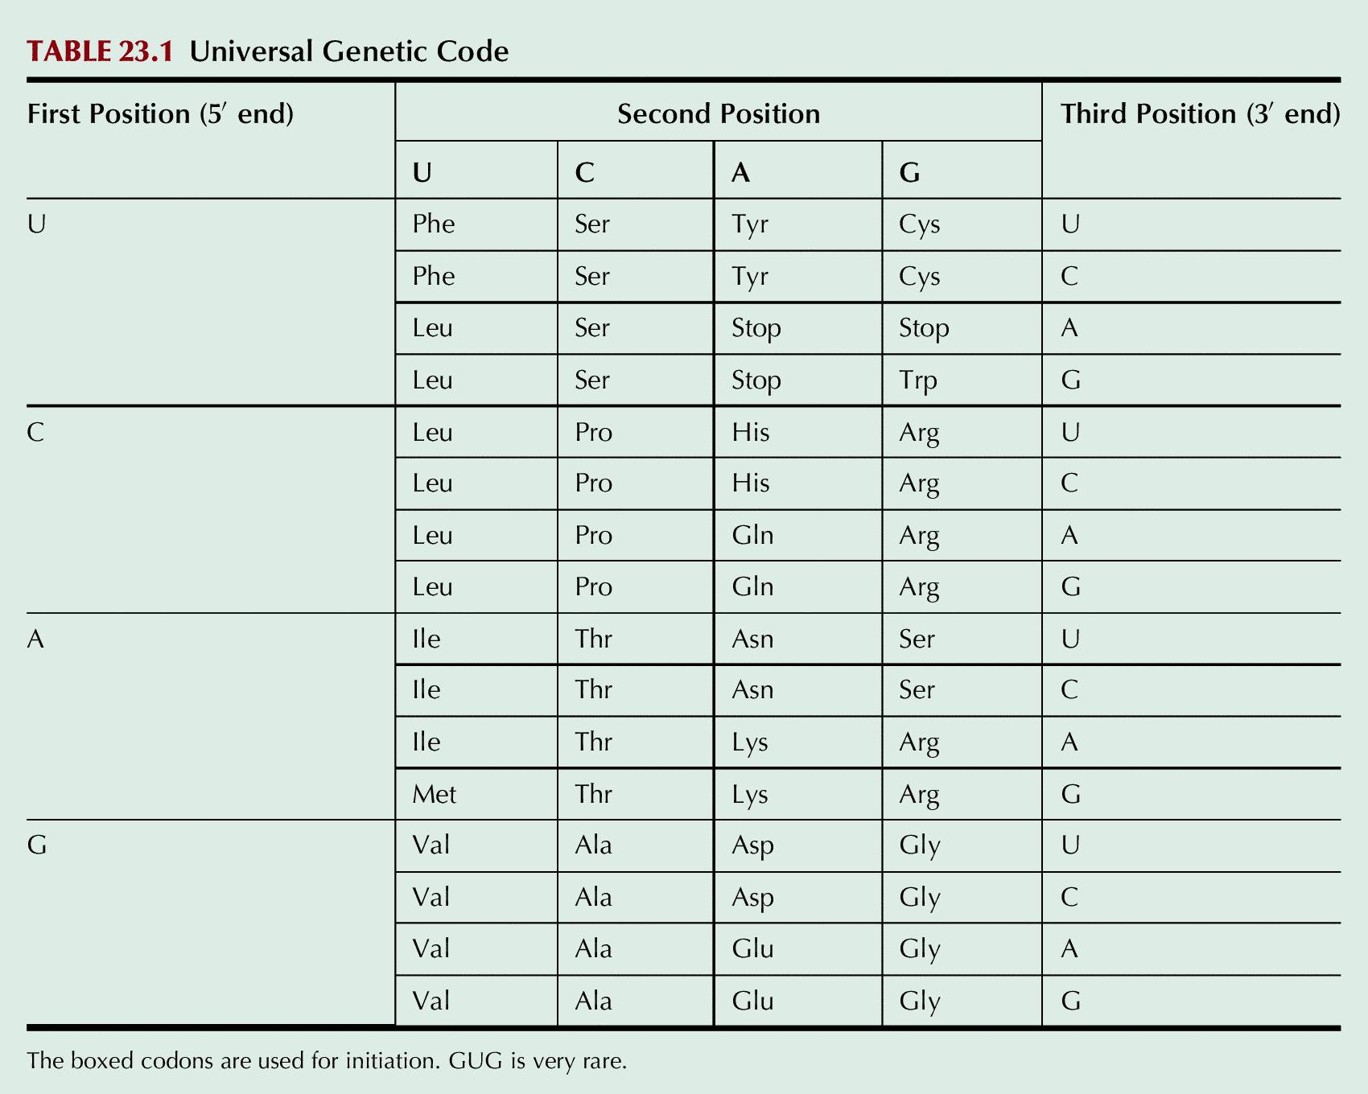
Table 23.1

Slide 21
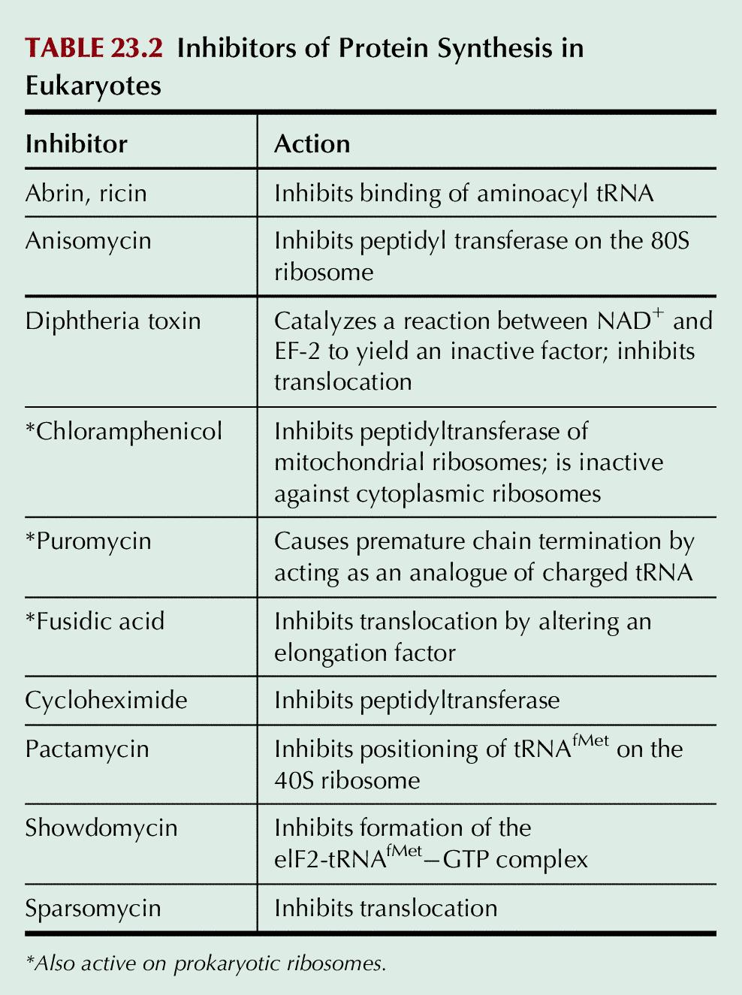
Table 23.2

Slide 22
UnFig 23.1

Slide 23
UnFig 23.2

Slide 24
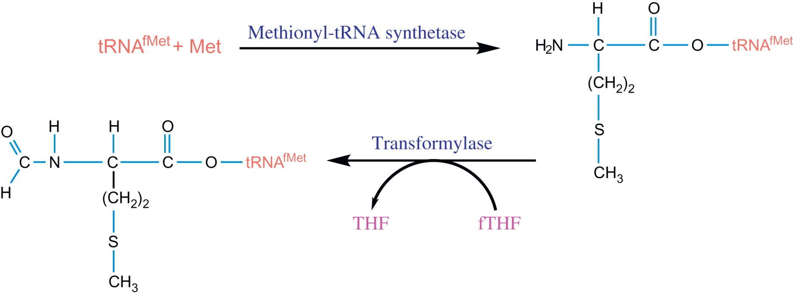
UnFig 23.3

Slide 25
UnFig 23.4

Slide 26
UnFig 23.5

Slide 27
UnFig 23.6

