Slide 1
Chapter 24
Regulation of Gene Expression

Slide 2
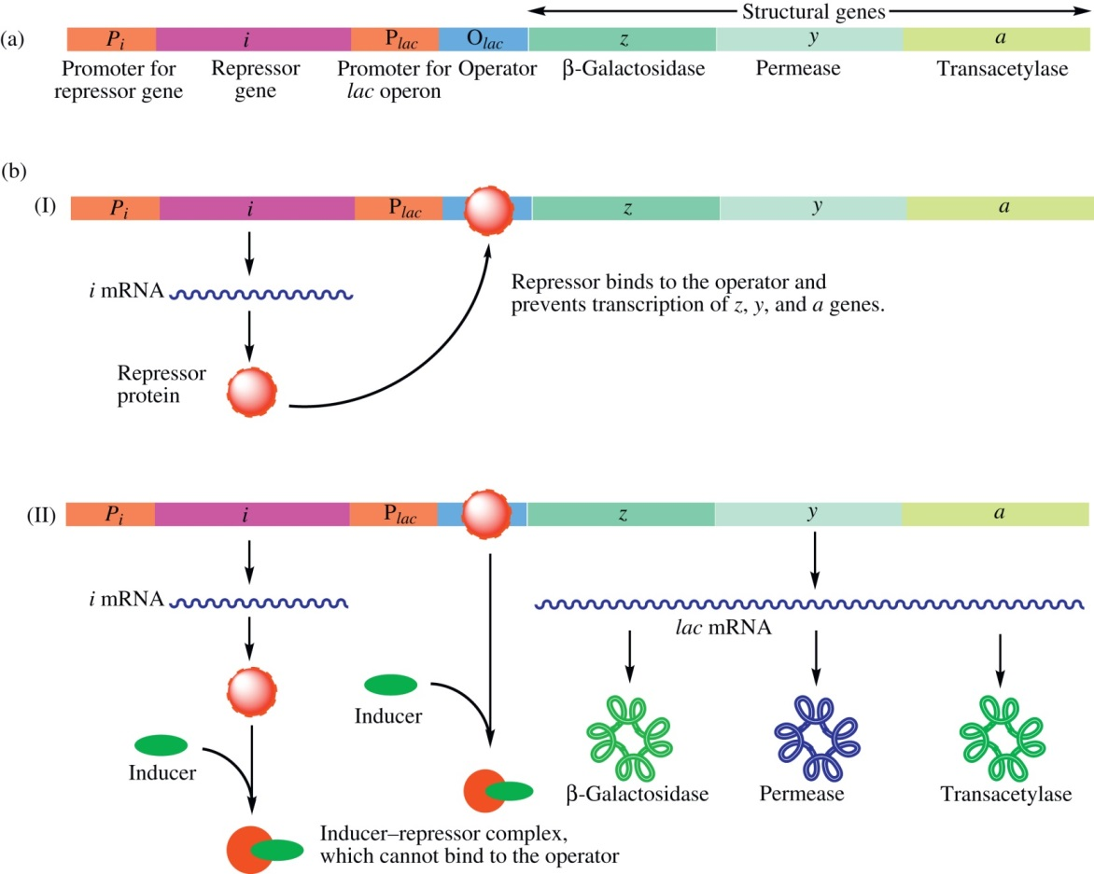
Figure 24.1

Slide 3
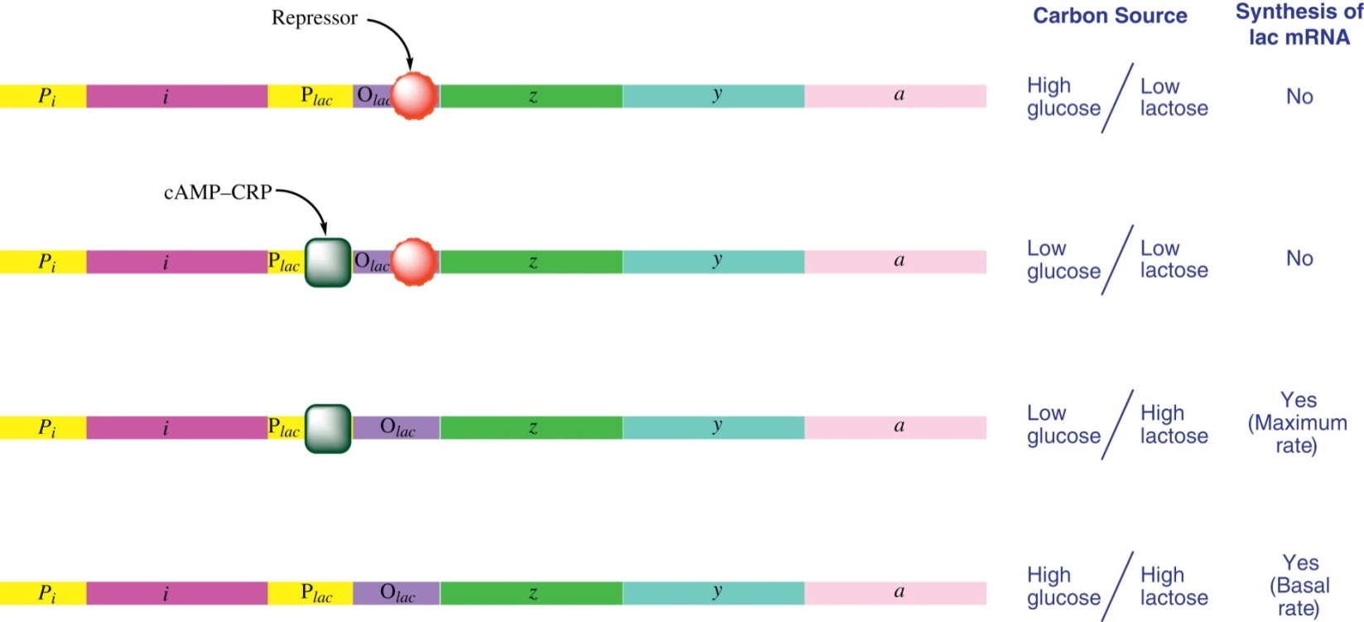
Figure 24.2

Slide 4
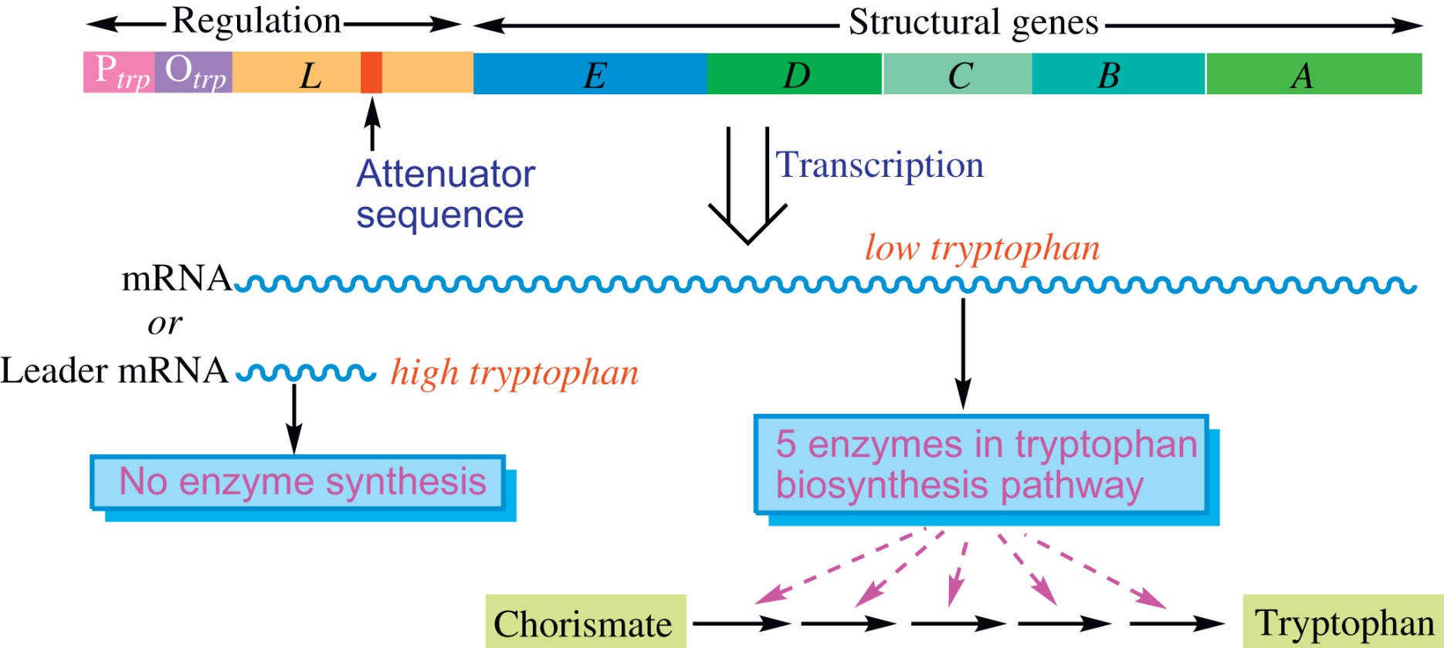
Figure 24.3

Slide 5
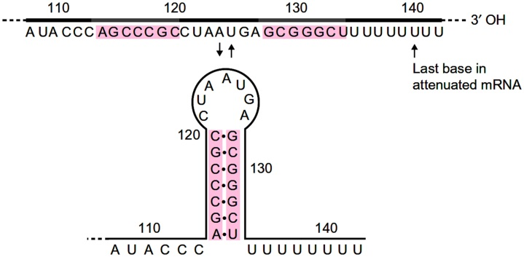
Figure 24.4

Slide 6
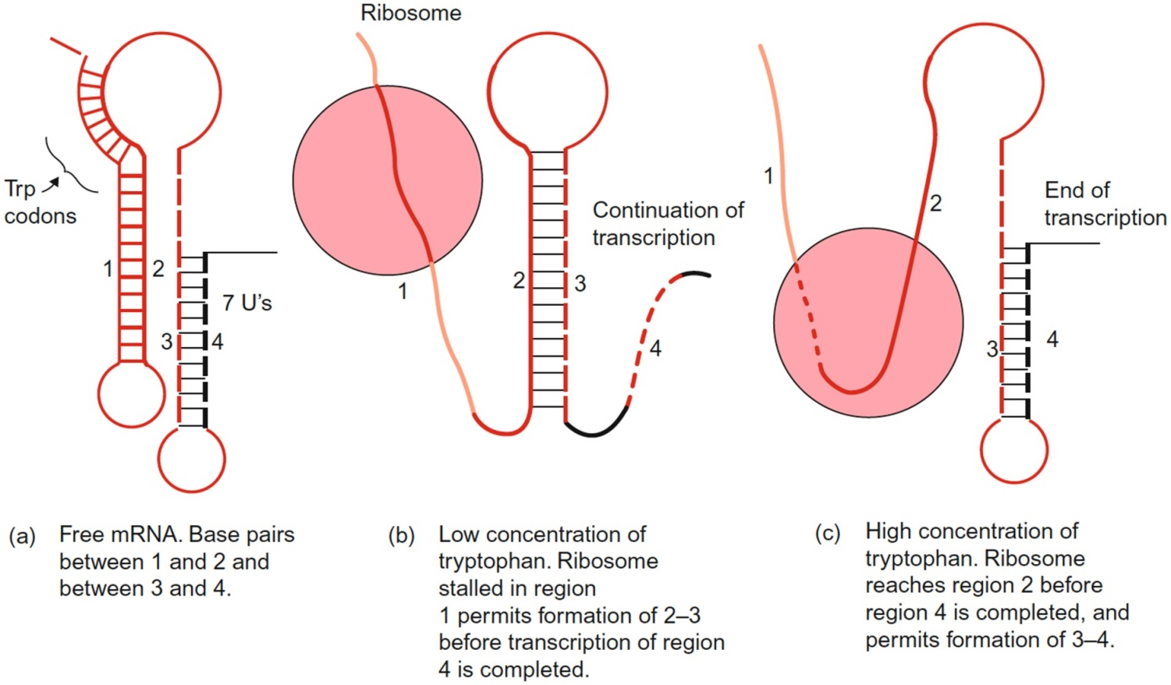
Figure 24.5

Slide 7
Figure 24.6

Slide 8
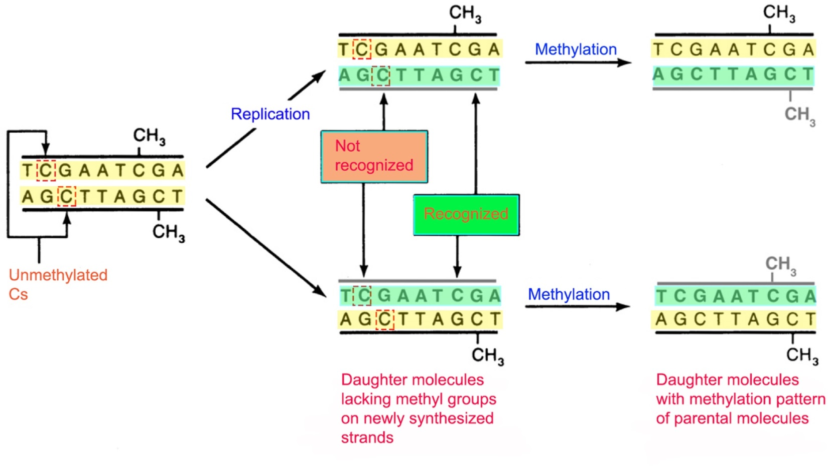
Figure 24.7

Slide 9
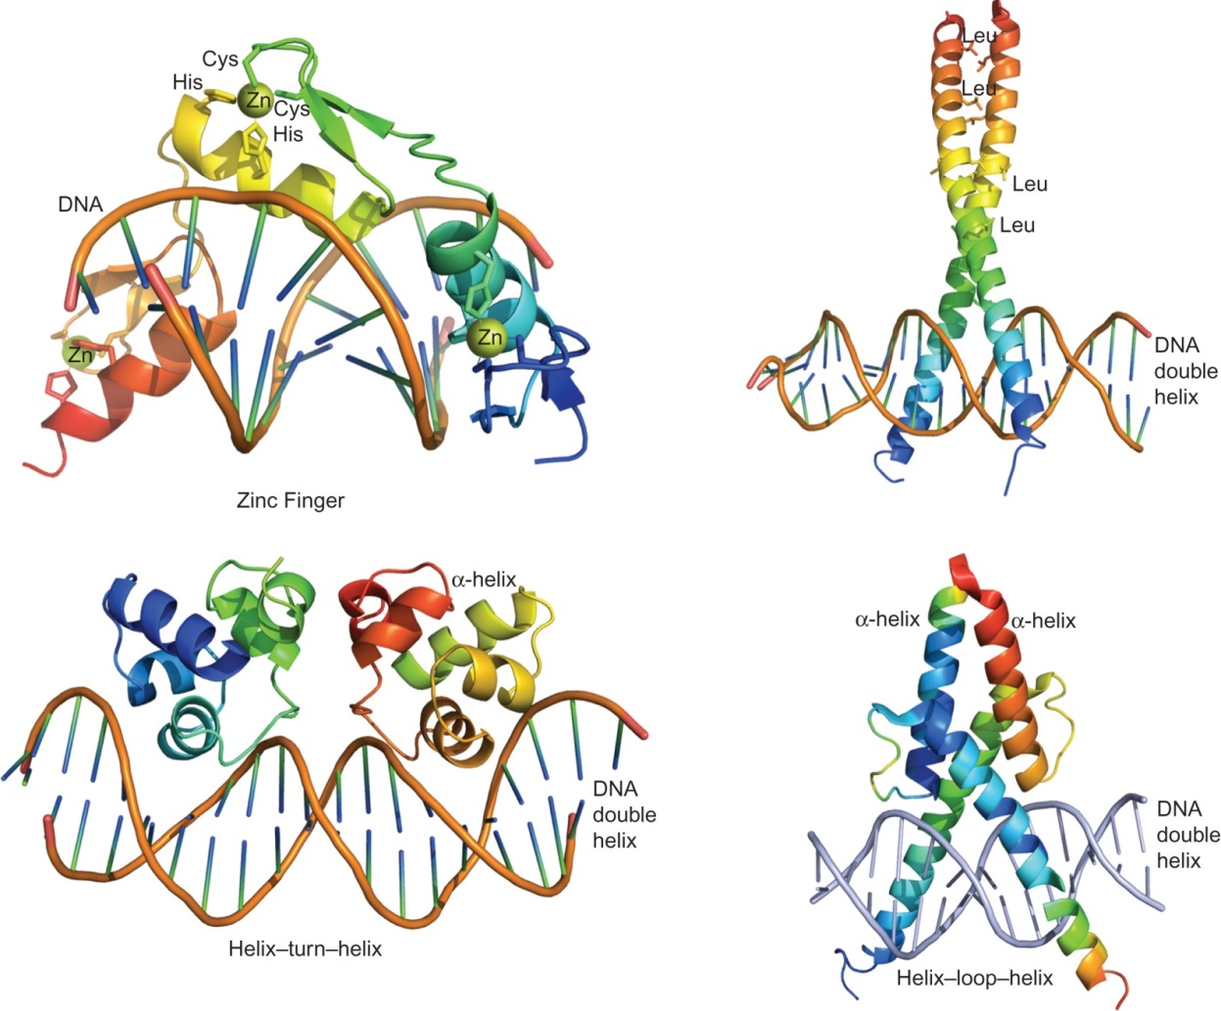
Figure 24.8

Slide 10
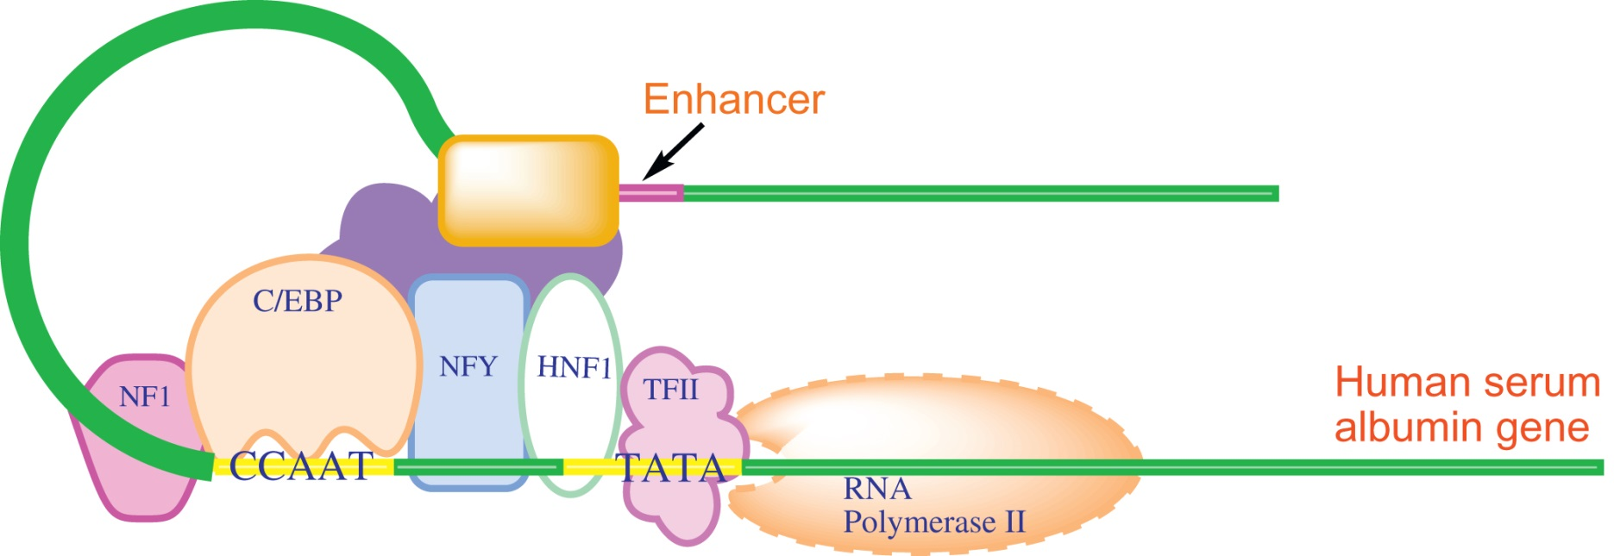
Figure 24.9

Slide 11
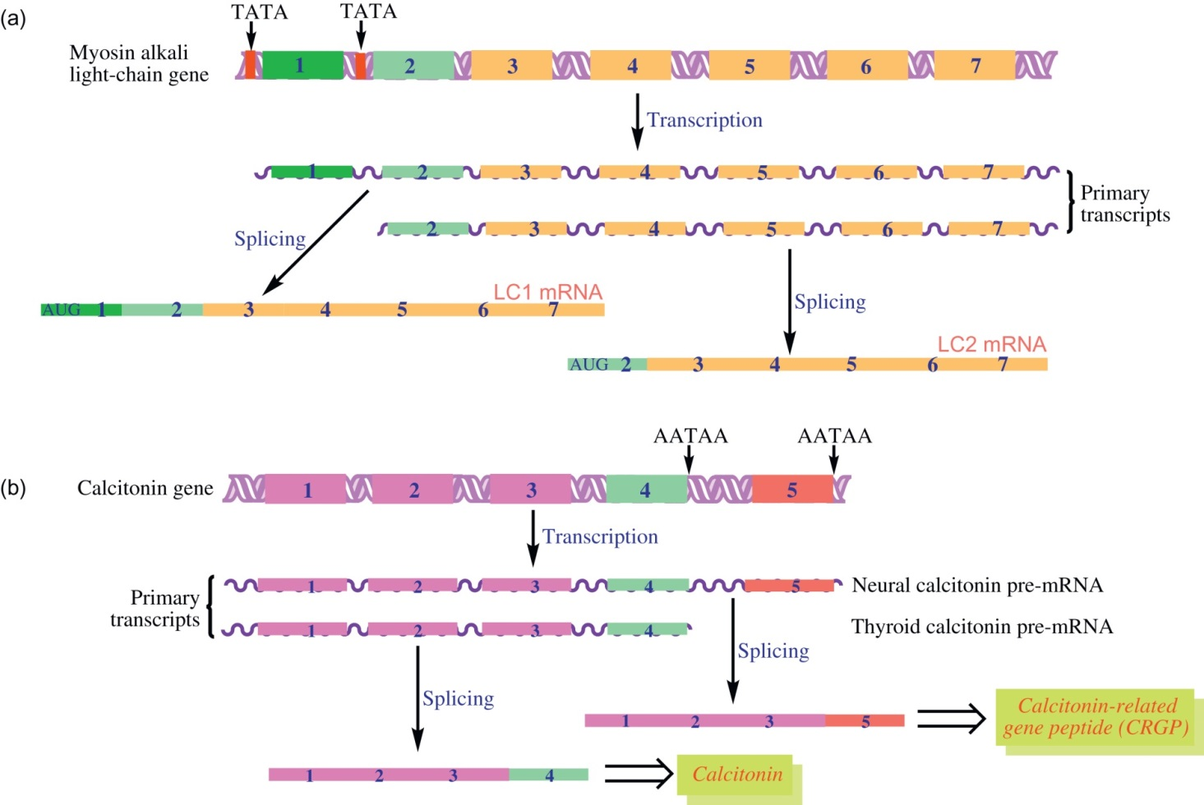
Figure 24.10

Slide 12
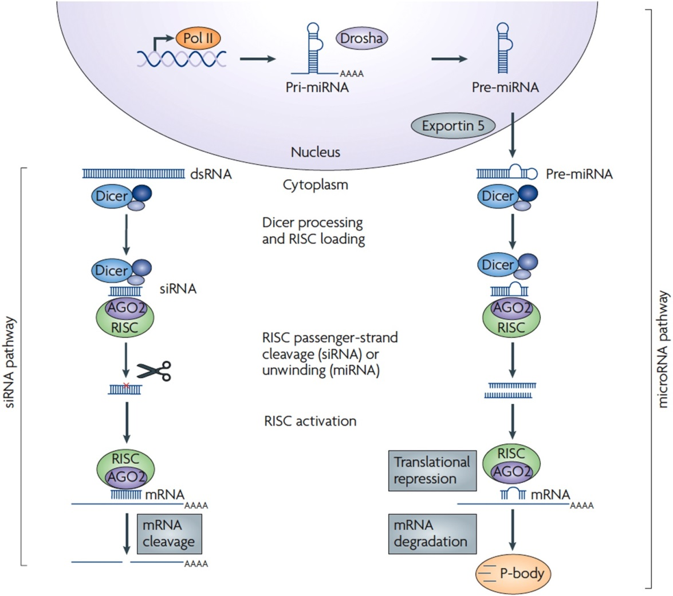
Figure 24.11

Slide 13
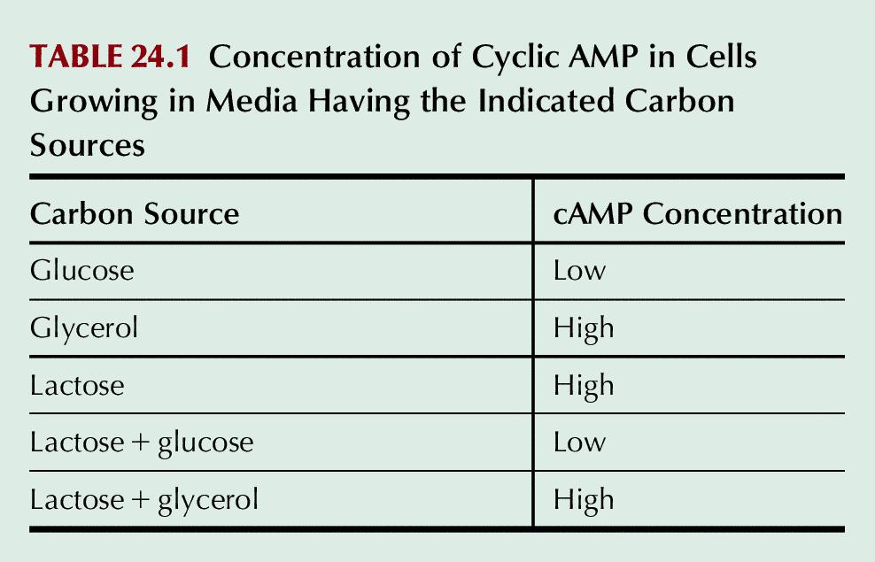
Table 24.1

Slide 14
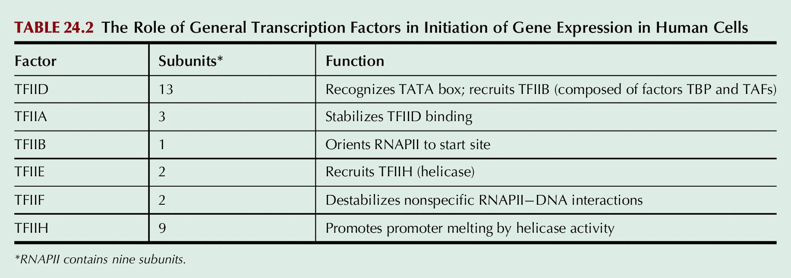
Table 24.2

Slide 15
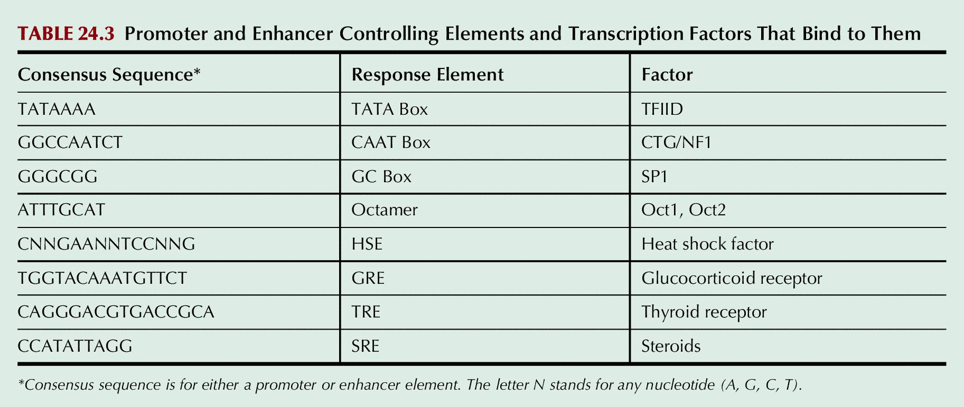
Table 24.3

Slide 16
Table 24.4

