Slide 1
Chapter 25
Nucleotide Metabolism

Slide 2
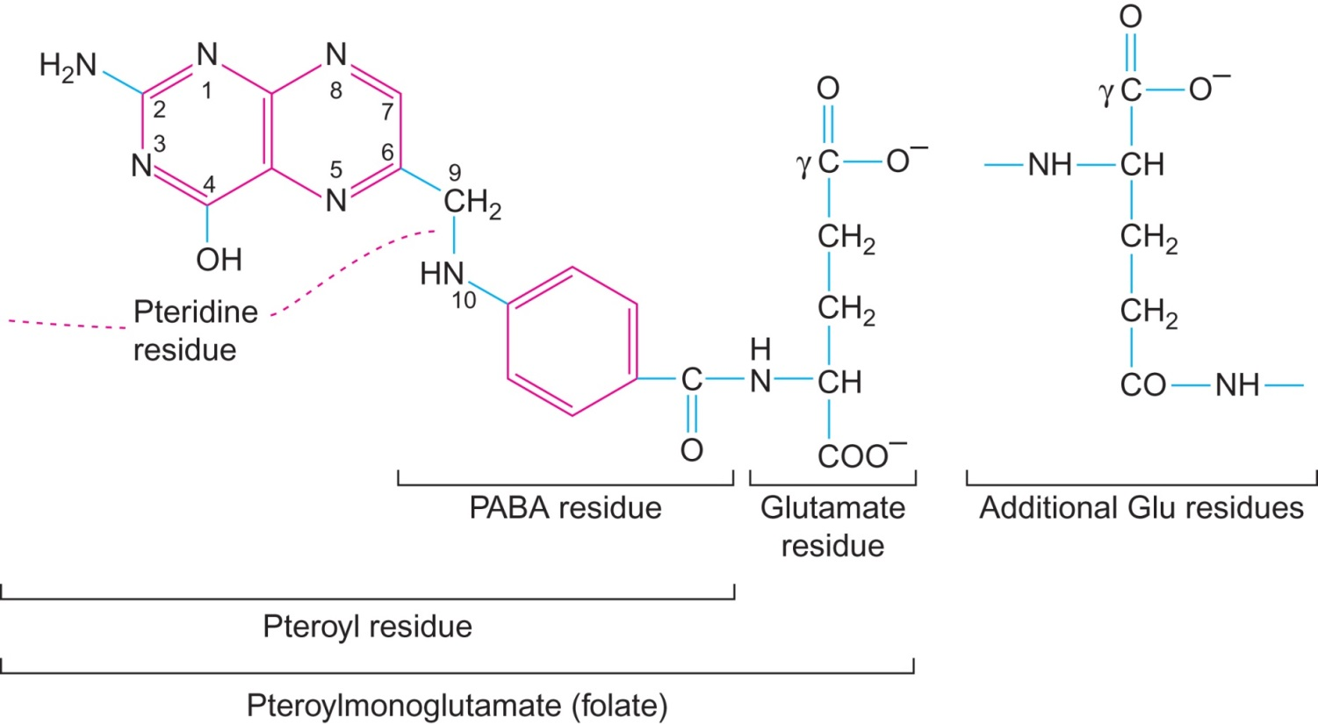
Figure 25.1

Slide 3
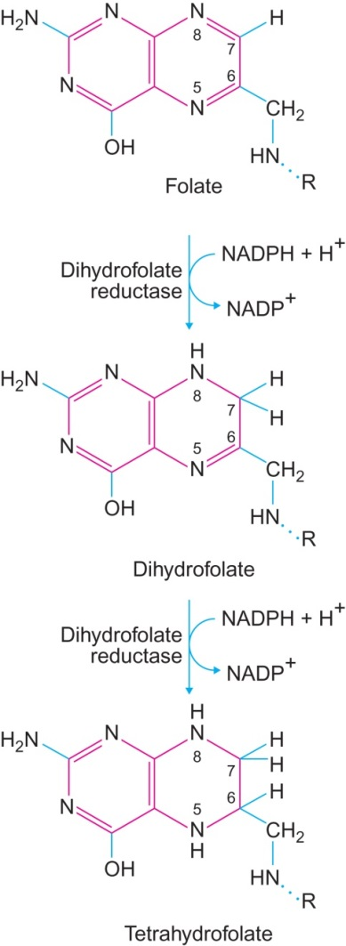
Figure 25.2

Slide 4
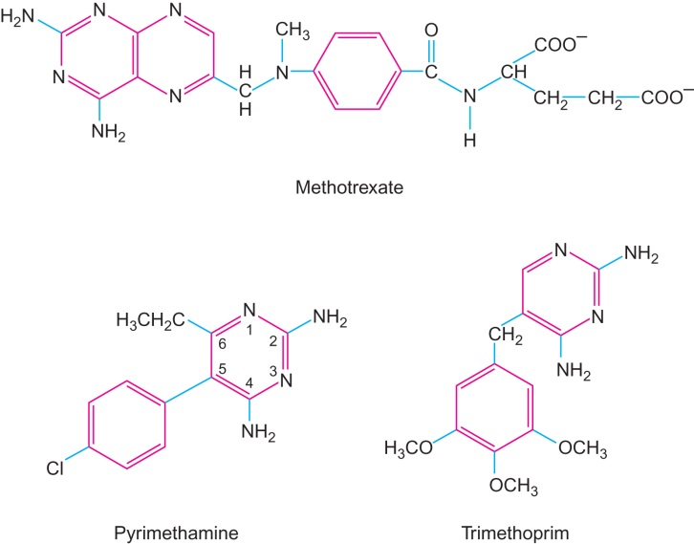
Figure 25.3

Slide 5
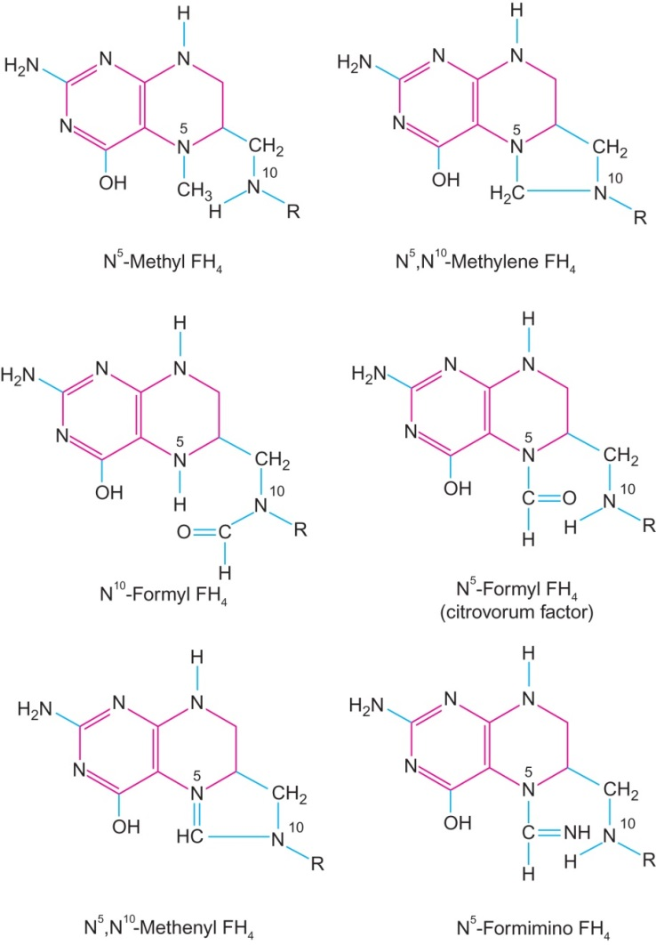
Figure 25.4

Slide 6
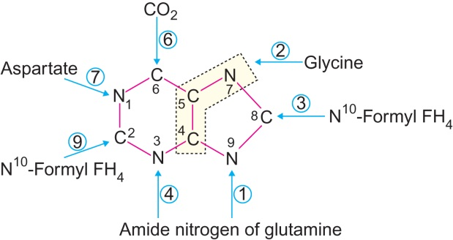
Figure 25.5

Slide 7
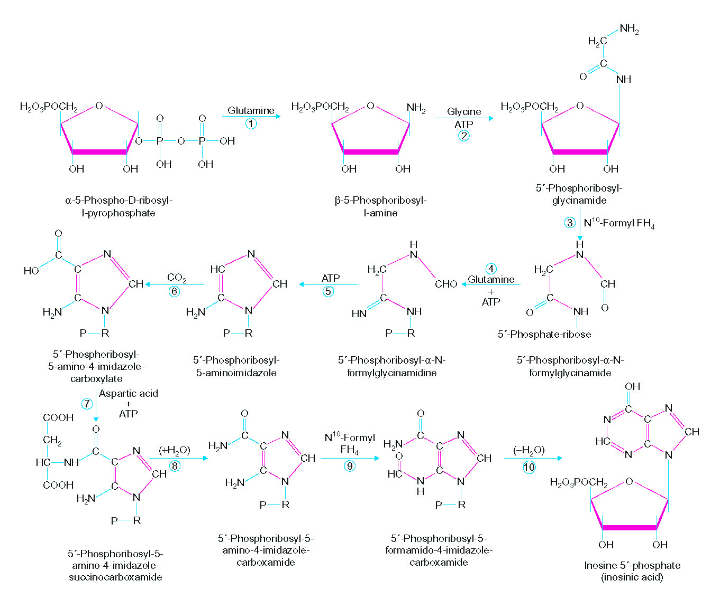
Figure 25.6

Slide 8
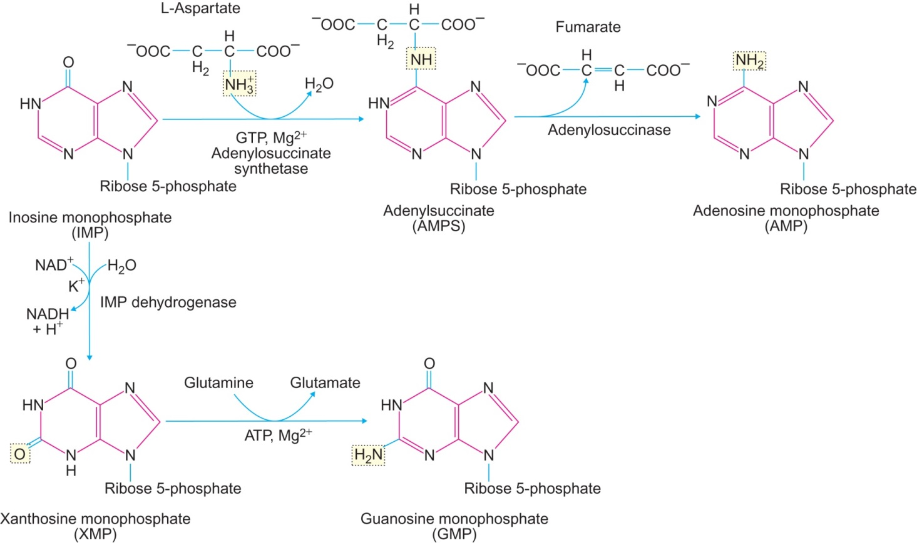
Figure 25.7

Slide 9
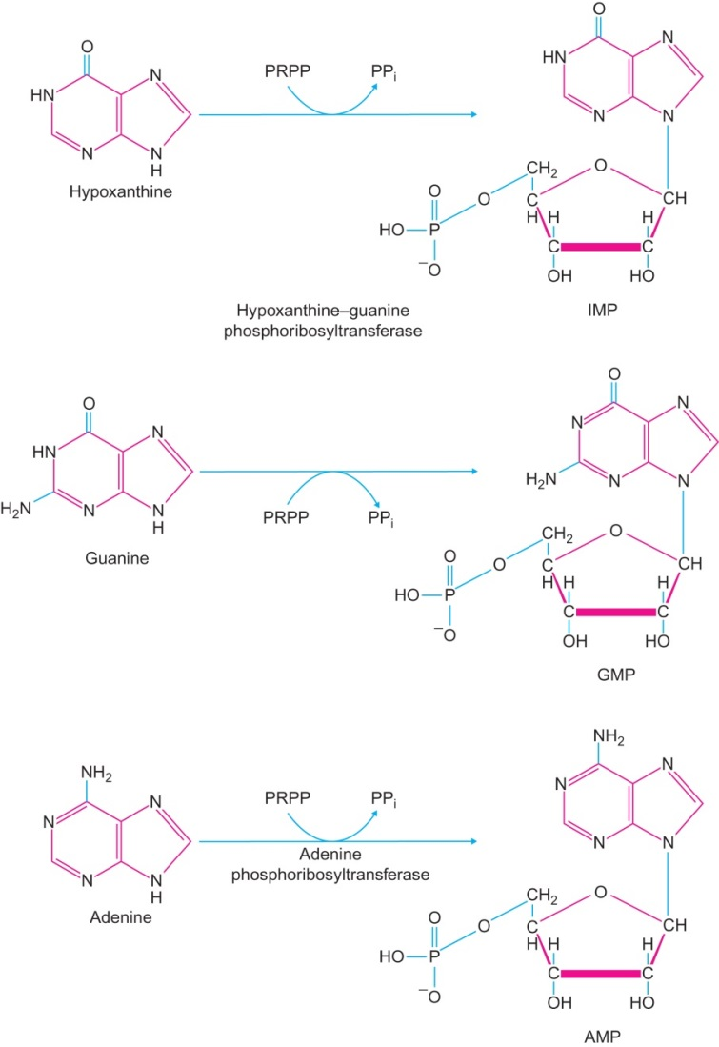
Figure 25.8

Slide 10
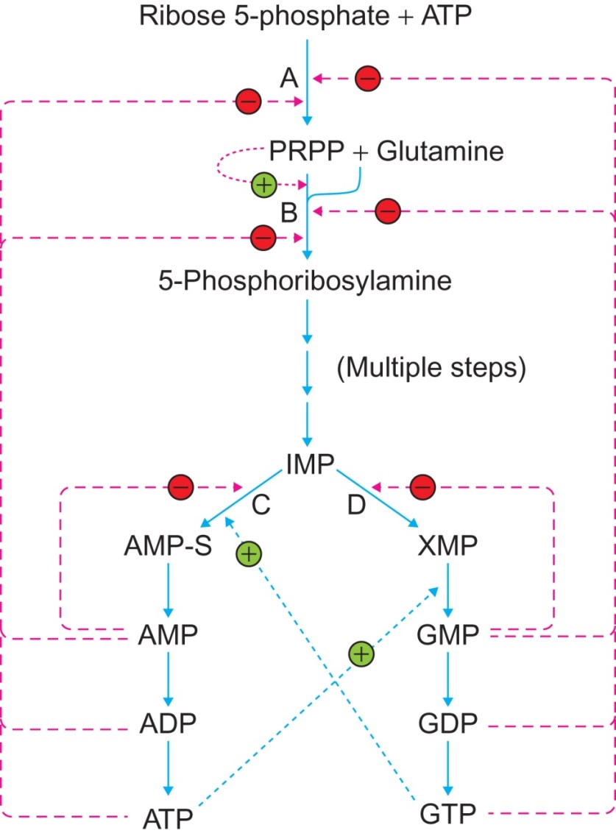
Figure 25.9

Slide 11
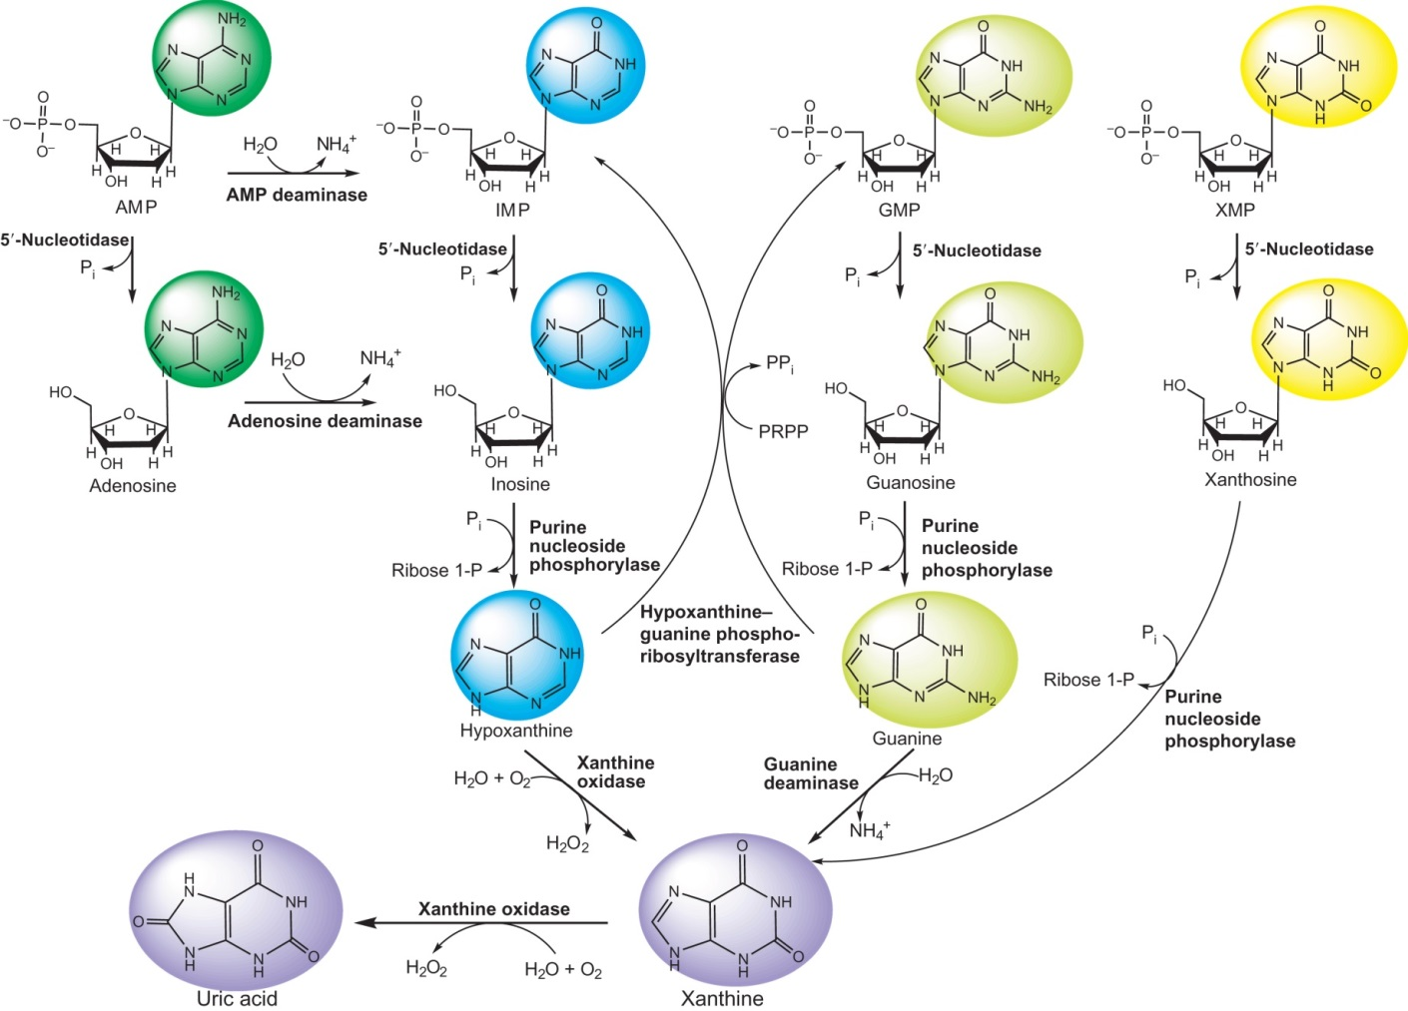
Figure 25.10

Slide 12
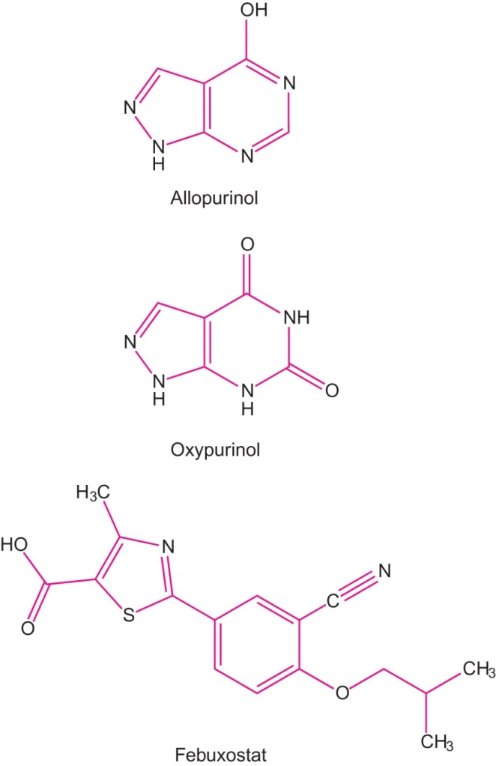
Figure 25.11

Slide 13
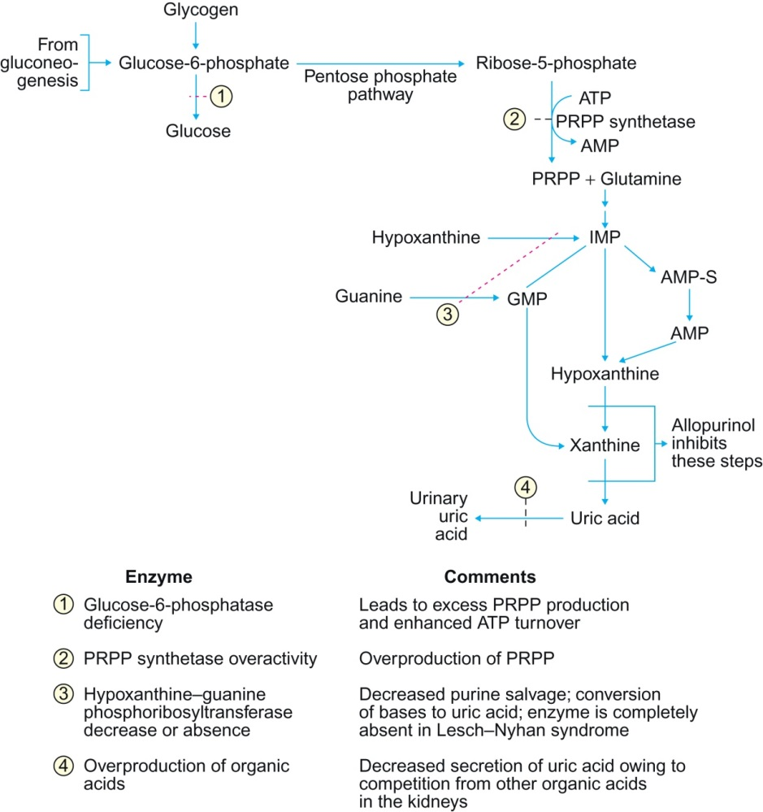
Figure 25.12

Slide 14
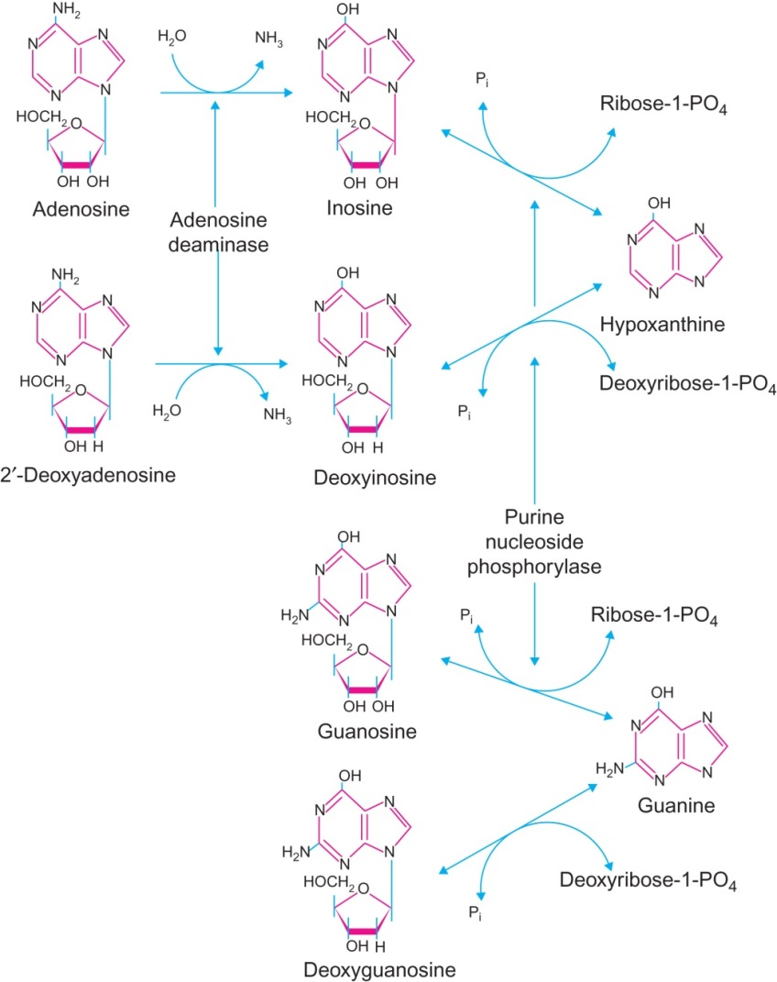
Figure 25.13

Slide 15
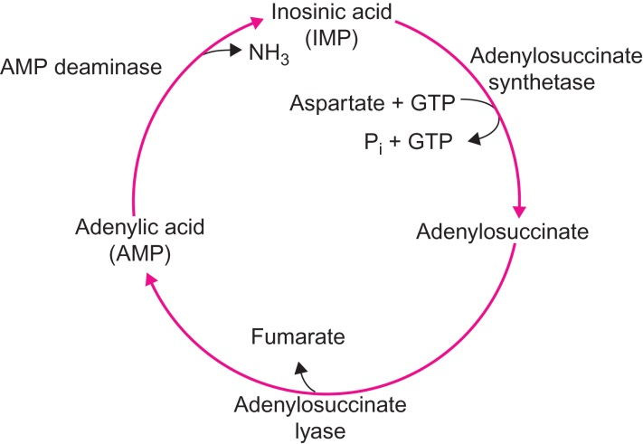
Figure 25.14

Slide 16
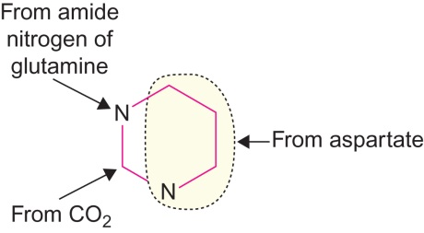
Figure 25.15

Slide 17
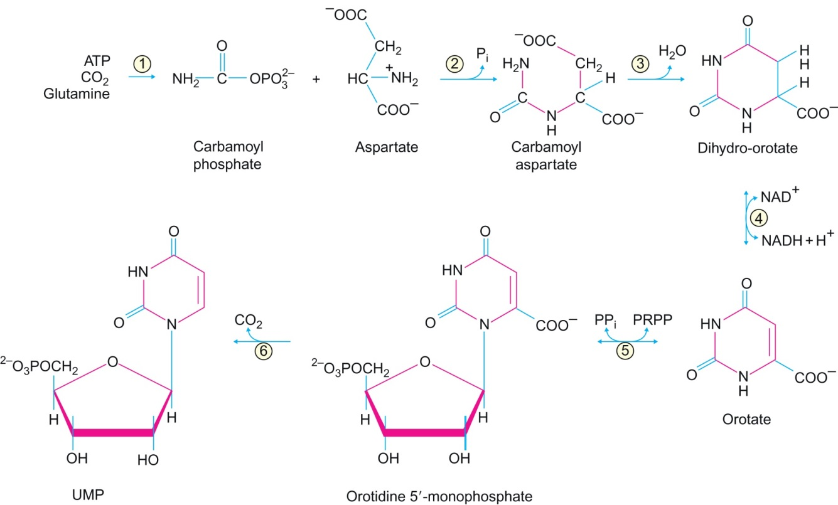
Figure 25.16

Slide 18
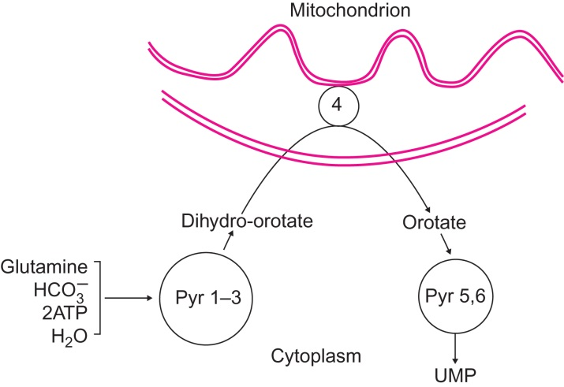
Figure 25.17

Slide 19
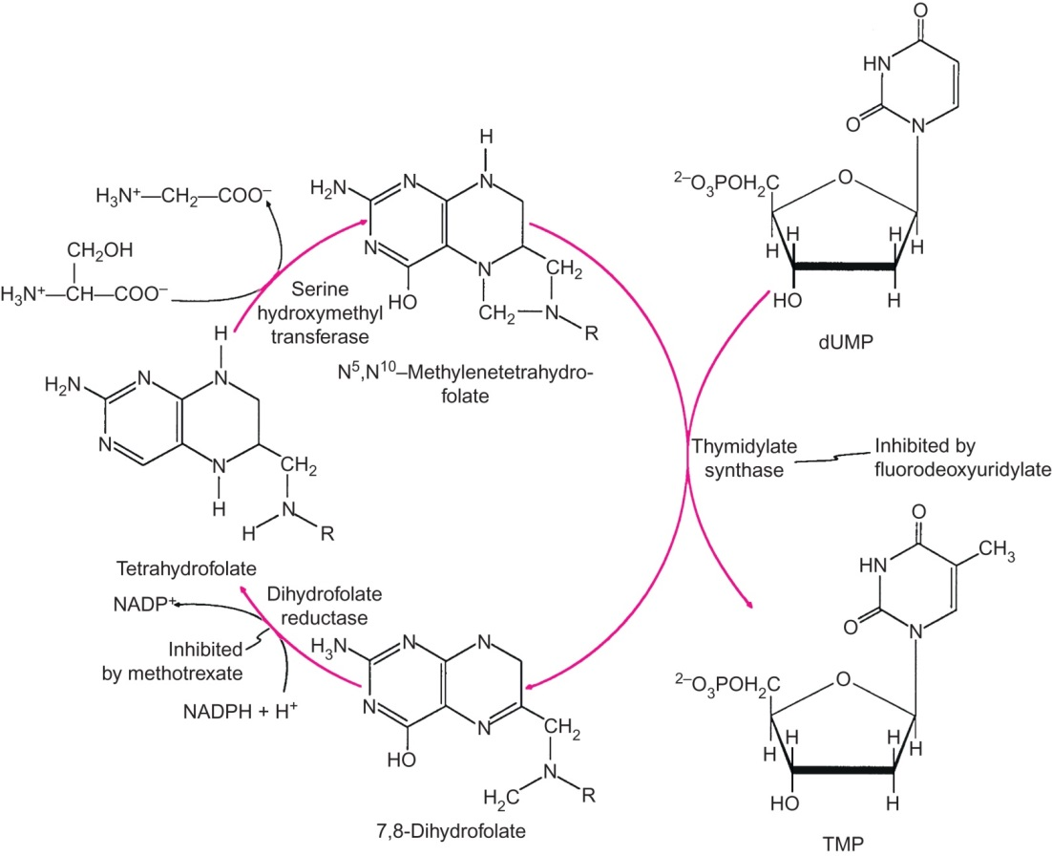
Figure 25.18

Slide 20
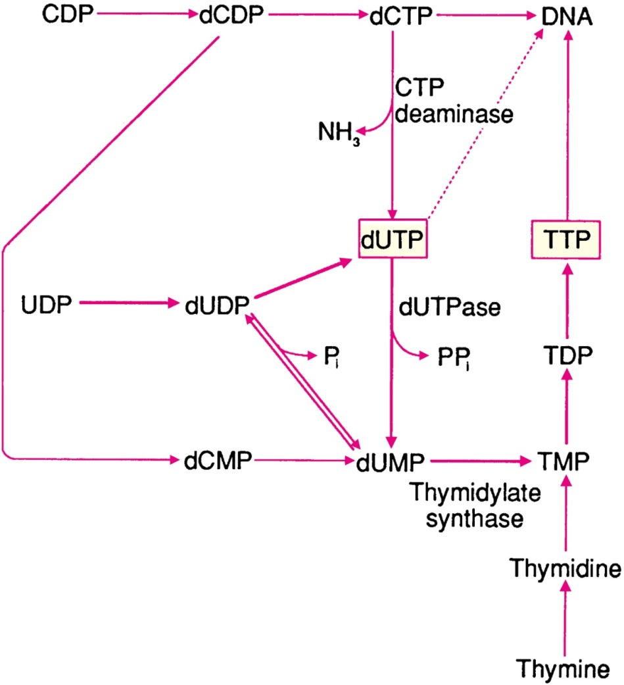
Figure 25.19

Slide 21
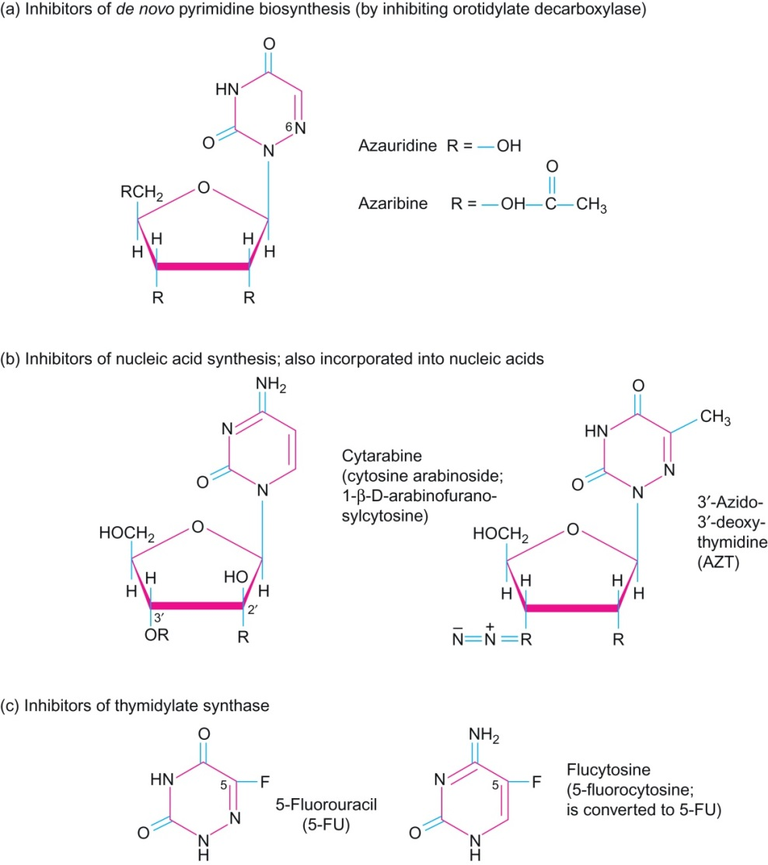
Figure 25.20

Slide 22
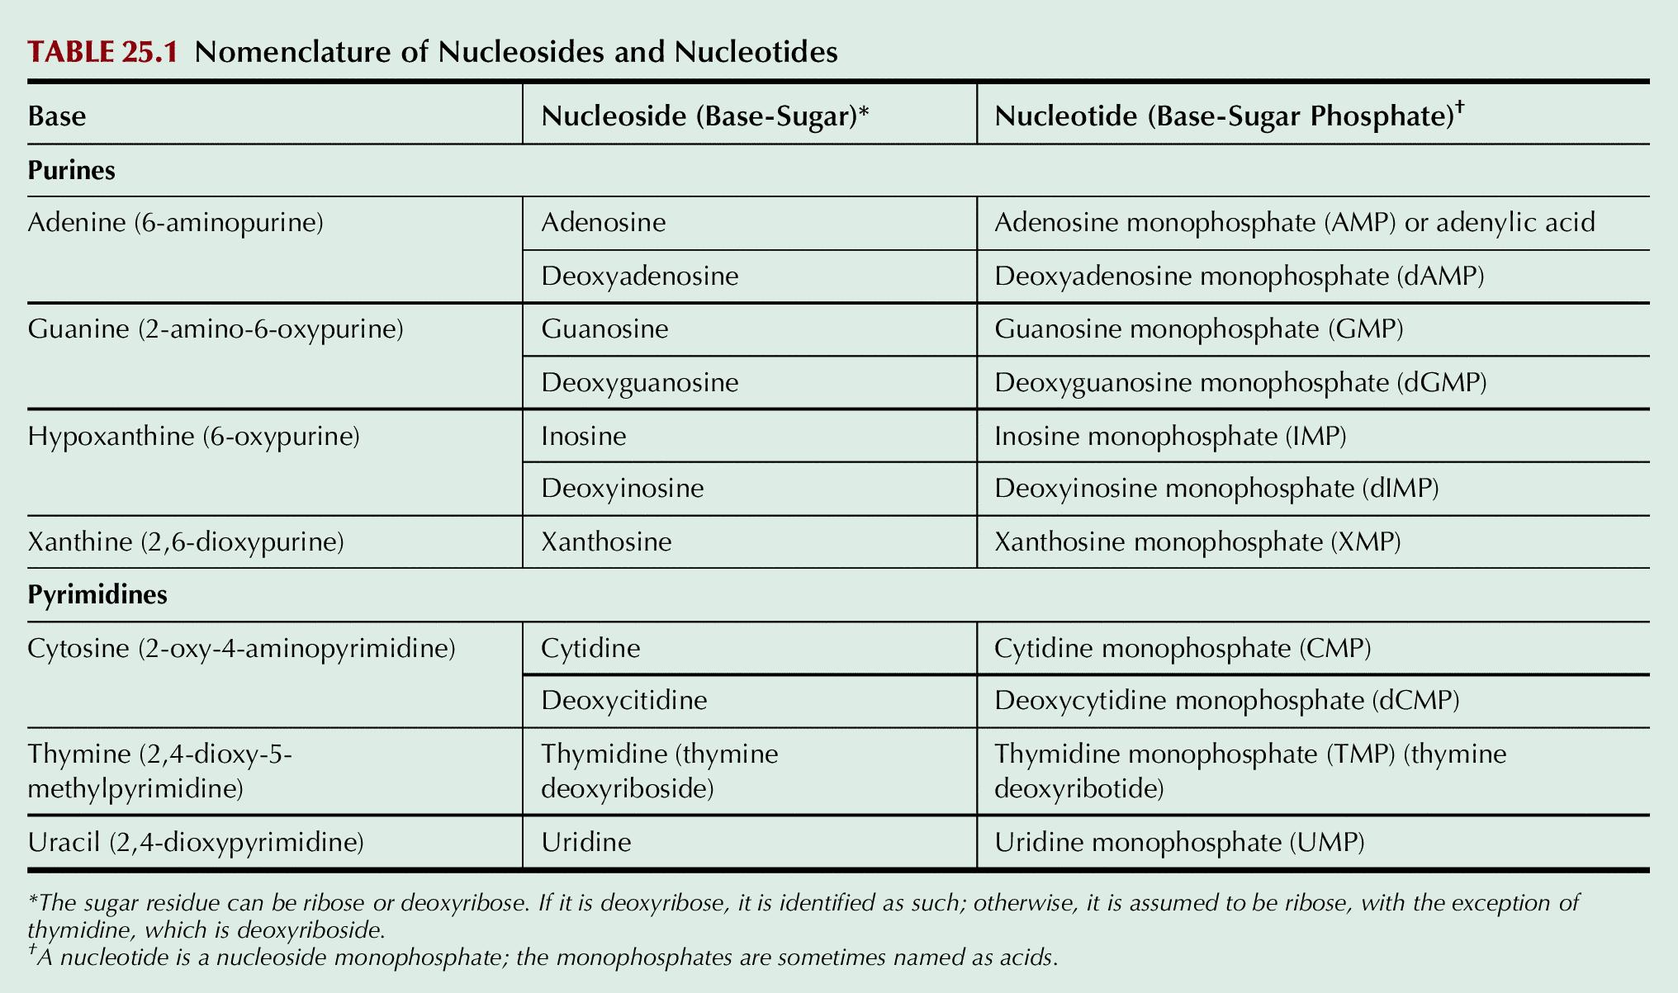
Table 25.1

Slide 23
UnFig 25.1

Slide 24
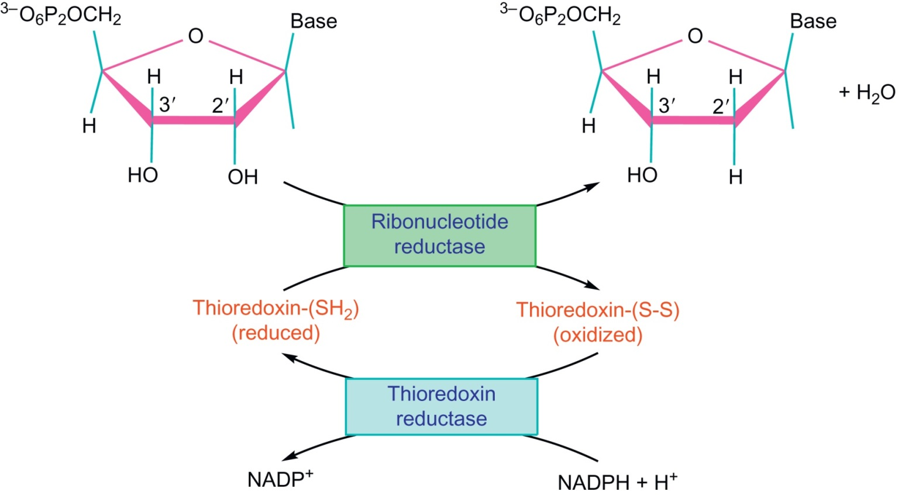
UnFig 25.2

Slide 25
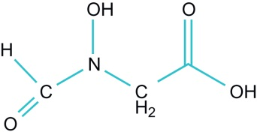
UnFig 25.3

Slide 26
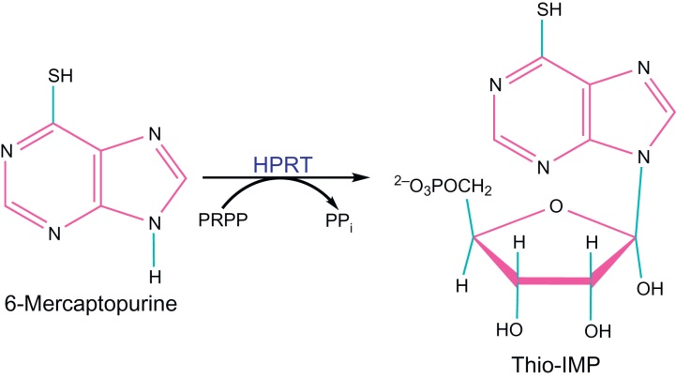
UnFig 25.4

Slide 27
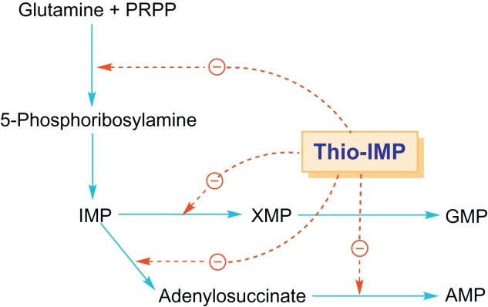
UnFig 25.5

Slide 28
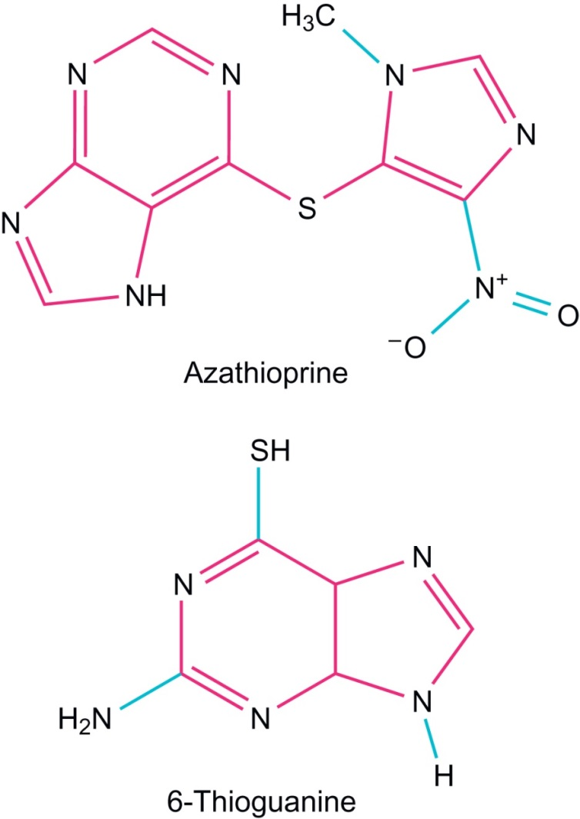
UnFig 25.6

Slide 29
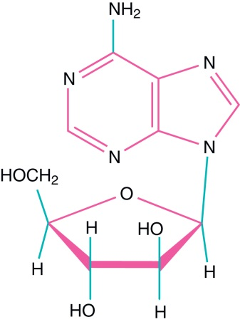
UnFig 25.7

Slide 30
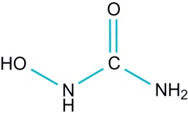
UnFig 25.8

Slide 31
UnFig 25.9

Slide 32
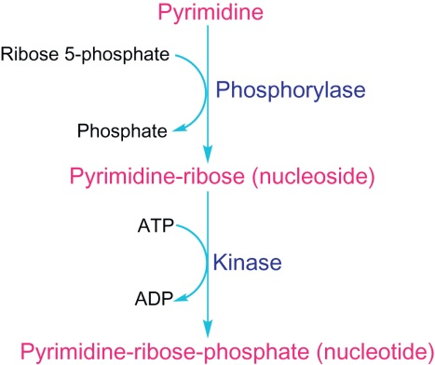
UnFig 25.10

