Slide 1
Chapter 30
Endocrine Metabolism III: Adrenal Glands

Slide 2
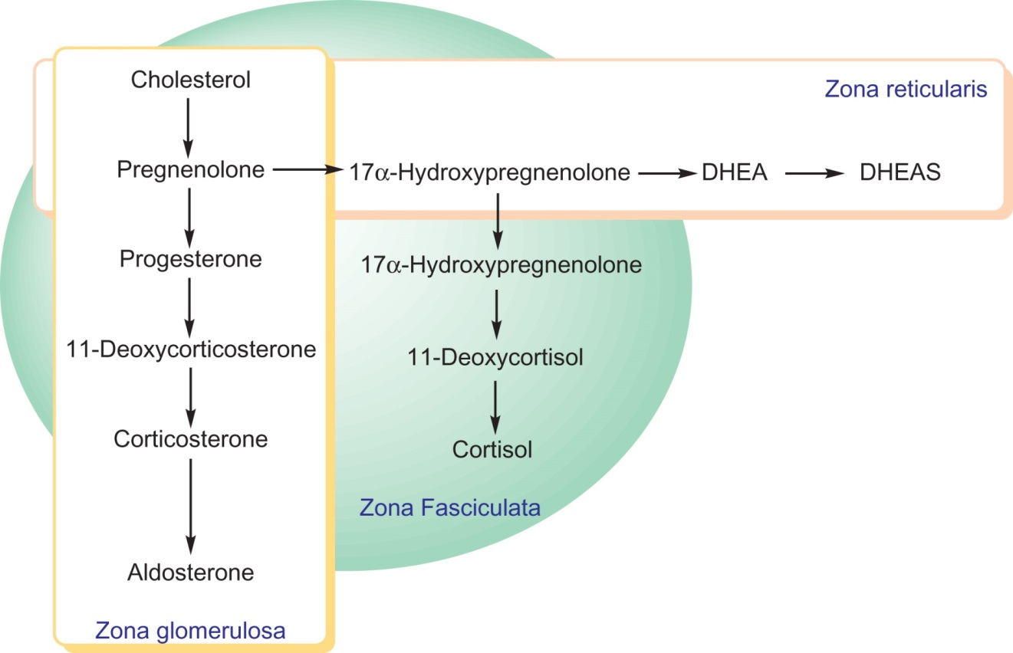
Figure 30.1

Slide 3
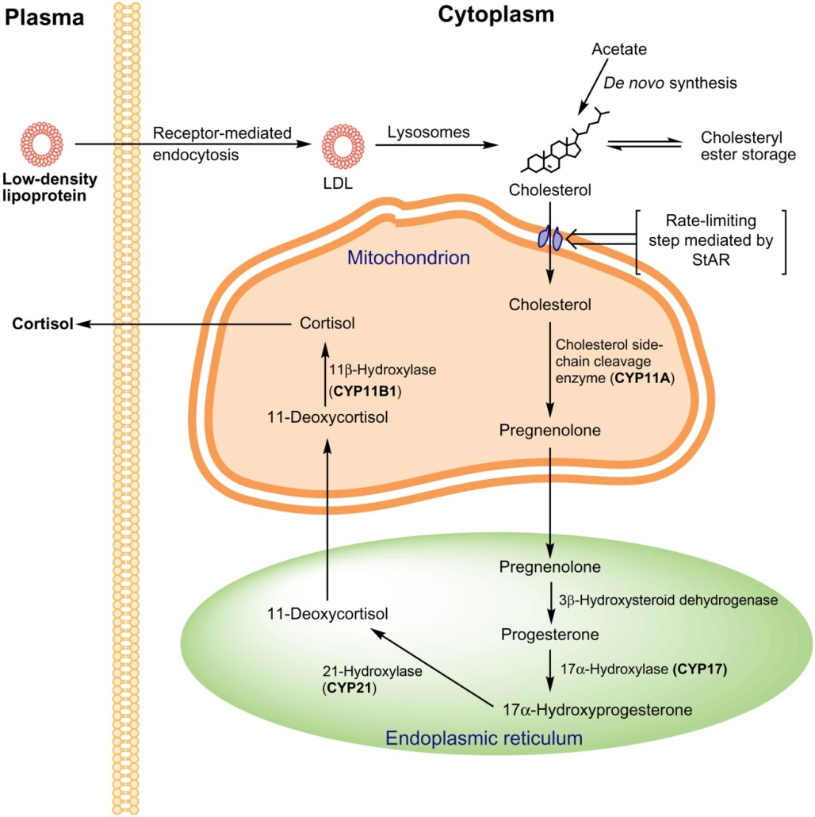
Figure 30.2

Slide 4
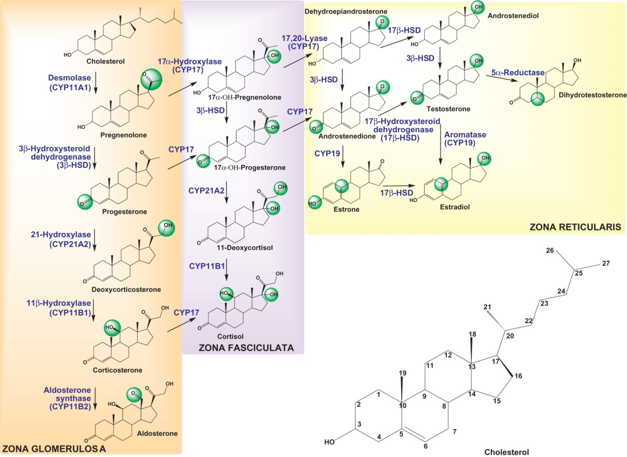
Figure 30.3

Slide 5
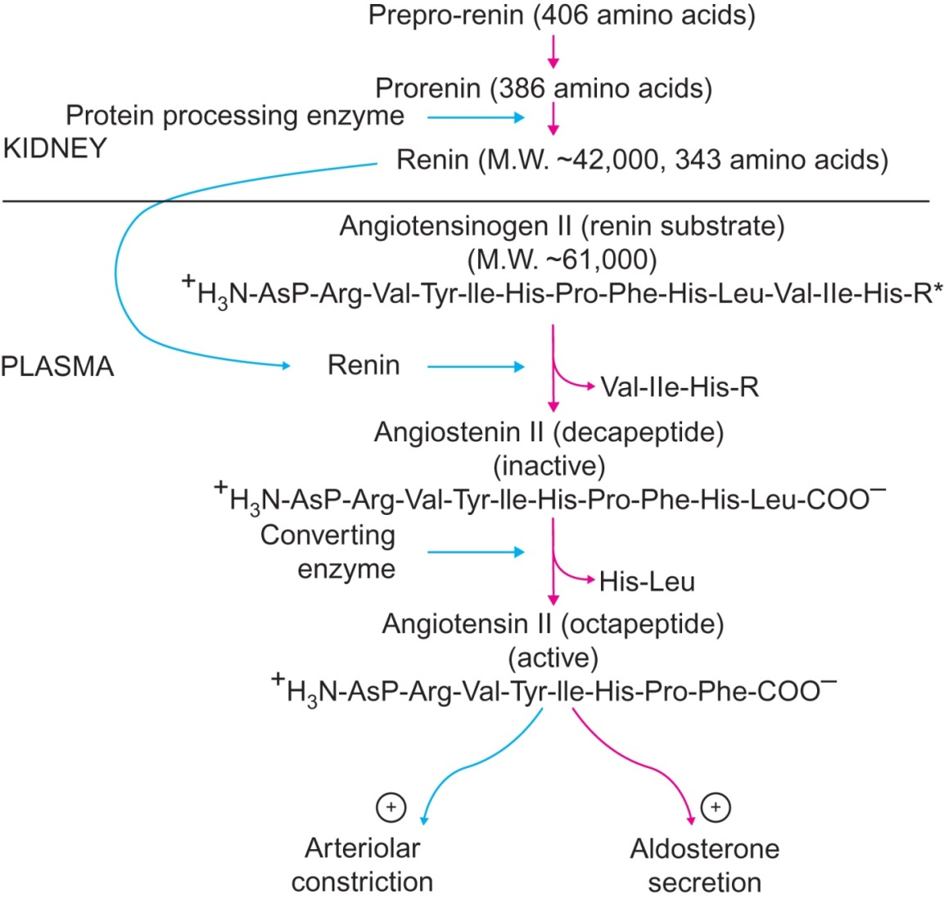
Figure 30.4

Slide 6
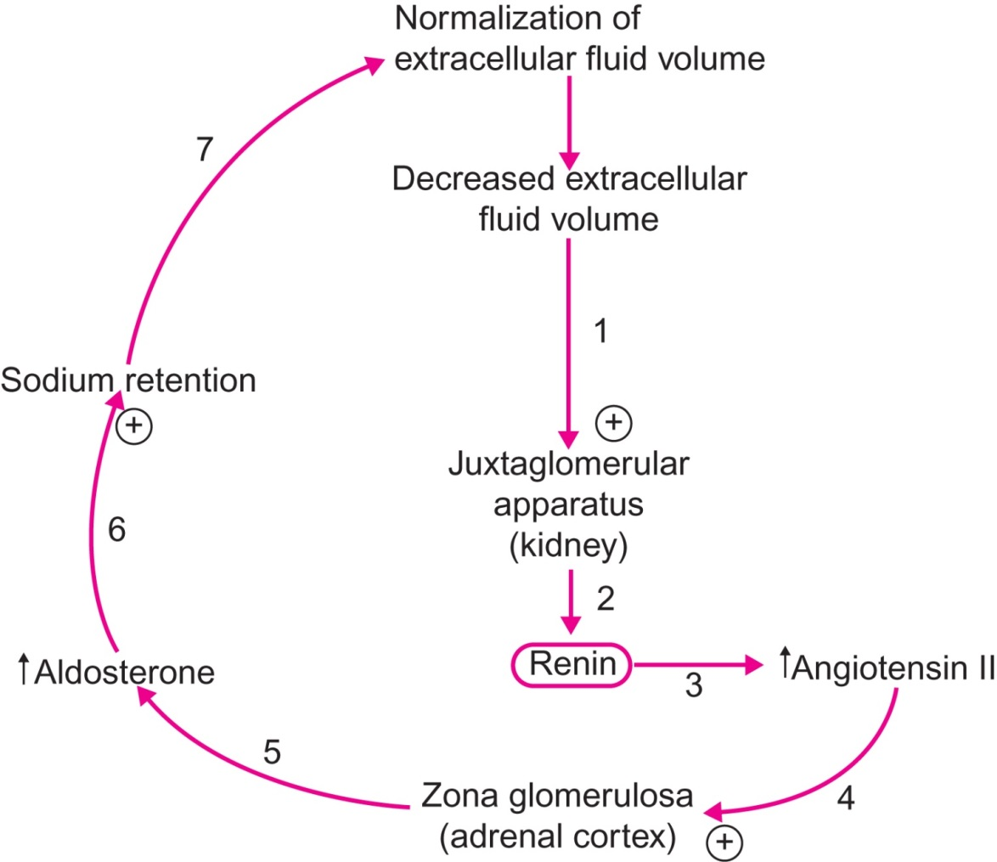
Figure 30.2

Slide 7
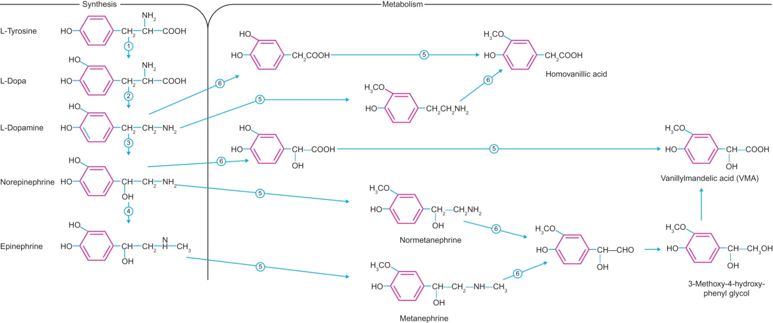
Figure 30.3

Slide 8
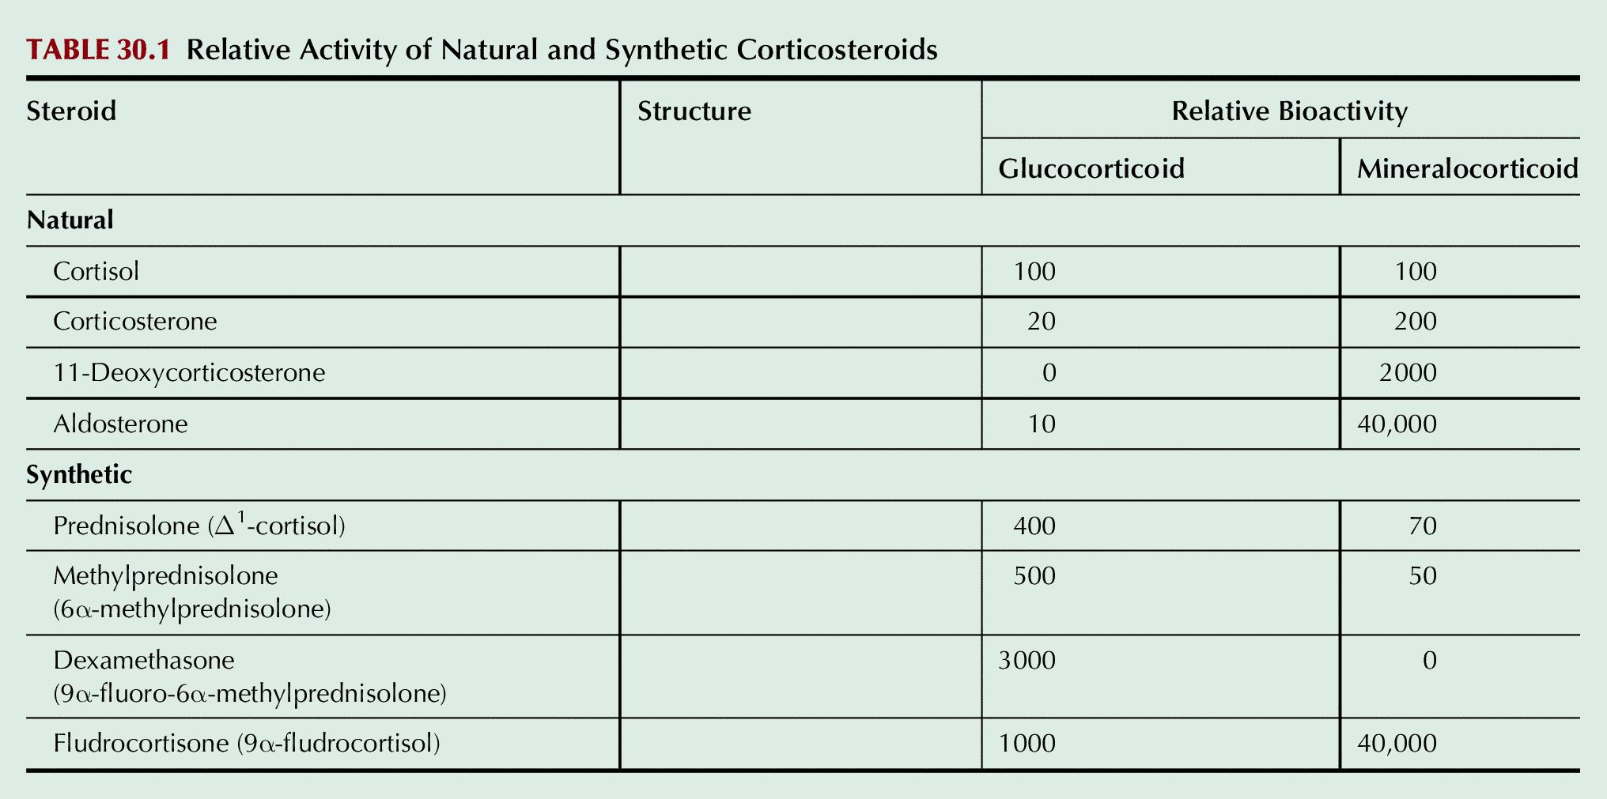
Table 30.1

Slide 9
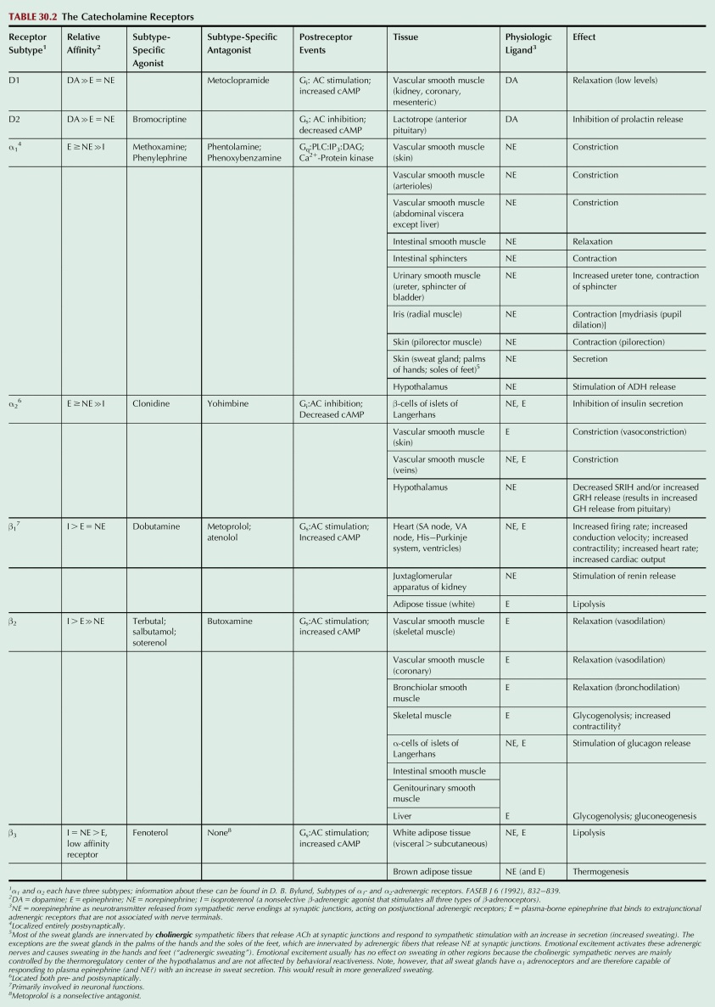
Table 30.2

Slide 10
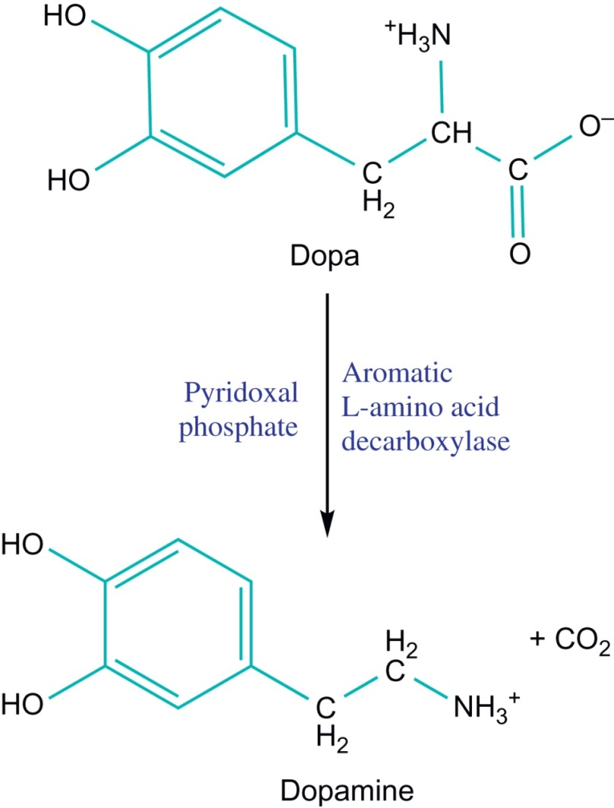
UnFig 30.1

Slide 11
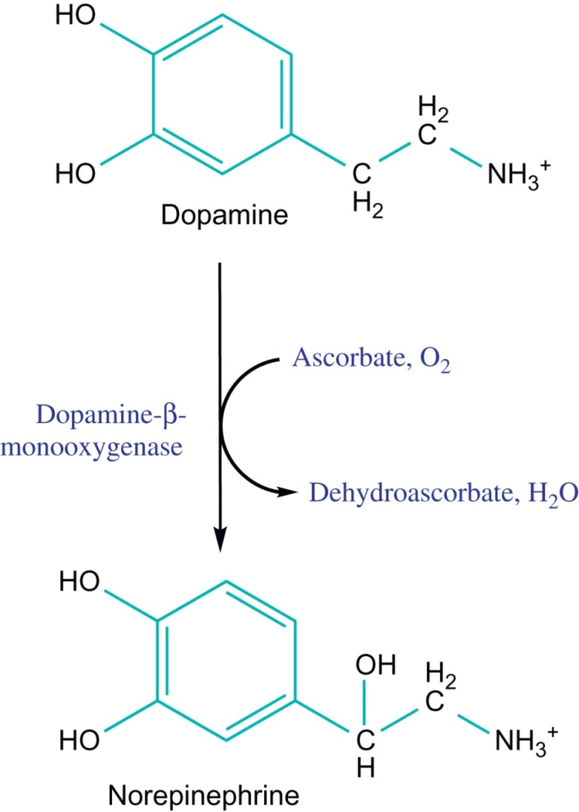
UnFig 30.2

Slide 12
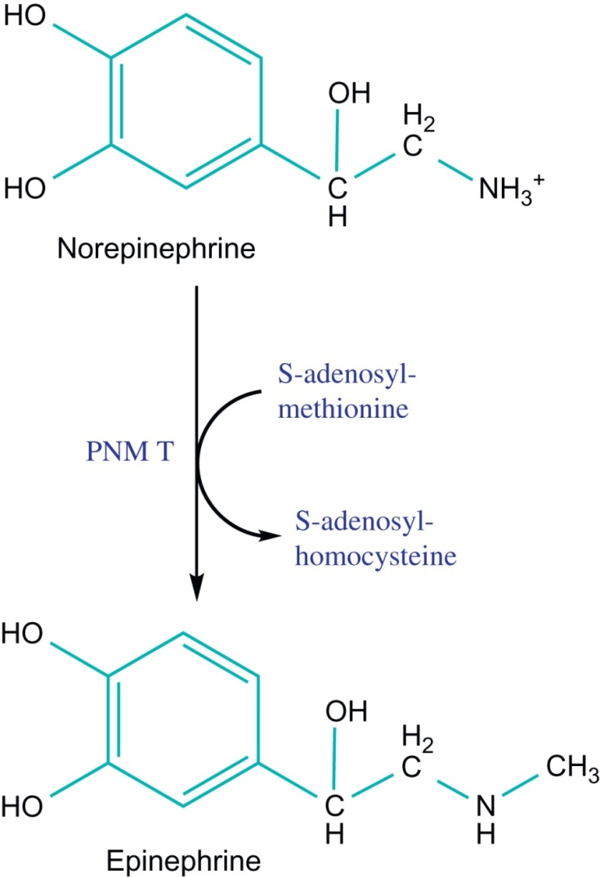
UnFig 30.3

Slide 13
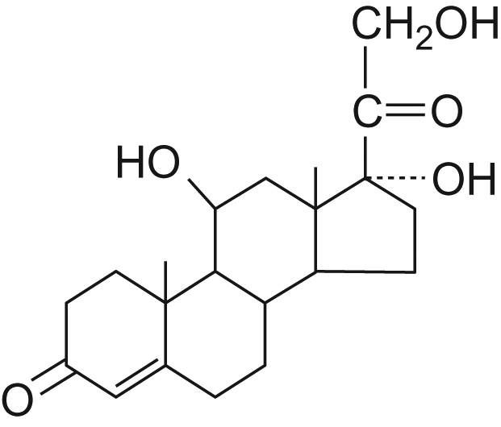
UnFig 30.2

Slide 14
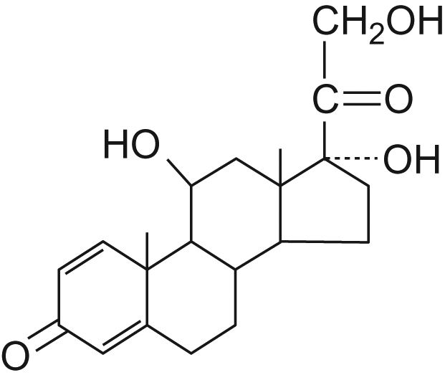
UnFig 30.3

Slide 15
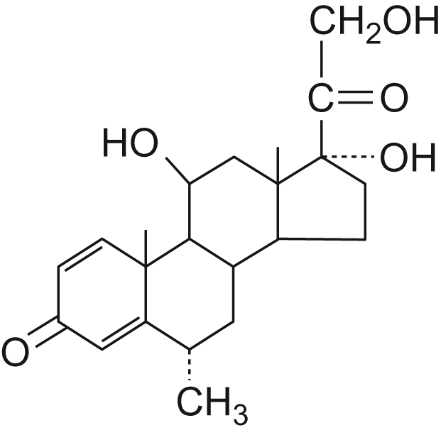
UnFig 30.4

Slide 16
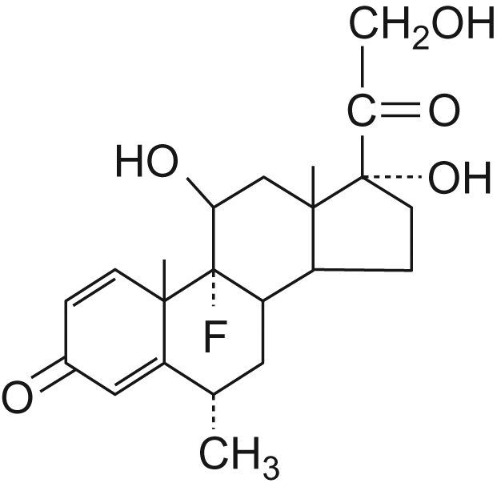
UnFig30.5

Slide 17
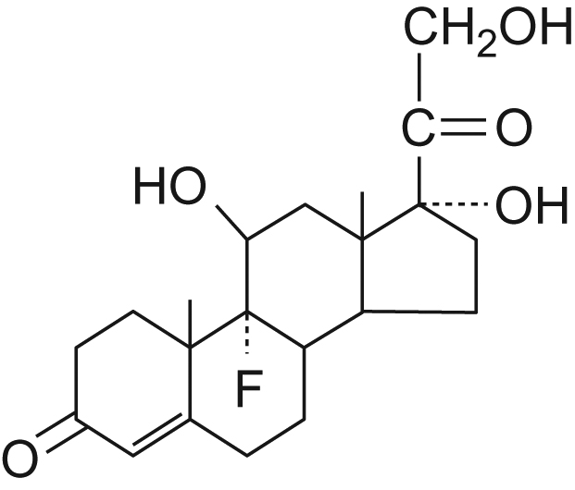
UnFig 30.6

Slide 18
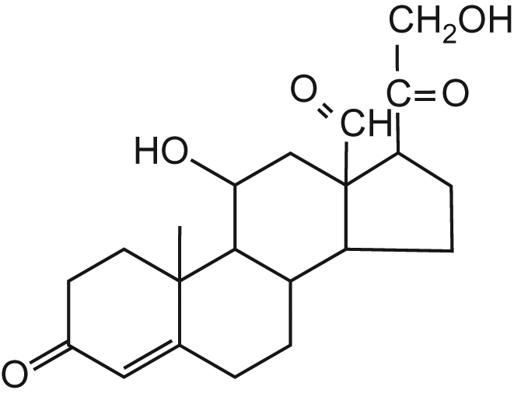
UnFig 30.7

