Slide 1
Chapter 34
Biochemistry of Hemostasis

Slide 2
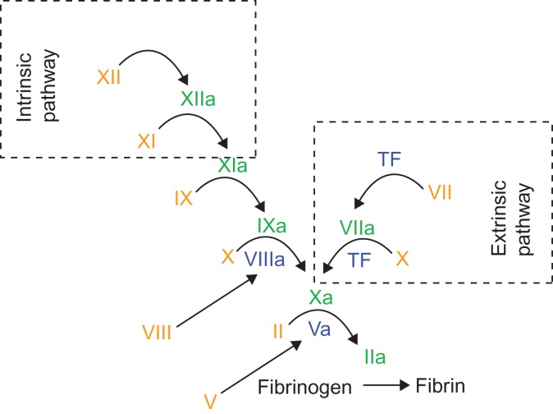
Figure 34.1

Slide 3
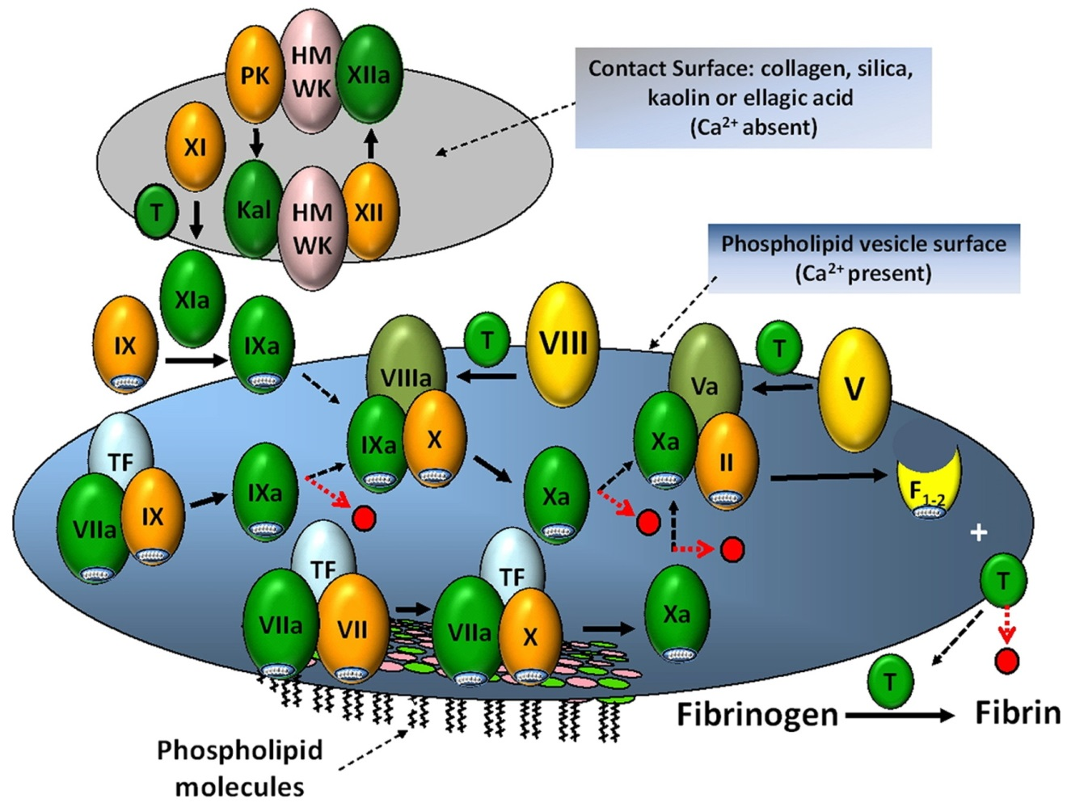
Figure 34.2

Slide 4
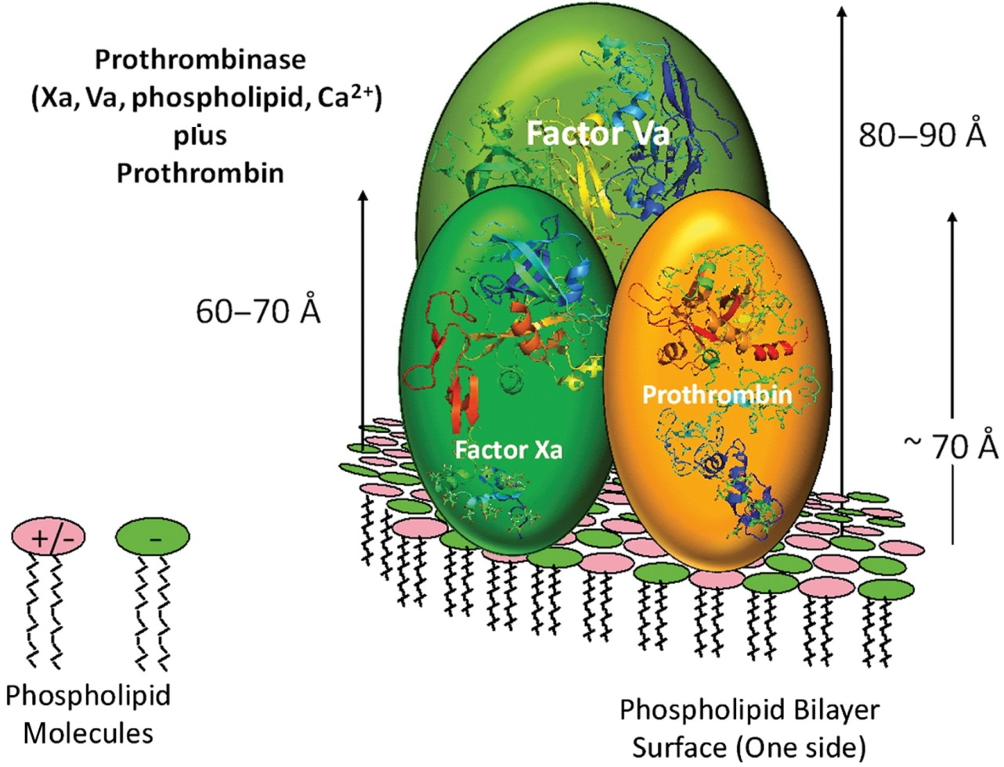
Figure 34.3

Slide 5
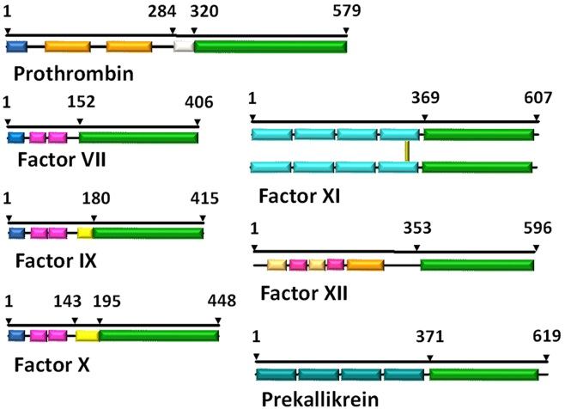
Figure 34.4

Slide 6
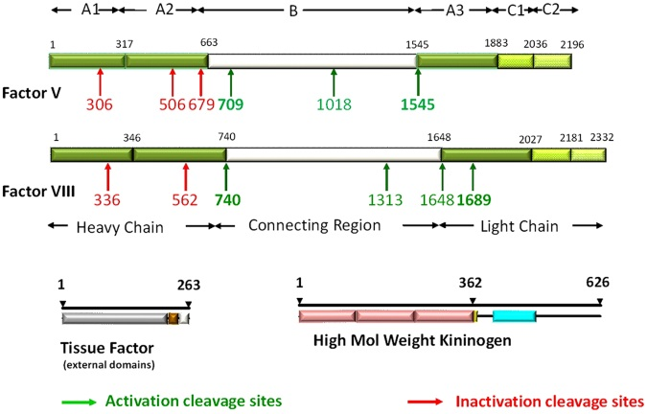
Figure 34.5

Slide 7
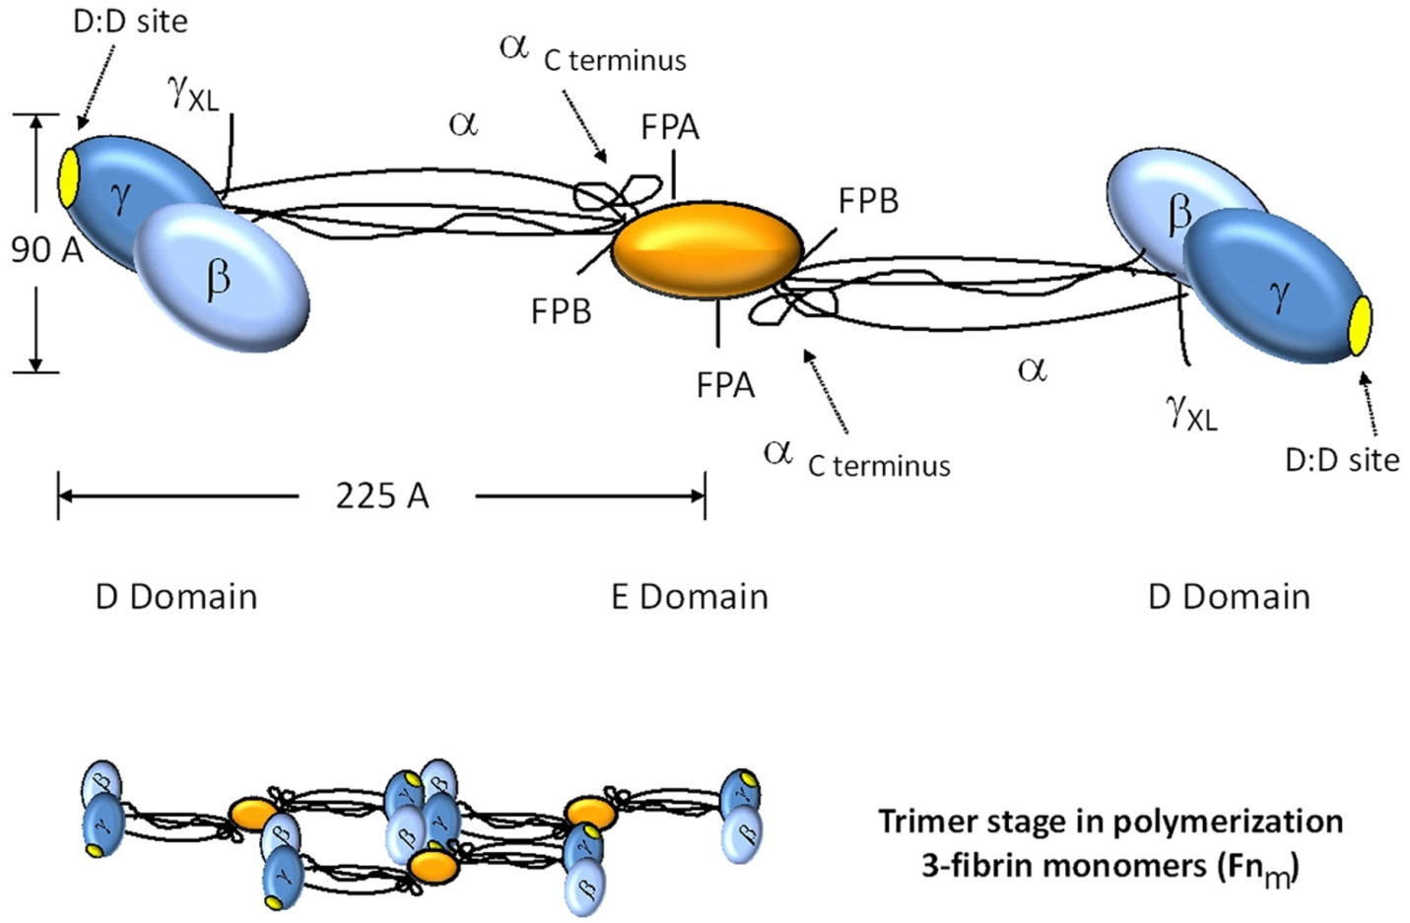
Figure 34.6

Slide 8
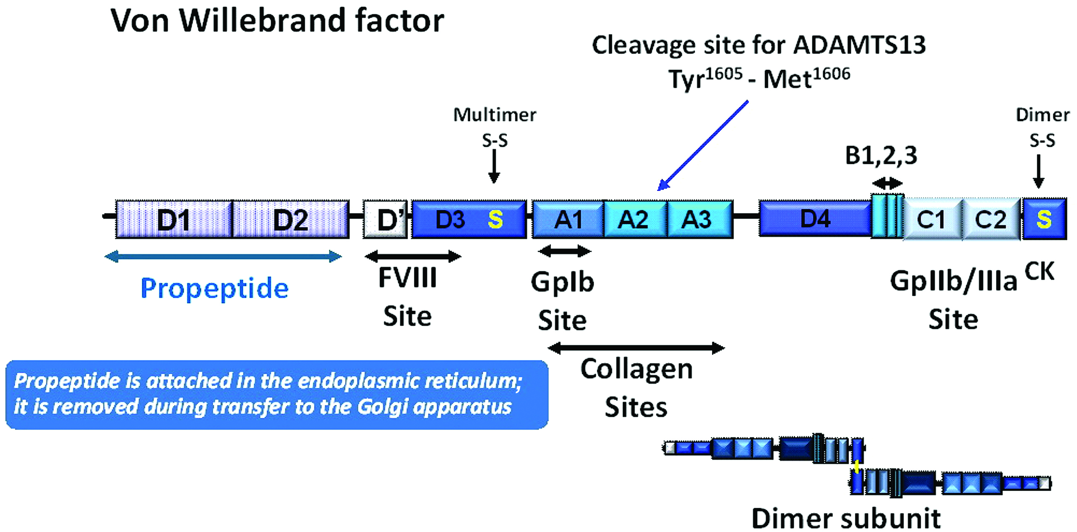
Figure 34.7

Slide 9
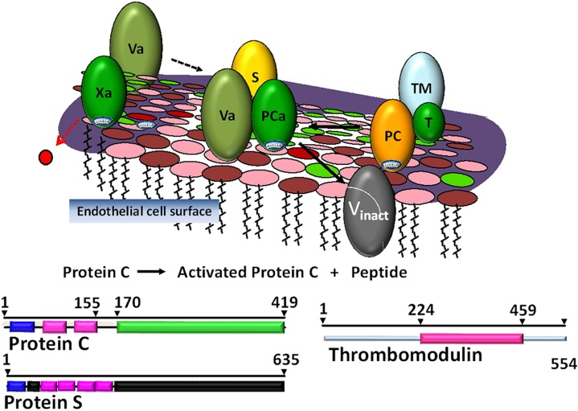
Figure 34.8

Slide 10
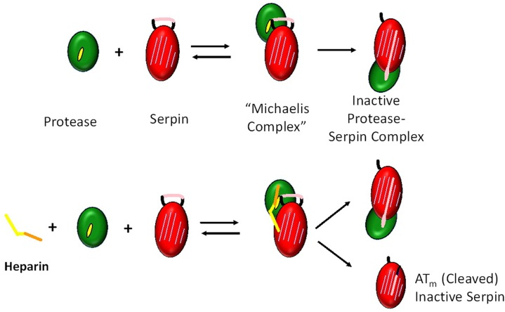
Figure 34.9

Slide 11
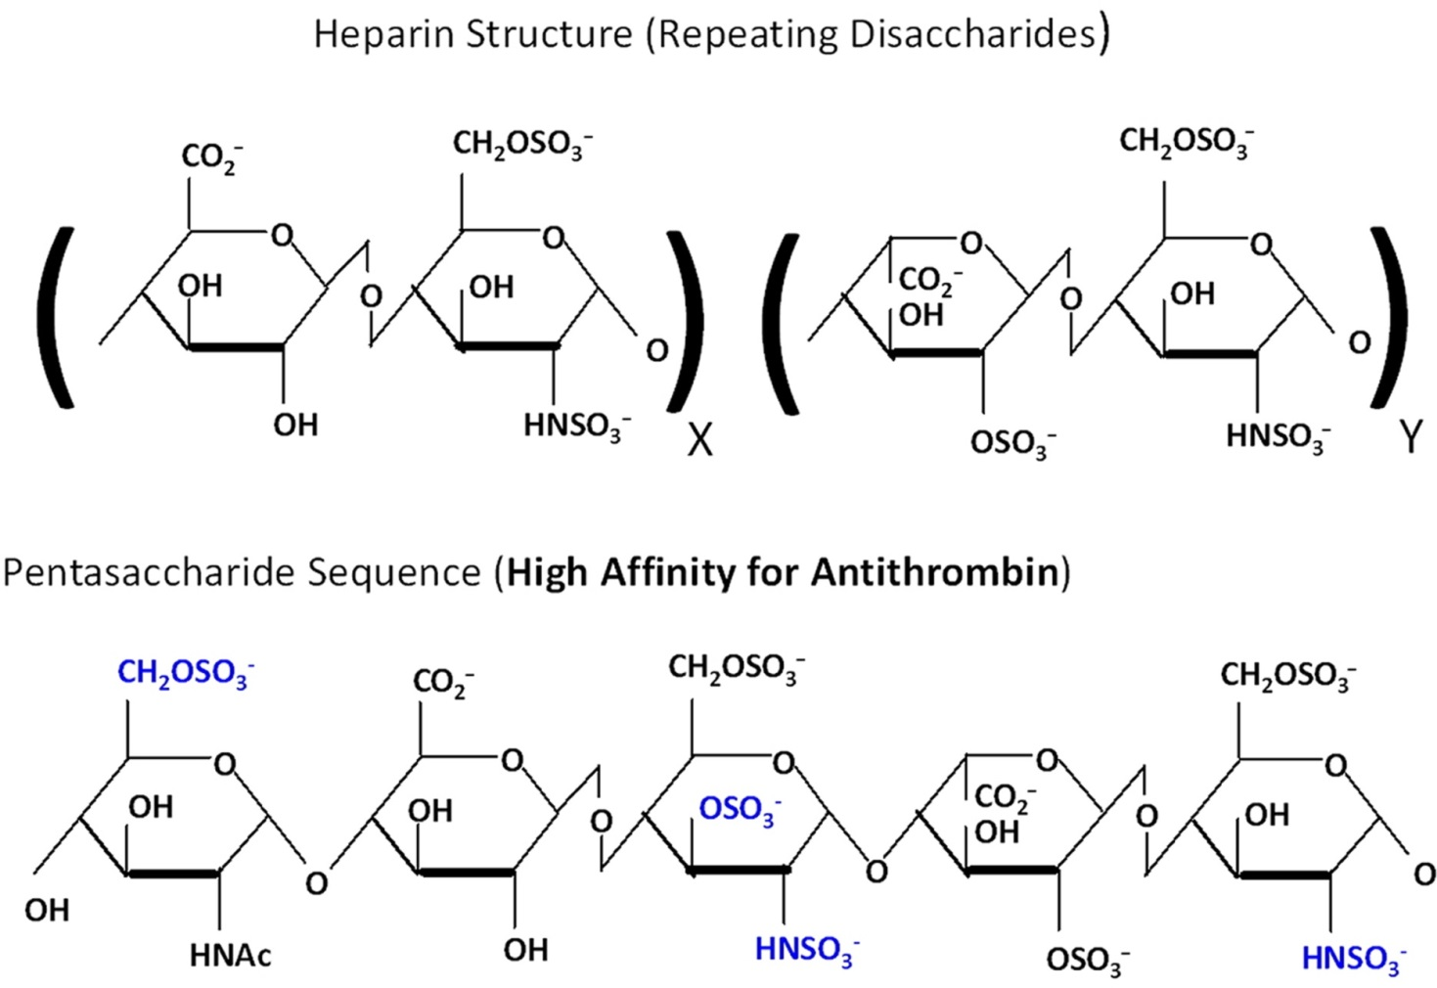
Figure 34.10

Slide 12
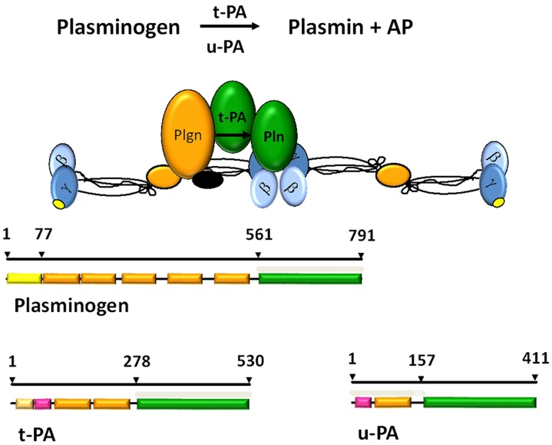
Figure 34.11

Slide 13
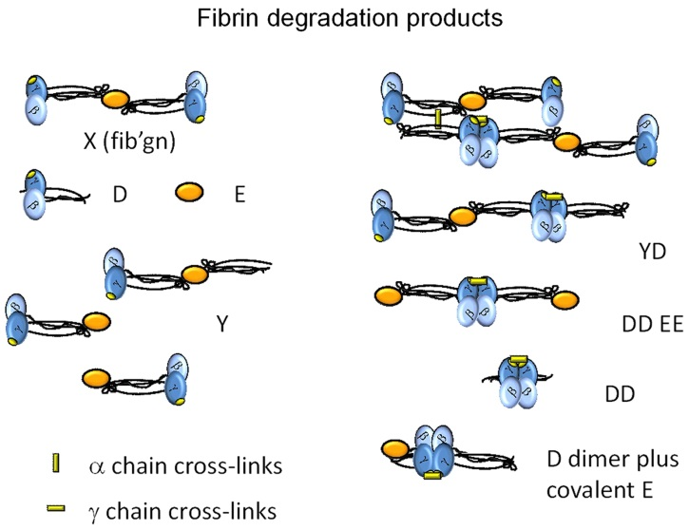
Figure 34.12

Slide 14
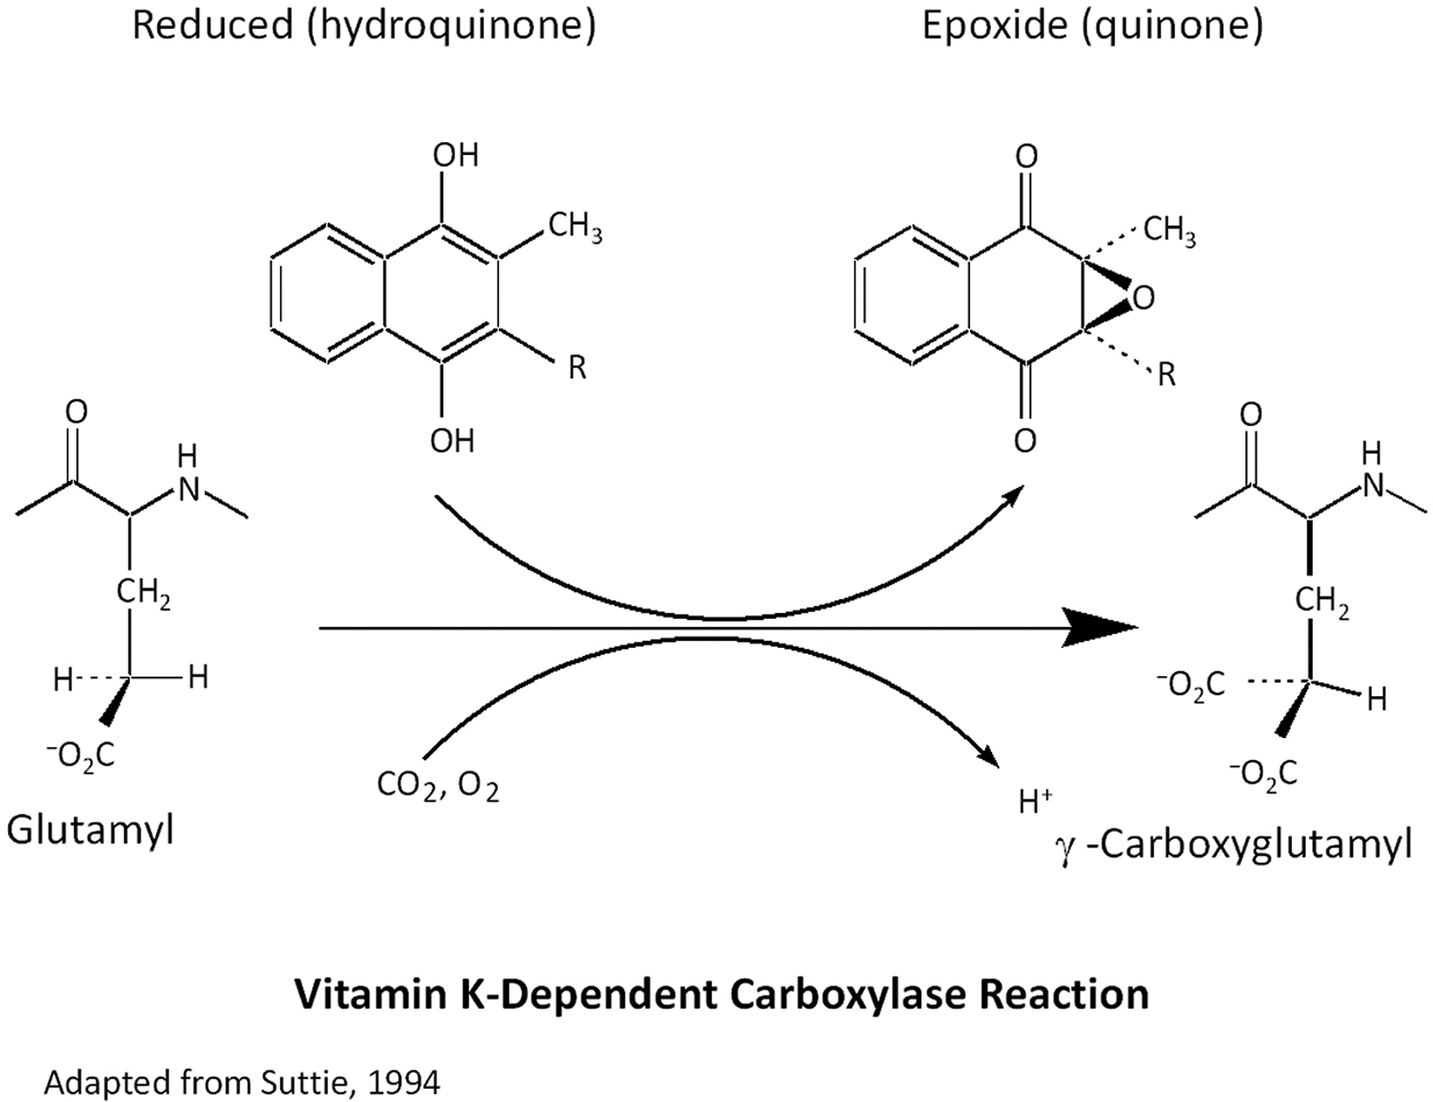
Figure 34.13

Slide 15
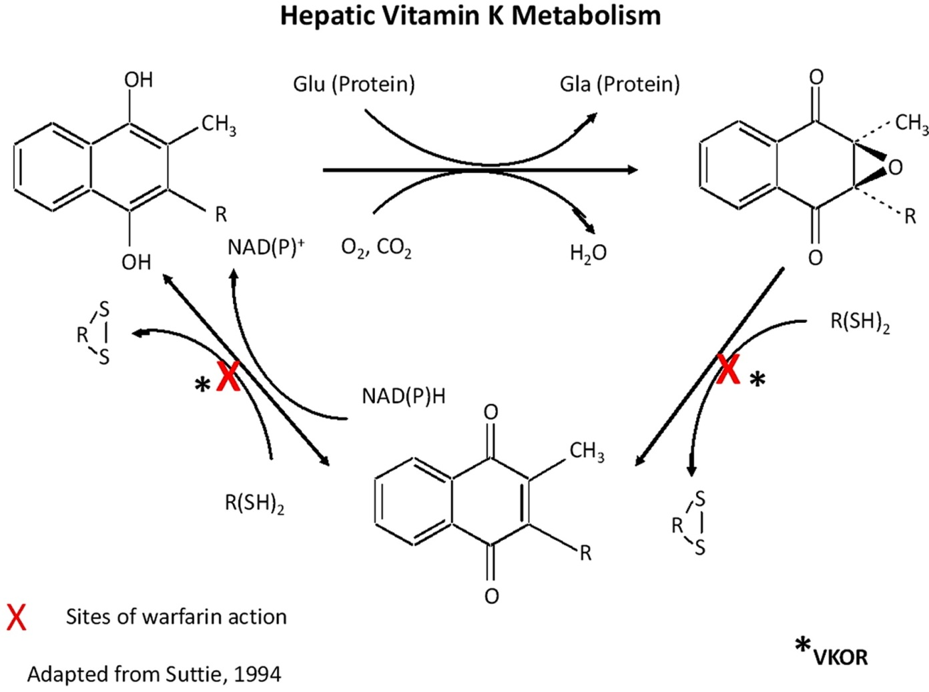
Figure 34.14

Slide 16
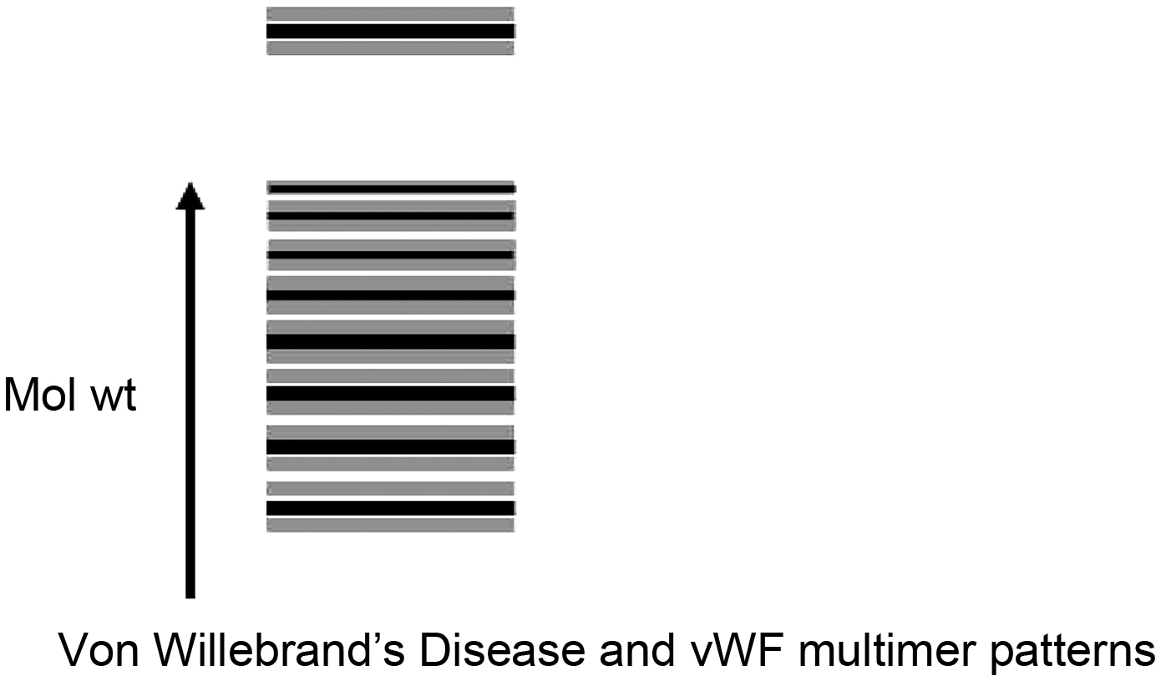
Figure 34.15

Slide 17
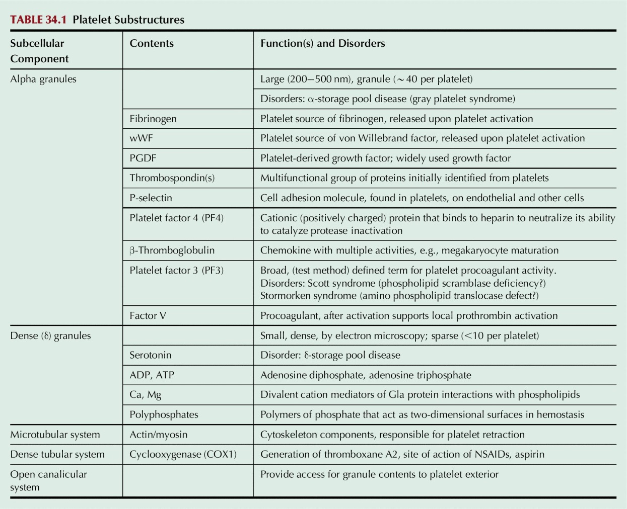
Table 34.1

Slide 18
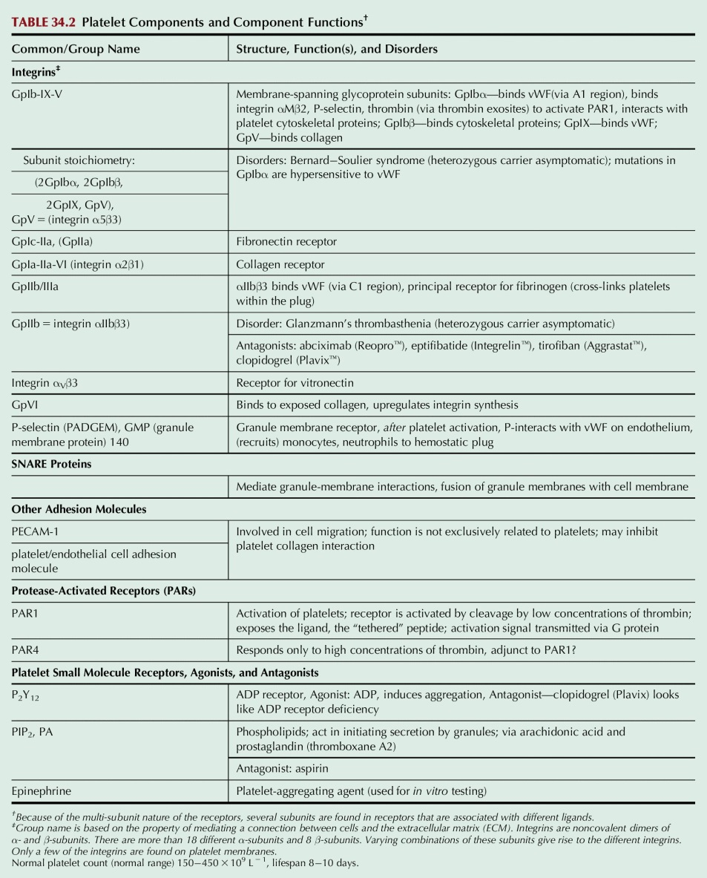
Table 34.2

Slide 19
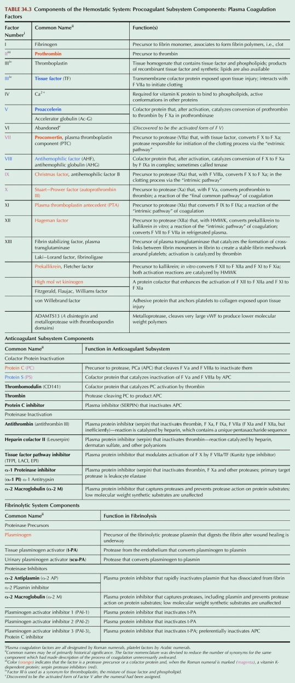
Table 34.3

Slide 20
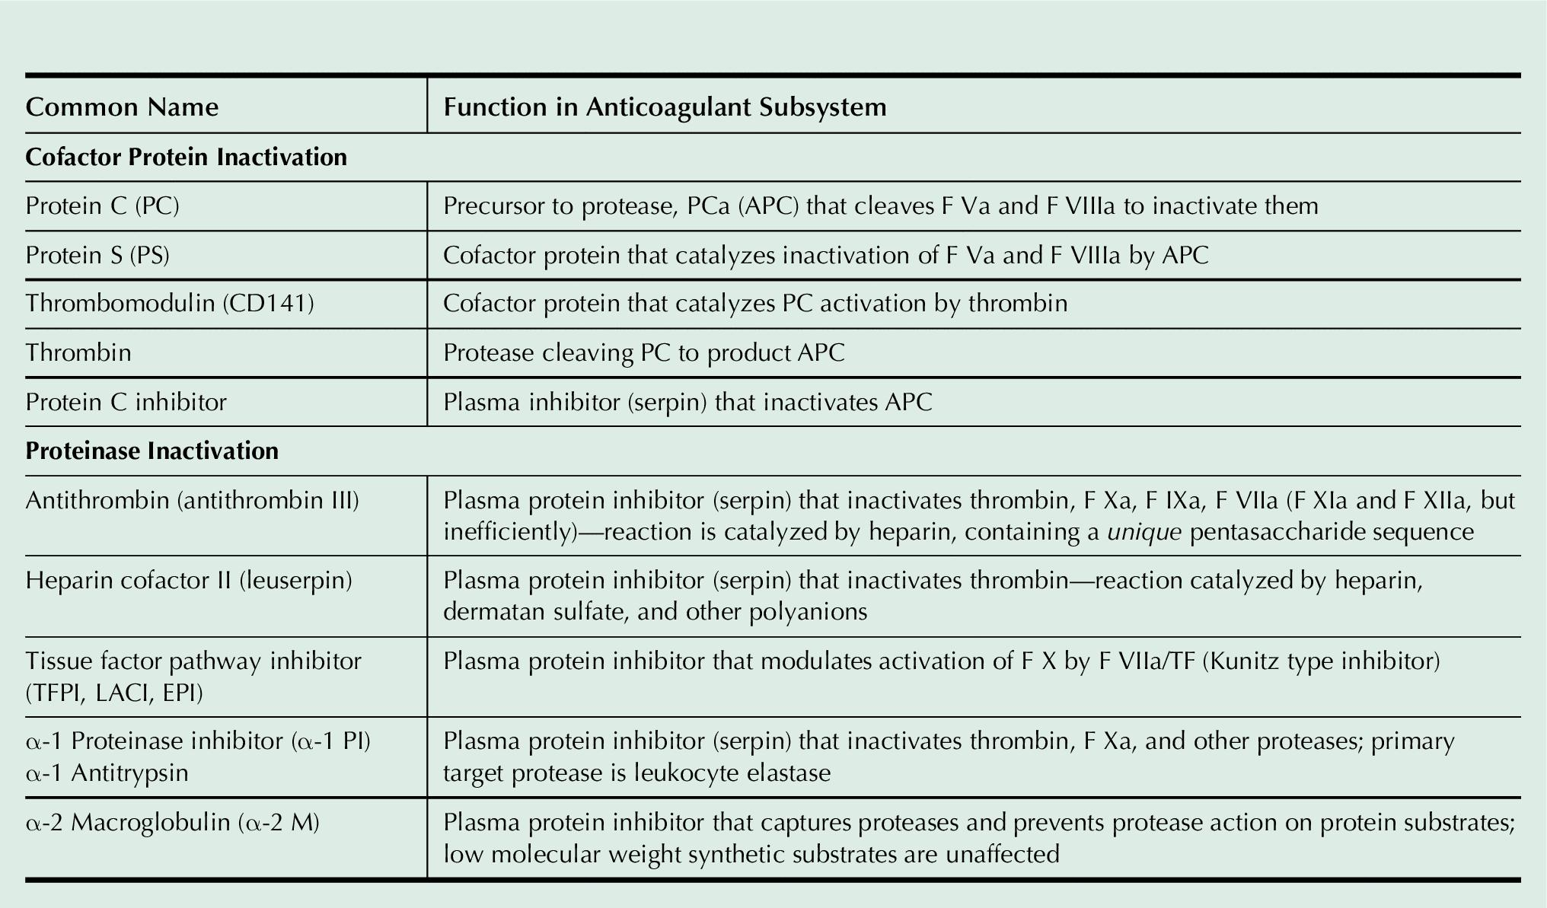
Table 34.4

