Slide 1
Chapter 35
Mineral Metabolism

Slide 2
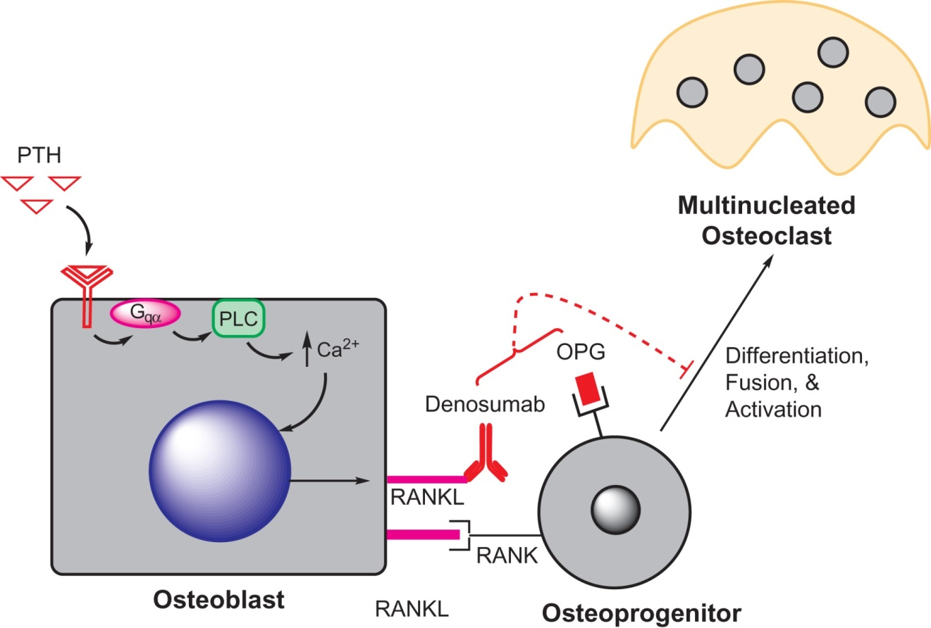
Figure 35.1

Slide 3
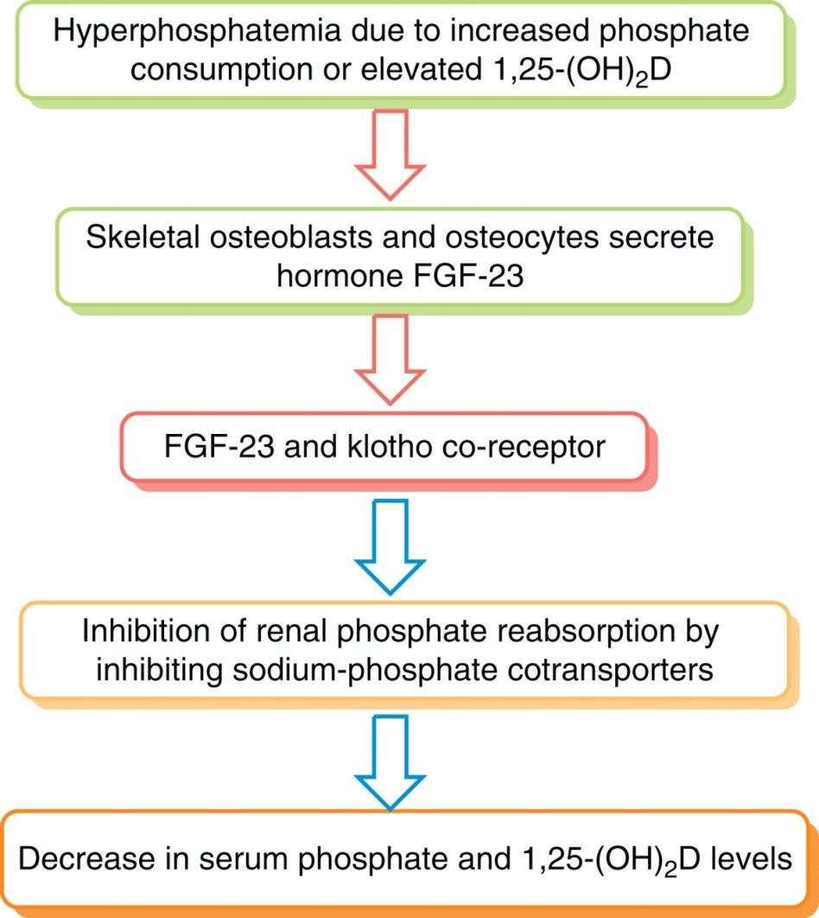
Figure 35.2

Slide 4
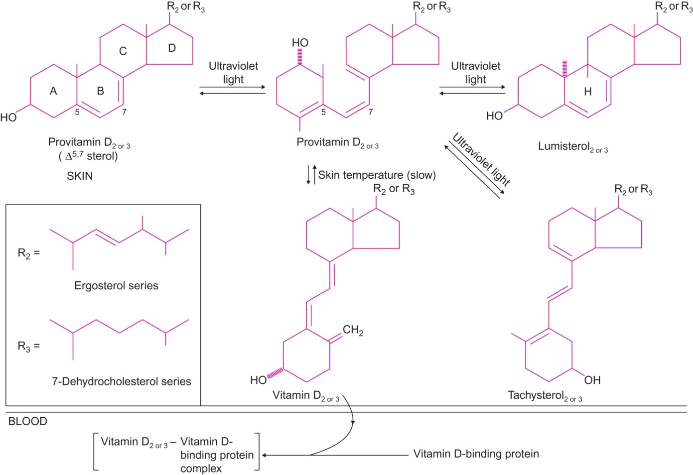
Figure 35.3

Slide 5
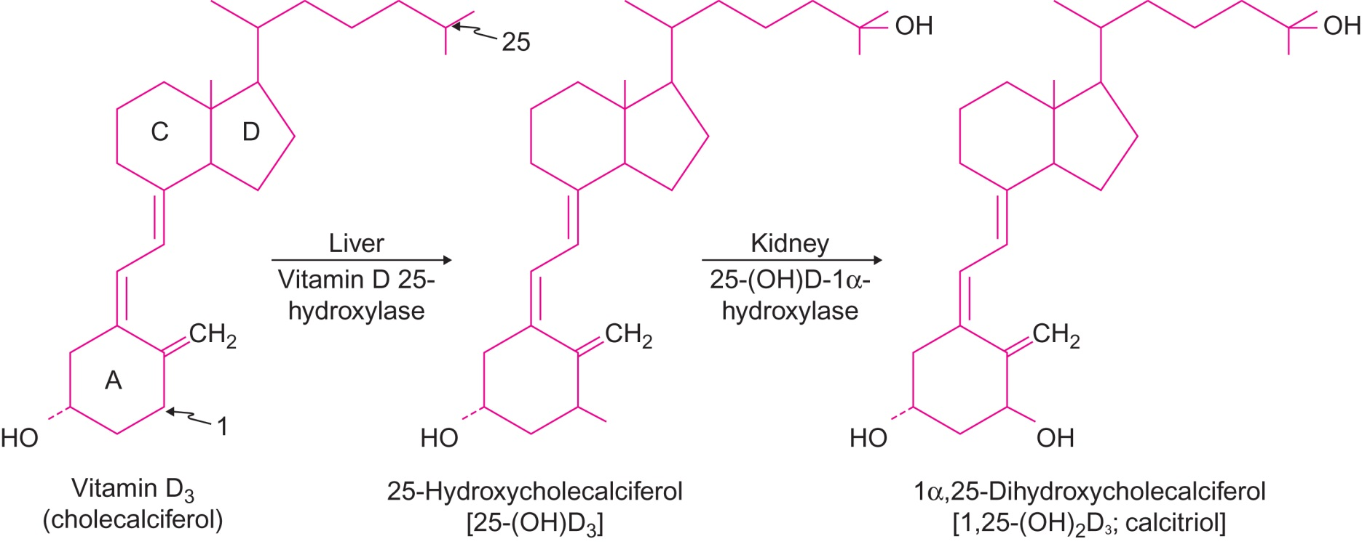
Figure 35.4

Slide 6
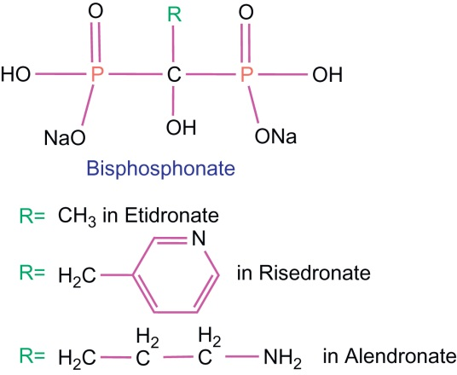
Figure 35.5

Slide 7
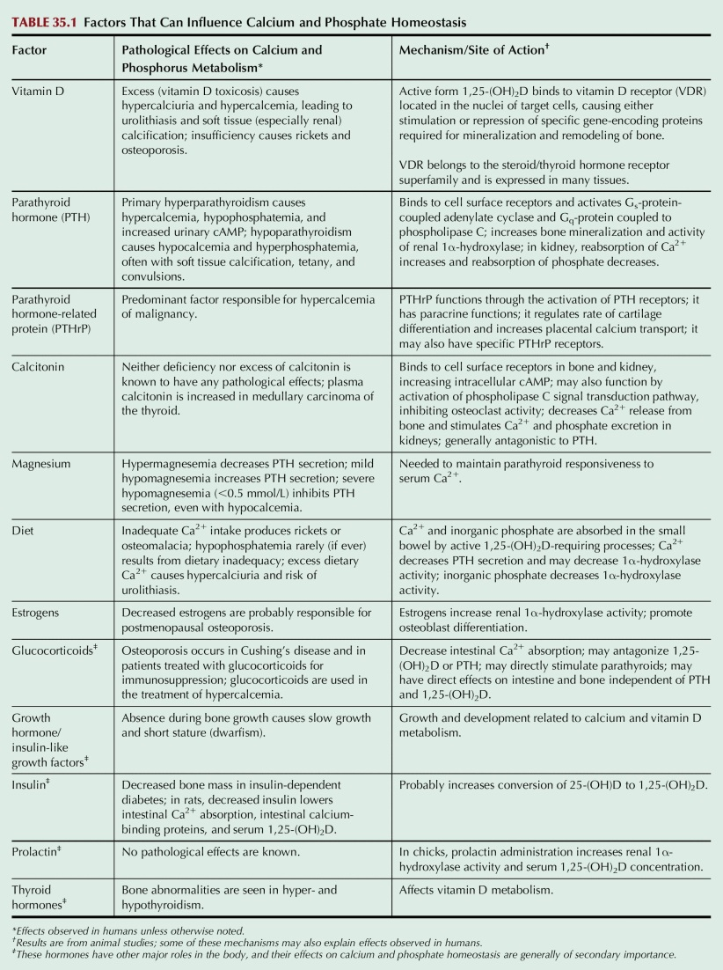
Table 35.1

Slide 8
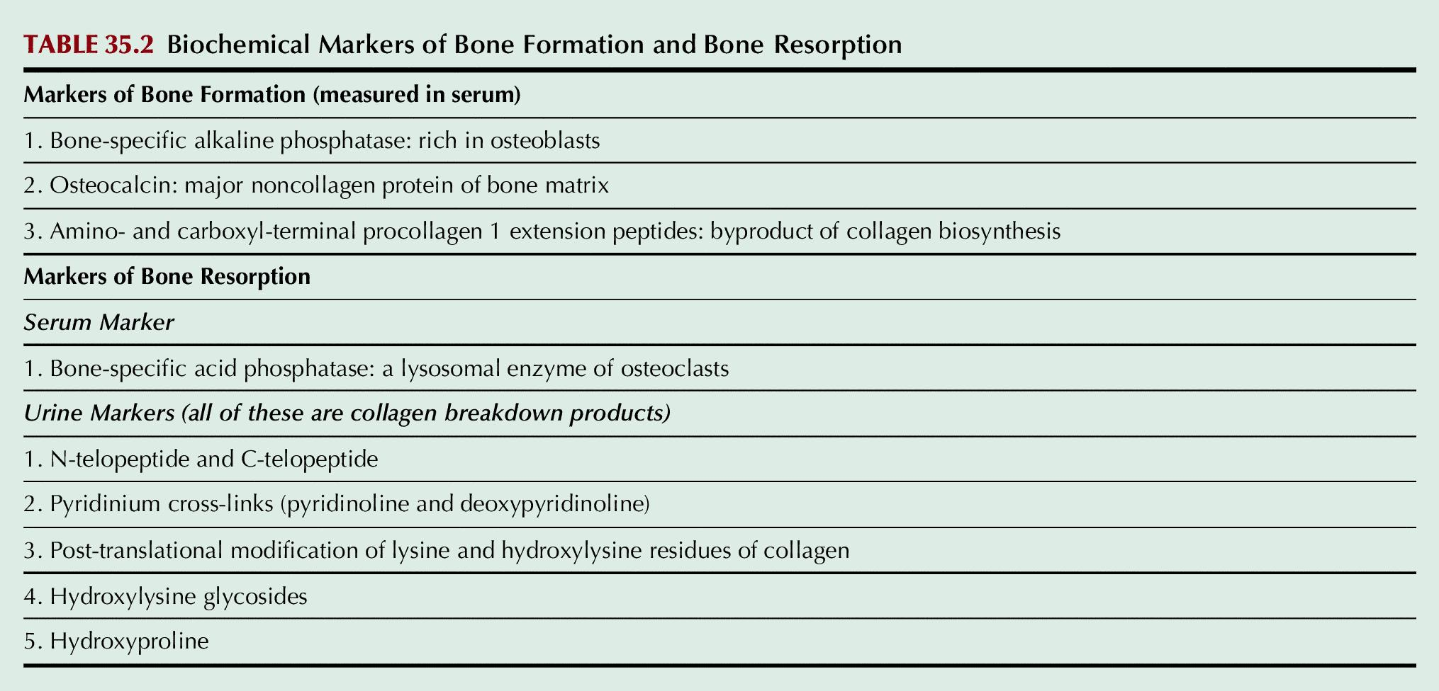
Table 35.2

Slide 9
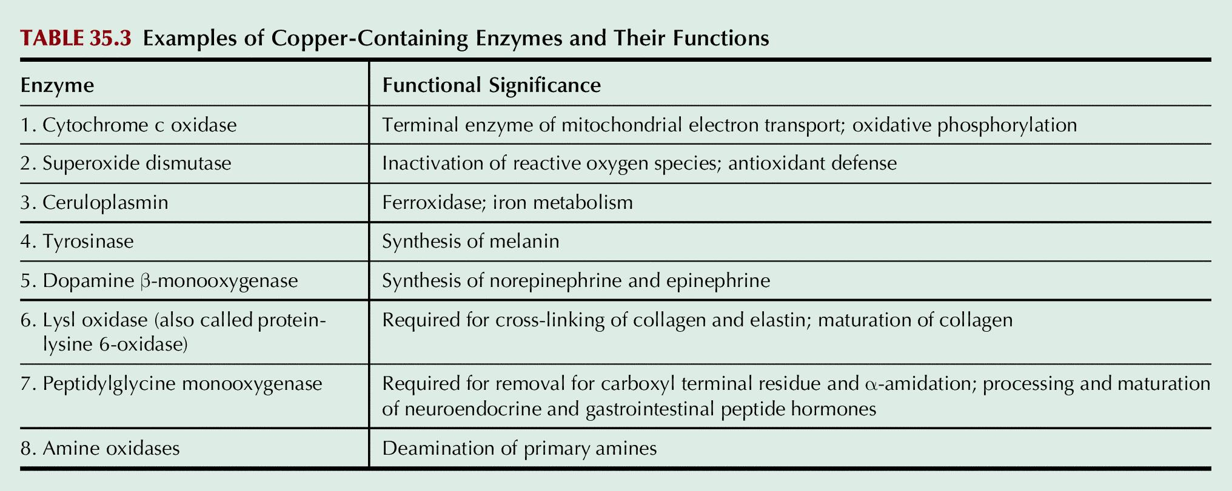
Table 35.3

Slide 10
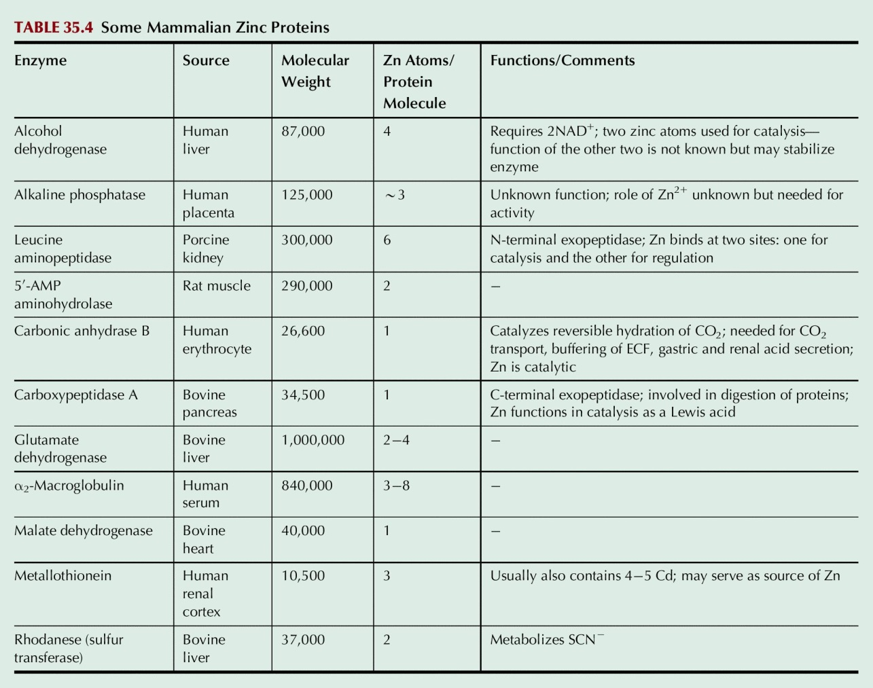
Table 35.4

Slide 11
Table 35.5

