Slide 1
I/O Systems
CH009

Slide 2
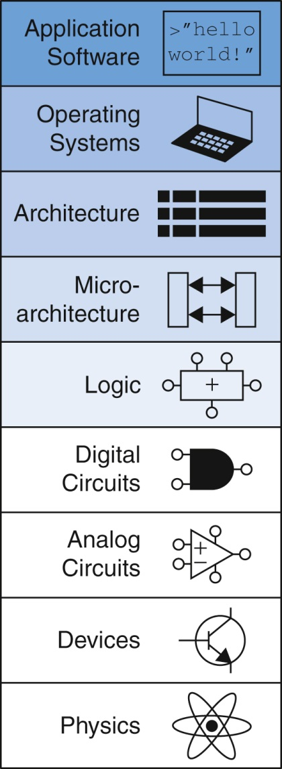
Fig U09-01

