Slide 1
Environmental Data Analysis with MatLab
2nd Edition
Lecture 19:
Smoothing, Correlation and Spectra
Notes:
Today’s lecture expands the idea of correlations within time series to correlations between time series.

Slide 2
SYLLABUS
Lecture 01 Using MatLab
Lecture 02 Looking At Data
Lecture 03 Probability and Measurement Error
Lecture 04 Multivariate Distributions
Lecture 05 Linear Models
Lecture 06 The Principle of Least Squares
Lecture 07 Prior Information
Lecture 08 Solving Generalized Least Squares Problems
Lecture 09 Fourier Series
Lecture 10 Complex Fourier Series
Lecture 11 Lessons Learned from the Fourier Transform
Lecture 12 Power Spectra
Lecture 13 Filter Theory
Lecture 14 Applications of Filters
Lecture 15 Factor Analysis
Lecture 16 Orthogonal functions
Lecture 17 Covariance and Autocorrelation
Lecture 18 Cross-correlation
Lecture 19 Smoothing, Correlation and Spectra
Lecture 20 Coherence; Tapering and Spectral Analysis
Lecture 21 Interpolation
Lecture 22 Linear Approximations and Non Linear Least Squares
Lecture 23 Adaptable Approximations with Neural Networks
Lecture 24 Hypothesis testing
Lecture 25 Hypothesis Testing continued; F-Tests
Lecture 26 Confidence Limits of Spectra, Bootstraps
Notes:
24 lectures

Slide 3
Goals of the lecture
examine interrelationships between
smoothing, correlation and power spectral density
Notes:
The key idea is that smoothing has two interrelated effects on a time series:
it makes neighboring points in a time series better correlated, and
its suppresses high frequencies from the power spectral density of the time series.

Slide 4
review

Slide 5
Autocorrelation and
Cross-correlation

Slide 6
Autocorrelation
Measure of correlation in time series
at different lags
u(t)
t

Slide 7
Autocorrelation
Measure of correlation in time series
at different lags
t
t
lag, multiply and sum area
no lag
a(t)
0
lag, t

Slide 8
Autocorrelation
Measure of correlation in time series
at different lags
t
t
lag, multiply and sum area
small lag
a(t)
0
lag, t

Slide 9
Autocorrelation
Measure of correlation in time series
at different lags
t
t
lag, multiply and sum area
large lag
a(t)
0
lag, t

Slide 10
Autocorrelation
Measure of correlation in time series
at different lags
t
t
lag, multiply and sum area
a(t)
0
lag, t

Slide 11
Autocorrelation
Measure of correlation in time series
at different lags
t
t
lag, multiply and sum area
a(t)
0
lag, t
a(t)=u(t)⋆u(t)

Slide 12
crooss-correlation
Measure of correlation between two time series
at different lags
u(t)
t
v(t)
t

Slide 13
crooss-correlation
Measure of correlation between two time series
at different lags
u(t)
t
v(t)
t
c(t)=u(t)⋆v(t)

Slide 14
important relationships
c(t) = u(t)⋆v(t) = u(-t)*v(t)
c(ω) = u*(ω) v(ω)
a(ω)= |u(ω)|²

Slide 15
rough time series
u(t)
t
sharp autocorrelation
a(t)
0
lag, t
wide spectrum
|u(ω)|²
0
frequency, ω

Slide 16
smooth time series
u(t)
t
wide autocorrelation
a(t)
0
lag, t
narrow spectrum
|u(ω)|²
0
frequency, ω

Slide 17
v(t)
t
rough timeseries
a(t)
a(t)
0
lag, t
0
lag, t
v(t)
t
a(t)
0
lag, t

Slide 18
Part 1
Smoothing a Time Series
Notes:
Ask the class to describe how they would smooth a time series.
Try to get at the idea that they need to average neighboring points,
and that such an operation is a kind of filter.

Slide 19
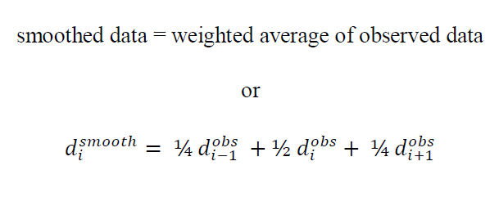
smoothing as filtering
(example of 3-point smoothing)

Slide 20
smoothing as filtering
(example of 3-point smoothing)
non-causal

Slide 21
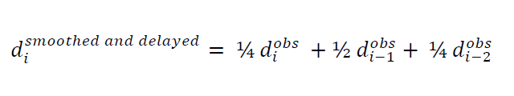
fix-up
allow for a delay

Slide 22
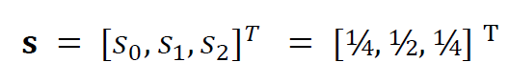
fix-up allow for a delay
d^{smoothed and delayed} = s * d^{obs}
causal filter, s

Slide 23
triangular smoothing filters
3 points
s_{i}
index, i
s_{i}
21 points
index, i
Notes:
The idea of a 3-point filter is easy to generalize.
We imagine the coefficeints [0.25 0.50 0.25] are a triangle.
A wider filter is just a wider triangle.

Slide 24
smoothing if Neuse River Hydrograph
Notes:
Note that the wider the filter, the smoother the time series becomes.

Slide 25
question how does smoothing effect the the autocorrelation of d
Notes:
Flash back to the hydrograph, and as the class which of the three time series has the widest autocorrelation function.

Slide 26
answer the autocorrelation of s acts as a smoothing filter on the autocorrelation of d
Notes:
if
s smoothes d
then
the autocorrelation of s
smoothes
the autocorrelation of d

Slide 27
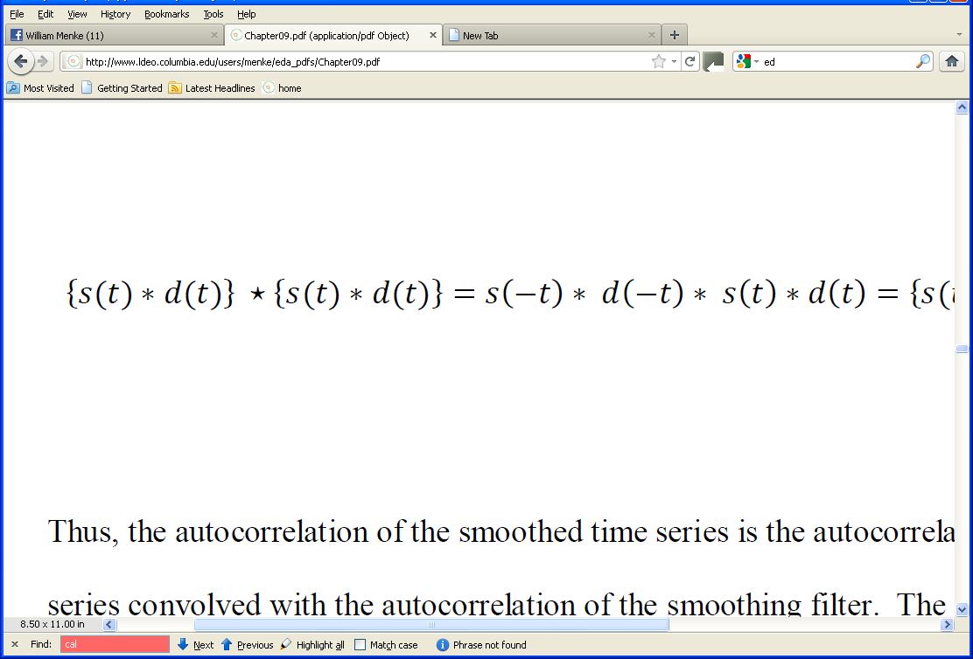
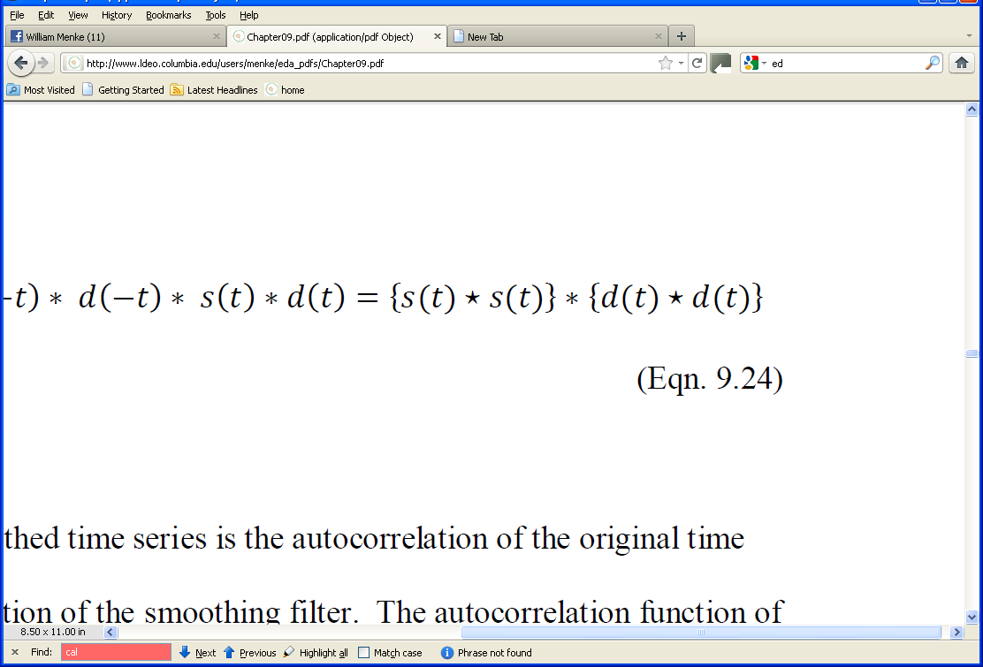
effect of smoothing on autocorrelation
Notes:
This is a step-by-step derivation

Slide 28
effect of smoothing on autocorrelation
autocorrelation of smoothed time series
Notes:
Step 1: write the smoothed time series as s*d and compute its autocorrelation.

Slide 29
effect of smoothing on autocorrelation
autocorrelation of smoothed time series
everything written as convolution
Notes:
Step 2: write the autocorrelation as a convolution

Slide 30
effect of smoothing on autocorrelation
autocorrelation of smoothed time series
everything written as convolution
regrouped
Notes:
Step 3: regroup and identify s(-t)*s(t) as the autocorrelation of s
and d(-t)*d(t) as the autocorrelation of d

Slide 31
effect of smoothing on autocorrelation
autocorrelation of smoothing filter
autocorrelation of time series
convolved with
*
Notes:
Step 4: Interpret the expression as the
autocorrelation of the filter
smoothing
the autocorrelation of the time series

Slide 32
answer the autocorrelation of s acts as a smoothing filter on the autocorrelation of d
Notes:
To reiterate the result:
if
s smoothes d
then
the autocorrelation of s
smoothes
the autocorrelation of d

Slide 33
Part 2
What Makes a Good Smoothing Filter?
Notes:
Not all smoothing filters produce equally good results.

Slide 34
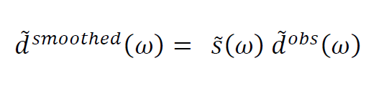
then by the convolution theorem
d^{smoothed}(t) = s(t) * d^{obs}(t)
Notes:
The convolution theorem say that the Fourier Transform of a convolution is the product of the transforms.

Slide 35
then by the convolution theorem
d^{smoothed}(t) = s(t) * d^{obs}(t)
so what’s this look like?
Notes:
So if we know the Fourier Transform of the filter
we can easily assess the effect of smoothing on the p.s.d. of the smoothed time series
since the effect is multiplicative

Slide 36
example of a uniform or “boxcar” smoothing filter
s(t)
1/T
time, t
0
T
Notes:
The easiest smoothing filter to analyze is the “uniform” or “box car” filter.
If the length of the filter is T then its amplitude must be 1/T so that it has unit area.

Slide 37
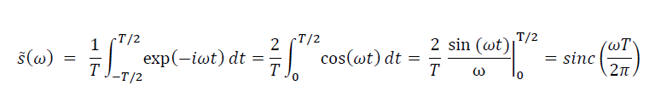
take Fourier Transform
where
sinc(x) = sin(πx) / (πx)

Slide 38
A) T=3
B) T=21

Slide 39
B) T=21
falls off with frequency (good)

Slide 40
B) T=21
bumpy side lobes (bad)

Slide 41
a box car filter does not suppress high frequencies evenly
the challenge
find a filter that suppresses high frequencies evenly

Slide 42
Normal Function
Fourier Transform of a Normal Function
is a
Normal Function
(which has no side lobes)

Slide 43
B) T=3
A) L=3
B) T=21
Notes:
Flash back and compare with the results of the boxcar.
The variance of the Normal functions have been chosen to match the variance of the box car functions, so
the two types of filters have roughly similar filters.

Slide 44
but a Normal Function
is non-causal
(unless you truncate it, in which case it is not exactly a Normal Function)
Notes:
A Normal function is non-zero for all T, so it makes an infinitely long filter.
In practice, one must truncate it.

Slide 45
Normal Function
Box Car
sidelobes
Triangle
simplicity
Notes:
Box cars simple but have terrible side lobes.
Normal functions have no side lobes but indefinitely long.
In practice, one picks something in between.
The triangle isn’t too bad, but something a little smoother than a triangle is better.

Slide 46
Part 3
Designing a Filter that Suppresses Specific Frequencies
Notes:
Ask the class to describe how they would smooth a time series.
Try to get at the idea that they need to average neighboring points,
and that such an operation is a kind of filter.

Slide 47
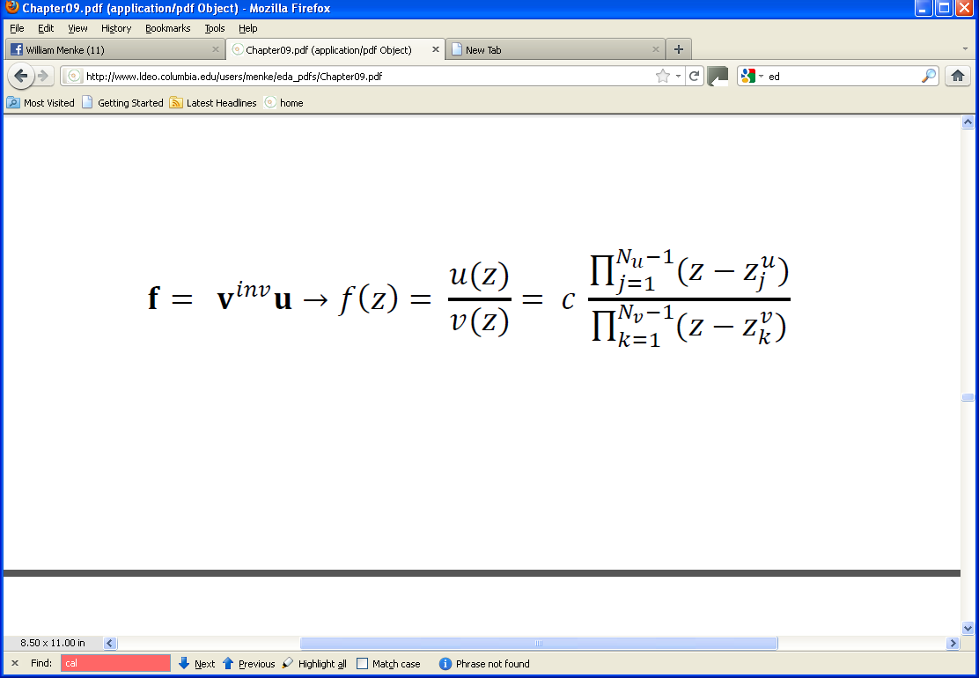
General form of the IIR Filter, f
Notes:
The starting place is the Infinte Impulse Response filter introduced in Chapter 7.
It is built up from two short filters, u(t) and v(t). Note that v^{inv} is the inverse filter to v.

Slide 48
z-transform of the IIR filter
Notes:
The z-transform changes u(t) and v(t) into polynomials, u(z) and v(z).
The inverse filter v^{inv} is just 1/v(z)
Each polynomial can be written as a product of its factors.

Slide 49
General form of the IIR Filter
z-transform

Slide 50
General form of the IIR Filter
z-transform
ratio of polynomials

Slide 51
z-transform of the IIR filter
u(z) as a product of its factors
roots of u(z)
roots of v(z)
z-transform
ratio of polynomials
v(z) as a product of its factors

Slide 52
so designing a filter is equivalent to specifying the roots of the two polynomails u(z) and v(z)
Notes:
In practice, u and v are short filters, so that each has only a few roots.
Thus, the number of parameters that we have to specify is small.

Slide 53
at this point we need to explore the relationship between the
Fourier Transform and the z-transform
Notes:
This is a pretty long digression … You might want to stop for questions at this point …

Slide 54
Answer
the Fourier Transform
is the
z-transform
evaluated at a specific set of z’s
Notes:
So the z-transform “contains” the Fourier Transform.

Slide 55
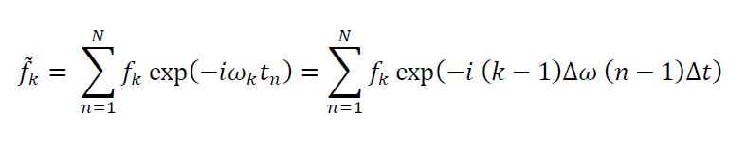
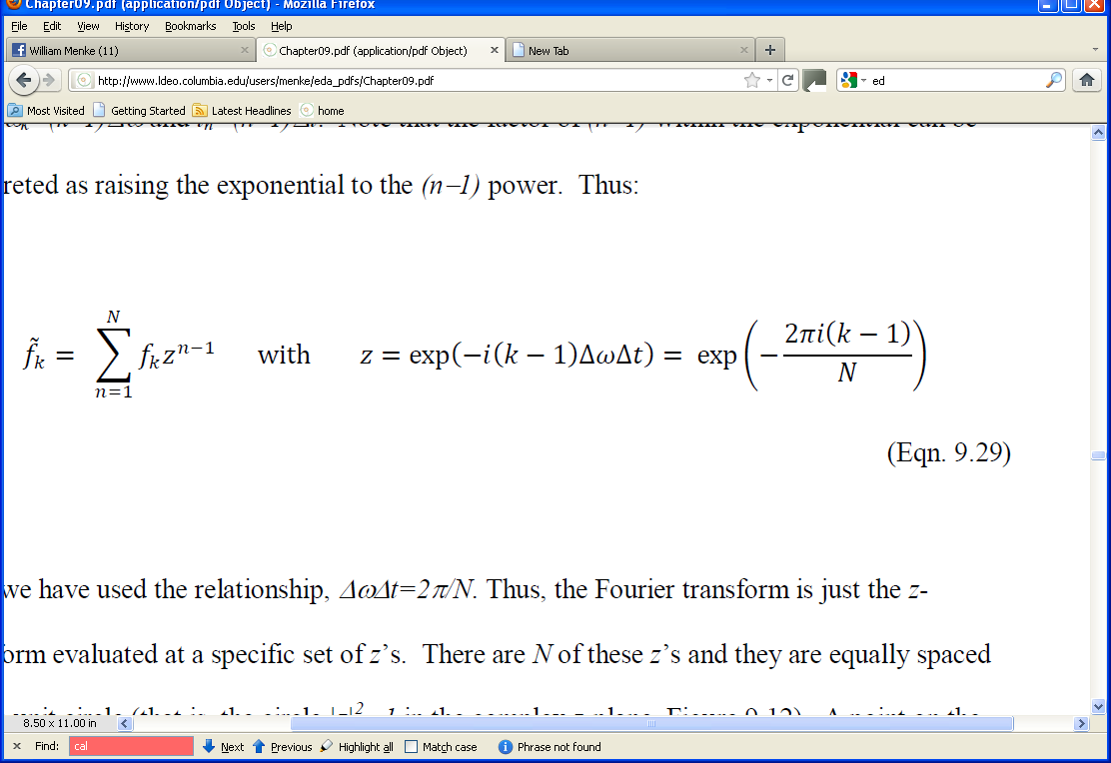
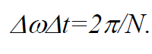
Relationship between Fourier Transform and Z-transform
since
Notes:
Another step-by-step derivarion

Slide 56
Relationship between Fourier Transform and Z-transform
Fourier Transform
since
Notes:
Step 1: use the definition of the Fourier Transform

Slide 57
Relationship between Fourier Transform and Z-transform
Fourier Transform
discrete times and frequencies
since
Notes:
Step 2: Note that both frequency and time are discrete.

Slide 58
Relationship between Fourier Transform and Z-transform
Fourier Transform
discrete times and frequencies
z-transform
since
Notes:
Step 3: Write the exponential exp{ … (n-1)} so the (n-1) is
raising the rest of the exponential exp{ … } to the (n-1) power

Slide 59
Relationship between Fourier Transform and Z-transform
Fourier Transform
discrete times and frequencies
z-transform
specific choice of z’s
since
Notes:
Step 4: Call the exp{…} z and identify the summation as a z-transform

Slide 60
in words
the Fourier Transform
is the
z-transform
evaluated at a specific set of z’s
Notes:
So the z-transform “contains” the Fourier Transform.

Slide 61
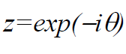
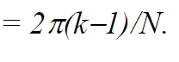
there are N specific z’s
z_{k}
or
with θ
Notes:
Write the specific set of z’s as a complex exponential with a parameter, θ.
The complex exponential has unit length (meaning |z|=1), so it describes a circle in the complex z-plane.

Slide 62
they plot as equally-spaced points around a “unit circle” in the complex z-plane
unit circle, |z|²=1
θ
real z
zero frequency
Nyquist frequency
imag z
Notes:
The specific z’s are evenly spaced around this unit circle.
Complex z-plane. showing the unit circle, |z|²=1. A point (+ sign) on the unit circle makes an angle, θ, with respect to the positive z-axis. It corresponds to a frequency, ω=θ/Δt, in the Fourier transform.
This ends the digression.

Slide 63
Back to the IIR Filter
roots of u(z)
roots of v(z)

Slide 64
Back to the IIR Filter
(z-z_{j}^{u}) is zero at z=z_{j}^{u}
produces a low amplitude region near z=z_{j}^{u}
called a “zero”

Slide 65
Back to the IIR Filter
1/(z-z_{k}^{v}) is infinite at z=z_{k}^{u}
produces a high amplitude region near z=z_{k}^{v}
called a “pole”

Slide 66
so build a filter by placing the poles and zeros at strategic points in the complex z-plane

Slide 67
Rules zeros suppress frequencies poles amplify frequencies all poles must be outside the unit circle
(so v^{inv} converges) all poles, zeros must be in complex conjugate pairs
(so filter is real)

Slide 68
A)
B)
Notes:
A) Complex z-plane representation of the high-pass filter, u=[1, -1.1]^{T} along with power spectral density of the filter. B) Corresponding plots for the low-pass filter, u=[1, 1.1] ^{T}. Origin (circle), Fourier transform points on the unit circle (black +) and zero (red and white circle) are shown.

Slide 69
A)
zero near zero frequency suppresses low frequencies
“high pass filter”
B)
zero near the Nyquist frequency suppresses high frequencies
“low pass filter”
Notes:
A) Zero near zero frequency suppresses low frequencies. Such a filter is called a high-pass filter.
B) Zero near the Nyquist frequency suppresses high frequencies. Such a filter is called a low-pass filter.

Slide 70
A)
B)
Notes:
A) Complex z-plane representation of a band-pass filter with u=[1, 0.60 + 0.66i]^{T} ∗ [1, 0.60 − 0.66i]^{T}
along with the power spectral density of the filter. B) Corresponding plots for the notch filter, u=[1, 0.9i]^{T} ∗ [1, − 0.9i]^{T} and v=[1, 0.8i]^{T} ∗ [1, − 0.8i]^{T} . Origin (circle), Fourier transform points on the unit circle (black +), zeros (red and white circles) and poles (red and black circles) are shown.

Slide 71
A)
poles near ± a given frequency amplify that frequency
“band pass filter”
B)
poles and zeros near ± a given frequency attenuate that frequency
“notch filter”
Notes:
Pole near a given frequency amplifies that frequency. Such a filter is called a band-pass filter.
Note that we use two poles at conjugate positions, so that the filter is real.
B) Combination of pole and a nearby zero attenuate a given frequency. Such a filter is called a notch filter.
Once again, both zeros and poles must be at conjugate positions, so that the filter is real.

Slide 72
something useful a tunable band pass filter
|f(ω)|²
-f_{ny}
-f₂
-f₁
0
f₁
f₂
+f_{ny}
frequency, f
Notes:
The ideal band-pass filter passes frequencies between f₁ and f₂.
Note that positive and negative frequencies must be attenuated symmetrically, so that the
filter is real.

Slide 73
Chebychev band-pass filter: 4 zeros, 4 poles
Notes:
This filter has only 4 zeros and 4 poles, so u(t) and v(t) are each of length 5. That’s a really short (=fast) IIR filter.
Complex z-plane representation of a Chebychev band-pass filter. The origin (small circle), unit circle (large circle),
zeros (*) and poles (+) are shown.

Slide 74
Chebychev band-pass filter: 4 zeros, 4 poles
pole
2 zeros
pole
2 zeros
pole
pole
Notes:
Two zeros at the same location really attenuate nearby frequencies.

Slide 75
Notes:
Power spectral density of the filter.

Slide 76
not quite as boxy as one might hope …
Notes:
It is not a perfect box, but for such a simple filter, is not so bad …

Slide 77
Notes:
(top) Input to filter is a spike.
(bottom) Output of the filter is a wavelet with most of its power in the 5-10 Hz band.

Slide 78
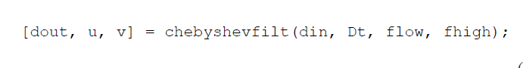
In MatLab
Notes:
This is a filter provided with the text, not a MatLab intrinsic.

Slide 79
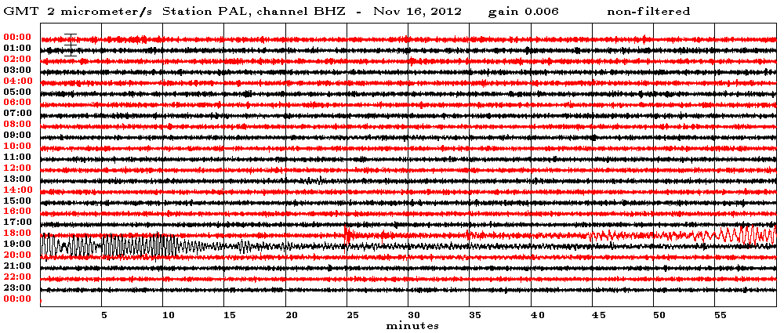
Ground velocity at Palisades NY

Slide 80
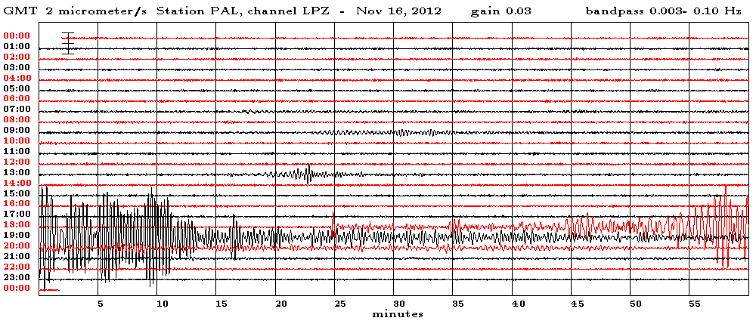
Ground velocity at Palisades NY
Low pass filter

Slide 81
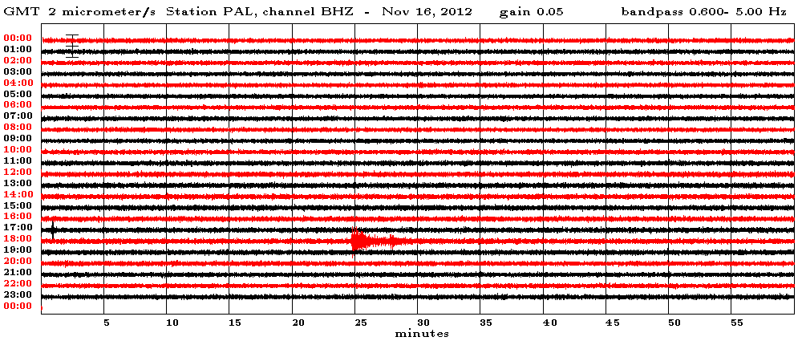
Ground velocity at Palisades NY
high pass filter

