Slide 1
Environmental Data Analysis with MatLab
2nd Edition
Lecture 20:
Coherence; Tapering and Spectral Analysis
Notes:
Today’s lecture finishes up the discussion of correlations and then examines
the effect of finite time series length on the calculation of power spectral density.

Slide 2
SYLLABUS
Lecture 01 Using MatLab
Lecture 02 Looking At Data
Lecture 03 Probability and Measurement Error
Lecture 04 Multivariate Distributions
Lecture 05 Linear Models
Lecture 06 The Principle of Least Squares
Lecture 07 Prior Information
Lecture 08 Solving Generalized Least Squares Problems
Lecture 09 Fourier Series
Lecture 10 Complex Fourier Series
Lecture 11 Lessons Learned from the Fourier Transform
Lecture 12 Power Spectra
Lecture 13 Filter Theory
Lecture 14 Applications of Filters
Lecture 15 Factor Analysis
Lecture 16 Orthogonal functions
Lecture 17 Covariance and Autocorrelation
Lecture 18 Cross-correlation
Lecture 19 Smoothing, Correlation and Spectra
Lecture 20 Coherence; Tapering and Spectral Analysis
Lecture 21 Interpolation
Lecture 22 Linear Approximations and Non Linear Least Squares
Lecture 23 Adaptable Approximations with Neural Networks
Lecture 24 Hypothesis testing
Lecture 25 Hypothesis Testing continued; F-Tests
Lecture 26 Confidence Limits of Spectra, Bootstraps
Notes:
24 lectures

Slide 3
Goals of the lecture
Part 1
Finish up the discussion of
correlations between time series
Part 2
Examine how the finite observation time affects estimates of the power spectral density of time series
Notes:
The lecture has two parts, both relating to material previously introduced.
Part 1 finishes up the discussion of correlations between time series.
Part 2 returns to spectral analysis (Chapter 6) and discusses an important issue
related to the estimation of power spectral density: when the true time series
is indefinitely long, what is the effect of computing the p.s.d. of just a piece of it?

Slide 4
Part 1
“Coherence”
frequency-dependent correlations between time series
Notes:
The key quantity that we will develop is Coherence. It
quantifies the degree of similarity between two time series
in a specific frequency range.

Slide 5
Scenario A in a hypothetical region windiness and temperature correlate at periods of a year, because of large scale climate patterns but they do not correlate at periods of a few days
Notes:
This scenario is purely hypothetical.

Slide 6
wind speed
1
2
3
time, years
temperature
1
2
3
time, years
Notes:
Point out that there are two plots: Top: Wind speed; Bottom, temperature.
Both have the same time scales, years.
Ask class to identify correlations.

Slide 7
summer hot and windy
winters cool and calm
wind speed
1
2
3
time, years
temperature
1
2
3
time, years
Notes:
Seasonal signals are correlated.

Slide 8
heat wave not especially windy
cold snap not especially calm
wind speed
1
2
3
time, years
temperature
1
2
3
time, years
Notes:
Signals do not correlate on short time scale.

Slide 9
in this case times series correlated at long periods but not at short periods

Slide 10
Scenario B in a hypothetical region plankton growth rate and precipitation correlate at periods of a few weeks but they do not correlate seasonally
Notes:
Another purely hypothetical example/

Slide 11
growth rate
1
2
3
time, years
precipitation
1
2
3
time, years
Notes:
Point out that there are two plots: Top: Growth rate; Bottom, precipitation.
Both have the same time scales, years.
Ask class to identify correlations.

Slide 12
growth rate has no seasonal signal
plant growth rate
summer drier than winter
1
2
3
time, years
precipitation
1
2
3
time, years
Notes:
Seasonal signal of precipitation not mirrored in growth rate.

Slide 13
growth rate high at times of peak precipitation
plant growth rate
1
2
3
time, years
precipitation
1
2
3
time, years
Notes:
Short period changes correlate well.

Slide 14
in this case times series correlated at short periods but not at long periods

Slide 15
Coherence a way to quantify frequency-dependent correlation
Notes:
Coherence will turn out to be a fast way to identify for frequency-dependent correlations.

Slide 16
strategy band pass filter the two time series, u(t) and v(t) around frequency, ω₀ compute their zero-lag cross correlation
(large when time series are similar in shape) repeat for many ω₀’s to create a function c(ω₀)
Notes:
The central idea is that the zero-lag cross-correlation is only large when the two time
series are similar in shape. Thus, by cross-correlating two band passed time series, we
assess their similarity at the frequency range of the band pass filter.

Slide 17
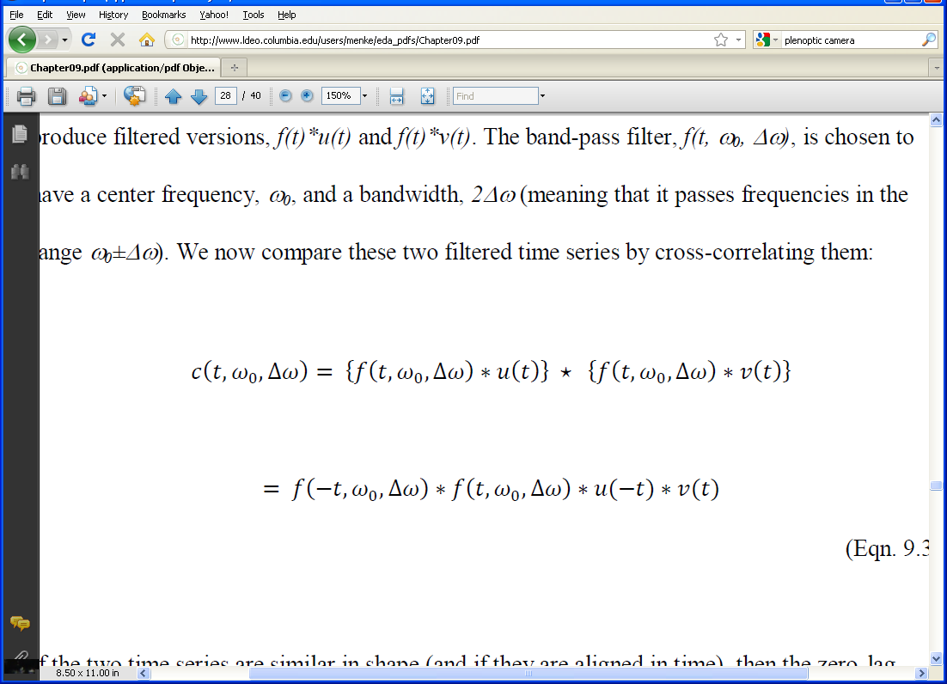
band pass filter f(t) has this p.s.d.
2Δω
|f(ω)|²
2Δω
ω
-ω₀
0
ω₀
Notes:
The function, c, is the cross-correlation of two time series, u and v, after band pass filtering with a filter that
has center frequency, ω₀, and band with 2Δω.
The second equation has the cross-correlation written as a convolution.
The diagram on the bottom is of the power spectral density of an ideal band pass
filter. It is unity in the pass band and zero outside of it. Remind the class that a
real filter must has a “two-sided” Fourier Transform, that is, its values at negative
frequencies must be the complex conjugate of the values at positive frequencies.
This fact becomes important in the derivation.

Slide 18
evaluate at zero lag t=0 and at many ω₀’s
Notes:
This would require band pass filtering the two time series, and then computing their cross-correlation,
many different times. Actually, there is a trick that allows this result to be achieved more efficiently.

Slide 19
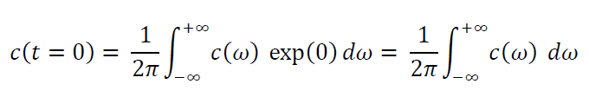
Short Cut
Fact 1
A function evaluates at time t=0 is equal to the integral of its Fourier Transform
Fact 2
the Fourier Transform of a convolution is the product of the transforms
Notes:
Fact 1 is derived from the formula for the Fourier Transform, just by realizing that
exp(iωt) is 1 when t=0.

Slide 20
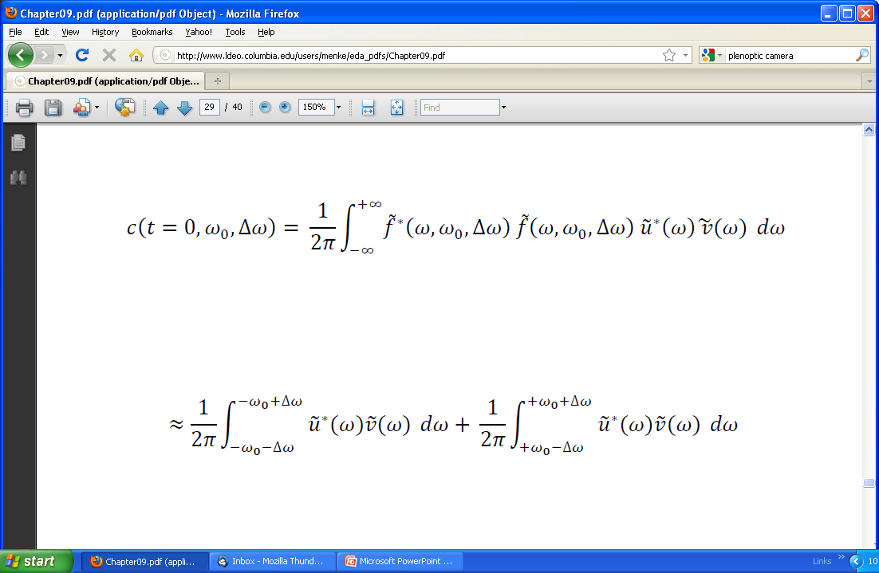
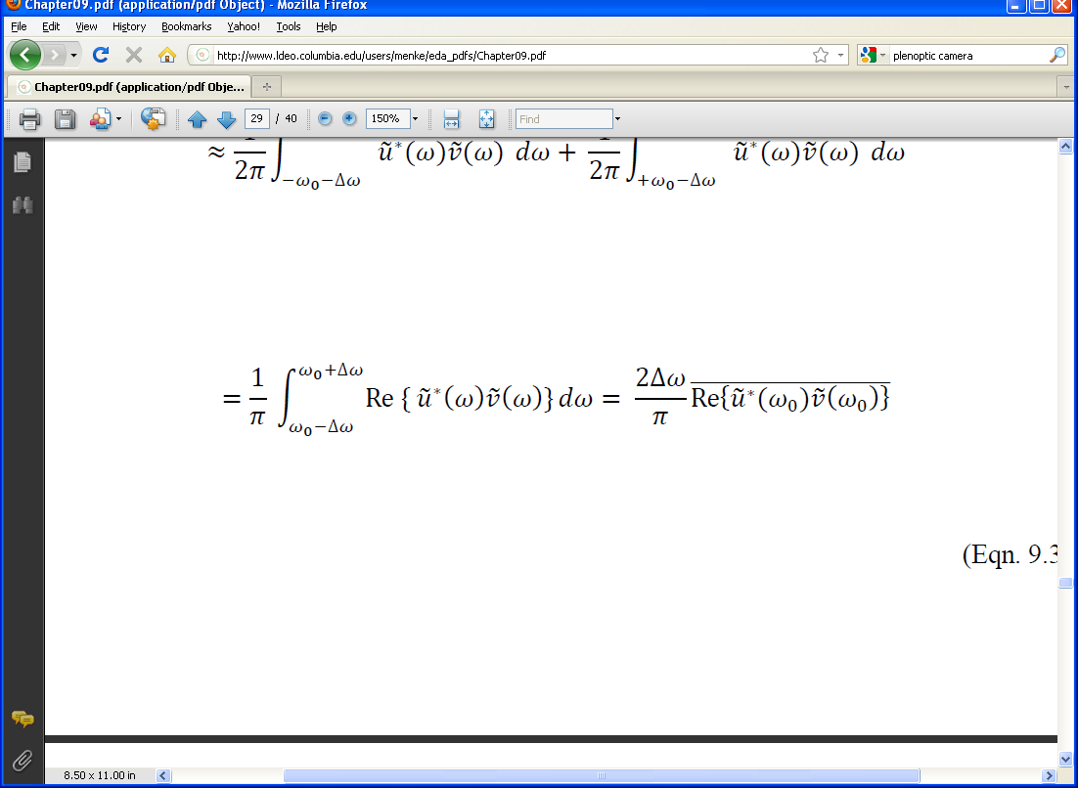
Notes:
This is a step-by-step derivation

Slide 21
integral over frequency
Notes:
Start with the integral over frequency. Note that the integrand contains the
p.s.d. of the band pass filter.

Slide 22
integral over frequency
assume ideal band pass filter that is either 0 or 1
negative frequencies
positive frequencies
Notes:
Now use the fact that the p.s.d. of the band pass filter is either 0 or 1 to reduce the limits of
integration to just those values of frequency where the p.s.d. of the filter is 1. There are two
frequency intervals where it is 1, since the filter has both positive and negative frequencies. You
might flash back to the diagram of it, a few slides back. Since the f*f term is 1, it can be removed
rom these integrals. That leaves just the u*v part.

Slide 23
integral over frequency
assume ideal band pass filter that is either 0 or 1
negative frequencies
positive frequencies
c is real
so real part is symmetric, adds
imag part is antisymmetric, cancels
Notes:
Because of the symmetry of the Fourier Transform of a real function,
the real parts of the two integrals are equal and add, while the
imaginary parts are equal and opposite in sign, and so cance.

Slide 24
integral over frequency
assume ideal band pass filter that is either 0 or 1
negative frequencies
positive frequencies
c is real
so real part is symmetric, adds
imag part is antisymmetric, cancels
interpret intergral as an average over frequency band
Notes:
The integral is interpreted as averaging its integrand. The overbar is used to
indicate such an average. It will be defined in the next slide.

Slide 25
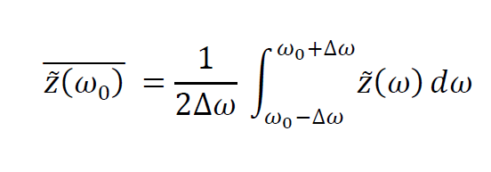
integral over frequency can be viewed as an average over frequency
(indicated with the overbar)
Notes:
This is true of any integral over a finite interval.

Slide 26
Two final steps
1. Omit taking of real part in formula
(simplifying approximation)
2. Normalize by the amplitude of the two time series and square, so that result varies between 0 and 1
Notes:
Some material needed to be left out of this lecture, else it become too long.
I have also opted here to leave out two technical points. The students should
be referred to the text for details.

Slide 27
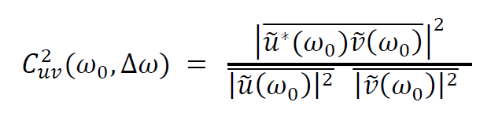
the final result is called
Coherence
Notes:
Point out that the denominator is the normalization. It is just the product
of the power spectral density of the two time series, also frequeny-averaged.

Slide 28
A)
B)
new dataset:
Water Quality
Reynolds Channel,
Coastal Long Island, New York
C)
D)
E)
F)
Notes:
Here we apply Coherence to a new dataset, Water Quality from Reynolds Channel,
Coastal Long Island, New York
Daily water quality measurements from Reynolds Channel (New York) for several years starting January 1, 2006. Six environmental parameters are shown: A) precipitation in inches; B) air temperature in °C; C) water temperature in °C; D) salinity in practical salinity units; E) turbidity; and F) chlorophyll in micrograms per liter.. The data have been linearly interpolated to fill in gaps.

Slide 29
precipitation
A)
air temperature
B)
new dataset:
Water Quality
Reynolds Channel,
Coastal Long Island, New York
water temperature
C)
D)
salinity
E)
turbidity
F)
chlorophyl
Notes:
You should introduce each variable.
turbidity=cloudiness
chlorophyll is a proxy for the amount of algae.

Slide 30
A) periods near 1 year
B) periods near 5 days
Fig, 9.18. Band-pass filtered water quality measurements from Reynolds Channel (New York) for several years starting January 1, 2006. A) Periods near one year; and B) periods near 5 days. MatLab script eda09_16.
Notes:
Left: Bandpassed at periods near 1 year;
Right: Bandpassed at periods near 5 days
Ask class to look for correlations.

Slide 31
A) periods near 1 year
B) periods near 5 days
Fig, 9.18. Band-pass filtered water quality measurements from Reynolds Channel (New York) for several years starting January 1, 2006. A) Periods near one year; and B) periods near 5 days. MatLab script eda09_16.
Notes:
Left: periods near 1 year. Air temperature, water temperature and precipitation are correlated.
Right: periods near 5 days. Precipitation and salinity is anticorrelated. Ask class why that’s so.
(A: Rain dilutes salt water in channel).

Slide 32
A)
B)
C)
one year
one year
one week
Notes:
Coherence of water quality measurements from Reynolds Channel (New York). A) Air temperature and water temperature; B) precipitation and salinity and C) water temperature and chlorophyll.

Slide 33
high coherence at periods of 1 year
A)
B)
C)
one year
one year
one week
moderate coherence at periods of about a month
very low coherence at periods of months to a few days
Notes:
Coherence of water quality measurements from Reynolds Channel (New York). A) Air temperature and water temperature; B) precipitation and salinity and C) water temperature and chlorophyll.

Slide 34
Part 2
windowing time series before computing power-spectral density

Slide 35
scenario:
you are studying an indefinitely long phenomenon …
but you only observe a short portion of it …
Notes:
This is an extremely important issue in spectral estimation.
Even though the phenomenon may be indefinitely long,
You are always limited to a finite set of observations.

Slide 36
how does the power spectral density of the short piece differ from the p.s.d. of the indefinitely long phenomenon
(assuming stationary time series)
Notes:
Remind the class that stationary means that the statistical properties don’t change with time.

Slide 37
We might suspect that the difference will be increasingly significant as the window of observation becomes so short that it includes just a few oscillations of the period of interest.
Notes:
In practice, one is always having to make do with a time series that is too short,
meaning that it includes just a few oscillations of the period of interest. One wants
to get as much as one can from it.

Slide 38
starting point short piece is the indefinitely long time series multiplied by a window function, W(t)
Notes:
Non-observation here is treated as equivalent to multiplying that part of the time series by zero.

Slide 39
Notes:
Top: long time series
Middle: Window function
Bottom: Short time series

Slide 40
by the convolution theorem
Fourier Transform of short piece is
Fourier Transform of indefinitely long time series convolved with
Fourier Transform of window function
Notes:
Standard application of the convolution theorem here.

Slide 41
so
Fourier Transform of short piece exactly
Fourier Transform of indefinitely long time series when
Fourier Transform of window function is a spike
Notes:
Since a function is unchanged when it is convolved with a spike
(technically a Dirac function)

Slide 42
boxcar window function
its Fourier Transform
Notes:
In the previous lecture we determined that the Fourier Transform of a
boxcar is a sinc() function.

Slide 43
boxcar window function
its Fourier Transform
sinc() function
sort of spiky
but has side lobes
Notes:
Actually, a sinc() functions is terrible. It as side lobes galore.

Slide 44
Notes:
Introduce arrangement of plot.
Left – time domain; Right – frequency domain
Top: indefinitely long cosine function, whose Fourier Transform is a spike
Middle: Boxcar, whose Fourier Transform is a sinc() function
Bottom: Windowed time series, and its Fourier Transform.

Slide 45
Effect 1: broadening of spectral peaks
narrow spectral peak
wide central spike
wide spectral peak
Notes:
Windowing the effect of widening the narrow spectral peak.
This widening arises from the finite width of the central peak of the Fourier Transform of the boxcar.

Slide 46
Effect 2: spurious side lobes
only one spectral peak
side lobes
spurious spectral peaks
Notes:
Windowing the effect of introducing artifacts.
This widening arises from the side lobes of the Fourier Transform of the boxcar.

Slide 47
Q: Can the situation be improved?
A: Yes, by choosing a smoother window function more like a Normal Function
(which has no side lobes) but still zero outside of interval of observation
Notes:
So the idea is to choose a function that not only windows, but also tapers the ends of the
windowed region.

Slide 48
boxcar window function
Hamming window function
Notes:
Note that the Hamming is tapering (= throwing away) parts of the time series that are
near the ends of the window of observation.
Hamming is just one example. People have proposed many window functions that trade off
sharpness of the central peak with the presence of side lobes in different ways.

Slide 49
Notes:
Application of the Hamming taper in the same format as the one already discussed.
Point out the tapering away of the end of the time series in the bottom left plot.

Slide 50
no side lobes
but
central peak wider than with boxcar
Notes:
The result is better than the boxcar, in the sense that no side lobes are present,
but worse than the boxcar in the sense that the central peak is wider.
You might flash back to the box car case, for comparison.
There is always some degree of trade off between the width and sidelobes.

Slide 51
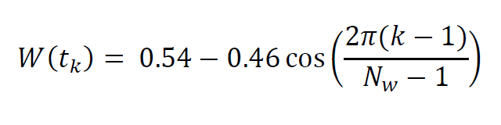
Hamming Window Function
Notes:
Formula for Hamming Taper. It’s just a cosine.

Slide 52
Q: Is there a “best” window function?
A: Only if you carefully specify what you mean by “best”
(notion of best based on prior information)
Notes:
Emphasize that what is meant by “best” will vary between circumstances.

Slide 53
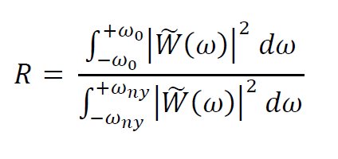
“optimal”window function
maximize
ratio of
power in central peak
(assumed to lie in range ±ω₀ )
to overall power
Notes:
The numerator is the power in the central peak.
The denominator is the overall power, meaning power in both the central peak and side lobes.
So the ratio is large when all of the power is in the central peak and none is in the side lobes.

Slide 54
The parameter, ω₀, allows you to choose how much spectral broadening you can tolerate
Once ω₀ is specified, the problem can be solved by using standard optimization techniques
One finds that there are actually several window functions, with radically different shapes, that are “optimal”
Notes:
The parameter ω₀ should be chosen to as large as possible but still provide sufficient
spectral resolution to solve whatever problem is being studied.
I have omitted the derivation of the solution here, due to lack of time in this lecture.

Slide 55
Family of three “optimal” window functions
v
W₁(t)
time, s
v
v
W₂(t)
time, s
v
v
W₃(t)
time, s
v
Notes:
Three window functions.
Note that the last two leave intact data near the ends of the window
that is heavily suppressed by the first.
Thus, the three functions are complementary – they each taper different
parts of the window of observation differently.

Slide 56
a common strategy is to compute the power spectral density with each of these window functions separately and then average the result technique called
Multi-taper Spectral Analysis
Notes:
“Multi-taper”, meaning use more than one taper.

Slide 57
v
v
d(t)
time t, s
frequency, Hz
v
v
B(t)d(t)
time t, s
frequency, Hz
v
v
W₁(t)d(t)
time t, s
frequency, Hz
v
v
W₂(t)d(t)
time t, s
frequency, Hz
v
v
W₃(t)d(t)
v
time t, s
v
frequency, Hz
v
frequency, Hz
v
Notes:
(Row 1) Data, d(t), consisting of a cosine wave, and its amplitude spectral density (ASD). (Row 2) Data windowed with boxcar, B(t), and its ASD. (Rows 3-5) Data windowed with the first three window functions, and corresponding ASD. (Row 6). ASD obtained by averaging the results of the first three window functions.

Slide 58
v
v
d(t)
box car tapering
time t, s
frequency, Hz
v
v
B(t)d(t)
time t, s
frequency, Hz
v
v
W₁(t)d(t)
time t, s
frequency, Hz
v
v
W₂(t)d(t)
time t, s
frequency, Hz
v
v
W₃(t)d(t)
v
time t, s
v
frequency, Hz
v
frequency, Hz
v
Notes:
(Row 1) Data, d(t), consisting of a cosine wave, and its amplitude spectral density (ASD). (Row 2) Data windowed with boxcar, B(t), and its ASD. (Rows 3-5) Data windowed with the first three window functions, and corresponding ASD. (Row 6). ASD obtained by averaging the results of the first three window functions.

Slide 59
v
v
d(t)
time t, s
frequency, Hz
v
v
B(t)d(t)
tapering with three “optimal” window functions
time t, s
frequency, Hz
v
v
W₁(t)d(t)
time t, s
frequency, Hz
v
v
W₂(t)d(t)
time t, s
frequency, Hz
v
v
W₃(t)d(t)
v
time t, s
v
frequency, Hz
v
frequency, Hz
v
Notes:
(Row 1) Data, d(t), consisting of a cosine wave, and its amplitude spectral density (ASD). (Row 2) Data windowed with boxcar, B(t), and its ASD. (Rows 3-5) Data windowed with the first three window functions, and corresponding ASD. (Row 6). ASD obtained by averaging the results of the first three window functions.

Slide 60
v
v
d(t)
time t, s
frequency, Hz
v
v
B(t)d(t)
time t, s
frequency, Hz
v
v
W₁(t)d(t)
time t, s
frequency, Hz
v
v
W₂(t)d(t)
time t, s
frequency, Hz
v
v
W₃(t)d(t)
v
time t, s
v
frequency, Hz
v
p.s.d. produced by averaging
frequency, Hz
v
Notes:
(Row 1) Data, d(t), consisting of a cosine wave, and its amplitude spectral density (ASD). (Row 2) Data windowed with boxcar, B(t), and its ASD. (Rows 3-5) Data windowed with the first three window functions, and corresponding ASD. (Row 6). ASD obtained by averaging the results of the first three window functions.

Slide 61
Summary
always taper a time series before computing the p.s.d.
try a simple Hamming taper first
it’s simple
use multi-taper analysis when higher resolution is needed
e.g. when the time series is very short

