Slide 1
APPENDIX -1 An introduction to OpenCL

Slide 2
FIGURE A.1: Mapping between OpenCL and CUDA data parallelism model concepts.

Slide 3
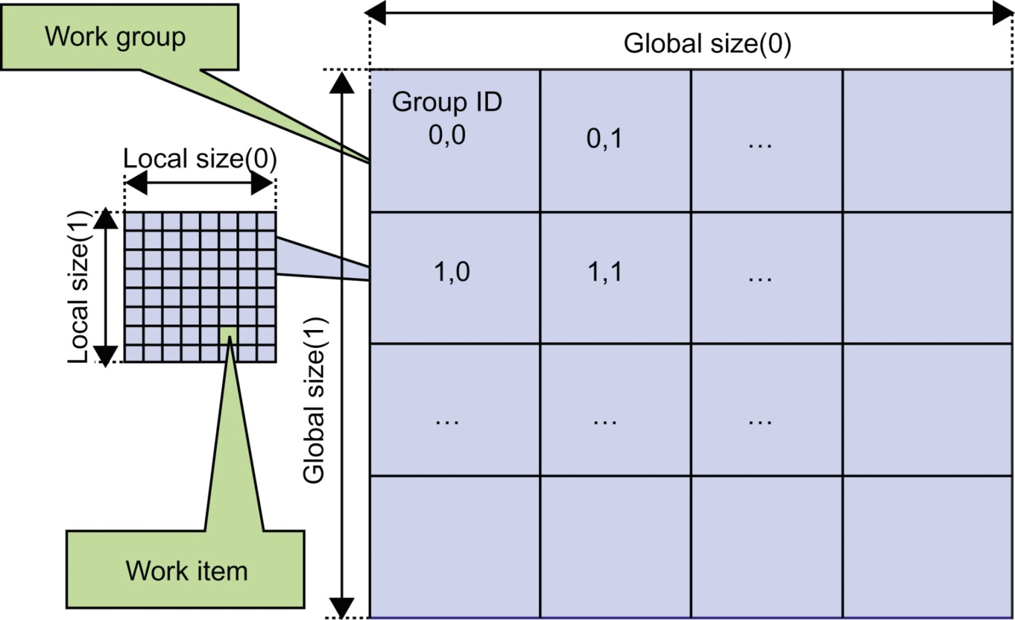
FIGURE A.2: Overview of the OpenCL parallel execution model.

Slide 4
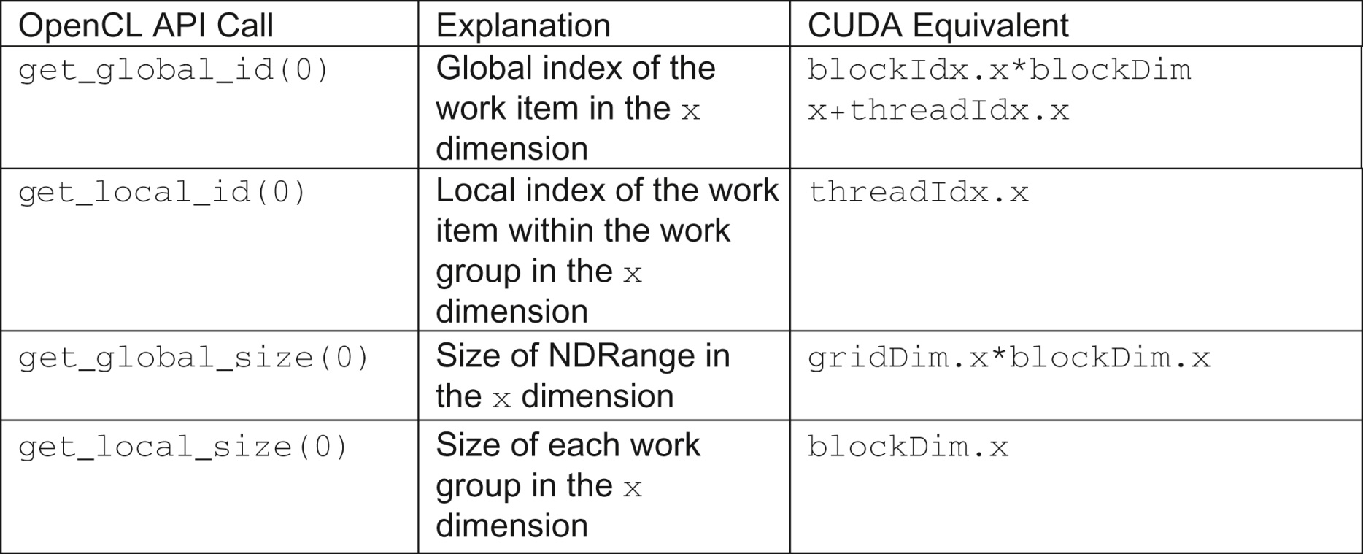
FIGURE A.3: Mapping of OpenCL dimensions and indices to CUDA dimensions and indices.

Slide 5
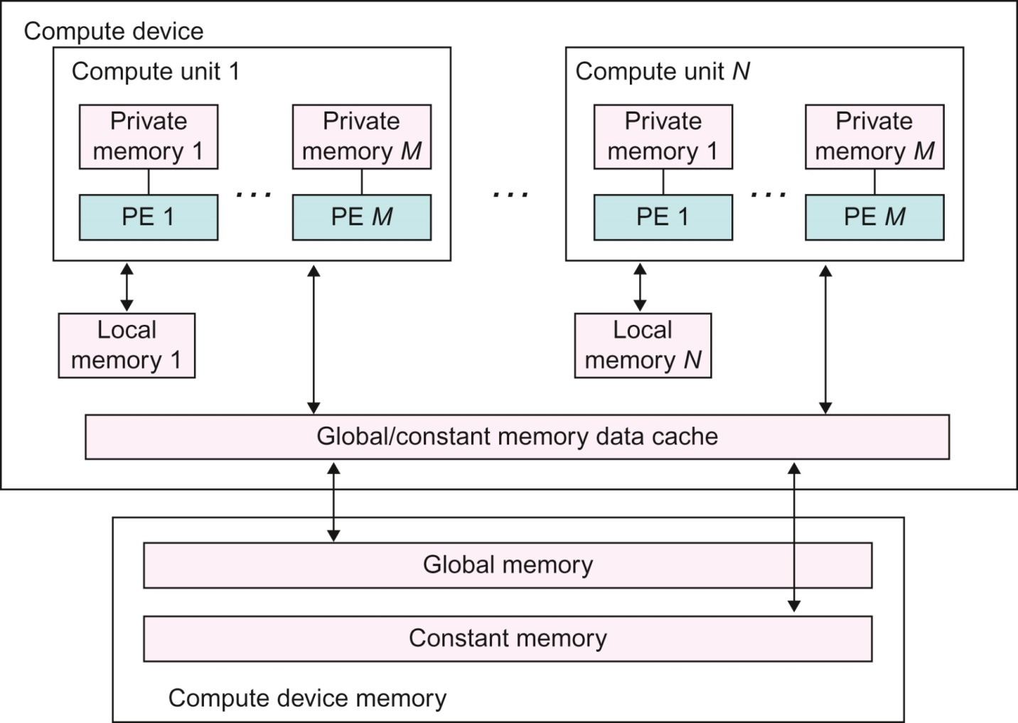
FIGURE A.4: Conceptual OpenCL device architecture. The host is not shown.

Slide 6
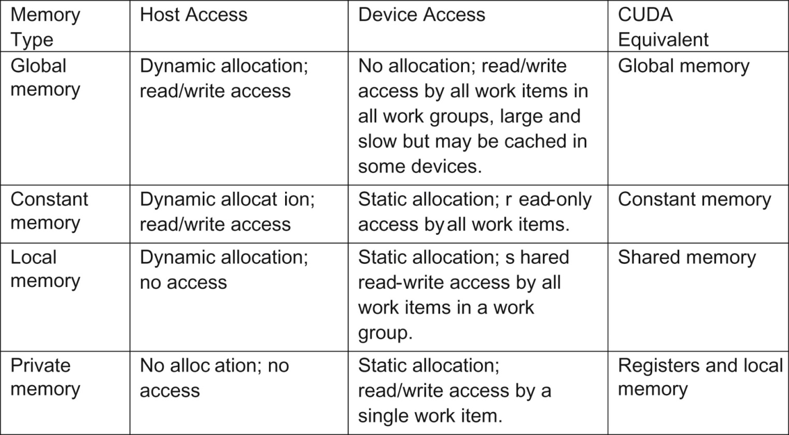
FIGURE A.5: Mapping between OpenCL and CUDA memory types.

Slide 7
FIGURE A.6: A simple OpenCL kernel.

Slide 8
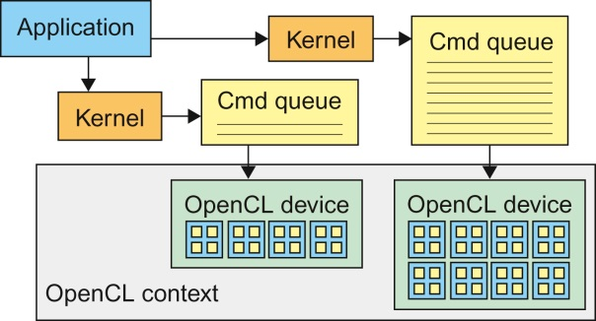
FIGURE A.7: OpenCL contexts are needed to manage devices.

Slide 9
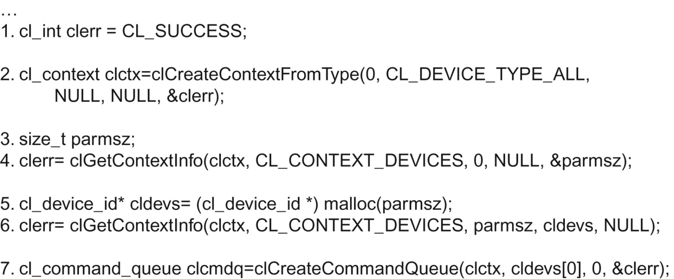
FIGURE A.8: Creating OpenCL context and command queue.

Slide 10
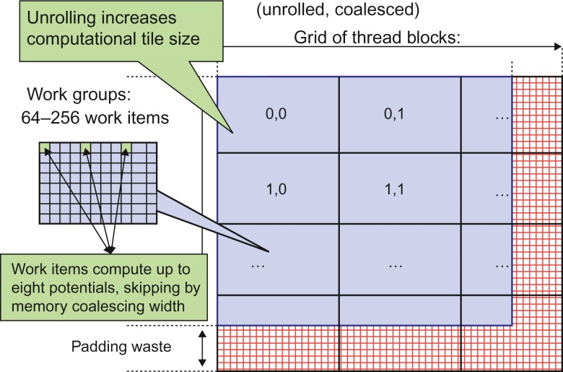
FIGURE A.9: DCS kernel version 3 NDRange configuration.

Slide 11
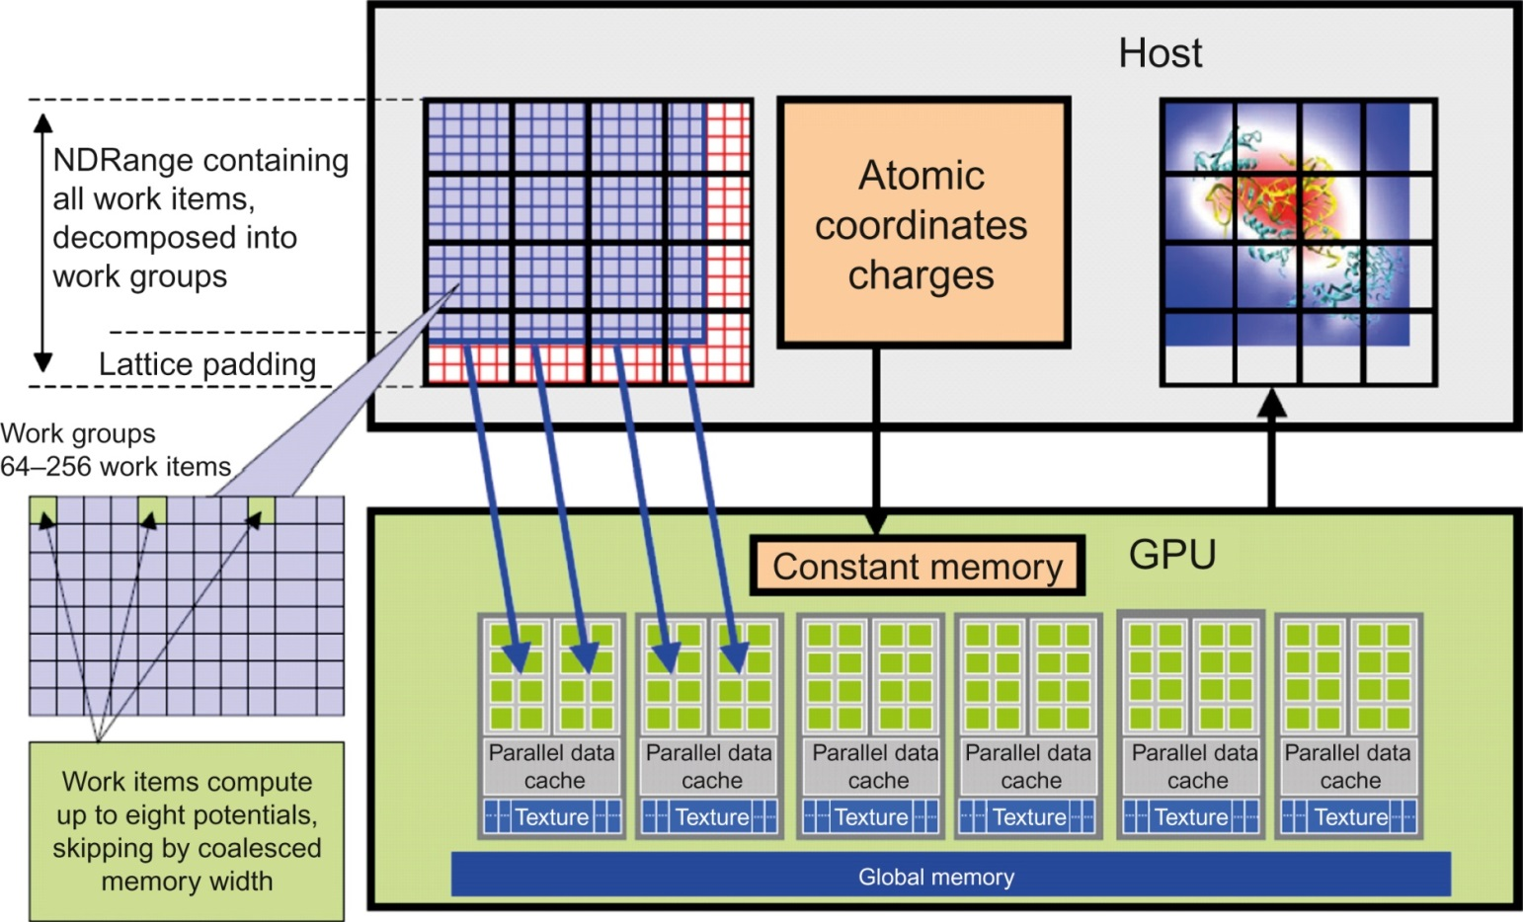
FIGURE A.10: Mapping DCS NDRange to OpenCL Device.

Slide 12
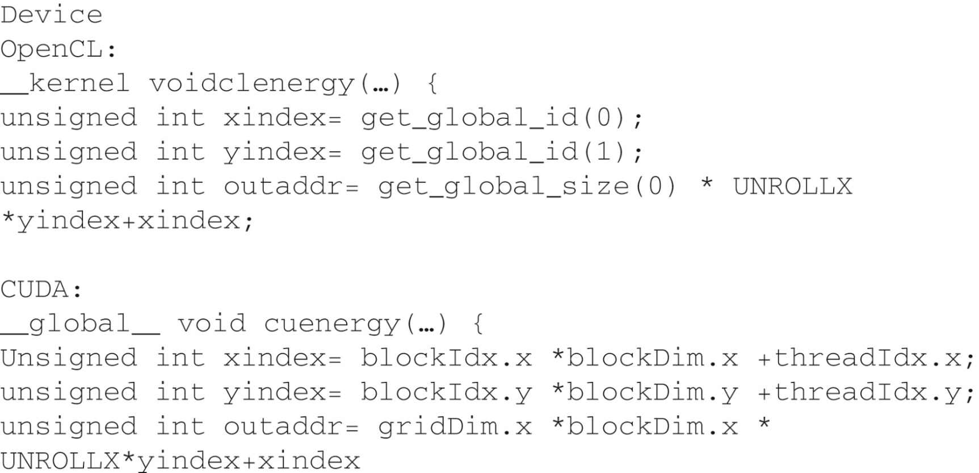
FIGURE A.11: Data access indexing in OpenCL and CUDA.

Slide 13
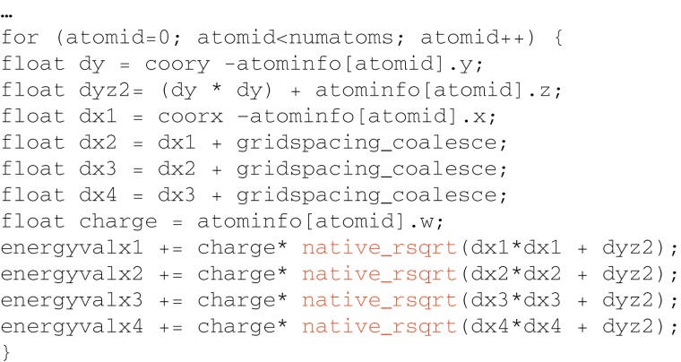
FIGURE A.12: Inner loop of the OpenCL DCS kernel.

Slide 14
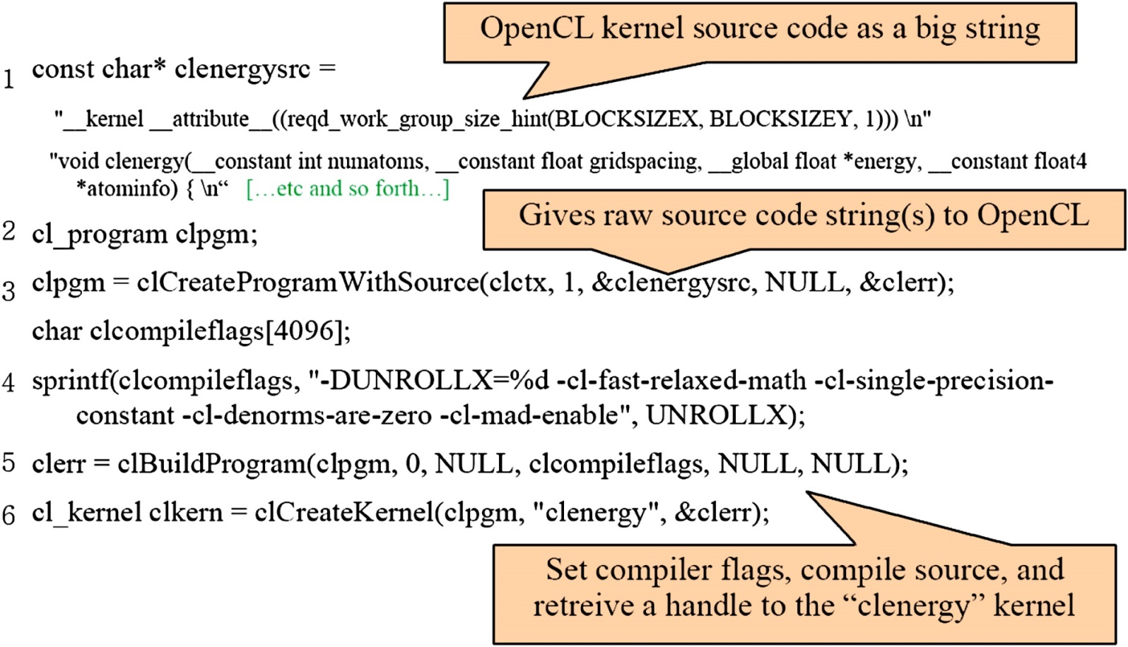
FIGURE A.13 : Building OpenCL kernel.

Slide 15
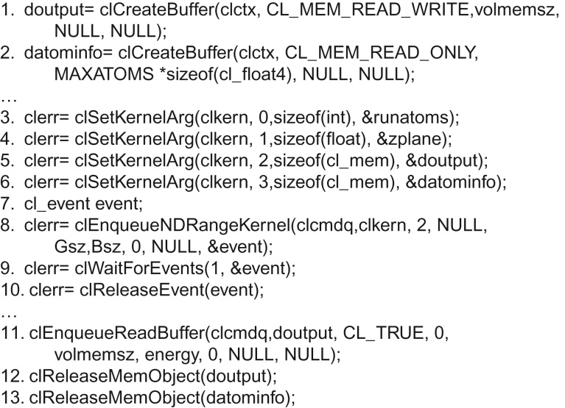
FIGURE A.14: OpenCL Host code for kernel launch and parameter passing.

