Slide 1
APPENTIX-2 THRUST: a productivity-oriented library for CUDA

Slide 2
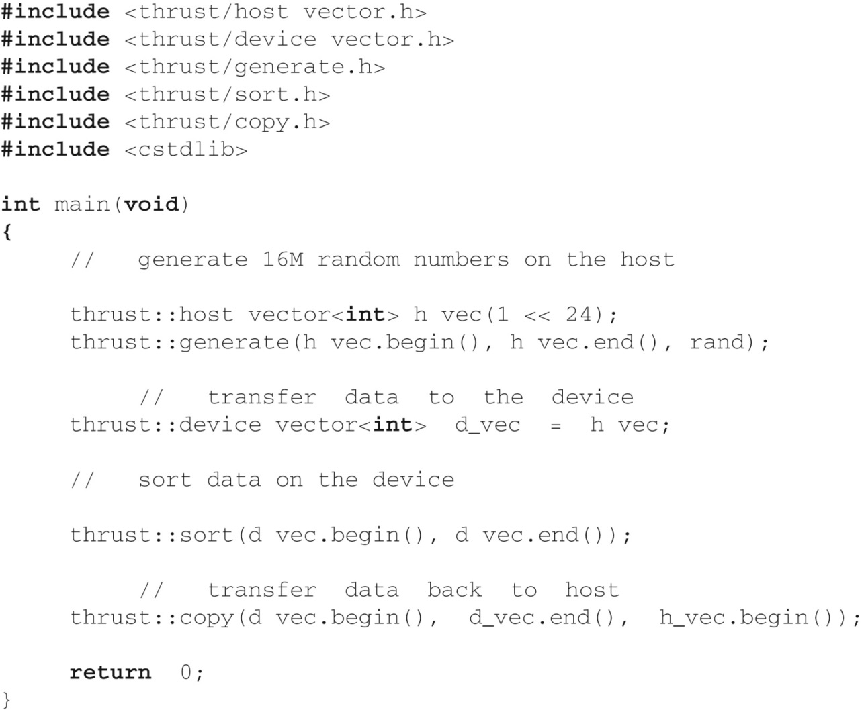
FIGURE B.1: A complete Thrust program which sorts data on the GPU.

Slide 3
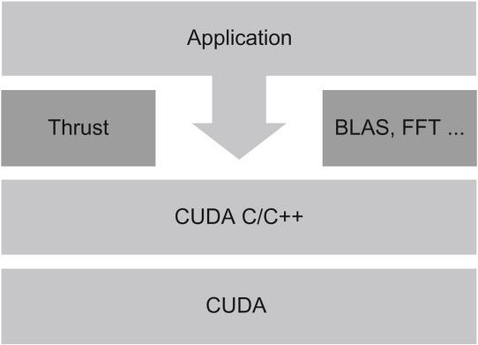
FIGURE B.2: Thrust is an abstraction layer on top of CUDA C/C++.

Slide 4
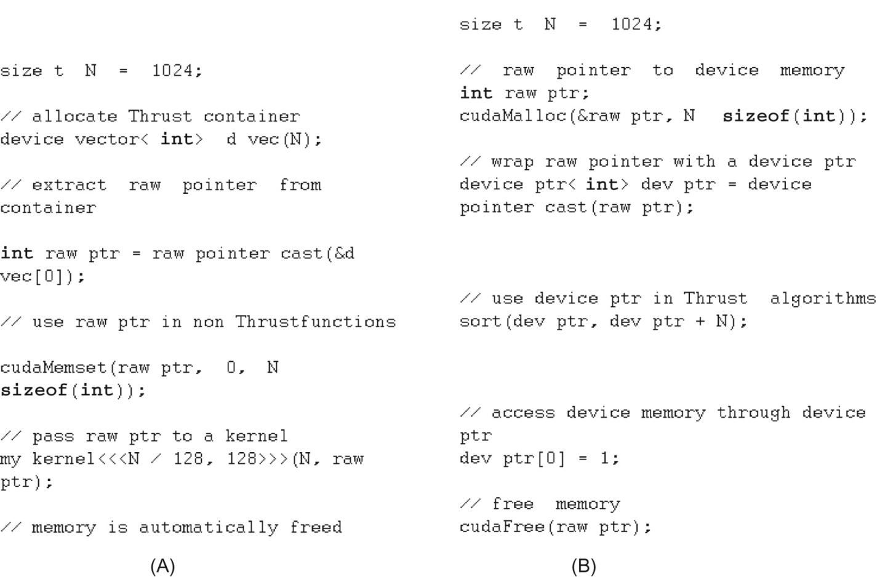
FIGURE B.3: Thrust interoperates smoothly with CUDA C/C++. (A) Interfacing Thrust to CUDA and (B) Interfacing CUDA to Thrust.

Slide 5
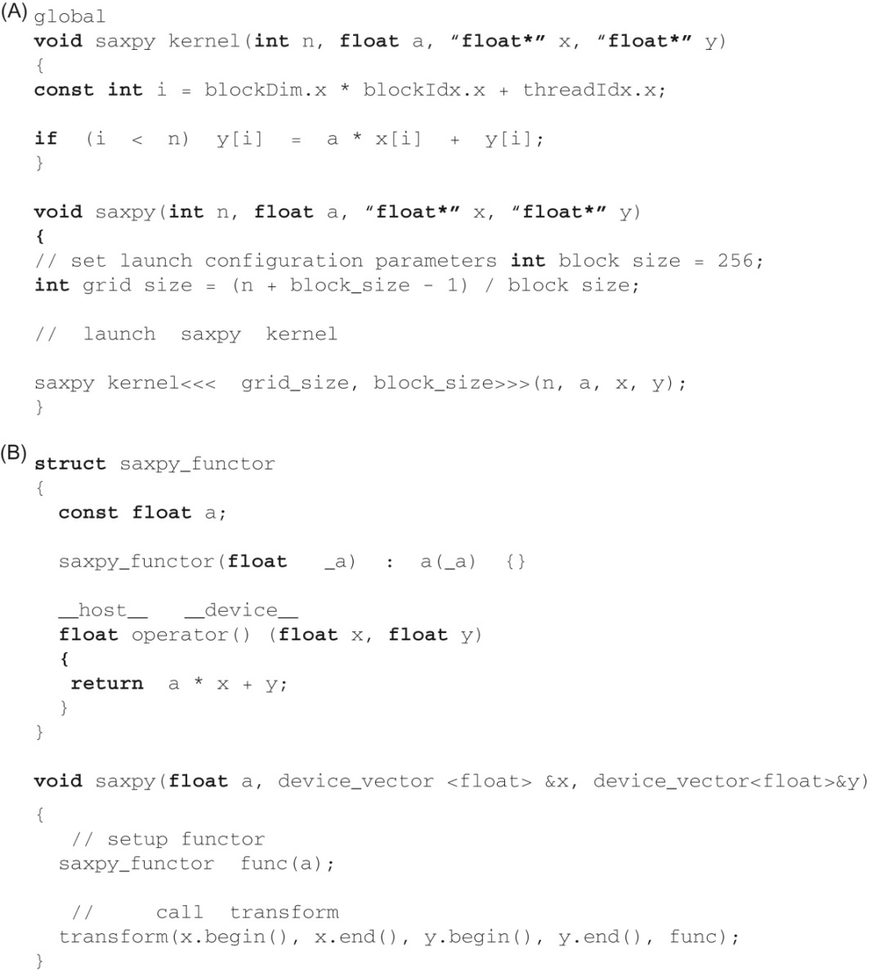
FIGURE B.4: SAXPY implementations in (A) CUDA C and (B) Thrust.

Slide 6
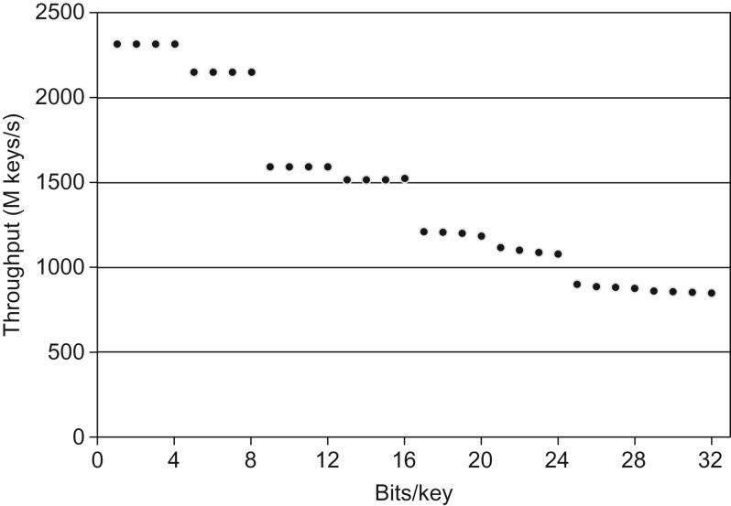
FIGURE B.5: Sorting integers on the GeForce GTX 480: Thrust’s dynamic sorting optimizations improve performance by a considerable margin in common use cases where keys are less than 32 bits.

Slide 7
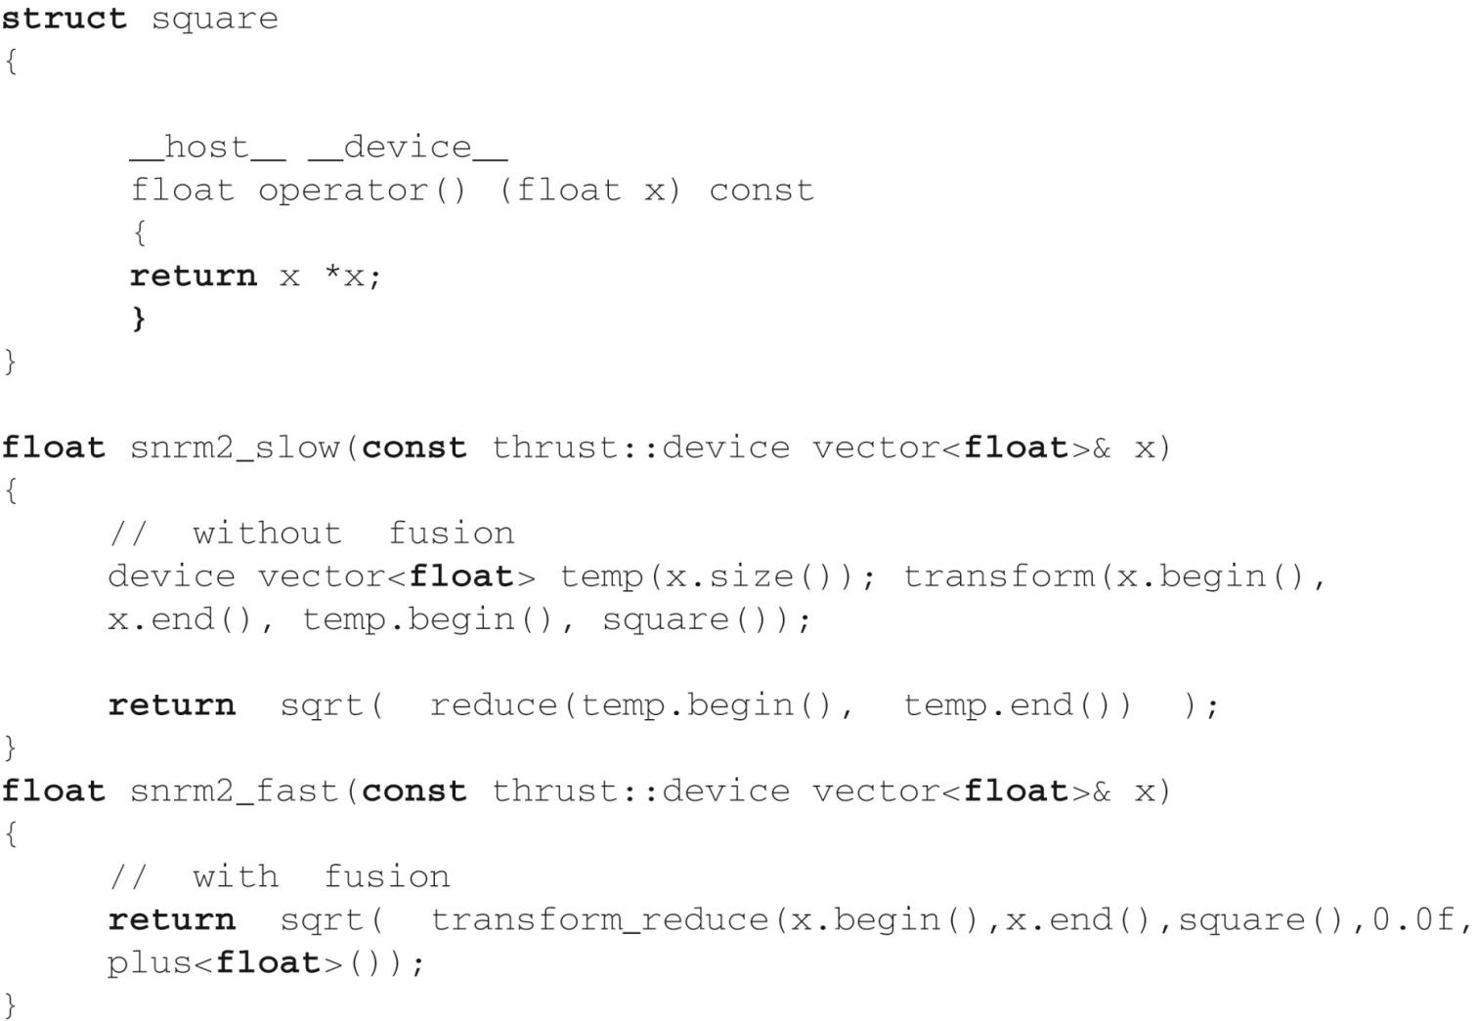
FIGURE B.6: SNRM2 has low arithmetic intensity and therefore benefits greatly from fusion.

Slide 8
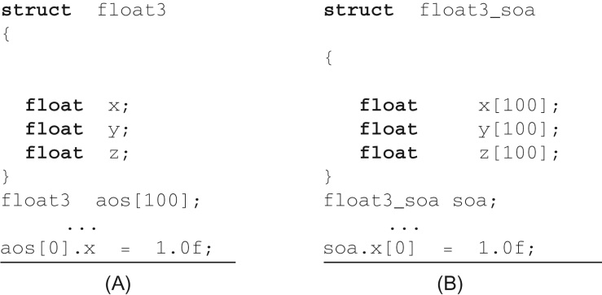
FIGURE B.7: Data layouts for three-dimensional float vectors. (A) Array of structures and (B) structure of arrays.

Slide 9
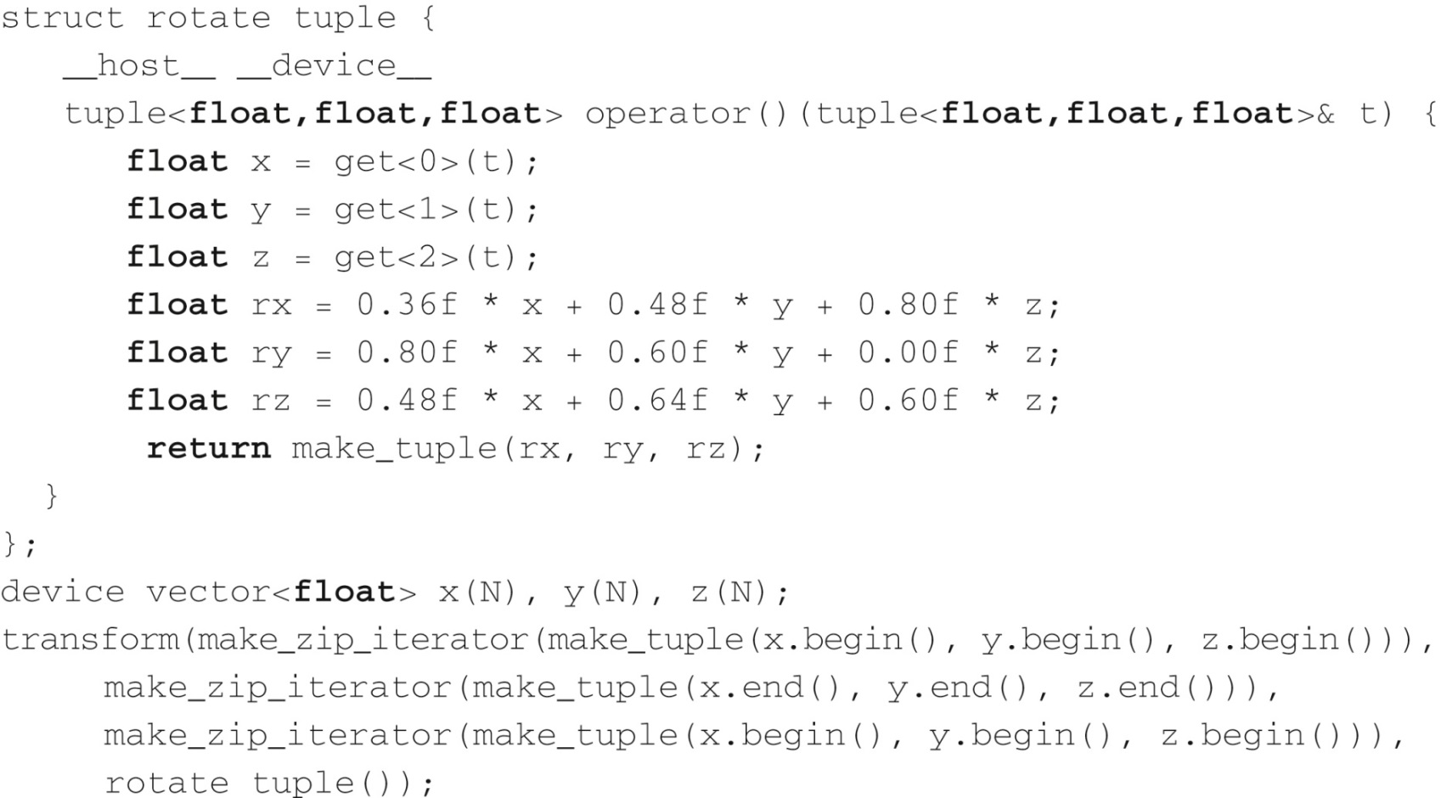
FIGURE B.8: The zip iterator facilitates processing of data in structure of arrays format.

Slide 10
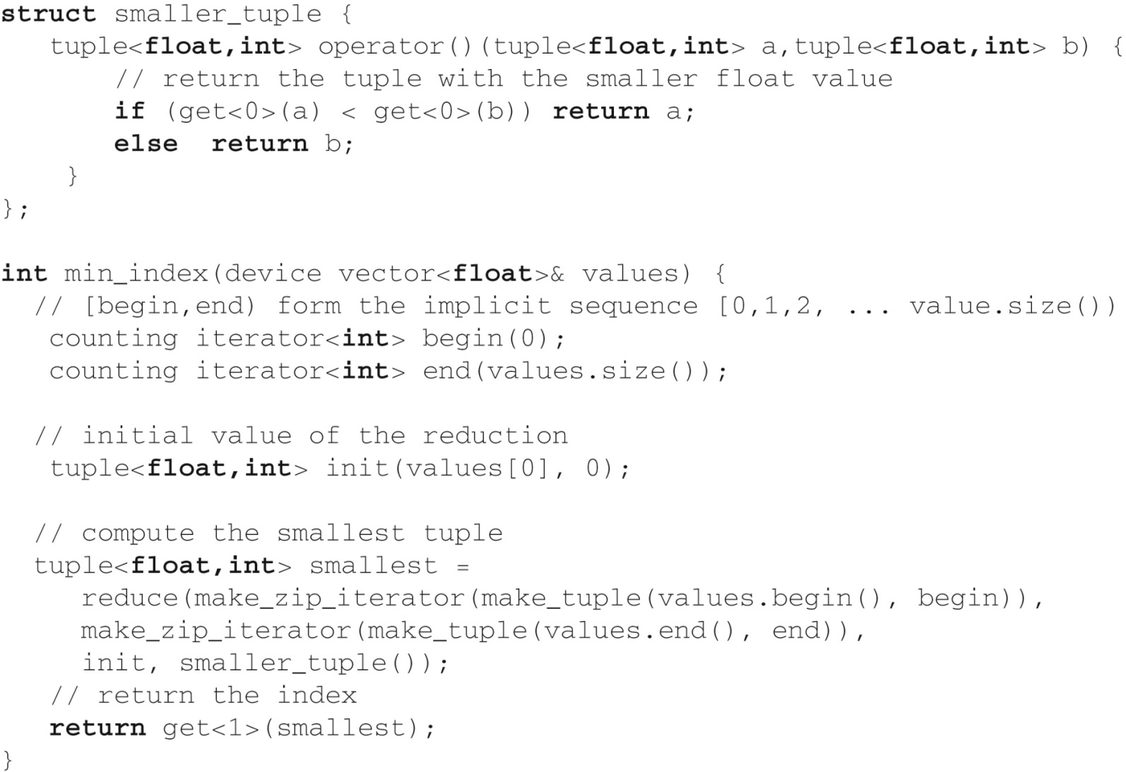
FIGURE B.9: Implicit ranges improve performance by conserving memory bandwidth.

