Slide 1
APPENTIX-3 CUDA Fortran

Slide 2
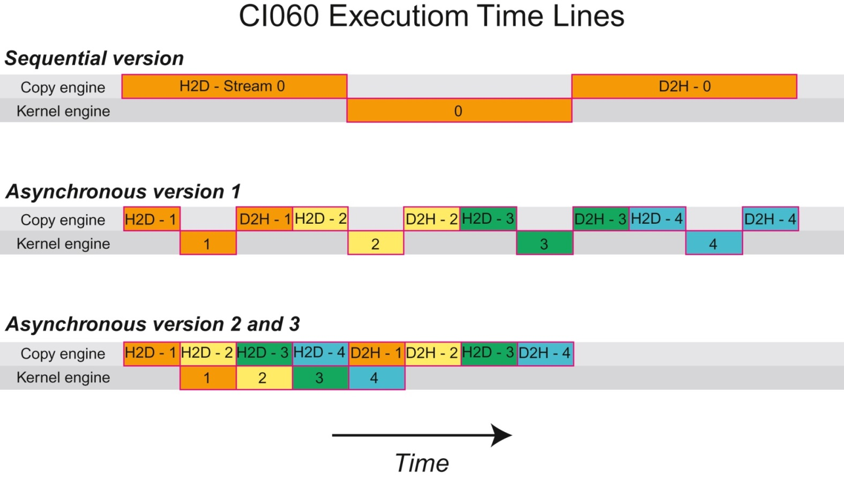
FIGURE C.1: Data transfer and kernel execution timing for the sequential and asynchronous versions when there is only one copy engine.

Slide 3
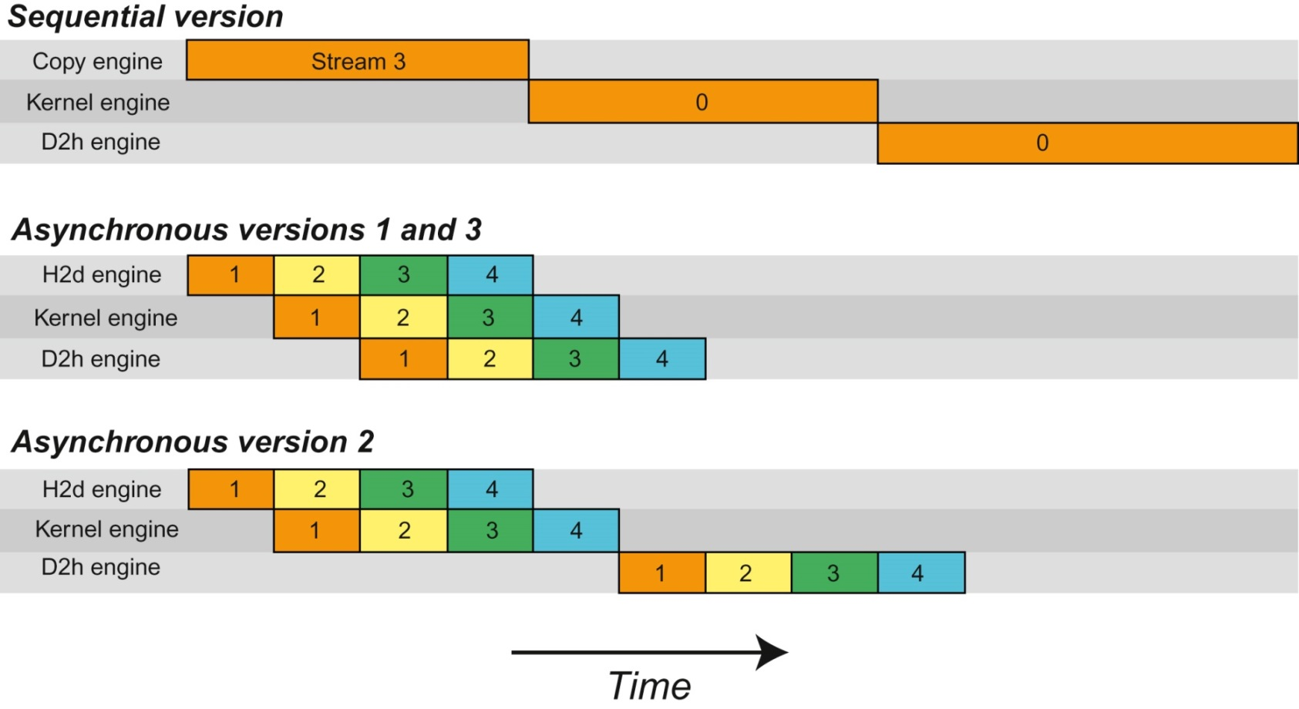
FIGURE C.2 : Data transfer and kernel execution timing for the sequential and asynchronous versions when there are two copy engines.

