Slide 1
APPENTIX-4 An introduction to C++ AMP

Slide 2
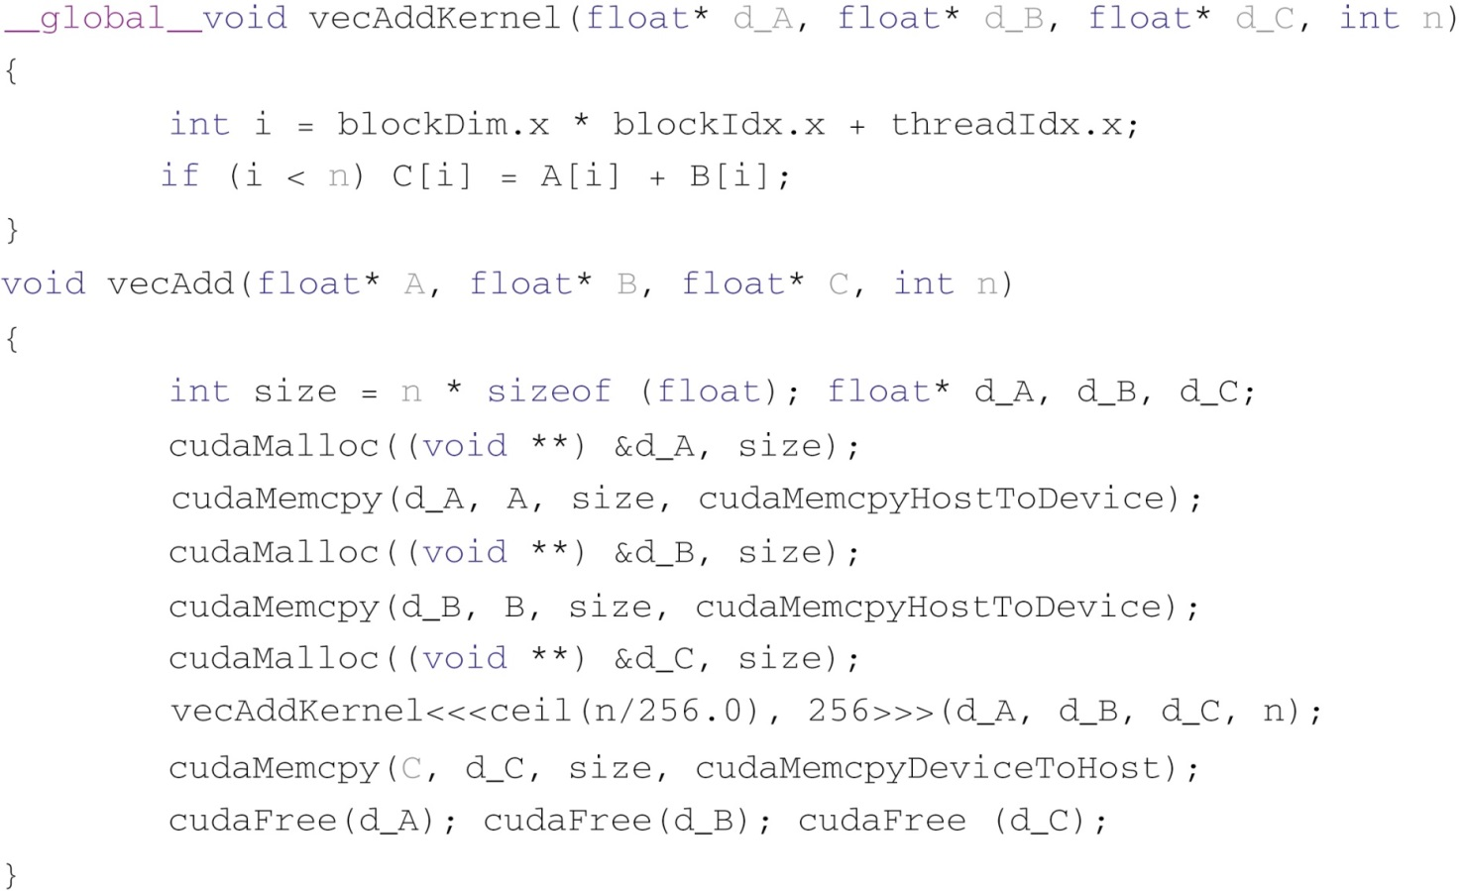
FIGURE D.1: CUDA vector addition from Chapter 2, Data parallel computing.

Slide 3
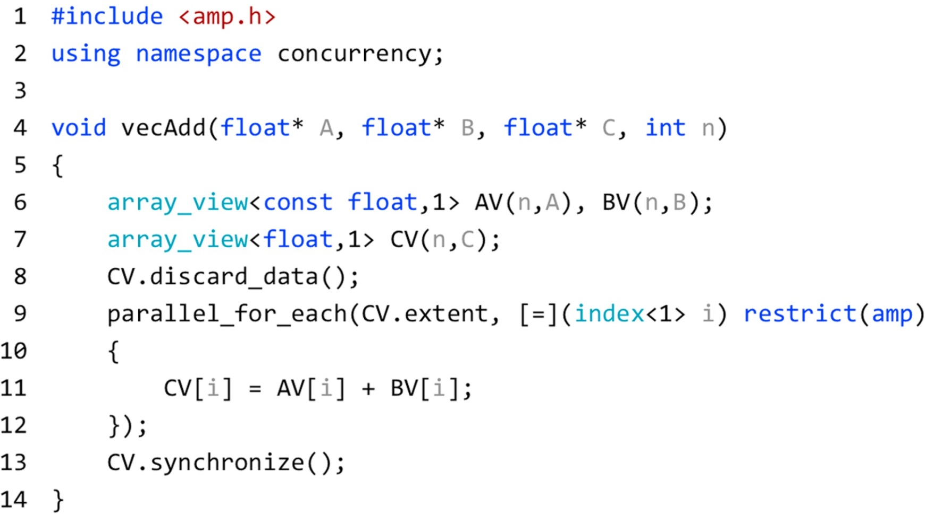
FIGURE D.2: Vector addition in C++ AMP.

Slide 4
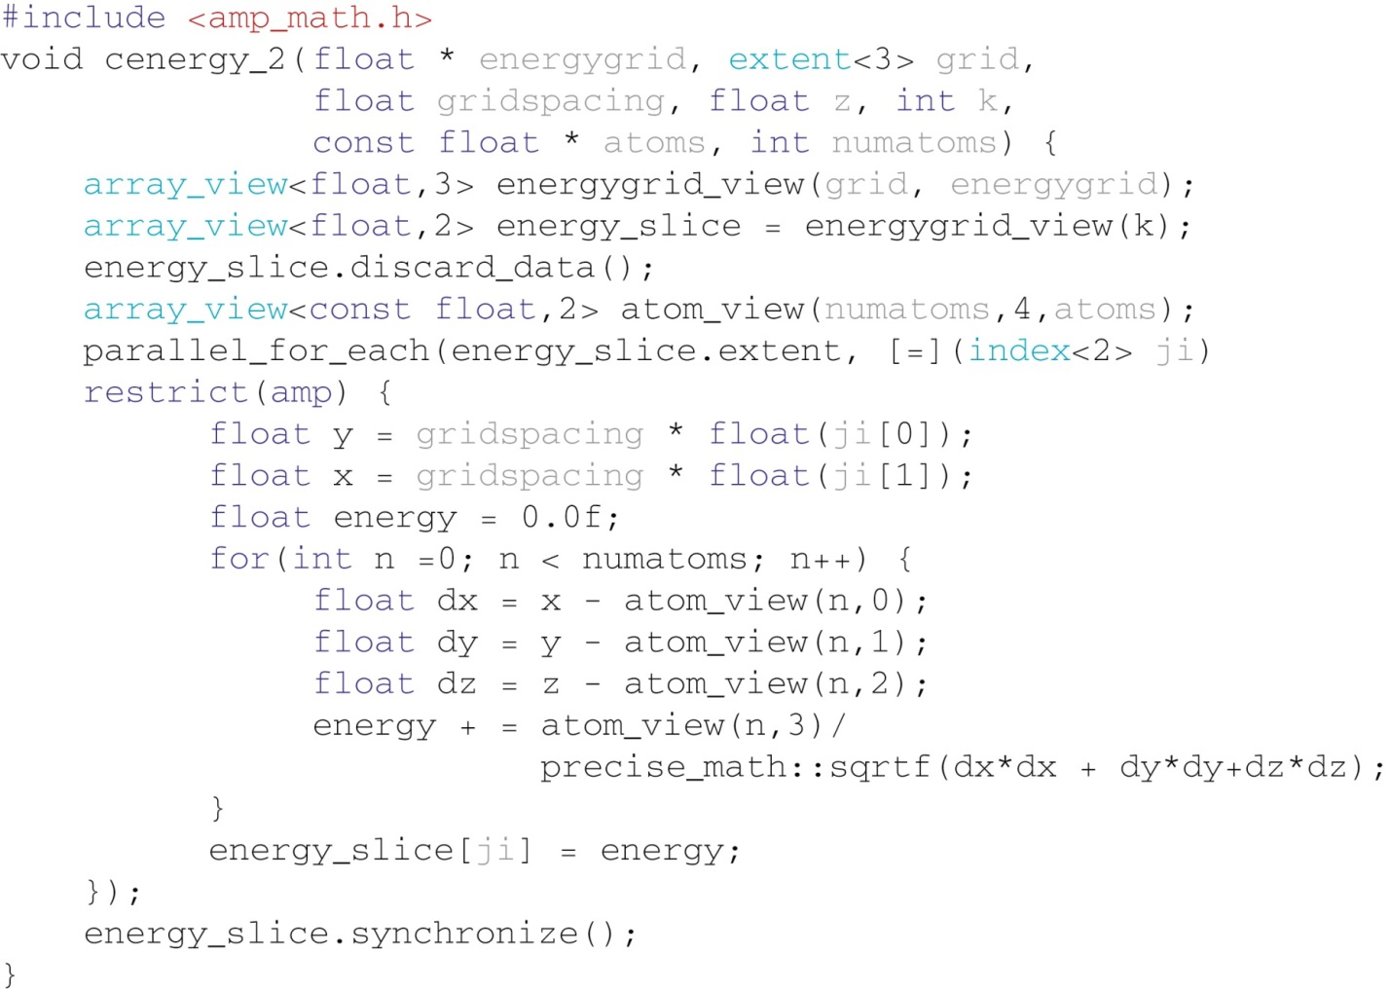
FIGURE D.3: Base Coulomb potential calculation.

Slide 5
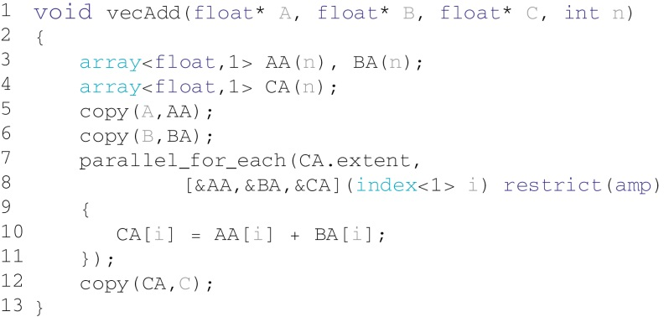
FIGURE D.4: Explicit memory and copy management.

Slide 6
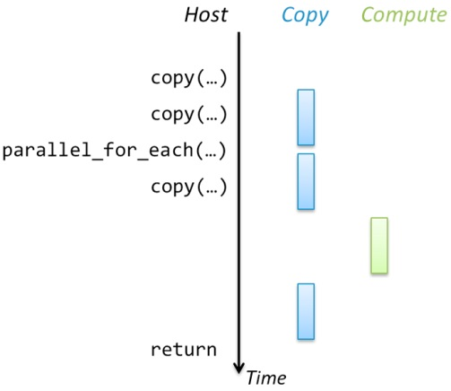
FIGURE D.5: Concurrent host/accelerator execution.

Slide 7
FIGURE D.6: Overlapped accelerator and host processing.

Slide 8
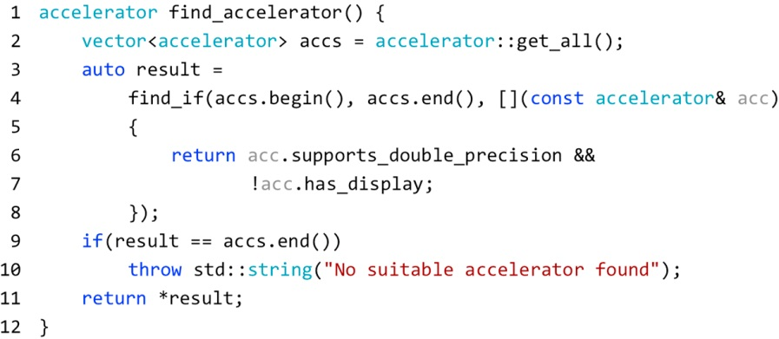
FIGURE D.7: Example of finding an accelerator.

Slide 9
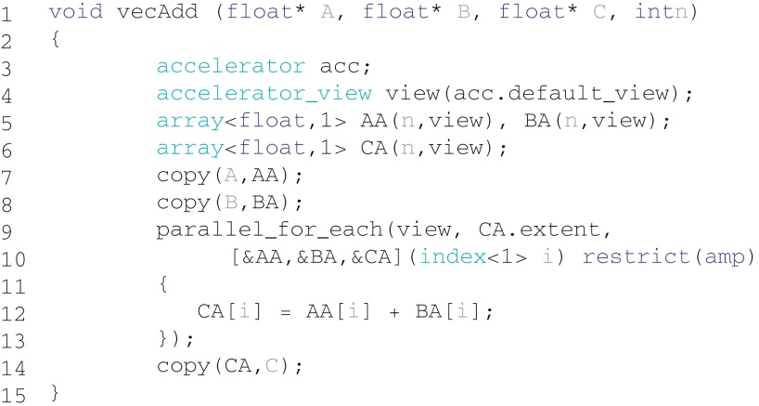
FIGURE D.8: Explicit accelerator use.

Slide 10
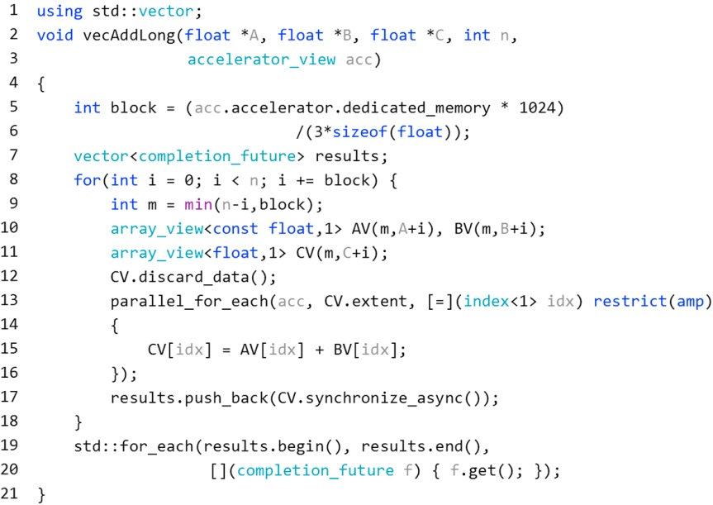
FIGURE D.9: Explicit accelerator with asynchronous transfers.

Slide 11
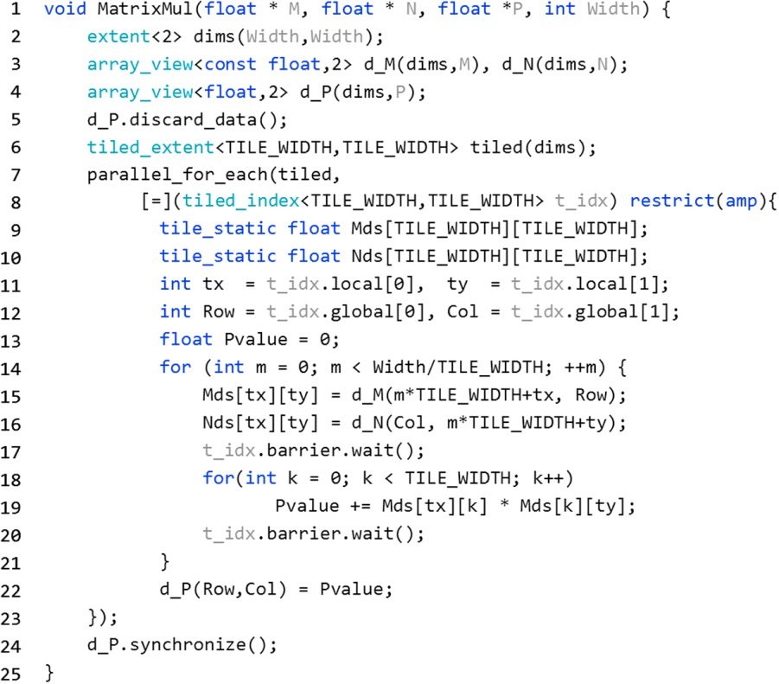
FIGURE D.10: Tiled matrix multiplication.

Slide 12
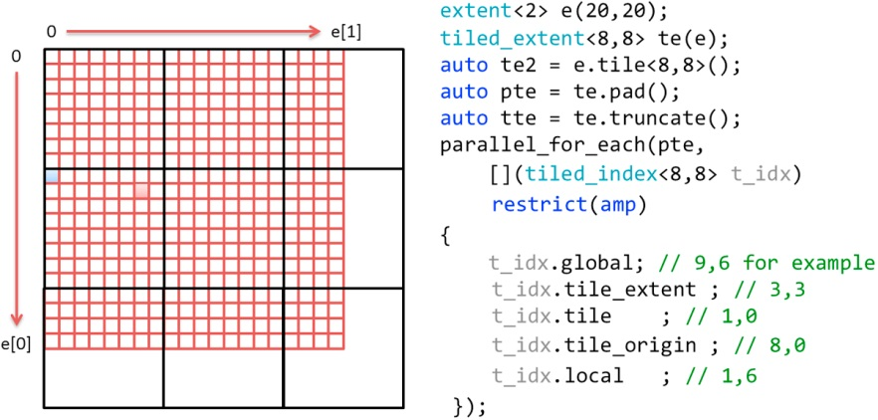
FIGURE D.11: Illustration of tiling 20× 20 compute domain.

Slide 13
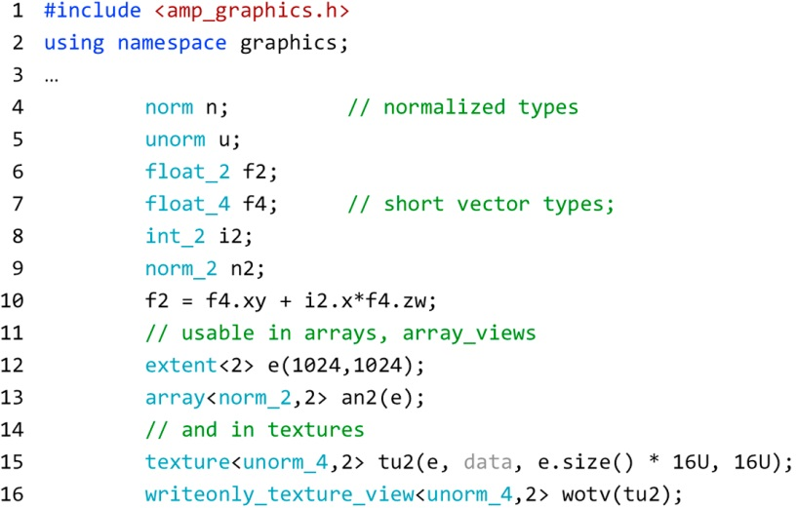
FIGURE D.12: Examples of type from concurrency::graphics.

Slide 14
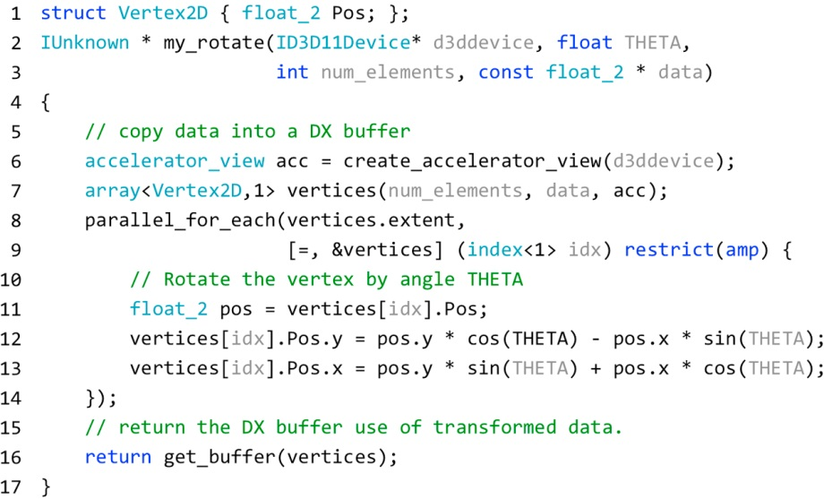
FIGURE D.13: Examples DirectX interop—rotate vertex list.

