Slide 1
Chapter-6 Numerical considerations

Slide 2
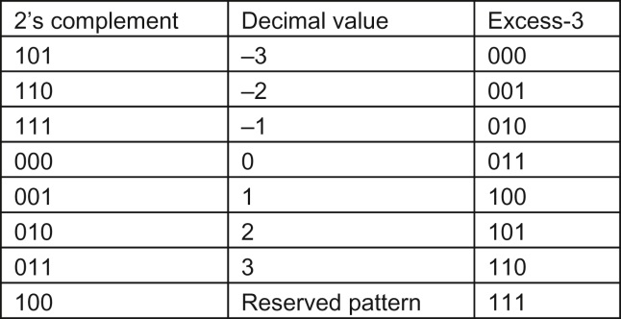
FIGURE 6.1: Excess-3 encoding, sorted by excess-3 ordering.

Slide 3
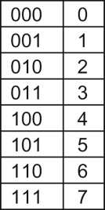
FIGURE 6.2: Representable numbers of a 3-bit unsigned integer format.

Slide 4
FIGURE 6.3: Representable numbers of a 3-bit unsigned integer format.

Slide 5
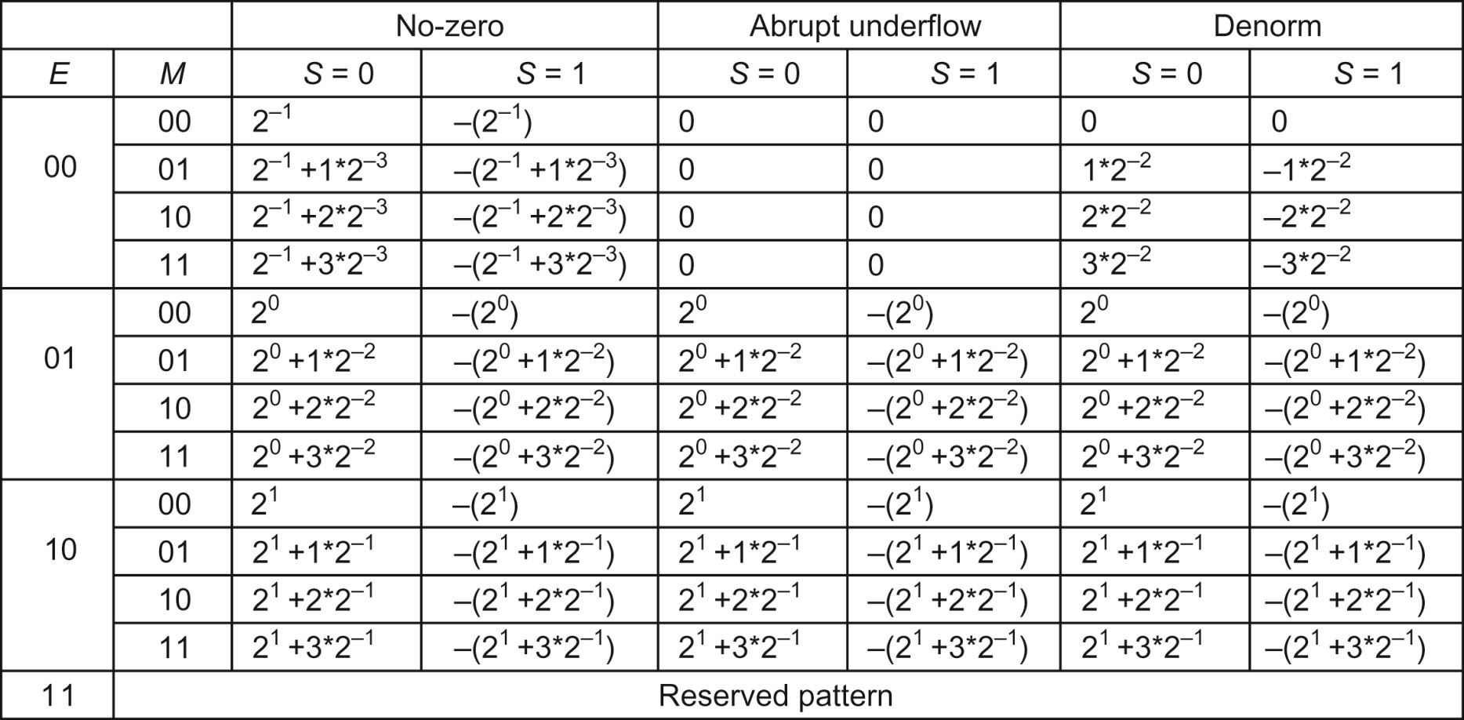
FIGURE 6.4: Representable numbers of no-zero, abrupt underflow, and denorm formats.

Slide 6
FIGURE 6.5: Representable numbers of the no-zero representation.

Slide 7
FIGURE 6.6: Representable numbers of the abrupt underflow format.

Slide 8
FIGURE 6.7: Representable numbers of a denormalization format.

Slide 9
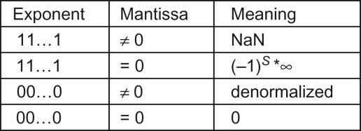
FIGURE 6.8: Special bit patterns in the IEEE standard format.

Slide 10
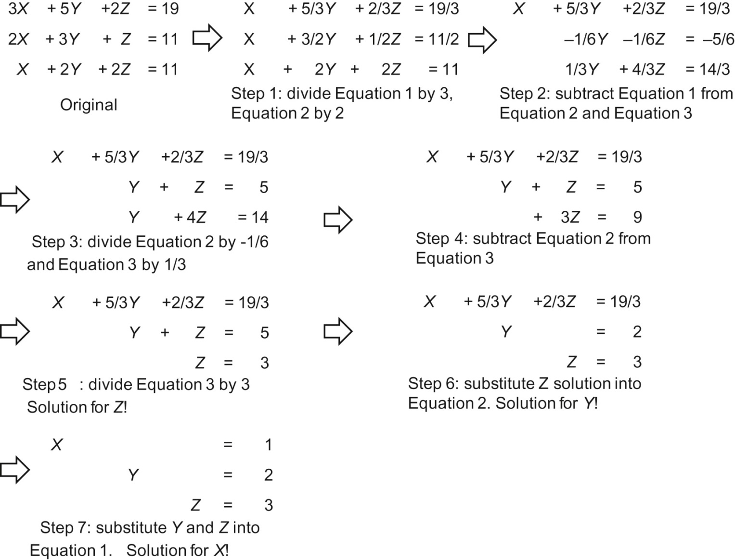
FIGURE 6.9: Gaussian elimination and backward substitution for solving systems of linear equations.

Slide 11
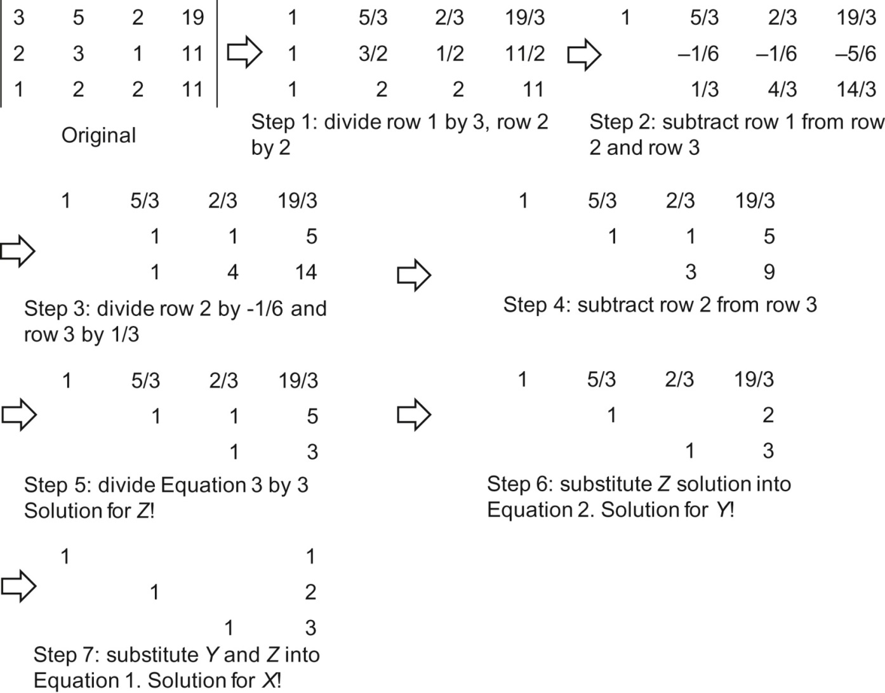
FIGURE 6.10: Gaussian elimination and backward substitution in matrix view

Slide 12
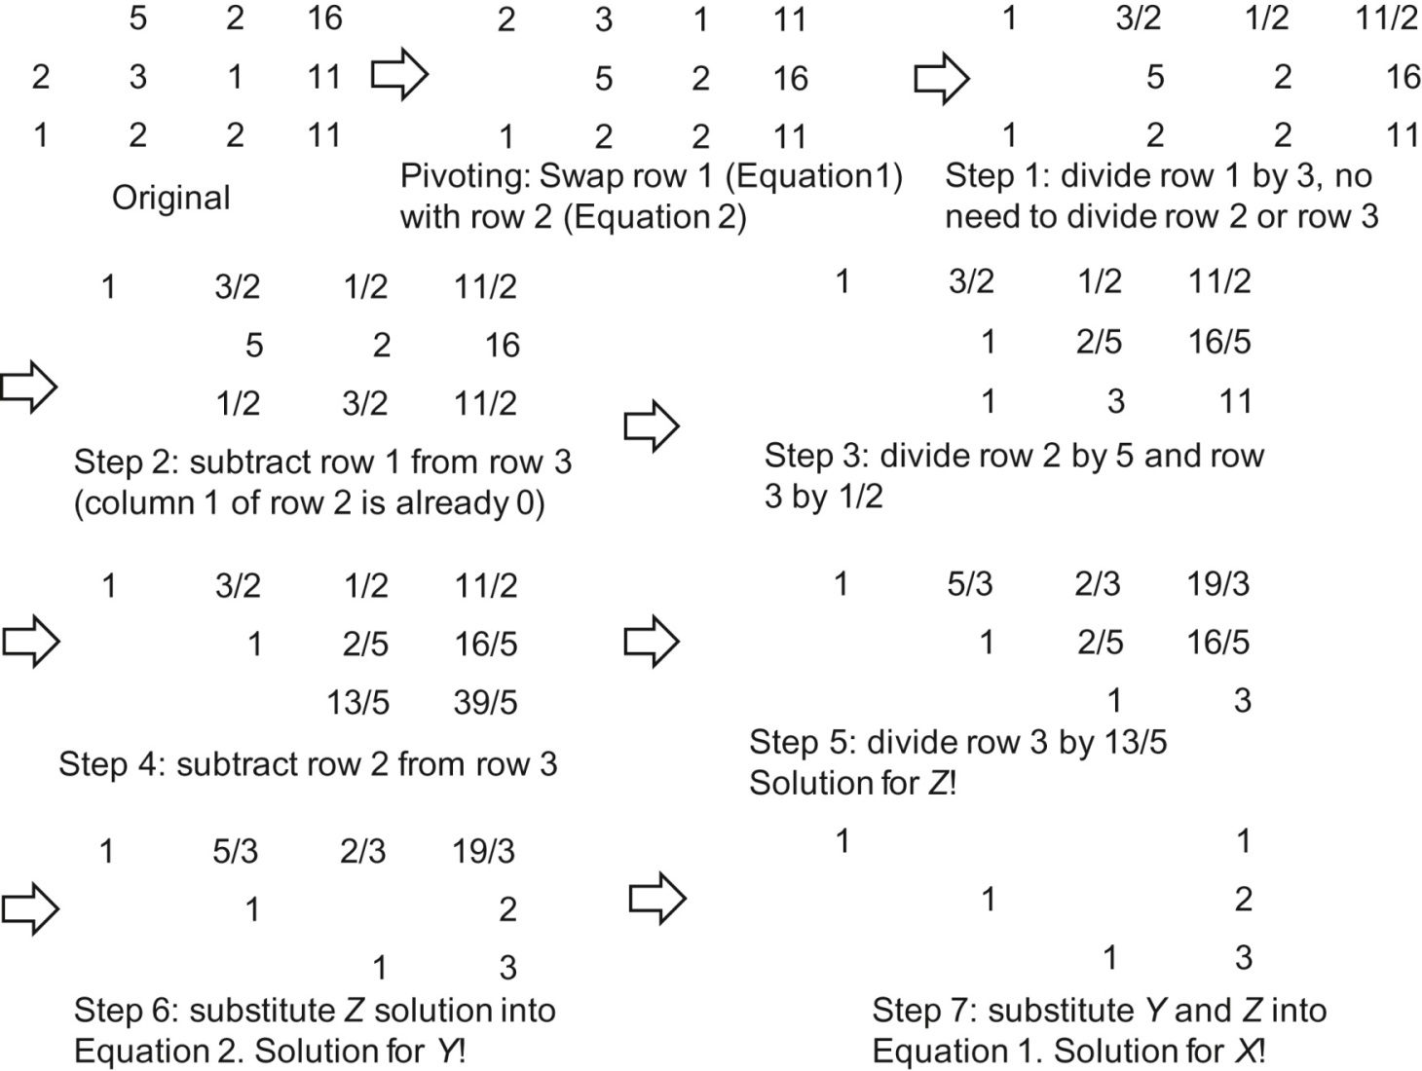
FIGURE 6.11: Gaussian elimination with pivoting.

