Slide 1
Chapter-7 Parallel patterns: convolution An introduction to stencil computation

Slide 2
FIGURE 7.1: A 1D convolution example, inside elements.

Slide 3
FIGURE 7.2: 1D convolution, calculation of P[3].

Slide 4
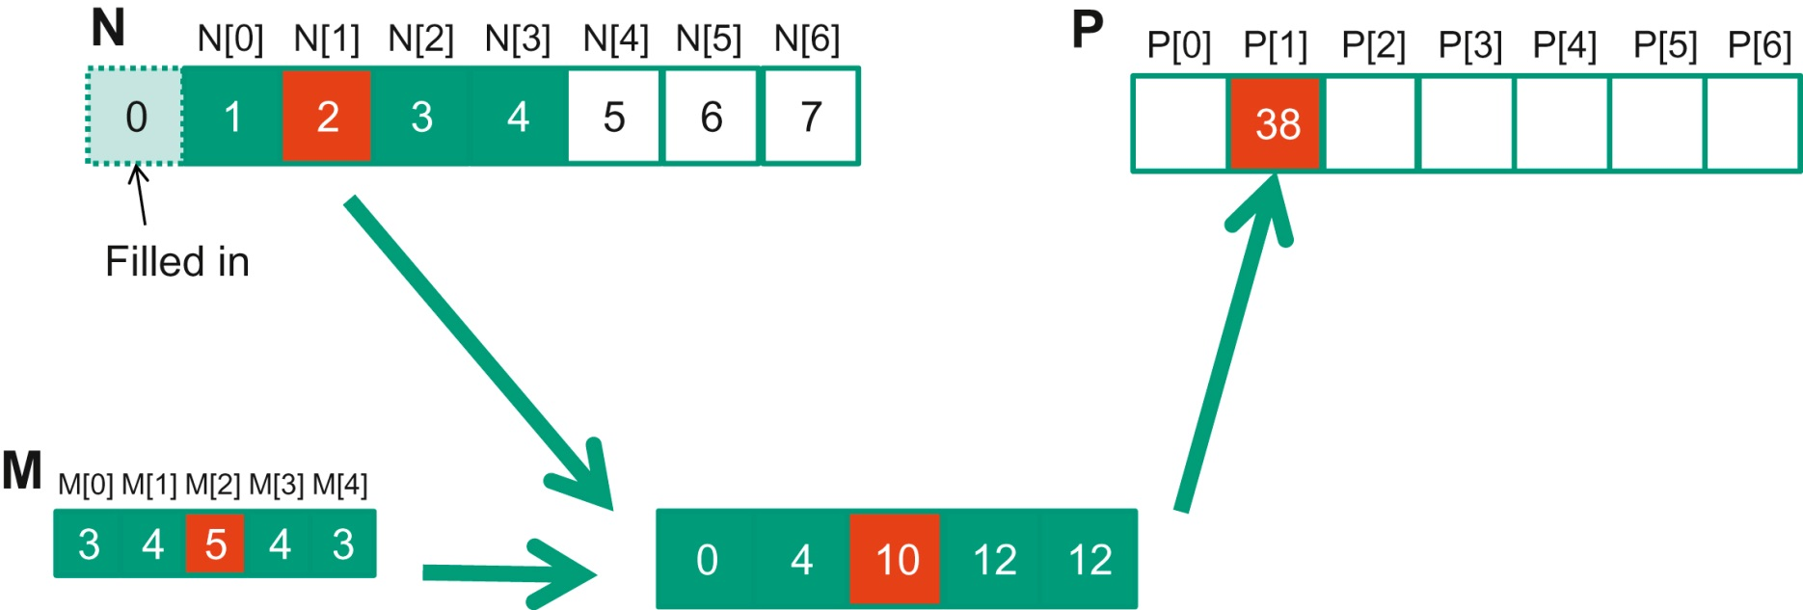
FIGURE 7.3: 1D convolution boundary condition.

Slide 5
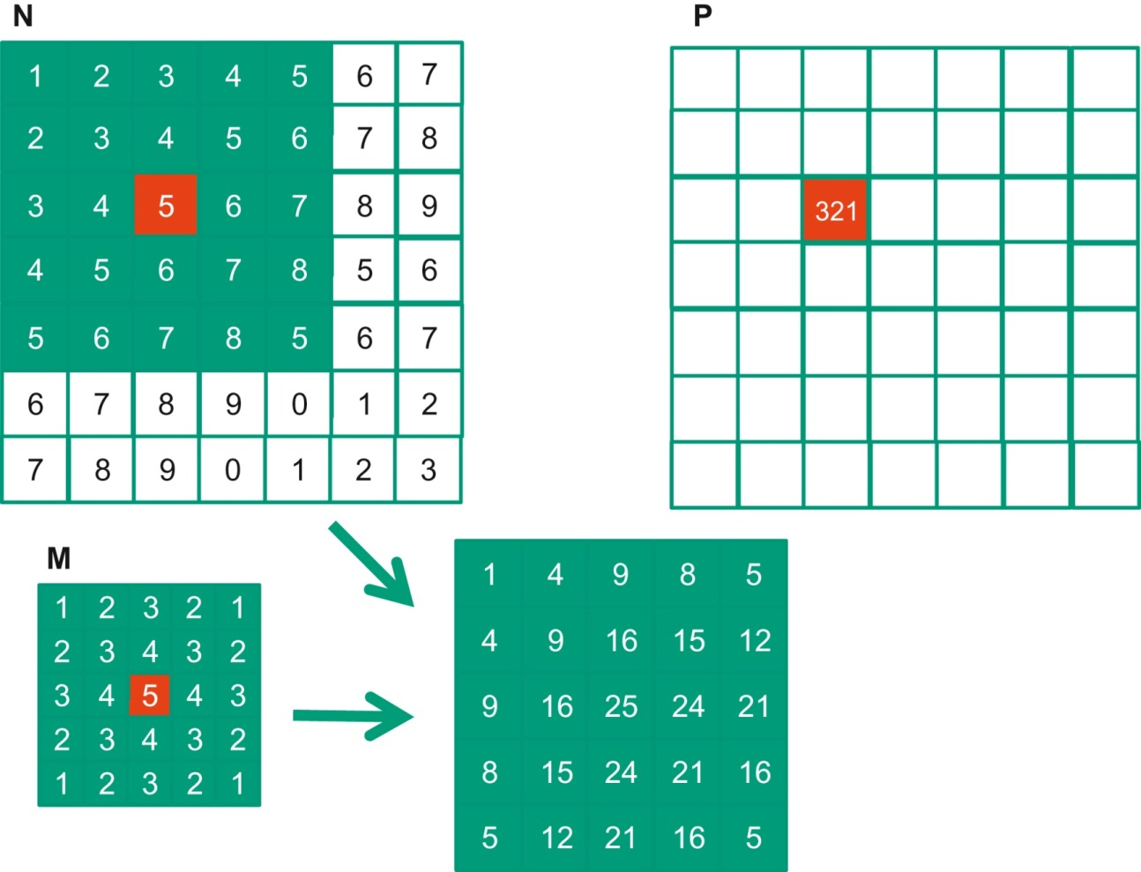
FIGURE 7.4: A 2D convolution example.

Slide 6
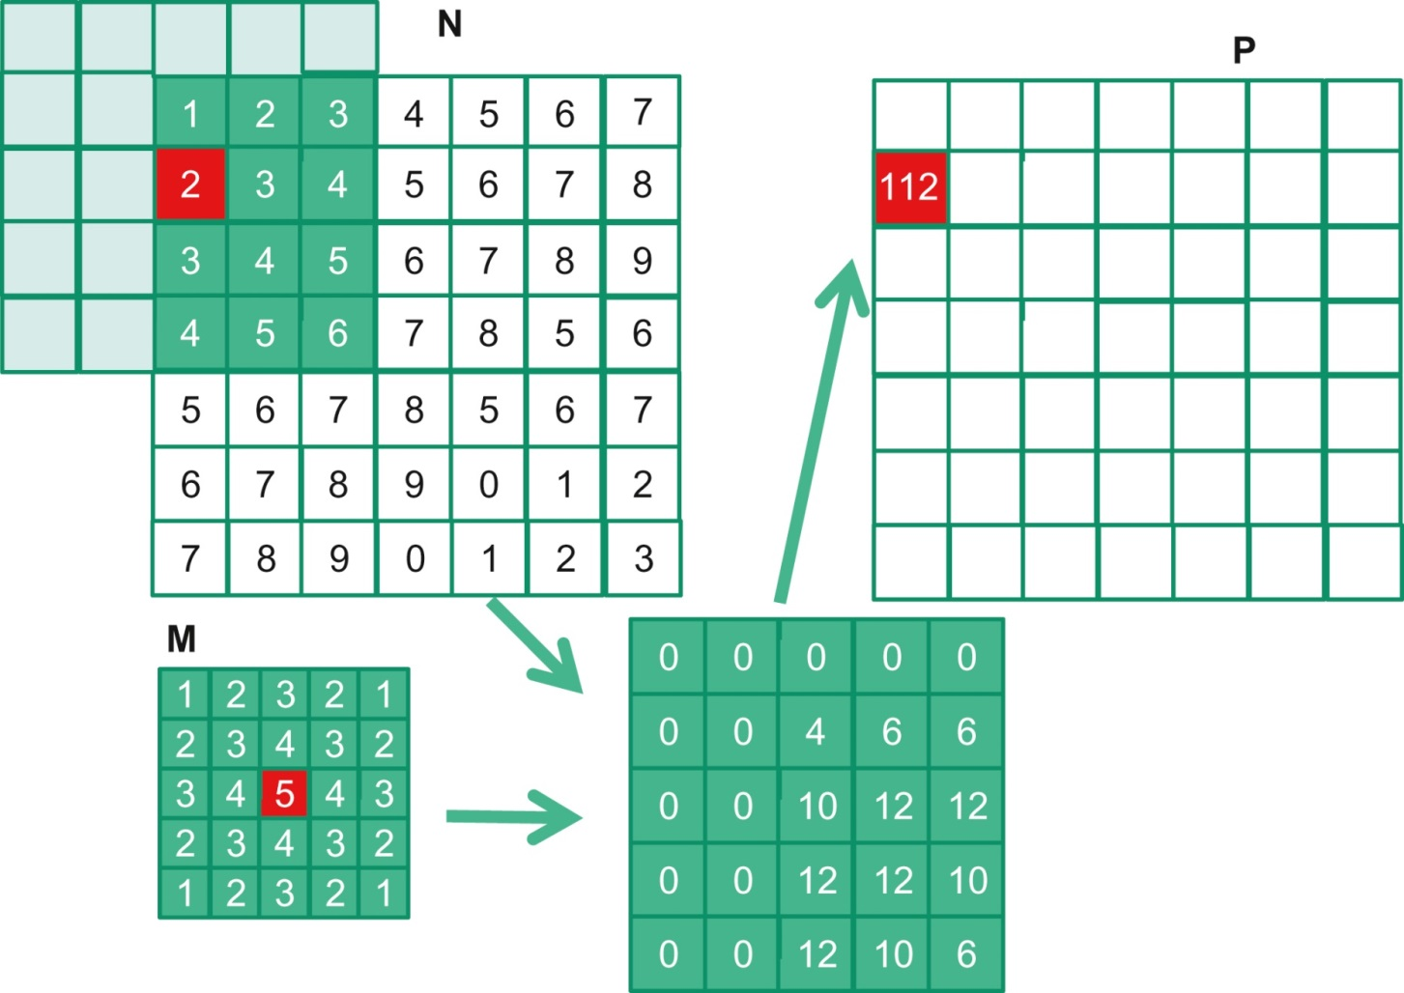
FIGURE 7.5: A 2D convolution boundary condition.

Slide 7
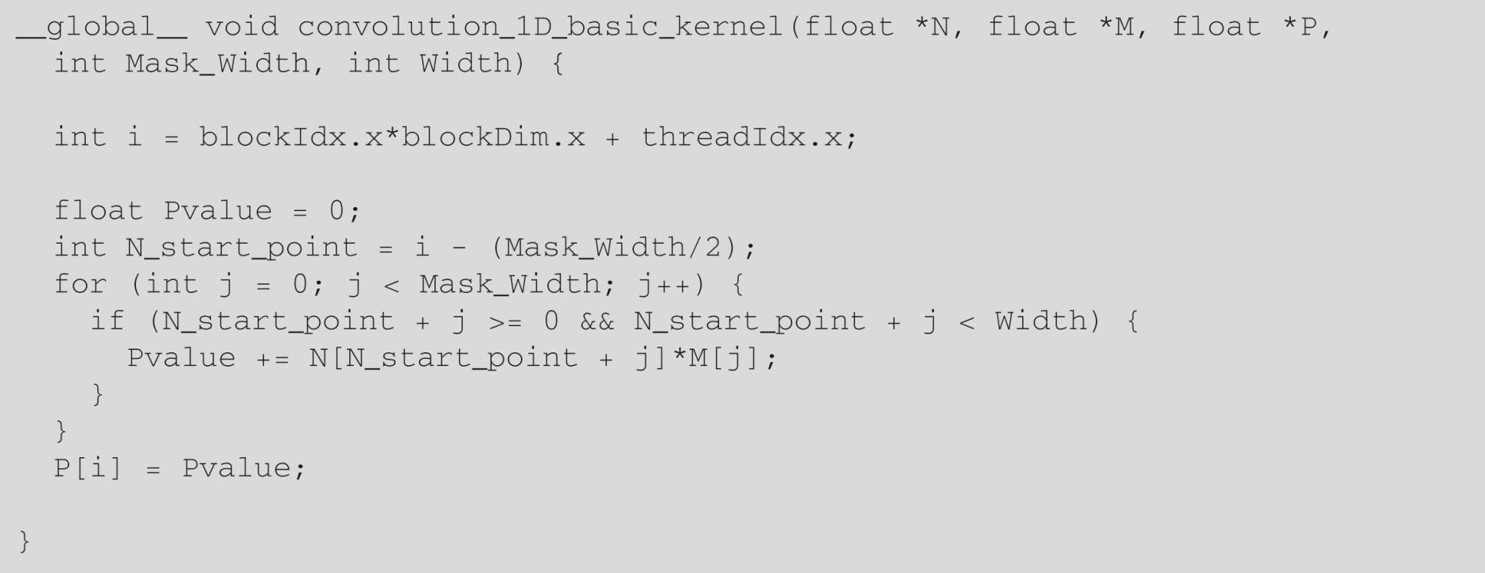
FIGURE 7.6: A 1D convolution kernel with boundary condition handling.

Slide 8
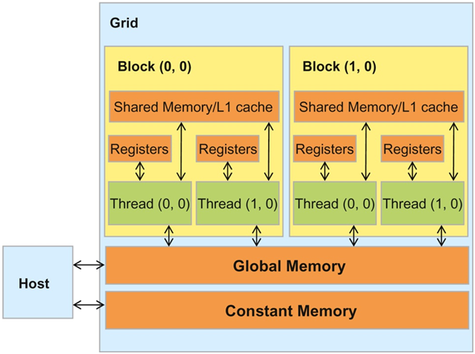
FIGURE 7.7: A review of the CUDA Memory Model.

Slide 9
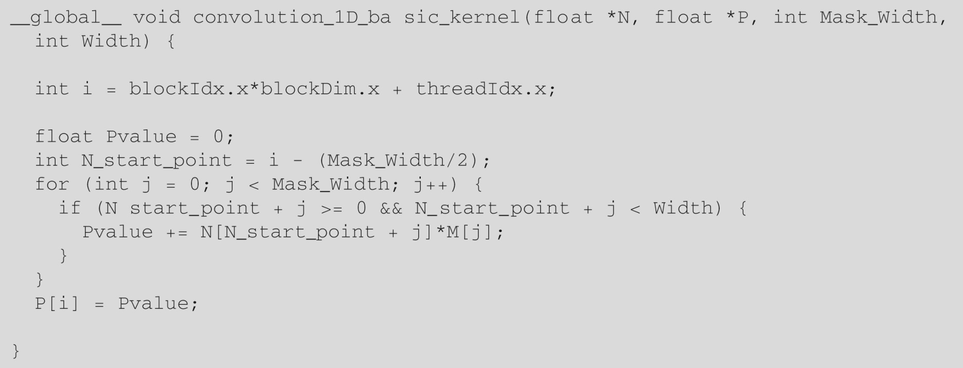
FIGURE 7.8: A 1D convolution kernel using constant memory for M.

Slide 10
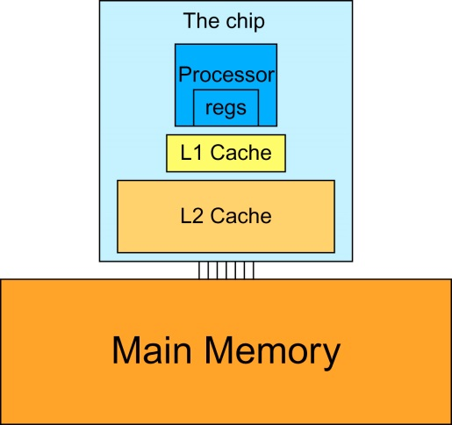
FIGURE 7.9: A simplified view of the cache hierarchy of modern processors.

Slide 11
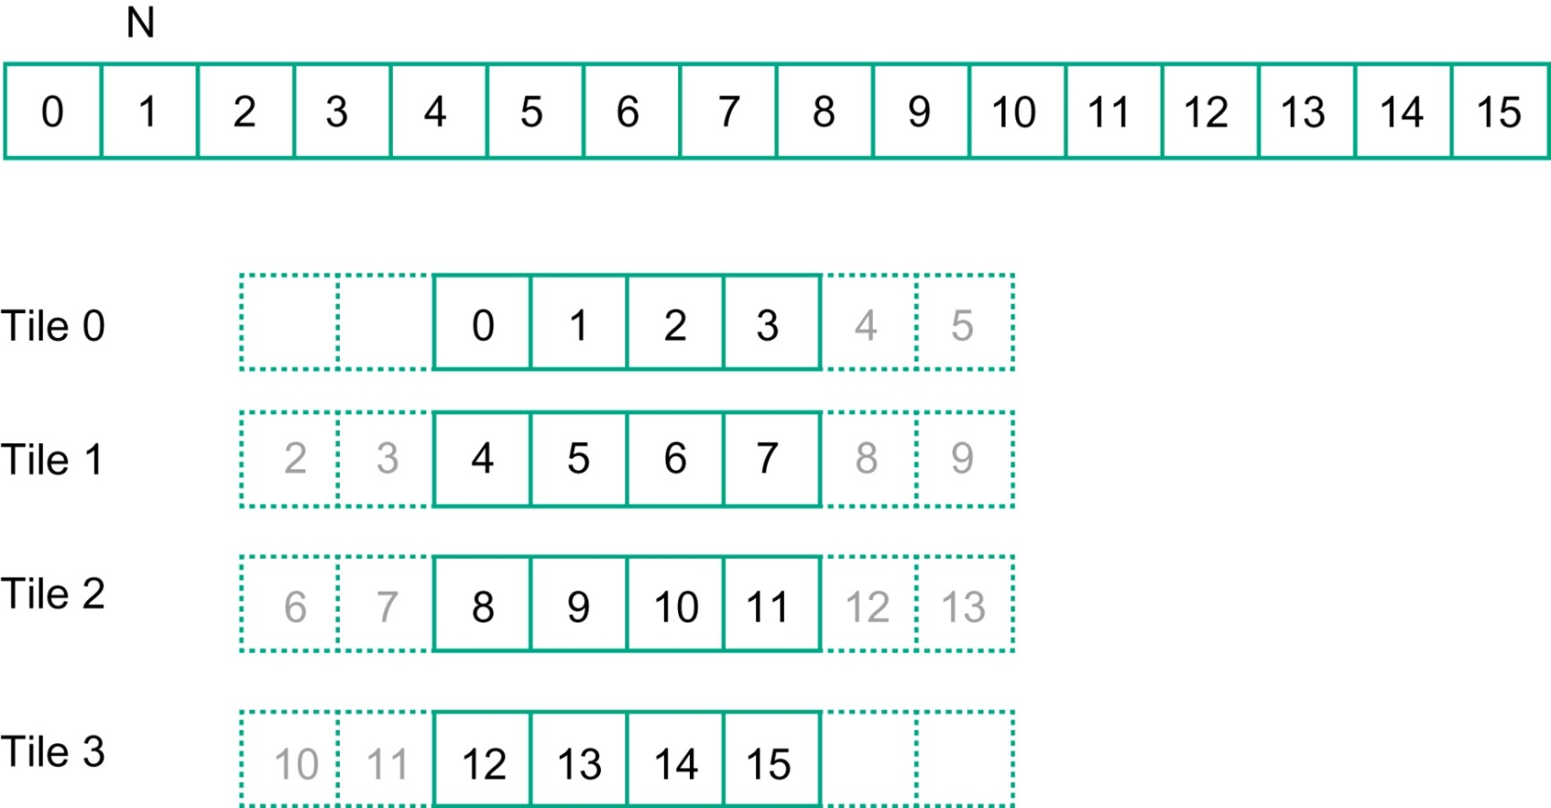
FIGURE 7.10: A 1D tiled convolution example.

Slide 12
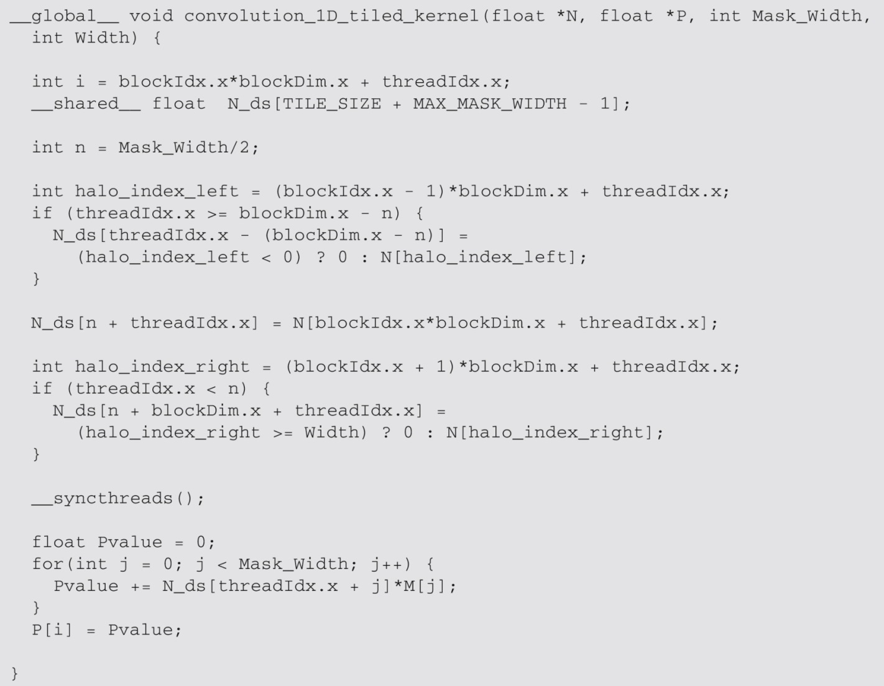
FIGURE 7.11: A tiled 1D convolution kernel using constant memory for M.

Slide 13
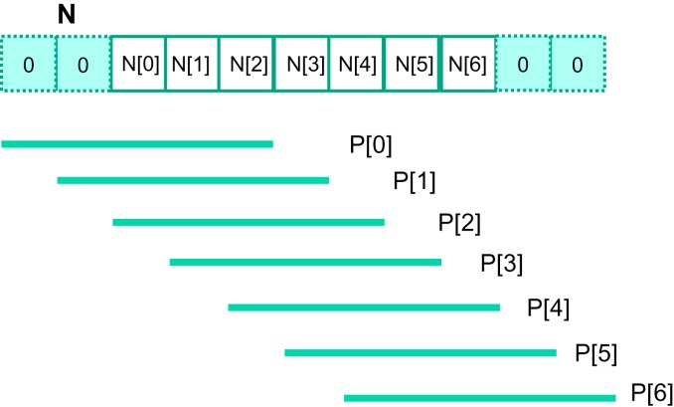
FIGURE 7.12: A small example of accessing N elements and ghost cells.

Slide 14
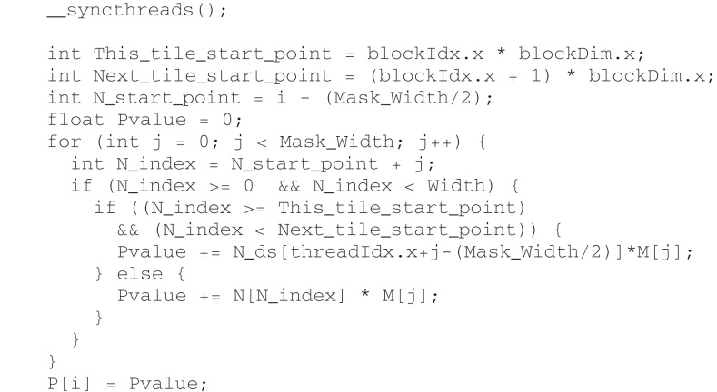
FIGURE 7.13: Using general caching for halo cells.

Slide 15
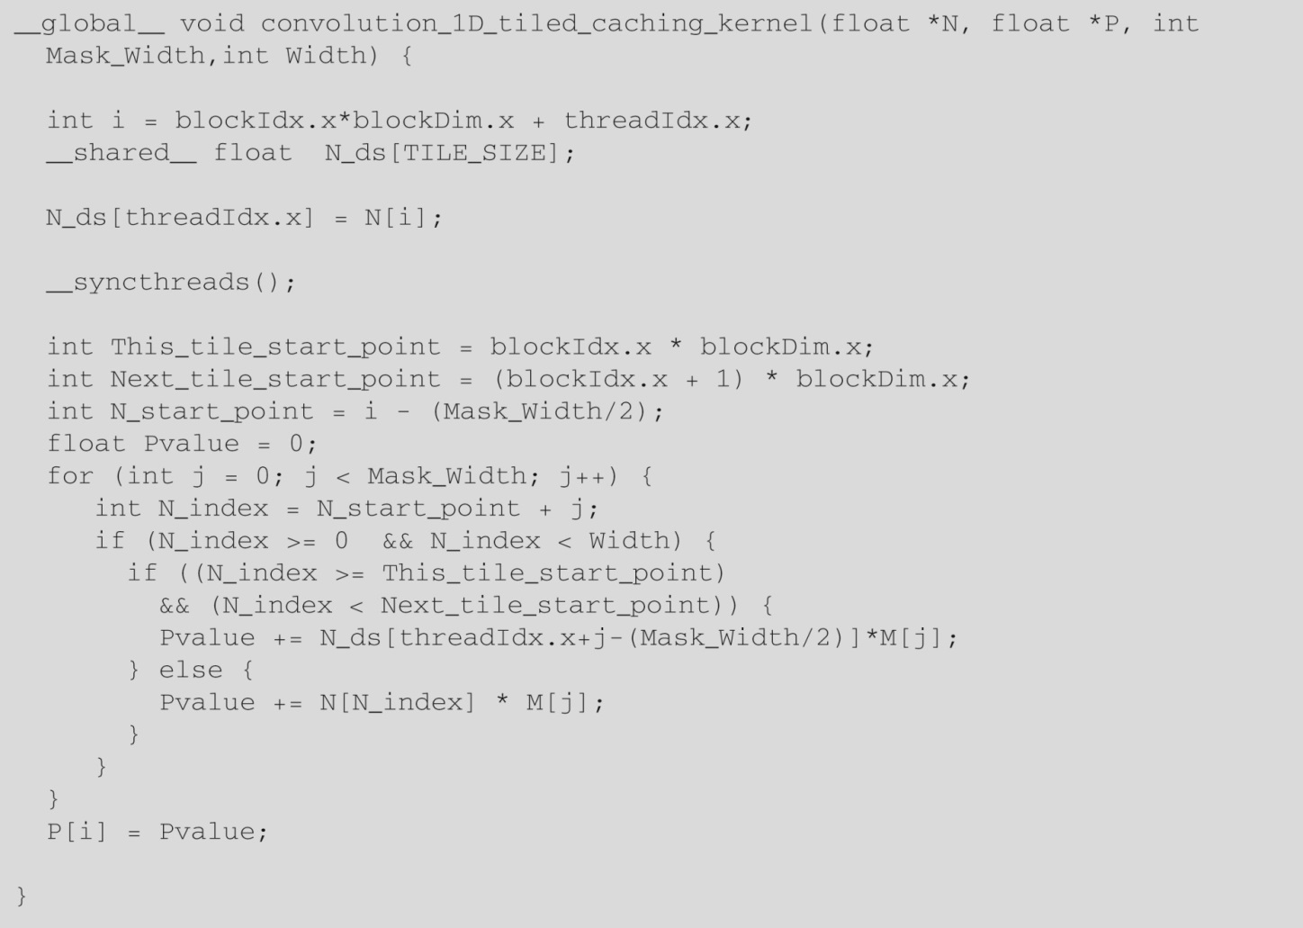
FIGURE 7.14: A simpler tiled 1D convolution kernel using constant memory and general caching.

Slide 16
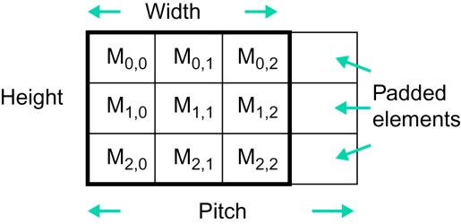
FIGURE 7.15: A padded image format and the concept of pitch.

Slide 17
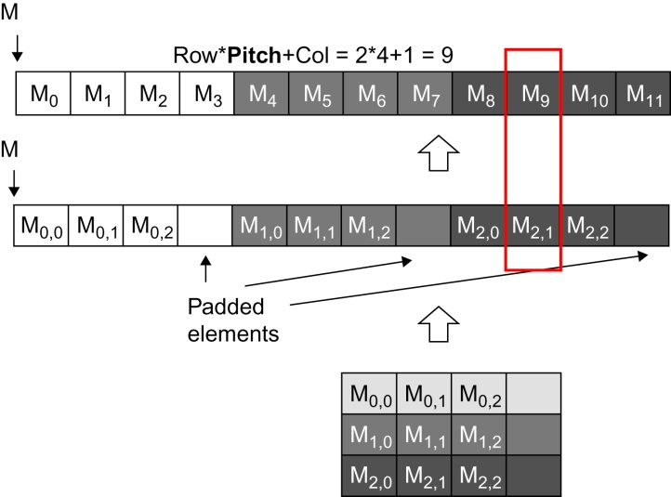
FIGURE 7.16: Row-major layout of a 2D image matrix with padded elements.

Slide 18
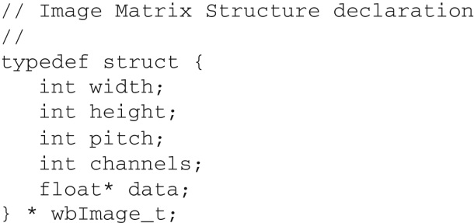
FIGURE 7.17: The C type structure definition of the image pixel element.

Slide 19
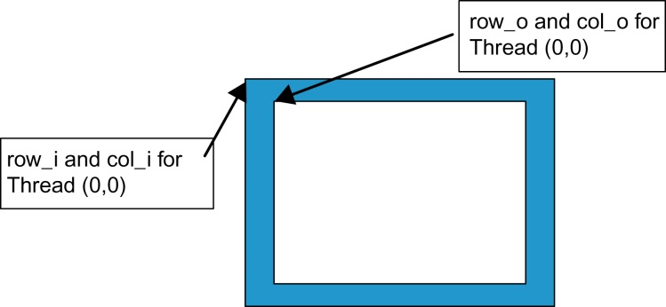
FIGURE 7.18: Starting element indices of the input tile versus output tile.

Slide 20
FIGURE 7.19: Part 1 of a 2D convolution kernel.

Slide 21
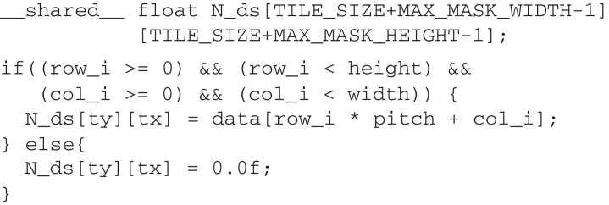
FIGURE 7.20: Part 2 of a 2D convolution kernel.

Slide 22
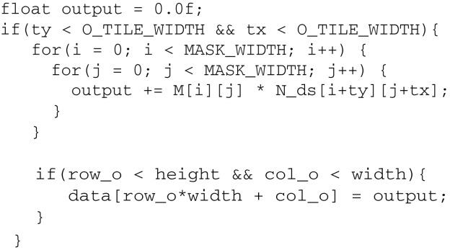
FIGURE 7.21: Part 3 of a 2D convolution kernel.

Slide 23
FIGURE 7.22: Image array access reduction ratio for different tile sizes.

